Slide 1


Session: Field and modelling approaches for the assessment of hydrogeological and engineering problems in the complex karst environment, 29 April 2021
The phenomenon of ascendant flow which characterizes karst springs, southern Apennines
Authors: Francesco Fiorillo, Guido Leone, Mauro Pagnozzi, Vittorio Catani, Gianni Testa, Libera Esposito
Dipartimento di Scienze e Tecnologie, University of Sannio, Italy

Slide 2
Preliminary points and main aspects of the presentation
The upwelling flux is a natural phenomenon in the discharge zone, which affects many (basal) karst springs
It is difficult to detect instrumentally this phenomenon
The upwelling flow may have an important role for both the water intake structures and the management of groundwater
This presentation shows the example of Grassano karst spring areas, Southern Italy
Data and Methods used
Hydraulic head monitoring
Temperature and electrical conductivity of spring waters
Radon (²²²Rn) in the spring waters
Karst features (sinkholes distribution)
Numerical code simulation

Slide 3
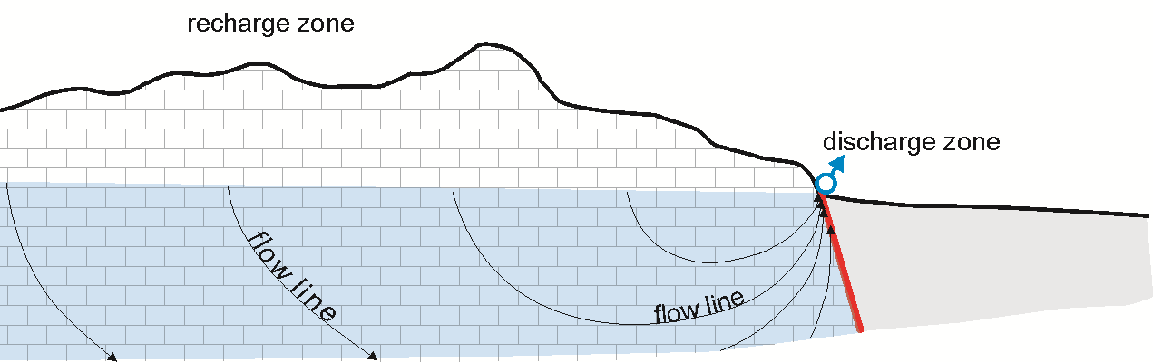
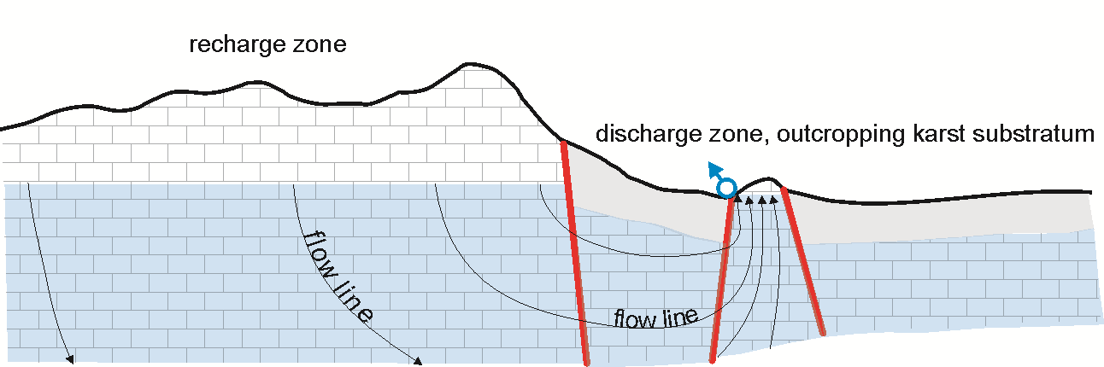
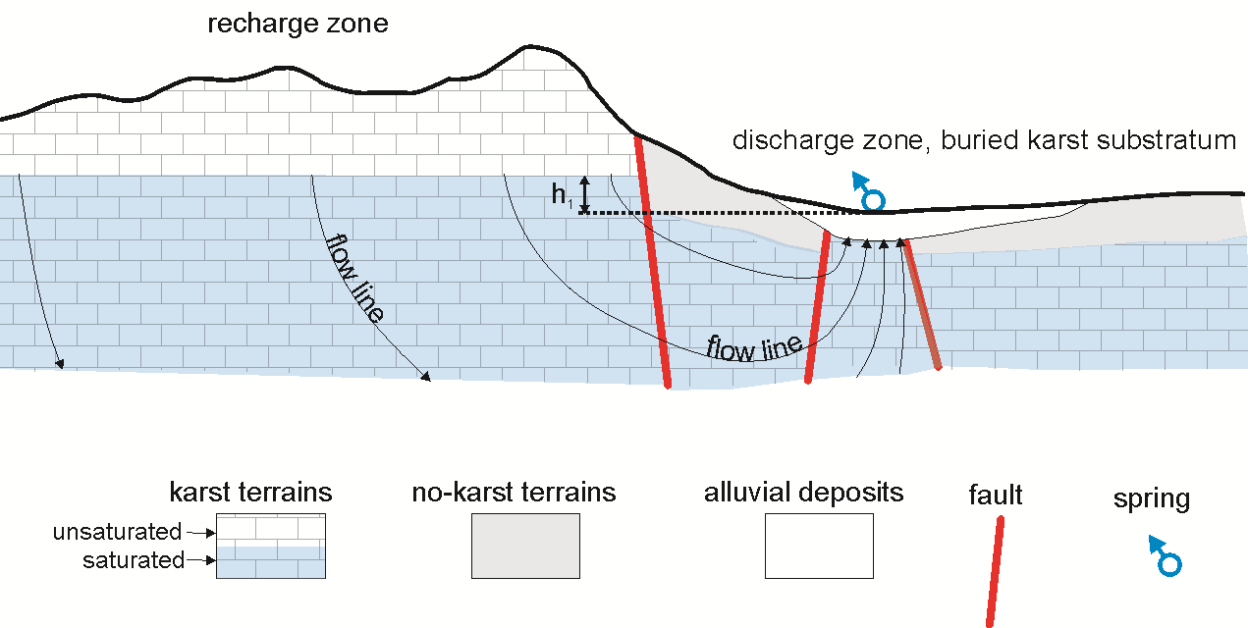
Hydrogeological sketch through groundwater flowpath karst aquifers of southern Apennines
Caposele spring
Pagnozzi et al. 2020, Applied Sciences
Grassano springs
Fiorillo et al. 2019, Water
Serino springs
Fiorillo et al. 2018, Water

Slide 4
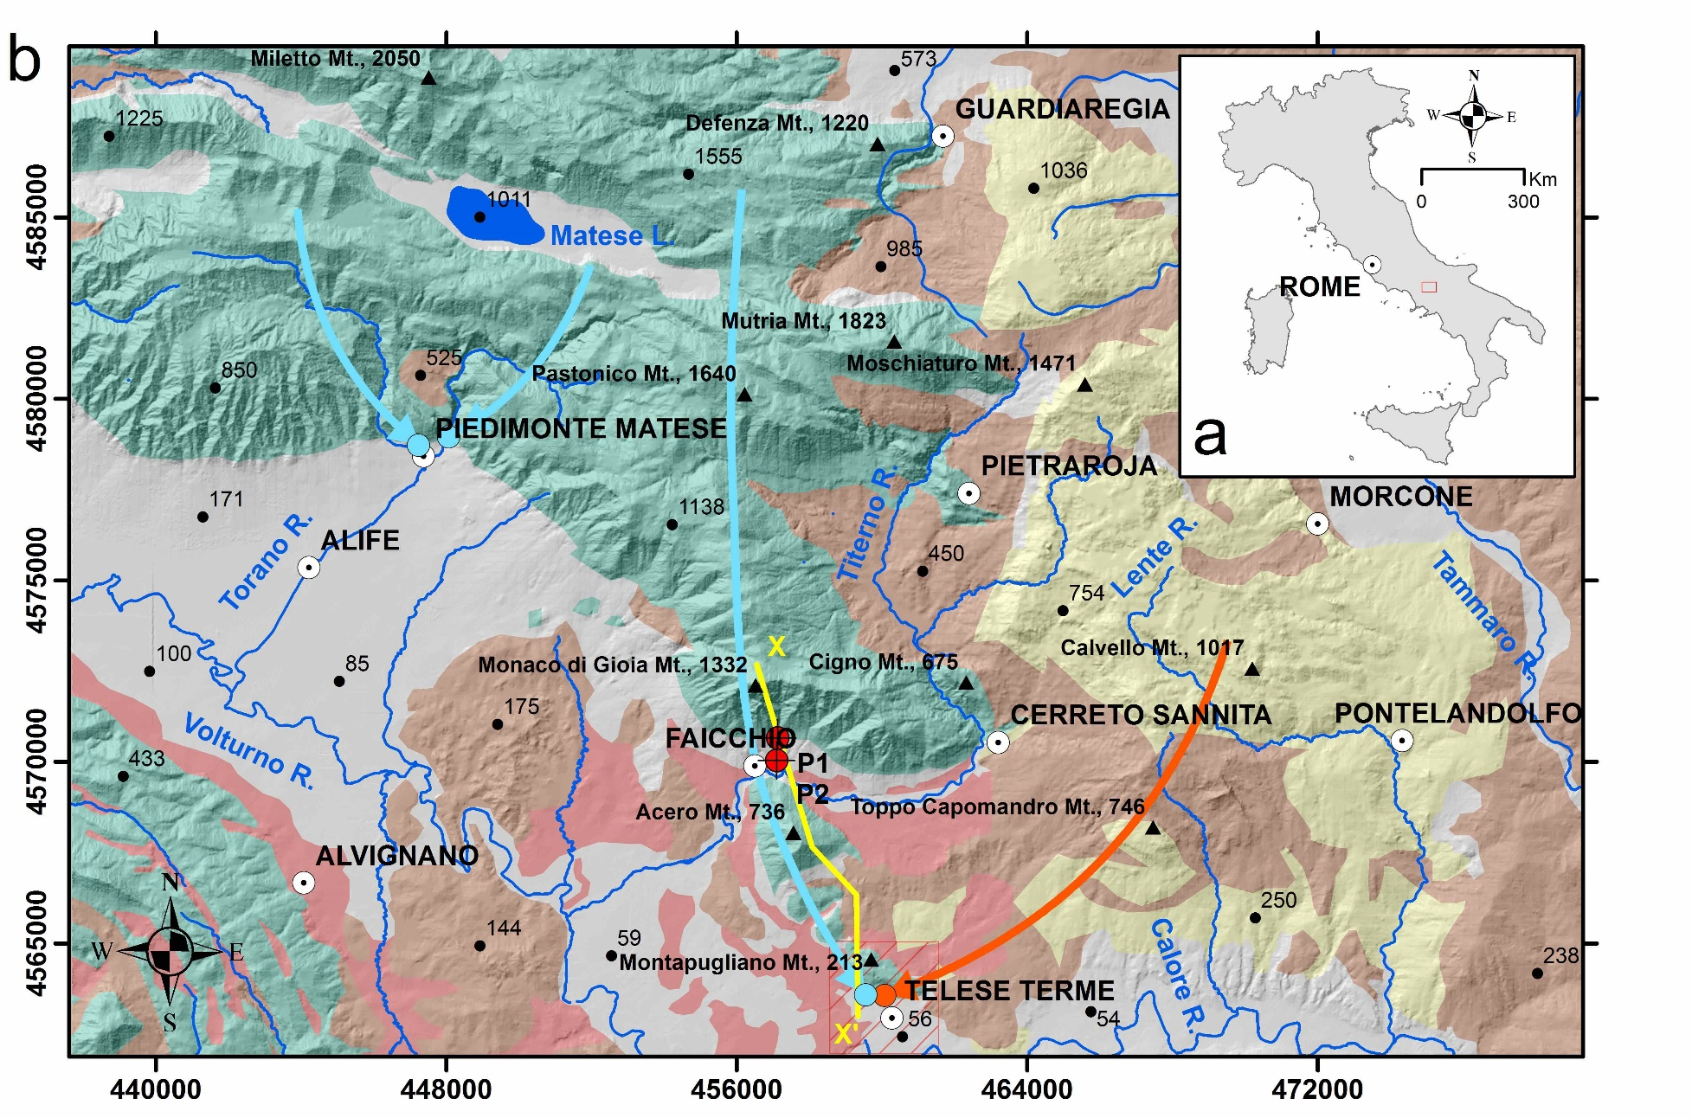
Matese karst massif and the Grassano springs
Grassano springs

Slide 5
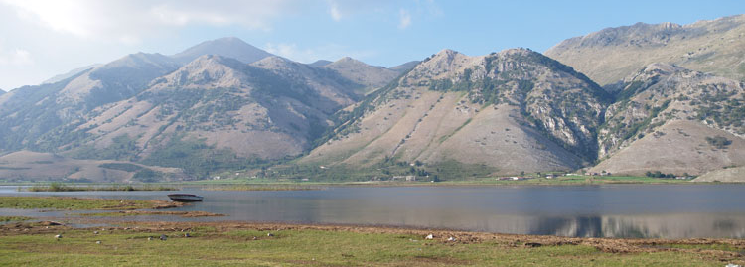
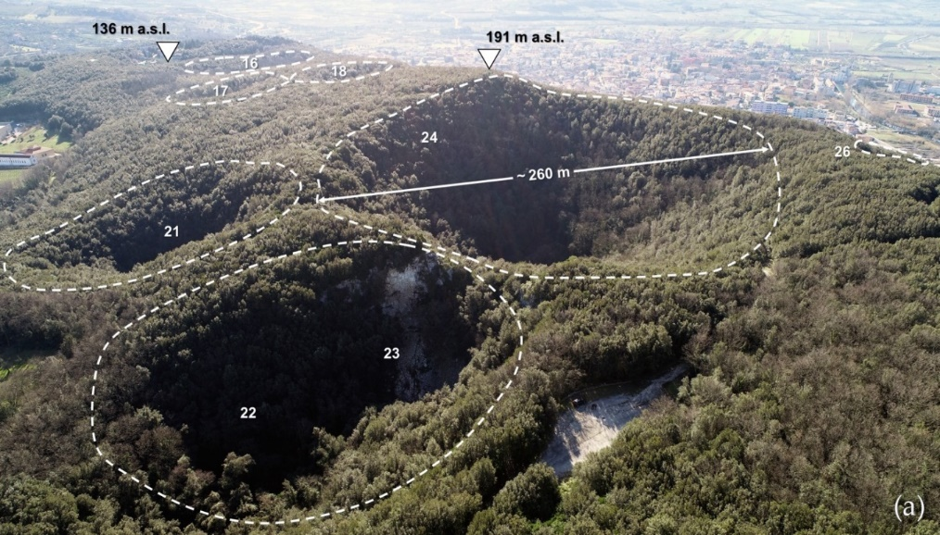
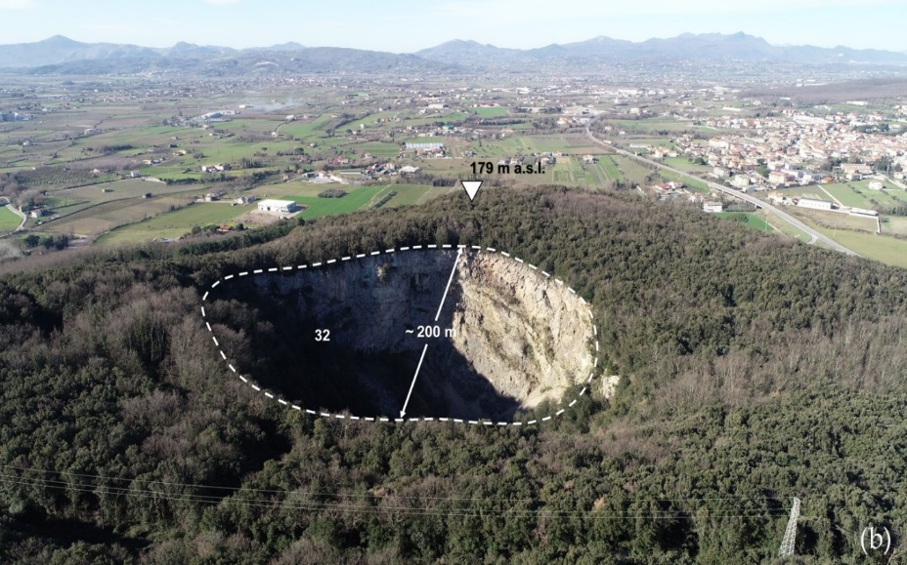
Matese lake (polje), recharge area
2050 m a.s.l.
1014 m a.s.l.
Montepugliano sinkholes, discharge area

Slide 6
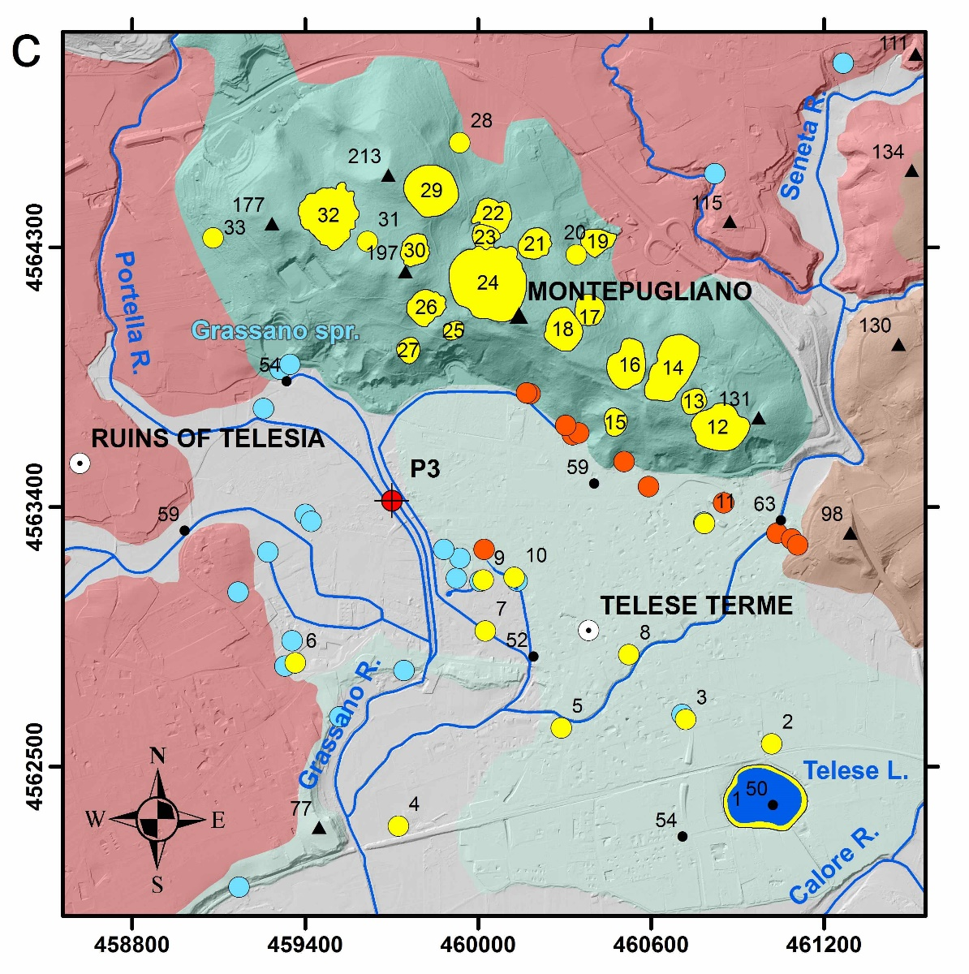

Main features of Montepugliano and Telese plain (discharge area)
fresh spring (<12 °C)
alluvial and travertine
tuff
flysch
limestone
sinkhole of Montepugliano relief
hot (>18 °C) and sulfurous spring
sinkhole of Telese plain

Slide 7
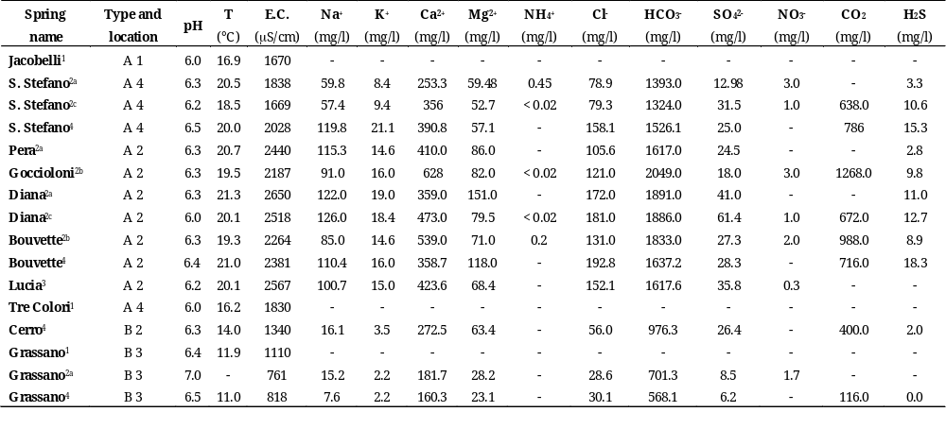
Physical and chemical characteristics of Grassano-Tesele spring water
Location: 1, Jacobelli Park; 2, Minieri Park; 3, Grassano Park; 4, other.
¹Data acquired using a multi-parameter water quality meters, between January and February 2019; ²Impresa Minieri S.p.A. relatively to years ª2000, ^{b}2017 and ^{c}2018; ³Harabaglia et al. (2002); ⁴Corniello e De Riso (1986).

Slide 8
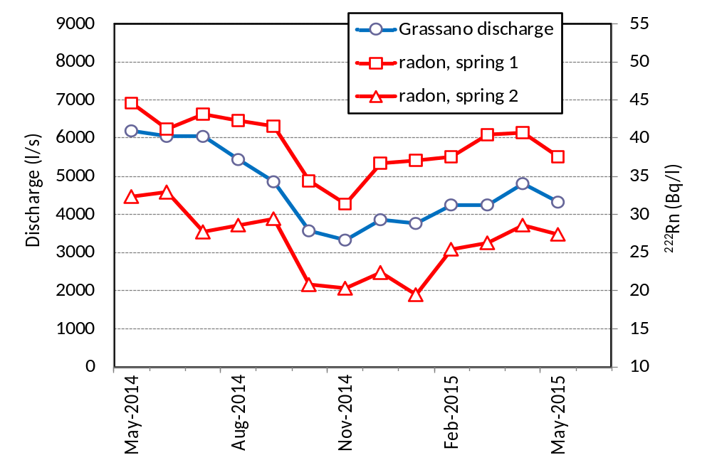
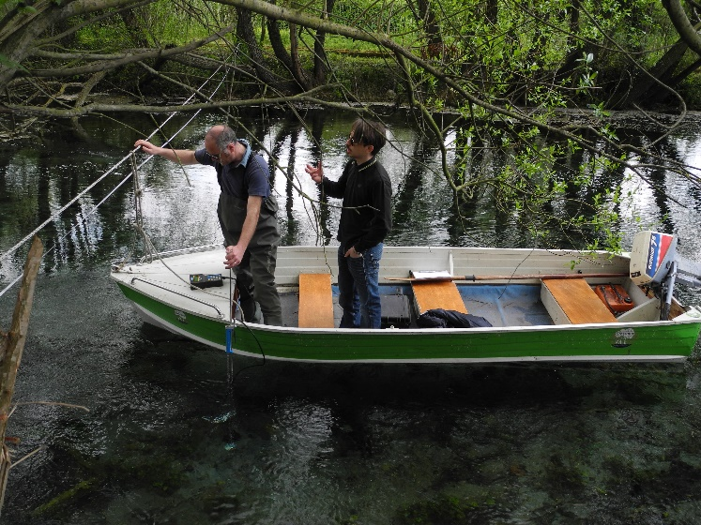
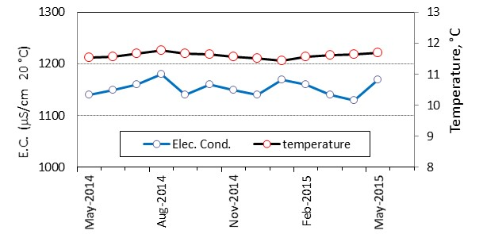
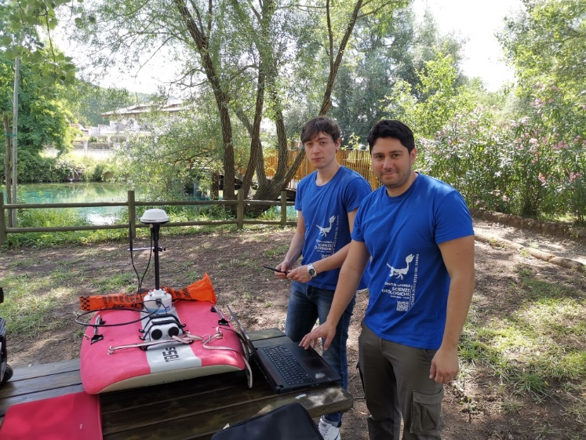
Physical and chemical characteristics, May 2014 - June 2015

Slide 9
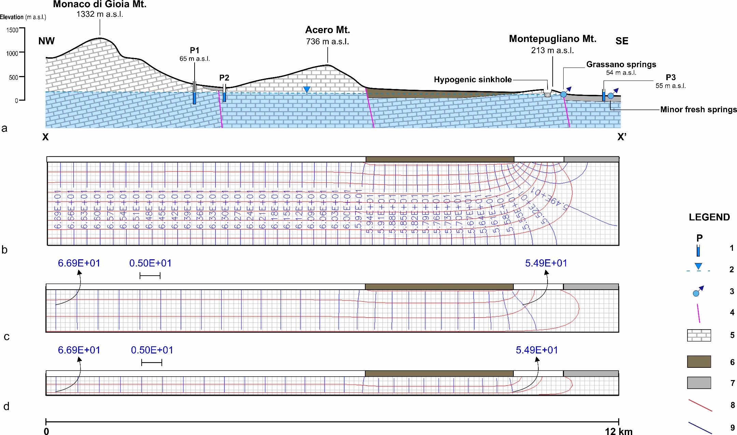
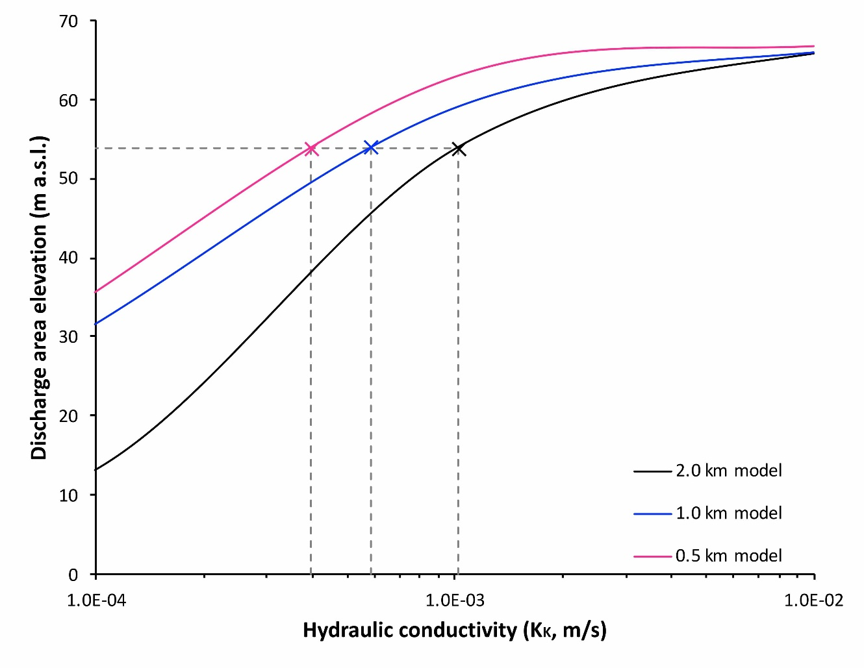
MODFLOW numerical code simulation along the groundwater flowpath the water table has been drawn by piezometers P1 and P2
Flow net
Hydraulic head, m asl

Slide 10
General sketch of the groundwater path behind spring outlet
flow net deducted from hydraulic heads by piezometers located upstream and downstream main spring outlet
recharge area is located on the left side

Slide 11
Conclusions
As recognized in many karst aquifers of southern Italy, the water table has a gentle slope, with values lower than 1%. This characteristic appears to be an important diagnostic feature to recognize the upwelling flow occurring in the discharge area. In fact, this condition favors a deep circulation, with flow lines initially descending (recharge zone), then converging toward springs (discharge zone), where they concentrate with a kind of flow typically ascendant.
Main diagnostic points of the ascendant flow in the discharge area:
hydraulic head downstream of the spring outlets can be higher than spring elevation
gentle slope of the water table would not support the high discharge measured at the spring outlet, which needs a vertical component of the groundwater path
spring water temperature almost constant trough the year
radon activity increases during the high flow period
many collapse sinkholes
formation of sub-vertical conduit (Vauclusian type springs)

