Slide 1
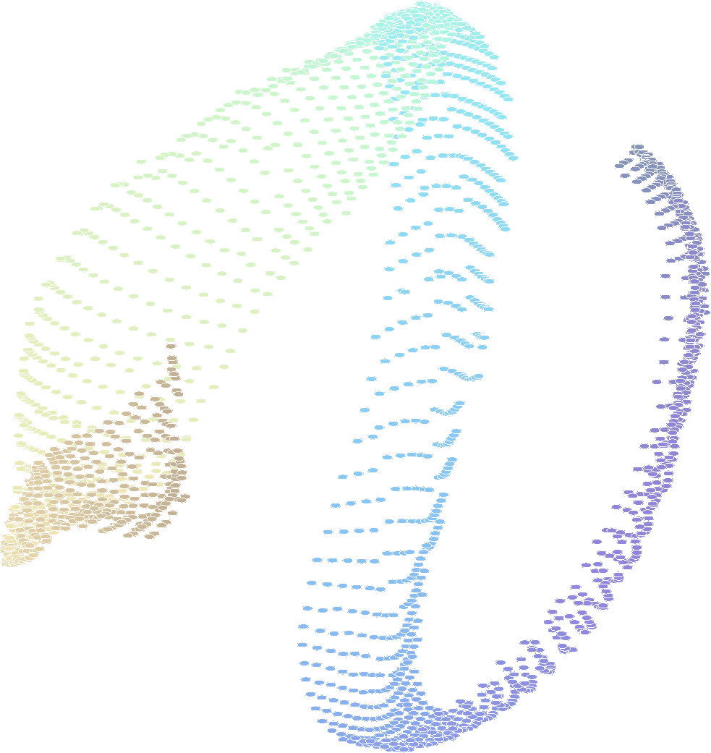
The Structure of Signal Space:
a case study of direct mapping between seismic waveforms and event distribution
Dave Harris Deschutes Signal Processing LLC
Doug Dodge Lawrence Livermore National Laboratory
LLNL-PRES-821840
This work was performed under the auspices of the U.S. Department of Energy by Lawrence Livermore National Laboratory under Contract DE-AC52-07NA27344. Lawrence Livermore National Security, LLC

Slide 2
This presentation is adapted from the paper:
“The geometry of signal space: a case study of direct mapping between seismic signals and event distribution”
Geophysical Journal International, Volume 224, Issue 3, March 2021, pages 2189-2208
https://doi.org/10.1093/gji/ggaa572

Slide 3
Machine learning has much to teach us about the structure of seismic data
Great claims are being made for machine learning algorithms in seismology
But, often the connection to the physics is not readily apparent
How do these algorithms work?
  We need some transparency into what machine learning algorithms are doing
  We also need some way to work classical seismological physics into these algorithms, perhaps as constraints
A first step is to investigate the link between seismic events and any discernable structure that may exist in the collection of observations they create

Slide 4
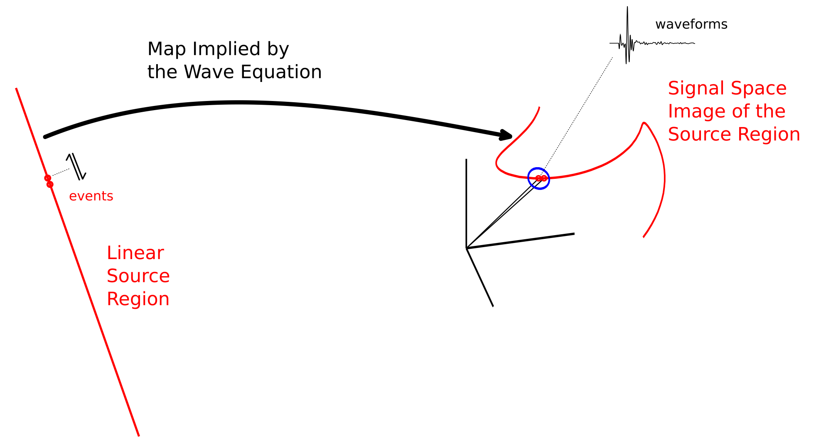
Fundamental notion: we think of waveforms as points in a high-dimension signal space
The wave equation implies a mapping from physical space to signal space.
From waveform correlation studies, we know that events that are close together produce signals that are “close” together, i.e. highly correlated. Waveform correlations estimate source separation.
As an event location moves continuously in a source region, the corresponding point in signal space traces out an image of the source region, which may be highly distorted (curved).

Slide 5
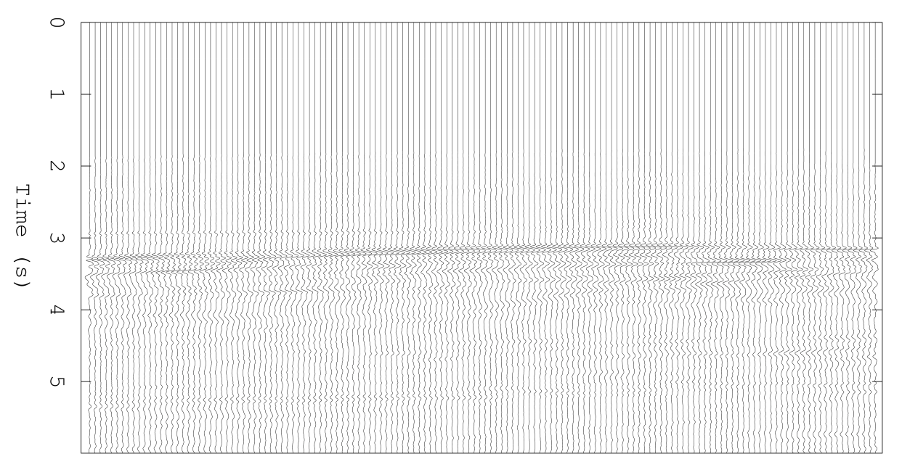
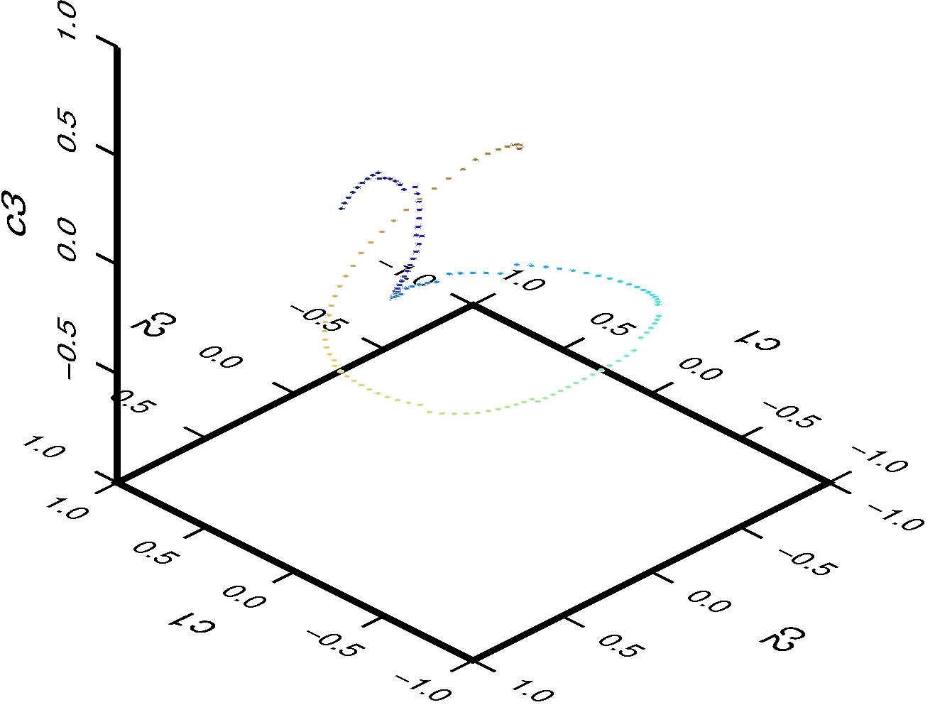

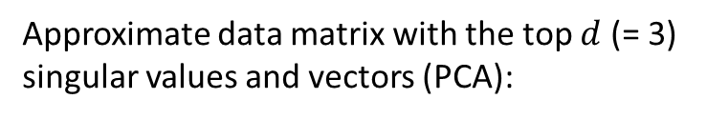



To visualize a signal space image, we project a collection of waveforms into a low-dimension space
Aligned Waveforms
$$X$$
Singular value decomposition:
$$X=UΣV^{T}$$
$$A_{d}=U_{d}^{T}X= Σ_{d}V_{d}^{T}$$
Approximate data matrix with the top $d$ (= 3) singular values and vectors (PCA):
$$X≈U_{d}{ Σ}_{d}V^{T}$$
Waveform
basis
Coordinates
Notes:
We assemble the digitized waveforms into a data matrix X as columns of the matrix (upper left). A singular value decomposition provides us with a low-dimension basis or representation for the collection of signals. Typically we choose the dimension to be three to support visualization, using the top 3 singular values and vectors to define the representation basis. The coefficients of the basis for each waveform then provide the coordinates of the waveform in the low-dimension representation (lower right). Typically the coefficients trace out a line or surface depending on whether the physical source region is a line or a surface. In this case, the source region in this cartoon is a line.

Slide 6
How do we align waveforms?
For synthetics there are two choices:
  “Natural alignment”, i.e. align to source origin times
  Align based on waveform correlation
For observed data, we align based on waveform correlation
  VanDecar-Crosson algorithm (see paper for details)
  High-correlation values imply soft constraints on time offsets between event pairs
  Find shifts for each event to minimize sum of squared correlation-derived offsets
Notes:
Synthetics are naturally aligned on the event origin times, but with real seismic data, we don’t know the origin times (at least not exactly and without an elaborate process of picking and event location). Consequently, we align waveforms with the VanDecar-Crosson algorithm, which uses the peak offset of the correlation function between pairs of waveforms to define the delay required to align the waveforms. Since we can measure N(N-1)/2 correlation offsets among N waveforms, if we specify a shift for each waveform to align all N waveforms, the correlation constraints imply an overdetermined system of equations defining those shifts. The VanDecar-Crosson algorithm minimizes the sum of square errors between the difference of the shifts and the offsets measured from the peak of the correlation functions.

Slide 7
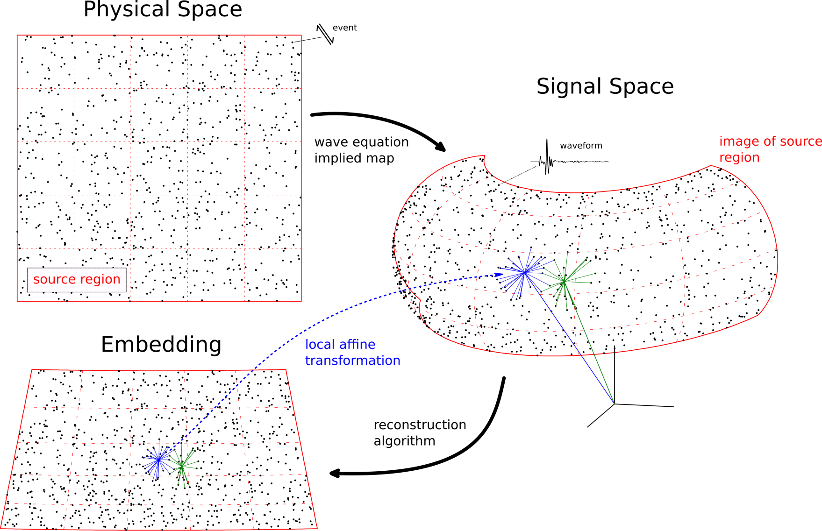
We want to reconstruct the source distribution from its signal-space image
How? Attempt global reconstruction of source distribution from local estimates of distance between sources. Assume local source distances are proportional to local distances in signal space measured from waveform correlation.
Notes:
The plan for estimating (reconstructing) the placement of sources in the source region from the measured positions of corresponding waveforms in signal space assumes that the geometry of waveforms in an infinitesimal region of signal space is the same as the geometry of sources in a corresponding small portion of the source region. The image of the sources in signal space may be a stretched and rotated version of the local geometry of sources in physical space. But we assume that the connectivity of sources in physical space and waveforms in signal space is the same, i.e. if sources in physical space are neighbors, then their corresponding waveforms are neighbors in signal space. We use the local connectivity defined by high values of waveform correlation to assemble a global picture of the distribution of sources in the source region. The “embedding” or reconstruction of the sources that results may be a somewhat distorted map of sources in physical space. In particular, it may be known only up to an arbitrary rotation and stretching. Thus it is an imperfect map of physical space, but nonetheless provides information on the distribution of sources.

Slide 8
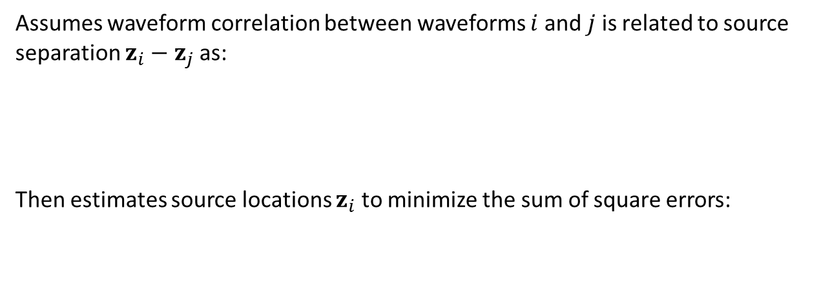
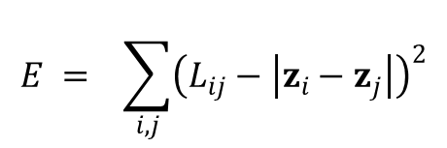


Menke’s method inverts pairwise correlation constraints on source distances for source locations
Assumes waveform correlation between waveforms $i$ and $j$ is related to source separation $z_{i}−z_{j}$ as:
Then estimates source locations $z_{i}$ to minimize the sum of square errors:
$$c_{ij} ≈ e^{−\frac{\left|z_{i}−z_{j}\right|}{s}}$$
$$L_{ij} = −\ln{c_{ij}} ≈ \left|z_{i}−z_{j}\right|$$
$$E = \sum_{i,j}{{\left(L_{ij}−\left|z_{i}−z_{j}\right|\right)}^{2}}$$
Notes:
Menke’s method was an early attempt in the seismological community (by William Menke) to estimate the relative locations of events related through waveform correlation. Hans Israelsson developed a closely-related method to estimate offsets of events from already-located master events based on waveform correlation. Both methods suffer from a deficiency in waveform correlation: while very high value of correlations generally are a reliable indication of event proximity, moderately high values may not be because the image of a source region in signal space may fold back upon itself to place points (waveforms) closer in signal space than would be predicted from the physical separation of the corresponding sources. This is particularly true of seismic signals which tend to be highly oscillatory; cycle-skipping is a significant problem. Low values of waveform correlation may not provide much information about event proximity at all due to a “floor” in correlation values set by the time-bandwidth product of the signals. Hence, only the highest-value correlations should be used to make inferences about relative event locations, implying that global information must be constructed from the pattern of local information. Note: the waveform correlation measurements indicated are those at the peak (maximum) of the correlation function.

Slide 9
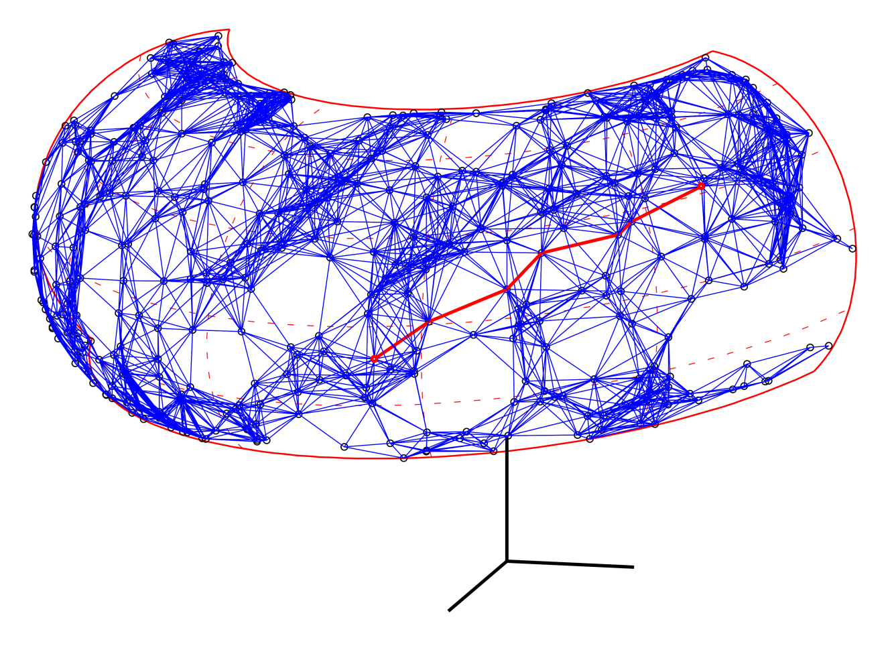
Isomap does something similar, but with a more complicated estimate of distance between waveforms
First builds a graph of nearest neighbors among waveforms.
  Nodes are at waveform locations (in signal space).
  Edges are labeled with Cartesian distance between waveforms.
Then traces distances between pairs of waveforms along an approximate geodesic.
  Minimum distance path (example in red).
  Distance is sum of edge lengths.
Finally inverts these “geodesic” distances for source locations.
Isomap seeks to preserve distances along paths confined to the source region image in signal space
Notes:
A more sophisticated approach to source-region reconstruction acknowledges that waveform correlation measurements provide only reliable local information on event proximity. The machine learning Isomap algorithm replaces the Euclidean distance in signal space that might be inferred from correlation measurements with the shortest distance along the image of the source region in signal space (the geodesic distance). Locally the distance estimate provided by waveform correlation is the same as the geodesic distance. But larger distances are traced through nodes in a graph that connects each waveform to its nearest neighbors. The ability to estimate distances as minimum path lengths in the graph is controlled by the density of points (waveforms) sampling the source region image in signal space. Consequently, this approach is well suited to situations where very large numbers of waveforms are available to define the image.

Slide 10
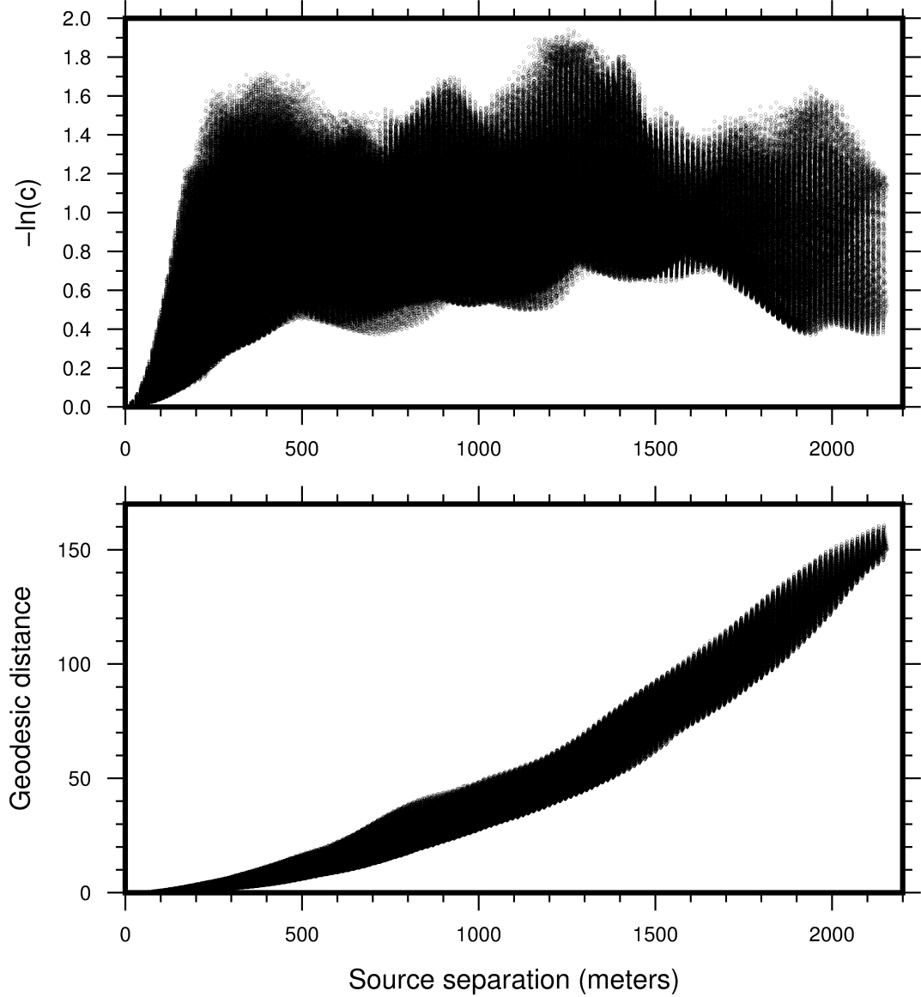
The geodesic distance is a more accurate reflection of source separation than –ln(c)
Estimates of correlation distance constraints plotted against actual source separation for synthetics (see coming slides for simulation).
Estimates of geodesic distance plotted against actual source separation for synthetics.
Notes:
This pair of figures demonstrates (for synthetics described in the next two slides) how the approximate geodesic distance in signal space used by Isomap is more nearly proportional to source separation than (the log of) the waveform correlation value. Both measures exhibit significant scatter due to the oscillatory nature of seismic waveforms, but the geodesic distance is significantly better at estimating source separation. Waveform correlations are roughly proportional to source separation only out to 200-300 meters in this example, then hit a ceiling determined by the T-B floor in correlation measurements. Measurements beyond 300 meters are largely useless. The geodesic distance is not perfectly linearly related to source separation, probably because the source region image exhibits some stretching along its long axis relative to the physical source region.

Slide 11
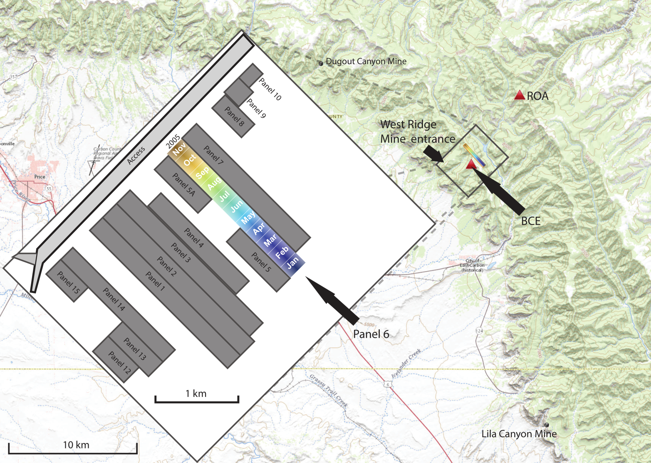
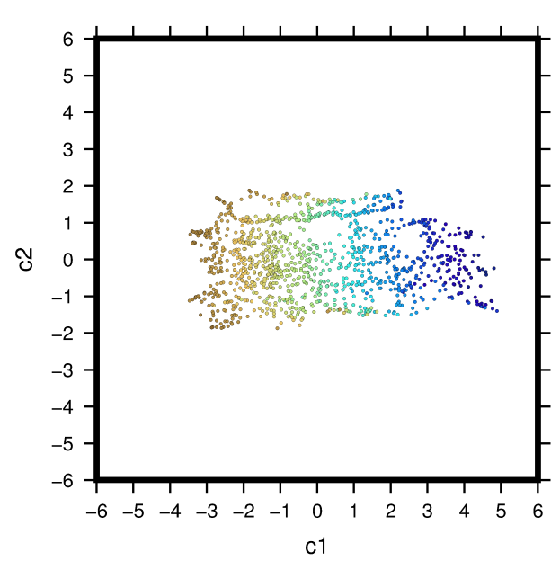
Induced seismicity at a coal mine in Utah provides a concrete example
In 2005, the West Ridge Mine extracted coal from a long panel; regulatory documentation provided an exact picture of how this mining operation progressed. Two University of Utah stations (BCE and ROA) observed the seismicity induced by the operation. Can something of the geometry of the mined region be inferred from the event waveforms observed by one of the stations?
One-station reconstruction
Yes!
Notes:
Note: color in panel 6, the source region, encodes the time that the panel was mined. We maintain this same color scheme for events (or the median time origin time of event clusters) throughout the rest of the presentation. Because the panel was mined uniformly from the southeast to the northwest, time of occurrence of observed events is presumed to be a good proxy for event location along the panel. This assumption is largely, though not perfectly correct, as we shall see.

Slide 12
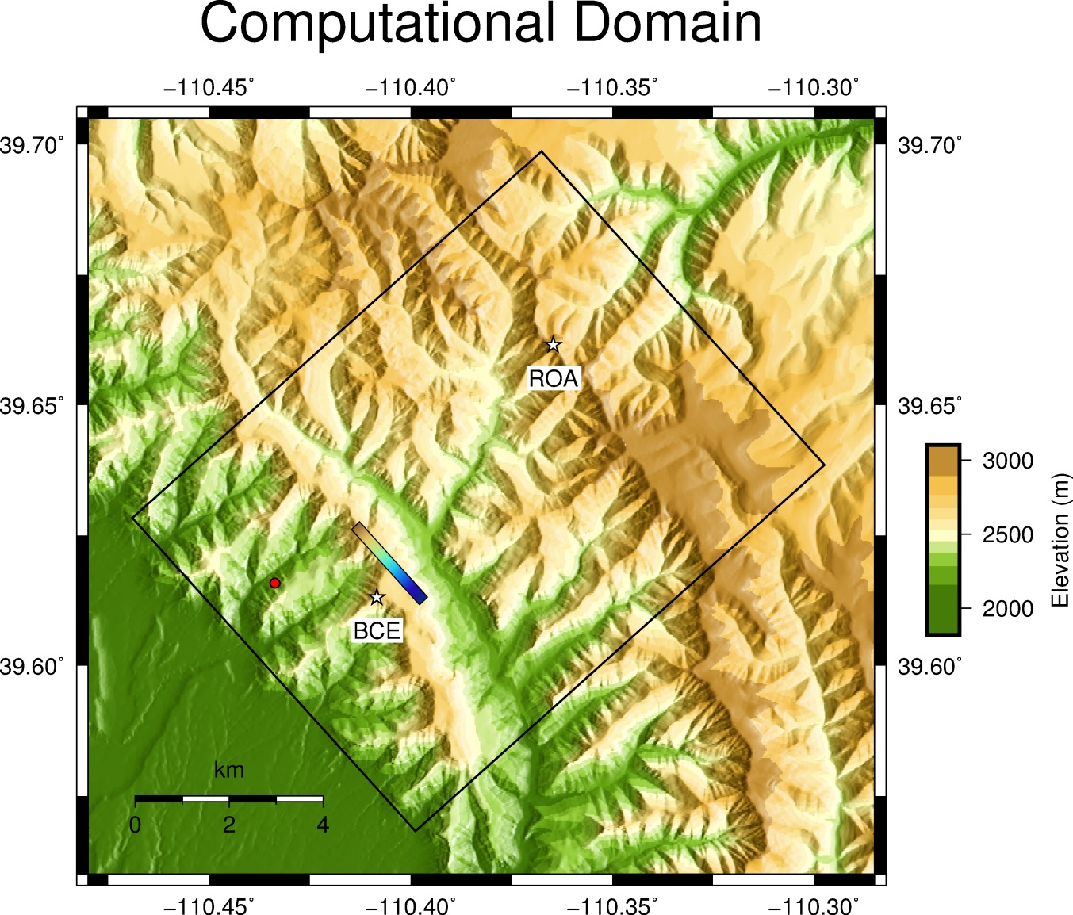
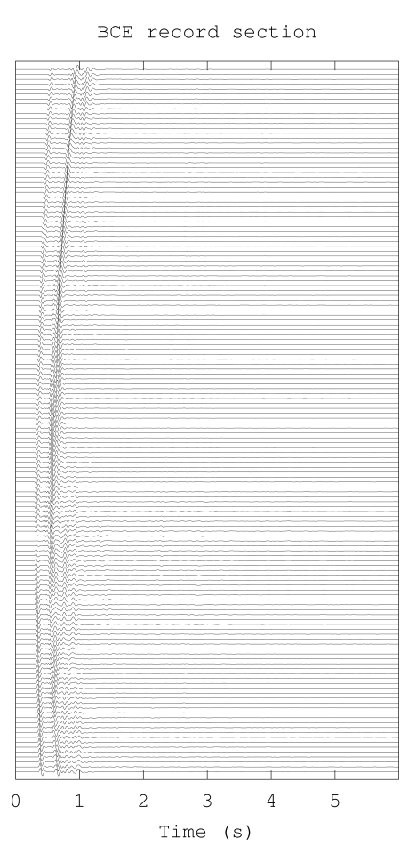

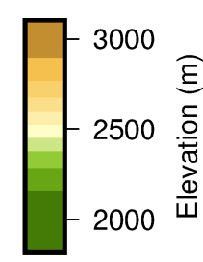
Testing Concepts and Algorithms with Synthetics
SW4 finite difference synthetics
Notes:
We tested the concepts described above first with finite-difference synthetics generated by SW4 in a simple model (layer over a half space, but with accurate topography). The source region is indicated in the map at left by the rainbow-colored narrow rectangle, which was sampled at a density of 15 meters producing a 16 x 144 point (2,304 total) representation of the source region. The simulation was accurate to 8 Hz. Record sections corresponding to the 144 point southwest boundary of the source region are shown at right for the two observing stations, ROA and BCE. We used only the vertical component records of ground motion in subsequent analyses.

Slide 13
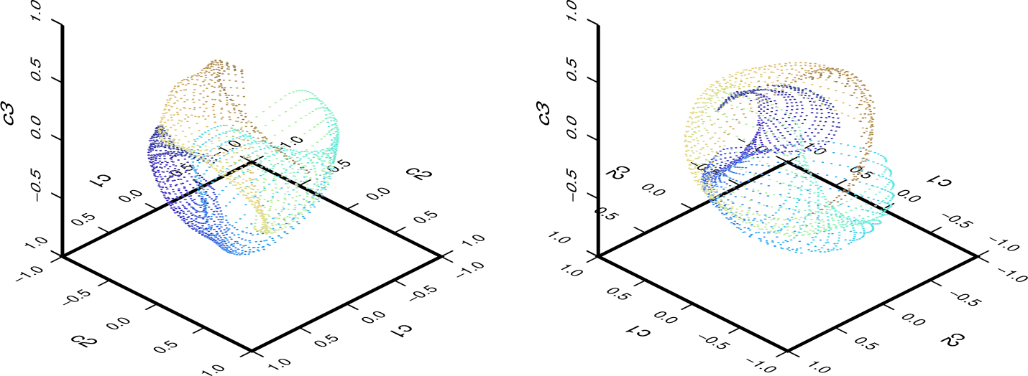
3D image obtained with natural alignment for station ROA
Color encodes position along the long axis of mined panel. Note that the simple process of projection sorts the waveforms by their corresponding event proximity.
Notes:
This is the 3D image created by synthetics (with natural alignment) for station ROA by the algorithm of slide 5. Note that the image is a two-dimensional surface: the image has the same dimension as the source region (which was a planar representation of the panel). The image is heavily folded, hence not a very good map of the source region, though waveforms corresponding to different neighborhoods of the source region map to different portions of signal space. Because of the folding, some waveforms corresponding to different parts of the source region are not that far apart. This characteristic is the problem with waveform correlation as an estimator of source proximity.

Slide 14
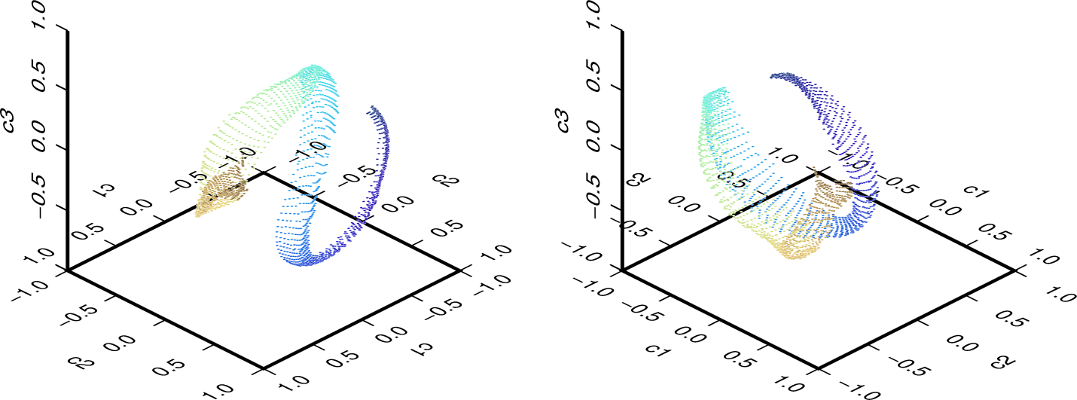
3D image obtained by VanDecar-Crosson alignment with waveform correlation constraints
This type of alignment produces an image with waveforms still sorted by corresponding source distribution, which is crucial for seismic observations with unknown origin times. Again station ROA synthetics.
Notes:
This is the corresponding 3D image with waveforms aligned by maximum correlation. Crucially, this type of alignment still separates waveforms by source location, and actually is less ambiguous than the previous image. This is a good thing, since this is the only type of alignment feasible with real observations.

Slide 15
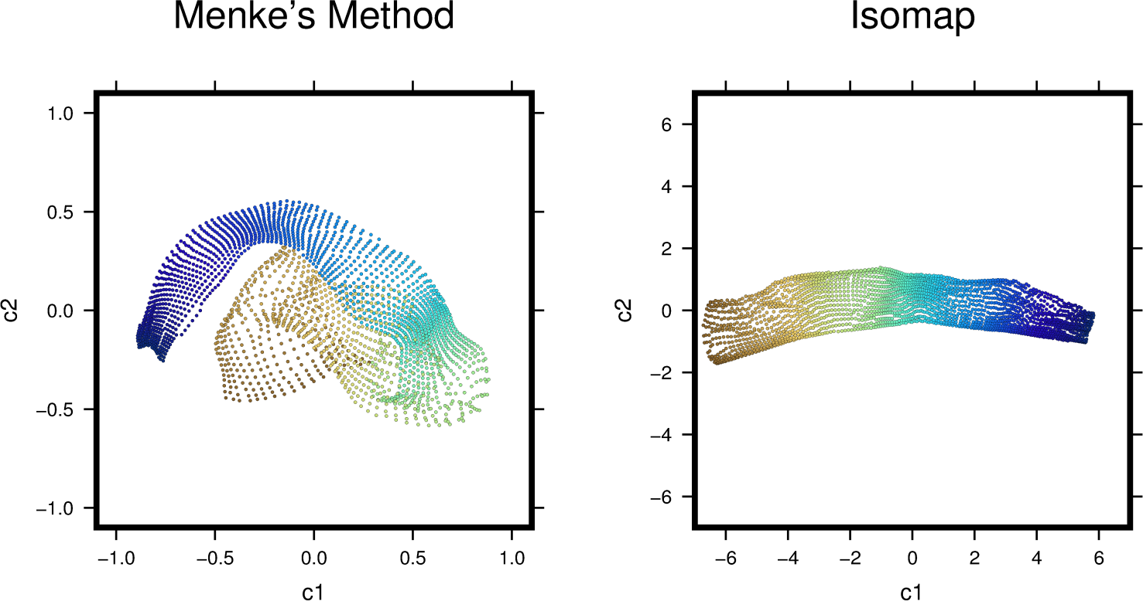
Reconstructions of source distribution by two algorithms
Menke’s algorithm fails to constrain large distances properly and produces a “wrapped” reconstruction; Isomap approximately constrains geodesic distances and produces a more accurate reconstruction
Notes:
These are noiseless reconstructions of the source distribution made from the synthetics. Because of the problem with raw correlation measurements not accurately representing source separation, Menke’s method produces a folded reconstruction. Isomap is free of this problem in this instance. This is an ideal situation because the source region is adequately and uniformly sampled. With these synthetics, color represents distance along the source region from southeast (blue) to northwest (brown).

Slide 16
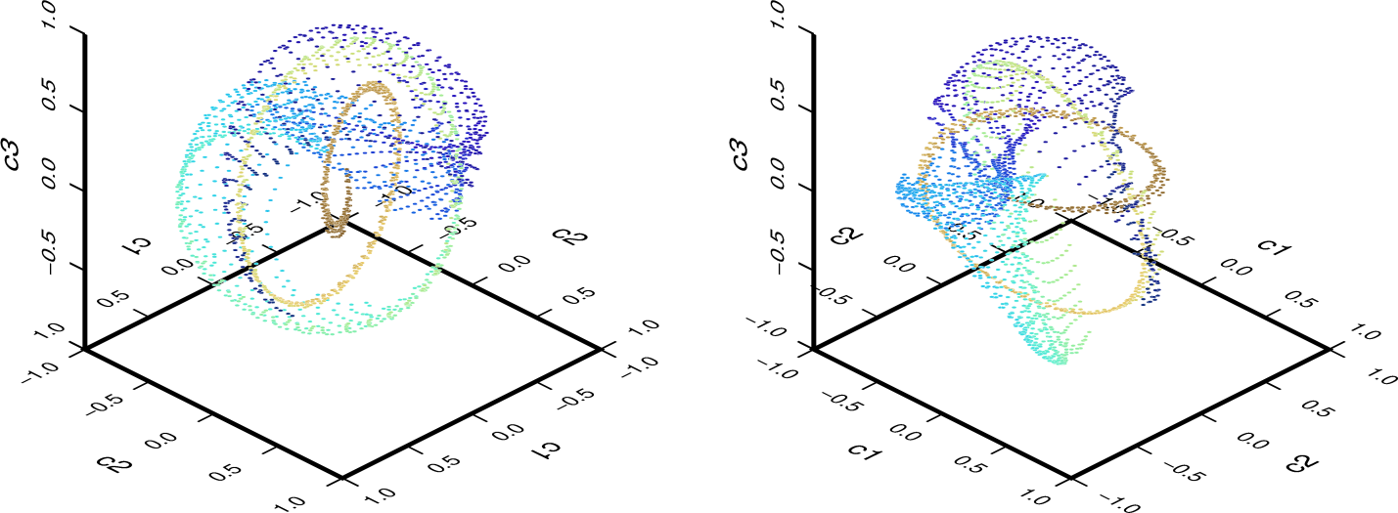
Natural alignment, 3D, signal-space image for station BCE synthetics
Notes:
Here is the same sort of 3D image using natural waveform alignment for the BCE synthetics. This image is highly folded and tightly curled due to the position of station BCE near one end of the panel.

Slide 17
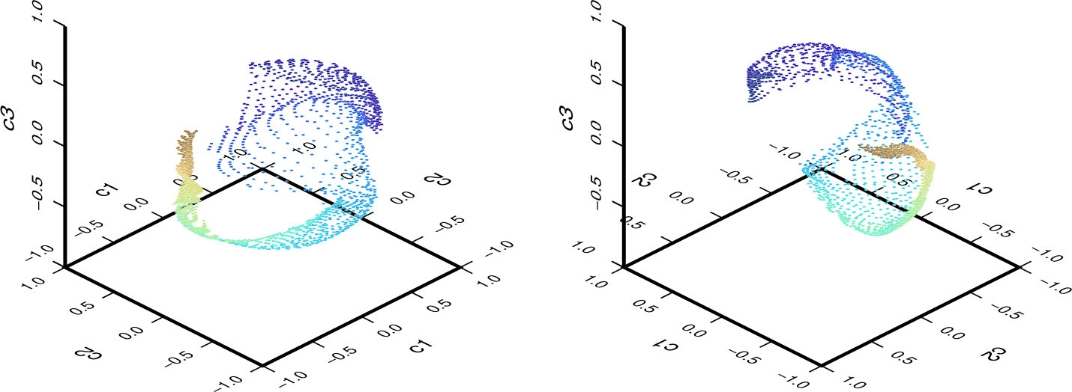
3D image obtained with VanDecar-Crosson alignment
Note that waveforms corresponding to the far end of the panel (from BCE, in brown) are compressed in a small region. This effect should make reconstruction of source distribution more difficult.
Notes:
This image, obtained again with the projection algorithm of slide 5 (Principle Components Analysis) is again considerably less ambiguous than the previous image, though still a highly distorted image of the source region.

Slide 18
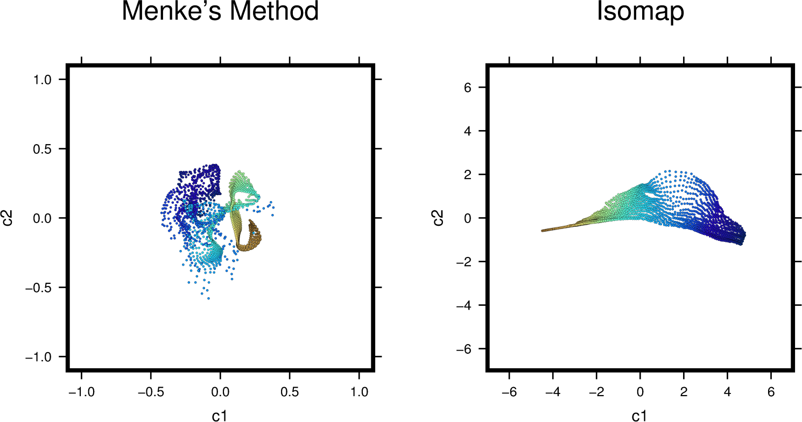
Reconstructions of the source region from BCE waveforms exhibit degeneracies, especially at the portion of the panel most distant from the station
This example highlights the need for a good observational geometry.
Notes:
Both reconstructions methods fail, in this case, to give a good estimate of source distribution, though Isomap fails less spectacularly. Here we have reached the limits of what can be done with observations from a single vertical-channel seismograph.

Slide 19
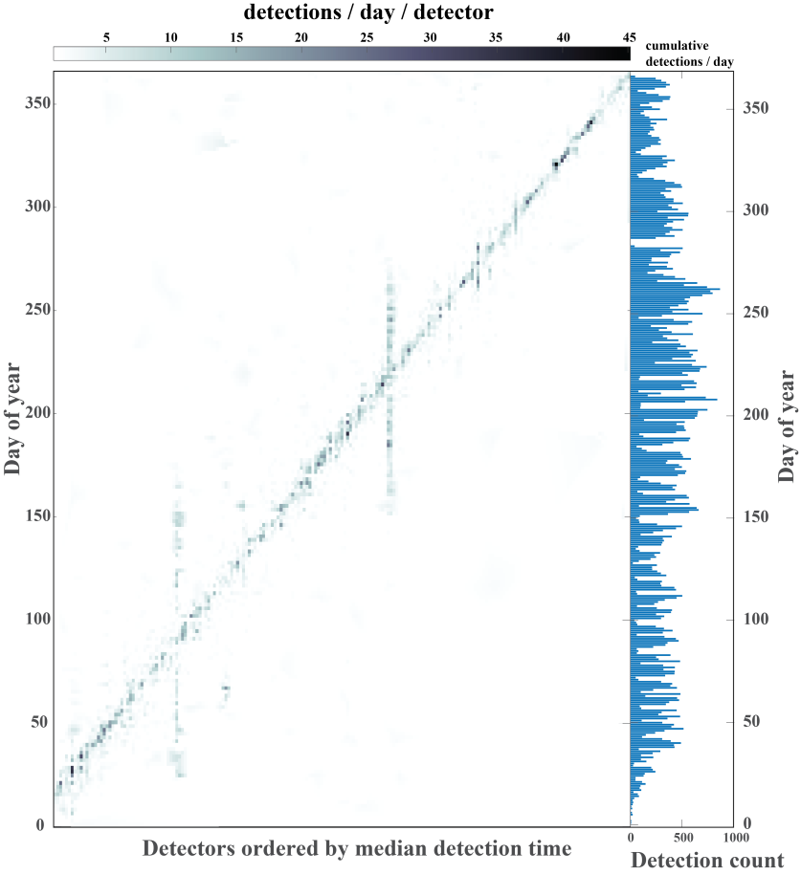
Inversion with West Ridge Mine Event Observations
Events/day/cluster
We performed substantial preprocessing to enhance waveform SNR and decluster events.
We ran correlation detectors to find 173,776 events and clustered these into 2212 clusters for BCE and 1600 clusters for ROA.
The waveforms were stacked in each cluster to produce a high-SNR template.
The clusters were active only for short time periods; we assume each represented a distinct source active at a median time.
The cluster templates were the waveform inputs to our subsequent analyses.
Clusters ordered by median detection time
Notes:
With correlation detectors applied to the continuous streams from stations BCE and ROA, we found a very large number of events over the 11 months that panel 6 was mined. To enhance the SNR and decluster the data, we clustered the detections (using a waveform correlation similarity measure), then stacked the waveforms for a given station in each cluster. We show here that the clusters were active only for short time periods; the two longer duration clusters that appear as large vertical streaks were actually due to another mine nearby, and were eliminated from the data. This operation gave us a reduced set of high-SNR waveforms to use in the inversion process. We assigned the median detection time for events in a cluster as the “origin time” of the stacked waveform for subsequent analysis. This approximation is legitimate since the clusters were active only for very short periods.

Slide 20
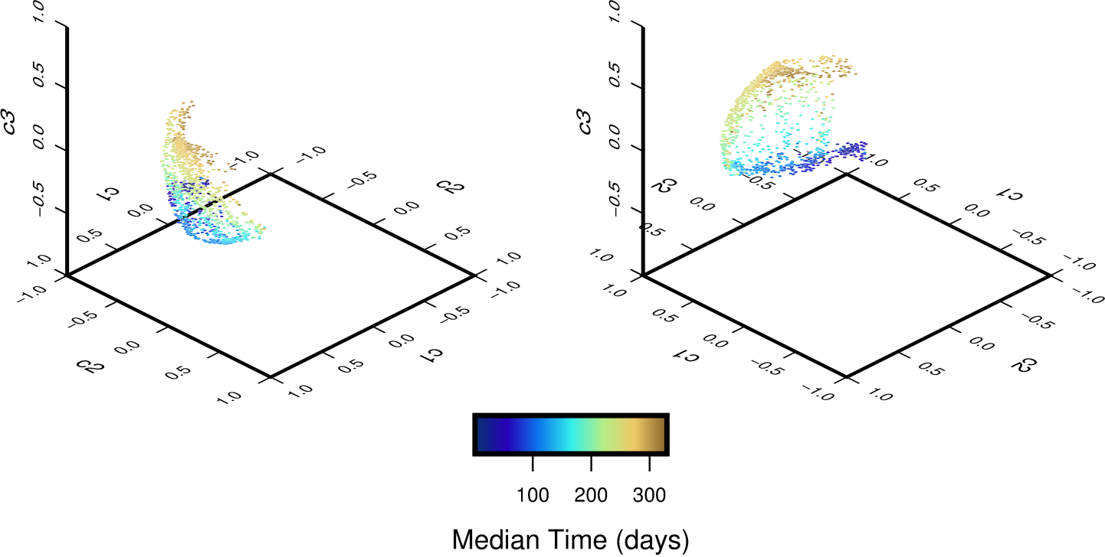
ROA signal space image produced with VanDecar-Crosson alignment
Color coding here denotes median time of event clusters, which is a proxy for location given the linear progression of mining along the panel.
As with the synthetic data, the projection algorithm sorts sources from different parts of the panel into different regions of signal space.
Notes:
Note: this image is significantly more compact than the one produced by the ROA synthetics. We think the difference is due to the fact that the real waveforms contain significantly more scattered energy, which tends to reduce the distinction between sources in different parts of the source region.

Slide 21

ROA reconstructions are broadly congruent (but distorted) with a rectangular source region
Notes:
Here is our main result: reconstructions with both Menke’s method and Isomap. We think the results are remarkable, given the fact that they are obtained with observations from a single vertical channel (in the 1-8 Hz band). Menke’s method performs better here than it does with synthetics (contrast with slide 15), a fact we attribute again to the greater amount of scattering in the real data, and might have been predicted from the image of slide 20, which is significantly less folded than the image of slide 14.

Slide 22
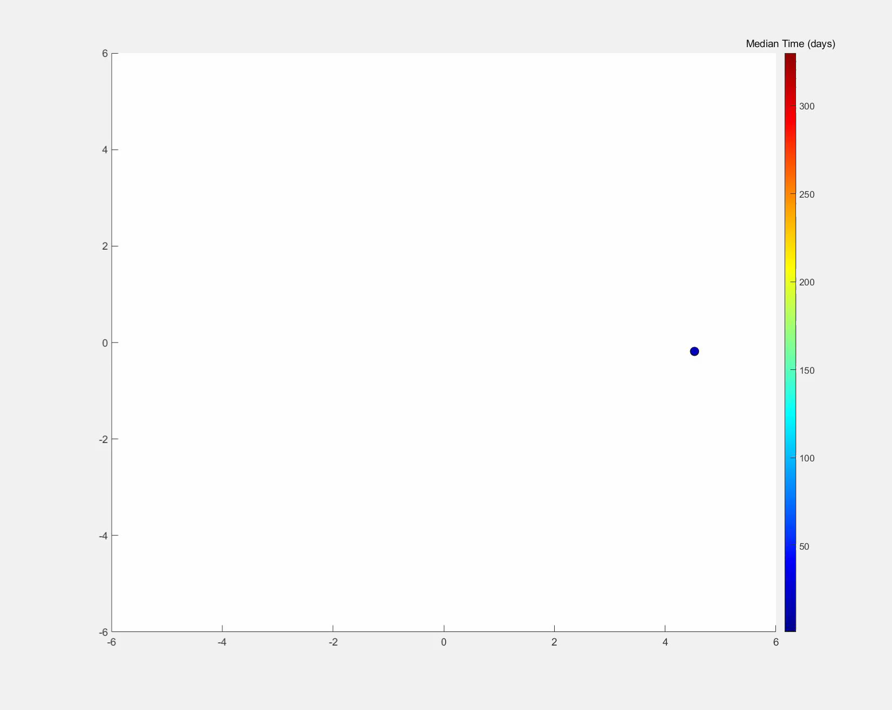
This time-lapse video shows the progression of source activity more clearly
We speculate that late time sources lagging along the top and bottom margins of the reconstruction represent delayed collapse along the sides of the panel.

Slide 23
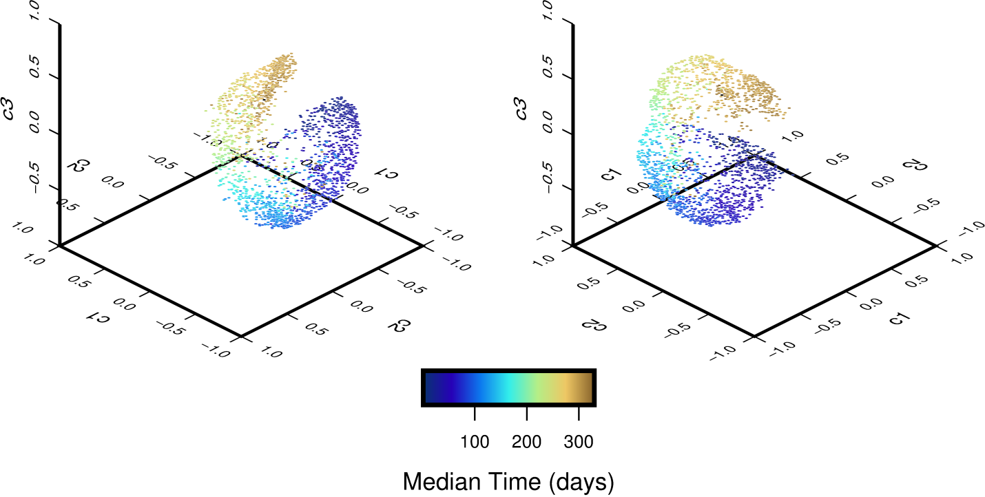
The BCE signal-space image is curled back on itself, which portends trouble for reconstruction

Slide 24
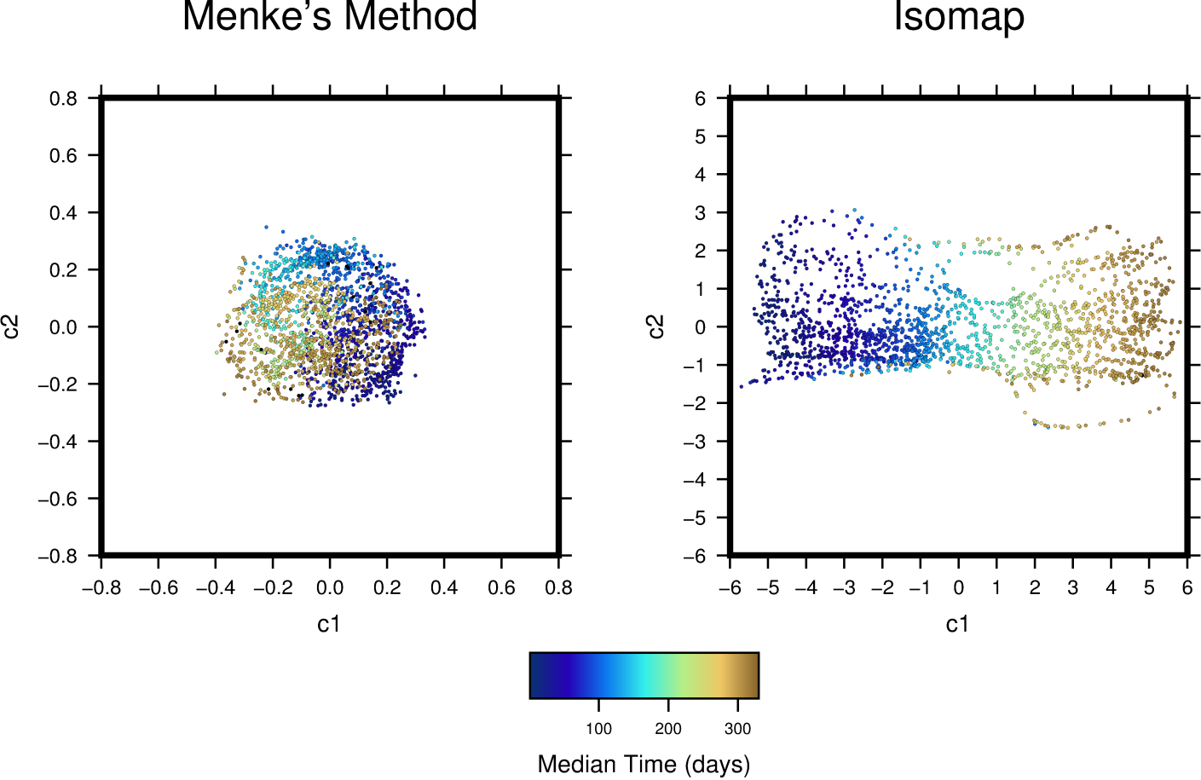
Menke’s method produces a locally correct, but globally folded reconstruction; Isomap correctly unfolds the image with some artifacts
Notes:
The Menke’s algorithm reconstruction from the BCE data shows the limitation of the method, due to the problem, noted in the last slide, of the signal space image of the source region being folded back upon itself. We tried many different thresholds for excluding low correlation values, but did not get a better result than this one. Isomap properly unfolds the image, but has some artifacts (gaps and the large loop at lower right). It is a bit counterintuitive, but data from the station closer to the source region actually is harder to interpret via these algorithms than those from the more distant ROA.

Slide 25
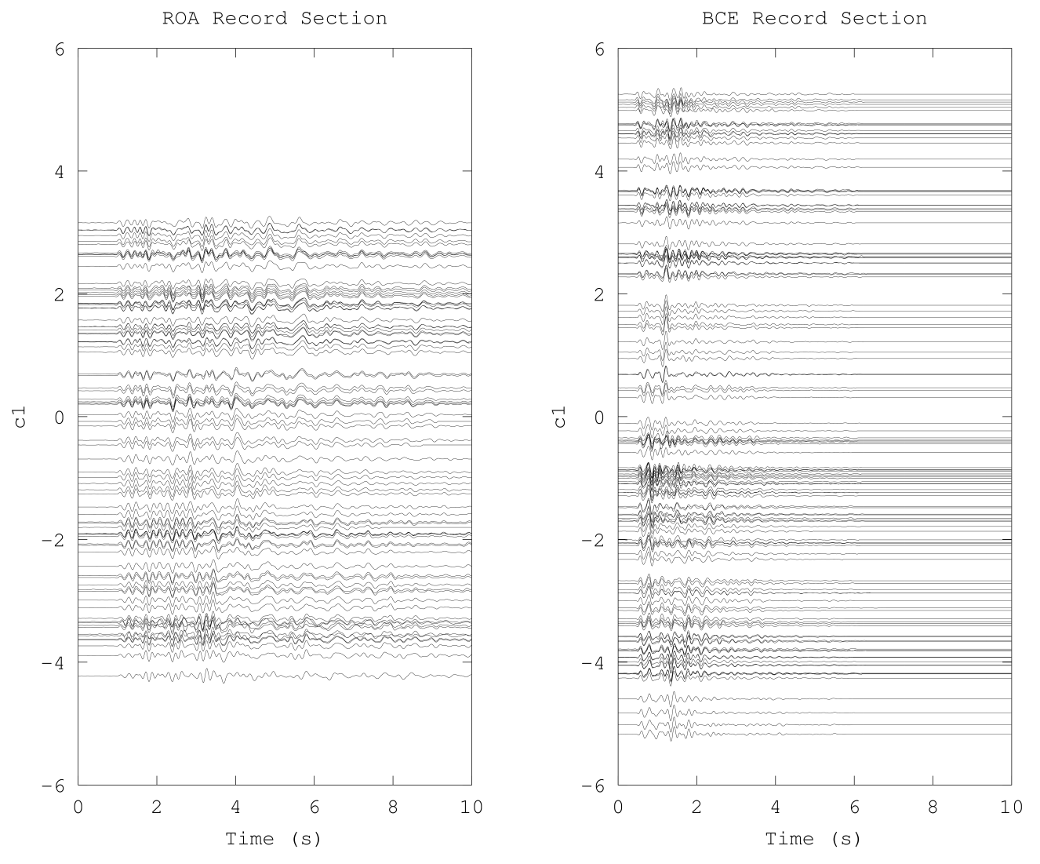
The Isomap reconstructions appear to place waveforms in a logical order
The ROA waveforms have a larger time-bandwidth product, which is favorable for distinguishing different parts of the source region.
Notes:
These record sections correspond to the Isomap results in slide 21 (left side) and slide 24 (right side).

Slide 26
Thank you for your attention …
We have learned several important lessons about the constraints that waveform similarity places on source region geometry
  With sufficiently dense sampling of signal space we can observe the signal-space geometry (a surface) of waveforms corresponding to sources related through a common generating process.
  Geodesic distances in signal space are a (far) better estimate of source separation than simple waveform correlations
  Samples of the signal space image can be inverted for an estimate of the topology (connectedness) of the source region and Isomap provides a better estimate than Menke’s method
Please refer to our paper for details

