Slide 1

Comparing traditional geomechanical and remote sensing techniques for rock mass characterization
Angela Caccia ¹, Biagio Palma ², and Mario Parise ¹
Aldo Moro, Earth and Enviromental Sciences, Bari, Italy
IDROGEO s.r.l., Vico Equense (NA), Italy

Slide 2
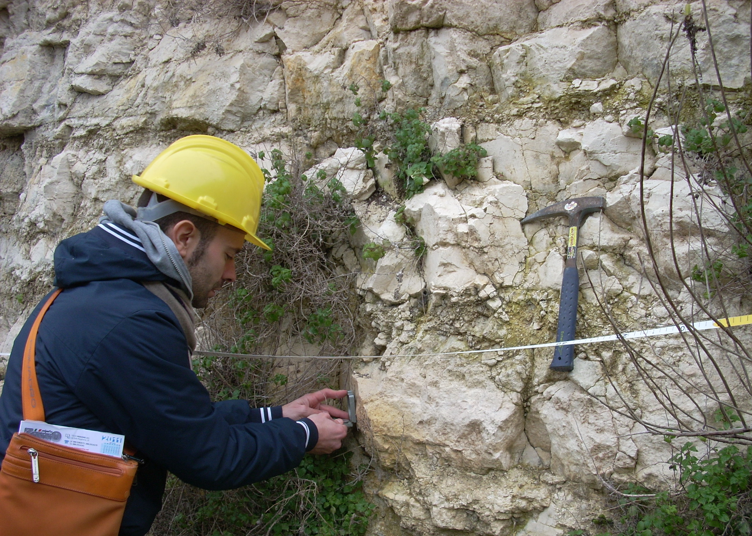
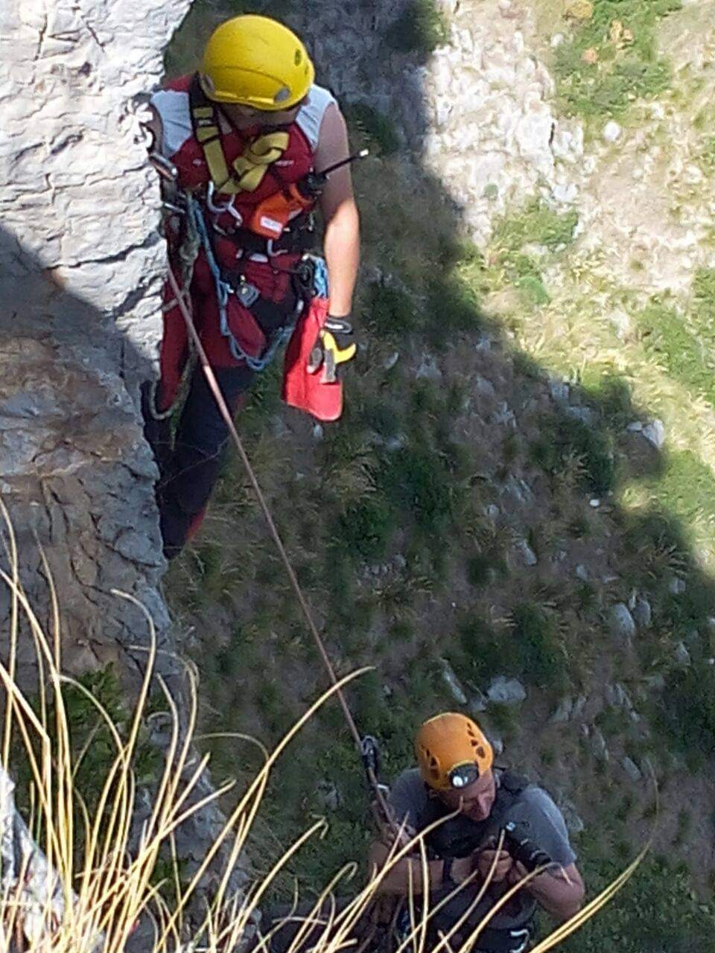
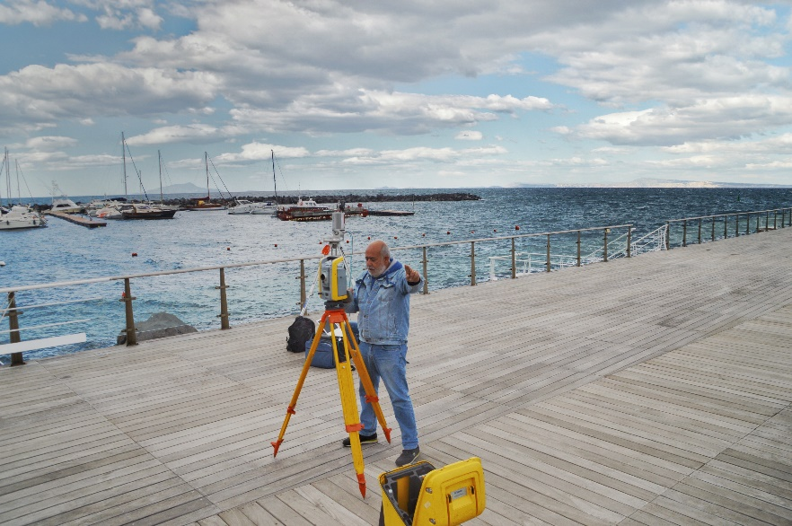
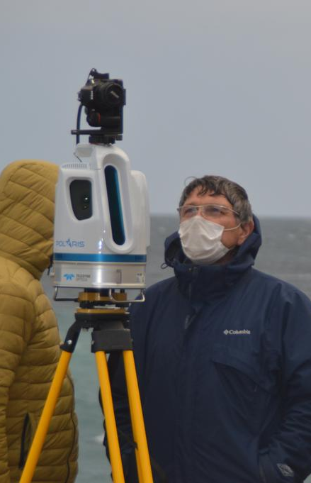
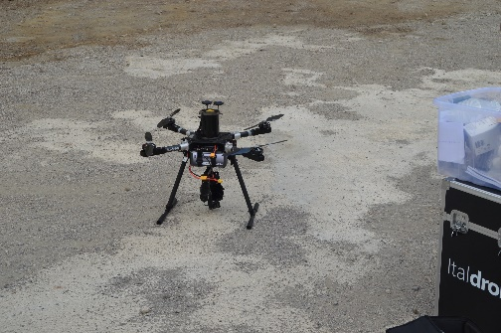
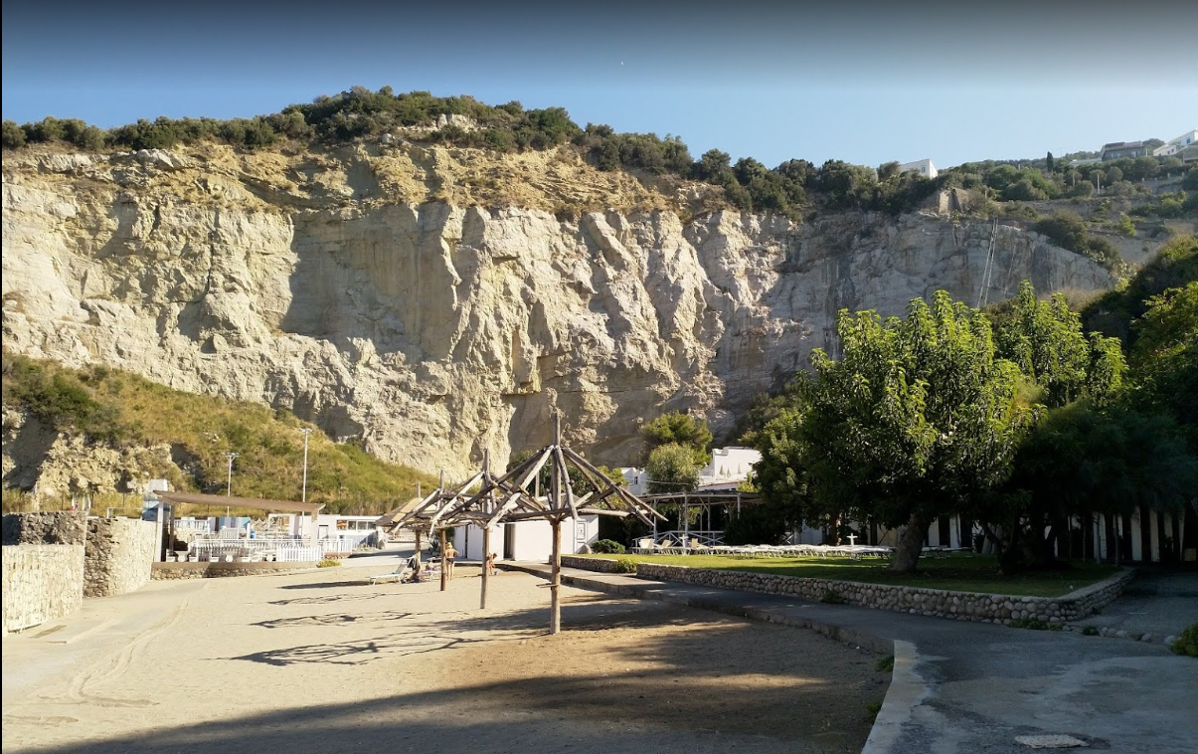
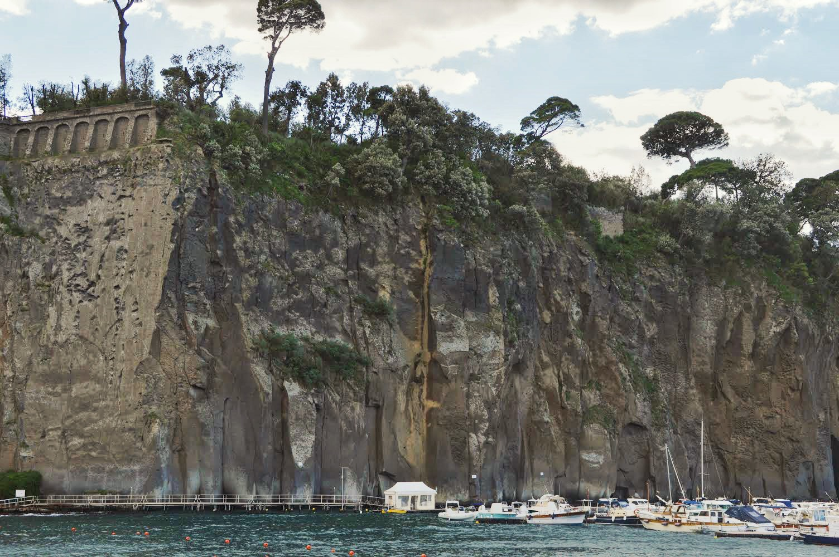
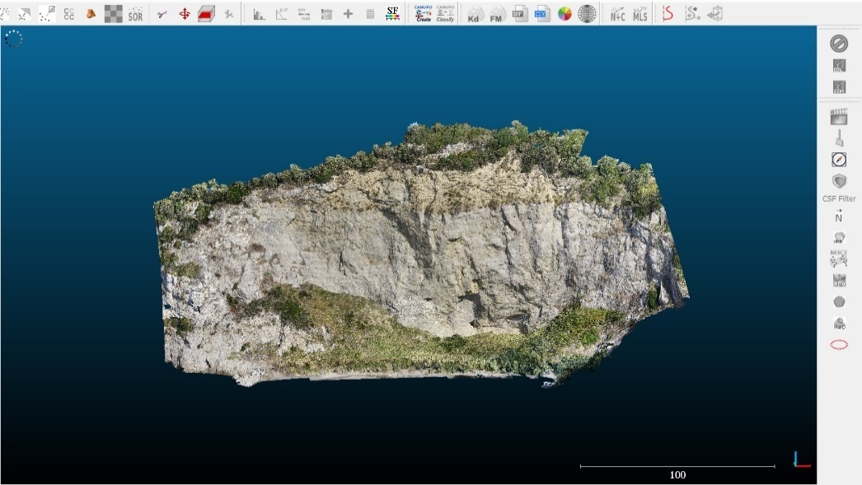
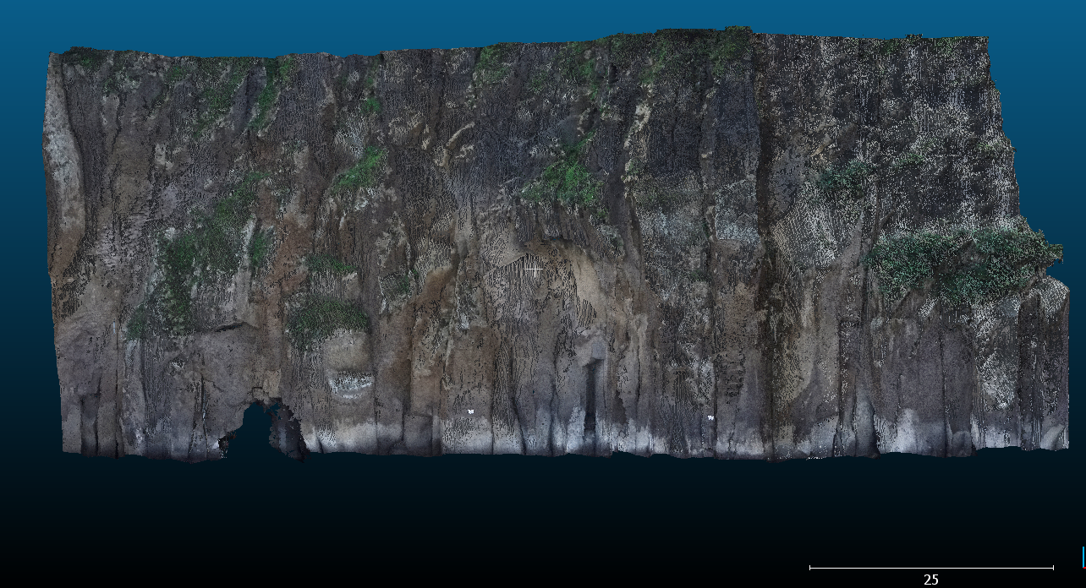
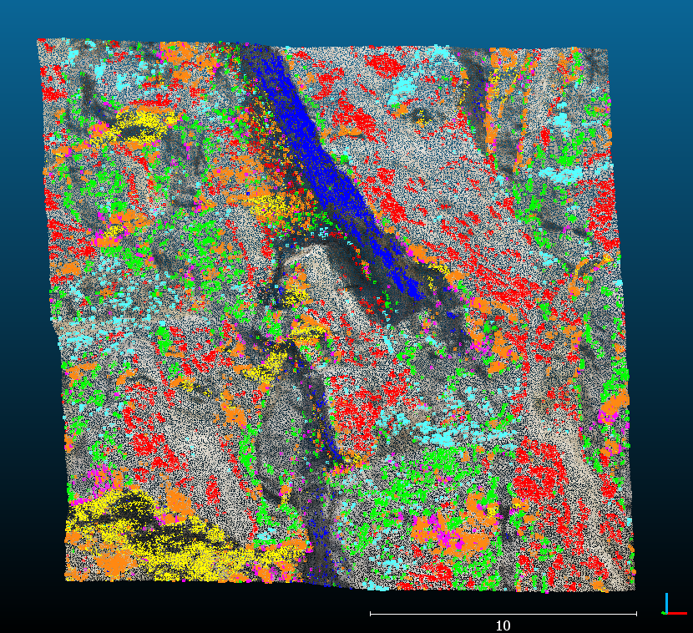
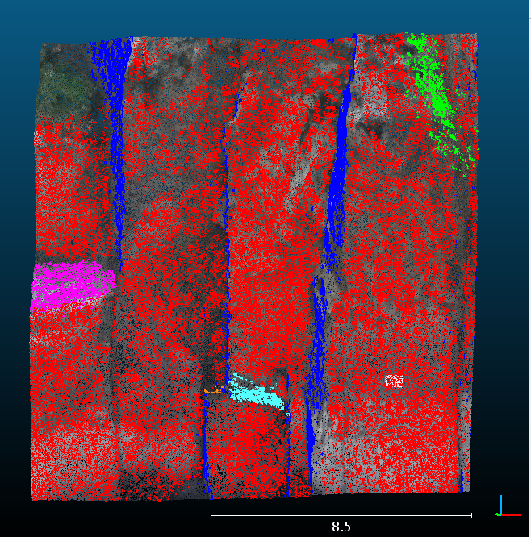
Traditional Geomechanical Surveying (ISRM 1978)
Remote Geomechanical Surveying
VS
Conca Azzurra,
Campania ( South Italy).
Caterina’s Beach,
Campania ( South Italy).

Slide 3




 | Traditional Geomechanical Surveying |  | Remote Geomechanical Surveying
 | Advantages | Limits | Advanges | Limits
Times | / | long | short | /
Costs | / | expensive | large | /
Amount of data | / | limited | wide | /
Characterization of discontinuities | accurate | / | / | inaccurate
Identification of discontinuities | accurate | / | / | Only with controlled software management
Discrimination in families | accurate | / | / | Only with controlled software management
Advantages & Limits

Slide 4
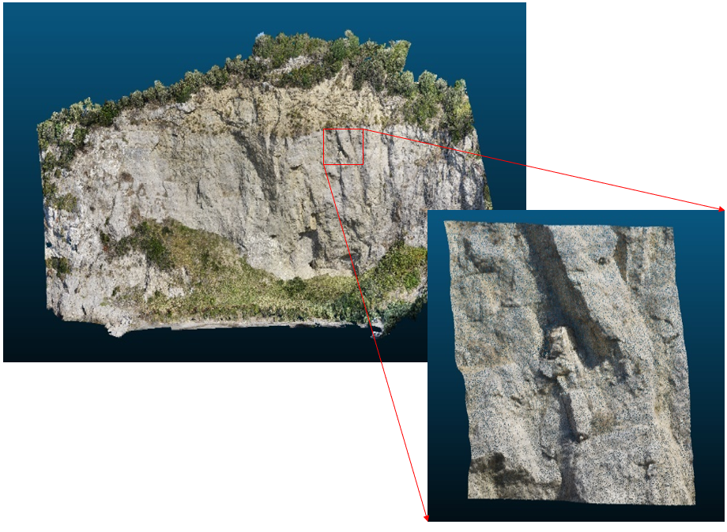
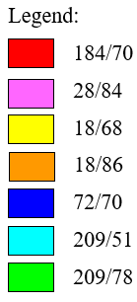
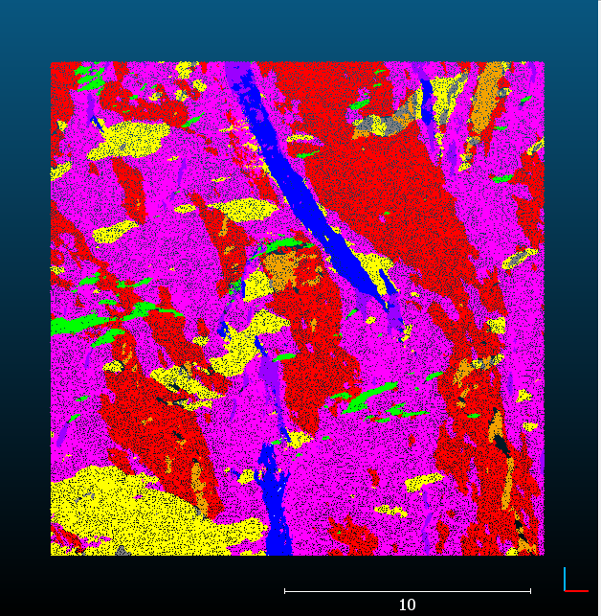
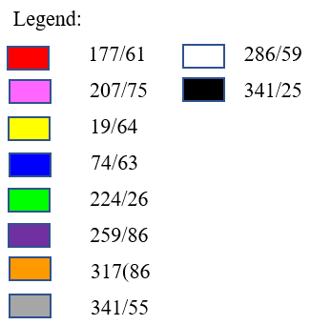
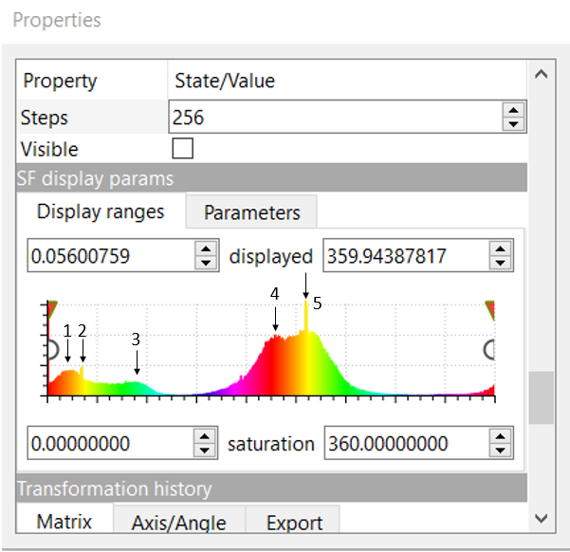
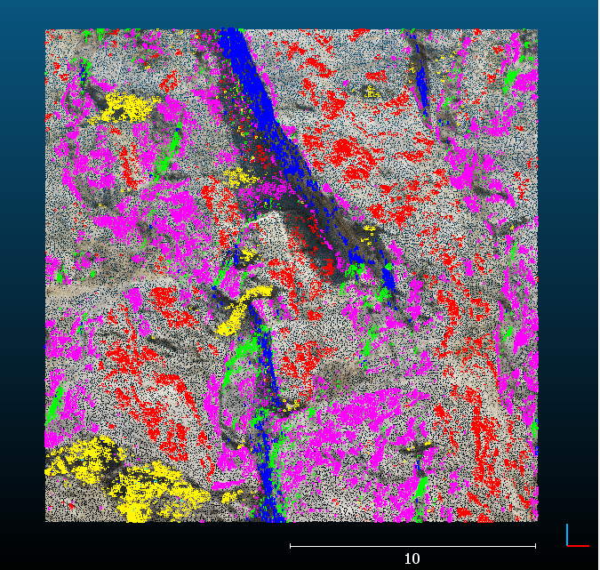
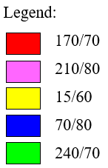
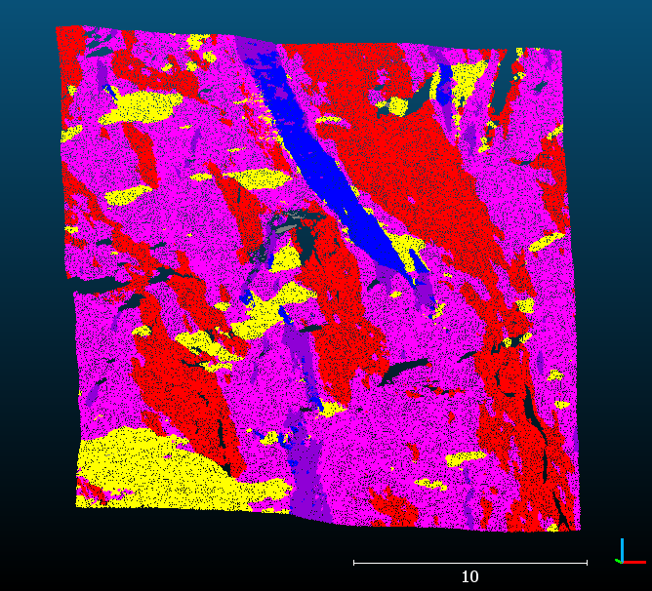
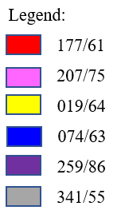
Conca Azzurra, Campania (South Italy)
Automatic software manegement
Cloud Compare
Discontinuity Set Extractor
USER software manegement
Cloud Compare
Discontinuity Set Extractor

Slide 5
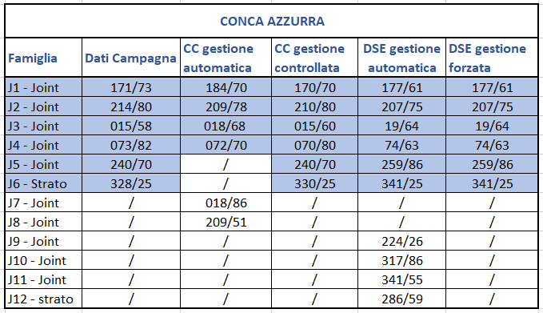
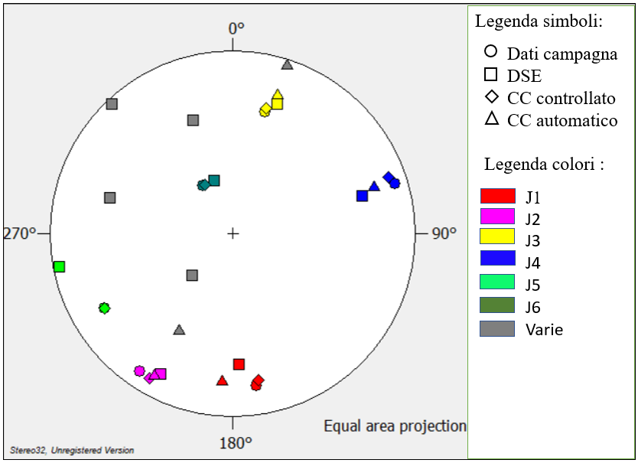
Conca Azzurra, Campania (South Italy)
Symbols legend
Field data
Discontinuity sets
Field data
CC automatic manegement
CC controlled manegement
DSE automatic manegement
DSE controlled manegement
DSE
CC controlled
CC automatic
Color legend
Various

Slide 6
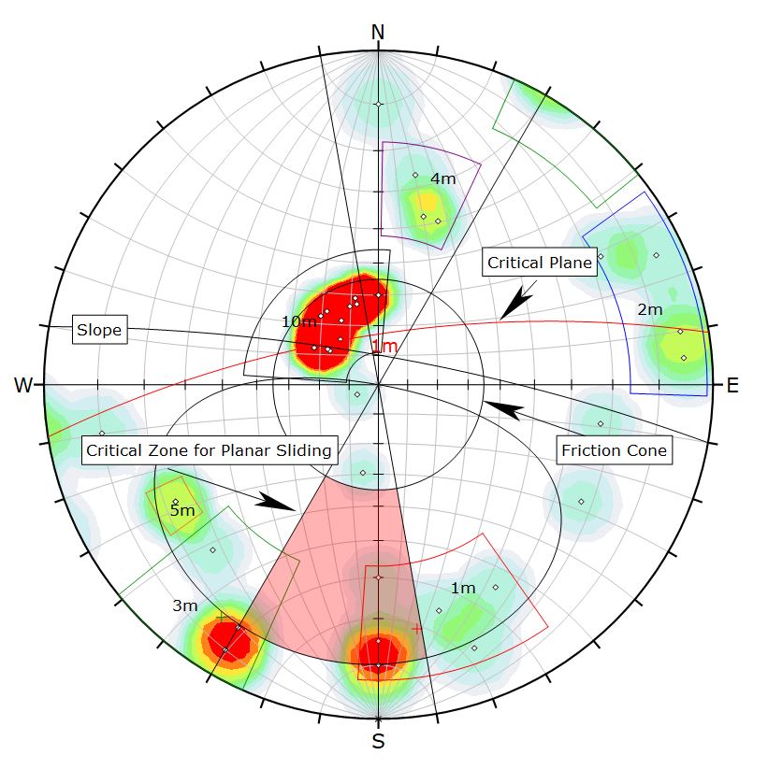
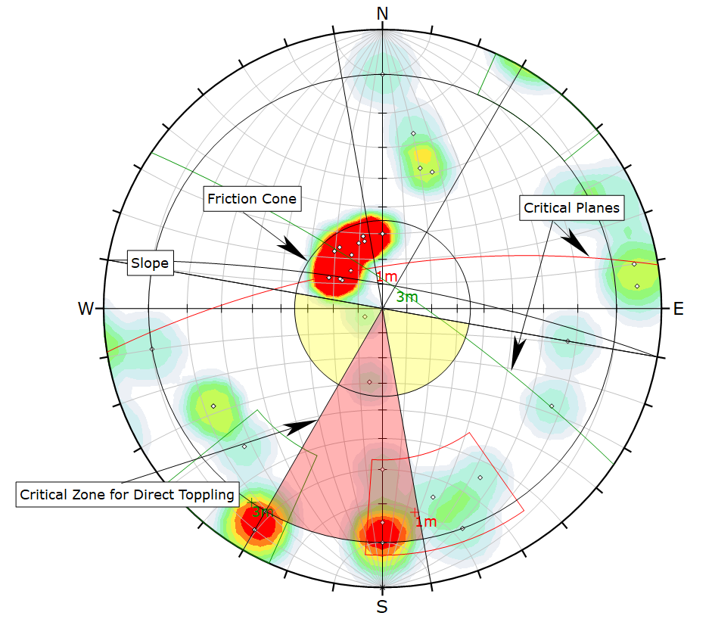
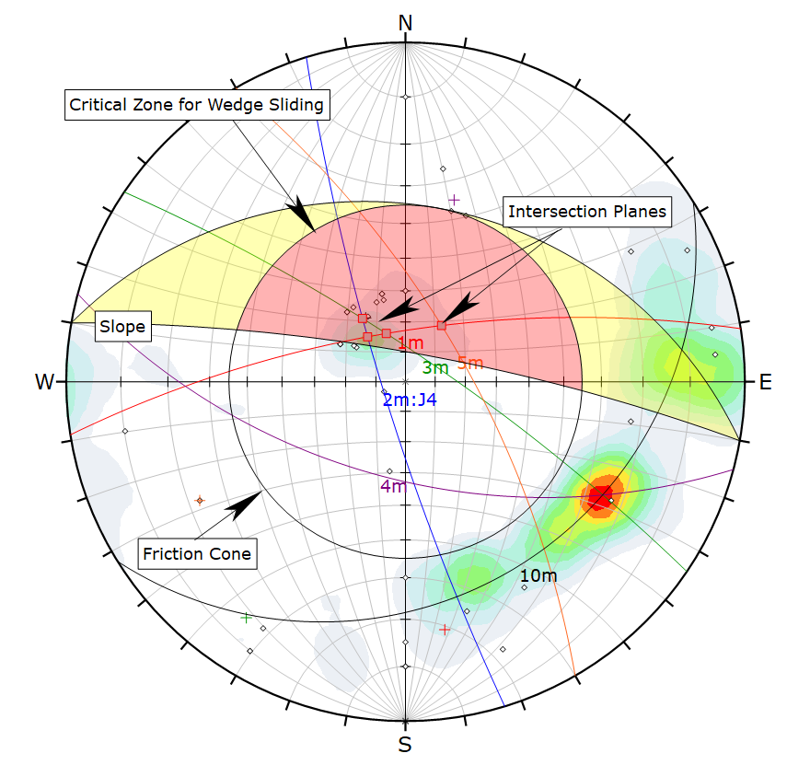
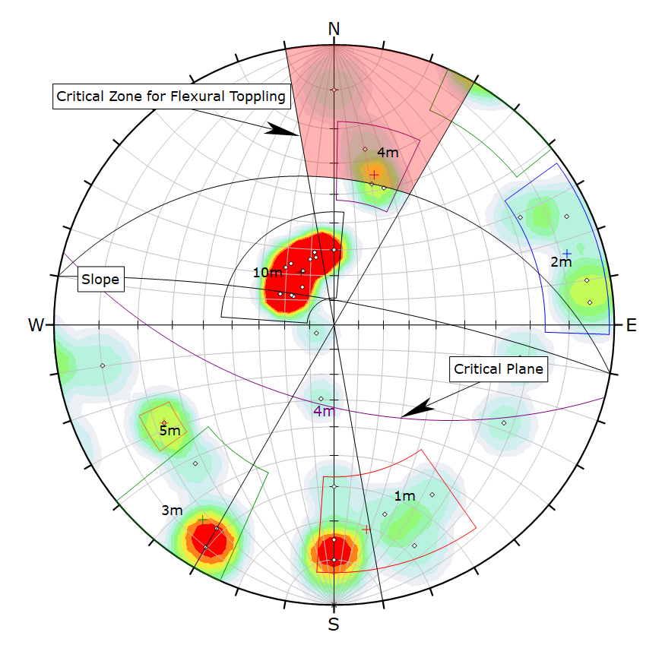
Conca Azzurra, Campania (South Italy)
Planar Sliding
Direct Topling
171/73
171/73
Wedge sliding
Flexural Topling
171/73
240/70
214/80
073/82
15/58

Slide 7
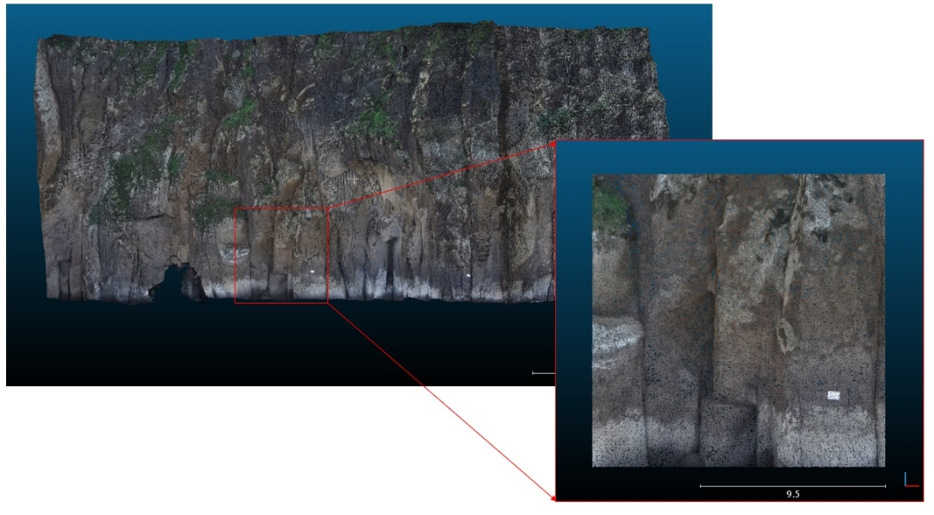
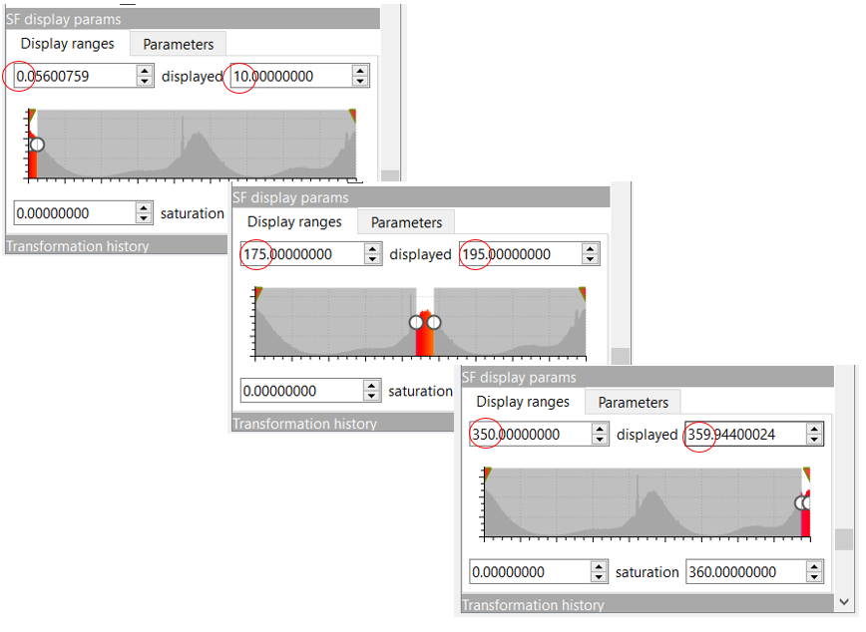
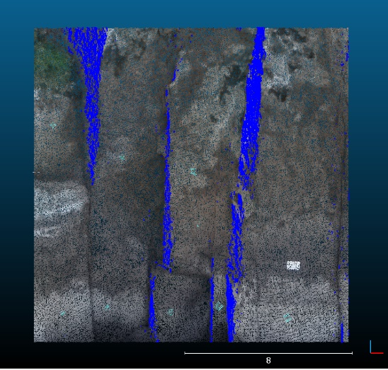
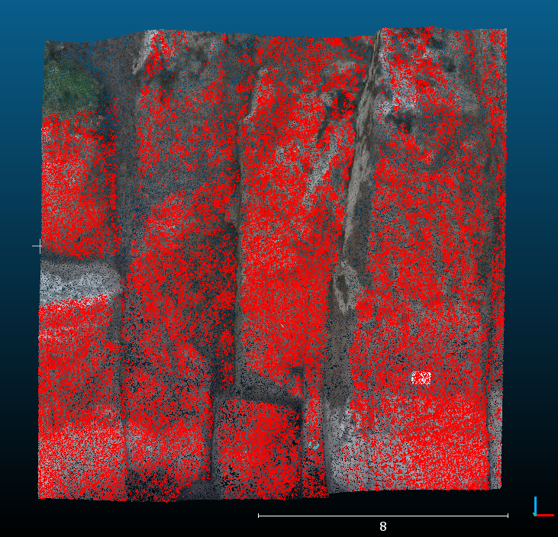
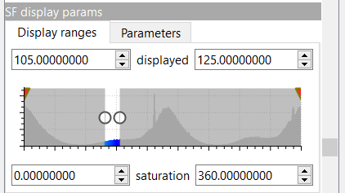
Caterina’s Beach, Campania (South Italy)
184/84
291/84

Slide 8
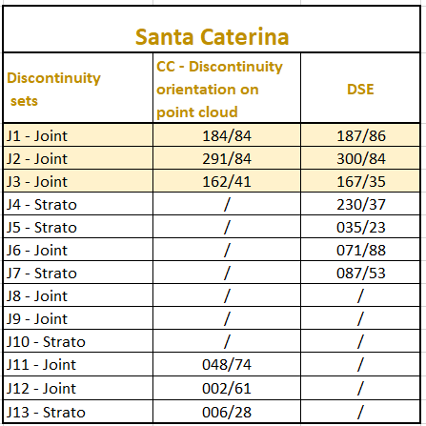
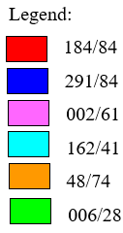
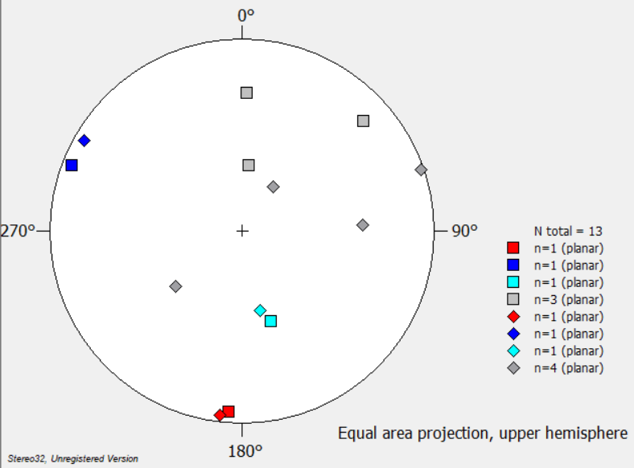
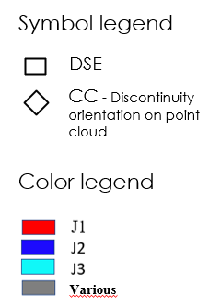
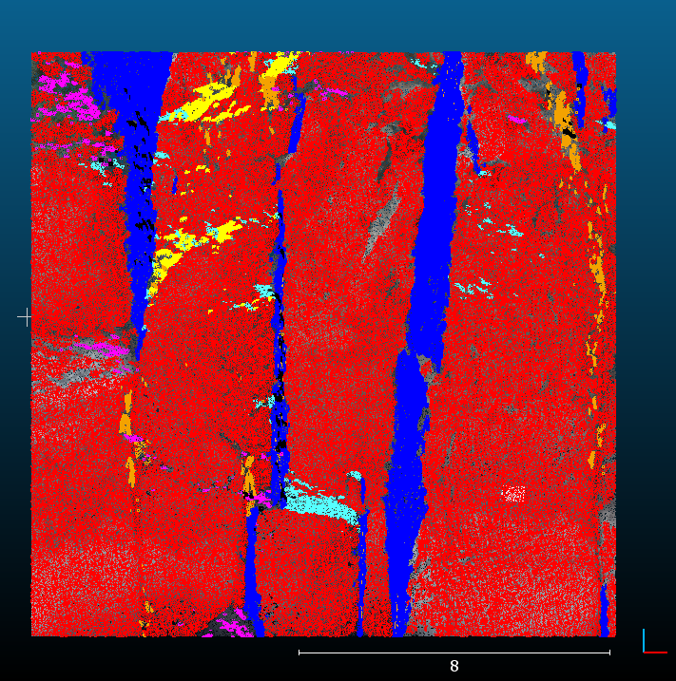
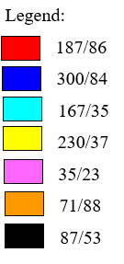
Caterina’s Beach, Campania (South Italy)
Controlled software manegement: CC
Automatic software manegement: DSE

Slide 9
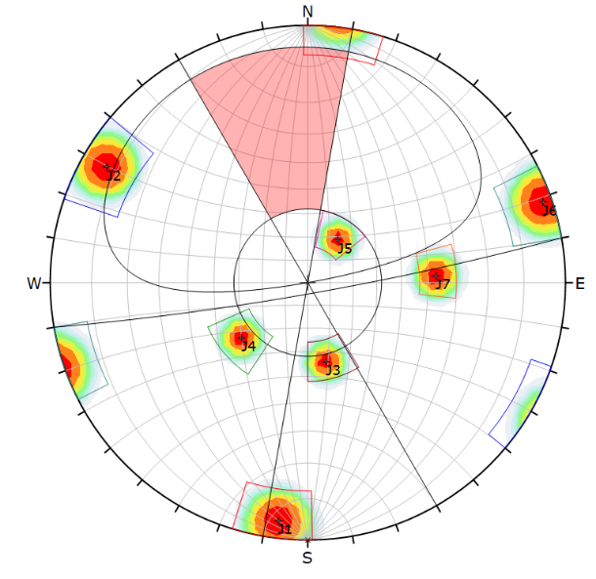
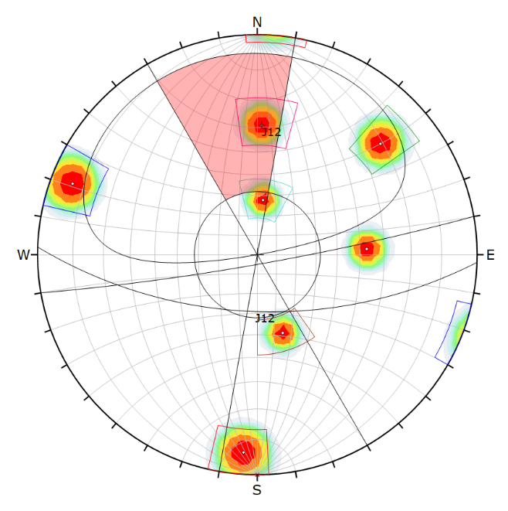
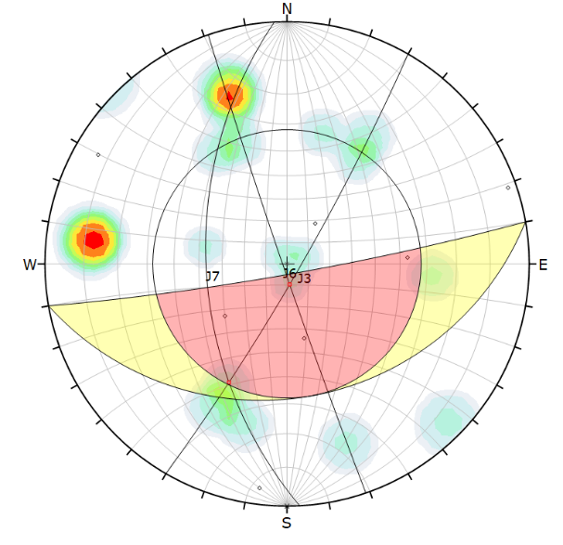
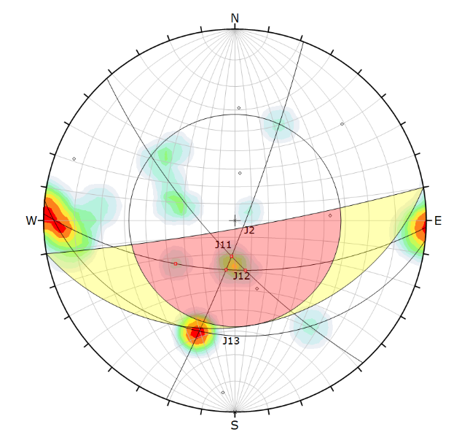
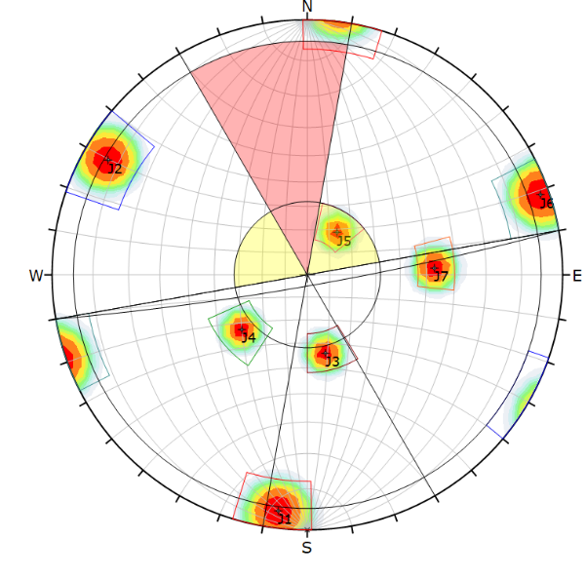
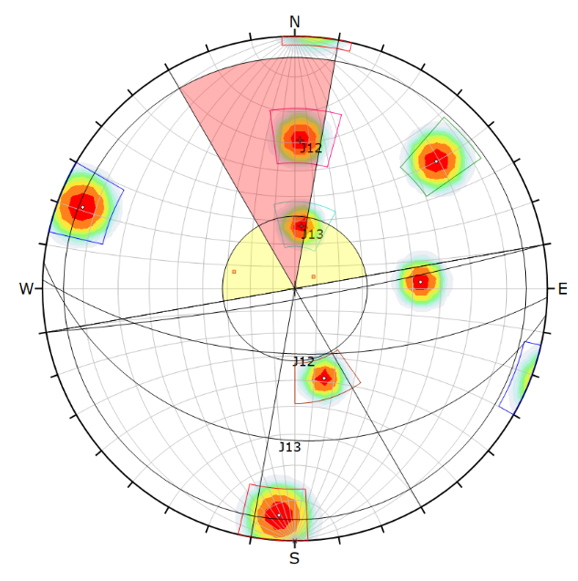
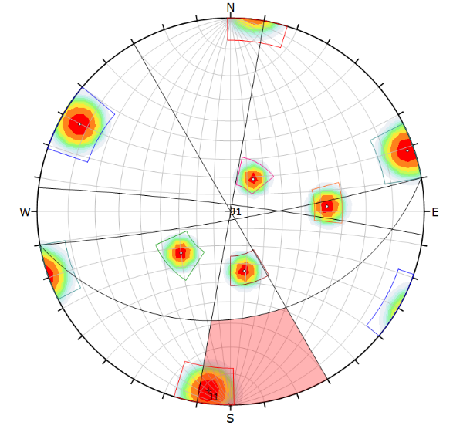
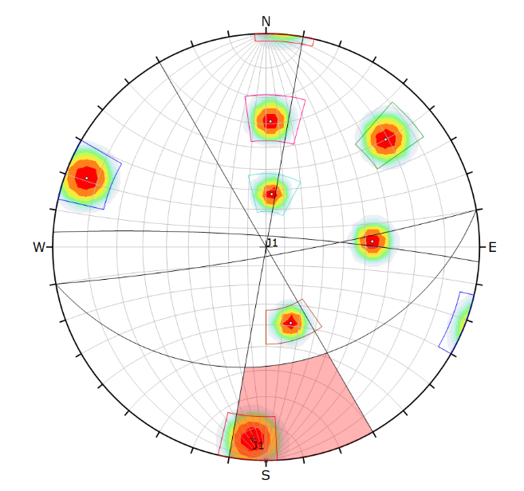
Caterina’s Beach, Campania (South Italy)
Planar Sliding
Wedge Sliding
DSE: automatic manegement
CC: controlled manegement
DSE: automatic manegement
CC: controlled manegement
J3= 167/35
J6= 071/88
J7= 087/53
J2= 291/84
J11= 048/74
J12= 002/61
J12= 002/61
Direct Toppling
Flexural Toppling
DSE: automatic manegement
CC: controlled manegement
DSE: automatic manegement
CC: controlled manegement
J12= 002/61
J13= 006/28
J1= 187/86
J1= 184/84

