Slide 1
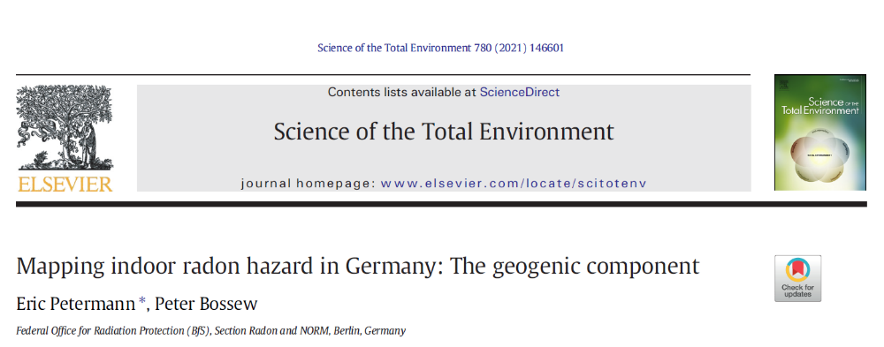

Slide 2
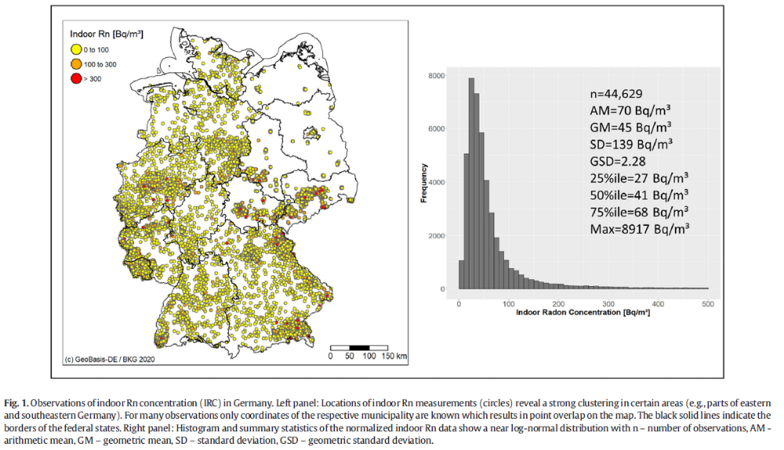

Slide 3
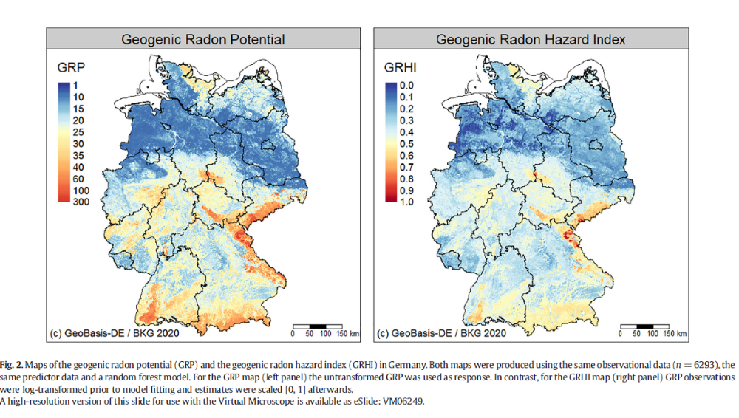

Slide 4



Petermann et al 2021, Sci. Total Environ. 754
Petermann & Bossew 2021, Sci. Total Environ. 780
Soil measurements
Radon
Gas permeability
Map of indoor Rn exceedance probability
Map of estimated residential buildings above reference level
Indoor Rn measurements
Map of geogenic Rn
40
20
Random forest
Logistic regression
(+calibration)
15
500
350
Municipality border
Environmental co-variables
Geology
Soil properties
Climate
Built-up area
100
Measurement
Residential building stock
Number of buildings

Slide 5
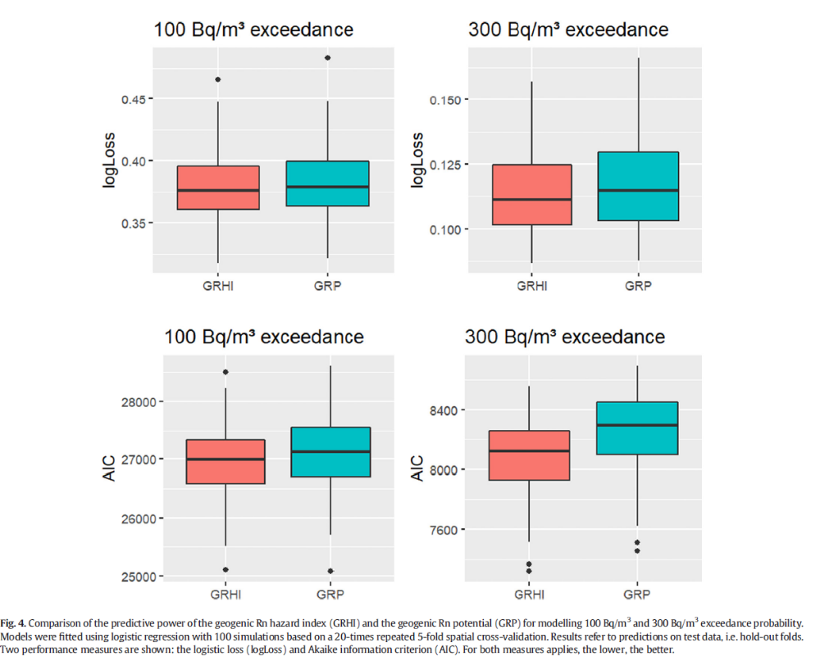

Slide 6
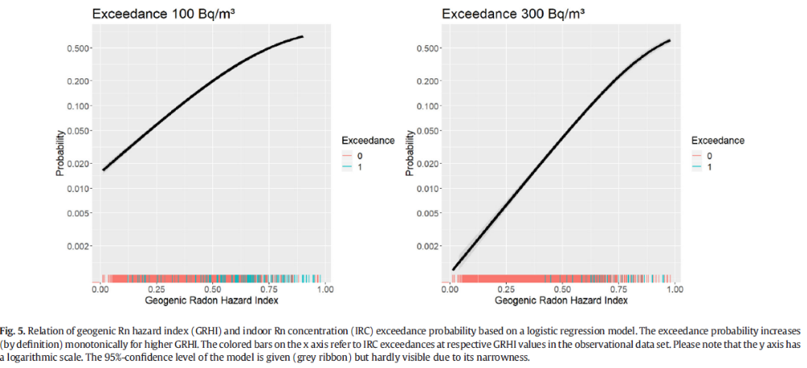
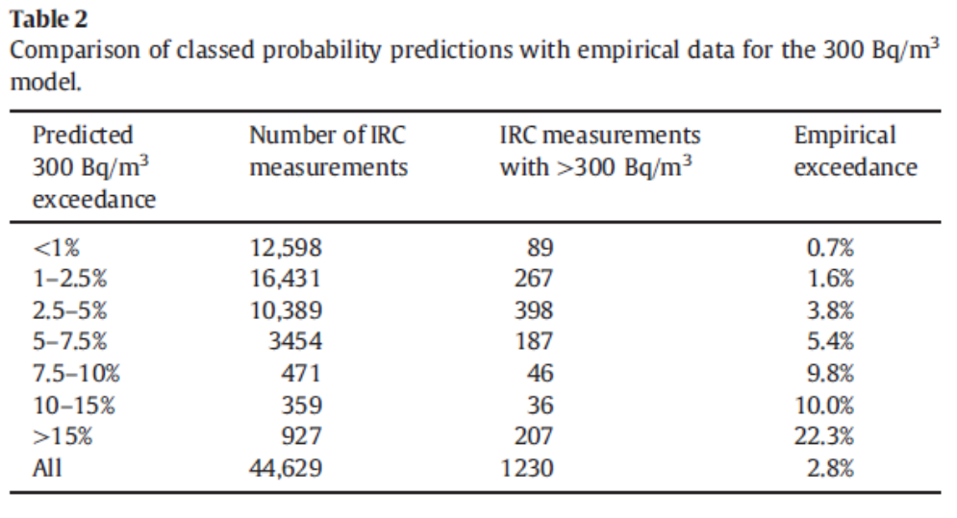

Slide 7
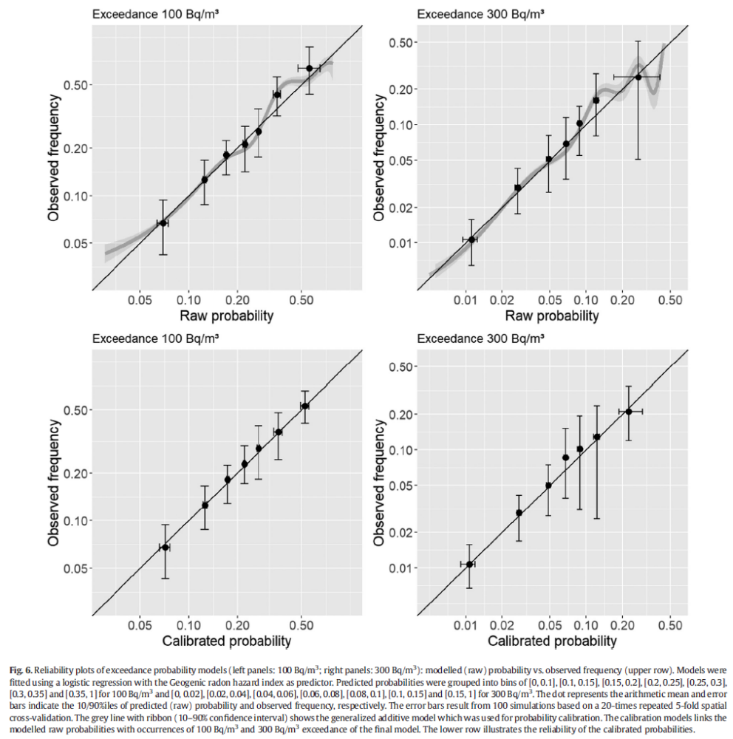

Slide 8
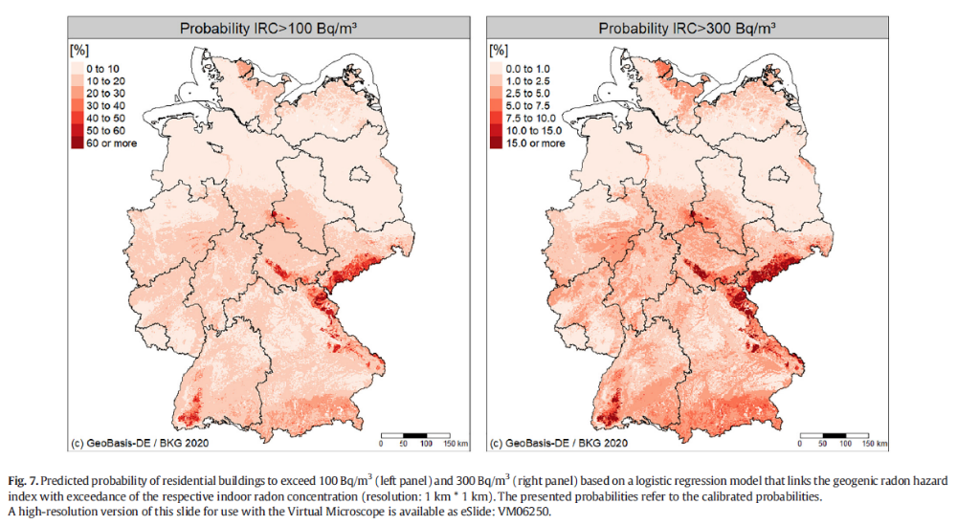

Slide 9
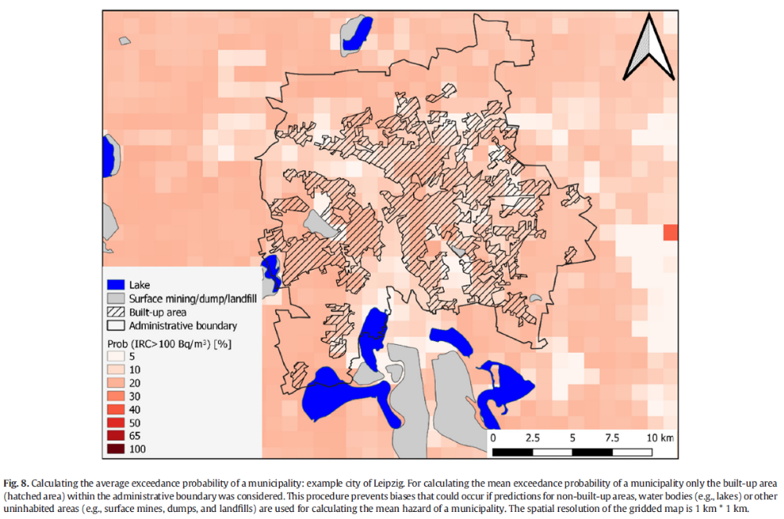

Slide 10
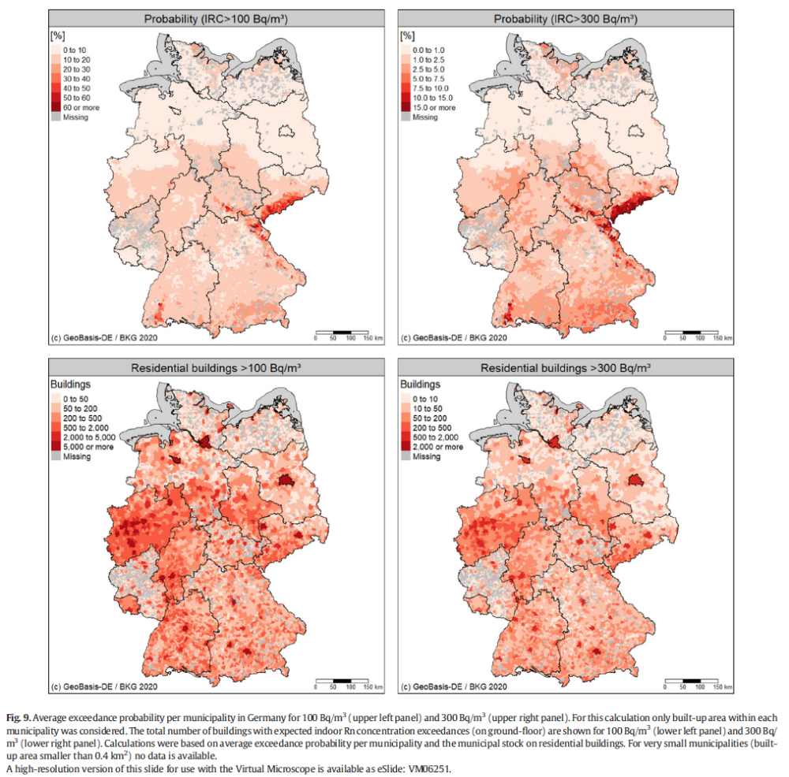

Slide 11
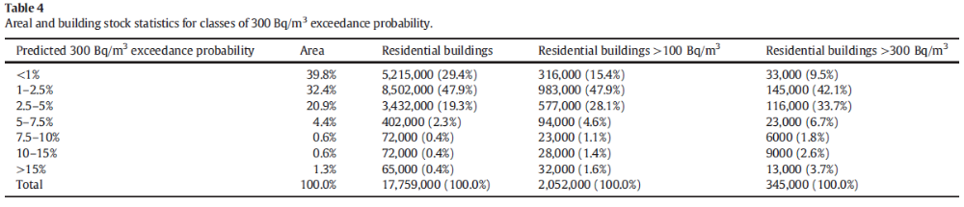

Slide 12
