Slide 1
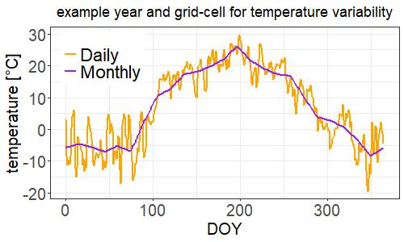
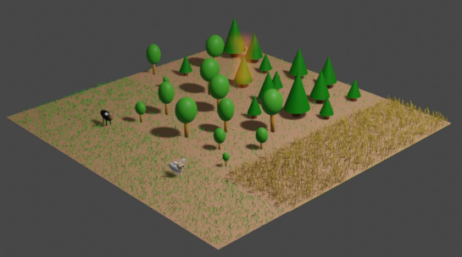
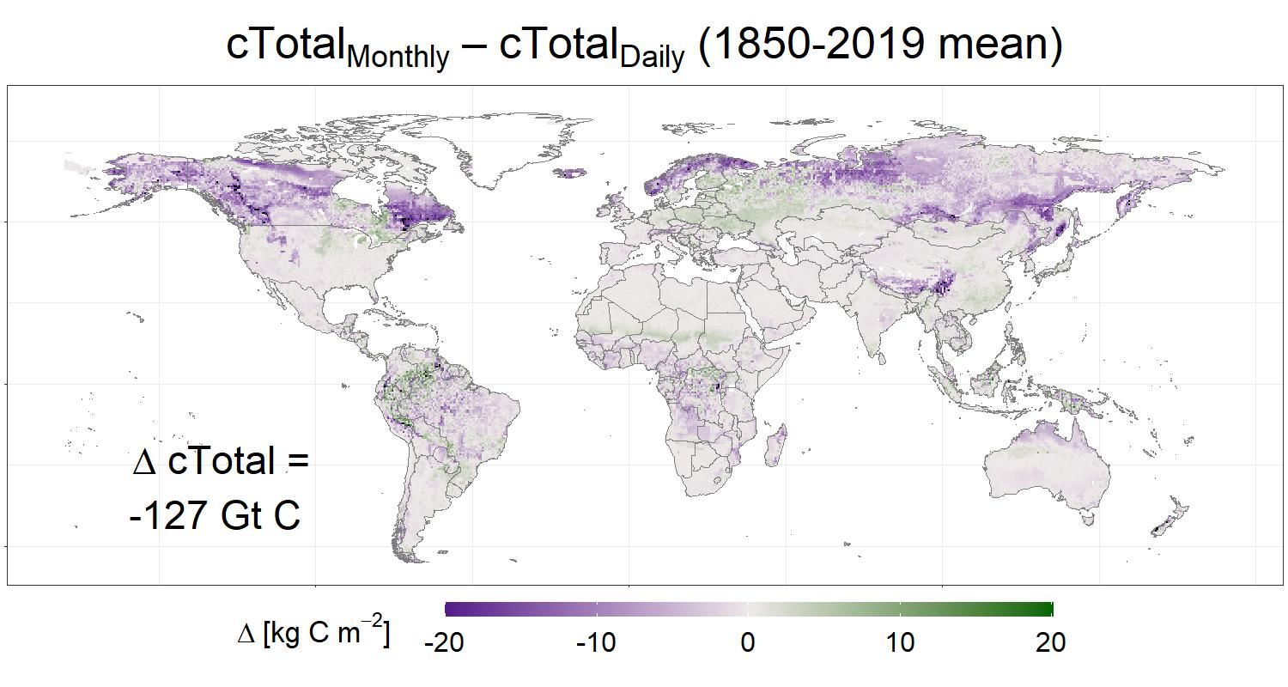
Forcing climate variability has large impacts on terrestrial carbon storage in a dynamic global vegetation model
Andreas Krause¹, Katharina Küpfer¹, Anja Rammig¹
¹ Technical University of Munich, TUM School of Life Sciences Weihenstephan, 85354 Freising, Germany
temperature, radiation, precipitation
a
b
Research question
Effects of monthly vs. daily climate variability on simulated carbon storage?
Result
High climate variability increases terrestrial carbon storage by 127 Gt C!
c
Conclusion
Modelers need to be aware that input climate temporal resolution may affect simulation results.

Slide 2
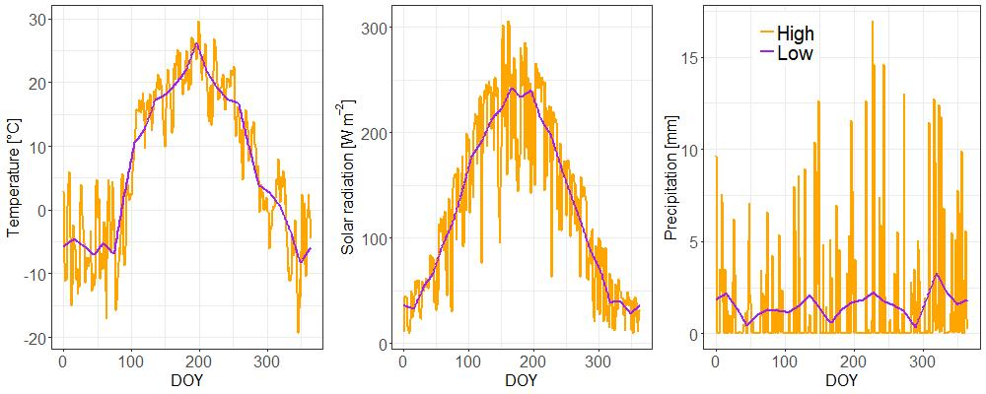
LPJ-GUESS simulations
Input climate for an example grid-cell and year
 | Temperature | Solar radiation | Precipitation
Low_{All} | Linear interpolation between monthly means (CRU-JRA-55) | Linear interpolation between monthly means (CRU-JRA-55) | Linear interpolation between monthly means (CRU-JRA-55)
High_{All} | Daily mean (CRU-JRA-55) | Daily mean (CRU-JRA-55) | Daily mean (CRU-JRA-55)
High_{Prec} | Linear interpolation between monthly means (CRU-JRA-55) | Linear interpolation between monthly means (CRU-JRA-55) | Daily mean (CRU-JRA-55)
High_{Temp} | Daily mean (CRU-JRA-55) | Linear interpolation between monthly means (CRU-JRA-55) | Linear interpolation between monthly means (CRU-JRA-55)
High_{Rad} | Linear interpolation between monthly means (CRU-JRA-55) | Daily mean (CRU-JRA-55) | Linear interpolation between monthly means (CRU-JRA-55)
High_{TempRad} | Daily mean (CRU-JRA-55) | Daily mean (CRU-JRA-55) | Linear interpolation between monthly means (CRU-JRA-55)

Slide 3
Precipitation variability has the largest impact on carbon storage. Temperature and radiation variability are less important.

Slide 4
Differences in carbon stocks are mostly a result of differences in ecosystem productivity.

Slide 5
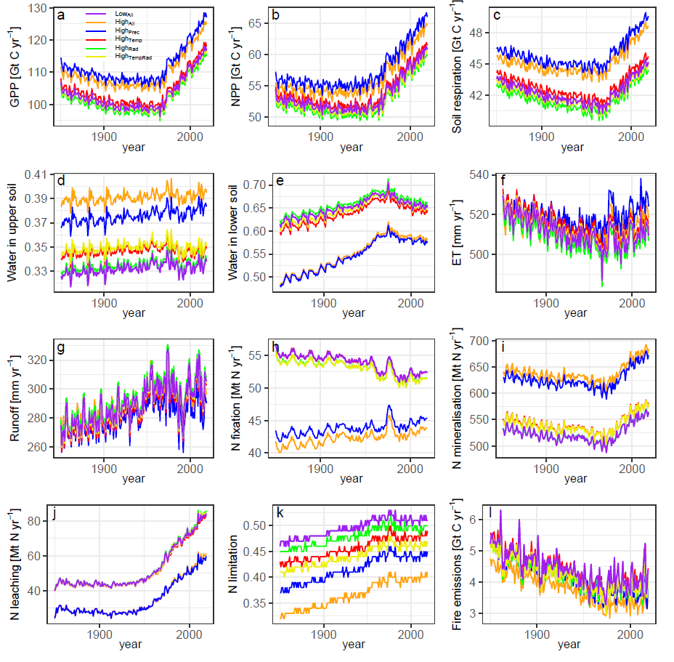

Slide 6
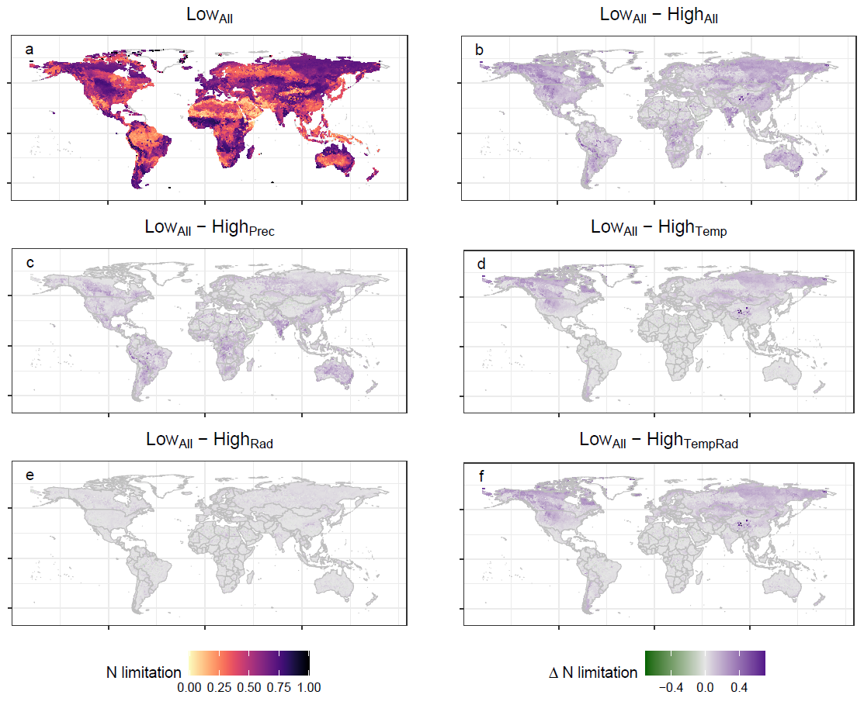
High climate variability increases net soil nitrogen mineralization, thereby reducing nitrogen limitation and promoting plant growth.

Slide 7
Both monthly and daily input climate are commonly used in existing LPJ-GUESS studies.
andy.krause@tum.de

