Slide 1
How well are we able to close the water budget at the global scale?
Fanny Lehmann, Bramha Dutt Vishwakarma, and Jonathan Bamber
Email: fanny.lehmann@bristol.ac.uk

Slide 2
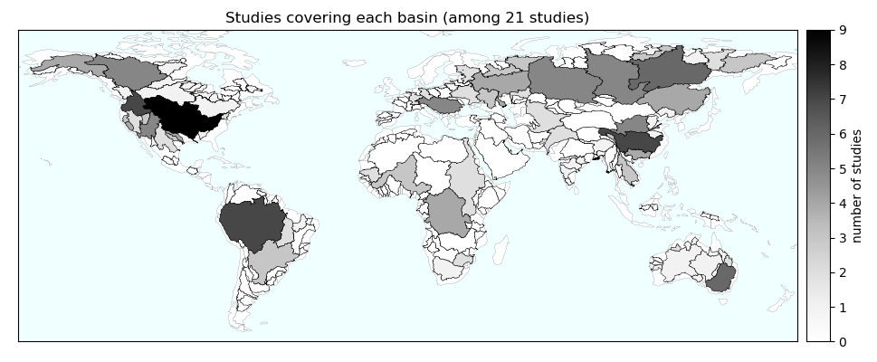
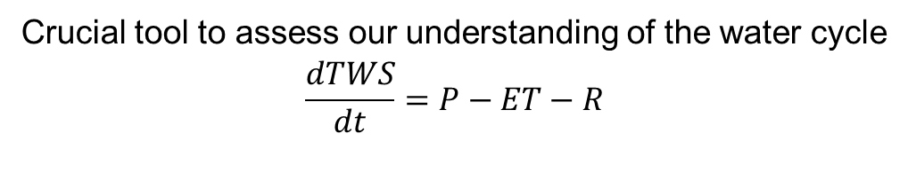
The water balance equation
Crucial tool to assess our understanding of the water cycle
$$\frac{dTWS}{dt}=P−ET−R$$
need for a global analysis of the water budget
with as many state-of-the-art datasets

Slide 3
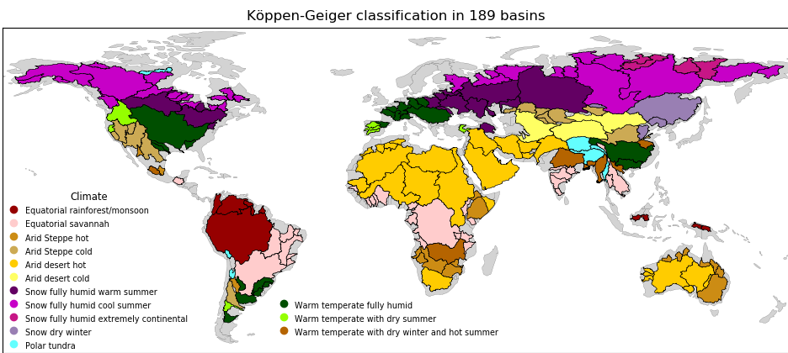
Study area
189 basins (GRDC) with an area larger than 65,000 km2 [Vishwakarma 2018]

Slide 4
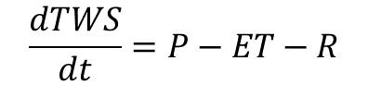
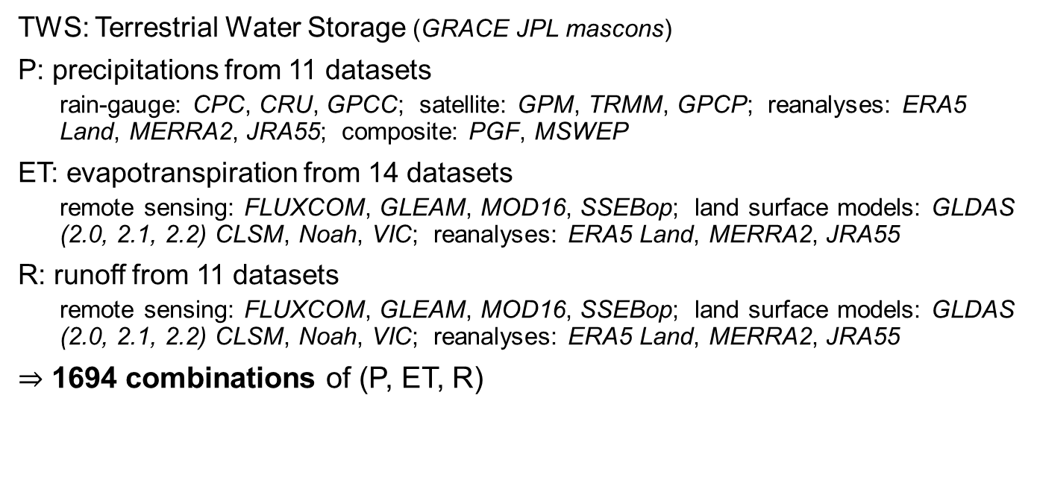
Datasets
$$\frac{dTWS}{dt}=P−ET−R$$
TWS: Terrestrial Water Storage (GRACE JPL mascons)
P: precipitations from 11 datasets
  rain-gauge: CPC, CRU, GPCC; satellite: GPM, TRMM, GPCP; reanalyses: ERA5 Land, MERRA2, JRA55; composite: PGF, MSWEP
ET: evapotranspiration from 14 datasets
  remote sensing: FLUXCOM, GLEAM, MOD16, SSEBop; land surface models: GLDAS (2.0, 2.1, 2.2) CLSM, Noah, VIC; reanalyses: ERA5 Land, MERRA2, JRA55
R: runoff from 11 datasets
  remote sensing: FLUXCOM, GLEAM, MOD16, SSEBop; land surface models: GLDAS (2.0, 2.1, 2.2) CLSM, Noah, VIC; reanalyses: ERA5 Land, MERRA2, JRA55
$⇒$ 1694 combinations of (P, ET, R)

Slide 5
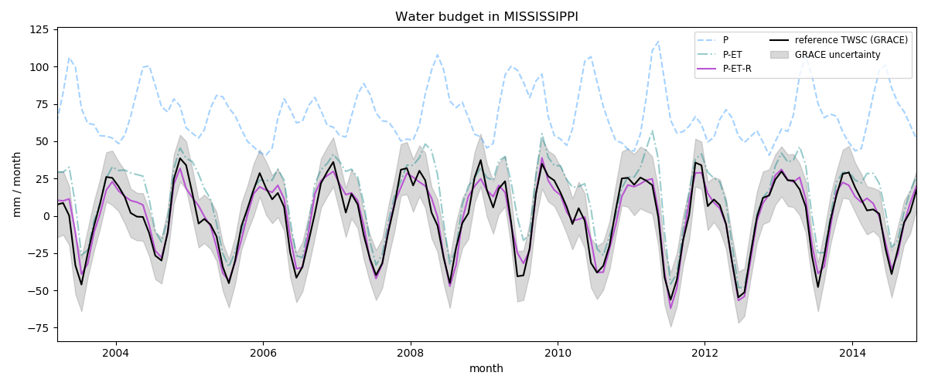
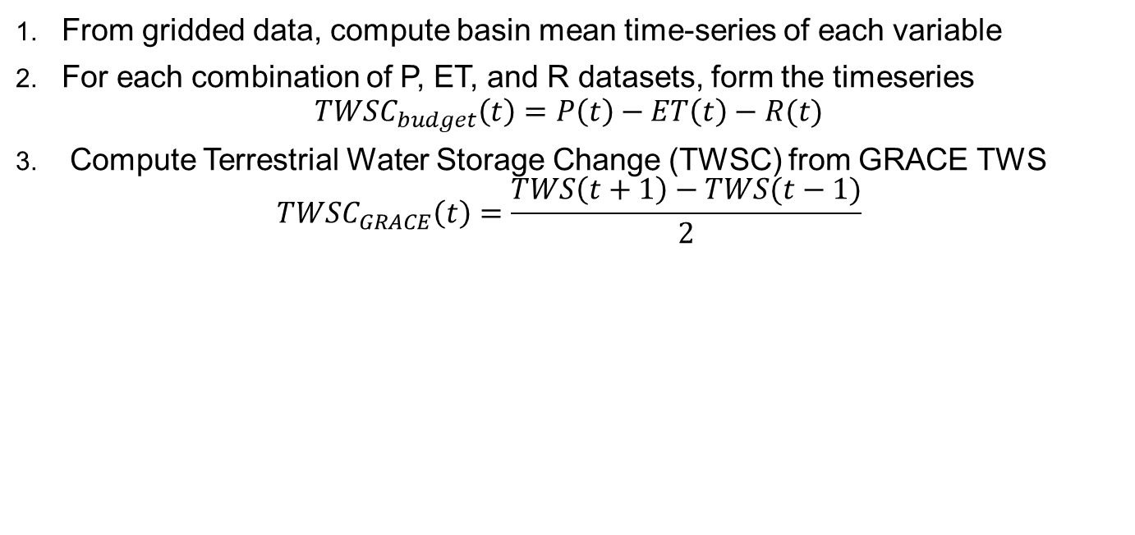
Water storage change time-series
From gridded data, compute basin mean time-series of each variable
For each combination of P, ET, and R datasets, form the timeseries
$$TWSC_{budget}\left(t\right)=P\left(t\right)−ET\left(t\right)−R(t)$$
Compute Terrestrial Water Storage Change (TWSC) from GRACE TWS
$$TWSC_{GRACE}\left(t\right)=\frac{TWS\left(t+1\right)−TWS(t−1)}{2}$$

Slide 6
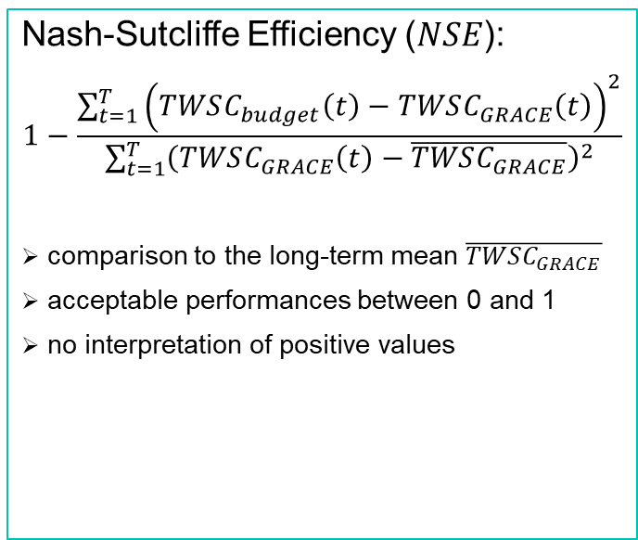

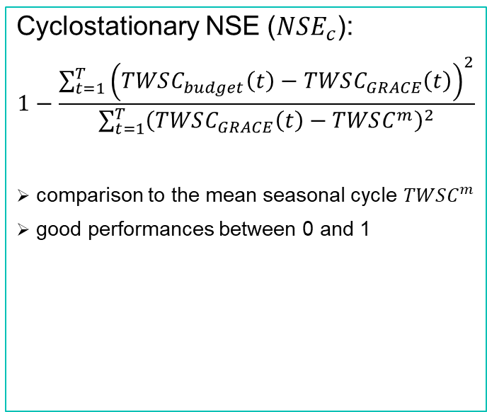
Metrics to compare $TWSC_{budget}$ and $TWSC_{GRACE}$
Nash-Sutcliffe Efficiency ($NSE$):
$$1−\frac{\sum_{t=1}^{T}{{\left(TWSC_{budget}\left(t\right)−TWSC_{GRACE}\left(t\right)\right)}^{2}}}{\sum_{t=1}^{T}{{\left(TWSC_{GRACE}\left(t\right)−\overline{TWSC_{GRACE}}\right)}^{2}}}$$
comparison to the long-term mean $\overline{TWSC_{GRACE}}$
acceptable performances between 0 and 1
no interpretation of positive values
Cyclostationary NSE ($NSE_{c}$):
$$1−\frac{\sum_{t=1}^{T}{{\left(TWSC_{budget}\left(t\right)−TWSC_{GRACE}\left(t\right)\right)}^{2}}}{\sum_{t=1}^{T}{{\left(TWSC_{GRACE}\left(t\right)−TWSC^{m}\right)}^{2}}}$$
comparison to the mean seasonal cycle $TWSC^{m}$
good performances between 0 and 1

Slide 7
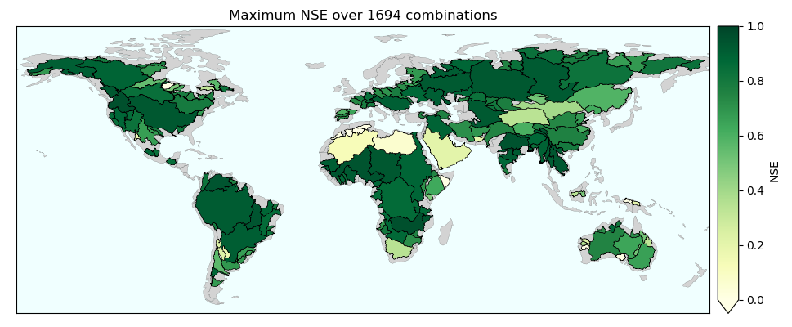
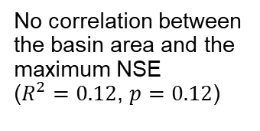
Global water budget closure
99% of the study area ($95.6 million km^{2}$) satisfy a positive NSE:
$TWSC_{budget}$ is a better approximation of $TWSC_{GRACE}$ than the constant $\overline{TWSC_{GRACE}}$
No correlation between the basin area and the maximum NSE
($R^{2}=0.12$, $p=0.12$)

Slide 8
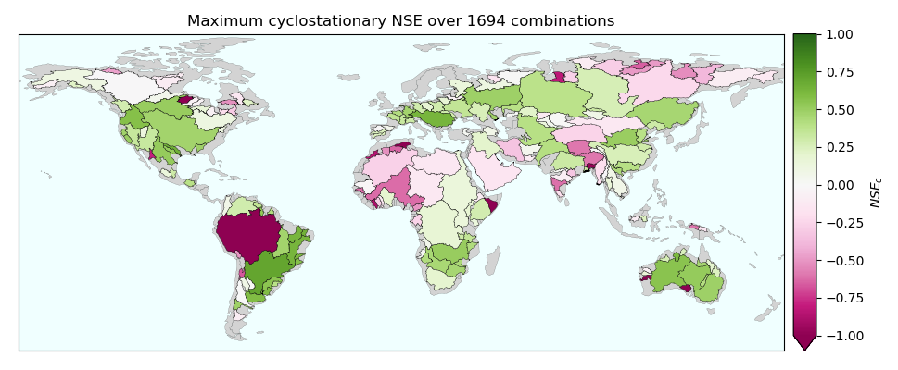
Global water budget closure (2)
62% of the study area ($62.3 million km^{2}$) satisfy a positive cyclostationary NSE: $TWSC_{budget}$ is a better approximation of $TWSC_{GRACE}$ than the mean seasonal cycle

Slide 9
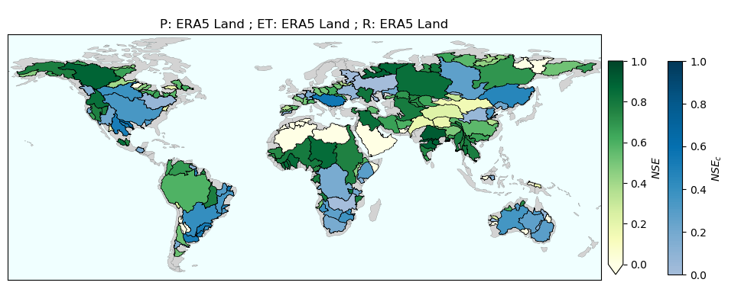
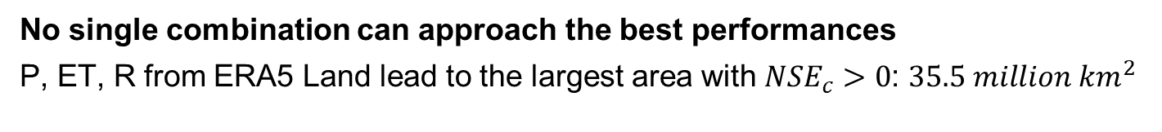
Performance of a single combination
No single combination can approach the best performances
P, ET, R from ERA5 Land lead to the largest area with $NSE_{c}>0$: $35.5 million km^{2}$

Slide 10
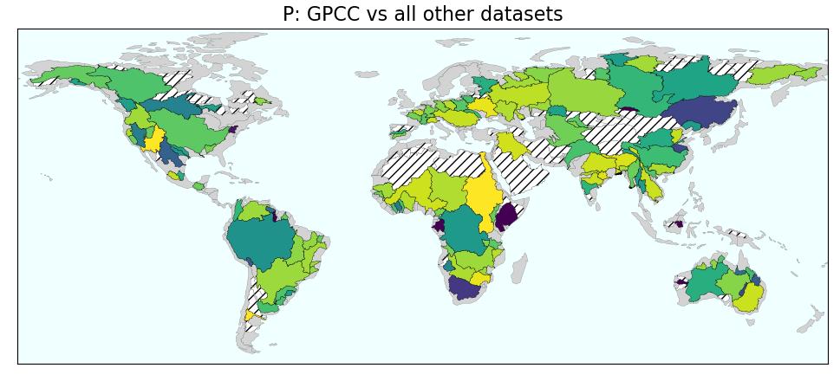
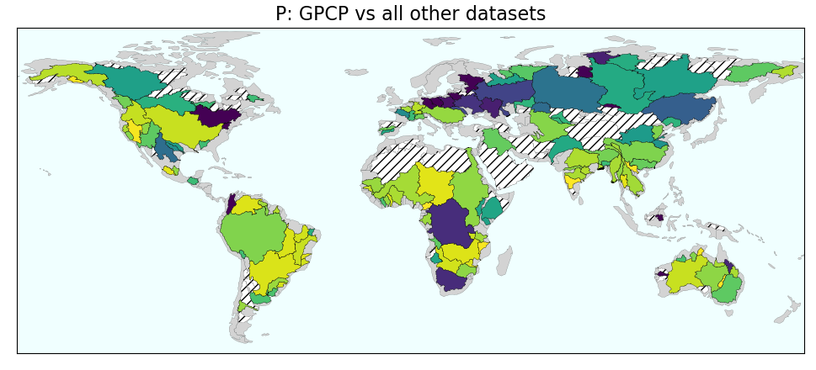
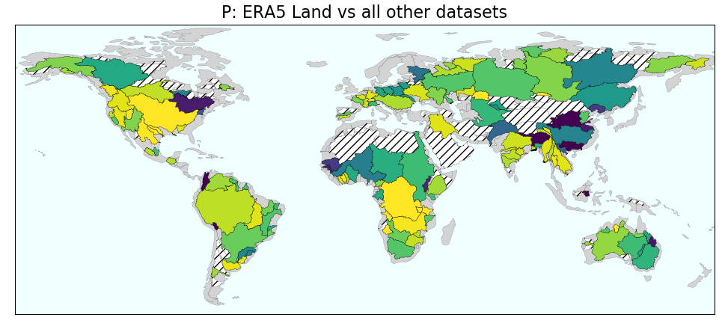
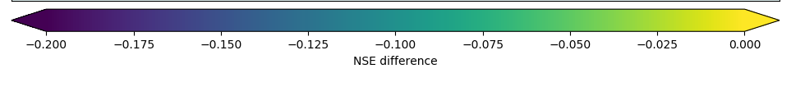
Best precipitation datasets
mean NSE for the 10 best combinations containing the reference P dataset
mean NSE for the 10 best combinations not containing the reference P dataset
« best » = highest NSE
GPCP
worse
GPCP
significantly better

Slide 11
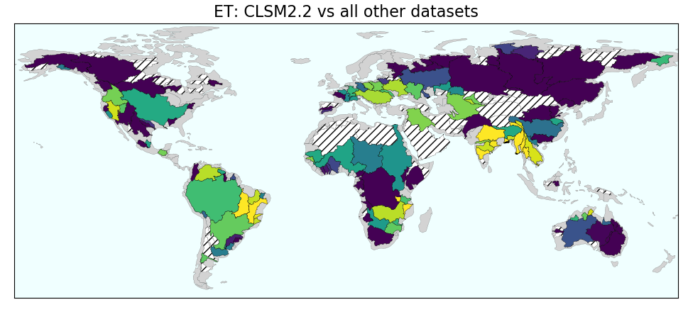
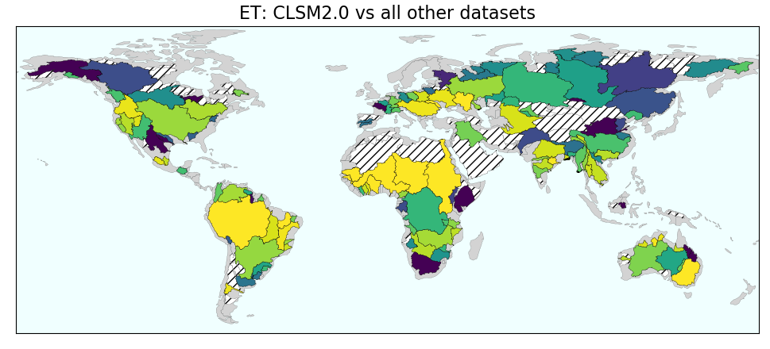
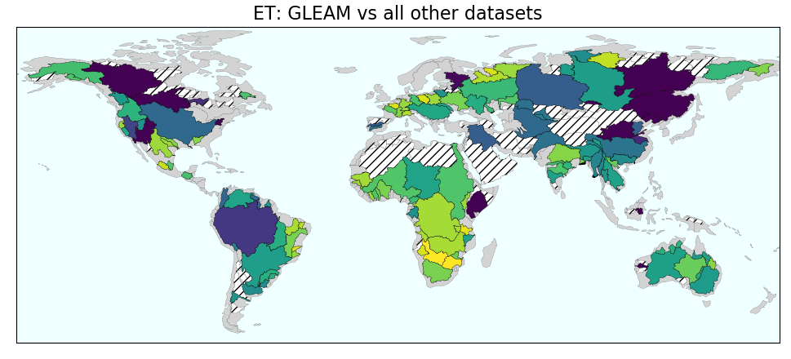
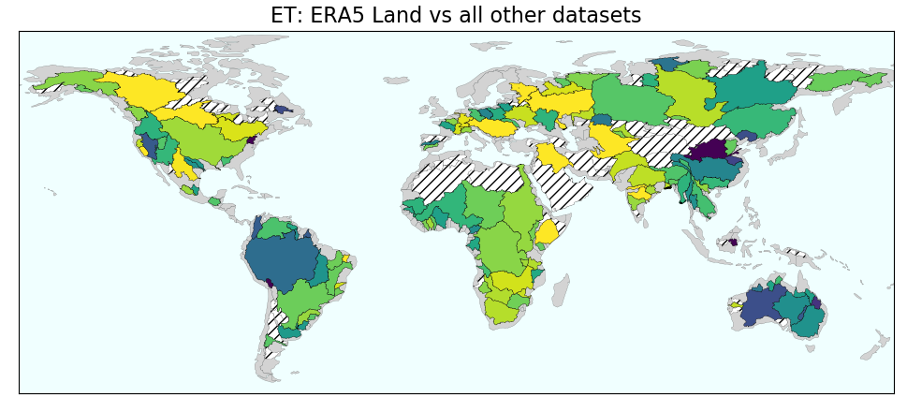
Best evapotranspiration datasets
CLSM2.2
worse
CLSM2.2
significantly better
CLSM2.2 yields highly negative values in snow basins

Slide 12
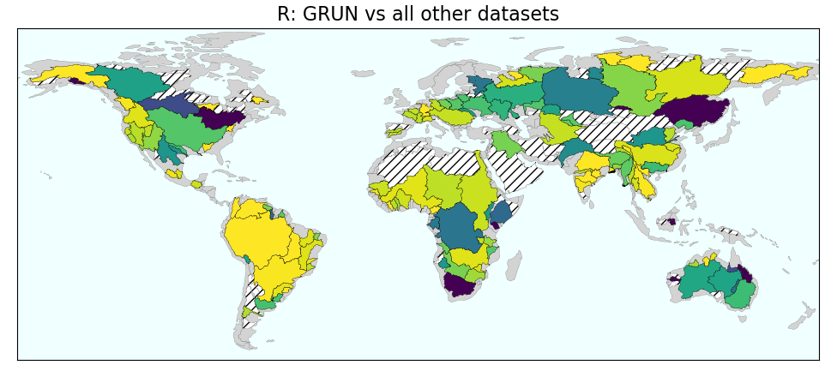
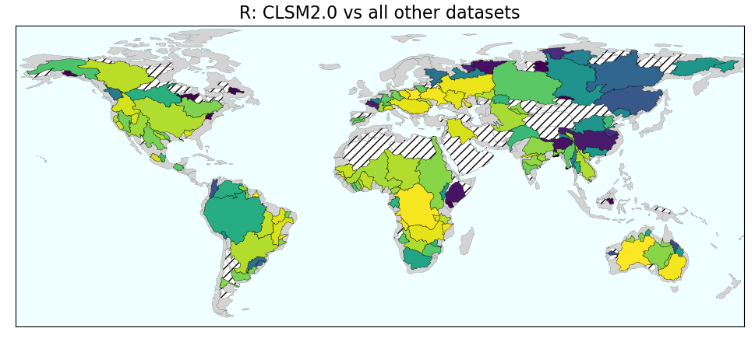
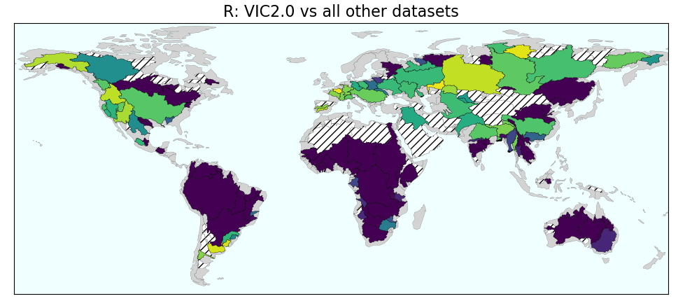
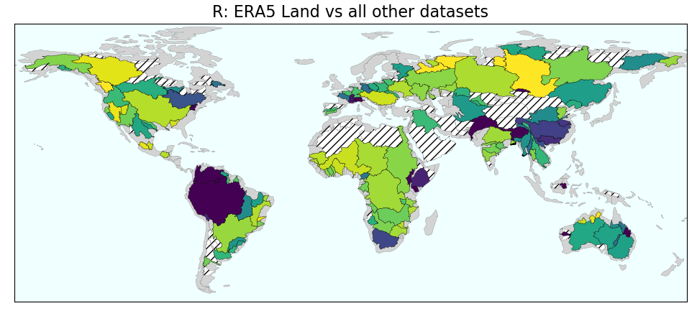
Best runoff datasets
GRUN
worse
GRUN
significantly better

Slide 13
Conclusions
The water budget can be closed in the vast majority of basins
No combination alone can close the water budget
A regional assessment is needed to chose the best datasets
Be aware of bias cancellation when doing so

Slide 14
Bibliography
Water budget studies:
Bhattarai, Nishan, Kaniska Mallick, Julia Stuart, Bramha Dutt Vishwakarma, Rewati Niraula, Sumit Sen, and Meha Jain. 2019. ‘An Automated Multi-Model Evapotranspiration Mapping Framework Using Remotely Sensed and Reanalysis Data’. Remote Sensing of Environment 229 (August): 69–92. https://doi.org/10.1016/j.rse.2019.04.026.
Chen, Jianli, Byron Tapley, Matt Rodell, Ki‐Weon Seo, Clark Wilson, Bridget R Scanlon, and Yadu Pokhrel. 2020. ‘Basin‐Scale River Runoff Estimation From GRACE Gravity Satellites, Climate Models, and In Situ Observations: A Case Study in the Amazon Basin’. Water Resources Research, October, 21. https://doi.org/10.1029/2020WR028032.
Gao, Huilin, Qiuhong Tang, Craig R. Ferguson, Eric F. Wood, and Dennis P. Lettenmaier. 2010. ‘Estimating the Water Budget of Major US River Basins via Remote Sensing’. International Journal of Remote Sensing 31 (14): 3955–78. https://doi.org/10.1080/01431161.2010.483488.
Liu, Wenbin, Lei Wang, Jing Zhou, Yanzhong Li, Fubao Sun, Guobin Fu, Xiuping Li, and Yan-Fang Sang. 2016. ‘A Worldwide Evaluation of Basin-Scale Evapotranspiration Estimates against the Water Balance Method’. Journal of Hydrology 538 (July): 82–95. https://doi.org/10.1016/j.jhydrol.2016.04.006.
Long, Di, Laurent Longuevergne, and Bridget R. Scanlon. 2014. ‘Uncertainty in Evapotranspiration from Land Surface Modeling, Remote Sensing, and GRACE Satellites’. Water Resources Research 50 (2): 1131–51. https://doi.org/10.1002/2013WR014581.
Long, Di, Yuting Yang, Yoshihide Wada, Yang Hong, Wei Liang, Yaning Chen, Bin Yong, Aizhong Hou, Jiangfeng Wei, and Lu Chen. 2015. ‘Deriving Scaling Factors Using a Global Hydrological Model to Restore GRACE Total Water Storage Changes for China’s Yangtze River Basin’. Remote Sensing of Environment 168 (October): 177–93. https://doi.org/10.1016/j.rse.2015.07.003.
Lorenz, Christof, Harald Kunstmann, Balaji Devaraju, Mohammad J. Tourian, Nico Sneeuw, and Johannes Riegger. 2014. ‘Large-Scale Runoff from Landmasses: A Global Assessment of the Closure of the Hydrological and Atmospheric Water Balances’. Journal of Hydrometeorology 15 (6): 2111–39. https://doi.org/10.1175/JHM-D-13-0157.1.
Lv, Meixia, Zhuguo Ma, Xing Yuan, Meizhao Lv, Mingxing Li, and Ziyan Zheng. 2017. ‘Water Budget Closure Based on GRACE Measurements and Reconstructed Evapotranspiration Using GLDAS and Water Use Data for Two Large Densely-Populated Mid-Latitude Basins’. Journal of Hydrology 547 (April): 585–99. https://doi.org/10.1016/j.jhydrol.2017.02.027.
Oliveira, Paulo Tarso S., Mark A. Nearing, M. Susan Moran, David C. Goodrich, Edson Wendland, and Hoshin V. Gupta. 2014. ‘Trends in Water Balance Components across the Brazilian Cerrado’. Water Resources Research 50 (9): 7100–7114. https://doi.org/10.1002/2013WR015202.

Slide 15
Pan, Ming, Alok K. Sahoo, Tara J. Troy, Raghuveer K. Vinukollu, Justin Sheffield, and Eric F. Wood. 2012. ‘Multisource Estimation of Long-Term Terrestrial Water Budget for Major Global River Basins’. Journal of Climate 25 (9): 3191–3206. https://doi.org/10.1175/JCLI-D-11-00300.1.
Pascolini-Campbell, Madeleine A., John T. Reager, and Joshua B. Fisher. 2020. ‘GRACE-Based Mass Conservation as a Validation Target for Basin-Scale Evapotranspiration in the Contiguous United States’. Water Resources Research 56 (2): e2019WR026594. https://doi.org/10.1029/2019WR026594.
Penatti, Natasha Costa, Teodoro Isnard Ribeiro de Almeida, Laerte Guimarães Ferreira, Arielle Elias Arantes, and Michael T. Coe. 2015. ‘Satellite-Based Hydrological Dynamics of the World’s Largest Continuous Wetland’. Remote Sensing of Environment 170 (December): 1–13. https://doi.org/10.1016/j.rse.2015.08.031.
Sahoo, Alok K., Ming Pan, Tara J. Troy, Raghuveer K. Vinukollu, Justin Sheffield, and Eric F. Wood. 2011. ‘Reconciling the Global Terrestrial Water Budget Using Satellite Remote Sensing’. Remote Sensing of Environment 115 (8): 1850–65. https://doi.org/10.1016/j.rse.2011.03.009.
Sheffield, Justin, Craig R. Ferguson, Tara J. Troy, Eric F. Wood, and Matthew F. McCabe. 2009. ‘Closing the Terrestrial Water Budget from Satellite Remote Sensing’. Geophysical Research Letters 36 (7). https://doi.org/10.1029/2009GL037338.
Swann, Abigail L. S., and Charles D. Koven. 2017. ‘A Direct Estimate of the Seasonal Cycle of Evapotranspiration over the Amazon Basin’. Journal of Hydrometeorology 18 (8): 2173–85. https://doi.org/10.1175/JHM-D-17-0004.1.
Wan, Zhanming, Ke Zhang, Xianwu Xue, Zhen Hong, Yang Hong, and Jonathan J. Gourley. 2015. ‘Water Balance-Based Actual Evapotranspiration Reconstruction from Ground and Satellite Observations over the Conterminous United States: Water Balance-Based Observational ET Reconstruction’. Water Resources Research 51 (8): 6485–99. https://doi.org/10.1002/2015WR017311.
Wang, Hailong, Huade Guan, Hugo A. Gutiérrez-Jurado, and Craig T. Simmons. 2014. ‘Examination of Water Budget Using Satellite Products over Australia’. Journal of Hydrology 511 (April): 546–54. https://doi.org/10.1016/j.jhydrol.2014.01.076.
Xie, Jingkai, Yue‐Ping Xu, Chao Gao, Weidong Xuan, and Zhixu Bai. 2019. ‘Total Basin Discharge From GRACE and Water Balance Method for the Yarlung Tsangpo River Basin, Southwestern China’. Journal of Geophysical Research: Atmospheres 124 (14): 7617–32. https://doi.org/10.1029/2018JD030025.
Zhang, Y., M. Pan, J. Sheffield, A. L. Siemann, C. K. Fisher, M. Liang, H. E. Beck, et al. 2018. ‘A Climate Data Record (CDR) for the Global Terrestrial Water Budget: 1984–2010’. Hydrology and Earth System Sciences 22 (1): 241–63. https://doi.org/10.5194/hess-22-241-2018.
Zhong, Yulong, Min Zhong, Yuna Mao, and Bing Ji. 2020. ‘Evaluation of Evapotranspiration for Exorheic Catchments of China during the GRACE Era: From a Water Balance Perspective’. Remote Sensing 12 (3): 511. https://doi.org/10.3390/rs12030511.
Nash, J.E., and J.V. Sutcliffe. 1970. ‘River Flow Forecasting through Conceptual Models Part I — A Discussion of Principles’. Journal of Hydrology 10 (3): 282–90. https://doi.org/10.1016/0022-1694(70)90255-6.
Vishwakarma, Bramha, Balaji Devaraju, and Nico Sneeuw. 2018. ‘What Is the Spatial Resolution of GRACE Satellite Products for Hydrology?’ Remote Sensing 10 (6): 852. https://doi.org/10.3390/rs10060852.
Zhang, Jinwei. 2019. ‘Assessing the Statistical Relations of Terrestrial Water Mass Changewith Hydrological Variables and Climate Variability’. München: Universität Stuttgart. https://publikationen.badw.de/de/046188119/pdf/CC%20BY.

