Slide 1




Geochemistry and geochronology of alkaline dykes from the Finero
Phlogopite Peridotite (Ivrea–Verbano Zone): insights into the Triassic–Jurassic
tectono-magmatic events of the Southern Alps
Abimbola Chris Ogunyele¹, Tommaso Giovanardi², Mattia Bonazzi^{1,3},
Maurizio Mazzucchelli^{3,2} and Alberto Zanetti^{3,1}
1 Dipartimento di Scienze della Terra e dell’Ambiente, Università di Pavia, Via Ferrata 1, I-27100 Pavia, Italy
2 Scienze Chimiche e Geologiche, Università degli Studi di Modena e Reggio Emilia, Via Campi 103, I-41125 Modena, Italy
3 Istituto di Geoscienze e Georisorse - Consiglio Nazionale delle Ricerche, Via Ferrata 1, I-27100 Pavia, Italy

Slide 2
Introduction
The Late Paleozoic to Early Mesozoic geodynamic evolution of the Southern Alps, including the Ivrea-Verbano Zone, is complex and strongly debated.
Only recently has the petrochemical record of Triassic–Jurassic magmatism been recognized in the Ivrea-Verbano Zone, mainly in the northernmost tip, the Finero Complex (Zanetti et al. 2013, 2016).
In this study, we investigated the tectono-magmatic events that occurred presumably during the Triassic-Jurassic in the Southern Alps with special focus on the Finero Complex where it is possible to observe the roots of the continental crust.
The study is focused on dykes which intruded the Finero Phlogopite Peridotite mantle unit.

Slide 3
Scientific rationale
Why study the dykes?
The geochemistry and geochronology of the investigated dykes can provide us insights about:
extension through time of the post-collisional processes/cycles of the Variscan orogeny;
break-up of the Pangaea and the initiation of the Alpine cycle

Slide 4
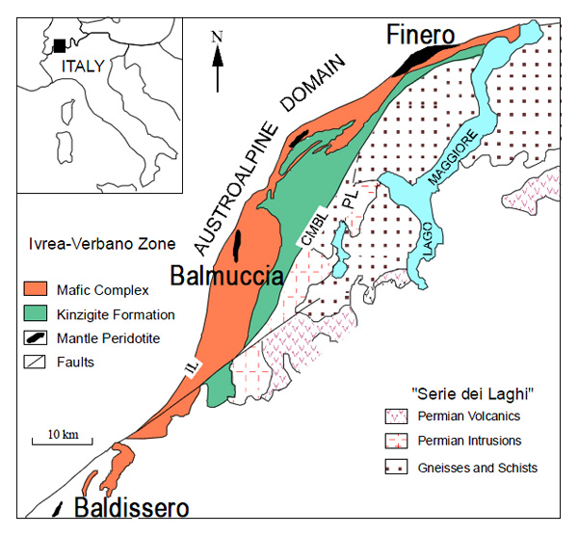
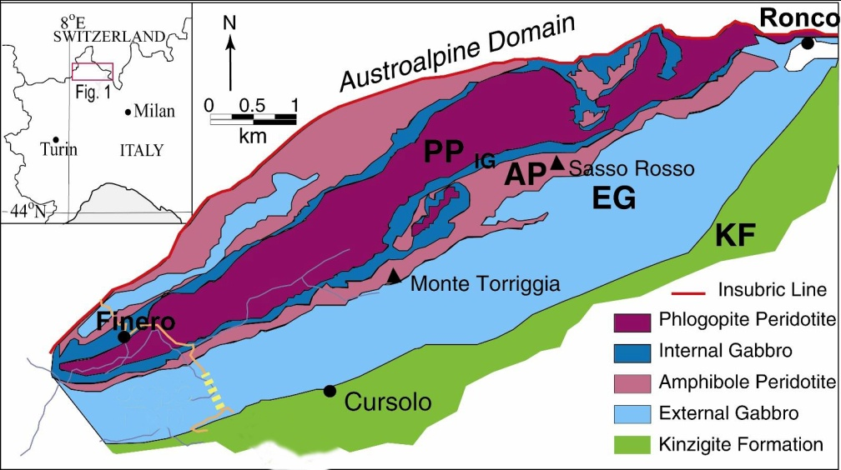
The Finero Complex
Northernmost part of Ivrea-Verbano Zone (IVZ), Southern Alps
Mafic Complex (Cawthorn, 1975; Siena & Coltorti, 1989):
EG: External Gabbro;
AP: Amphibole Peridotite;
IG: Internal Gabbro (or Layered Internal Zone)
Mantle Sequence:
PP: Phlogopite Peridotite mantle unit
(a)
(b)
Fig. 1: (a) Geological map of the Ivrea-Verbano Zone (IVZ), Southern Alps; (b) detailed geology of the northern IVZ, the Finero Complex (Steck & Tièche, 1976; Rivalenti & Mazzucchelli, 2000)

Slide 5
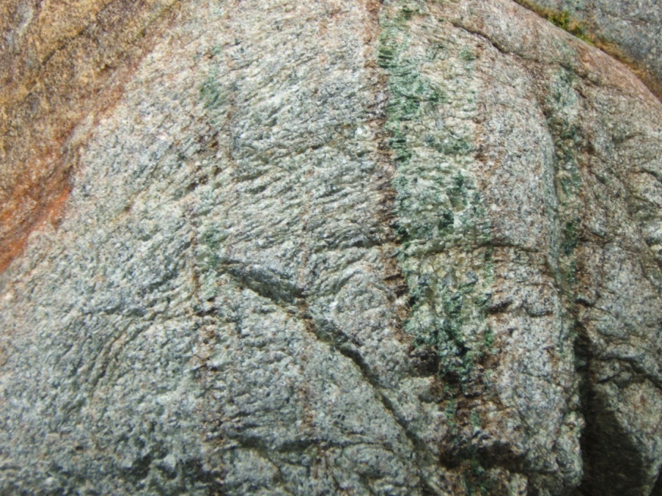
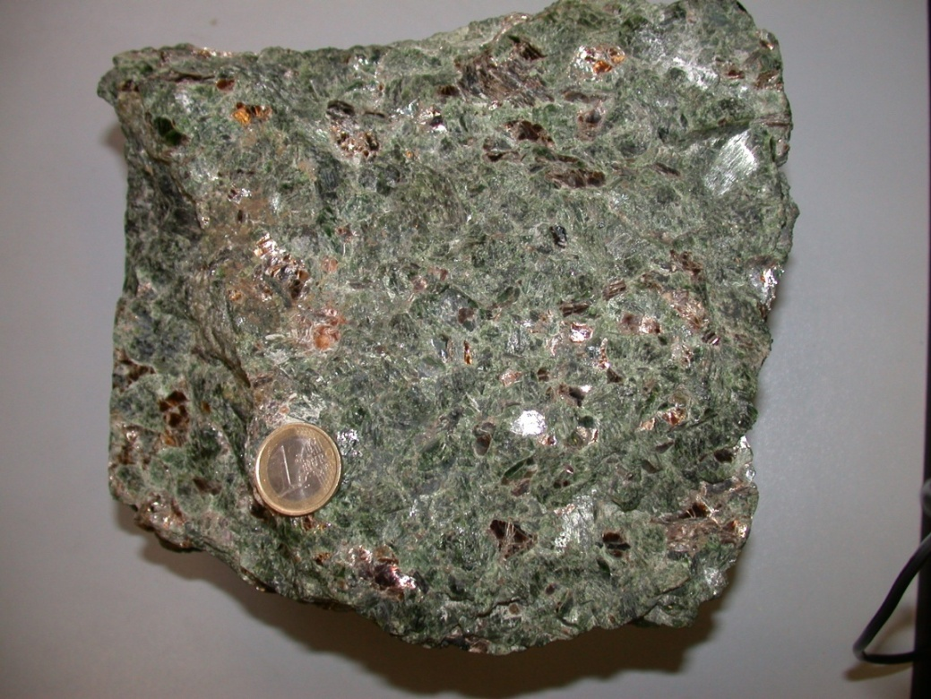
The Finero Phlogopite Peridotite (Mantle unit)
Fig. 2a: Phlogopite-Amphibole harzburgite with phlogopite websterites and orthopyroxenites
Fig. 2b: Phlogopite-Amphibole websterite
Cpx + Opx + Amph + Phl + Spl ± Ol
In particular, the studied alkaline dykes occur in the mantle unit. The FPP shows a complete recrystallization due to pervasive to channelled melt migration.
The pervasive metasomatism formed, during Paleozoic, a main lithologic association constituted by phlogopite harzburgite associated to phlogopite pyroxenite (mainly websterites and orthopyroxenites).
These lithologies are also rich in amphibole and do not show significant chemical gradients among them
(i.e. Zanetti et al., 1999, 2016).

Slide 6
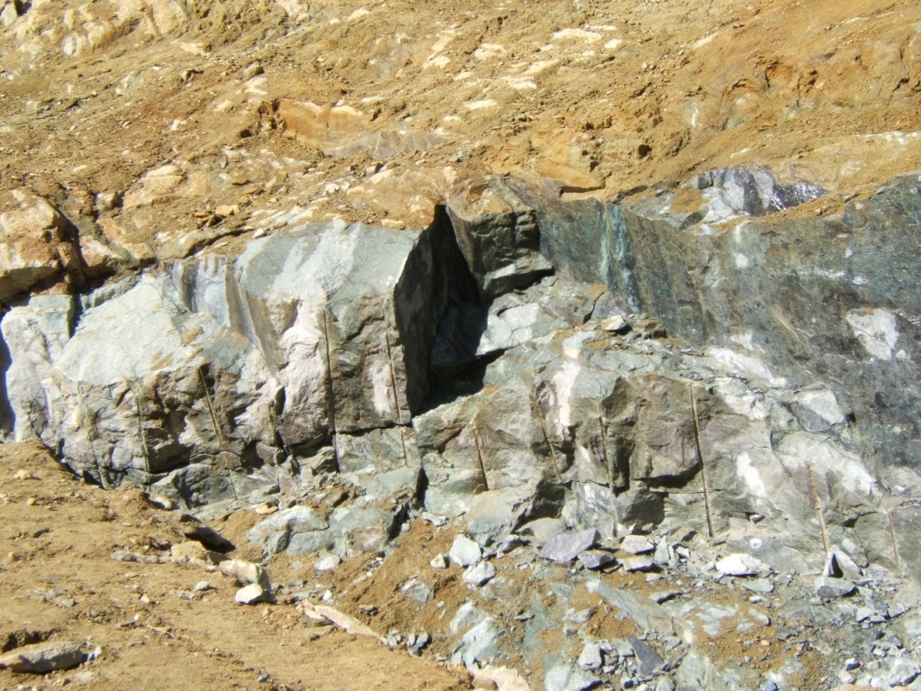
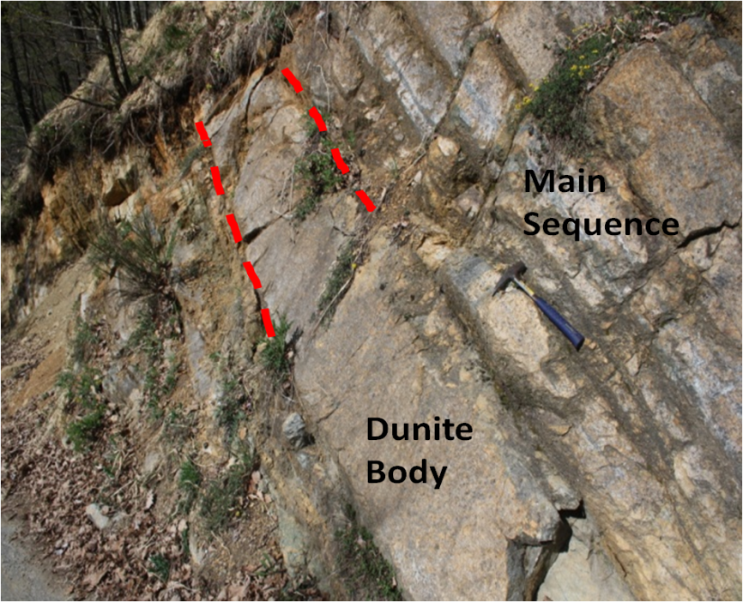
The Finero Phlogopite Peridotites: the concordant Dunites
(a)
(b)
Dunite
1 m
Fig. 3a-b: Concordant dunites within the Finero Phlogopite Peridotites
In FPP, focused melt migration of Si-undersaturated melts formed dunite channels mainly concordant with the mantle foliation.
Dunites sometimes contain stratiform chromitites, and more rarely pyroxenites.

Slide 7
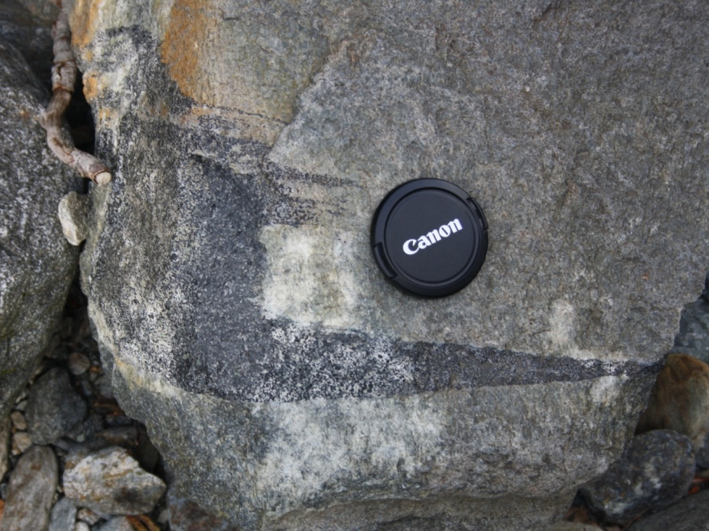
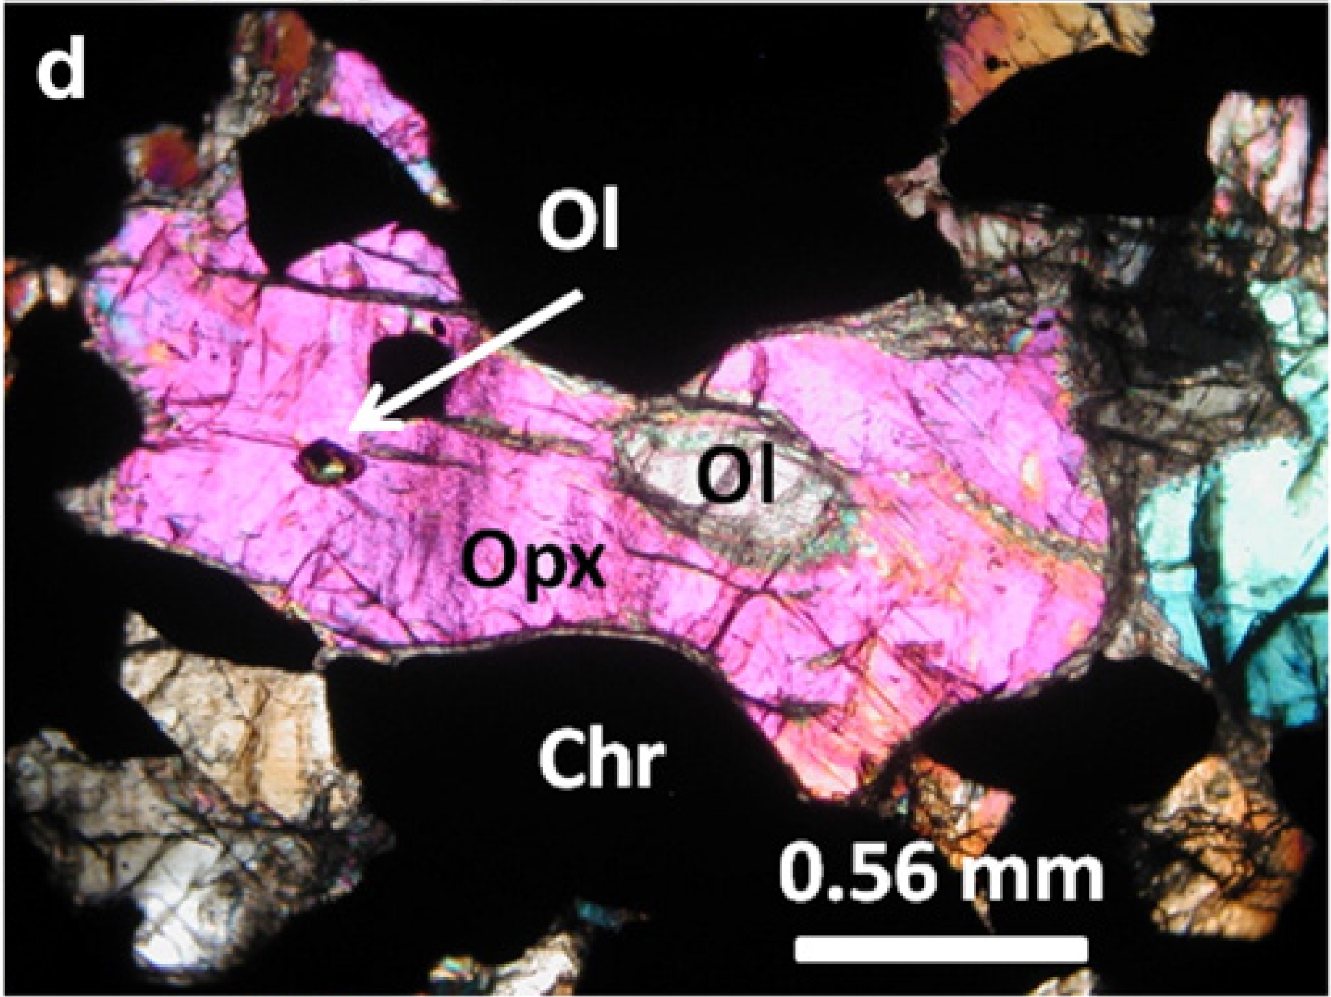
The Finero Phlogopite Peridotites: the concordant Dunites
(c)
(d)
Fig. 3: (c) Stratiform chromitites within dunite; (d) chromitite formed by chromite and orthopyroxene, with
rounded olivine relicts within large orthopyroxene (Zanetti et al., 2016)

Slide 8

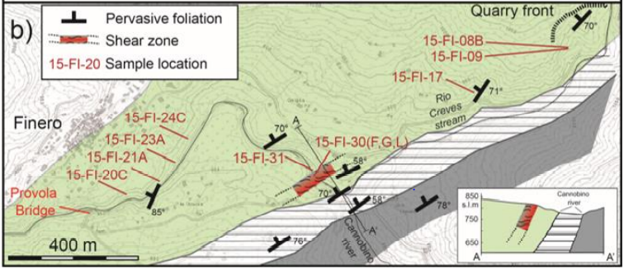
The Finero Complex
a)
Alkaline Dykes: the outcrops
The studied samples were mainly collected along and around a quarry front.
The pervasive mantle foliation is nearly vertical (dip angle 70°) and broadly parallel to the contact with the crustal units.
Fig. 4: (a) Geological map of the northern Ivrea -Verbano Zone (IVZ), Southern Alps; (b) Sketch map of the Finero area showing location (in yellow square) of the alkaline dyke samples (modified after Corvò et al. 2020)

Slide 9
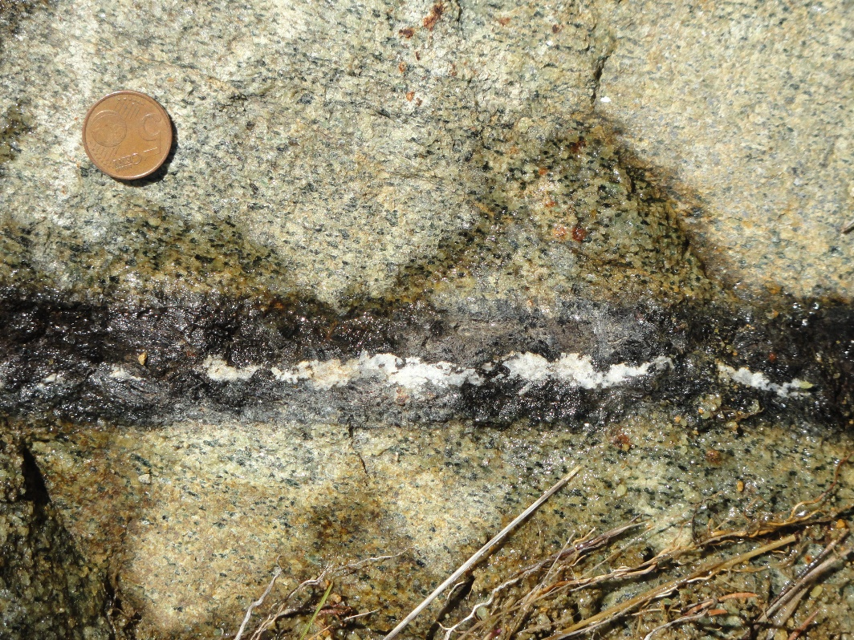
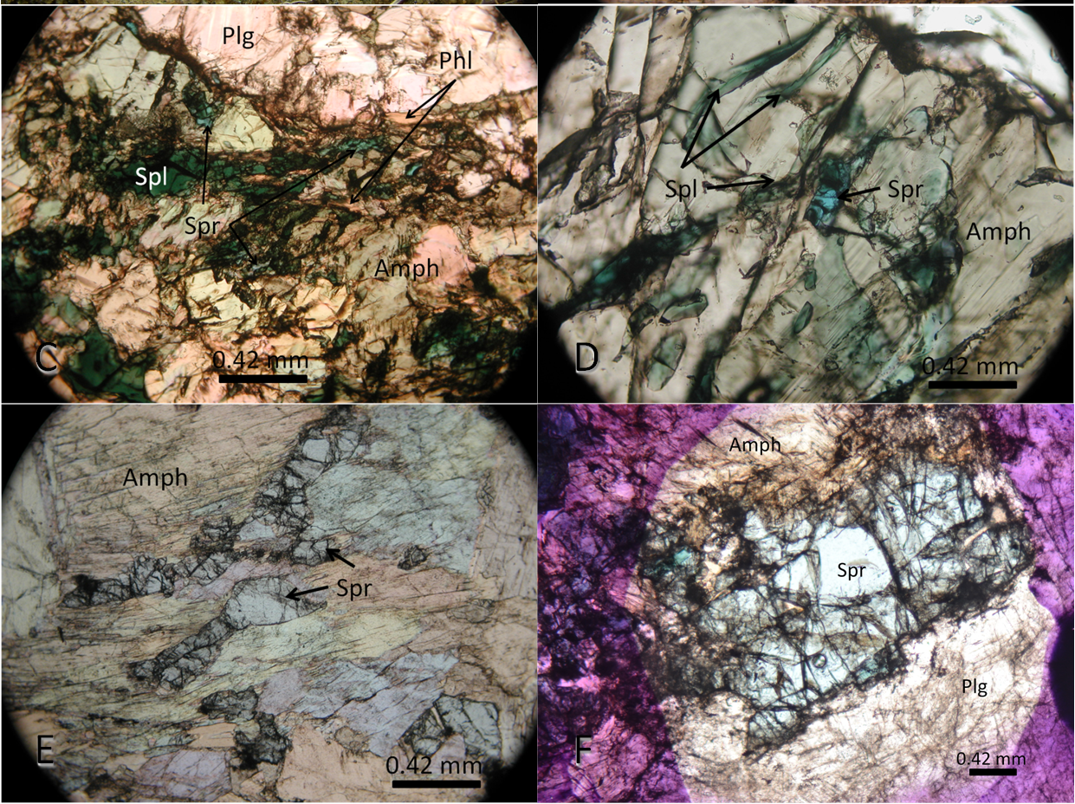
The outcrops of the alkaline dykes are tens of meters far from the occurrence of sapphirine-bearing hornblendite-anorthosite veins investigated by Giovanardi et al. (2013, 2020)
Magmatic Sapphirine!!! (Spr = 14% SiO₂, 63% Al₂O₃, 5% FeO, 18% MgO): P ≥ 1 GPa T > 1000°C

Slide 10
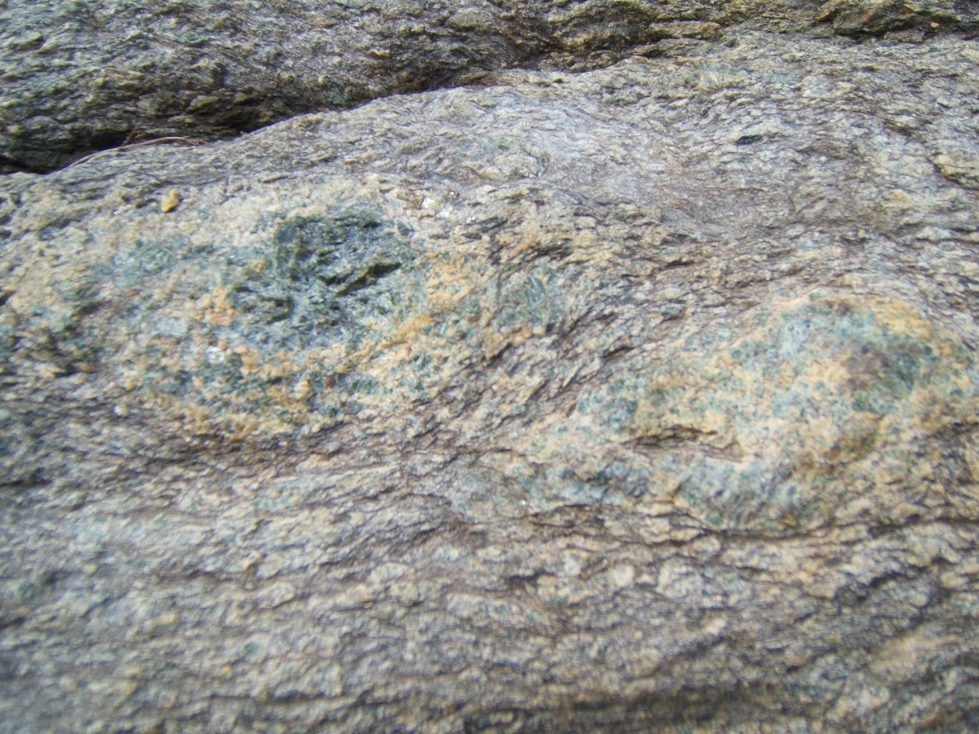
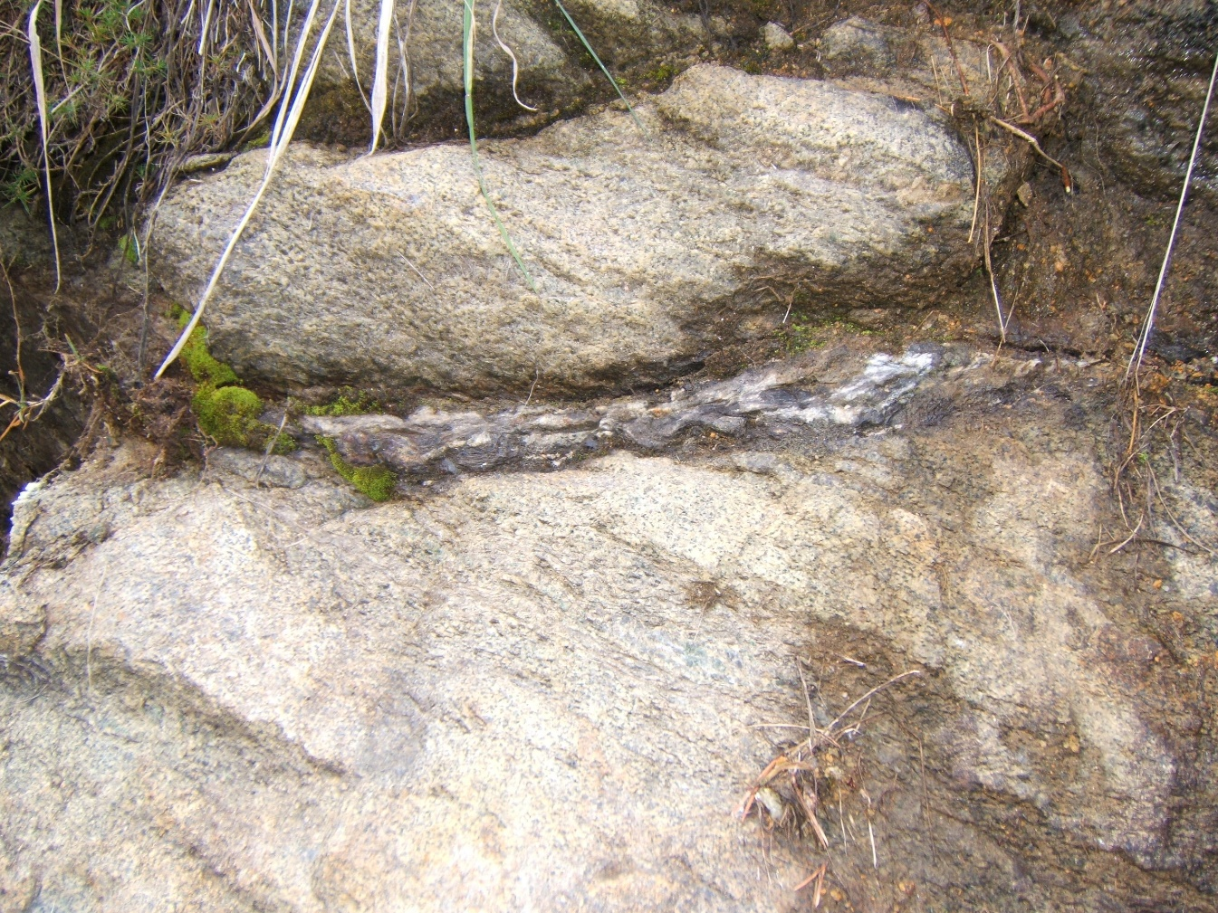
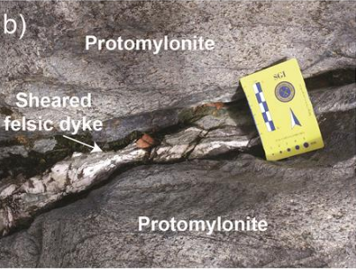
The outcrops of Alkaline Dykes
A
The main outcrops of alkaline dykes is close to a large shear zone (A), which underwent multistage evolution. The injection of the sapphirine-bearing dykes postdates early ductile deformation (B), but it was before the development of mylonitic stages (C). The latter happened during Lower Jurassic or later (<190 Ma, Corvò et al., 2020).
B
C

Slide 11
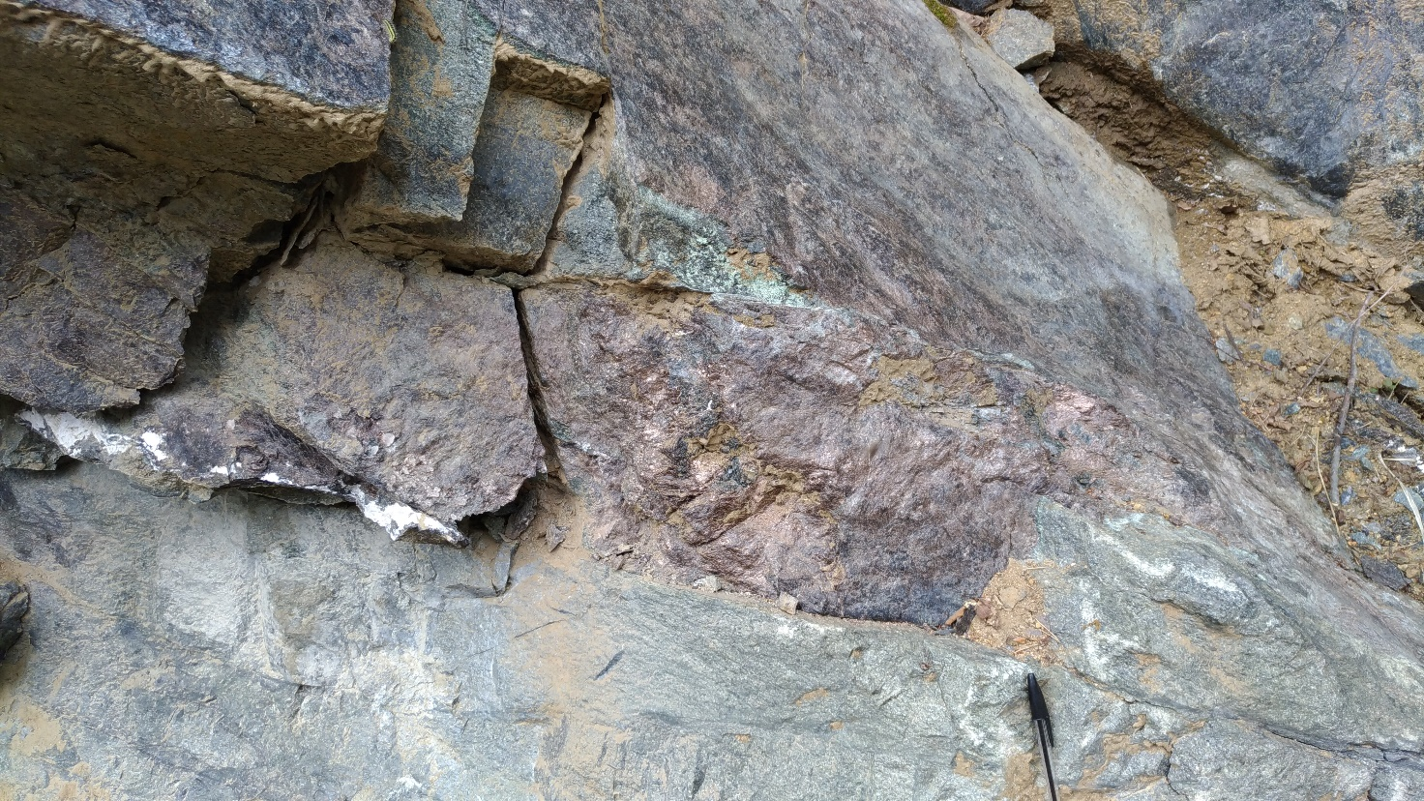
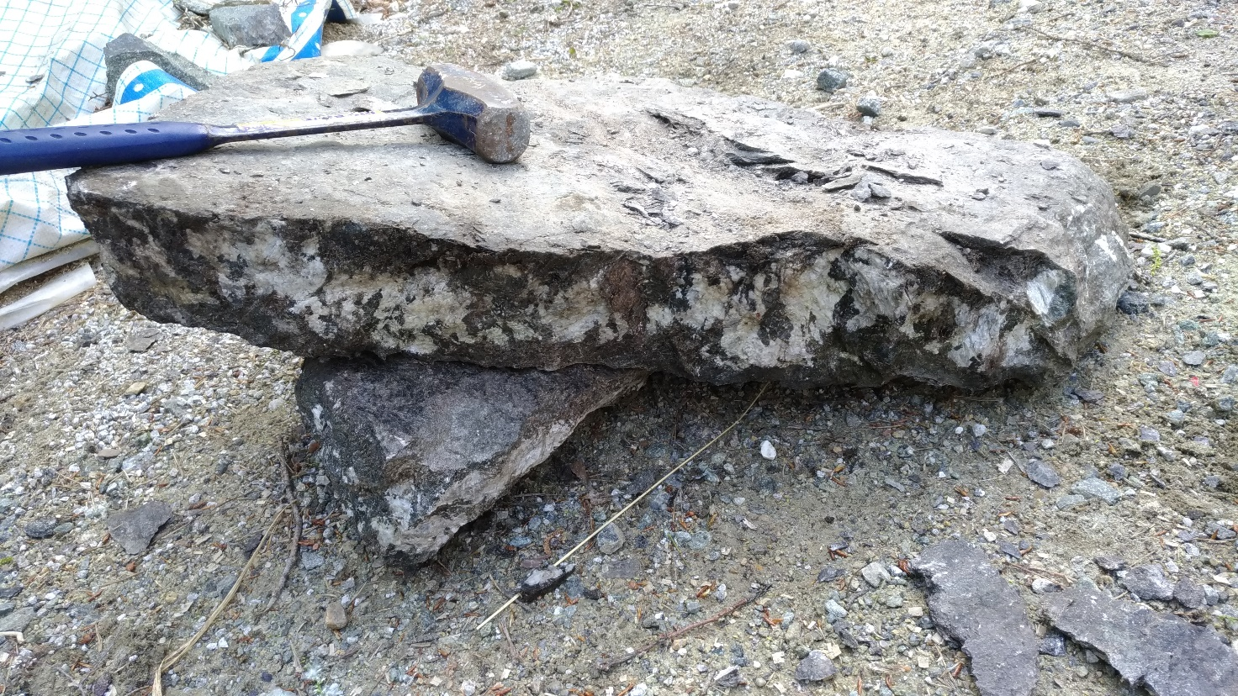
Alkaline Dykes
The alkaline dykes cut at high angle the plane of the pervasive mantle foliation (frequently at right angle, e.g. Fig. A). Macroscopically, the dykes show different mineralogical features and relationships with the host.
A
B
Figure A documents a dyke consisting mainly of fine-grained mica. The boundary with the host peridotite is sharp and no metasomatic halos are apparent. Composite dykes (like in Figure B) are common. They consist of variable ratios of hornblendite and anorthosite. They preserve cumulus magmatic texture, with evidence of late reaction with late melts/fluids producing fine-granied mica pockets/domains.

Slide 12
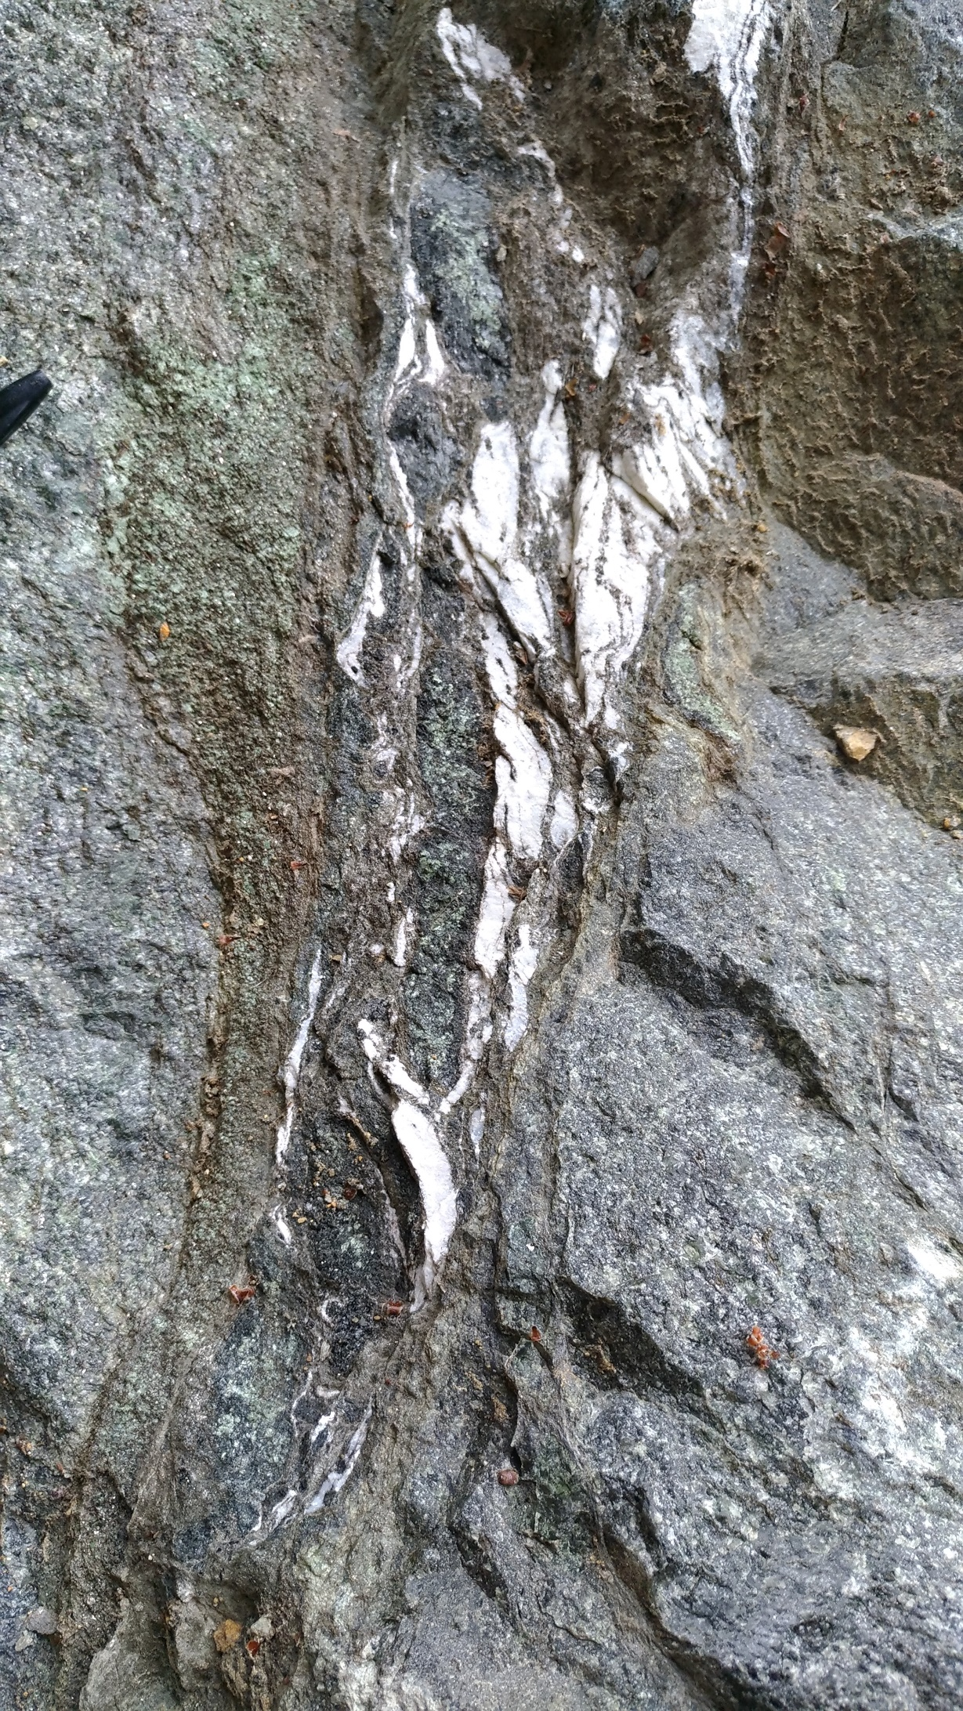
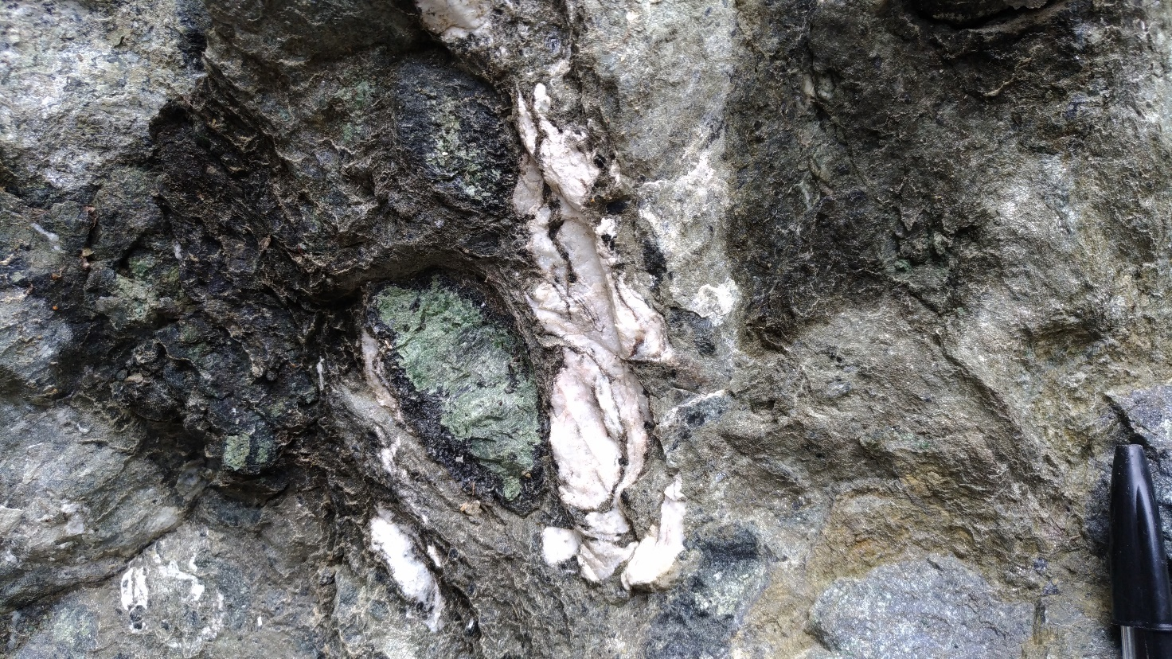
Alkaline Dykes
C
D
Figures C and D describe complex composite dykes, in which the magmatic structure has been highly deformed by syn-magmatic volatile-driven overpressure that took place in the conduit. This process is evidenced by the absence of such deformation in the host peridotite. It is also apparent the occurrence of metasomatic halos in the host peridotite (D).

Slide 13
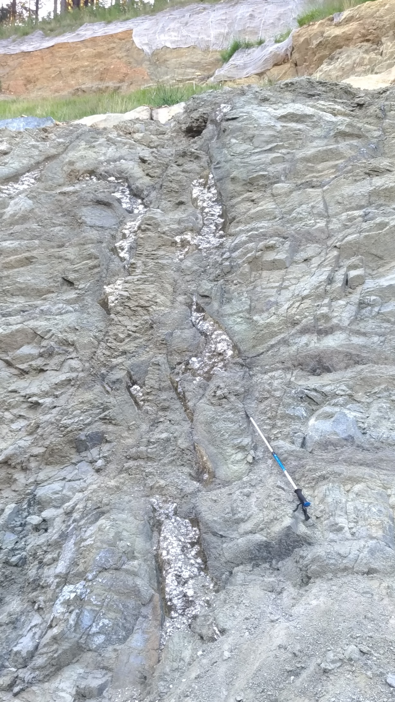
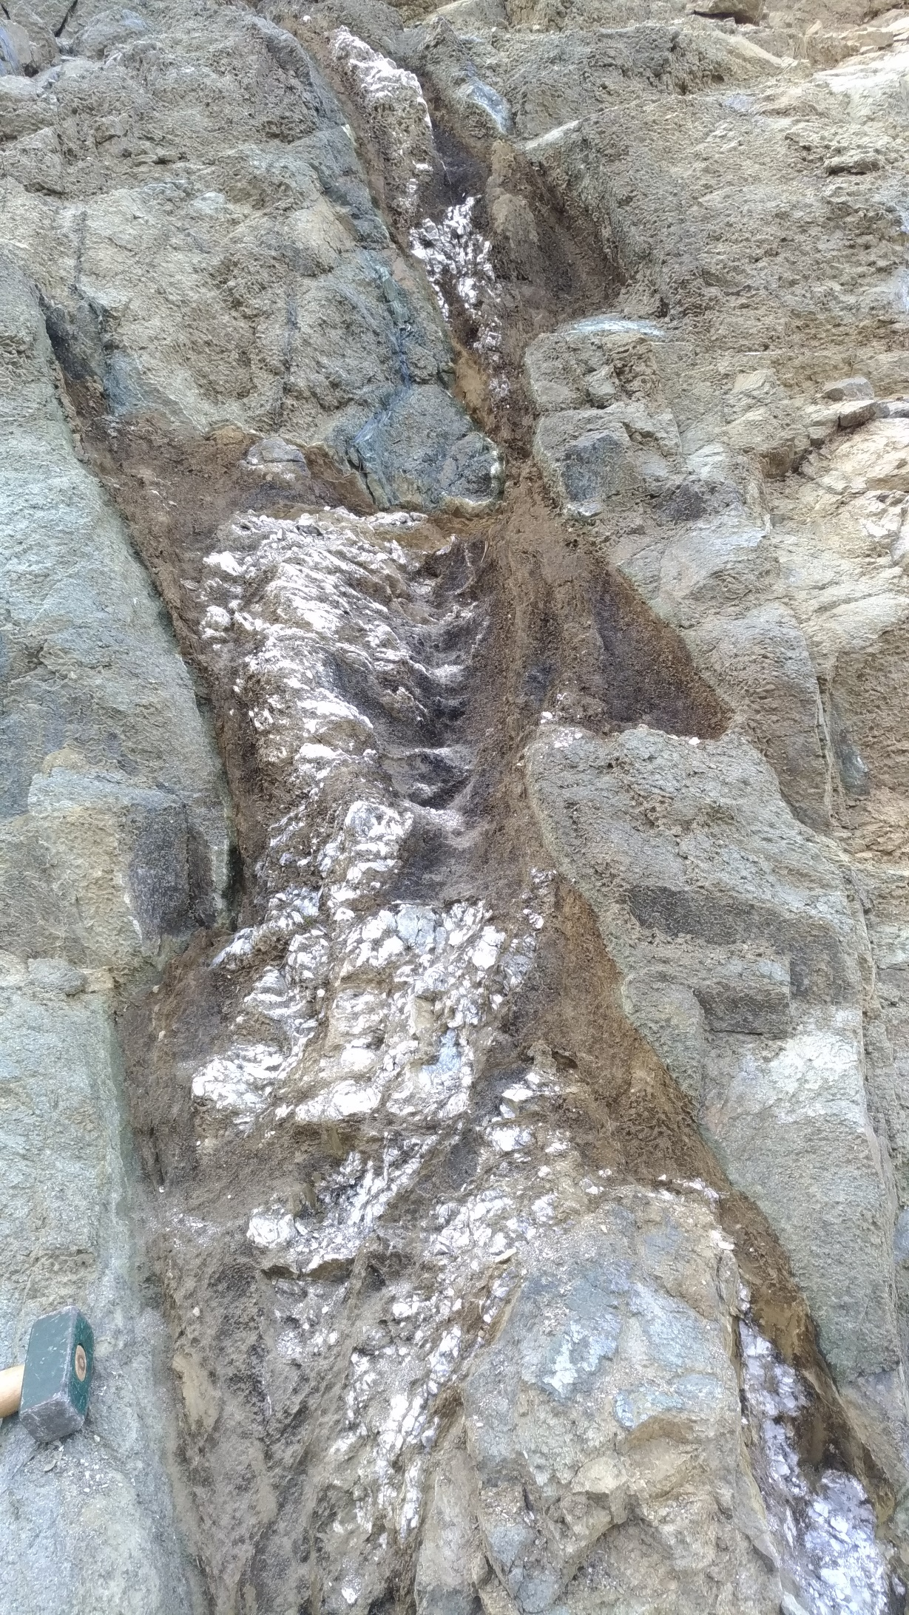
F
E
Farther from the quarry front (Figs. E and F), dyke swarm made by nearly pure anorthosite are present, with dyke thicknesses locally greater than 1 m.

Slide 14
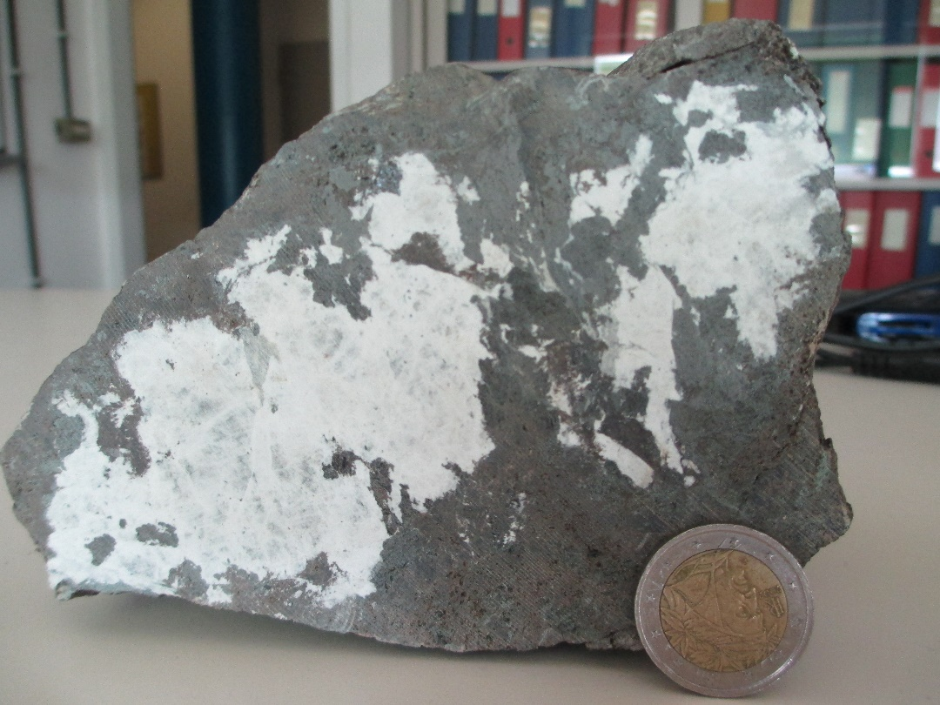
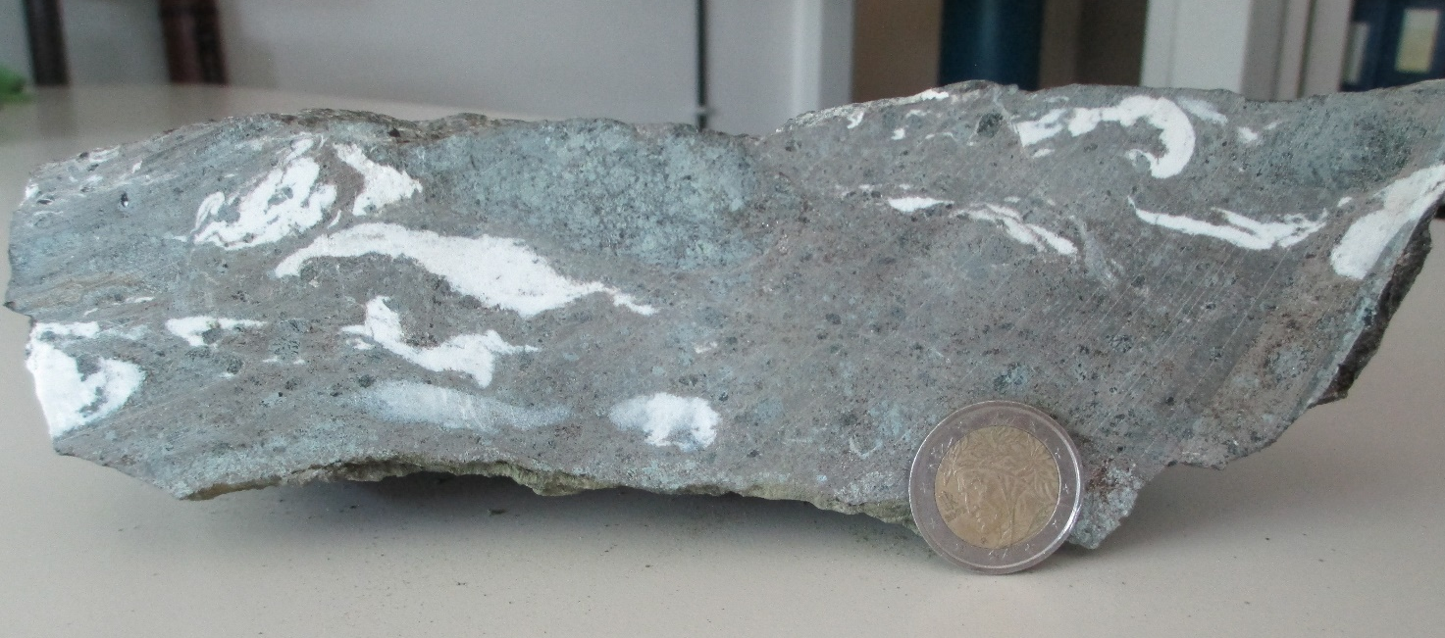
Studied samples
FI1604. It is mainly formed by fine-grained micas, segregated after or during violent migration of late melts/fluids inducing the destruction of former cumulate texture. Plagioclase strings are rotated. There are xenoliths of previous cumulus phases.
FI1603. It is a composite dyke sample comprising hornblendite and anorthosite domains, preserving in part magmatic texture. Reaction with late melts/ fluids mostly occur in the horblendite sections

Slide 15
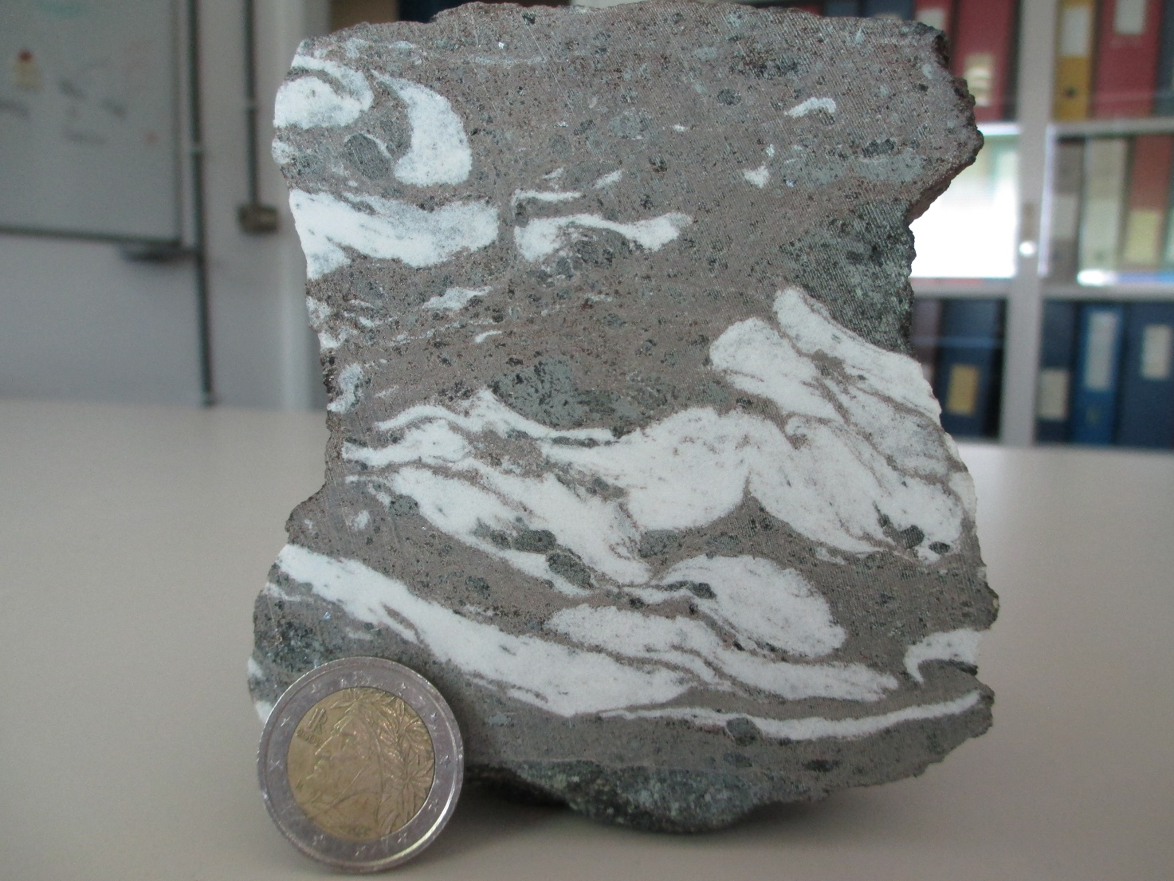
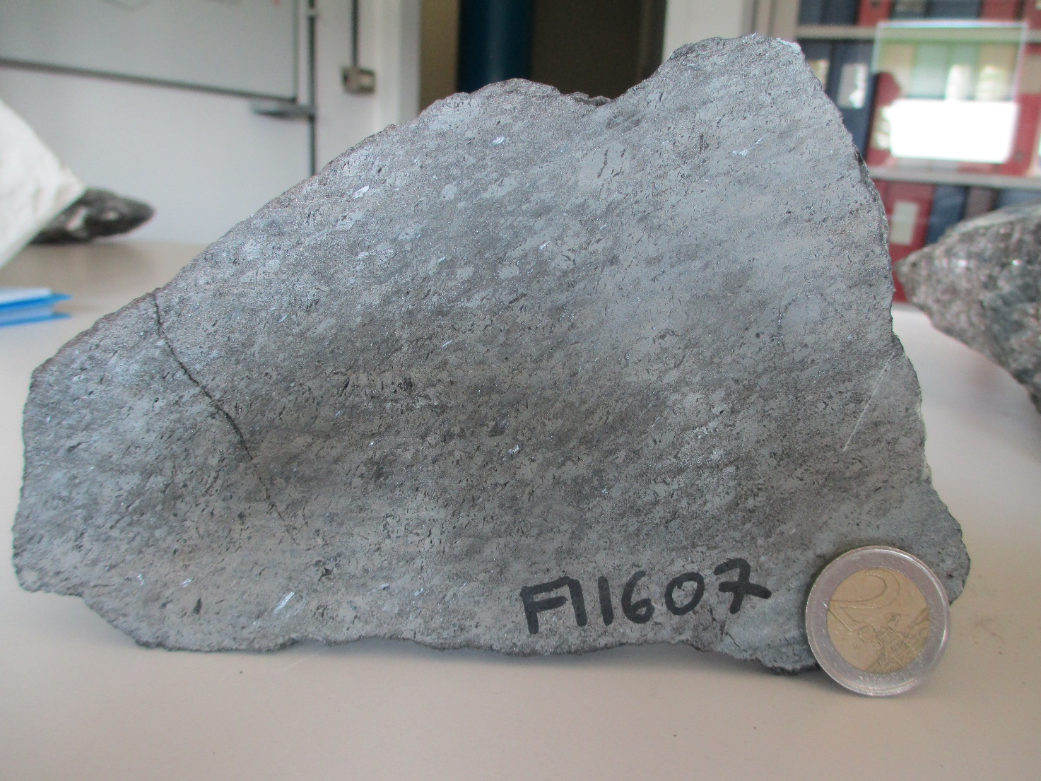
FI1605. It is basically similar to FI1604. The anorthositic domains show plastic flow and rotation.
FI1607. It is formed by hornblendite with a corner of peridotite. The hornblendite shows porphyroclastic texture and development of phlogopite at the boundary with the peridotite.

Slide 16
Analytical methods
 | Major Element Mineral Chemistry | Trace Element in Amphibole and Plagioclase | U-Pb zircon ages | Lu-Hf systematic in zircon | Trace element in zircon | Isotopic Sr composition
FI1603 | X | X | X | X | X | Amphibole, mica, plagioclase
FI1604 |  |  | X | X | X
FI1605 | X |  | X | X | X
FI1607 | X | X |  |  |  | Amphibole

Slide 17
Results
Mineral Classification and Chemistry
Alkali-rich dykes = amph + phl + alb + apatite ± monazite ± ilmenite ± zircon ± Nb-rich oxides ± carbonates
Literature data:
Spr dykes = Giovanardi et al., 2020
Ap-FPP = Zanetti et al., 1999
FPP = Zanetti et al., 1999; Giovanardi et al., 2020
Lamprophyre = Casetta et al., 2019
IVZ Felsic dykes = Bonazzi et al., 2020
Neph-anorthosite = Stähle et al., 1990, 2001
Classification of amphiboles in the studied dykes (Hawthorne et al., 2012)

Slide 18
Mineral Classification and Chemistry
An-Ab-Or classification of plagioclase in the studied plagioclase-bearing dykes
Classification of phlogopite in the studied dykes

Slide 19
(a)
(c)
Major Elements Mineral Chemistry: Amphiboles
(b)
(d)

Slide 20
(a)
(c)
Major Elements Mineral Chemistry: Phlogopites
(b)

Slide 21
Trace Elements Mineral Chemistry: Amphiboles
PM-normalised incompatible trace elements plot for amphiboles in the studied dykes
(Sun & McDonough, 1995)
CI-normalised REE plot for amphiboles in the studied dykes (Lyube & Korenaga, 2007)

Slide 22
(a)
(c)
Comparison of amphiboles trace elements in the melanocratic ultramafic dyke with literature data
(b)
(d)

Slide 23
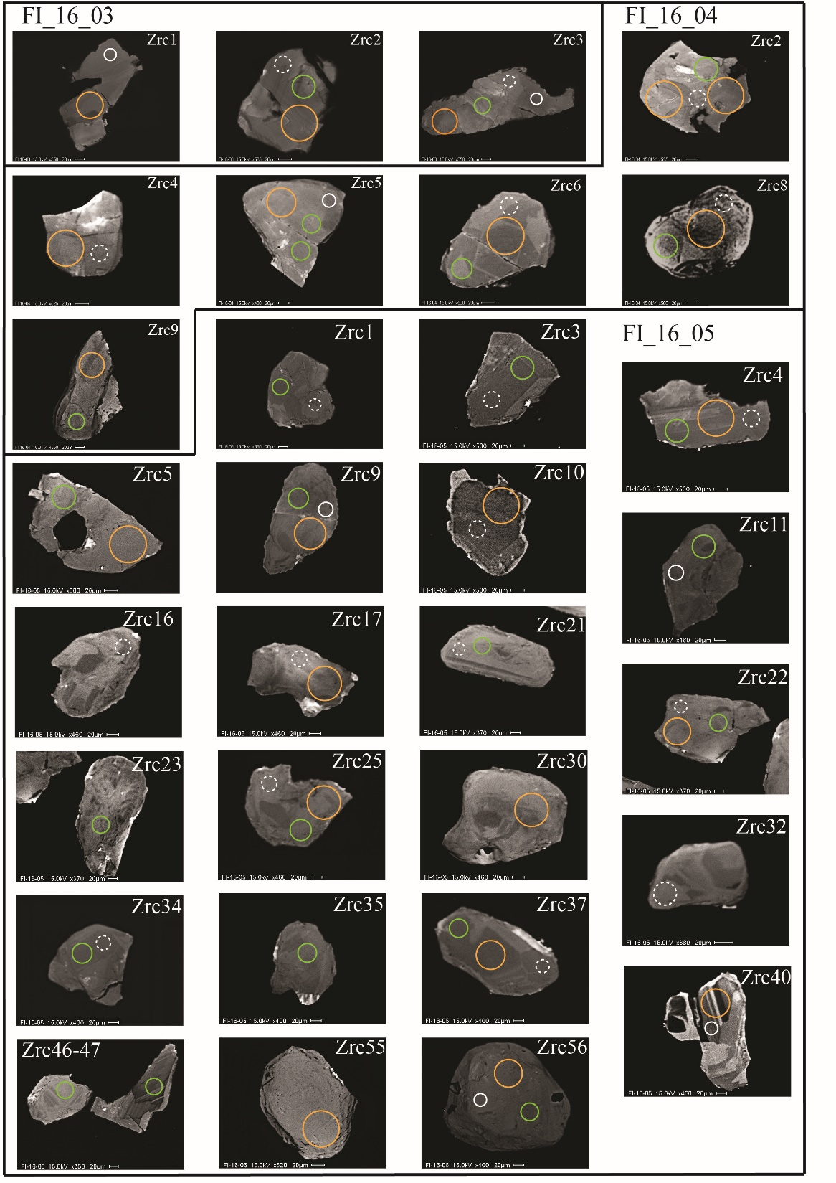
CL internal structures of zircons

Slide 24
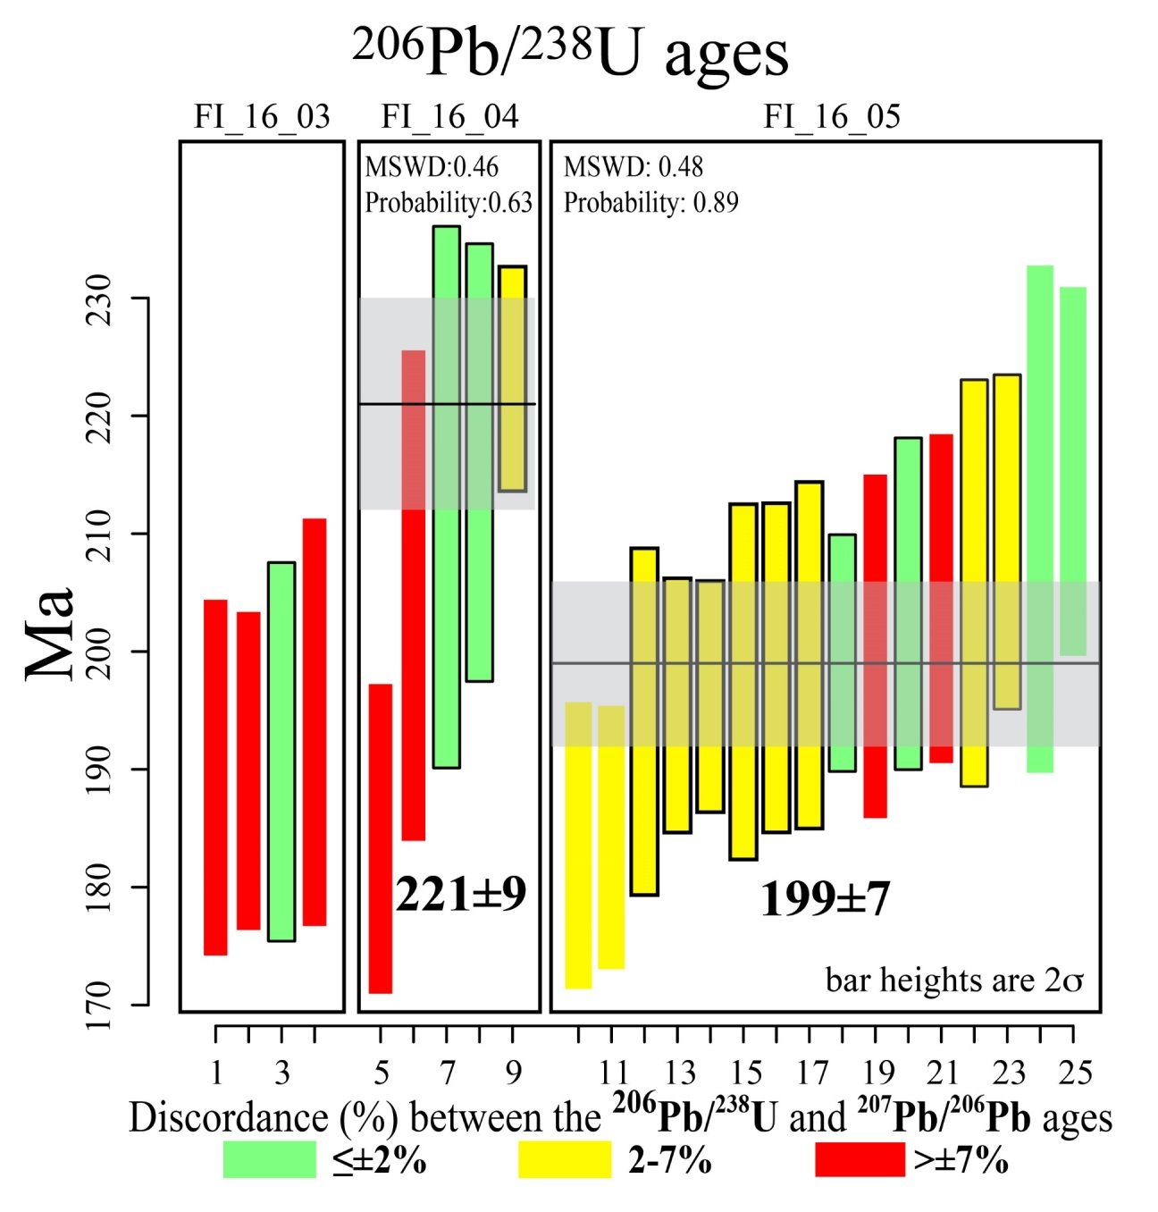
U/Pb zircon geochronology

Slide 25
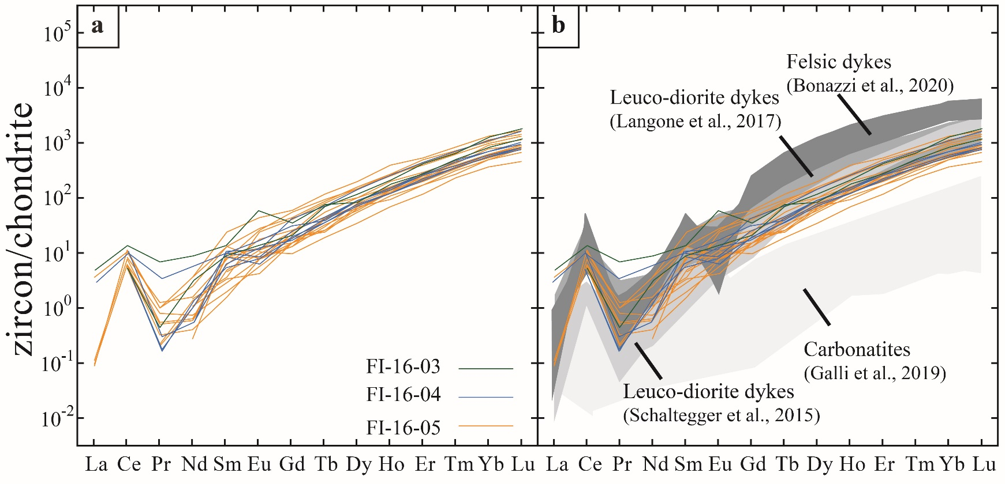
Trace element zircon data

Slide 26
Isotopic Hf zircon composition

Slide 27
Isotopic Sr mineral composition

Slide 28
Discussion and Conclusions
Textural, geochemical and geochronological data indicate that the dykes’ conduits record complex, multistage and prolonged magmatic/fluid activity;
The syn-magmatic mylonitic structure of the dykes is related to volatile overpressure, possibly accompanied by exsolution melt-melt or melt-fluid processes, confirming that these crustal units were welded with the Phlogopite Peridotite mantle unit at Triassic time.
Exsolution processes may also explain the bimodal lithologic association of ultramafic (hornblendite-glimmerite) and leucocratic (anorthosite) intrusives.
The large volatile contents associated to the intense deformation of the Finero unit from Triassic to Jurassic (Langone et al., 2017; 2018; Corvò et al., 2020) may explain the widespread Mesozoic reset of the geochronological isotopic clocks in both mantle peridotite and crustal intrusives as well as in metamorphic basement of the Finero Complex.

Slide 29
Alkaline Dyke Mantle Source
The combination of Hf and Sr isotopic compositions, large volatile contents, the LILE and LREE enrichments, and the variable REE/HFSE ratios point to a derivation of the parent melts from variably enriched mantle sources.
Large positive Ta–Nb and Zr–Hf anomalies and negative Ti anomalies shown by amphiboles in the plagioclase-bearing dykes (FI1603/05) is a rare geochemical feature probably produced by segregation from alkaline melts with HIMU isotopic composition (Jackson et al., 2008; Raffone et al., 2009).
Depleted Nb, Ta, Zr and Hf in amphiboles from the melanocratic ultramafic hornblendite (FI16C07) approach those found in sapphirine-bearing hornblendite-anorthosite veins (δ18O Amph = 6.86-6.94, Pl = 8.60, Giovanardi et al., 2020), which parent melts contained significant amount of recycled continental crust components.

Slide 30
Geodynamic Implications
As a whole, our data, in combination with literature (e.g., De Min et al., 2020), suggest that the Upper Triassic to Lower Jurassic magmatism in the Southern Alps was potentially characterized by uprising of mantle-derived melts with both anorogenic to orogenic character.
Heterogeneous mantle sources, possibly including continental crust delaminated during post-collisional stages of Variscan orogeny, are thus responsible for the Mesozoic magmatism of the Southern Alps.

Slide 31
Thank you

