Slide 1
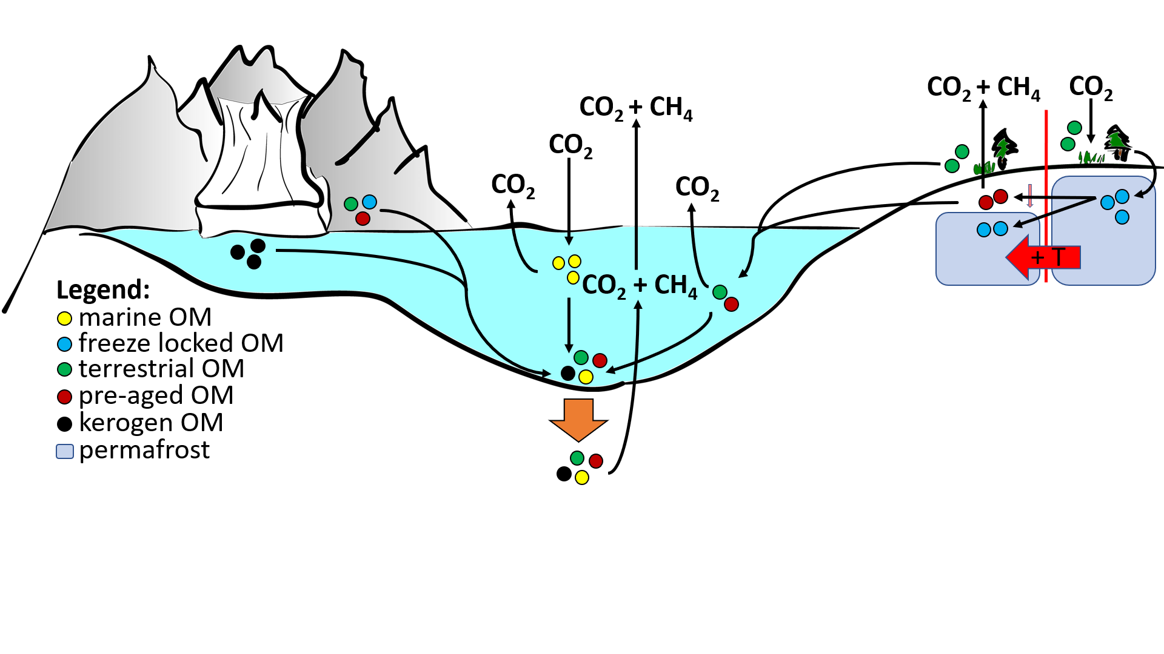
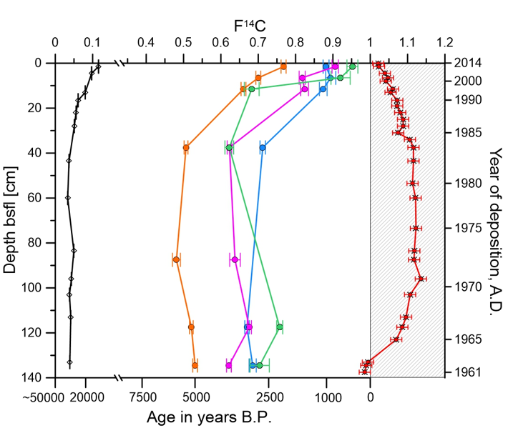
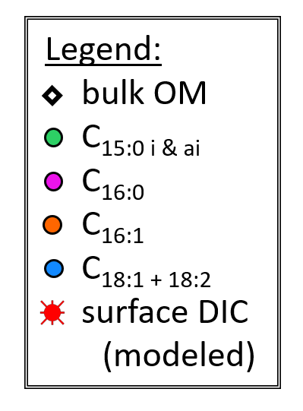
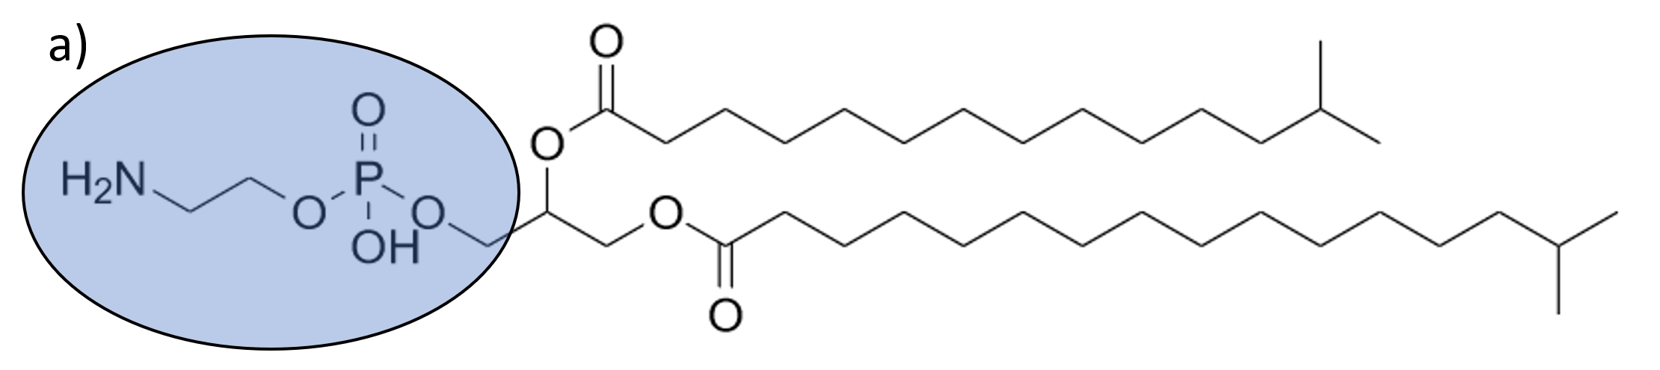
Mobilization of permafrost material to aquatic systems and its biogeochemical fate
Does microbial utilization of permafrost OC in marine sediments contribute to global GHG emissions?
Our concept approach:
Manuel Ruben^{1,2}, Florence Schubotz^{2,3}, Jens Hefter¹, Hendrik Grotheer^{1,3}, Matthias Forwick⁴, Witold Szczuciński⁵, Hannah Marchant⁶, Gesine Mollenhauer^{1,2,3}
Hornsund Fjord, Svalbard
IPL fatty acid radiocarbon signature
Intact polar lipid
membrane lipids of “living” microbiota
Ruben et al., in prep.

Slide 2
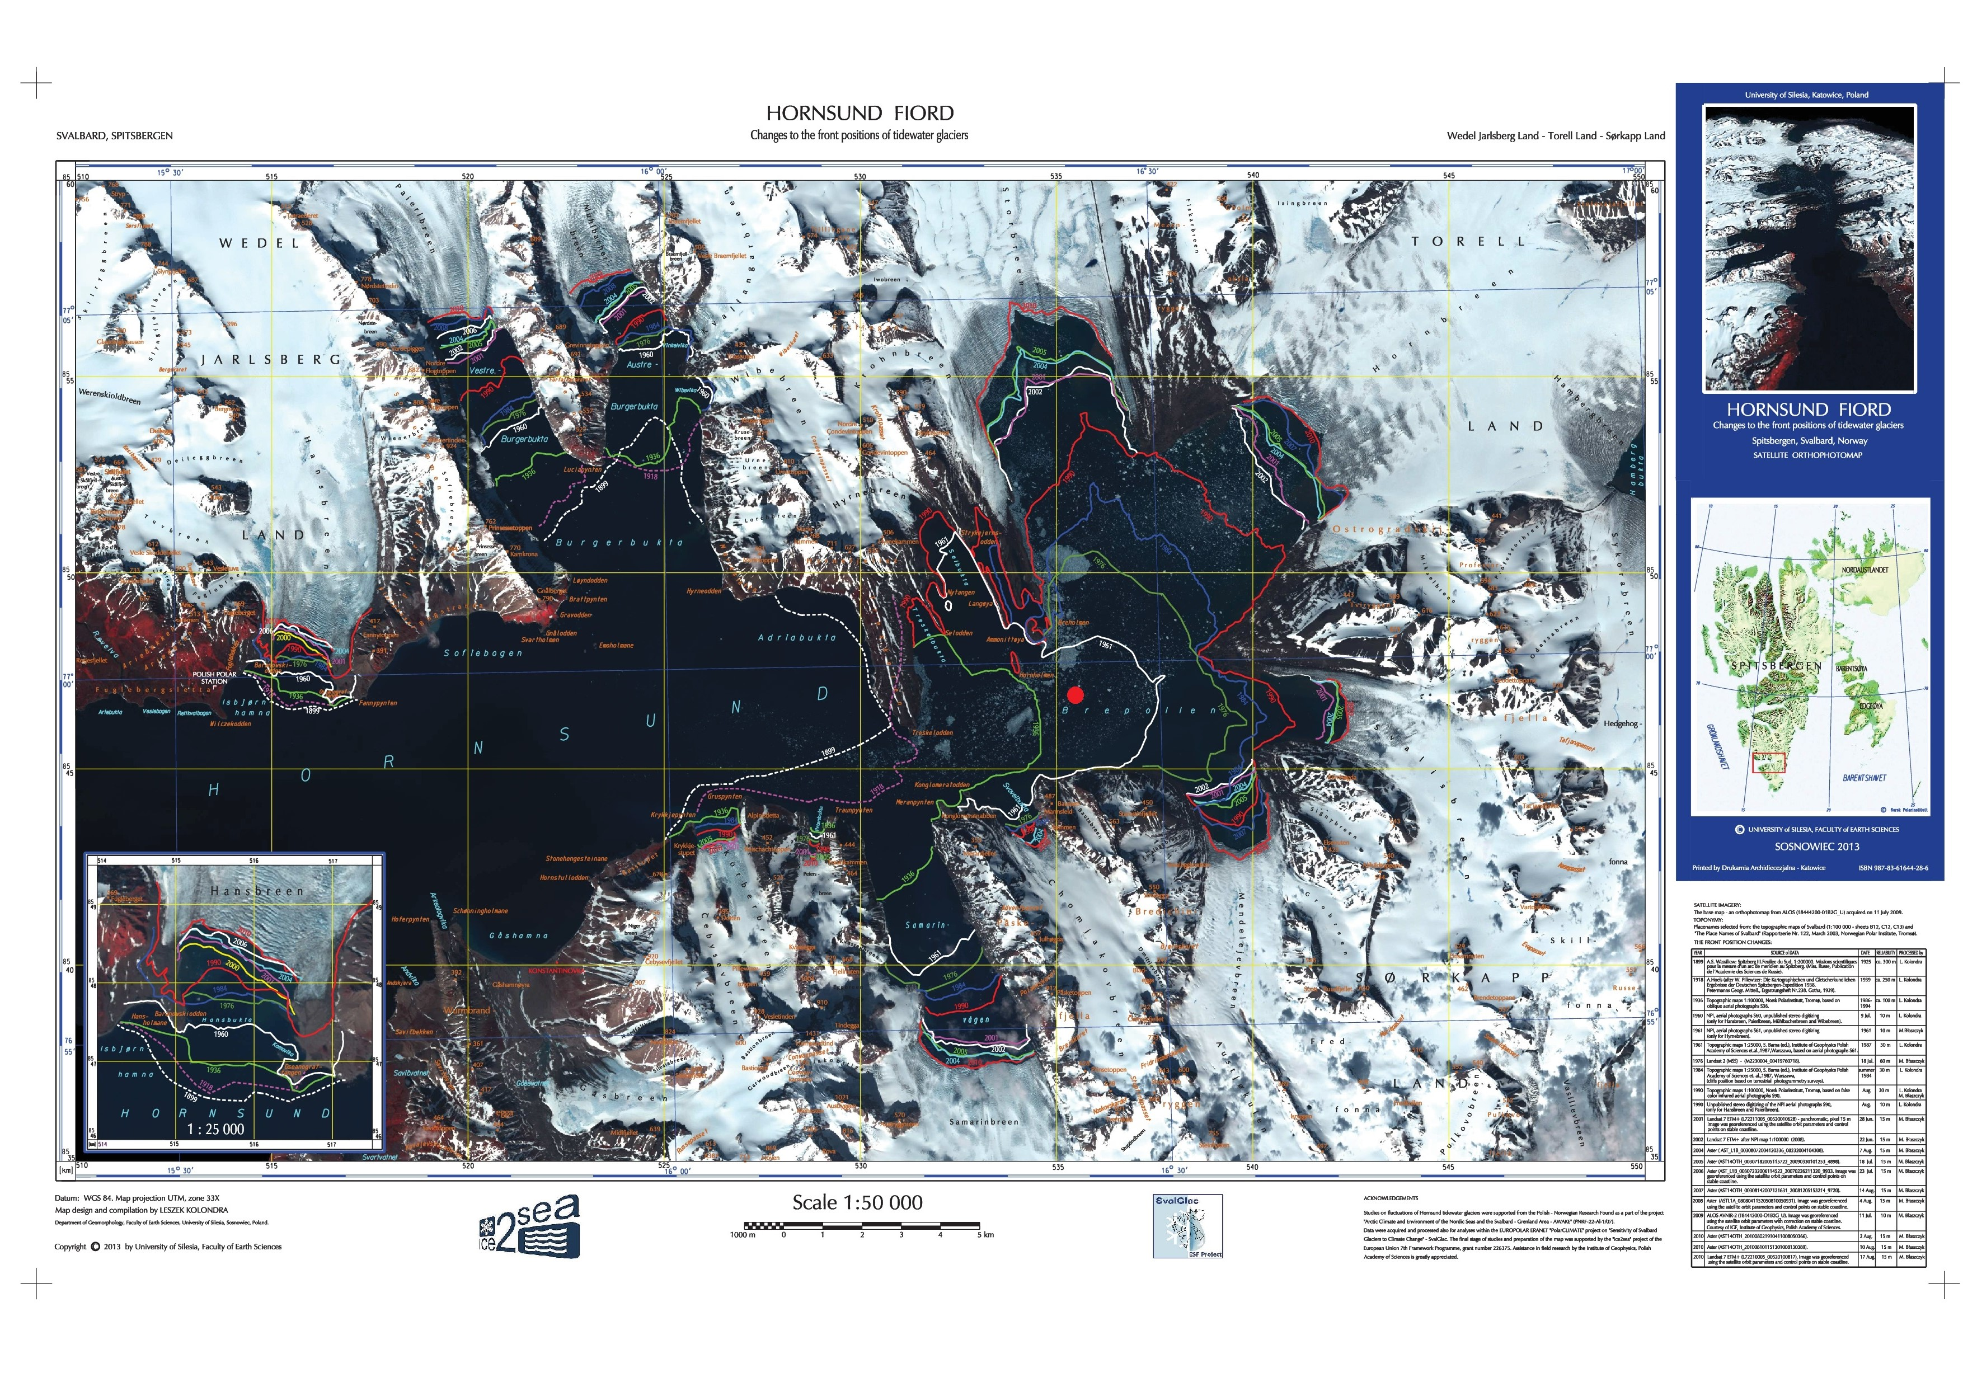
Analyzed sediment cores rin Hornsund Fjord
1
2
3
Błaszczyk et al. - 2013

Slide 3
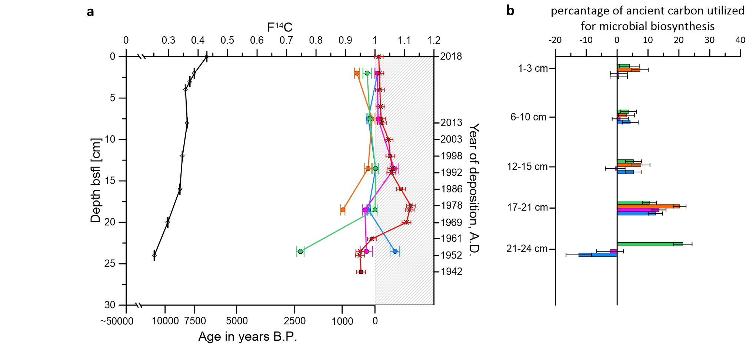
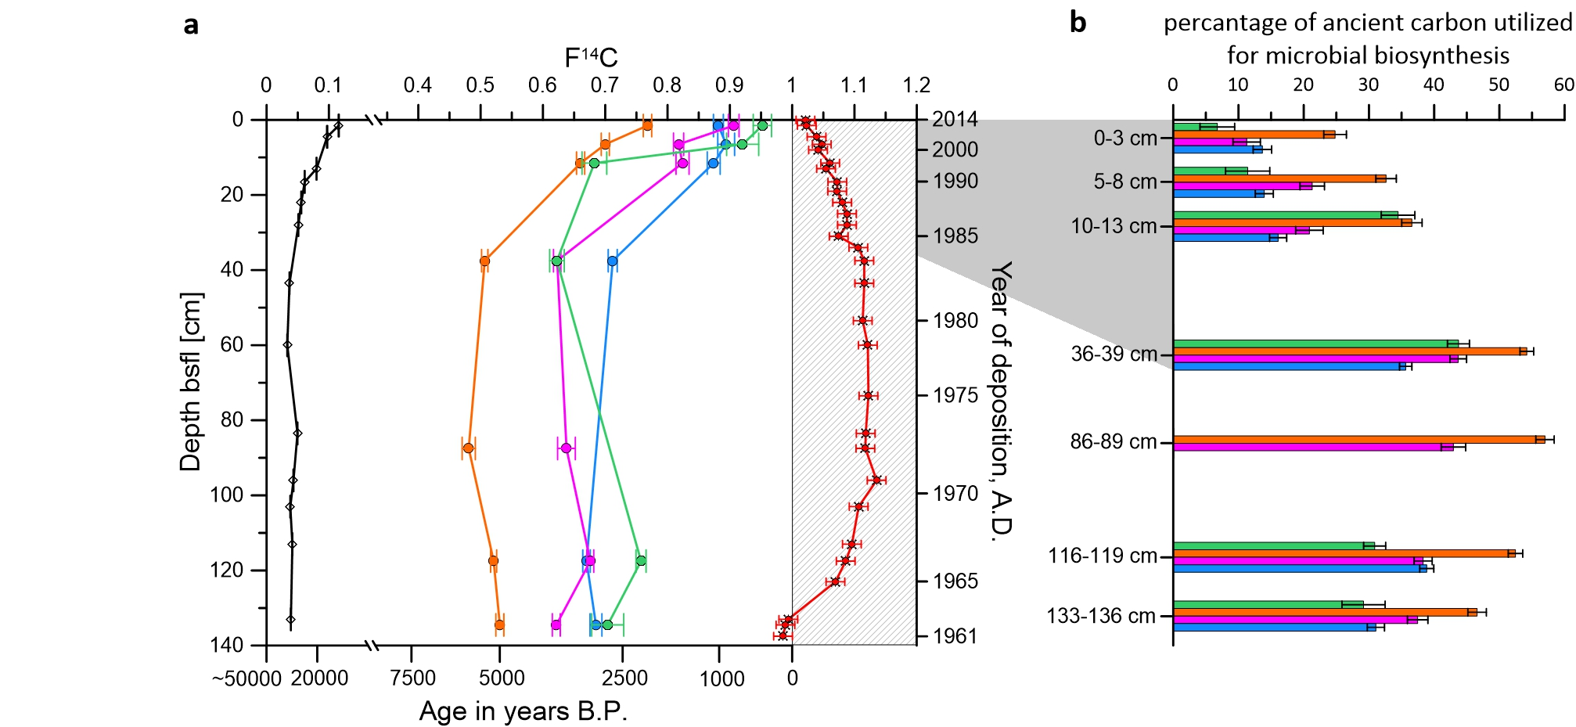

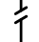
Main Basin
He519_2-3
distal to glacier
Legend:
bulk OM
C_{15:0 i & ai}
C_{16:0}
C_{16:1}
C_{18:1 + 18:2}
surface DIC (modeled)
Breepollen Bay
HH14-897-MF-GC
proximal to glacier
Ruben et al., in prep.

Slide 4
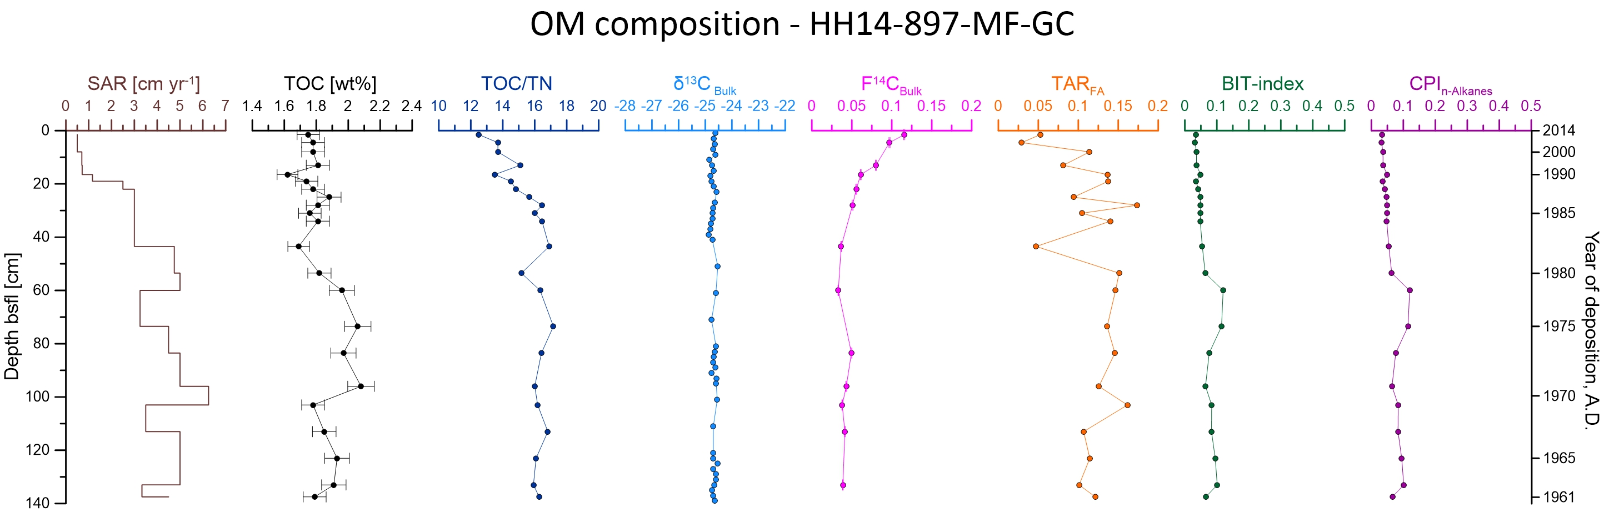
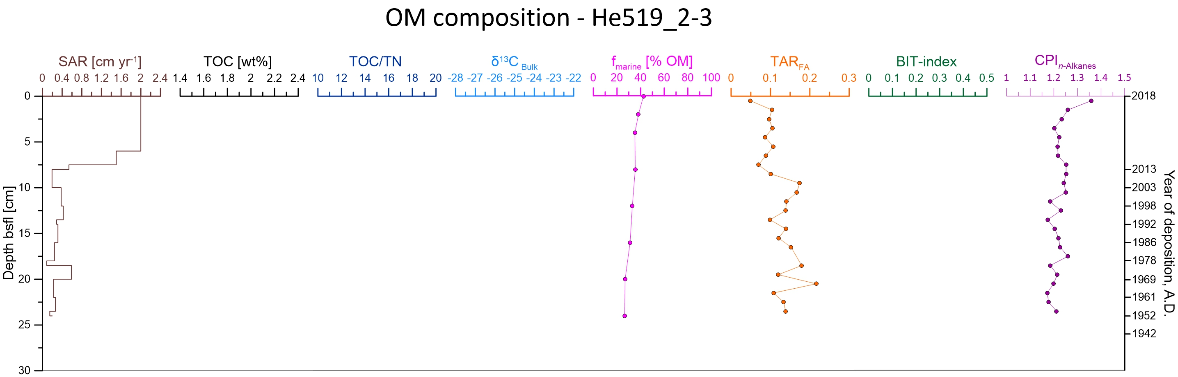

Slide 5
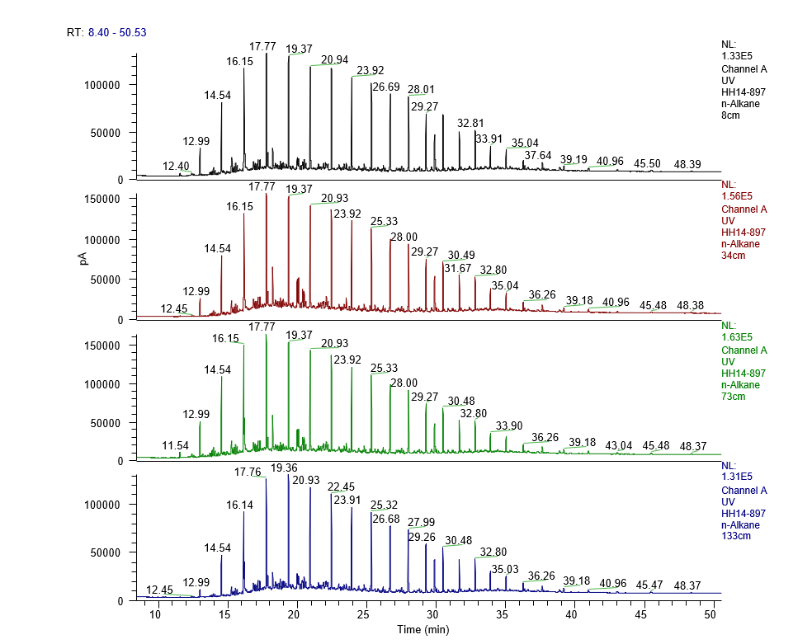
HH14-897-GC-MF Alkane distribution

Slide 6
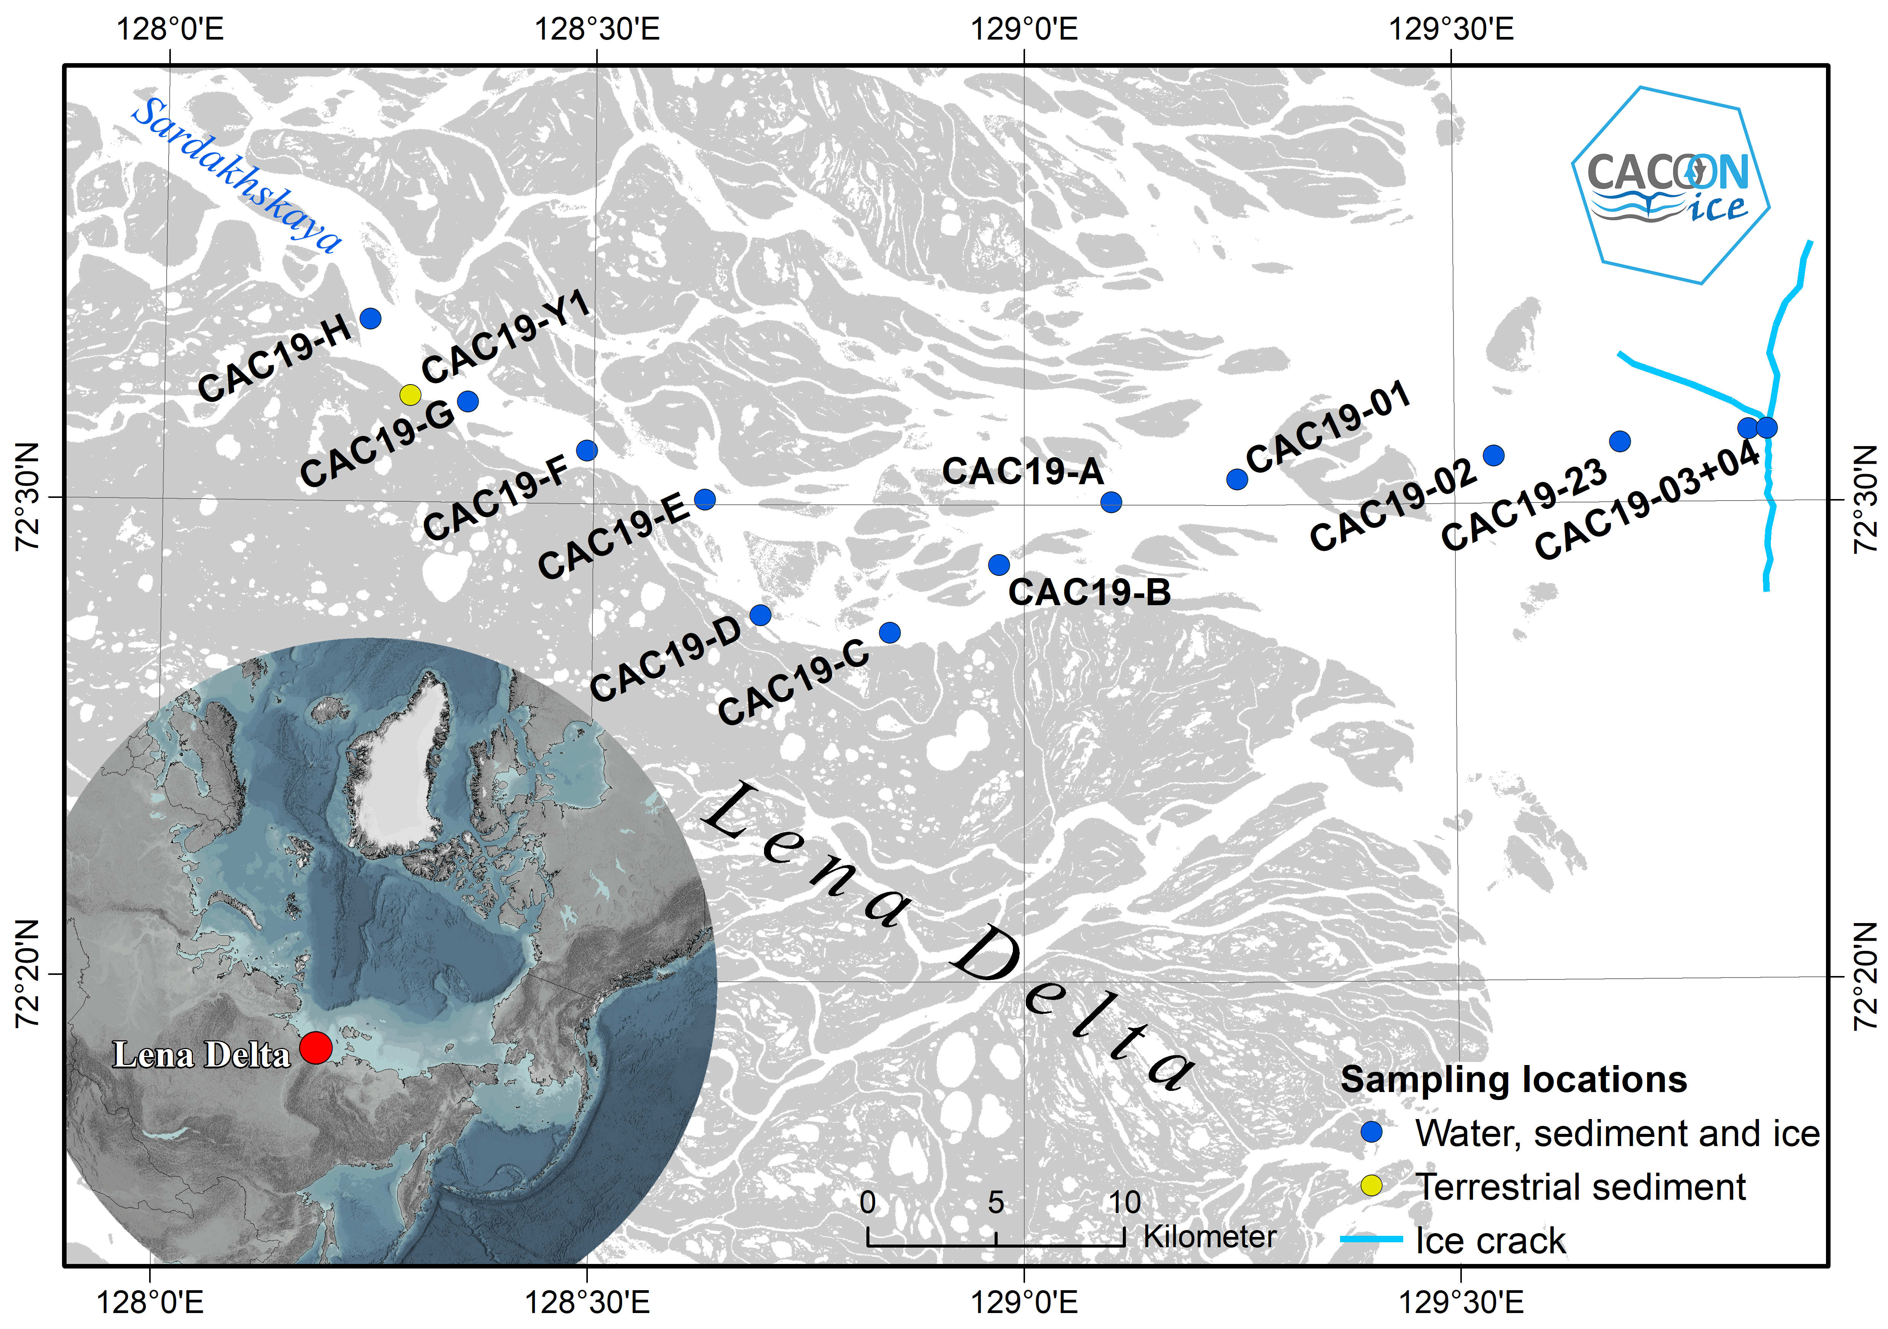
Permafrost utilization in marine sediments (CAC19-23)

