Slide 1
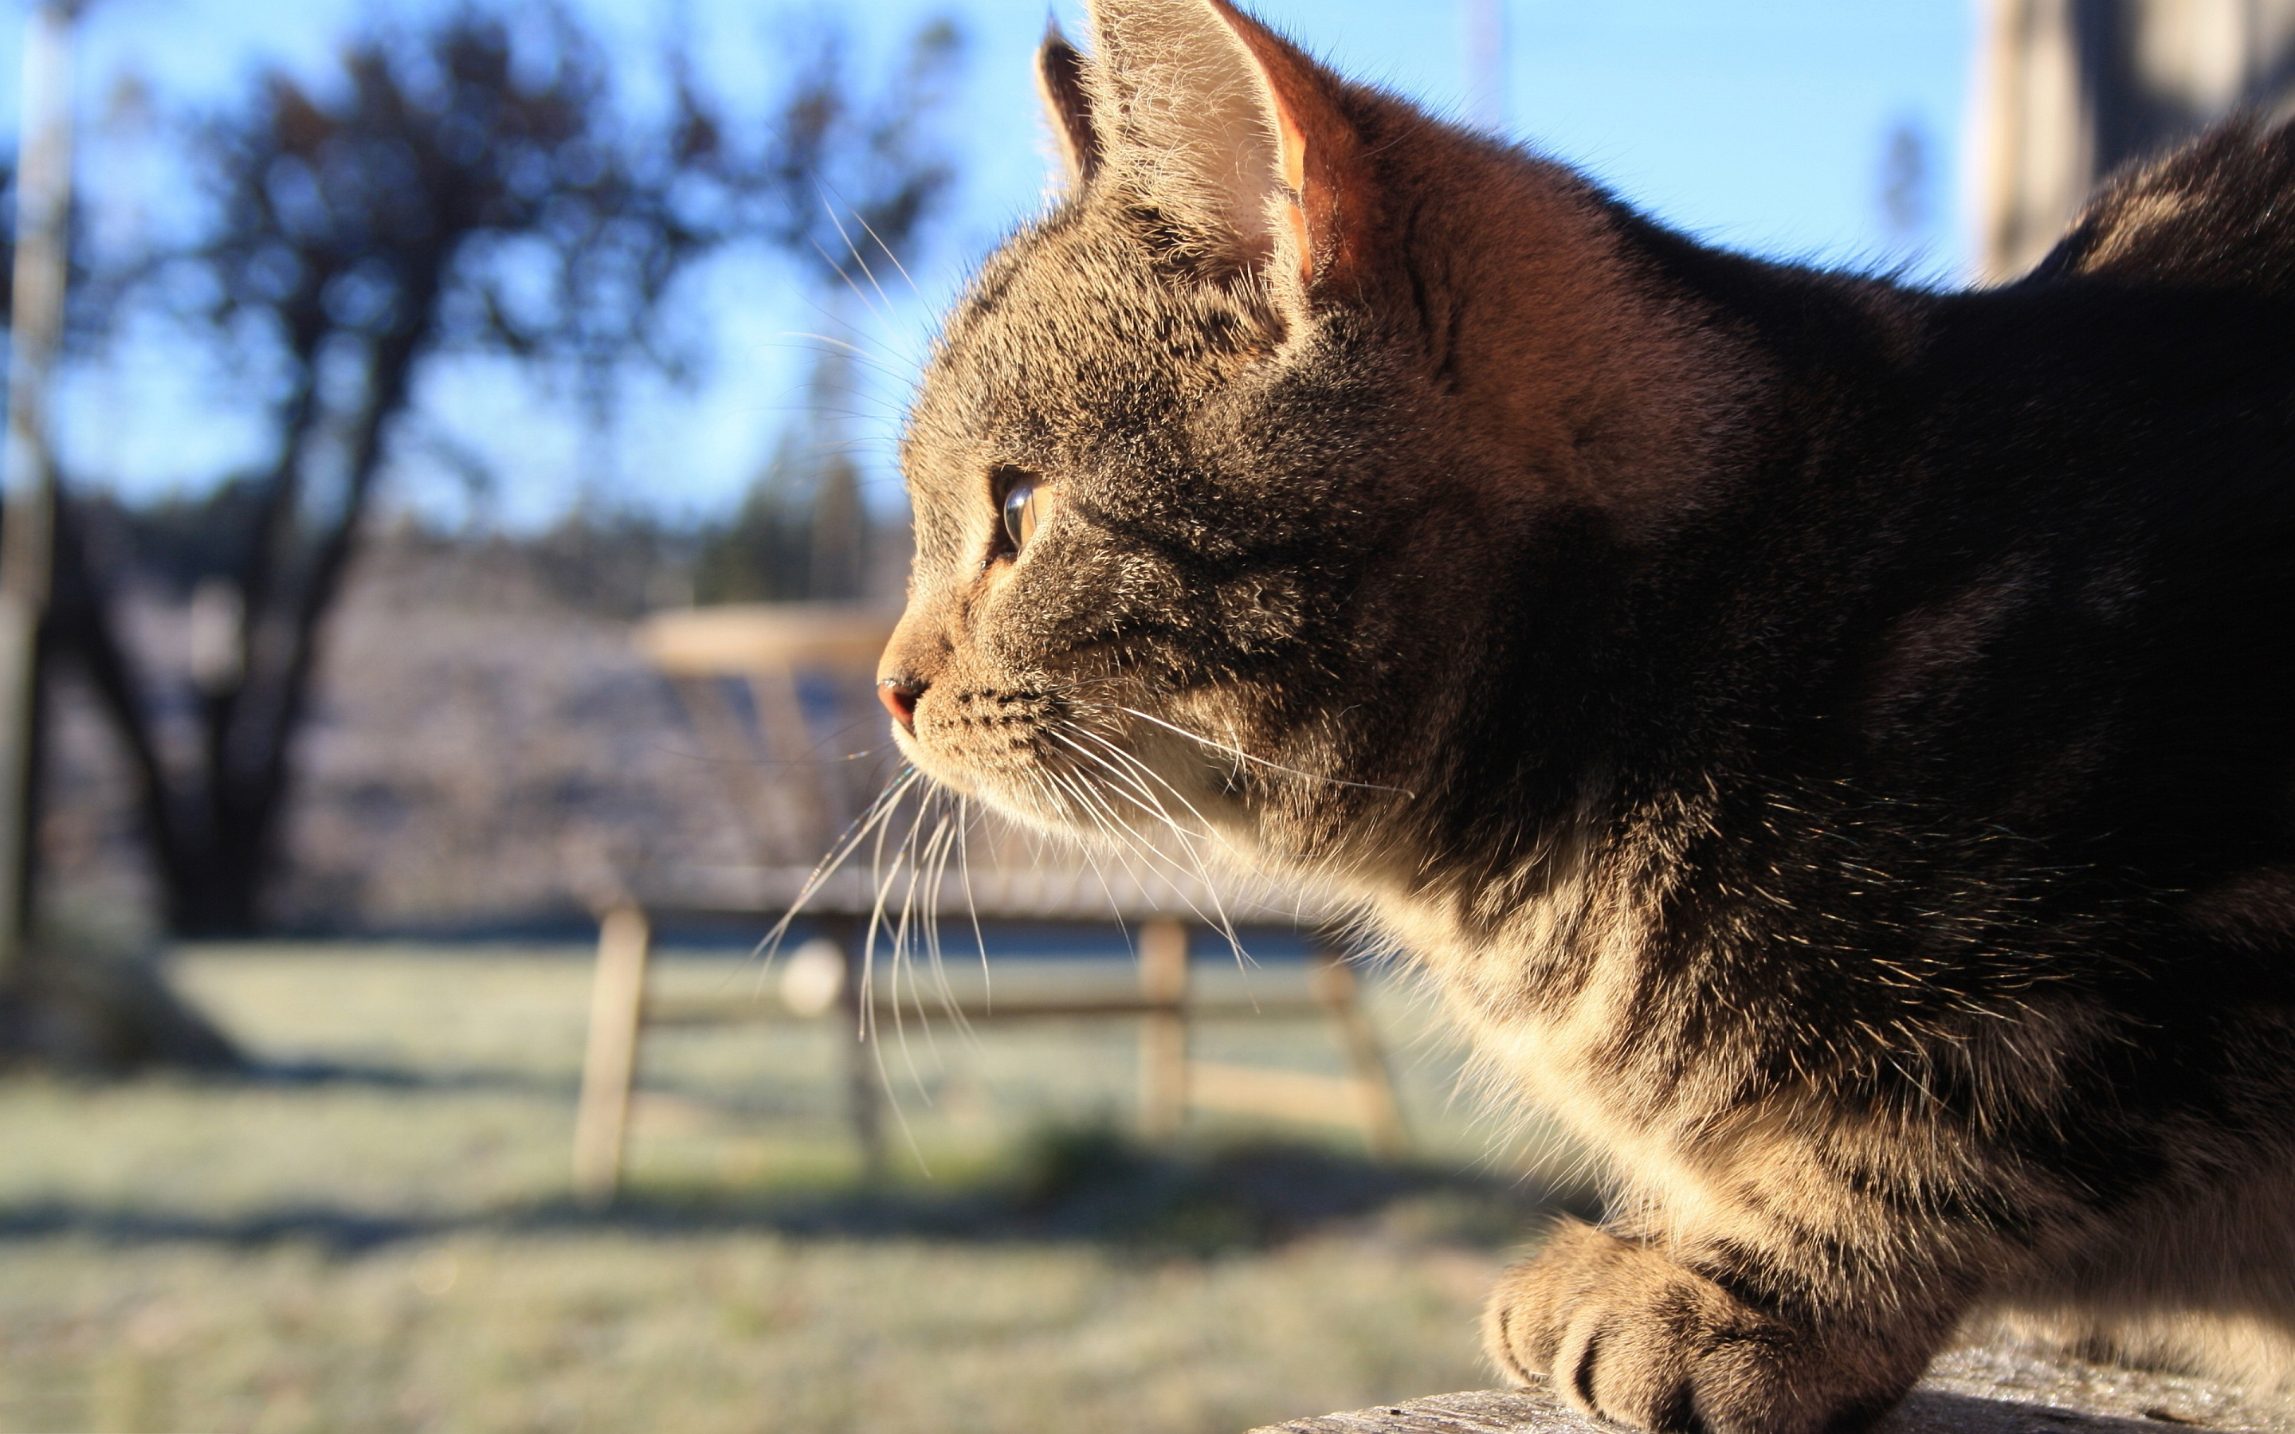
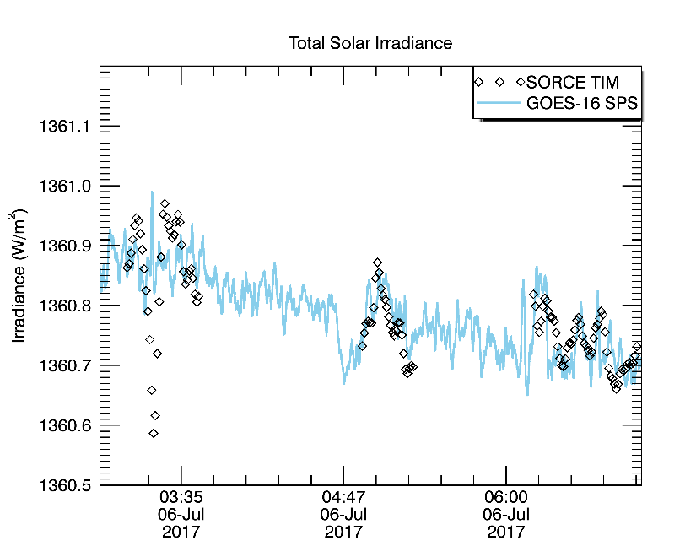
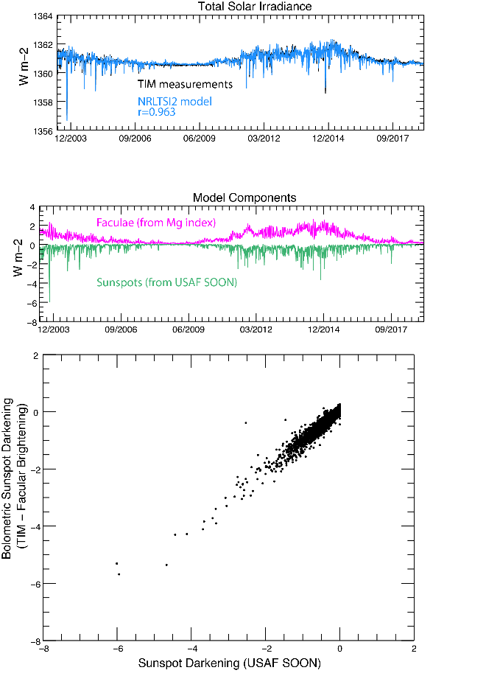
GOES High cadence operational total irradiance (GHOTI): planned data products
EGU21-10348
M. Snow, S. Béland, O. Coddington, S. Penton, D. Woodraska (SANSA & LASP) msnow@sansa.org.za
The Geostationary Operational Environmental Satellites (GOES-R)
now include the Extreme Ultra-Violet Spectrometer (EUVS). We will use two channels of the EUVS, the solar position sensor (SPS) and Magnesium II index (EUVS-C), to create two high-cadence data products.
The SPS alone will create a proxy for Total Solar Irradiance.
The SPS plus EUVS-C will create a model spectrum from the UV to the IR.
The NRLSSI/2 (Coddington et al. 2016) model uses a linear combination of the Magnesium II index and sunspot areas to create the solar irradiance spectrum from 115 nm to 100 microns. We will adapt the algorithm to use the EUVS-C measurement (cadence 3 sec), and the TSI proxy.
The SPS is a silicon diode with a broadband response to visible light. Variations in the signal are highly correlated to variations in TSI. Long-term calibration will use existing TSI composites.
Measurement cadence is 4 Hz.

