Slide 1
Retrievals of Atmospheric Carbonyl Sulfide from IASI
Michael P. Cartwright¹, Jeremy J. Harrison¹ and David P Moore¹
¹University of Leicester & National Centre for Earth Observation.
Here we present an update on advances in retrieving carbonyl sulfide total columns from the IASI instruments.
The long term outlook of this work is to provide fresh insight into carbon cycle processes driven by carbonyl sulfide.

Slide 2
Background – OCS
Carbonyl Sulfide (OCS):
Can be used as a proxy for photosynthetic uptake of carbon dioxide (CO₂) by vegetation.
Global average atmospheric mixing ratio of ~500 pptv and a negligible trend – therefore a closed budget.
Sources | Sinks
Oceanic Emission | Vegetation
Biomass Burning | Soil
Anthropogenic Emissions | Photochemical loss

Slide 3
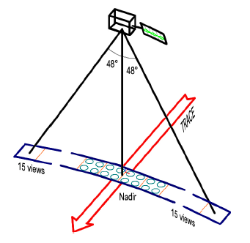
Instrumentation – IASI & ACE-FTS
Infrared Atmospheric Sounding Interferometer (IASI):
Three nadir FTS instruments onboard the MetOp satellite array.
These satellites make 1.3 million measurements per day.
Data record dating back to 2006, spanning 15 years.
Atmospheric Chemistry Experiment – FTS (ACE-FTS):
Limb sounding FTS, with approximately 98k profiles.
Profiles used to calculate an a priori profile and corresponding covariance matrix.
Figure 1. IASI Observing mode, measuring infrared radiation over 2200 km swatch width (Clerbaux et al., 2009)

Slide 4
Method – ULIRS
University of Leicester IASI Retrieval Scheme (ULIRS):
ULIRS makes use of the Optimal Estimation Method, more specifically the Levenberg-Marquardt iterative method.
The forward model used in this work to resolve the forward problem (equation below) is the RFM (Dudhia, 2016):
$$y=F\left(x, b\right)+ ϵ$$
Look up tables for the additional state vectors are used to speed up computation.

Slide 5
Method – Retrieval Setup
Retrieval Setup:
Profiles of OCS are retrieved on a 32-layer grid, equidistant in altitude for the first 31 layers (up to 31 km) – with an additional layer between 31 km and 50 km.
114 spectral channels from the IASI instrument are used in the retrieval, between 2030 cm⁻¹ and 2100 cm⁻¹ wavenumbers.
Due to contamination with several other species, we include the following additional state vectors: H₂O, CO₂, CO and O₃. Temperature is also retrieved.
A priori profiles are composed in 10° latitude bins, where we stitch a tropospheric value of 480 ppt to profiles of ACE-FTS above the tropopause.

Slide 6
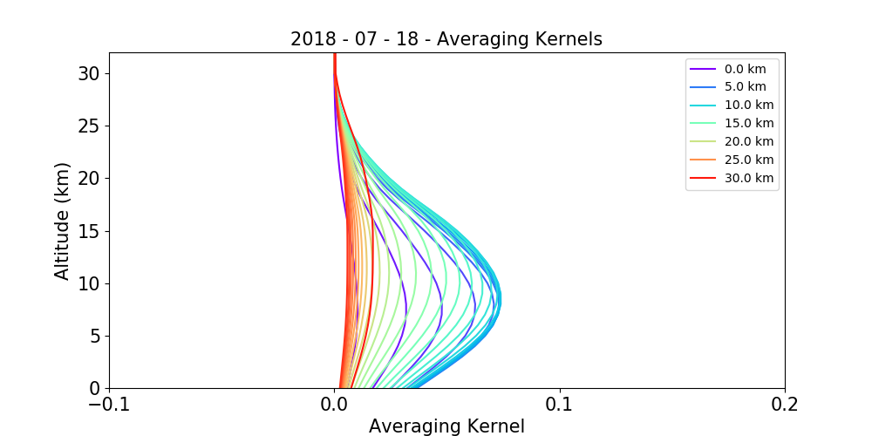
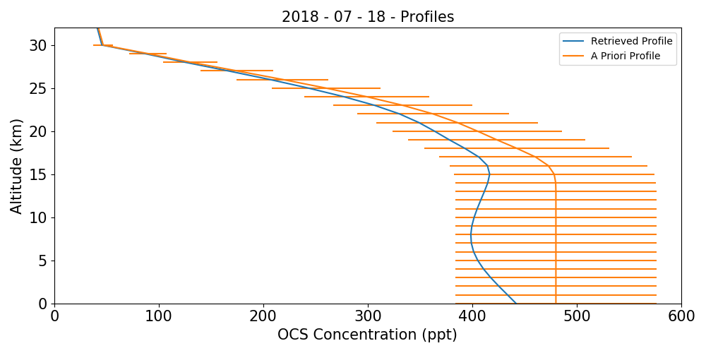
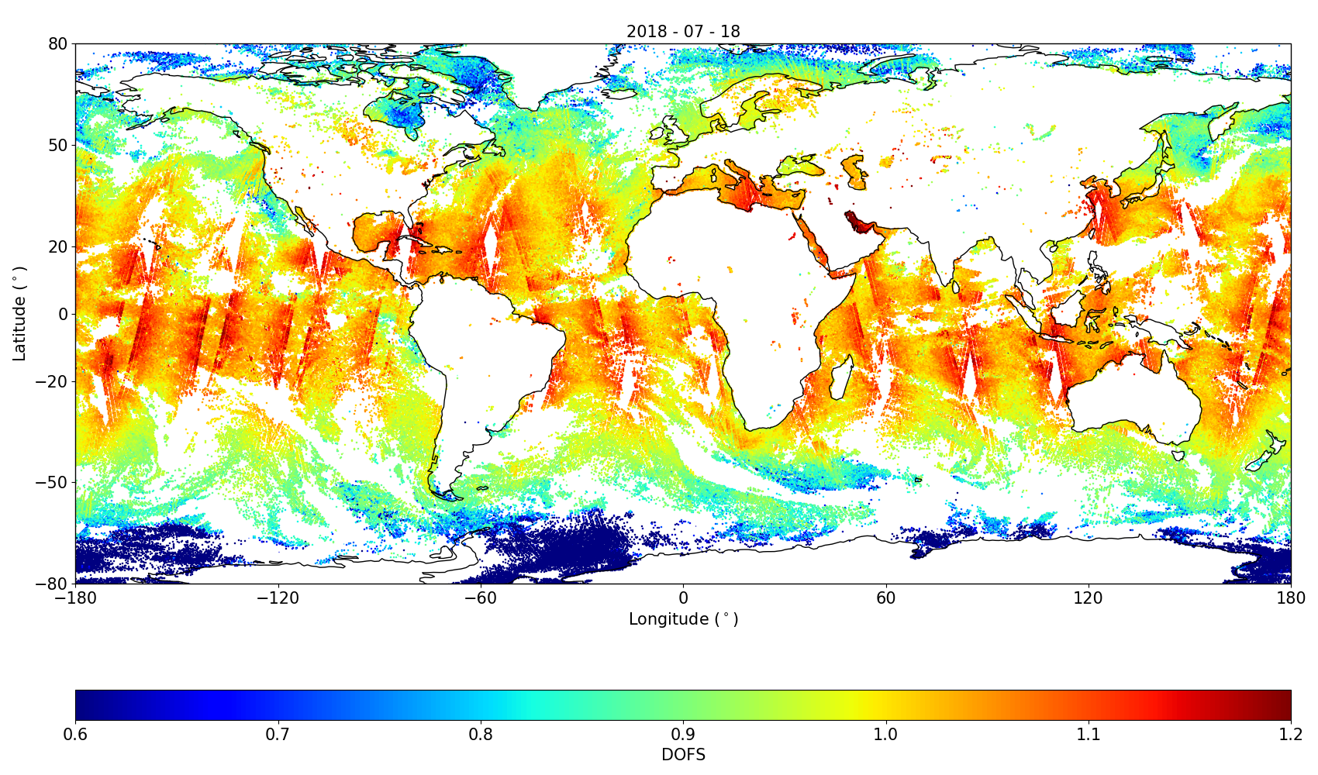
Results – Profiles and Sensitivity
Profiles:
A priori covariance constrains the retrieved profiles to within 40% of the a priori.
Averaging Kernels:
Averaging kernels peak around 10 km.
Oceanic retrievals show a DOFs globally of between 0.9 and 1.1.
Figure 2. Averaging kernels for a Central Pacific ocean pixel: 1.99S and 140.93W.
Figure 3. A profile and retrieved profile for a Central Pacific ocean pixel: 1.99S and 140.93W.
Figure 4. Degrees of Freedom over oceans. For 18th July 2018.

Slide 7
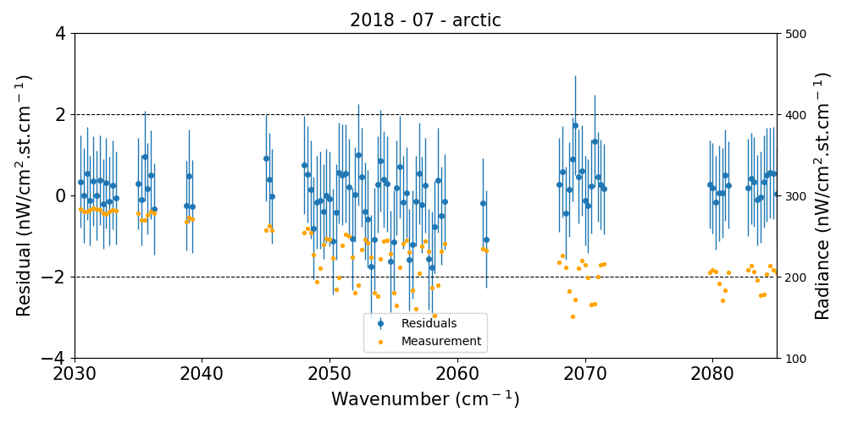
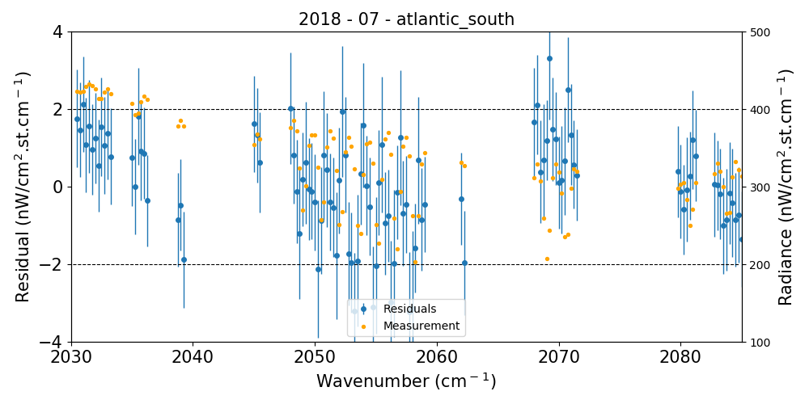
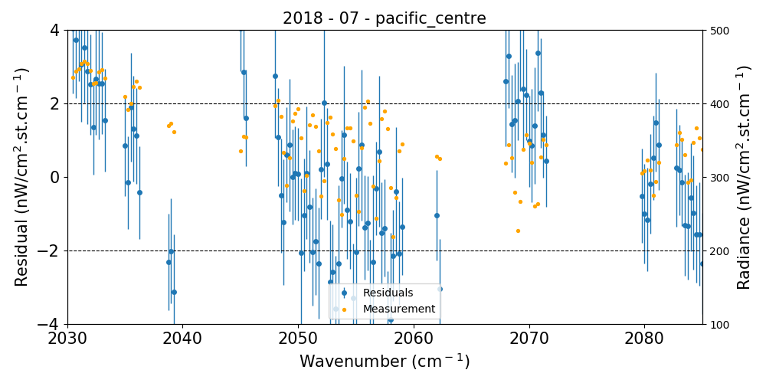
Results – Measurement, Model and Residual Spectra
Spectra:
Residual spectra of the residuals generally sits within the 2 nW noise limit of the IASI instruments.
Some spatial variation in how well they fit, with the region in the central Pacific deviating out at several of the spectral points.
Figure 4. Measurement (yellow) and residual spectra (blue) for retrievals in 3 oceanic regions, the arctic, central Pacific and Southern Atlantic. These are averaged residuals for several hundred pixels and the error bars represent the standard deviation.

Slide 8
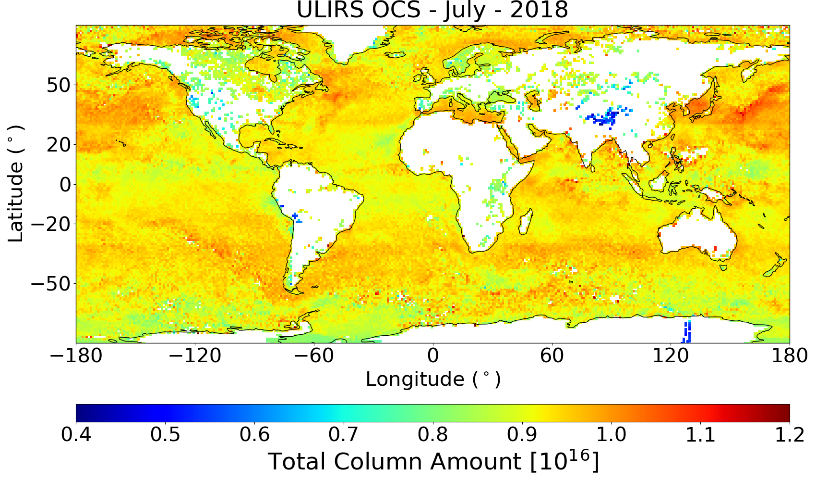
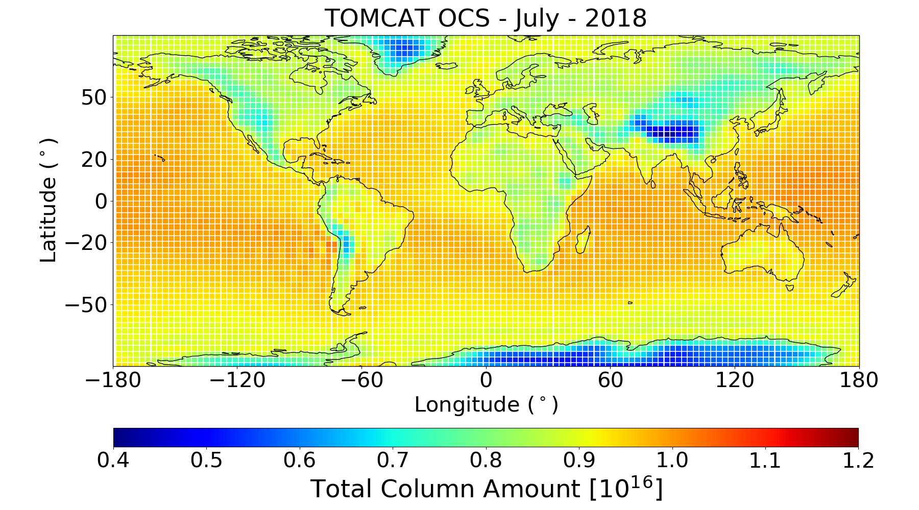
Results – Total Columns
Total Columns:
Retrieved total columns of OCS for a 5-day period in July 2018 underestimate global modelled OCS from TOMCAT.
Figure 5. Retrieved total column amounts for a 5-day period in July 2018 (15th – 19th). Units: Molecules/cm2
Figure 6. Modelled monthly mean total column amounts from TOMCAT for July 2018. Units: Molecules/cm2

Slide 9
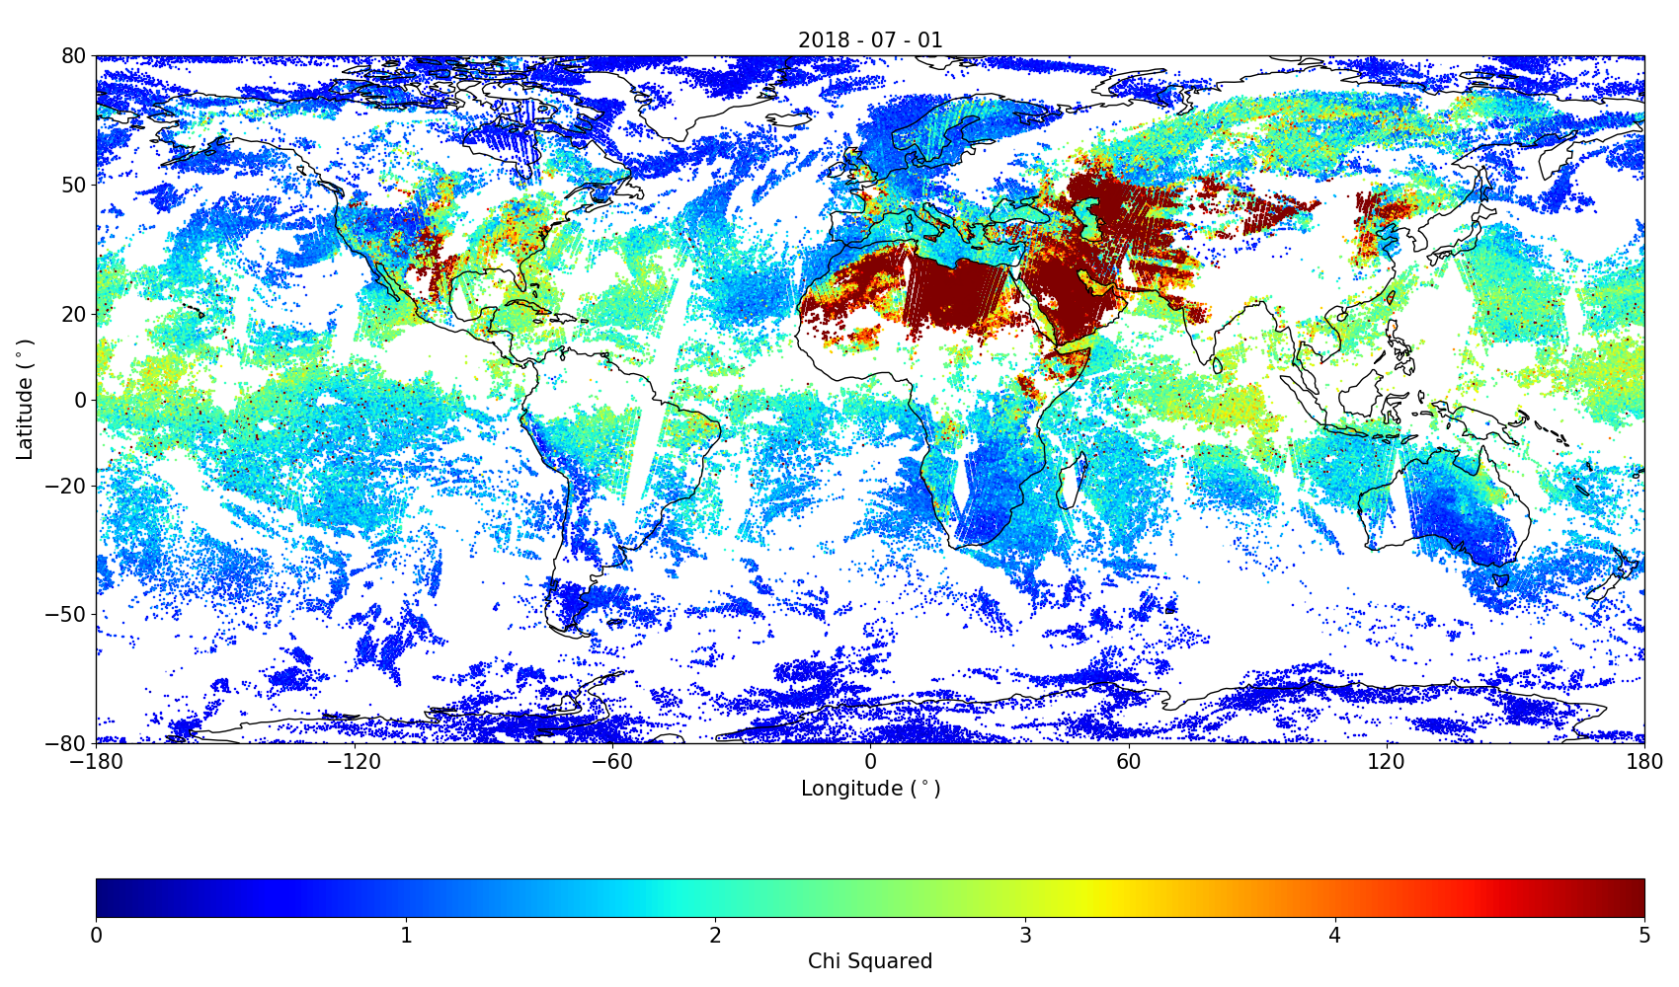
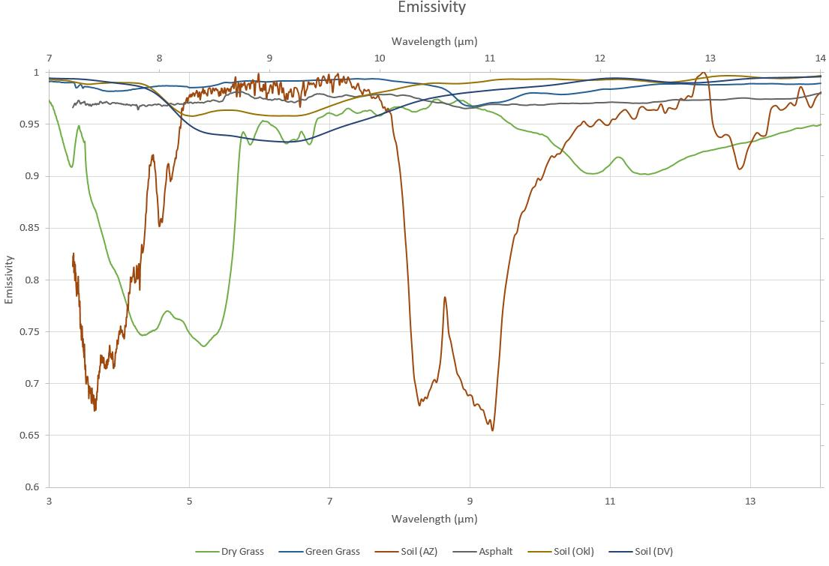
Results – Land Retrievals
Land Retrievals:
Large chi-square values suggest an unreliable measurement over desert and bare soil regions.
Emissivity properties over these regions show a steep gradient around the retrieal window around 2000 cm⁻¹ wavenumbers or 5 µm.
Figure 6. Chi-square values for global retrievals on 1st July 2018.
Figure 7. Emissivity for different land types. Note the difference in gradients around 5 µm.

Slide 10
Outlook
Conclusions:
Testing is reaching a conclusion and a good retrieval setup has been achieved.
Still a small amount of work to do to resolve some issues over ocean regions.
Land retrievals are significantly more complex, with some provision required in how emissivity is handled in the retrieval.
Outlook:
Make retrievals for an extended period in 2018.
Validate against available surface, aircraft and satellite data.
Use this to draw conclusions on the spatial distribution and magnitude of OCS fluxes.

Slide 11
References
Clerbaux, C., Boynard, A., Clarisse, L., George, M., Hadji-Lazaro, J., Herbin, H., Hurtmans, D., Pommier, M., Razavi, A., Turquety, S., Wespes, C., 2009. Monitoring of atmospheric composition using the thermal infrared IASI/MetOp sounder. Atmos. Chem. Phys. 9, 6041–6054. https://doi.org/10.5194/acp-9-6041-2009
Dudhia, A., 2016. The Reference Forward Model (RFM). J. Quant. Spectrosc. Radiat. Transfer 186, 243–253. https://doi.org/10.1016/j.jqsrt.2016.06.018

