Slide 1
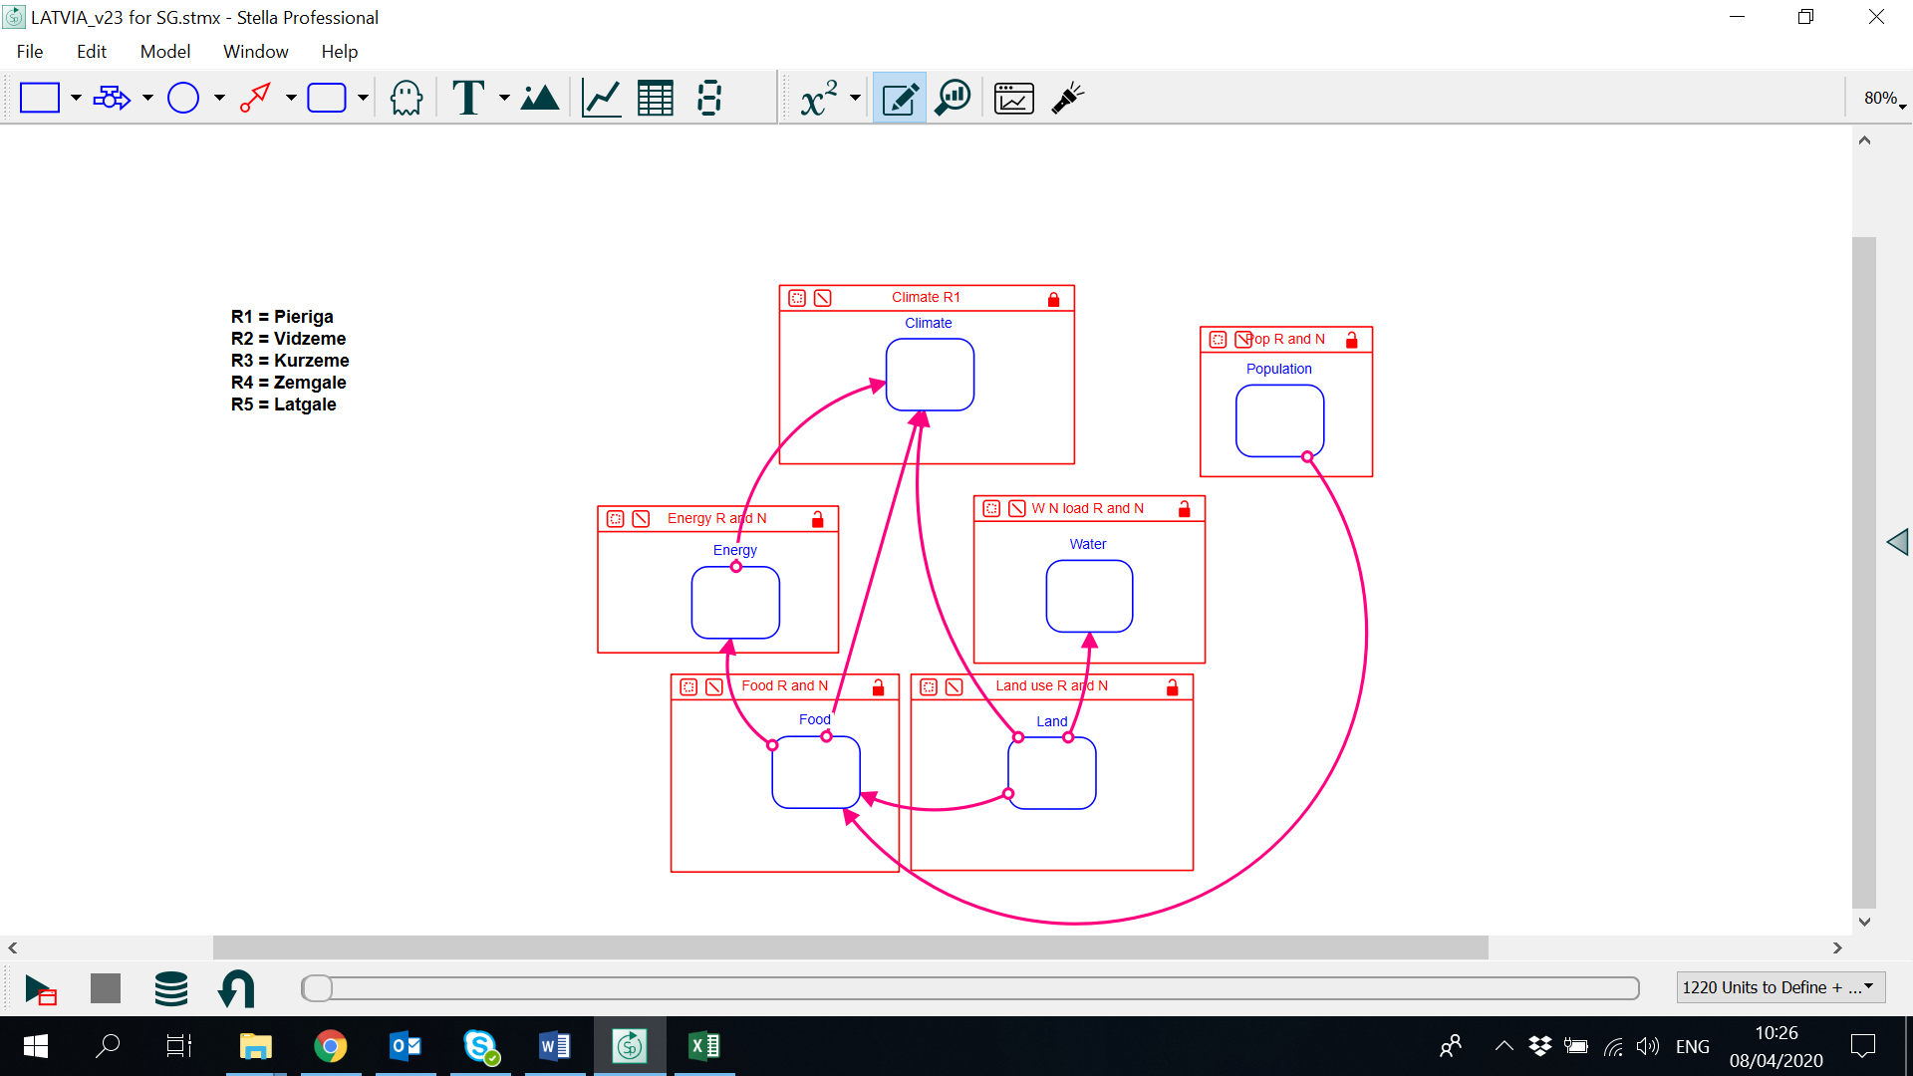
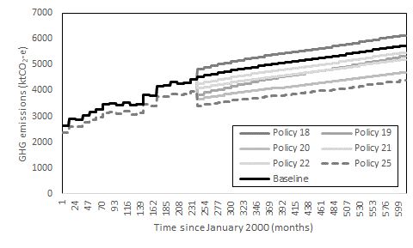
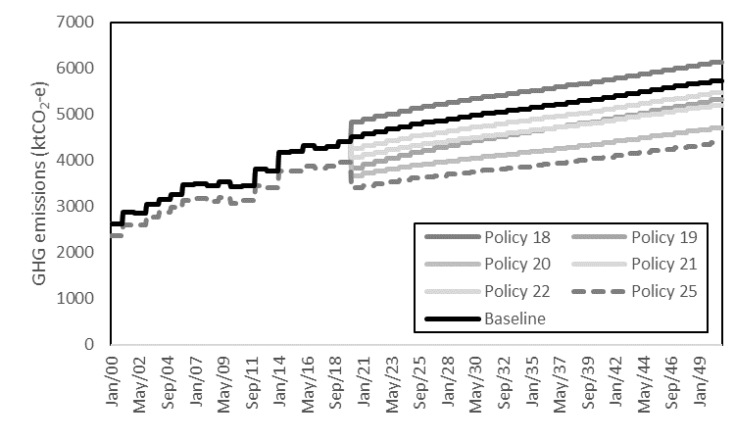
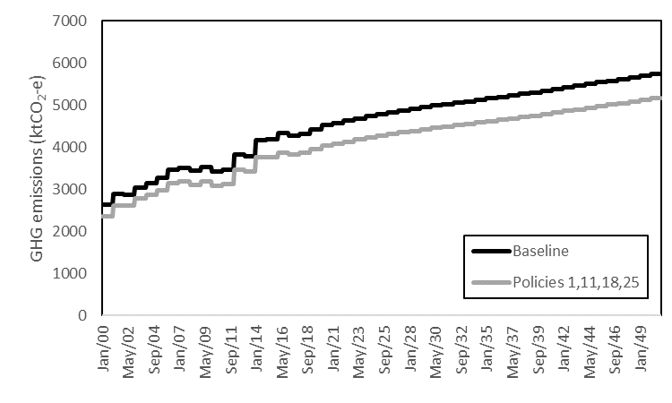
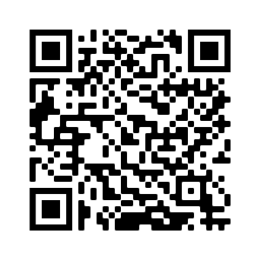
SYSTEM DYNAMICS MODELLING OF THE WEF NEXUS IN LATVIA
Janez Sušnik¹, Sara Masia¹, Daina Indriksone², Ingrida Bremere², Lydia Vamvakeridou-Lyroudia^{3,4}
¹ IHE Delft Institute for Water Education, The Netherlands; j.susnik@un-ihe.org; @JanezSusnik
² Baltic Environmental Forum Latvia, Latvia
³ KWR Water Research Institute, The Netherlands
⁴ Centre for Water Systems, University of Exeter, UK
A complex SDM assesses WEF-nexus response to policies in Latvia
Developed with local experts
Critical to understand WEF nexus response
Assessed individual policies and policy-suites
Could help policies account for other-sector impacts
System dynamics model
Nexus-relevant policy information
WEF Nexus
National policies
Policy combinations may be less effective as individual policies in reaching specific goals
Combining policies offers nexus-wide benefits
Complex policy interactions must be carefully considered
Seek for ‘least worst’ solutions
Land policies
Policy suite
Sušnik J., Masia S., Indriksone D., Brēmere I., Vamvakeridou-Lyroudia L.S. 2021. System dynamics modelling to explore the impacts of policies
on the water-energy-food-land-climate nexus in Latvia. Science of the Total Environment. 775: 145827. DOI: 10.1016/j.scitotenv.2021.145827

