Slide 1
Whodunnit? Solving the mysteries of soil phosphorus mobilisation in an ectomycorrhizal tripartite interaction

Slide 2
Forest trees are limited by phosphorus:
Locked up in unavailable forms in leaf litter
Available forms are quickly depleted
P
P
P
P
P
P
P
P
P
P

Slide 3
Forest trees are limited by phosphorus (P):
Locked up in unavailable forms in leaf litter
Available forms are quickly depleted
?
?
To acquire P, forest trees are dependent on:
Ectomycorrhizal fungi
Soil bacterial community
?

Slide 4
Experimental design:
Eucalyptus grandis
Pisolithus albus
Pisolithus microcarpus
Low nitrogen
High nitrogen
Ambient CO₂
Elevated CO₂

Slide 5
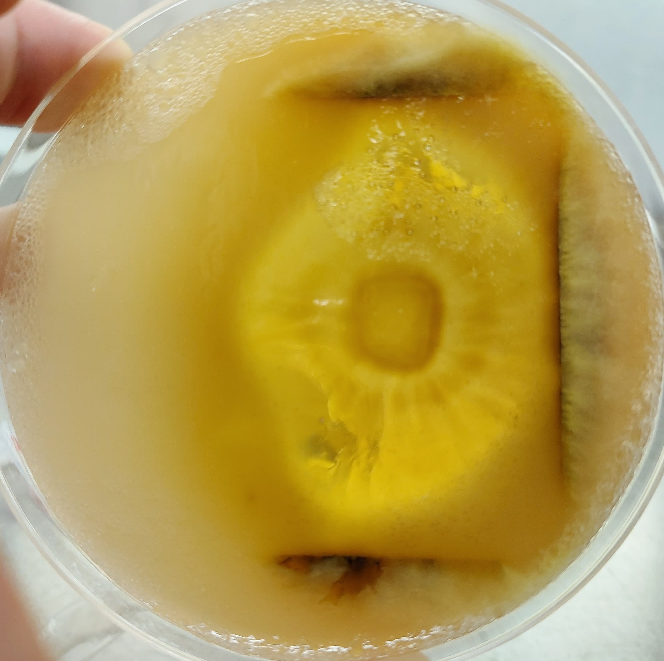
1. Variation between Pisolithus species in P mobilisation ability
5 x acid phosphatases
1 x glucose dehydrogenase
1 x acid phosphatase

Slide 6
2. Complementary roles between fungi and bacteria in P mobilisation
P. albus and
P. microcarpus
Soil bacterial community
Soil bacterial community
P. albus
Organic P mobilisation
(acid phosphatase)
Inorganic P
mobilisation
(Glucose dehydrogenase)
Organic P
mobilisation
(alkaline phosphatase)

Slide 7
3. Environmental effects on fungal and bacterial roles
High N → negative effect on bacterial acid and alkaline phosphatases I in Pisolithus-inoculated soils
→ positive effect on fungal acid phosphatase activity in P. albus-inoculated soils
Elevated CO₂ → positive effect on bacterial alkaline phosphatase in Pisolithus-inoculated soils increased

