Slide 1

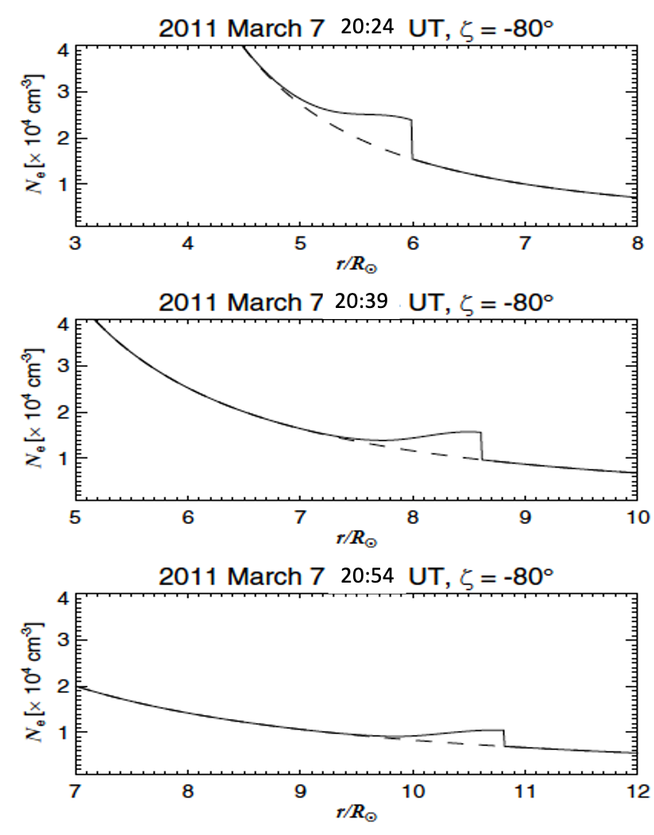
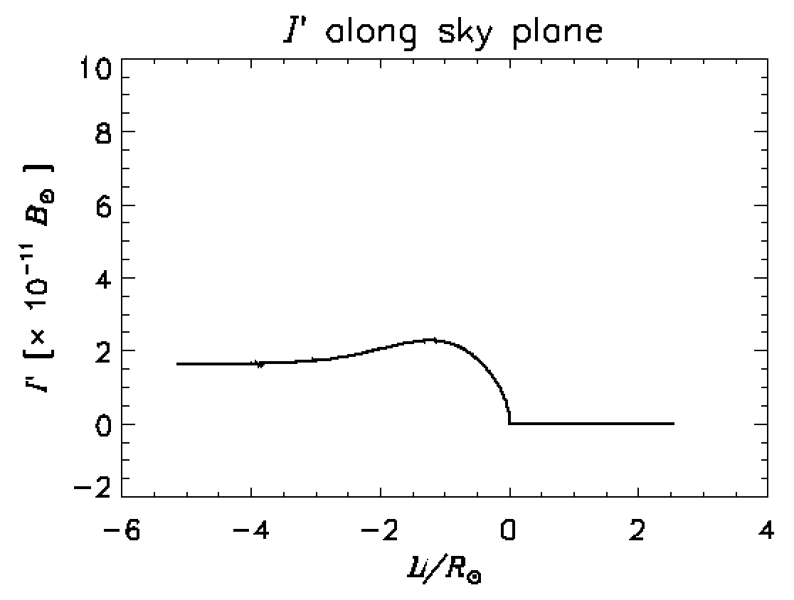
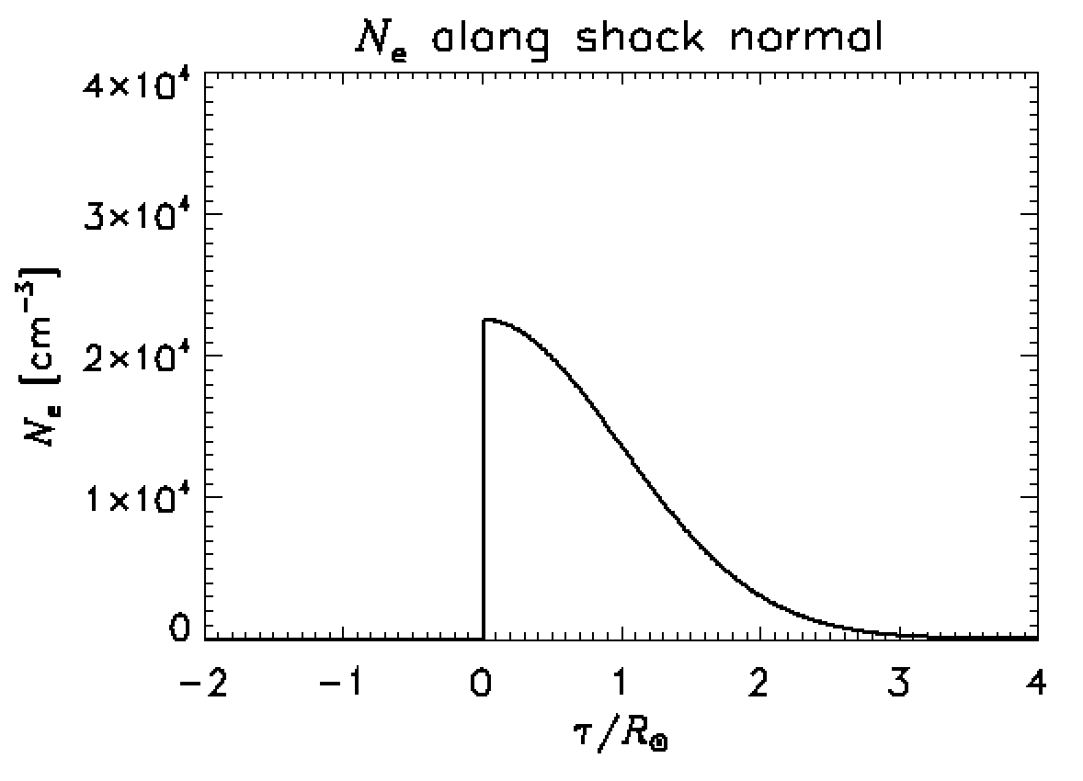
EGU21-10578: vPICO presentation at the EGU General Assembly 2021 in session ST1.1 - 'Open Session on the Sun and Heliosphere’
Title: The three-dimensional density compression ratio of shock fronts observed as halo coronal mass ejections
Ryun Young Kwon, Korea Astronomy and Space Science Institute
Figure 1 Where is the shock front on the image?
Figure 3 Temporal evolution of an electron density profile along the 3D shock normal.
Figure 2 Model fittings to the observed brightness profiles.
Figure 3 Determined density compression ratio.
This talk is based on a published paper, Kwon and Vourlidas 2018, JSWSC, 8, 8

Slide 2
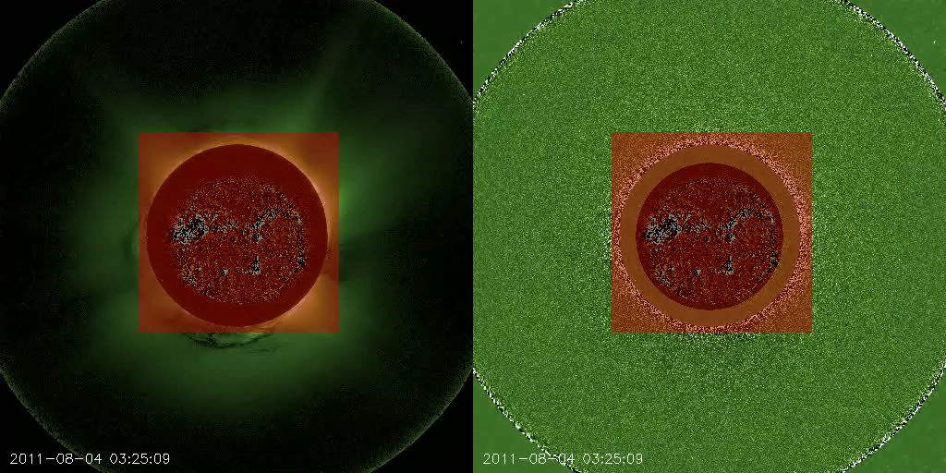
Fast mode wave in imaging observations?
Kwon+(2013)
“Amber waves of grain” Sheeley+(2000)

Slide 3
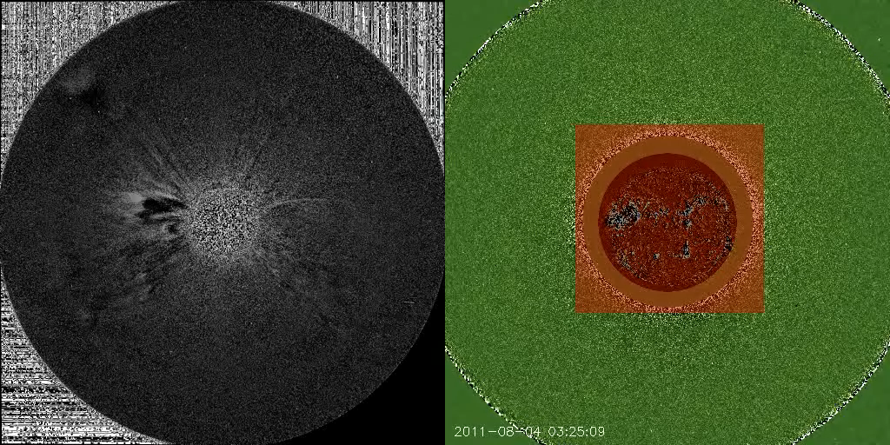
Halo CMEs

Slide 4
Halo CMEs
Kwon et al. 2015

Slide 5
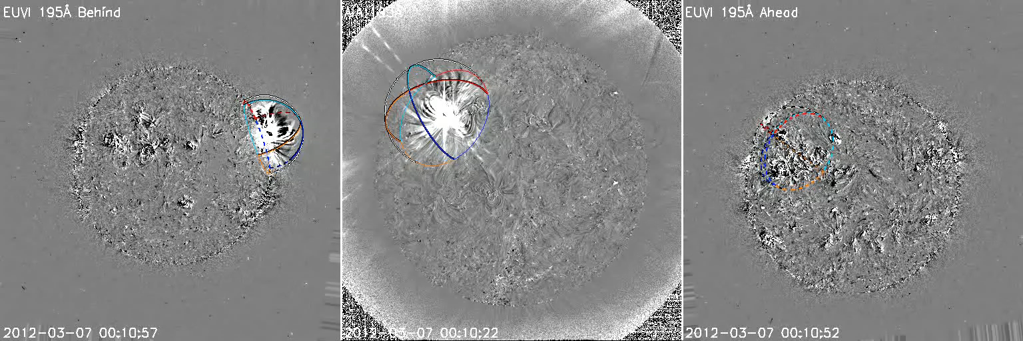
EUV waves:
The footpoints of halo fronts

Slide 6
Where are the halo fronts?
“Amber waves of grain”, “spheres of influence” Sheeley et al. (2000)
”Circumsolar shock” Cliver et al. (1995)
“Moving on the plane of the sky” Lara+(2006)
Halo
Non-halo
Halo

Slide 7
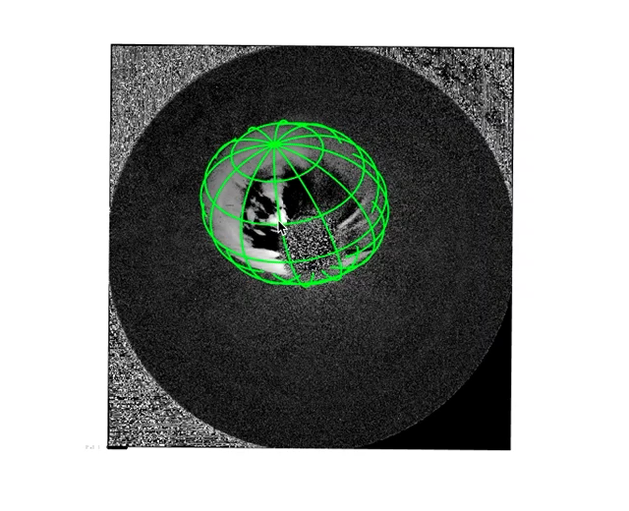
Known 3D geometry of shock waves

Slide 9
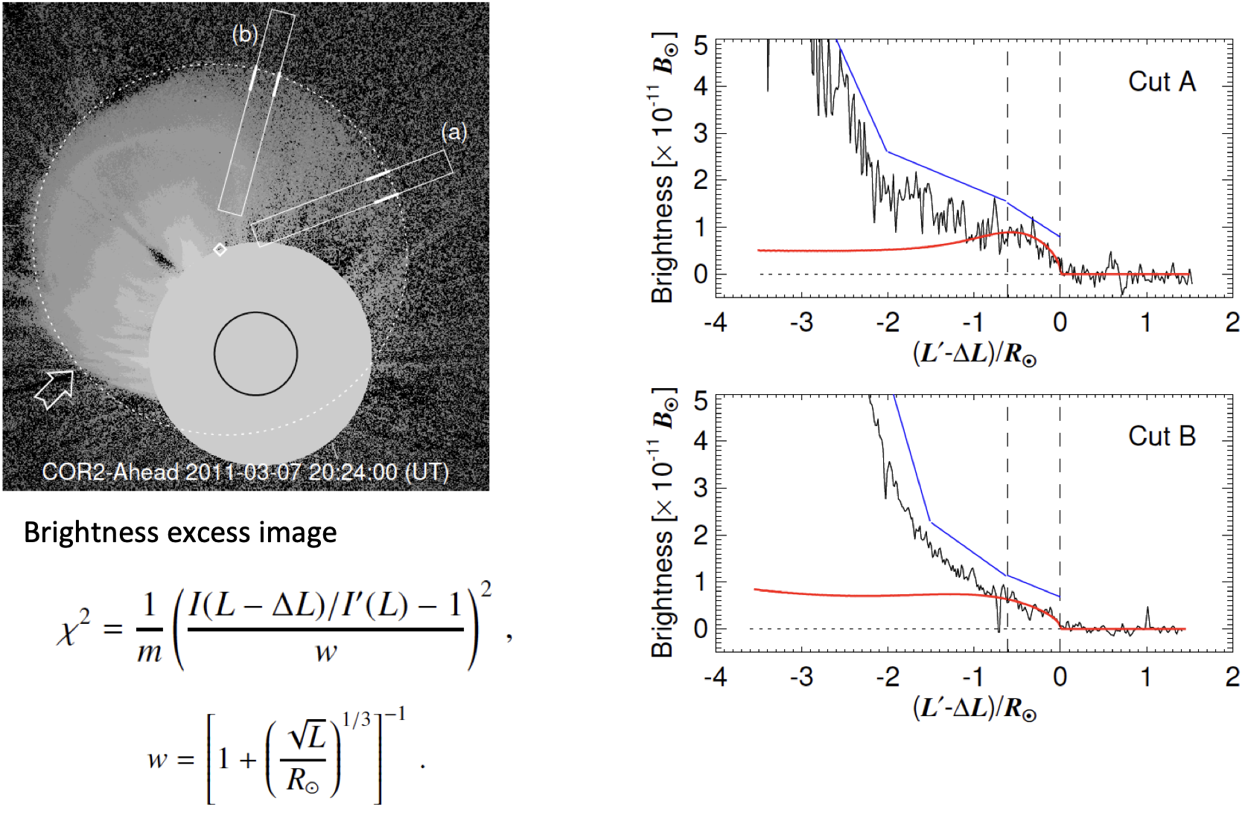
Fitting

Slide 10
Density excess

Slide 11
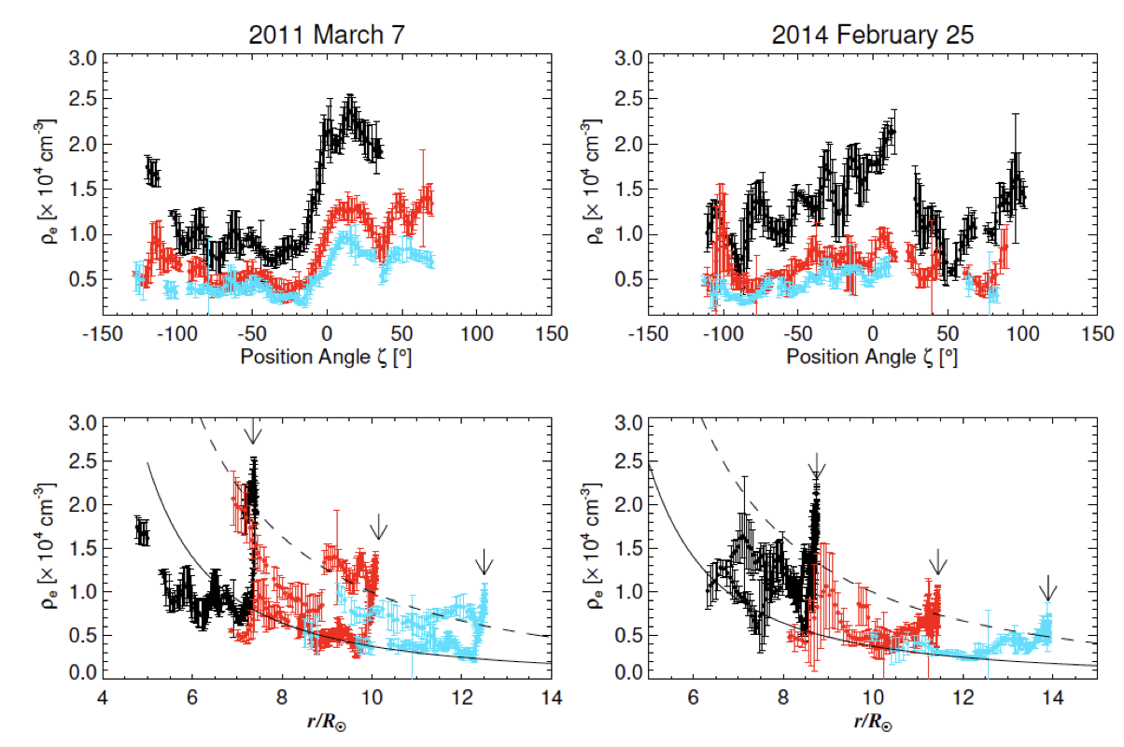
Density excess

Slide 12
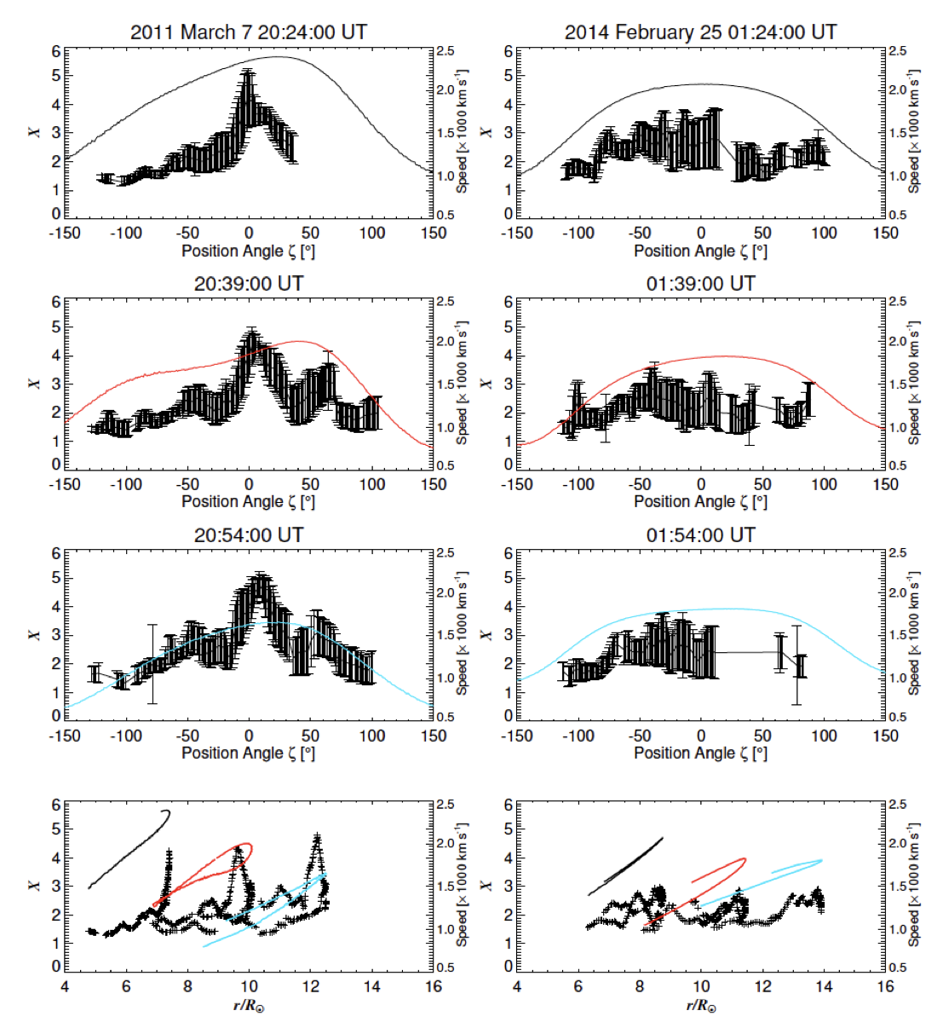
Density compression ratios

Slide 13
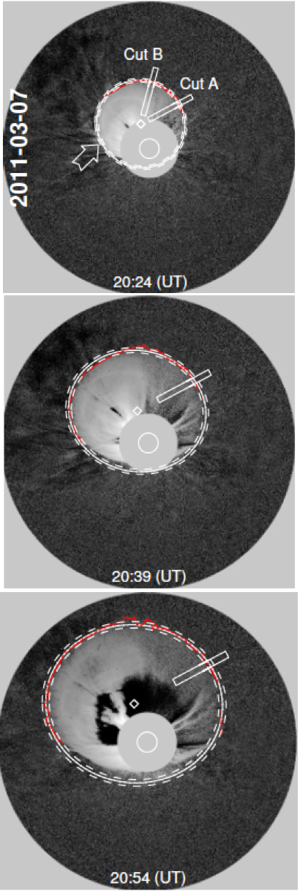
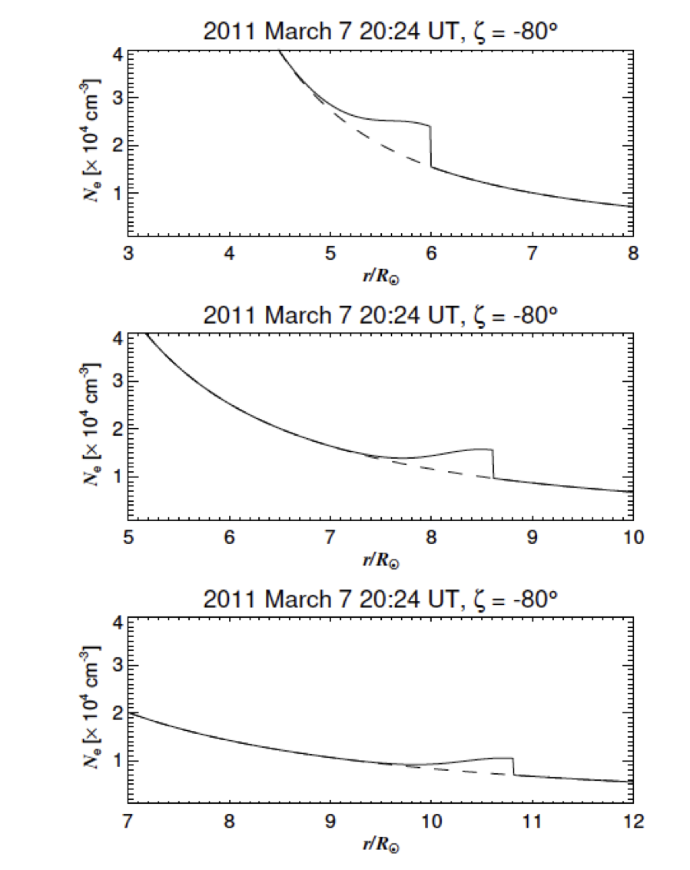
Density excess vs.
Upstream density

Slide 14
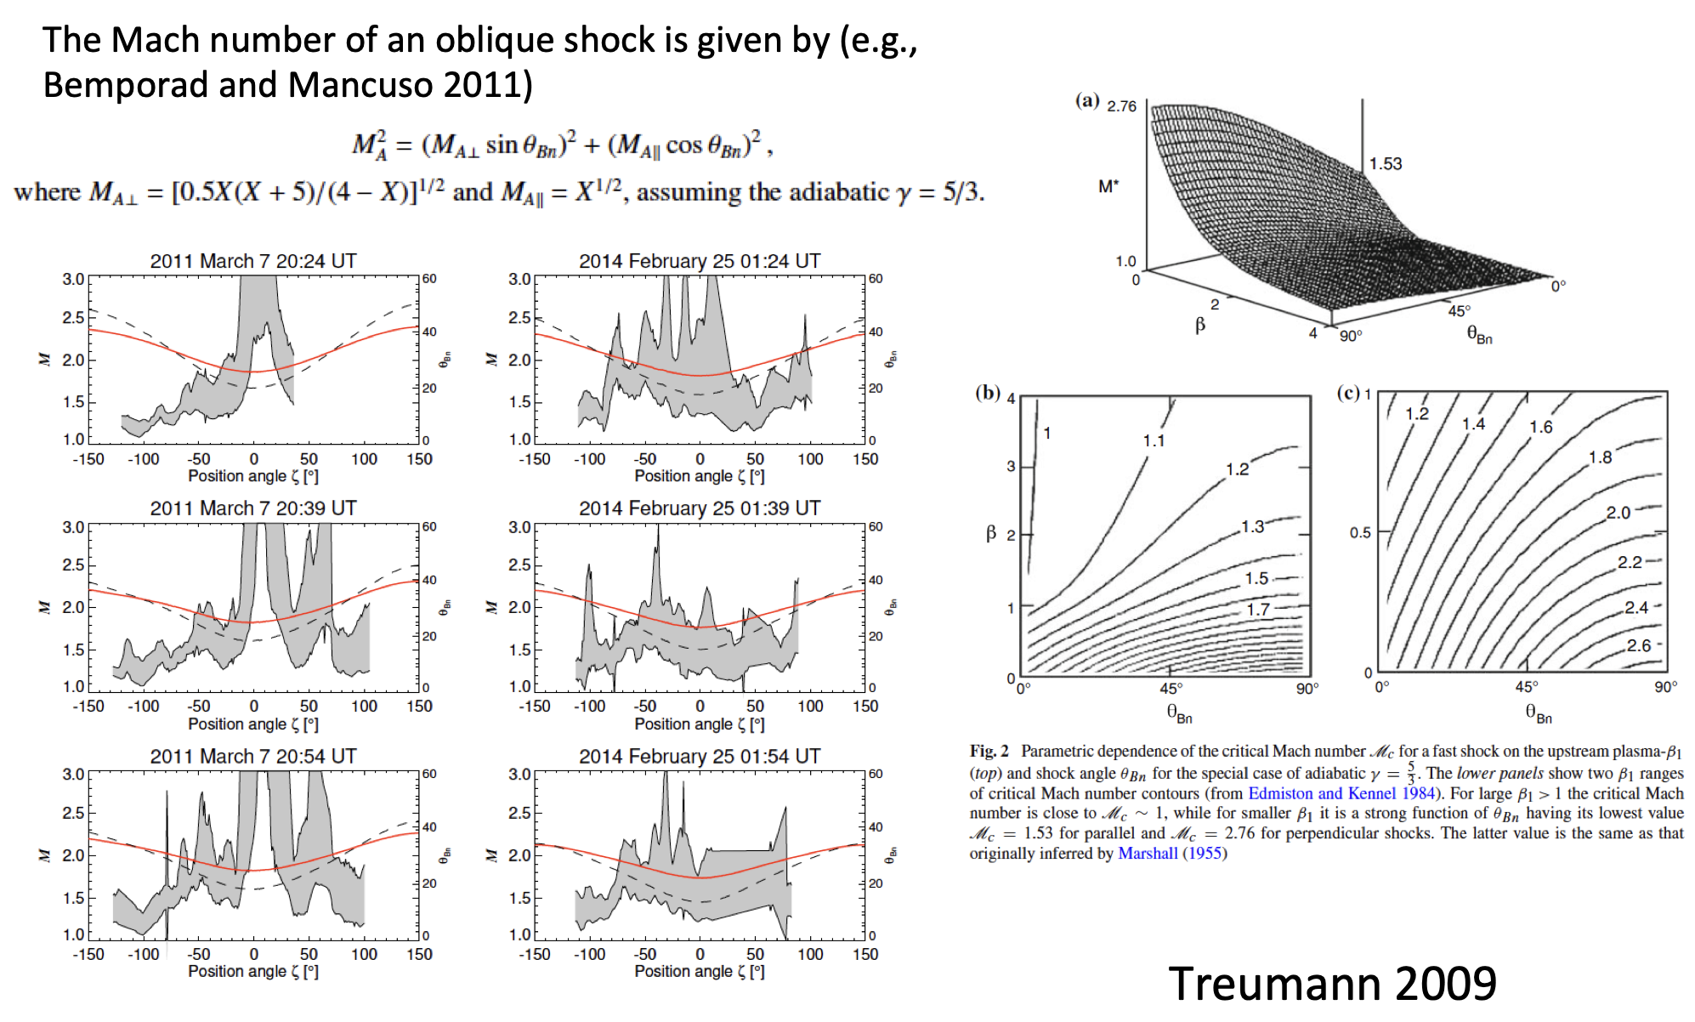
Mach numbers

Slide 15
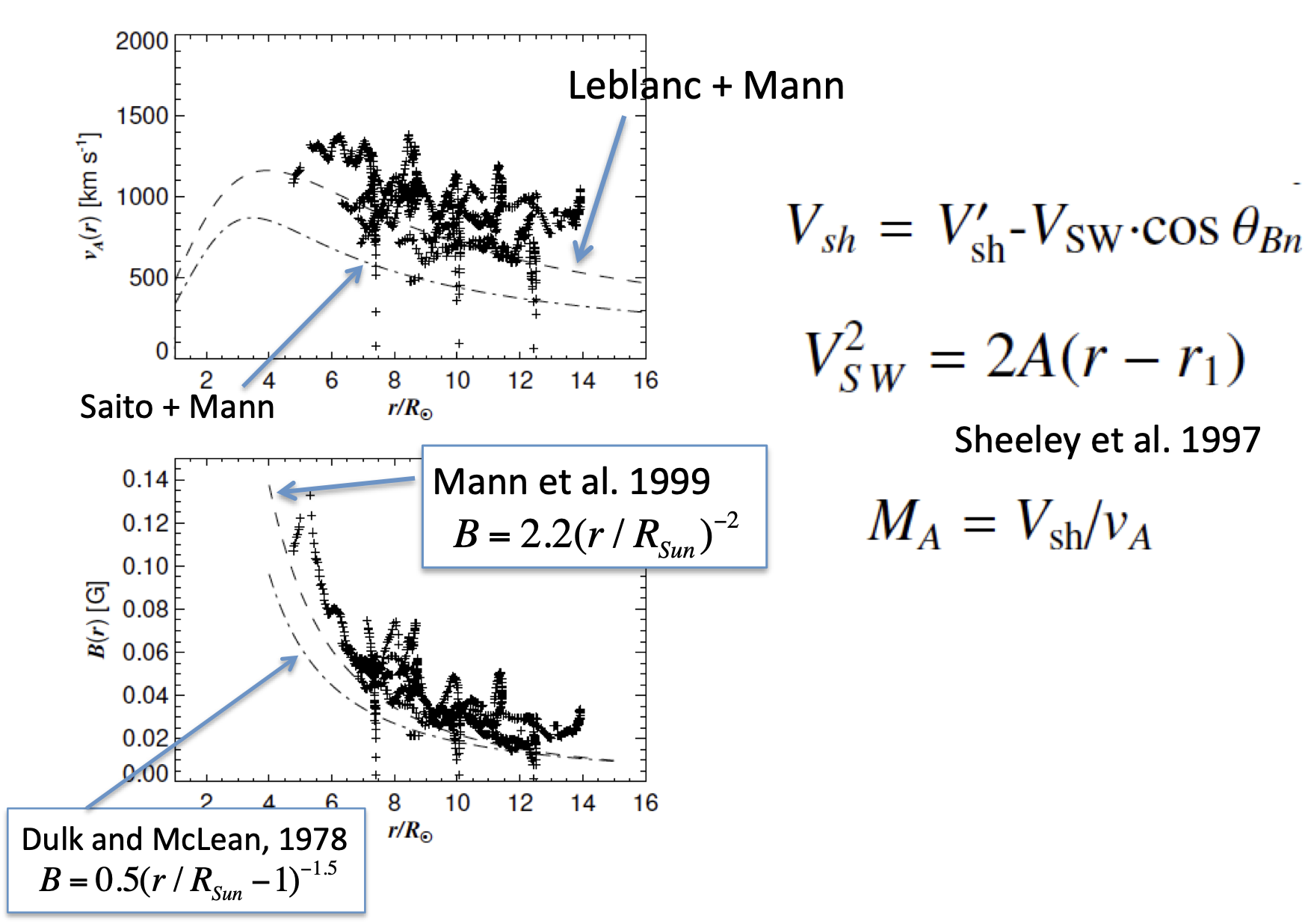
Coronal Seismology

