Slide 1
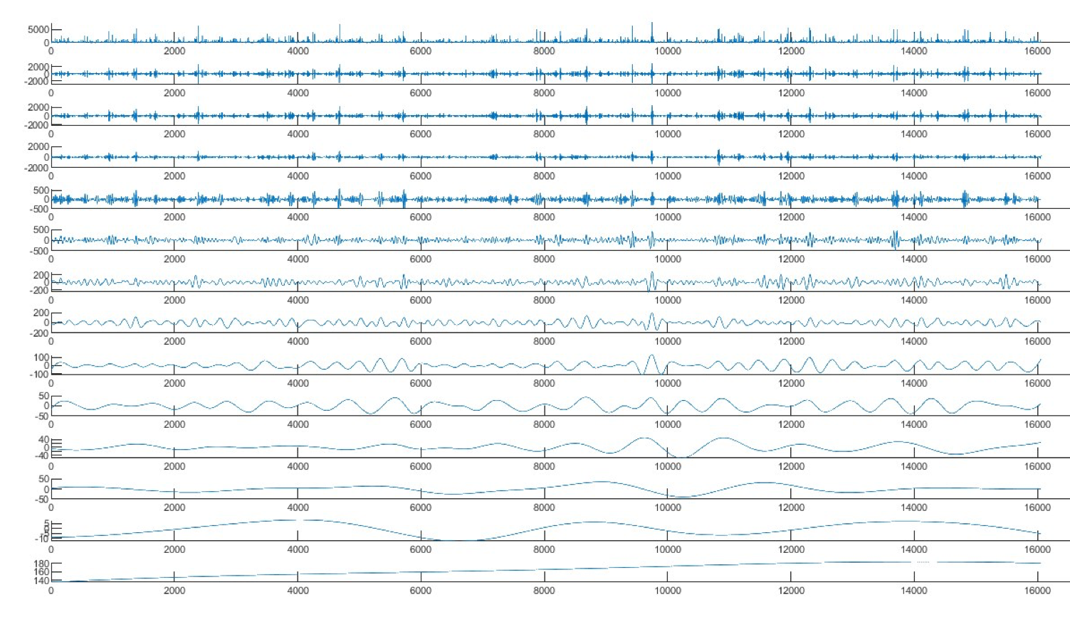




Spatiotemporal Trend and Variability of Precipitation in Taiwan Based on Multi-dimensional Complementary Ensemble Empirical Mode Decomposition (MCEEMD)
Chun-Hsiang Tang¹ and Christina W. Tsai²
¹ Graduate Student, Department of Civil Engineering, National Taiwan University, Taipei, Taiwan (r08521316@ntu.edu.tw)
²Professor, Department of Civil Engineering, National Taiwan University, Taipei, Taiwan (cwstsai@ntu.edu.tw)

Slide 2
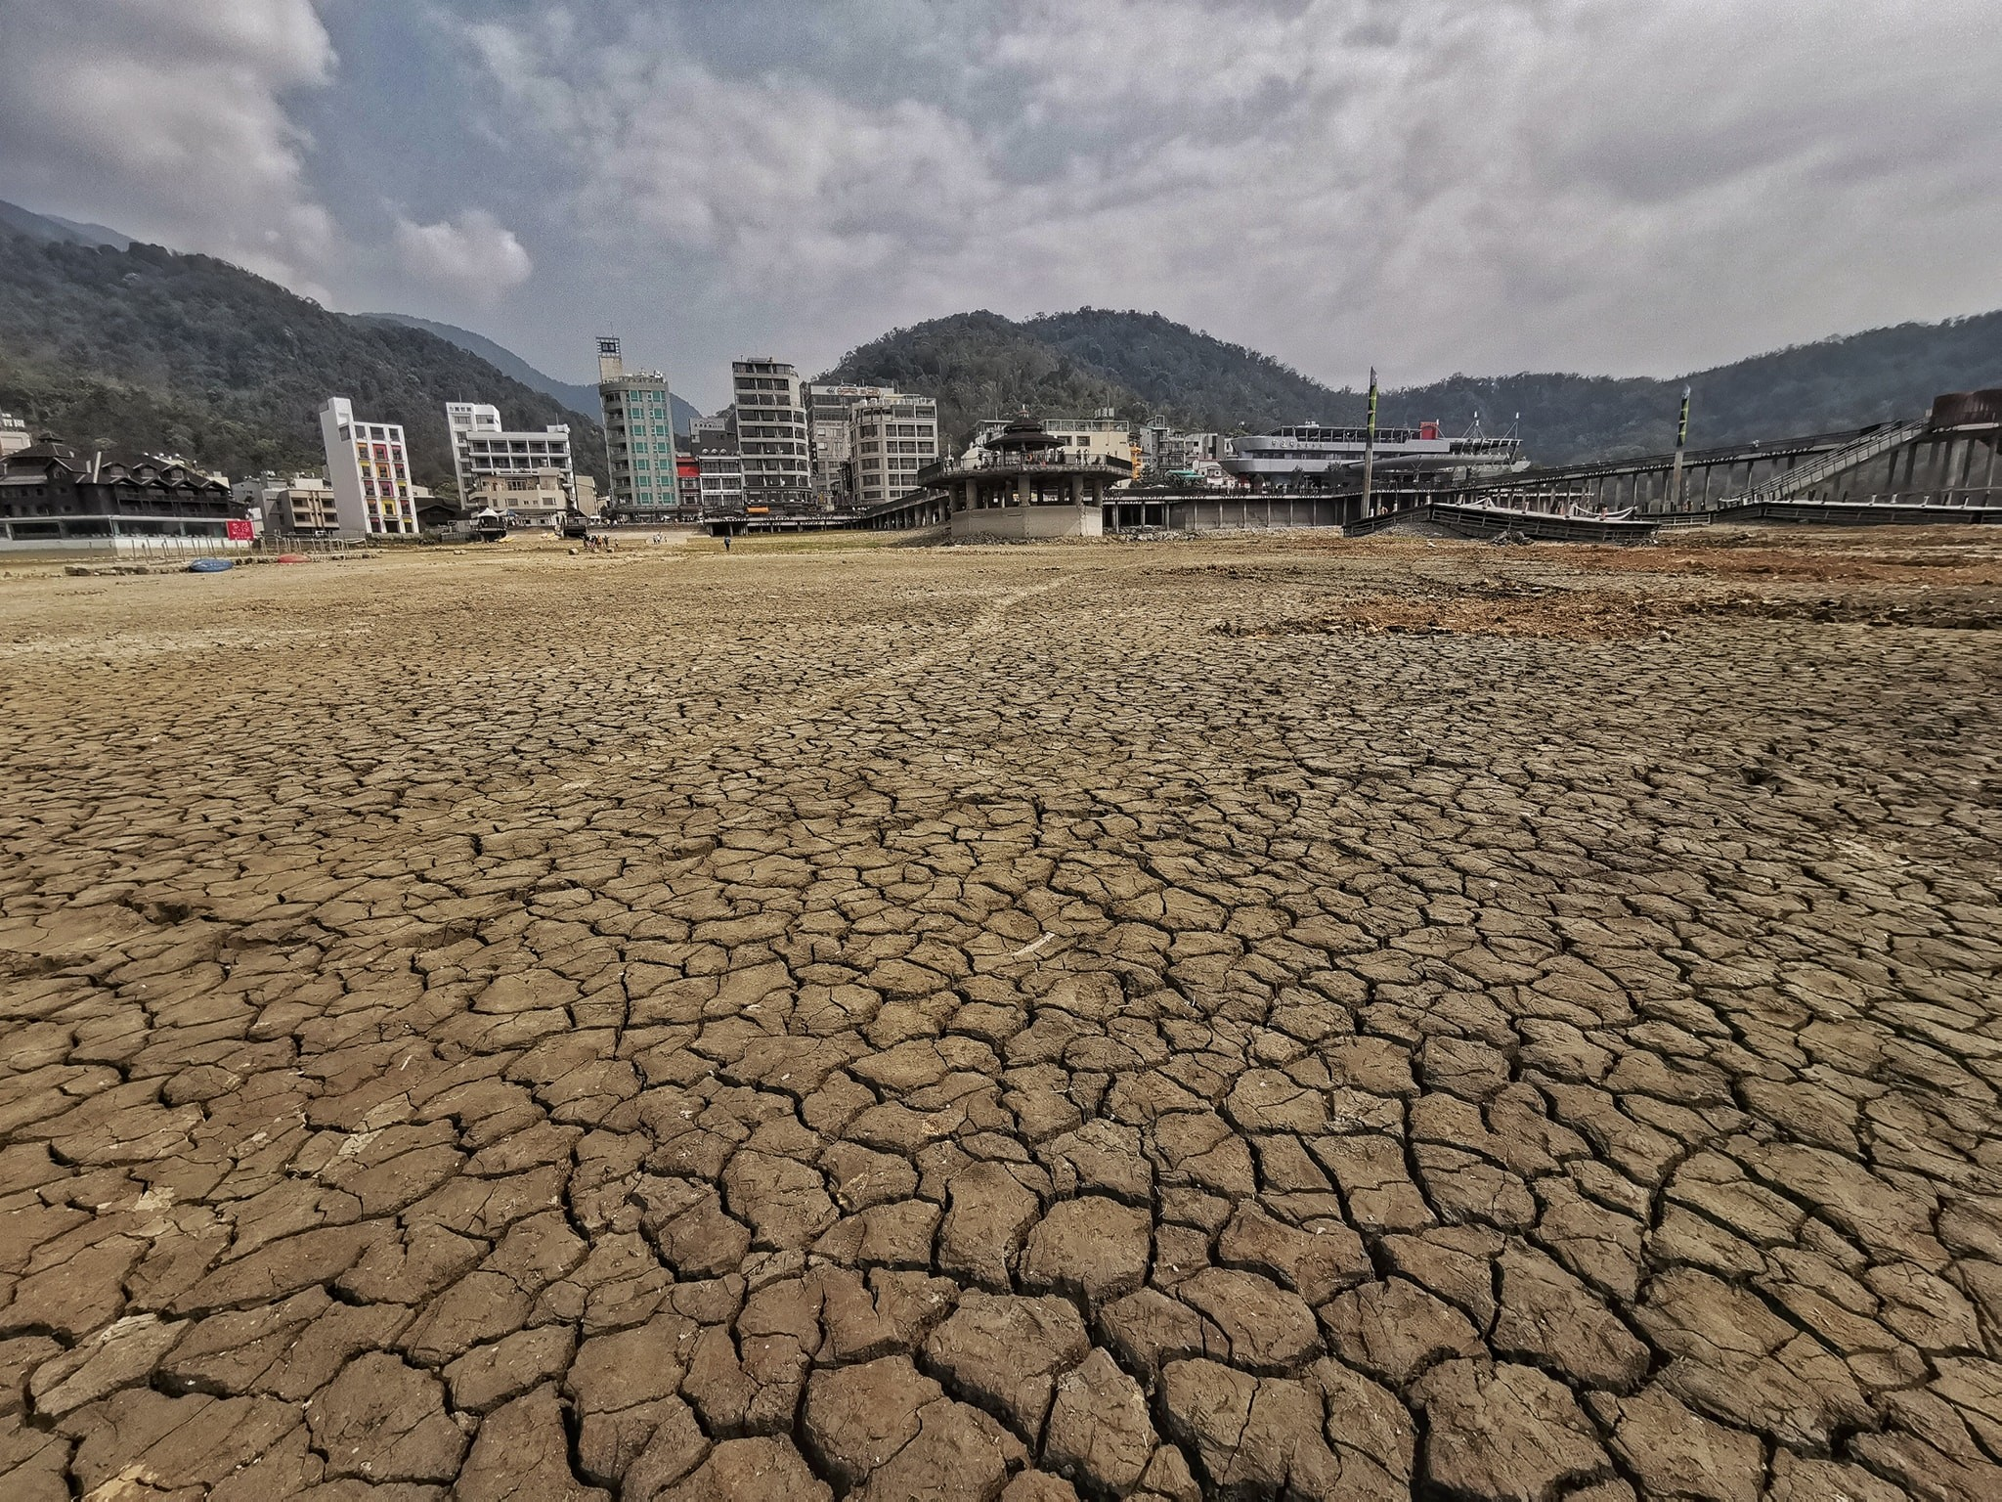
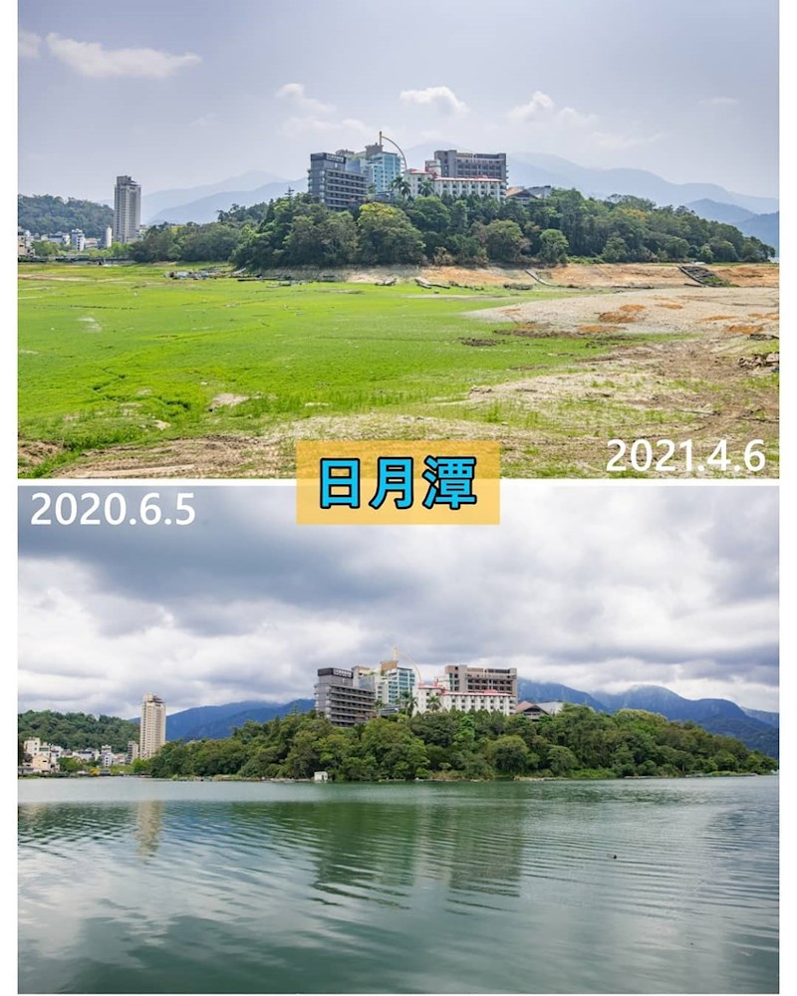
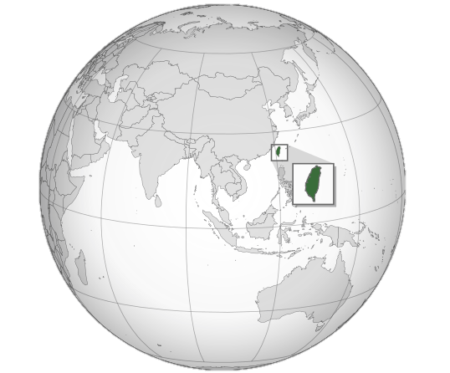
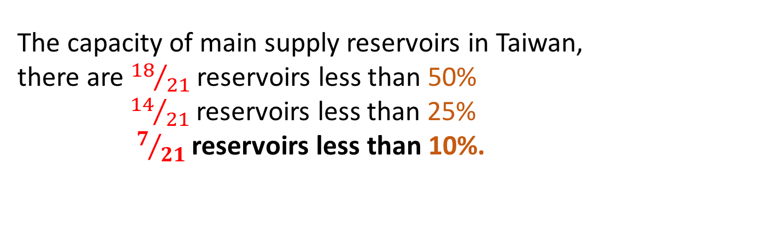
Introduction & Objectives
2021/04/05
To investigate precipitation events in Taiwan to analysis the trend of
Drought
Heavy rainfall
Precipitation
for the period 1975-2019 using a time-frequency analysis tool, multi-dimensional complementary ensemble empirical mode decomposition (MCEEMD).
2020/06/05
2021/04/06
The capacity of main supply reservoirs in Taiwan,
there are ${18}/{21}$ reservoirs less than 50%
${14}/{21}$ reservoirs less than 25%
$7/{21}$ reservoirs less than 10%.

Slide 3
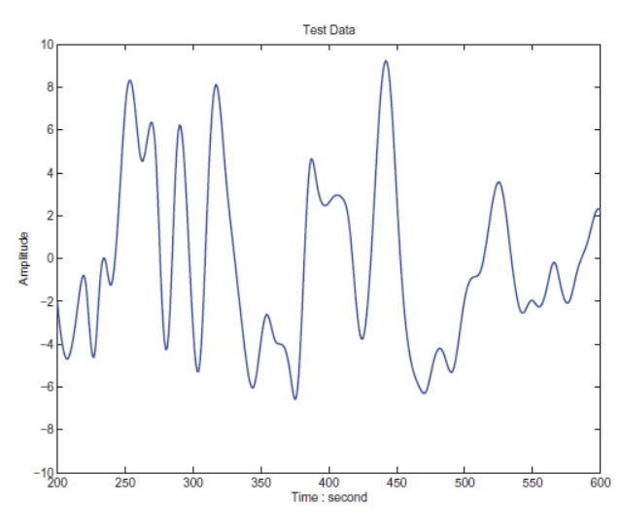
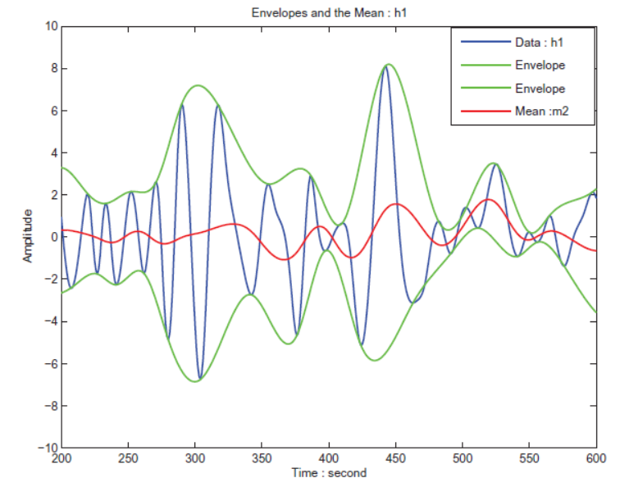
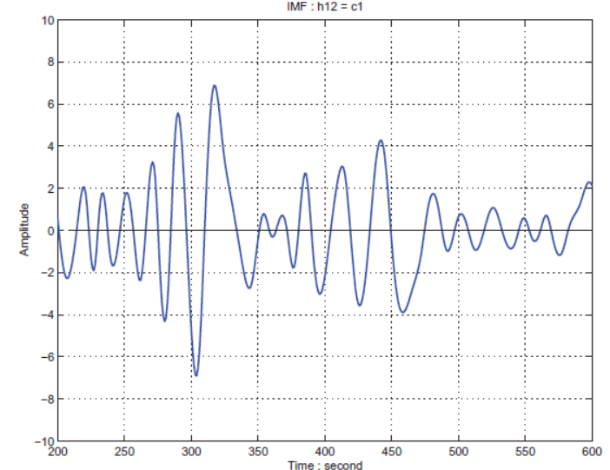
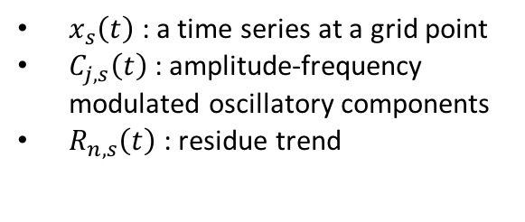



Methodologies
Empirical Mode Decomposition(EMD)
Hilbert-Huang Transform
EMD
(1998)
EEMD(2009)
CEEMD(2010)
Pseudo-BEMD(2001)
Genuine-BEMD(2005)
MEMD
(2010)
NAMEMD
(2011)
MEEMD(2009)
MCEEMD
(Hu et al,2019)
Hilbert spectral analysis (HSA)
Sifting process:
MCEEMD: The extracted residue of the added white noise can be effectively canceled.
$$x_{s}\left(t\right)= \sum_{j=1}^{n}{C_{j,s}\left(t\right)+R_{n,s}\left(t\right)}$$
$x_{s}\left(t\right)$ : a time series at a grid point
$C_{j,s}\left(t\right)$ : amplitude-frequency modulated oscillatory components
$R_{n,s}\left(t\right)$: residue trend
Strategy of combining components :
$$C_{i}= \sum_{k=i}^{K}{h_{i,k}}+\sum_{j=i+1}^{J}{h_{j,k}}$$
the final $i^{th}$ component $C_{i}$
Huang et al. (1998)

Slide 4
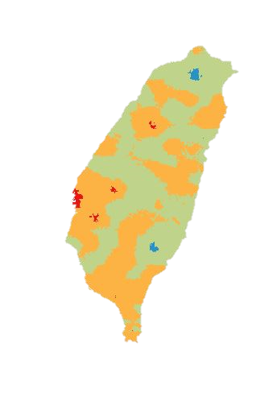
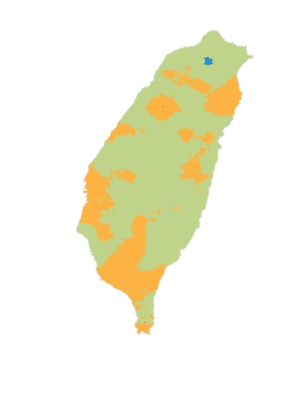
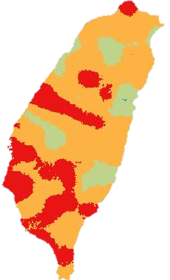
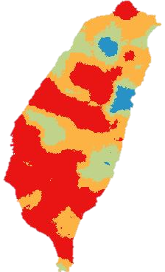
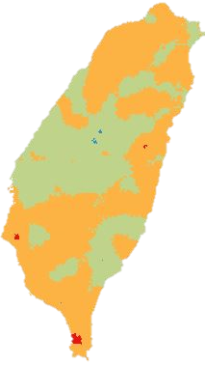
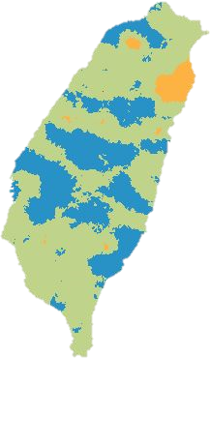
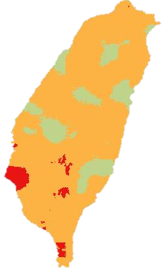
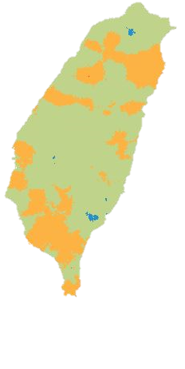
Trends of weather extreme: Drought & Heavy Rainfall
The occurrence of Heavy Rainfall : 1995~2005
The occurrence of Drought : 1995~2005
The occurrence of Heavy Rainfall : 1985~1995
The occurrence of Drought : 1985~1995
The occurrence of Heavy Rainfall : 2005~2019
The occurrence of Drought : 2005~2019
The occurrence of Heavy Rainfall : 1975~1985
The occurrence of Drought : 1975~1985
-12 0 7
-0.25 0 0.25
Drought: 1% daily accumulated rain
Heavy rainfall: more than 200mm/24hr

Slide 5
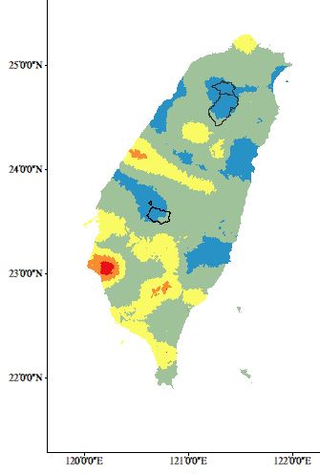
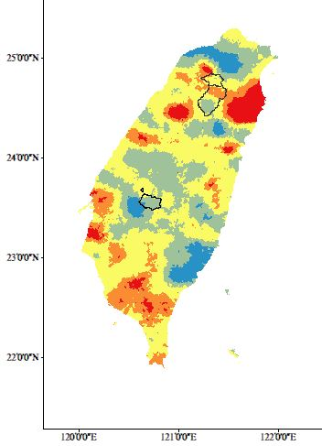
Comparison with Shihmen reservoir and Hushan reservoir :
The trend of the occurrence of Drought (1975~2019)
The trend of the occurrence of Heavy rainfall (1975~2019)
Shihmen reservoir
Shihmen reservoir
Hushan reservoir
Hushan reservoir
-35 -20 -7 0
0 1 2 3

Slide 6
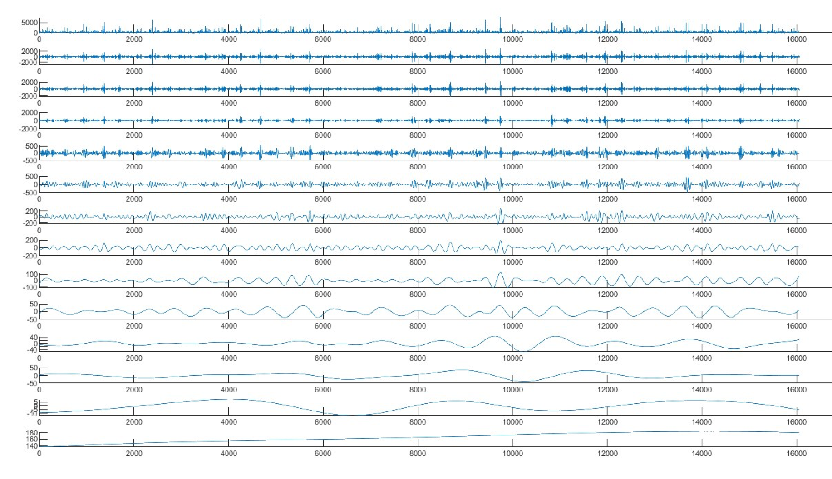
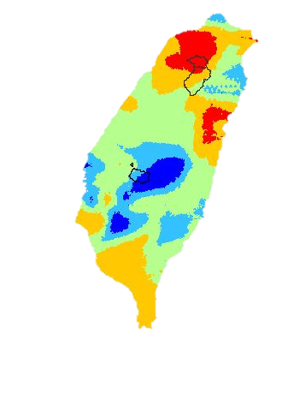
Thanks for listening~
The trend of precipitation (1975~2019)
The results point out that comparing with the Hushan reservoir, the Shihmen reservoir intends to high shortage in water resources.
Shihmen reservoir
Ongoing works
Including hydrologic factors, for example temperature, evapotranspiration…
Forecasting the occurrences of drought and heavy rainfall events using the ANN under CMIP5 environment.
Hushan reservoir
References
https://www.lookit.tw/travel/33586 (reservoir comparison figure)
https://www.ettoday.net/news/20210406/1953996.htm (Drought event figure)
Huang, N. E., Shen, Z., & Long, S. R. (1999). A new view of nonlinear water waves: the Hilbert spectrum. Annual review of fluid mechanics, 31(1), 417-457.
Huang, N. E. (2001). Computer implemented empirical mode decomposition method, apparatus, and article of manufacture for two-dimensional signals.
Huang, N. E., Shen, Z., Long, S. R., Wu, M. C., Shih, H. H., Zheng, Q., ... & Liu, H. H. (1998). The empirical mode decomposition and the Hilbert spectrum for nonlinear and non-stationary time series analysis. Proceedings of the Royal Society of London. Series A: mathematical, physical and engineering sciences, 454(1971), 903-995.
0 7 14 21

