Slide 1
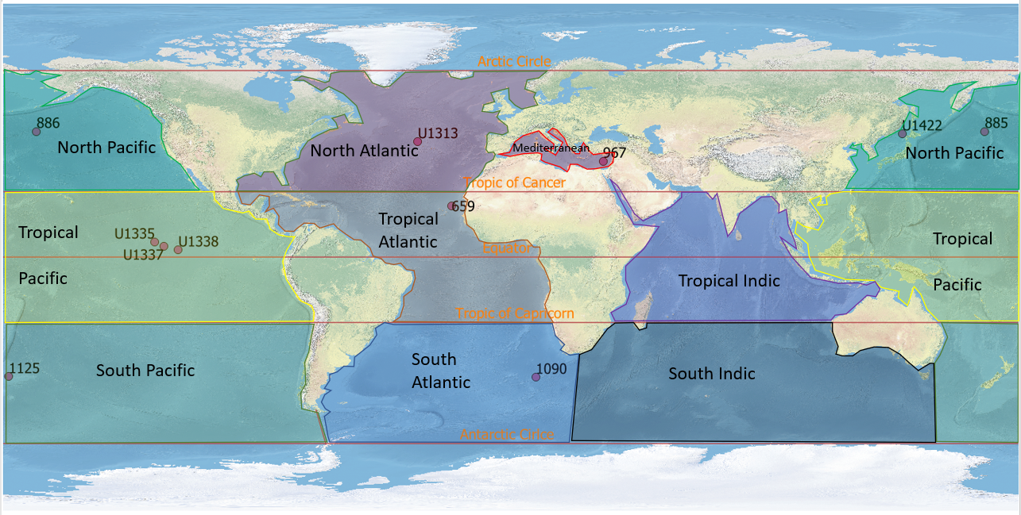
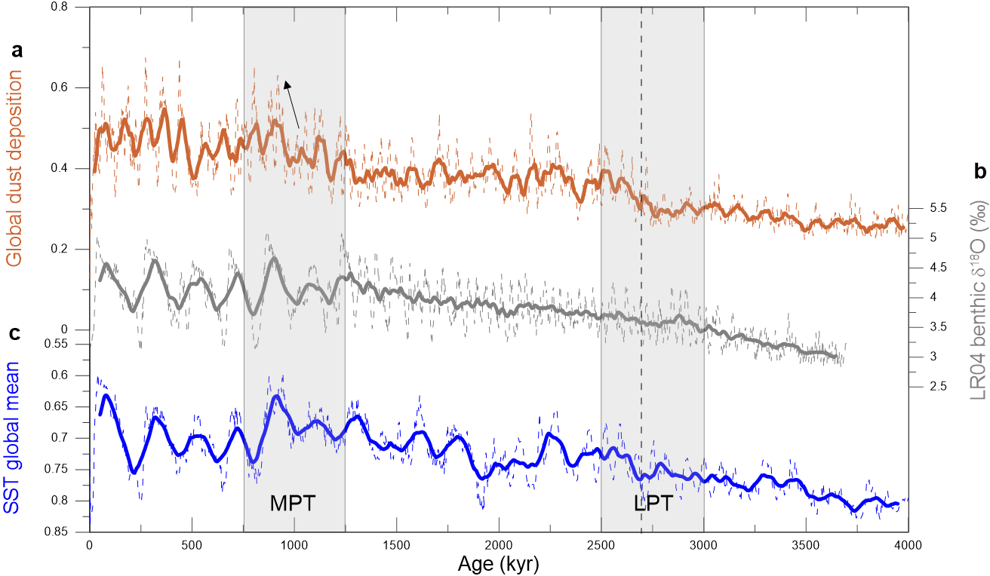
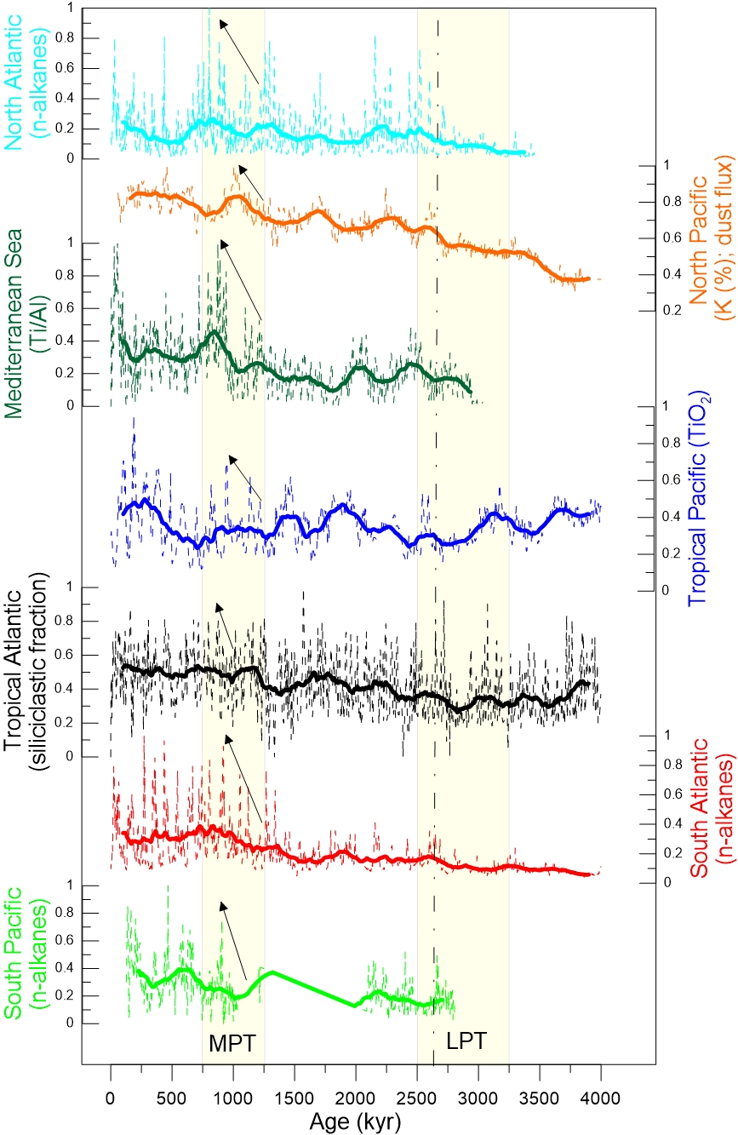





Global dust pattern during the Pliocene-Pleistonce transitions
Teruel, O.¹ , Penalva-Arias, N.¹ , Rosell-Melé. A. ^{1,2} (Oriol.Teruel@uab.cat)
Institut de Ciència i Tecnologia Ambientals (ICTA), Universitat Autònoma de Barcelona, Bellaterra 08193, Catalonia, Spain
Institució Catalana de Recerca i Estudis Avançats (ICREA), Barcelona 08010, Catalonia, Spain
INTRODUCTION
Dust in the atmosphere (i.e. the atmospheric dust loading) influence the climate system through affective radiative forcing, chemical reactions with other atmospheric constituents, and acting as a source of nutrients to biological system (Prospero, 1998). Its cooling effect compensates the global warming effect of the greenhouse gases (IPCC, 2013). One of the major achievements is to know how dust deposition has changed on a global scale during the last 4 Ma.
RESULTS
Aeolian deposition during the PPT, show variations in the concentration of geochemical element concentrations through time. During the last 4 Ma the transport and deposition of dust in the ocean has increased globally. This trend reflects changes in the source area, reflecting an aridification in the major global dust sources. The first significant rise occurs during the LPT, when the intensification of the Northern Hemisphere Glaciation (iNHG) occurred. Later, the most significant rise occurs during the LPT, and the emerge of the 100-kyr ice age cycles between 1.2 and 0.8 Ma ago
The evolution of dust deposition in the ocean has been larger in mid-latitudes than in the tropics and equator. Indeed, near the equator, the evolution of deposition has remained nearly constant over the last 4 Ma.
CONCLUSIONS
Dust has been increasing for the last 4 Ma, according with the general cooling during the Pliocene-Pleistocene transitions, specially in mid-latitudes. During the mid Pleistocene Transition and the 100-kyr ice age cycles, there is an amplification between maximum and minimum dust deposition during glacial-interglacial periods. Within the intensification of Northern Hemisphere Glaciation around 2.7 Ma ago, a first significant rise in dust is observed.

