Slide 1
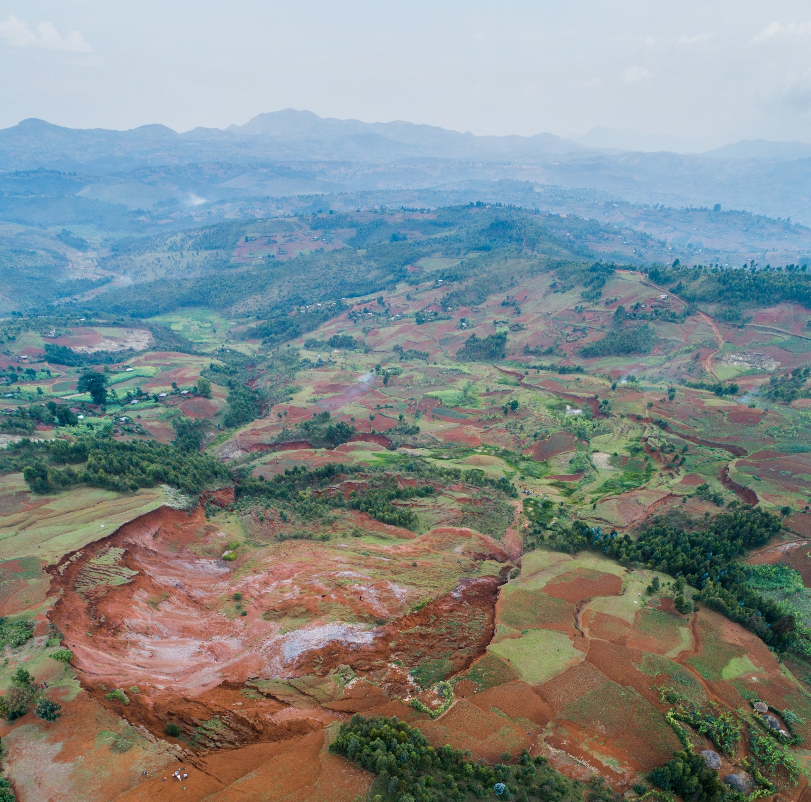


WHEN IMAGE CORRELATION IS NEEDED
combining very dense radar-amplitude and optical times series for unravelling the complex dynamics of a not so slow slow-moving landslide in the tropics
A. Dille^{1,2}, F. Kervyn¹, A. Handwerger^{3,4}, N. d’Oreye^{5,6}, D. Derauw^{5,7,8}, T. Mugaruka Bibentyo^{1,9,10}, S. Samsonov¹¹, J-P Malet¹², M. Kervyn², O. Dewitte¹
¹ Royal Museum for Central Africa, Belgium
² Vrije Universiteit Brussel, Belgium
³ University of California, Los Angeles, CA, USA
⁴ JPL, California Institute of Technology, USA
⁵ European Centre for Geodynamics and Seismology, Luxembourg
⁶ National Museum of Natural History, Luxembourg
⁷ Universidad Nacional de Rio Negro - CONICET, Río Negro, Argentina
⁸ Centre Spatial de Liège, Université de Liège, Belgium
⁹ Université Officielle de Bukavu, DR Congo
¹⁰ Ghent University, Belgium
¹¹ Natural Resources Canada, Canada
¹² CNRS/Université de Strasbourg, France
Supervisors
Olivier Dewitte & François Kervyn | Royal Museum for Central Africa
Matthieu Kervyn | Vrije Universiteit Brussel
Notes:
This research was motivated by the uncertainties associated with our incomplete understanding of the causes and controls on landslide failure and motion and, in particular, the little consideration for constraints typical in tropical environments.
Better understanding the influence of changing landscape conditions, weathering, tropical rainfall patterns, etc. is key for apprehending landslide processes and hazards in mountain regions of the tropics and this is what we tackled here.
This research was motivated by the uncertainties associated with our incomplete understanding of the causes and controls on landslide failure and motion and, in particular, the little consideration for constraints typical in tropical environments such as changing landscape conditions, weathering, tropical rainfall patterns, etc. that are all factors potentially affecting the nature of landsliding.
This research aimed at improving our understanding of the mechanisms that control the occurrence and motion of slow-moving landslides; and, in particular, to investigate how constraints typical in tropical environments (changing landscape conditions, weathering, tropical rainfall patterns, etc. ) are affecting landslide processes.
notably analyze/characterize how landslides respond to environmental changes. You have an example of environmental changes typical for many countries of the tropics on the left figure, where you see the head of a large landslide that has been progressively urbanized over the last decades.
3 years research project (MODUS) that aimed at improving our understanding of the mechanisms that control the motion of landslides by investigating large landslides in changing environments of the tropics
Specific attention in this presentation will be given to remote sensing aspects, since it is the common ground between all our presentations today, aspects that had to be adapted and optimized to the constraints brought by the tropical climate and the complexes patterns of landslide movement.
With the MODUS project we aimed at improving our understanding of the mechanisms that control the motion of such landslides, see if tropical enviornmental conditions influenced its movement, and analyze if, and how such landslide responded to the dramatic environmental changes brought by it urbanisation.
To better assess the hazard this specific landslide poses, but also across the other many cities of the tropics where similar environmental and societal conditions are met., we
3 years research project (MODUS) aims at improving our comprehension of the mechanisms that control the motion of landslides, with a special focus on understanding if, and how landslide respond to environmental changes.
In today’s world, some of the major changes to the environment are brought by urban expansion, particularly in Africa and Asia. This urbanisation drastically modifies landscapes and we wanted to investigate its impact on the dynamics of landslides. In the city of Bukavu, in eastern DR Congo, you have active landslide that are now hosting more than 80,000 inhabitants living in overcrowded, poor-quality housing with inadequate infrastructure, a small section (the head) of such a landslide is illustrated here.
Specific attention in this presentation will be given to remote sensing aspects, that had to be adapted to constraints brought by the tropical climate and the movement of landslide.
because the methods used to measure landslide motion and had to be adapt them to constraints brought by the tropical climate and the movement of landslide.
by that I mean able to provide multiyear measurements with a high temporal sampling.
Located, what you see is the head of a large and active landslide that was urbanized in the past decades in the rapidly expanding city of Bukavu, in eastern DR Congo
They profoundly transform landscapes, and we want to investigate how they affect the movement of landslide.
and that profoundly transform landscapes. I provide here an illustration of a landslide profoundly transformed by urbanisation. What you see here is the head of a very large and active landslide in the rapidly expanding city of Bukavu, in eastern DR Congo
urbanized during the last decades, and we wan
also had to optimize remote sensing methods adapted to constraints brought by this context, and the movement of landslide, by that I mean able to provide multiyear measurements with a high temporal sampling.
Focus on the causes of motion of landslides. Large, deep-seated landslides are very common in mountainous landscapes, often manifesting long-term, persistent movements with velocity variations primarily controlled by rainfall-induced changes in water pressure within the slope. Yet, our understanding of their controls remains largely elusive, and this particularly in tropical mountain regions where environmental conditions (intense rainfalls, rapid weathering of rocks, etc.) and a growing human footprint are thought to play an important role on the overall stability of hillslopes.
And methods that can be used to unravel those controls – need multiyear measurements with high temporal sampling.
affecting sediment transfers, hillslopes morphology but also the livelihood of local communities.
Our incomplete understanding of controls on landslide origin and evolution is a major source of uncertainty in assessing the hazard they pose. It is especially crucial in montane regions of the tropics where landslide impacts are high and on the rise, and the dearth of accurate process characterisation is large. The Kivu Rift, in eastern DR Congo, is one of these regions. Tropical environmental conditions (intense rainfalls, rapid weathering of rocks, etc.) and a growing human footprint are thought to play an important role on the overall stability of hillslopes. Yet, our understanding of their controls remains largely elusive, and this PhD research project aims at unravelling their respective roles.
Most large, deep-seated landslides show slow, persistent movements with transient and/or seasonal accelerations that are primarily controlled by rainfall-induced changes in water pressure within the slope. Changes to rainfalls or hillslope hydrological properties may therefore impact the overall landslide behaviour.”
3 years research project (MODUS) that aimed at improving our understanding of the mechanisms that control the motion of landslides; notably analyze/characterize how landslides respond to environmental changes. You have an example here, what you see is the head of a large and active landslide that has been urbanized over the last decades, and we want to see if it has impacted its movement.
Where? We here focus our investigations on landslides located in the Kivu Rift, at the border between eastern DR Congo, Rwanda and Burundi. Tropical montane regions such as the Kivu Rift are often experiencing very large environmental changes and are disproportionately impacted by landslides compared to the rest of the world. , while being often overlooked in landslide research.
While it certainly poses constraints on measuring landslide motion (think of cloud cover, difficulties for maintaining instrumentations, etc.), it is a highly relevant because it is a) very landslide-prone, b) and experienced large environmental changes over the past decades.
How? As the title suggests, because Landslides rarely feature spatially nor temporally uniform deformation patterns, studying the causes of motion therefore requires high temporal and spatial resolution measurement of surface deformation. We here used state-of-the-art remote sensing techniques, seeking complementarity/synergies between radar and optical wavelengths
adapting methods to increase the temporal sampling of deformation measurements.
We here focus our investigations on landslides located in the Kivu Rift, at the border between eastern DR Congo, Rwanda and Burundi. While it certainly poses constraints on measuring deformation (think of cloud cover, difficulties for maintaining instrumentations, etc.), it is a highly relevant because it is a) very landslide-prone, b) and experienced large environmental changes over the past decades, therefore a perfect place to answer those question of the influence of environmental changes on the dynamic of landslides. Also, tropical regions are consistently overlooked.
We investigate those questions in montane regions of the tropics, that are perfect place because of widespread environmental changes and disproportionately high impact of landsliding on local communities. And, I shall say, a flagrant lack of research.
Landslides rarely feature spatially nor temporally uniform deformation patterns, studying the causes of motion therefore requires high temporal and spatial resolution measurement of surface deformation. We here used state-of-the-art remote sensing techniques, seeking complementarity/synergies between radar and optical wavelengths, adapting methods to increase the temporal sampling of deformation measurements.
It is a STEREO project, so remote sensing is a key aspect. We build set of surface deformation measurements based on state-of-the-art remote sensing techniques, seeking complementarity/synergies between radar and optical wavelengths, adapting methods to increase the temporal sampling of deformation measurements – that is key for unravelling what is/are controlling landslides movement.
We investigate those questions in montane regions of the tropics, that are perfect place because of widespread environmental changes and disproportionately high impact of landsliding on local communities. And, I shall say, a flagrant lack of research. We here focus on landslides in the Kivu Rift, at the border between eastern DR Congo, Rwanda and Burundi.
Multi-platform remote sensing using space-, airborne and ground-based sensors has become essential tools for landslide assessment and disaster-risk prevention.
Today, the key for understanding landslides is the complementarity of methods and the automation of the data processing.
Context where geophysical instrumentation is difficult, we have no permanent in-situ measurements and we so have to rely on remote sensing data, and complementary between different methods.
– and that’s where it becomes interesting even for the few you aren’t excited about understanding how humans can affect the movement entire hillslopes –
such as satellite synthetic aperture radar interferometry (InSAR), image correlation applied on radar and optical satellite imagery that provided millimeter to meter-scale measurements of ground surface deformation used to quantify landslide motion. Combined with field measurements.
→ Unravel its kinematics, and investigate factors that control its dynamics and how it evolved with its progressive urbanisation
What is the role of human activity on the natural behaviour of a deep-seated landslide?
Context where geophysical instrumentation, we have no permanent in-situ measurements and we so have to rely on remote sensing data, and complementary between different methods
→ what we intended to investigate here at two-time scales
Over the last years using dense InSAR time series, High resolution surface topography from UAV and GNSS measures
Over the long term, combining recent remote sensing products with archive aerial imagery over the area
allowing us to investigate human-induced stress perturbations in the landslide evolution (unique dataset for such tropical env)
The analysis of these deformation patterns with regard to the environmental changes derived from the aerial photographs allows to further explore the interplay between natural and human controls over several decades
identify human-induced stress perturbations in its evolution
Remote sensing observation
High temporal and spatial density of measurement, allowing to compare behaviour of individual landslide units within the landslide

Slide 2
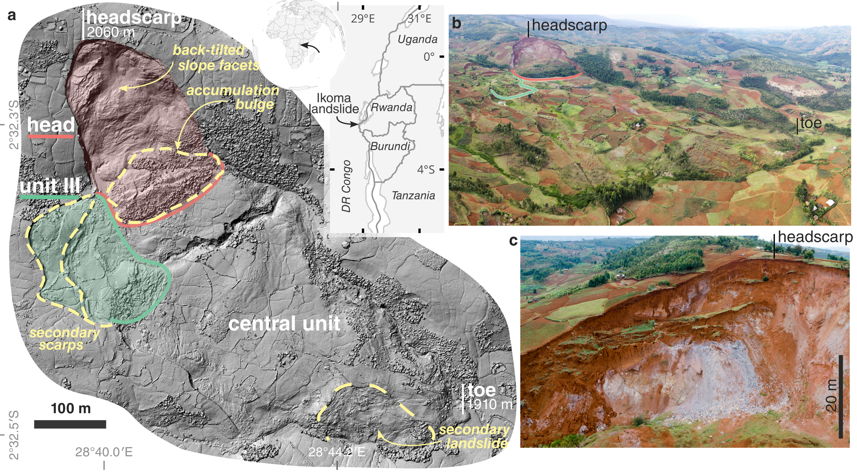
dynamics of a tropical landslide
Ikoma landslide
initial failure associated with weathering
main phases of instability > 2015
difficult to monitor
m/yr velocity, transient surges
highly variable deformation in space and time
rapid surface changes
in situ monitoring difficult to implement and maintain
persistent cloud cover
© All rights reserved by the authors.
Dille et al. (2021), Remote Sensing of Environment
Notes:
First focus on landslide with little influence of human activities.
To analyse the dynamics, you need to gather dense time series of deformation with a temporal resolution sufficiently high to grasp potential transient velocity changes, and you will see here you need a pretty high resolution.
Measuring its motion posed many challenges
This landslide is quite interesting because initial failure have occurred without clear external triggers such as an earthquake or an intense rainfall event, and is thought to be primarily associated with weathering-related weakening of the slope strength over time; so now, how is it evolving?
Measuring its motion poses challenges, because of
Interesting because of weathering of slope material that affect the stability and intitiate the instability, so now, how is it evolving?
A bit of context
Relatively recent landslide, initial failure associated to weathering
main phases of instability > 2015
Interesting because of weathering of slope material that affect the stability and intitiate the instability, so now, how is it evolving?
Recent landslides, with main phase of instability from 2015, so perfect case study.
But, rapid, with change in surface cover and tropical climate that lead to near persistent cloud cover over most of the year.

Slide 3
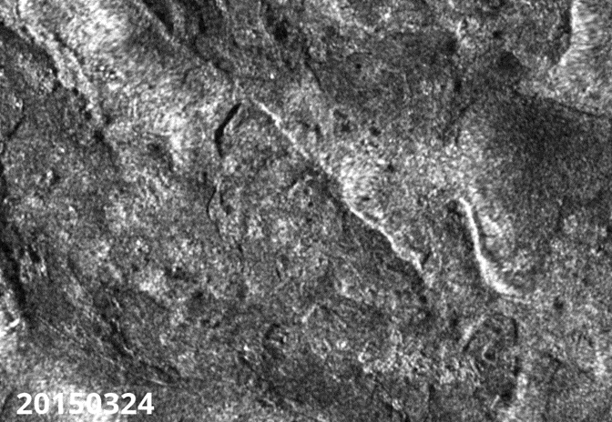
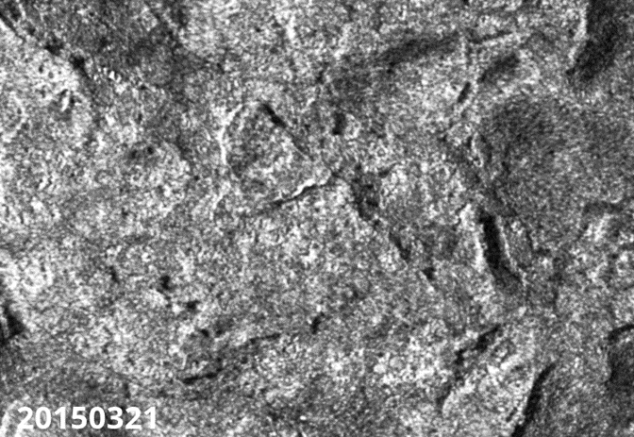
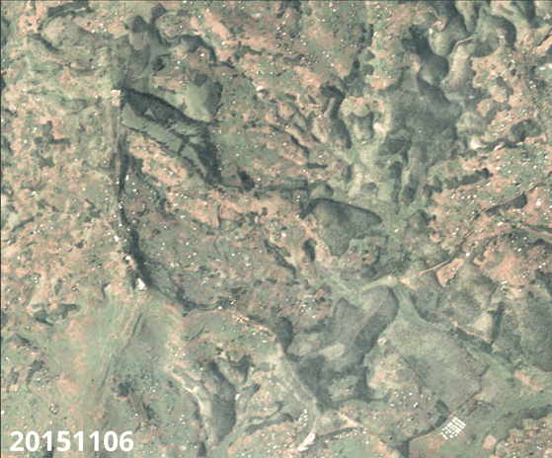
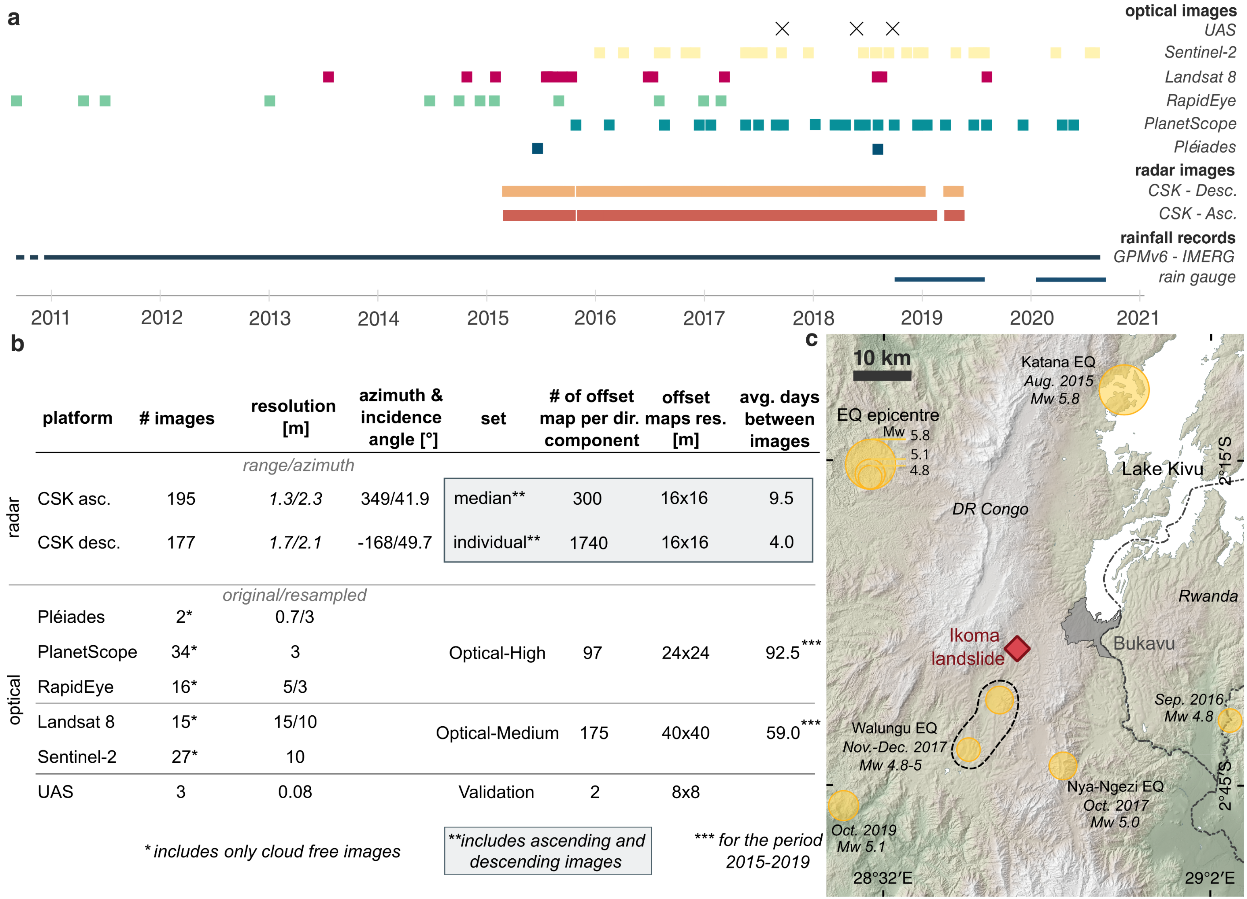

dynamics of a tropical landslide
methods
© All rights reserved by the authors.
SAR amplitude ascending
SAR amplitude descending
optical satellites
~100 images
~400 images

Slide 4
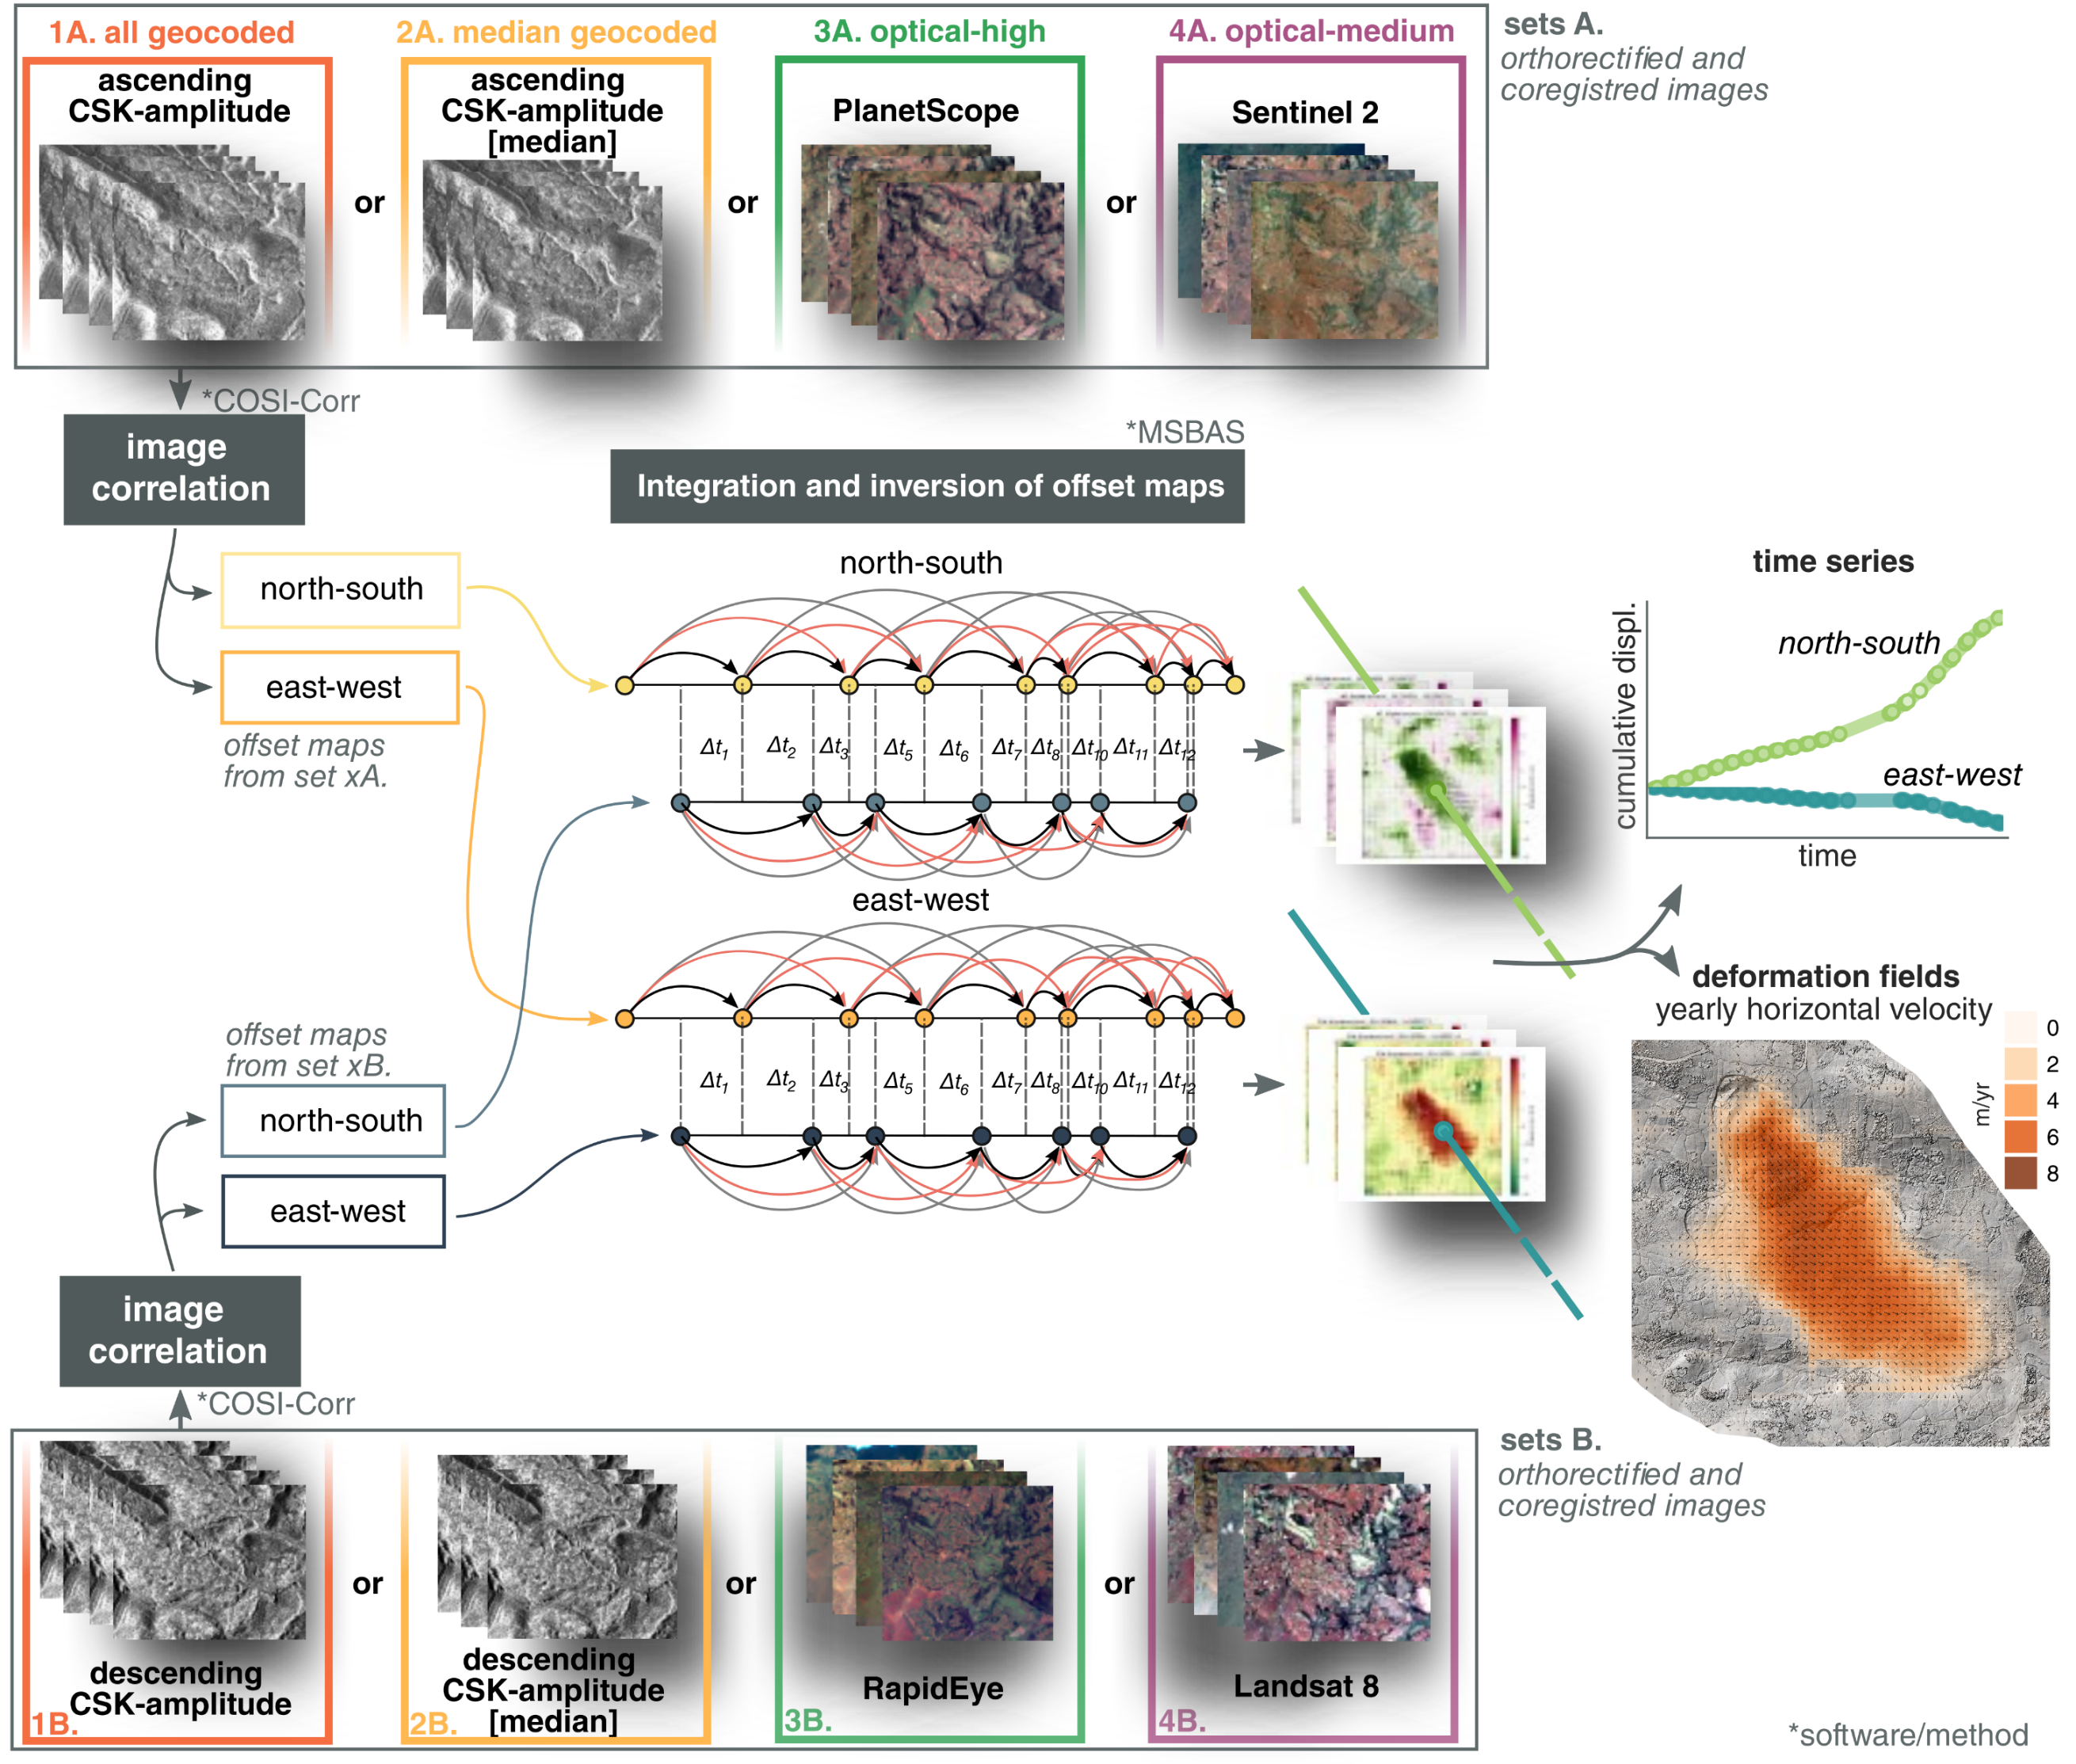
dynamics of a tropical landslide
methods
Combine images from different sensors
+
Integrate and invert
© All rights reserved by the authors.
Dille et al. (2021), Remote
Sensing of Environment
Notes:
Averages out the effect of various sources of noise

Slide 5
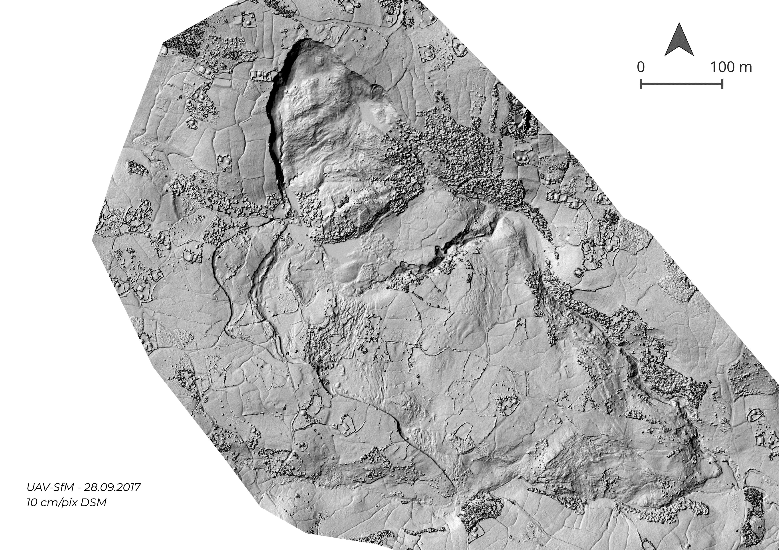

dynamics of a tropical landslide
validation set – UAS
3 UAS campaigns
© All rights reserved by the authors.
Notes:
Failure Mechanisms confirmed whe looking to kinematics

Slide 6
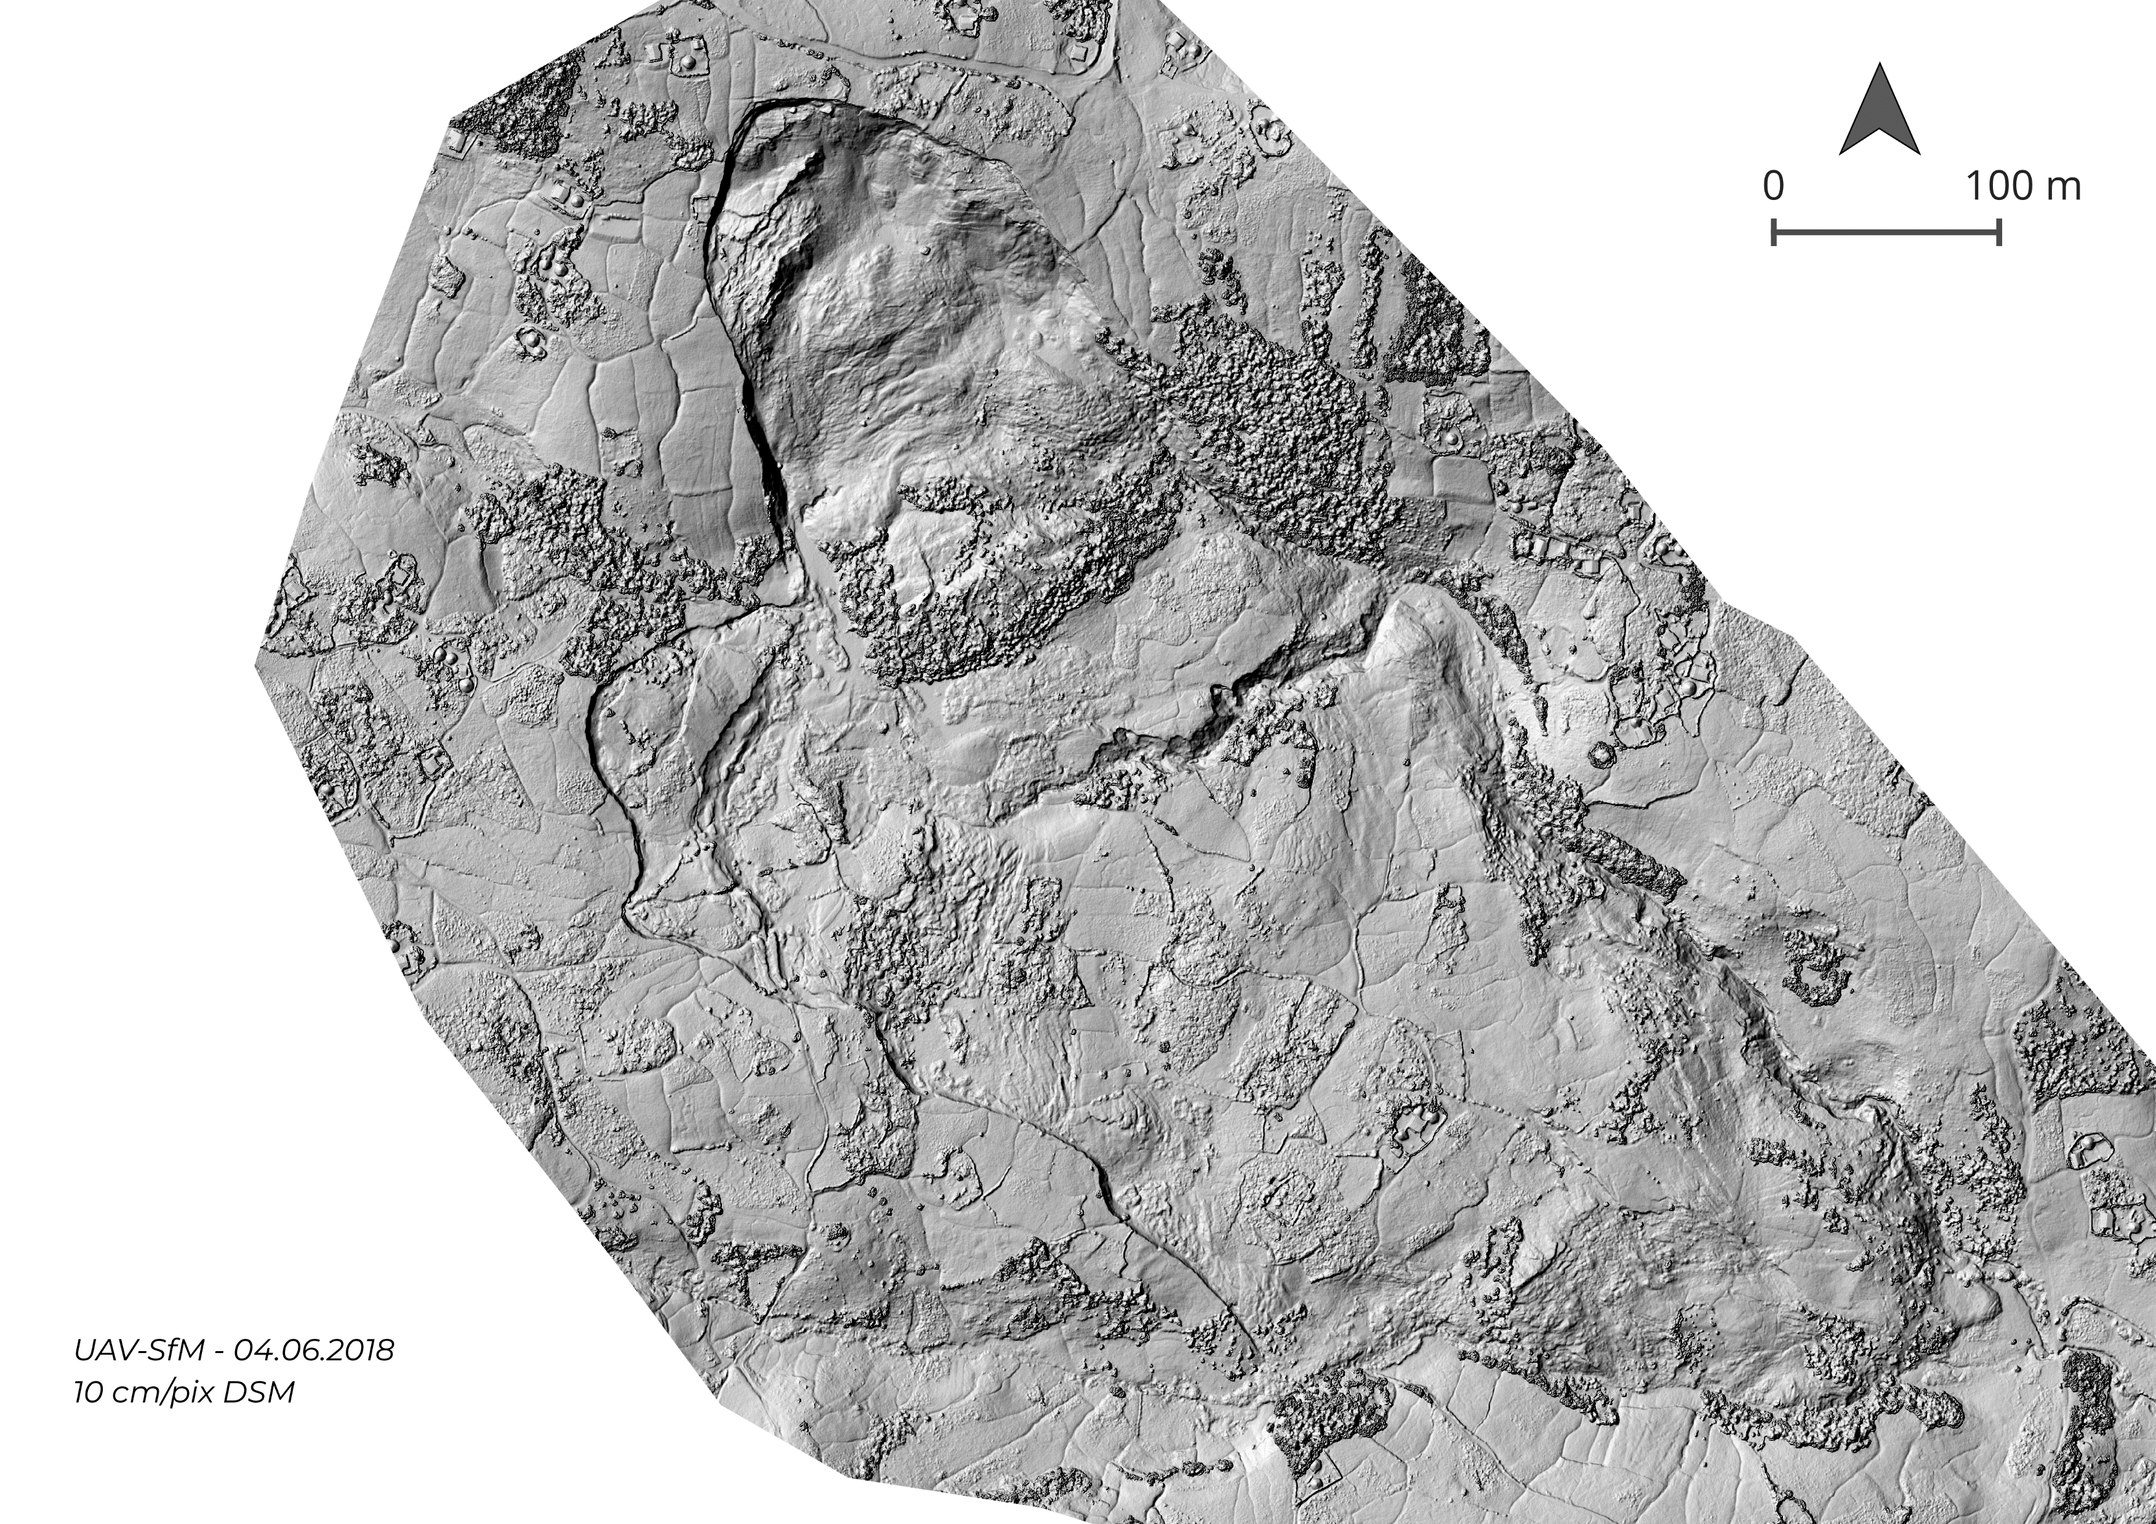
dynamics of a tropical landslide
validation set – UAS
3 UAS campaigns
© All rights reserved by the authors.

Slide 7
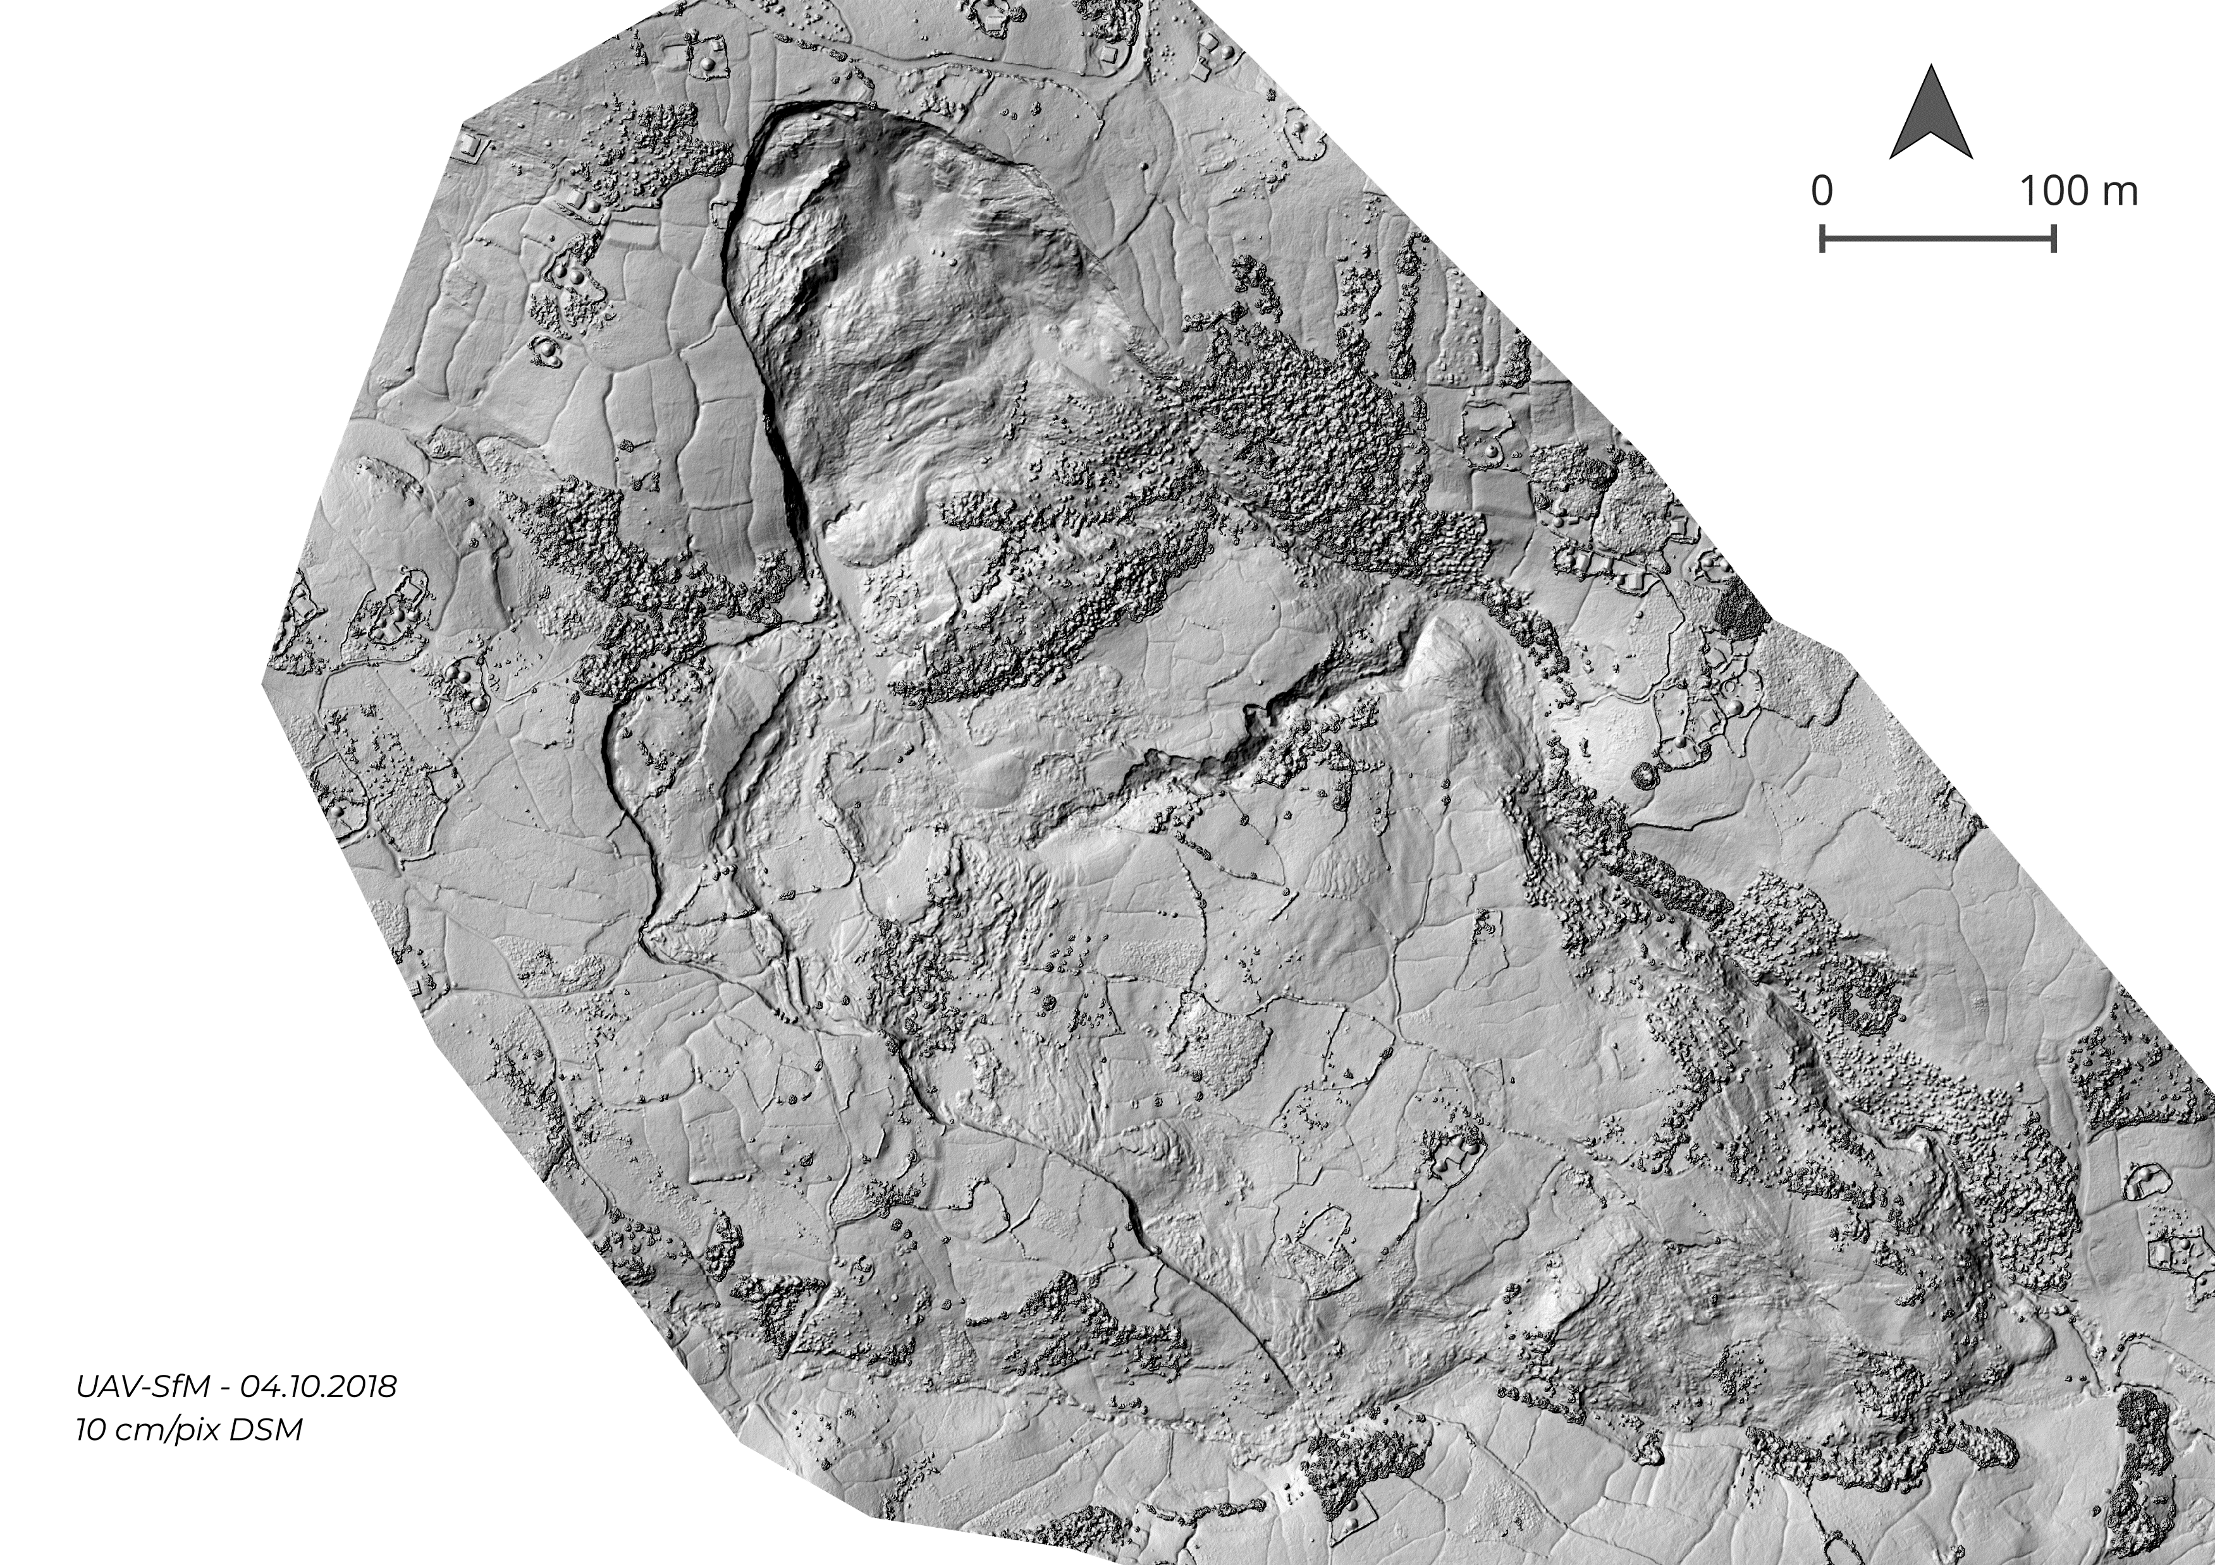
dynamics of a tropical landslide
validation set – UAS
3 UAS campaigns
© All rights reserved by the authors.

Slide 8
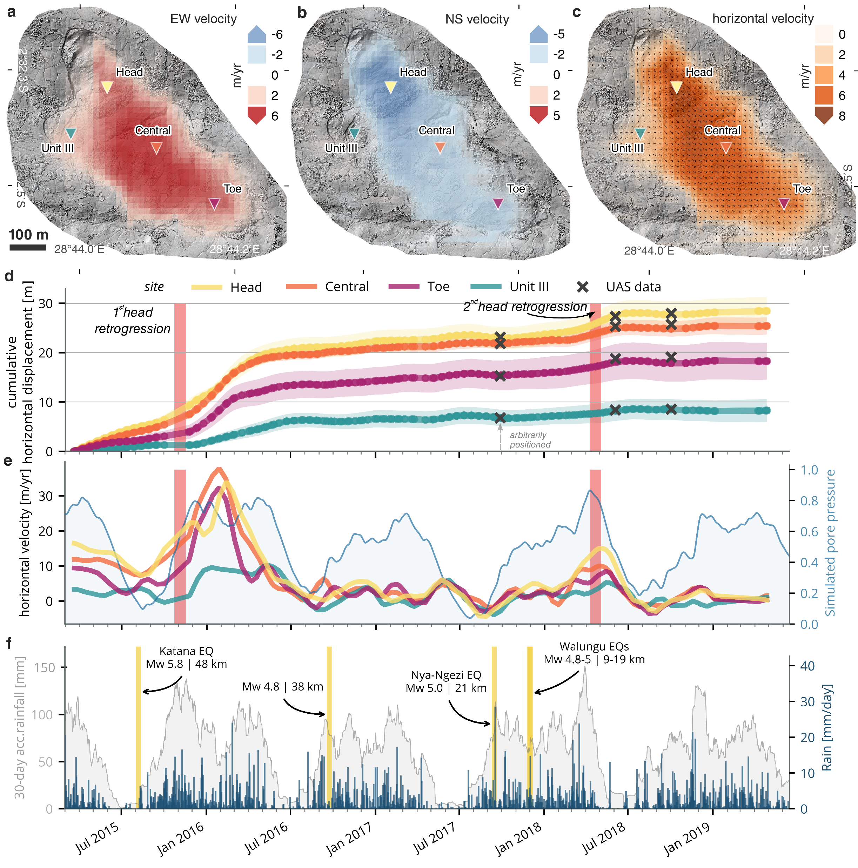
dynamics of a tropical landslide
controls on landslide motion
UAS data
© All rights reserved by the authors.
Dille et al. (2021), Remote Sensing of Environment
Notes:
Seasonal variations, transient acceleration episodes that seems related to particularly wet periods and surges associated to failure at the landslide head

Slide 9
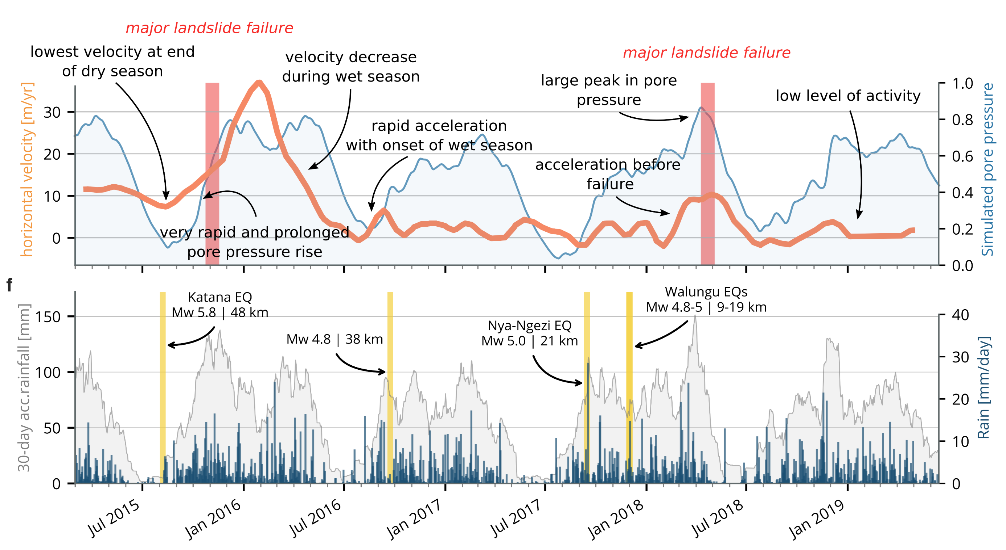
dynamics of a tropical landslide
controls on landslide motion
landslide velocity vs pore-water pressure
closely tied relationship between rainfalls and landslide motion
minor changes in effective stress control changes in velocity
© All rights reserved by the authors.
Dille et al. (2021), Remote Sensing of Environment
Notes:
Simplified graph, just showing one velocity time series (here central unit)
There is a closely tied relationship between rainfalls and landslide motion
Lowest velocity at the end of the dry season, rapid acceleration with the onset of the wet season
Rapid accelerations both at end of dry and during wet that suggest that the landslide remains close to an acceleration threshold all year long (minor changes in effective stress control changes in velocity)

Slide 10
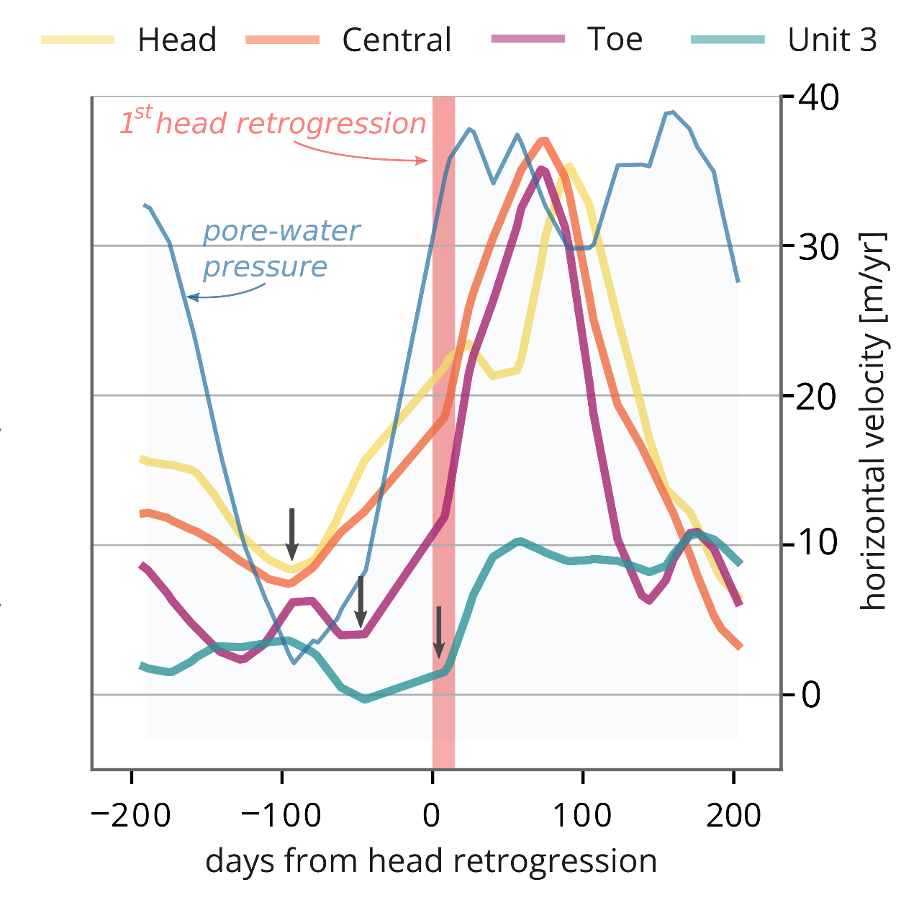
dynamics of a tropical landslide
controls on landslide motion
velocity changes not synchronous across the landslide
stress propagation/transfer
© All rights reserved by the authors.
Dille et al. (2021), Remote Sensing of Environment
Notes:
Different behaviours for individual landslide units in term of both magnitude and timing of kinematic changes
Propagation of downslope kinematic wave alongside landslide surge following the first head retrogression (similar to slope failure development in Chapter I.) – not present when no headscarp collapse
Propagation wave not present in absence of episodic headscarp collapse
Breaks in velocity patterns
velocity changes not synchronous across the landslide
stress propagation/transfer
Why high spatiotemporal resolution?
minor changes in effective stress control changes in velocity
Very high temporal sampling (and rare)
Very short time lag; rainfall → pore water pressure in the slope
This lag is reduced to below ~20 days if we compare acceleration phases to the simulated pore-water pressure (Fig. 4e, 5a). This is a very rapid compared to most landslides, for which prolonged periods of increased precipitations are usually found necessary to trigger acceleration (Iverson and Major, 1987; Malet et al., 2002; Hilley et al., 2004; Handwerger et al., 2013; Massey et al., 2013). Such behaviour is however not unique (Malet et al., 2002; Corominas et al., 2005), and our very-dense time series may capture a response that is usually missed with the lower sampling frequency of conventional InSAR or satellite optical measurements
Bathtub hypothesis
This stress that predicting the velocity of landslides from rainfall alone may be challenging
stress propagation/transfer; landslide geometry
In both cases, the behaviour seems influenced by local conditions and internal dynamics associated with movement and stress transfer between units

Slide 11
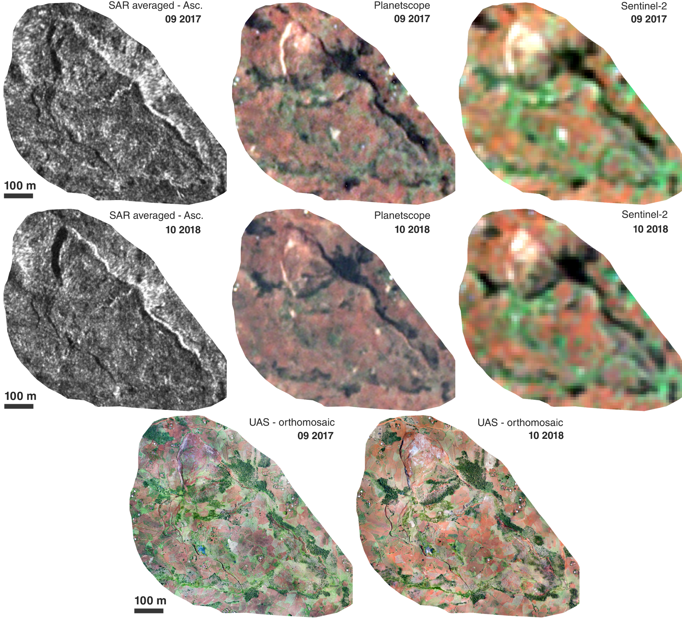
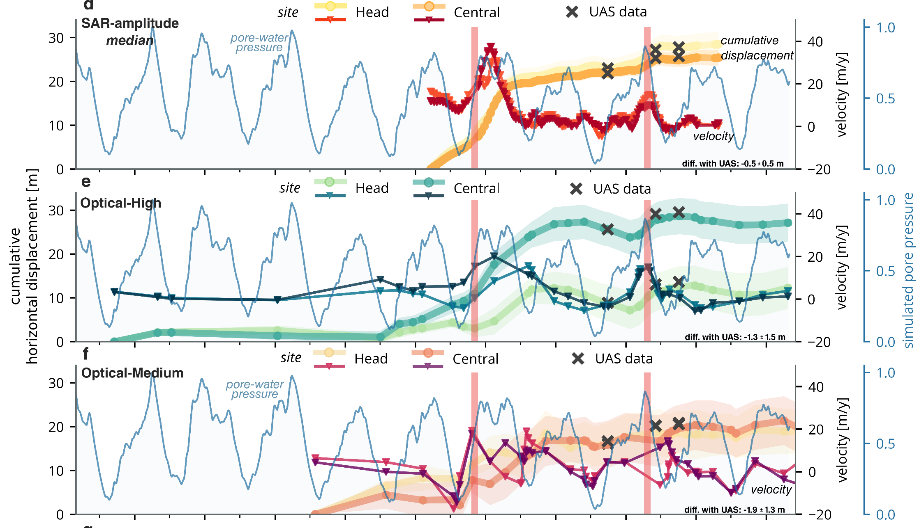
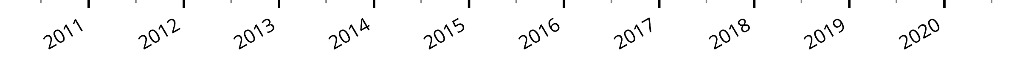
370 CSK
SAR-amplitude
SAR-amplitude vs optical satellite time series
SAR-amplitude
images
50 PlanetScope
& RapidEye
High-resolution optical satellite images
© All rights reserved by the authors.
40 Landsat 8
& Sentinel-2
Medium-resolution optical satellite images
Dille et al. (2021), Remote Sensing of Environment
Notes:
Applied the same method on all cloud free optical satellite images we could find.
High/Medium resolution
Allow to go further back in time, but temporal sampling much lower (affecting the timing of the acceleration phases because images essentially during dry season), artifacts much more present.
Larger standard deviation, erroneous negative velocities
Missed timing of surge 2
Averages out the effect of various sources of noise
Cloud cover, resolution, etc.
Lower temporal sampling and noisier
Very few temporal gaps with SAR
Considering how dense time-series are key to the identification and comprehension of time-dependent and transients surface processes
The characteristics of these radar-amplitude data (low dependence to weather conditions, repetitiveness, spatial resolution, etc.) make them particularly suited to study surface processes in zones affected by persistent cloud cover. Yet, our results stress that they should be considered as performing alternative to optical images for landslide studies anywhere on the globe.
Our workflow is moreover simple and build only on existing tools.
! Complementarity

Slide 12
dynamics of a tropical landslide
We used dense time series from radar and optical sensors to quantify landslide dynamics
Rainfall-induced changes in pore-water pressure exerts the main control, but high-spatio-temporal kinematic data stress the role of internal landslide dynamics
We highlight the viability of sub-pixel image correlation with radar-amplitude data
© All rights reserved by the authors.
Dille et al. (2021), Remote Sensing of Environment
Notes:
we here provide an unprecedented detailed and long-term characterisation of the dynamics of a tropical landslide.
We show that rainfall-induced changes in pore-water pressure exerts the main control, but we also highlight that external forcings alone cannot explain all variability, emphasizing that internal landslide dynamic (extension, compression, material redistribution, etc.) and interactions between kinematic units exert strong control on the landslide motion. (stress propagation, hysteresis, etc.)
We highlight the viability of sub-pixel image correlation with radar-amplitude data, which characteristics (low dependence to weather conditions, repetitiveness, spatial resolution, etc.) makes them particularly well-suited to study surface processes such as landslides
Long-term, detailed characterisation of landslide kinematics remains rare and generally concerns a few case studies in high-income countries (Schulz et al., 2009; Lacroix et al., 2020) that are not representative for the diversity of environmental conditions (climate, tectonic, lithology, weathering, etc.) and external forcings (rainfalls, earthquakes, human influence, etc.) that impact landslide activity.
Rare are the landslide were such tied relationship is described, and it may also be related to the very high temporal sampling
Yet, it also shows that external forcings alone cannot explain all variability, emphasizing that internal landslide dynamic (extension, compression, material redistribution, etc.) and interactions between kinematic units exert strong control on the landslide motion.
This stress that predicting the velocity of landslides from rainfall alone may be challenging
Characteristics of SAR-amplitude data (low dependence to weather conditions, repetitiveness, spatial resolution, etc.) makes them particularly well-suited to study surface processes
By highlighting these relationships, this PhD research helps improve the evaluation of landslide hazard and mitigation in the area, but also across many other regions of the tropics where similar environmental and societal conditions are met. These findings also have wider implications for our understanding of landslide dynamics and how humans are interfering with landscape evolution. We finally hope this work will contribute to highlighting the importance of giving sufficient attention to earth surface processes in tropical contexts, where rates and relative importance of dynamic processes can be different from temperate or paraglacial regions where most of the attention is set.
Quantifying the controls on landslide motion is essential for characterising how surface processes influence paces of landscape evolution and the accurate evaluation of the landslide hazard.
While research usually focuses on the use of either optical or radar wavelengths, detailed kinematic measurements will always benefit from taking advantage of synergies between both imaging techniques, that complement each other drawbacks and increase the frequency of measurements (Lacroix et al., 2020). This will ensure a better exploitation of the large and growing archive of repeat satellite imagery, as well as better meet the increasing needs to quantify and monitor landslides around the globe.

