Slide 1
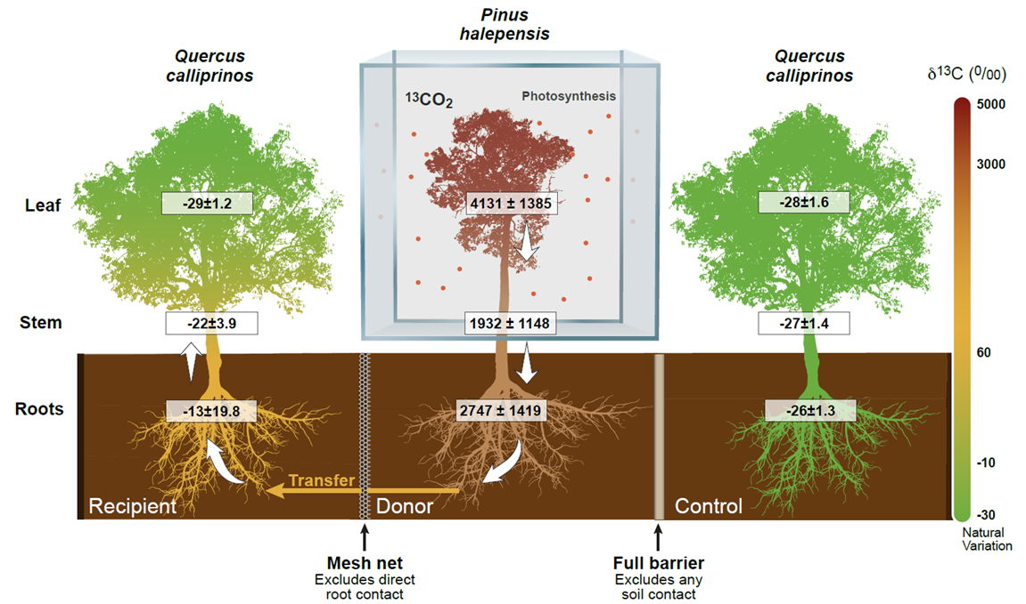
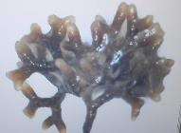
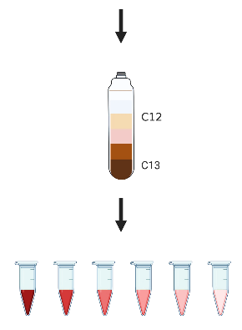
Shooting the messenger: Identifying the mycorrhizal species transferring carbon between neighbouring trees
Stav Livne-Luzon, Rotem Cahanovitz, Tamir Klein
Using Stable Isotope Probing (SIP) we identified the main Ectomycorrhizal fungi receiving C from their hosts, and are the primary suspects for C transfer between neighboring trees of similar, or distinct, phylogeny
The intrinsic tree carbon pool, and not the tree species identity, was the main factor governing carbon transfer between trees

Slide 2
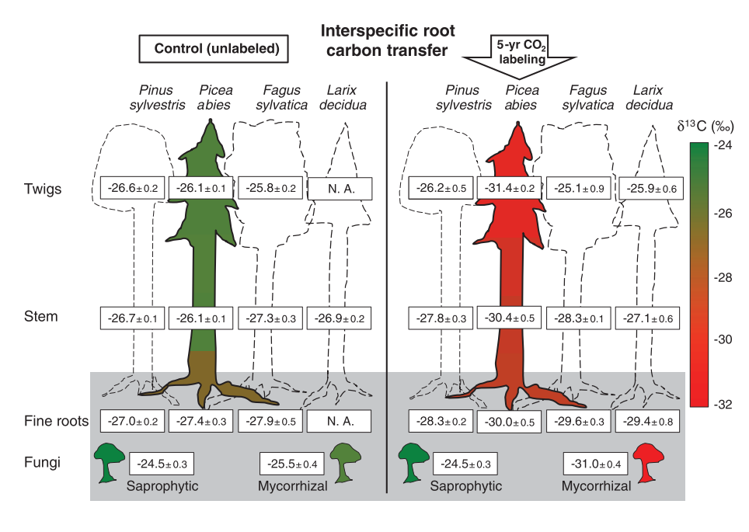
EMF play an important role in forests around the globe, by improving tree nutrition and water supply, as well as connecting different tree species through common mycorrhizal networks (CMN's)
Interspecific carbon transfer summing to 4% of the forest net carbon uptake (net primary production), among 40m tall trees in field conditions. Results indicate a bidirectional carbon exchange, which is not along a demand-supply gradient.
Do ectomycorrhizal fungi facilitate carbon resource sharing between trees?

Slide 3
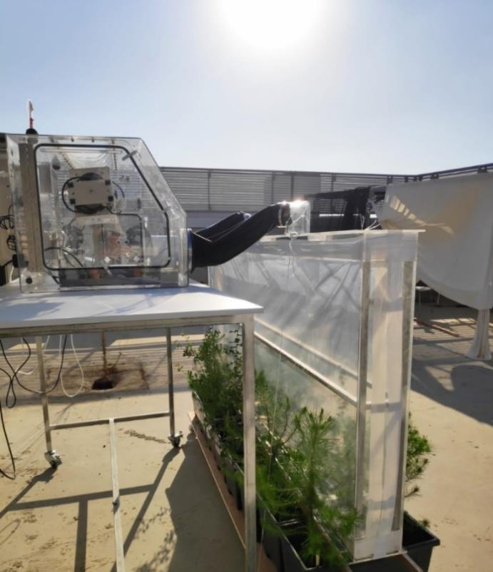
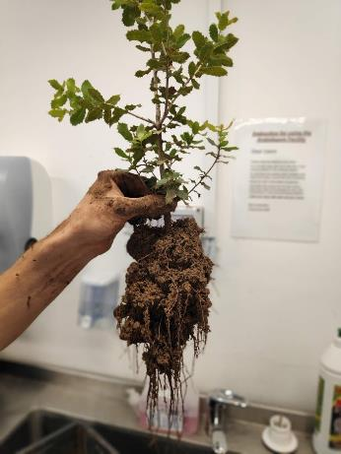
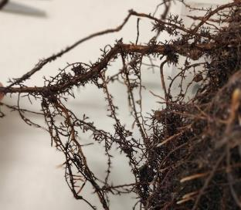
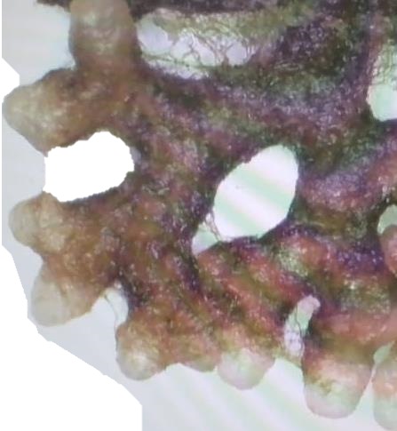
Using ¹³C isotope as “dye” for transfer
3 Trees in a Pot
¹³CO₂ Labelling system
Extract tree tissues
8
Fine net
excludes only
roots
Full barrier excludes roots & mycorrhiza network

Slide 4
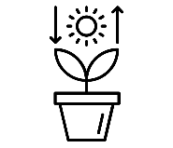
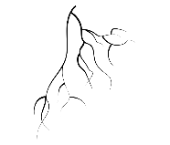
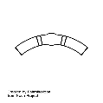
Experiment sampling scheme
Beginning of Labeling
Plant Harvesting
Day 1-3
(13-15.7.20)
Day 36
(17.8.20)
Measurements taken
Plant Tissue Sampled
CRDS
IRGA
Leaf
Root
Stem

Slide 5
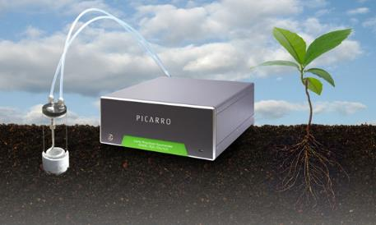
Is carbon transferred belowground between trees? What are its temporal and spatial dynamics?
Cavity Ring-Down Spectroscopy (CRDS) Picarro
Calculate the isotope ¹³C ratio
Natural δ¹³C signature between -24-32‰ (O'Leary 1988)

Slide 6
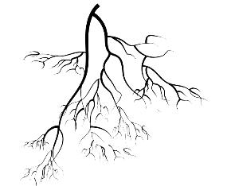
¹³C was transferred belowground across four tree combinations
How much?
Where & When?
Who?

Slide 7
Identifying the main agents of C transfer using Stable Isotope Probing (SIP)

Slide 8
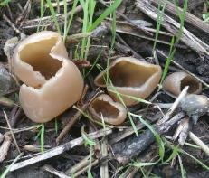
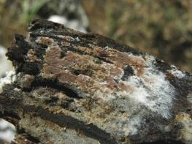
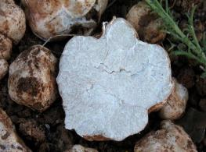
Tomentella, Terfezia, and Tuber are known to have symbiotic interaction with both pine and oak trees
Genus | Species | Percentage of total reads | Tree host
Pustularia | NA | 49% | ?
Tomentella | ellisii | 19% | Oak & Pine
Terfezia | pini | 4% | Oak & Pine
Tuber | oligospermum | 1% | Oak & Pine
Who?

Slide 9
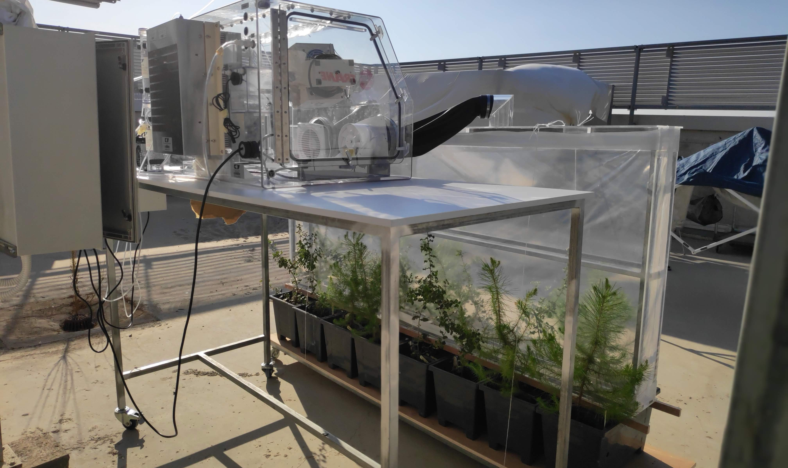
http://www.weizmann.ac.il/plants/klein/
stavl@weizmann.ac.il

