Slide 1

Effect of desalinated water derived treated wastewater on soil structural and hydraulic properties
Robert Neufeld and Gilboa Arye
French Associates Institute for Agriculture and Biotechnology of Drylands
Jacob Blaustein Institutes for Desert Research
Ben Gurion University of the Negev, Israel
Introduction
Treated Waste Water (TWW) irrigation is common practice in Israel
Since 2003 Israel is using Desalinated Water (DSW) in large scale and in 2020 it has become about 100% of the water supplied to urban and industrial water demand
DSW derived TWW is assumed to have higher SAR and lower EC compared to natural water derived TWW.
Reduced salinity and higher SAR in irrigation water are known to negatively affect hydraulic and structural qualities of soil
Therefore, we hypothesize an increase in Exchangeable Sodium Percentage (ESP) and structural degradation, and therefore reduction in flux (hydraulic conductivity) upon irrigation with DSW-derived TWW
Our aim was to quantify the effects of DSW-derived TWW with different levels of salinity, SAR and DOC on soil structural and hydraulic properties

Slide 2
Effect of desalinated water derived treated wastewater on soil structural and hydraulic properties
Robert Neufeld and Gilboa Arye
Set A
Set B
Set C
Methodology
x 4
x 4
x 4
Four water qualities (WQ) were applied to soil columns in flowthrough experiments (design for 1 WQ shown in fig. 1)
A clay soil was packed in columns grouped in sets A, B and C to represent layers during 4th irrigation and rain simulation
Four consecutive irrigation and drying cycles were applied
Leachates and soil profile were analyzed for main cations
160 mm
160 mm
160 mm
37 °C 3d
37 °C 3d
37 °C 3d
160 mm
160 mm
160 mm
37 °C 3d
37 °C 3d
37 °C 3d
160 mm
160 mm
160 mm
37 °C 3d
37 °C 3d
37 °C 3d
Table 1. Flow chart of the experimental design.
Irrigation water | EC (mS/cm) | SAR (meq/L)^{0.5} | DOC (mg/L)
DSW | 0.2 | 0.7 | 3.4
TWW | 1 | 4 | 17.2
TWW without DOC | 1 | 4 | 0
TWW with added salts | 2 | 4 | 19
120 mm
120 mm
120 mm
37 °C 7d
37 °C 7d
37 °C 7d
4 PV
3 PV
2 PV
Fig. 1. Flow chart of the experimental design.

Slide 3
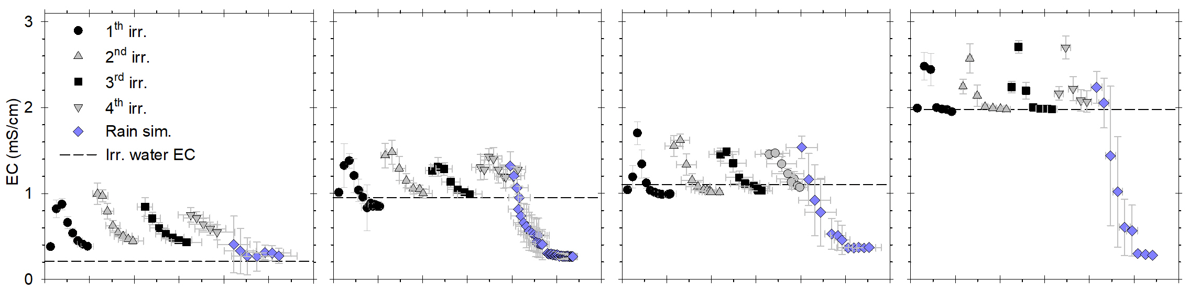
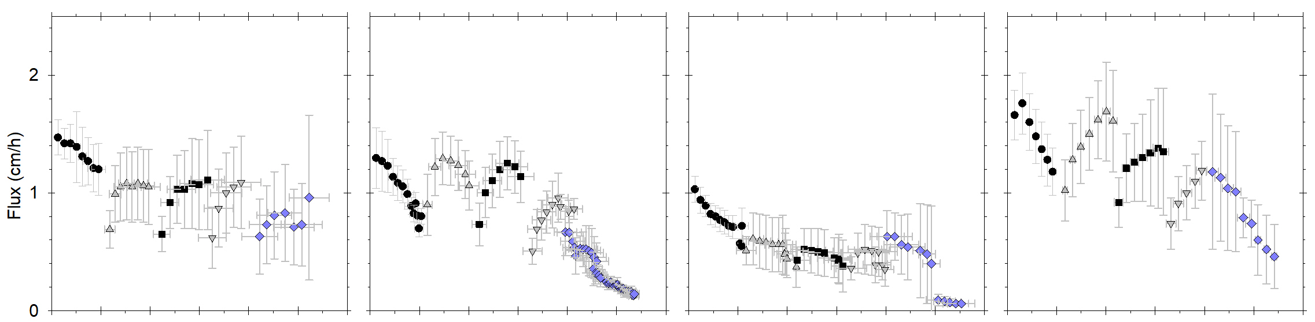
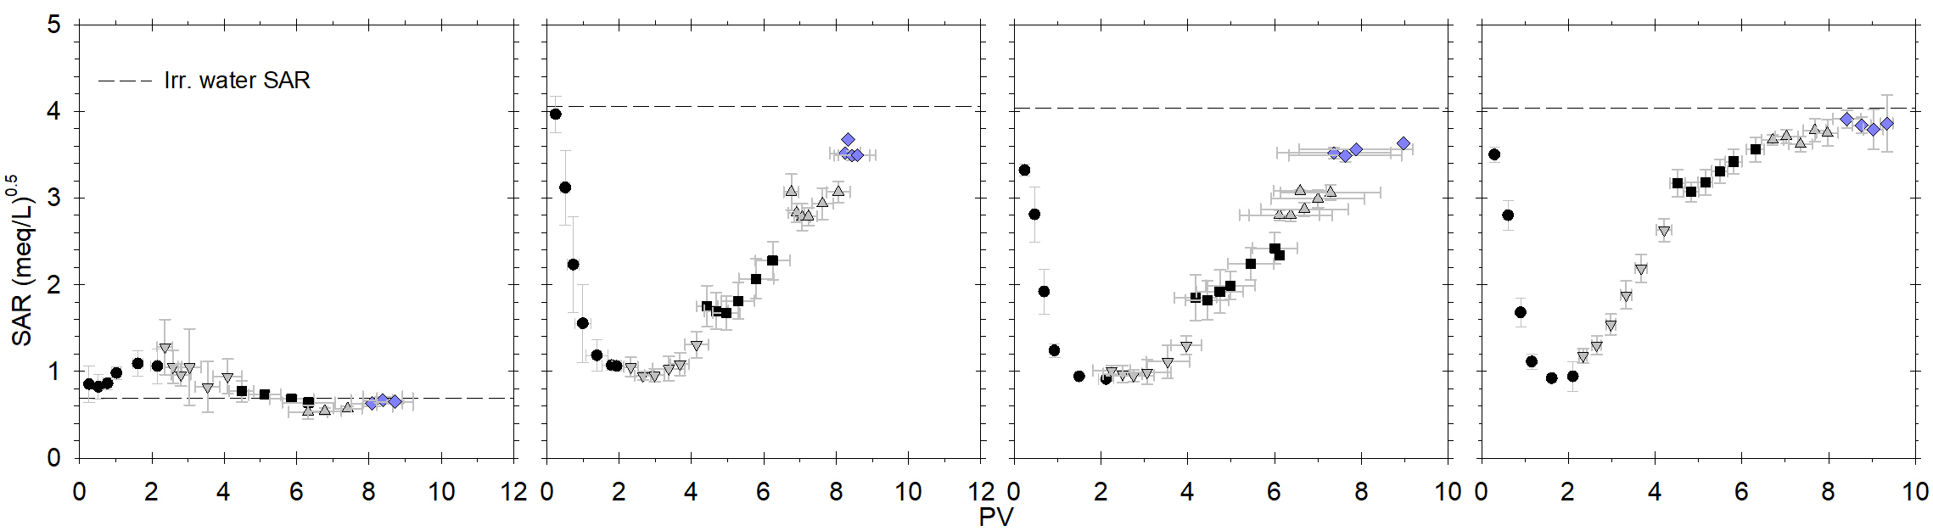
Effect of desalinated water derived treated wastewater on soil structural and hydraulic properties
Robert Neufeld and Gilboa Arye
DSW
TWW
TWW without DOC
TWW with added salts
Results - leachates
At the start of each irrigation event a higher EC which than slowly converged with the irrigation water EC was observed
The flux of TWW was overall lower than TWW with added salts (natural TWW). TWW without DOC exhibited reduced flux
SAR showed a reduction before converging to the irrigation water SAR, which illustrates the retardation of Na⁺ due to exchange reactions
Fig. 2. EC, flux and SAR of leachates (in rows) of respective WQ (columns), all as function of Pour Volume (PV).

Slide 4
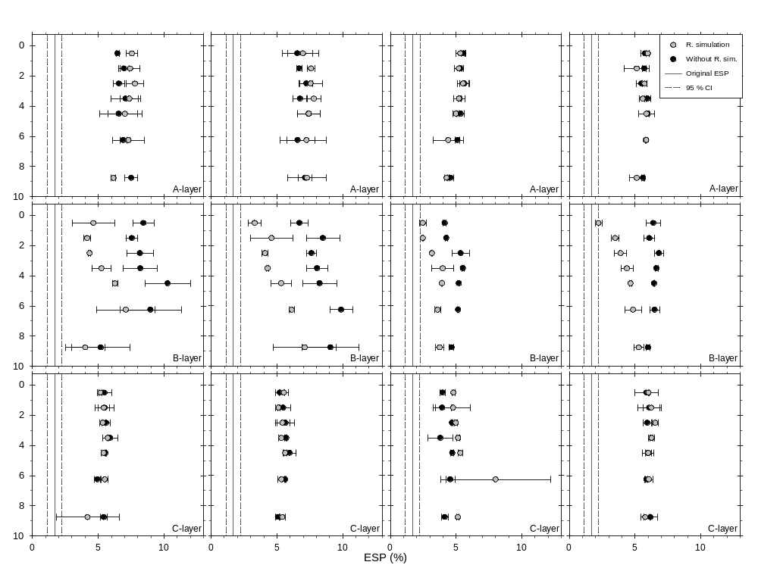
Effect of desalinated water derived treated wastewater on soil structural and hydraulic properties
Robert Neufeld and Gilboa Arye
DSW
TWW
TWW without DOC
TWW with added salts
Results – ESP
Overall ESP increased from below 2 % to above 4 % and up to 10 %
A significant reduction in ESP upon rain simulation was observed in the B-layer
Fig. 3. ESP as function of depth for four WQ.

Slide 5
Effect of desalinated water derived treated wastewater on soil structural and hydraulic properties
Robert Neufeld and Gilboa Arye
Conclusion
Our results indicate that irrigation with DSW-derived TWW will reduce hydraulic conductivity of clay soils
Furthermore, the increase in ESP and reduction in EC of DSW-derived TWW may lead to reduced structural stability and dispersion of clay aggregates and thus, soil degradation may take place

