Slide 1
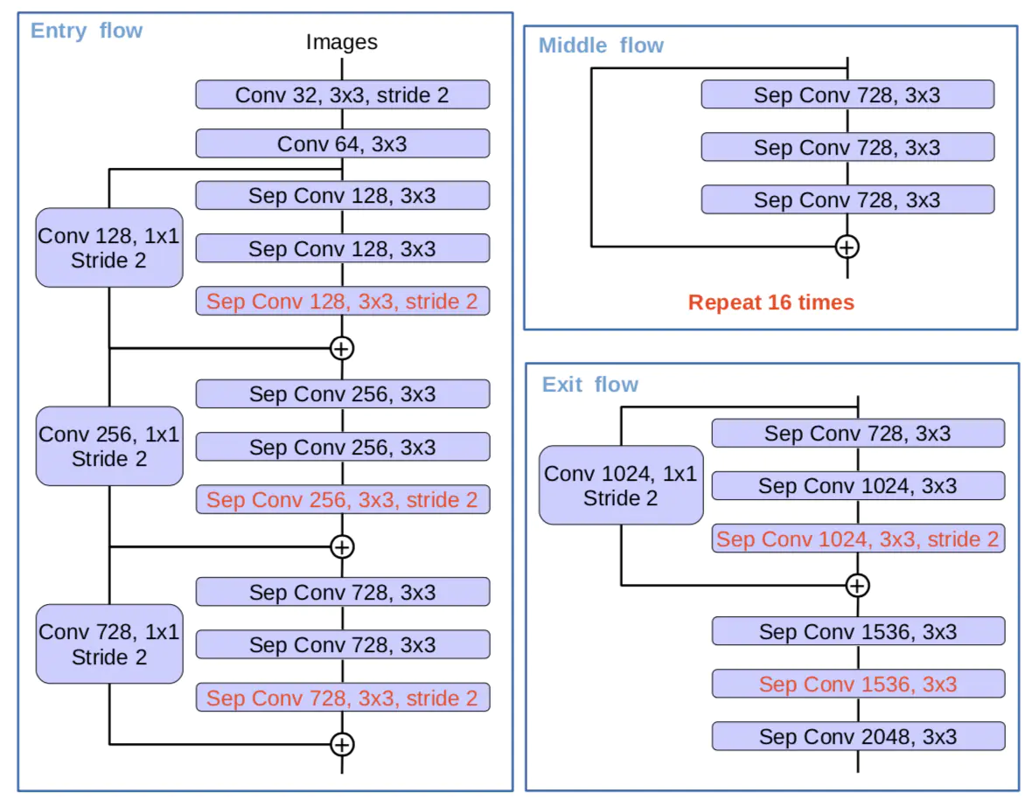
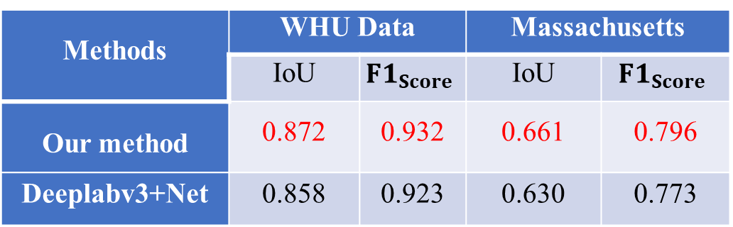
Reducing the stride of the convolution kernel: a simple and effective strategy to increase the performance of CNN in building extraction from remote sensing image
Meng Chen ¹, Jianjun Wu ^{1 ,2 ,3,} *,Feng Tian ¹, Bingyu Zhao ¹
¹ Faculty of Geographical Science, Beijing Normal University, Beijing 100875, China; ² State Key Laboratory of Remote Sensing Science, Beijing Normal University, Beijing, 100875, China;
³ Beijing Key Laboratory for remote sensing of Environmental and Digital Cities, Beijing, 100875, China; * Correspondence: jjwu@bnu.edu.cn; Tel.: +86-010-588-02283
Introduction
(IoU) increased by 1.4% and F1 score increased by 0.9%; in terms of Massachusetts Building Dataset, IoU increased by 3.31% and F1 score increased by 2.3%.
During study process, I found an interesting phenomenon that convolutional neural networks can achieve better classification results in high spatial resolution remote sensing images, but poor performance in low spatial resolution remote sensing images. Some studies have proved that texture information plays an important role in classification. While low-resolution remote sensing images contain insufficient texture information. While Most of neural network used to remote sensing image classification, Originated in the natural images with extremely high resolution. These networks with some dawn-sampling layers reduce the resolution of the feature maps which may reduce the performance of the network on remote sensing image.
Table 1. the results of our method and deeplabv3+Net on different datasets
Methods | WHU Data |  | Massachusetts
 | IoU | $$F1_{Score}$$ | IoU | $$F1_{Score}$$
Our method | 0.872 | 0.932 | 0.661 | 0.796
Deeplabv3+Net | 0.858 | 0.923 | 0.630 | 0.773
Conclusion
Figure 1. The basic structure of xception block used in our network
Data
① The significance of the down-sampling operation is to reduce the number of parameters and reduce the complexity of the network. However, the price is that the spatial resolution of the feature map is reduced, which has a great negative impact on the classification accuracy of low-resolution remote sensing images.
② Reducing the number of down-sampling layers is more conducive to mining texture information in low-resolution remote sensing images and improving its classification accuracy.
③We agree that for remote sensing images with different resolutions, different numbers of down-sampling layers should be designed.
WHU Data with 0.3m spatial resolution and Massachusetts with 1m spatial resolution were used to experiment. Both datasets contain two classes (buildings and backgrounds). They could be acquired from:
http://study.rsgis.whu.edu.cn/pages/download/ https://www.cs.toronto.edu/~vmnih/data/
Method
Based on the above analysis, a convolution block with a convolution stride of 2 was removed from modified xception block in Deeplabv3 + network. In order to reduce the number of parameters, the number of convolutional kernels are reduced. the rest of the network structure remained unchanged. The xception block in our method is shown in figure 1.
Result
Compared with the deeplabv3+net our method has a better performance. In terms of WHU building data set, the Intersection over Union

