Slide 1
Isotopic Characterization of Groundwater in Semi-arid Western India: Insights into Hydrogeological Processes
(Preliminary Results of Gujarat Groundwater)
Amit Pandey
SRF
Geosciences Division
Physical Research Laboratory
Ahmedabad, Gujarat, India
380009

Slide 2
Outlines
Groundwater budget of India
Study area and availability of Groundwater
Hydrogeological settings
Objectives
Preliminary results

Slide 3
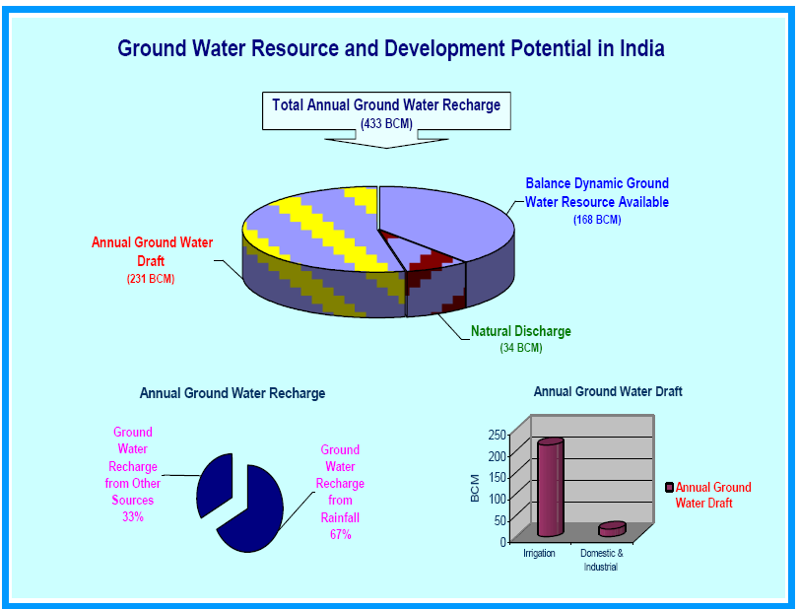
Indian Groundwater Budget
Source: Groundwater year book (2015)

Slide 4
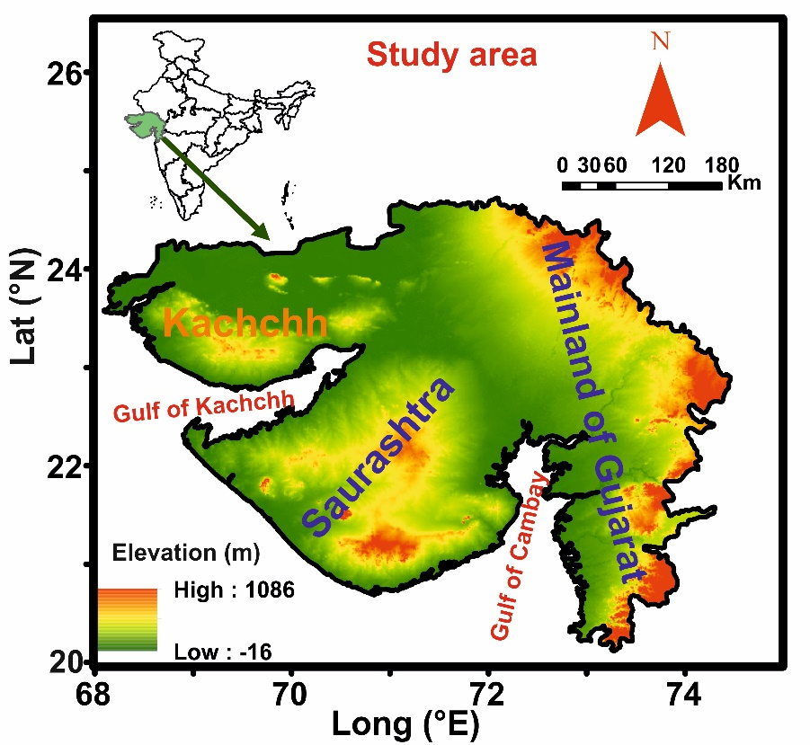
Study area
The state of Gujarat located in the semi-arid western India is fall under water stressed region
About 27% of the total area (~1.96×10⁵ km²) of the state is drought prone
The state is predominantly dependent on groundwater for its agriculture water demand, with as much as 82% of the net irrigated area in the state is groundwater-irrigated
An alarming fact about water resource scenario in the state is that there are 31 talukas (sub-district zones) which are categorised as over-exploited (groundwater development >100%), 12 talukas as critical (groundwater development 90-100%) and 69 talukas are semi-critical (groundwater development 70-90 %) ( CGWB 2017)
North Gujarat
South Gujarat

Slide 5
Availability of groundwater in Gujarat
Although adequate amount of water is available in Gujarat but the availability is vary spatially and temporally and skewed towards south Gujarat
Area | One Billion cubic meters
Area | Total Water Quota (Billion Cubic Mtrs) | Surface Water (Billion Cubic Mtrs) | Underground Water (Billion Cubic Mtrs) |  | % of Water Resources | % of area
Central & South Gujarat | 38.2 | 31.8 | 6.4 |  | 69 | 25
North Gujarat | 6.3 | 2.1 | 4.2 |  | 11 | 20
Saurashtra | 9.7 | 3.6 | 6.1 |  | 17 | 33
Kutch | 1.4 | 0. | 0.8 |  | 3 | 22
Total | 55.6 | 38.1 | 17.5 |  | 100 | 100
Surface and groundwater usage
Central and south Gujarat
Saurashtra
North Gujarat
Total availability of water is ∼ 55.6 BCM (Billion Cubic Meter)
The availability of surface water is more ( ∼ 38 BCM) but the spatial and seasonal distribution is heterogeneous
Source: http://www.gujenvis.nic.in/PDF/water.pdf

Slide 6
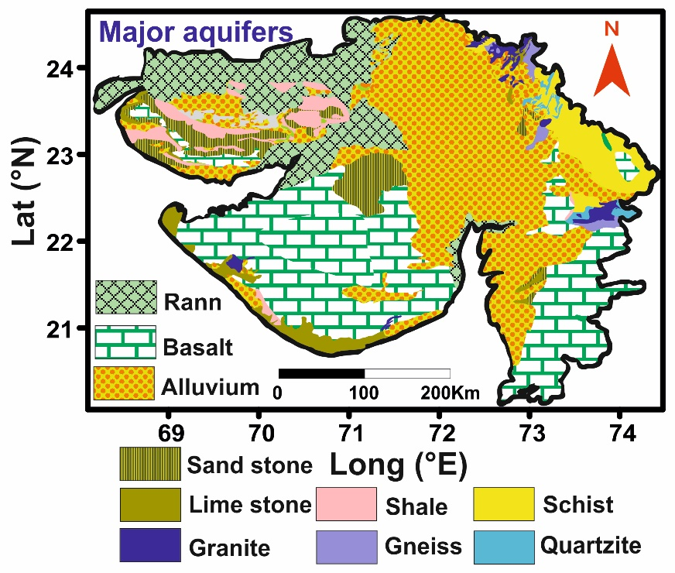
Hydrogeology of Gujarat
The study area have unconsolidated, semi-consolidated and fissured geological formation which act as a potential aquifer for groundwater and has a distinct hydrogeological characteristic.
These aquifer have different specific yield and rainfall infiltration factor which control the recharge proces
Modified from S. S. Merh, (Geology of Gujarat)

Slide 7
Objectives
Understanding the interaction between surface water and groundwater
Identify the areas which do receive influx of freshwater and which do not
Detecting source of groundwater recharge (rainwater, canal water, river, reservoir, irrigation return flow)
Explore the spatial heterogeneity in GW recharge rate

Slide 8
Methodology
The shallow groundwater samples (maximum water table depth 40 m) were collected during pre-monsoon (April) and post-monsoon (November) seasons from across the study area.
The groundwater samples were collected from the shallow unconfined aquifers, from the dug wells, to ensure that dynamic groundwater, seasonally replenished by freshwater, is authentically sampled to study surface water – groundwater interaction
The groundwater samples were collected in High Density Poly Ethylene Bottles (1 litre) after thoroughly rinsing it by the ground water from the same well to be sampled. Sample bottles were sealed with inner stub with pilferage proof caps
The samples were analysed for stable isotopes of oxygen (δ¹⁸O) and hydrogen (δ²H) using Delta V Plus Isotopic Ratio Mass Spectrometer (IRMS) in continuous flow mode with gas bench II at Physical Research Laboratory
The spatial and seasonal variation in δ¹⁸O, δ²H, and d-excess in conjunction with hydrological (Temporal variation of rainfall) and geohydrological (water table depth, types of the aquifer, and physiography of the region) parameters are used in this study to discern various processes like the interaction between seasonally present rain and groundwater, recharge dependency on aquifer type and physiography

Slide 9
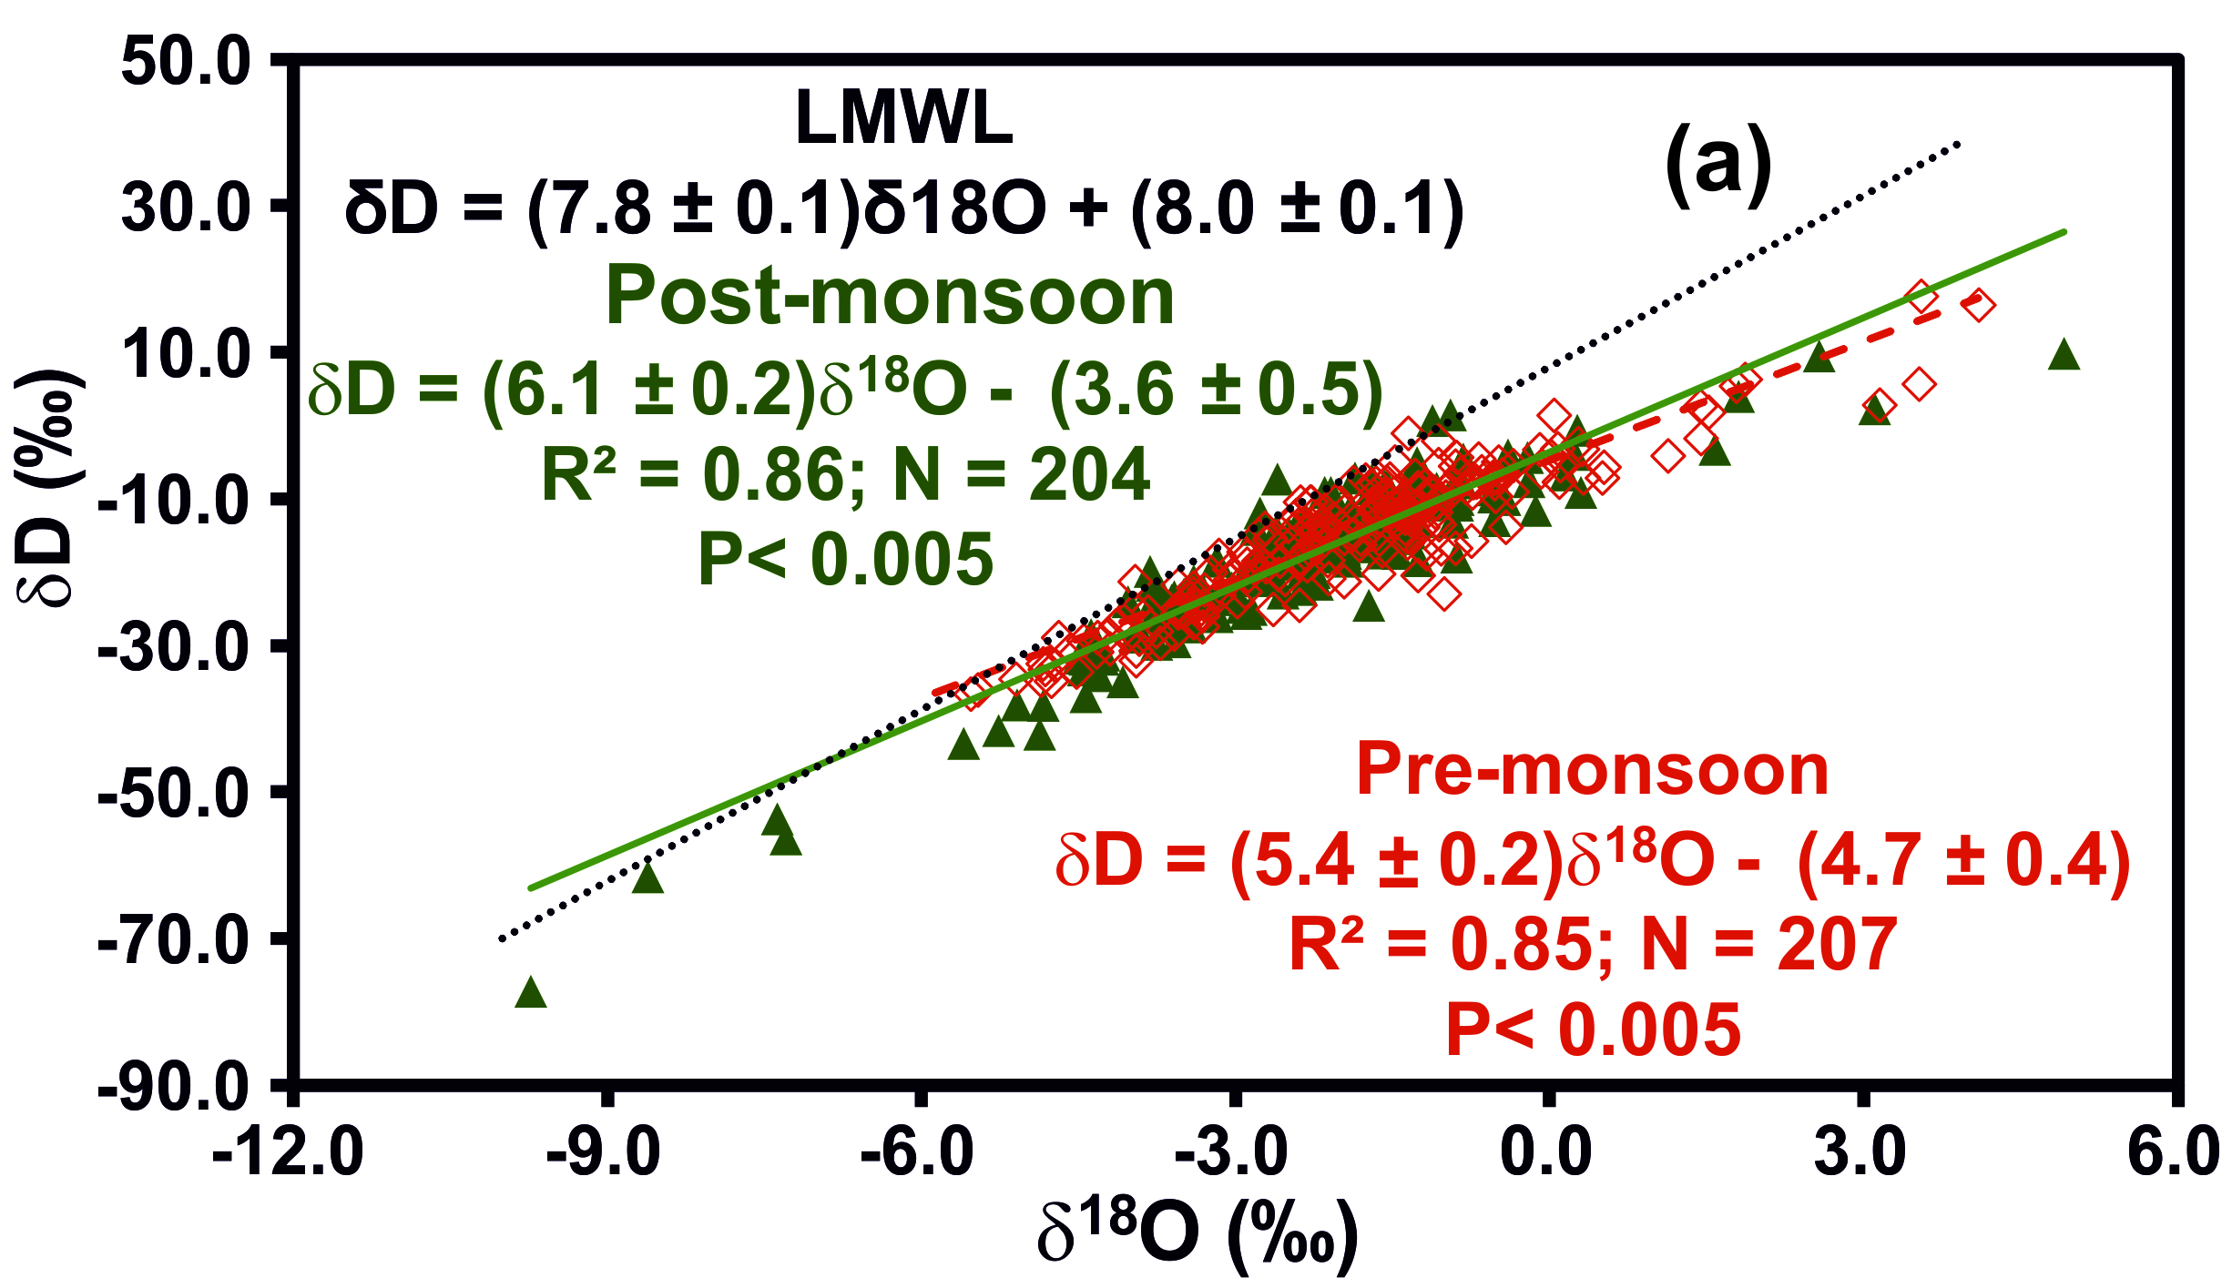
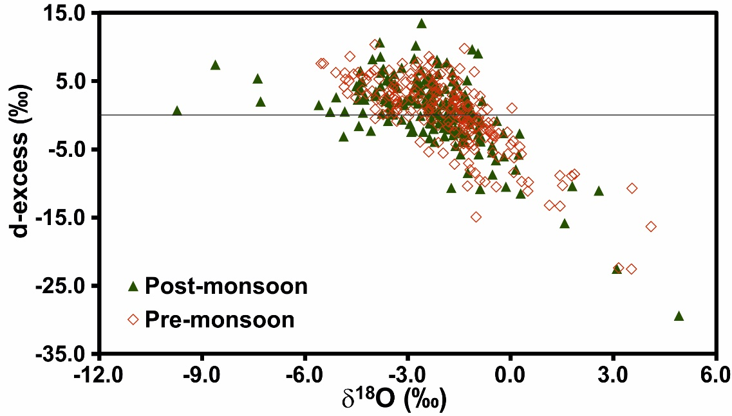
Results and discussion
The δ¹⁸O - δD regression lines for groundwater samples collected in pre-monsoon and post-monsoon have different values of slope and intercept which are statistically distinguishable
GW regression line slope for post-monsoon GW is lower than the LMWL indicating that the united effect of local atmospheric and ground surface processes results in minor to significant evaporation of water before groundwater recharge
the slope of pre-monsoon GW is less than the Post-monsoon GW as well as LMWL which indicates extensive evaporation from the unsaturated zone or even evaporative losses from the water table as the study area lies in semi-arid to the arid region

Slide 10
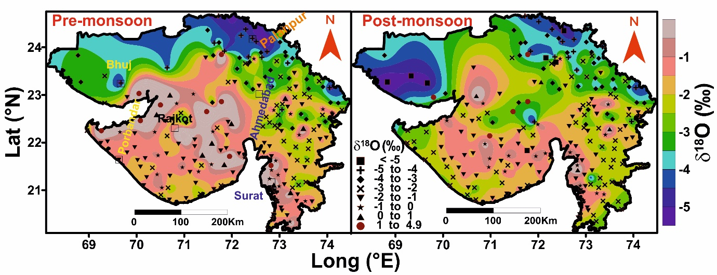
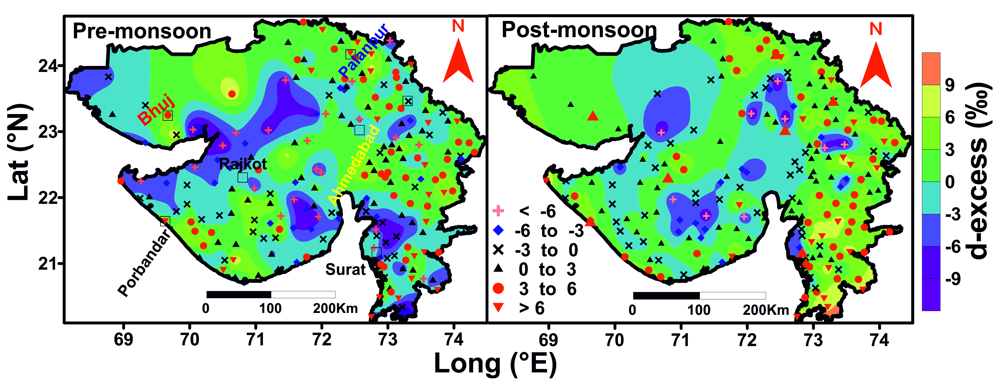
Spatial variation in δ¹⁸O and d-excess
spatial variation in isotopic composition of GW were observed across the study area which can be explained by the isotopic composition of rain, aquifer type, proximity to sea and latitude effect
The western coast of Saurashtra shows depleted δ¹⁸O compare to pre-monsoon as well as compare to rest part of Saurashtra which infer recharge from southwest monsoon rain and recharge process was faster compare to rest part of Saurashtra
The depletion of δ¹⁸O in the eastern part of south Gujarat is the combined effect of high altitude and recharge through secondary migratory pathways
Coastal Saur.
SG
SG

Slide 11
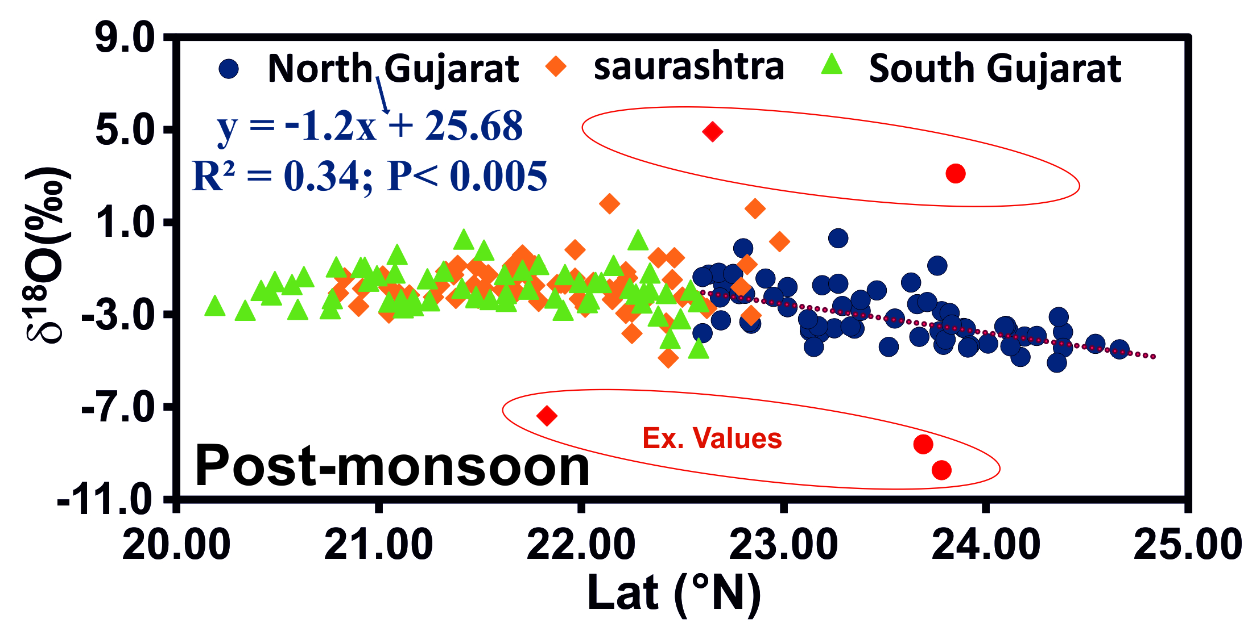
δ¹⁸O variation with latitude in shallow and deep Groundwater

Slide 12
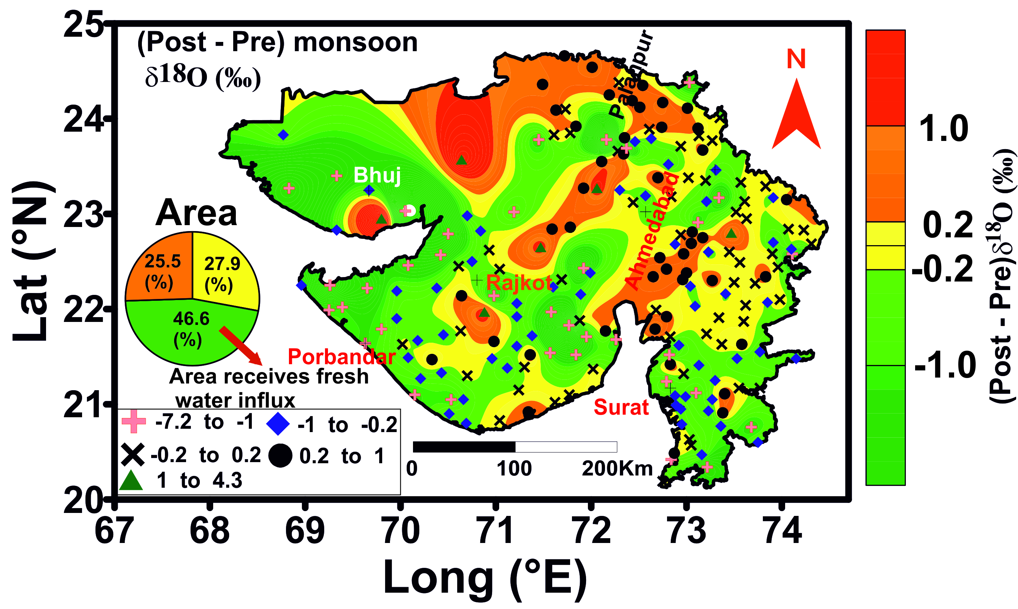
Temporal variation in δ¹⁸O

Slide 13
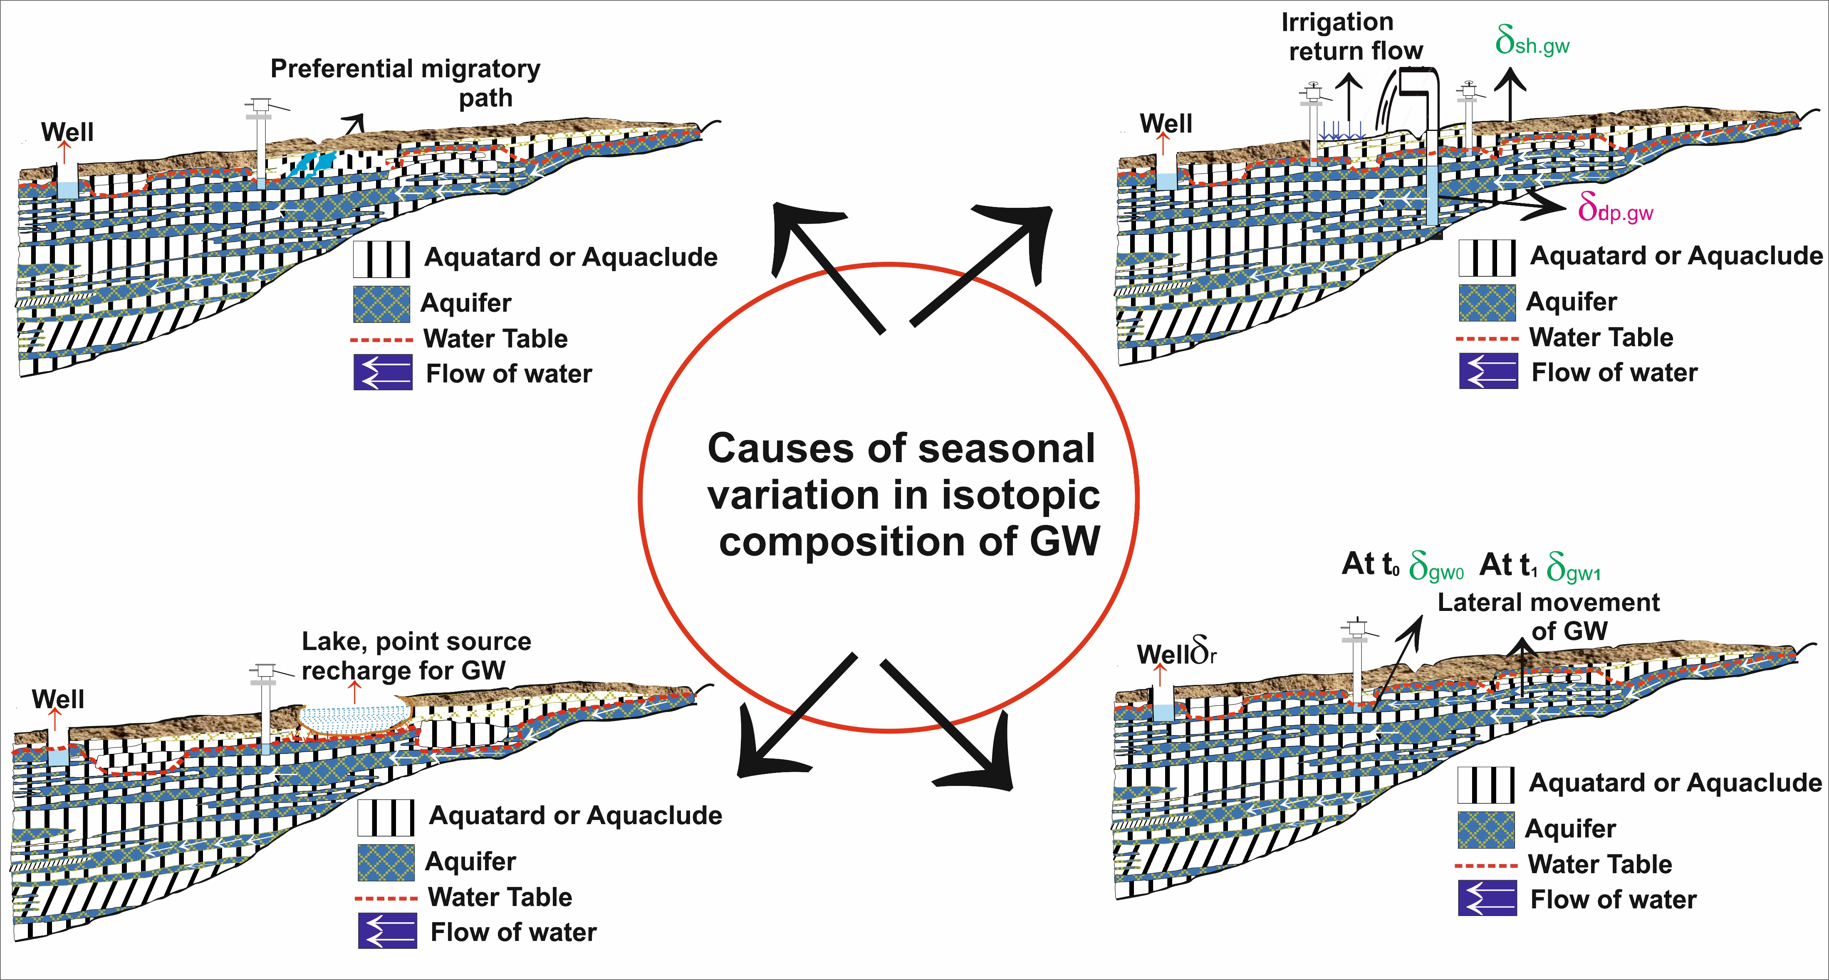
Conceptual model:

Slide 14
Summary:
δ¹⁸O depletion in post-monsoon GW compare to pre-monsoon infer the seasonal recharge of GW
δ¹⁸O of post-monsoon GW ( -2.3‰) lie in between the δ¹⁸O of pre-monsoon GW ( -1.9‰) and δ¹⁸O of southwest monsoon rainfall (-4.1‰) indicates post-monsoon GW is the mixture of these two components
Seasonal variation in δ¹⁸O deduce that 46.6% ( ∼91696 km2) of the total land area (∼ 196773 km2) shows seasonal GW recharge
Latitude effect in δ¹⁸O of groundwater was observed in north Gujarat
Norther Gujarat receives irrigation return
Faster recharge in coastal area of Saurashtra compared to rest part
Thank you…

