Slide 1



Evaluation of Earth Observation Products and Their Potential for Crop Damage and Crop Loss Assessment. The Case of Beacon Project.
Using a Satellite Drought Indicator for
Drought Damage Classification and
Parcel Based Crop Loss Assessment
Lekakis, E., Tarquis, A.M., Kotsopoulos, S., Mygdakos, G., Dimitrakos A., Tsioutsia, I.-M, Rivas-Tabares, D. and Simeonidou, P.
EGU General Assembly 2021
Session NH1.5 Hazard Risk Management in Agriculture and Agroecosystems
This project has received funding from the European Union's Horizon 2020 research and innovation programme under grant agreement No 821964.

Slide 2

transforms the Agri-Insurance Sector…
From…
Weather Risk
Uncertainty of Future Risk
Costs
Higher Operational & Administrative costs
Market
Low market uptake & High Premiums
To…
Weather Risk
Accurate estimation of the potential losses and indemnities
Costs
Remote Damage Estimation reduces Operational costs
Market
High market uptake & Affordable Premiums

Slide 3
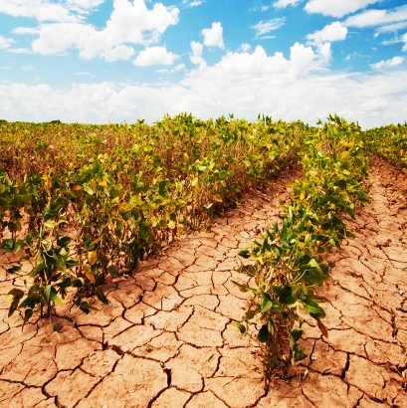
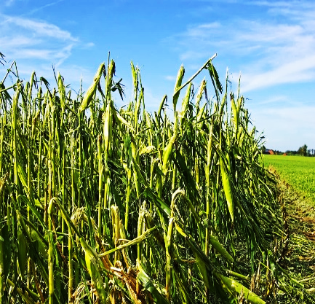
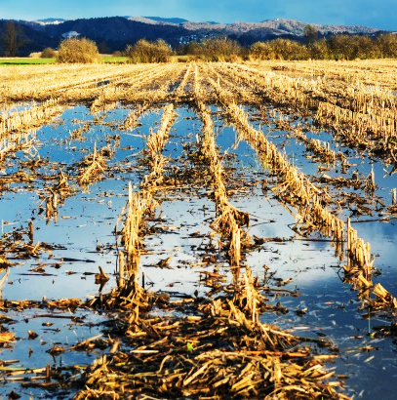
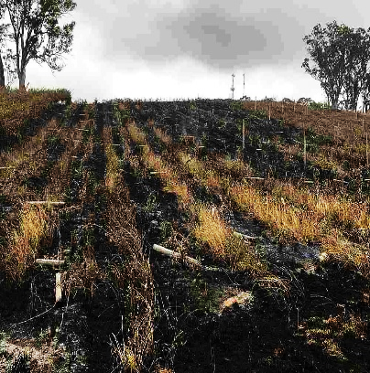
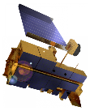
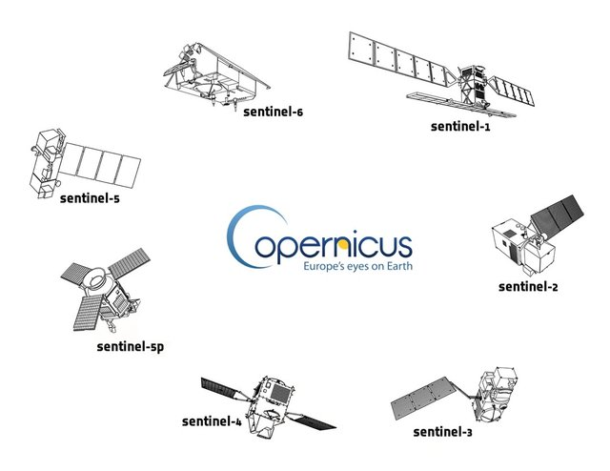
…by upscaling EO Data value
Drought damage assessment
Crop loss assessment
MODIS
composite NDVI data sets
NDVI Anomaly
Hailstorms damage assessment
Crop loss assessment
Sentinel-2
Change Detection
pre- post-damage imagery
Floods damage assessment Flood extent & duration
Sentinel-2, Sentinel-1
Change Detection
pre- post-damage imagery
Wildfires damage assessment
Fire extent & severity
Sentinel-2
Change Detection
pre- post-damage imagery
Drought
Hailstorms
Floods
Wildfires

Slide 4
Satellite Drought Indicator
Drought Damage Assessment
MODIS Terra GMOD09Q1 product
    Daily
    surface reflectance
    data
Satellite-
derived
vegetation
indices
products
    8-day NDVI composite at 250 m spatial resolution
Historical
NDVI composites
available
from 2001

Slide 5
The Spanish use case
Drought Damage Assessment

Slide 6


DATA
Data collection and preprocess
Geospatial Data
Satellite Data
Year | Drought | Non-Damaged
2014-2015 | 12 | -
2015-2016 | - | 117
2016-2017 | 95 | 53
2017-2018 | 13 | -
2018-2019 | 42 | -
2019-2020 | - | 109
Total | 162 | 280
MODIS NDVI 8-day composites (250 m resolution)
Relative NDVI Anomaly
NDVI current is the current 8-day NDVI composite
NDVI mean is the average NDVI from 2001 for the same 8-day period
Crops | Rainfed wheat and barley
Region | Ávila and Segovia
Damage | 10 – 100%
Parcel size | 1 – 60 ha

Slide 7
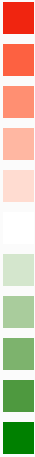
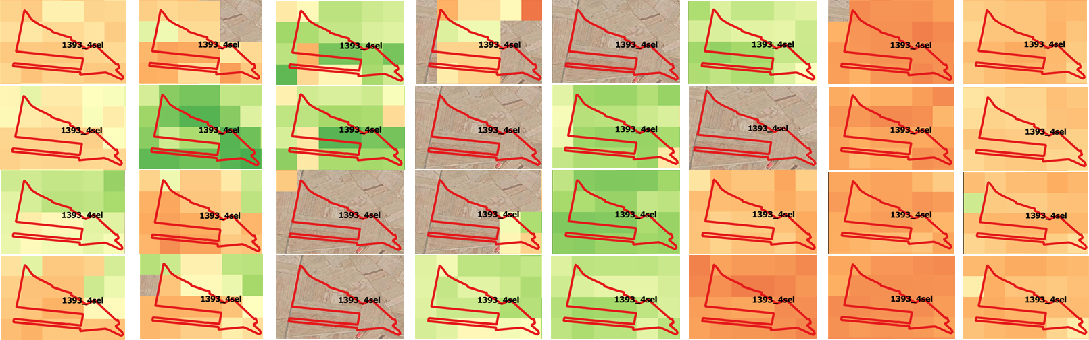
NOVEMBER
DECEMBER
JANUARY
FEBRUARY
MARCH
APRIL
MAY
JUNE
NDVI - Anomaly
Relative NDVI – Anomaly calculation
-100
-80
-60
-40
-20
0
20
40
60
80
100
1st 8d
2nd 8d
3rd 8d
4th 8d
Pixels Mean Values per 8d period

Slide 8

Indicator – Impact functions
Correlation between drought damage and NDVI Anomaly metrics
Drought Damage Assessment
The approach was applied for both rainfed wheat and barley.
Only damaged parcels data were used.
Different metrics of the NDVIA were tested.

Slide 9
Indicator – Impact functions
x | Best fit for damage quantification (%) | RMSE (in %) | nRMSE | MAE (in %) | r
Accumulation of positive and negative NDVIA values throughout the growing season | sqrt(6472.31 - 1.53753x) | 18.57 | 23.69 | 11.59 | -0.140
Accumulation of positive and negative NDVIA values from sowing until 1st May | (8.61906+0.000779977x)² | 20.03 | 25.51 | 16.34 | 0.143
Accumulation of positive and negative NDVIA values from 1st April until harvest | (7.97835-0.00489403x)² | 20.49 | 27.24 | 15.67 | -0.557
Accumulation of absolute negative NDVIA from 1st April until harvest | exp(3.70932+0.0434447sqrtx) | 20.42 | 25.78 | 16.19 | 0.482
Accumulation of absolute negative NDVIA from sowing until 1st May | exp(4.34483-0.00000163952x²) | 18.23 | 24.06 | 14.66 | -0.170
Accumulation of absolute negative NDVIA lower than -25% throughout the growing season | (7.43214+0.0995222sqrtx)² | 15.70 | 20.10 | 11.39 | 0.372
Accumulation of absolute negative NDVIA lower than -25% from 1st April until harvest | (7.01467+0.154791sqrtx)² | 14.53 | 18.51 | 11.13 | 0.530
Accumulation of absolute negative NDVIA lower than -25% during May | exp(3.82504+0.0587201sqrtx) | 18.67 | 23.14 | 14.89 | 0.587
Accumulation of absolute negative NDVIA lower than -25% during April and May (8 values) | exp(3.96415+0.0394364sqrtx) | 18.80 | 23.64 | 14.04 | 0.504
Accumulation of absolute negative NDVIA lower than -25% during March, April and May (12 values) | exp(3.91805+0.0436961sqrtx) | 22.78 | 29.21 | 17.81 | 0.558
Accumulation of absolute negative NDVIA lower than -25% during May and June (8 values) | exp(3.79778+0.0484829sqrtx) | 19.22 | 24.99 | 14.10 | 0.629
Accumulation of absolute negative NDVIA lower than -25% during June (4 values) | exp(3.86061+0.0671895sqrtx) | 18.60 | 23.20 | 14.12 | 0.560
Drought Damage Assessment
The late season NDVI–Anomaly was moderately strong correlated with the damage.
Accumulation of absolute negative NDVI-Anomaly lower than -25% during May was moderately strong correlated with the damage (r = 0.587)

Slide 10
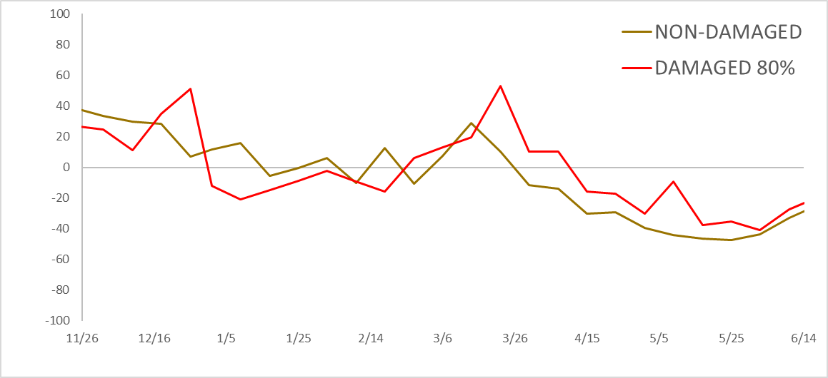
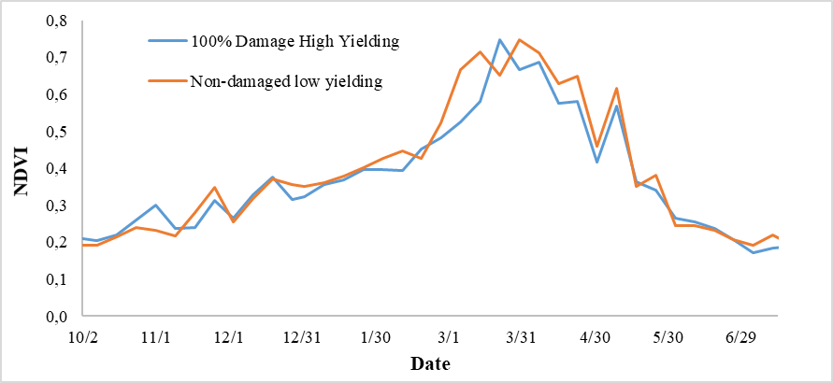
NDVI-Anomaly of damaged and non-damaged parcels is similar:
The historical NDVI timeseries may not necessarily reflect previous wheat and barley crops at the same parcel, but also incorporation of other crops through a rotation program or even fallow land.
Results should take into account only wheat and barley cropping seasons. Seasons not affected by drought.
Limitations of NDVI-Anomaly for claim-based insurance
Results are crop and region specific. Are they PARCEL-SPECIFIC too?
Does NDVIA reflect historically the same crop? Should all previous seasons (2001-2020) be used?
How can we take into account the dynamics of the parcels?
NDVI of damaged and non-damaged parcels is similar:
There is probably a lag between drought effects and NDVI (impact on vegetation reflected on NDVI)
The dynamics of a parcel are not apparent on EO data - NDVI. This is the reason yield prediction fails.
Damaged and non-damaged parcels should be examined separately.

Slide 11
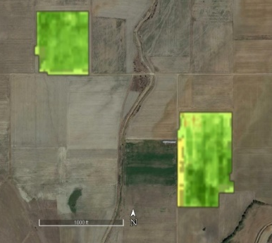
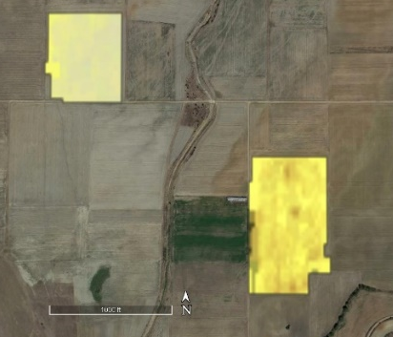
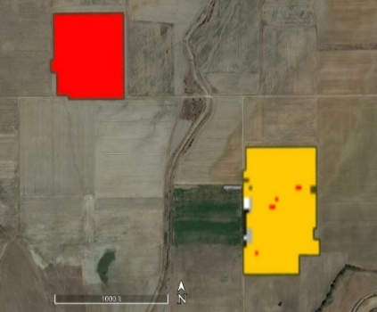
Change detection – VI differencing
Ηail damage assessment
Pre-damage Image Post –damage Image Result (DPI)
Sentinel-2 Optical VIs
Sentinel-2 Biophysical Parameters
Sentinel 1 Radar VIs

Slide 12
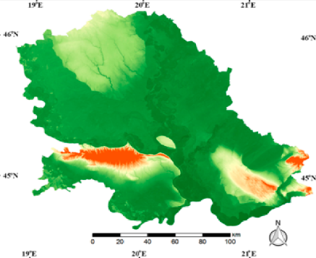
The Serbian use case
Hail Damage Assessment

Slide 13

DATA
The Serbian use case
Geospatial Data
Satellite Data
Year | Hail |  |  | Non-Damaged
 | wheat | maize | soybean | wheat | maize | soybean
2015-2016 | - | 26 | 22 | - | - | -
2016-2017 | - | 16 | 11 | - | - | -
2017-2018 | 59 | 1 | 24 | - | - | -
2018-2019 | - | - | - | - | 55 | 66
2019-2020 | 33 | 26 | 39 | 16 | 15 | 7
Total | 91 | 69 | 86 | 16 | 70 | 73
Sentinel-1, Sentinel-2
Damage Percentage Index (DPI):
Crops | Wheat, maize, soybean
Region | Vojvodina
Damage | 5 – 100%
Parcel size | 0.1 – 55 ha
Sentinel-2 Optical VIs
NDVI, GNDVI, MCARI, REIP
Sentinel-2 Biophysical Parameters
LAI, fAPAR, fCOVER
Sentinel 1 Radar VIs
MPDI, VH/VV, VV and VH backscatter signals

Slide 14
Simple VI differencing
Pre-damage Image Post –damage Image Result Damage (%)
Ηail damage assessment
Object-(parcel)-based methodology.
The approach was applied separately for wheat, maize and soybean.
SAR and Optical VIs were tested against ground truth data.
VI differencing in the in the first available pre- and post-damage image.
Only damaged parcels data were used.
Metric | Value
Mean Error (ME) | -1.7%
Root Mean Square Error (RMSE) | 20.4%
Coefficient of Residual Mass (CRM) | 0.07
Correlation Coefficient (R²) | 0.23
Wheat
Metric | Value
Mean Error (ME) | -3.1%
Root Mean Square Error (RMSE) | 8.5%
Coefficient of Residual Mass (CRM) | 0.17
Correlation Coefficient (R²) | 0.54
Maize

Slide 15
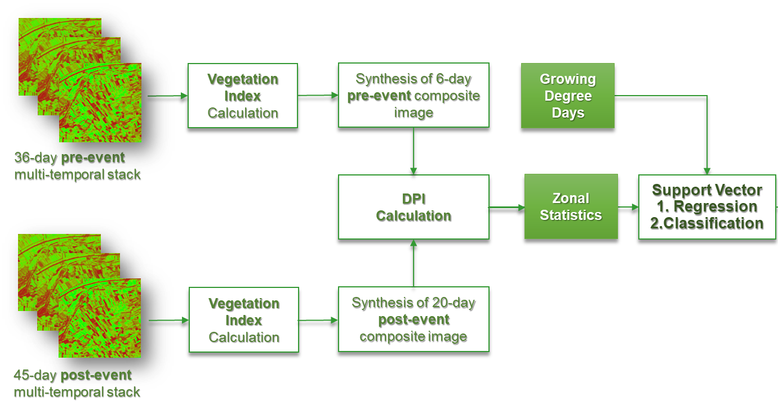
Machine learning for hail damage assessment
Object-(parcel)-based methodology.
A general model and three crop-specific models for wheat, maize and soybean.
Two ML algorithms: i. Support Vector Machines (SVM) and ii. Random Forest (RF)
Only optical VIs were used as training data.
DPI obtained by the 6 days-pre and 20 days-post damage image.
Damaged and non-damaged parcels were used.
Damage classification 0-10, 10-30, 30-70 and 70-100%.
Damage percentage.

Slide 16
SVM Regression
Crop | Outlier Detection |  | Feature Selection |  | RMSEC | R^2 Cali | RMSEV | R^2 Vali |  | RPD |  | RPIQ
All | PCA Res & Inf |  | All |  | 1.89 | 0.99 | 17.53 | 0.21 |  | 1.13 |  | 1.14
Maize | PCA Maha |  | SBF |  | 7.20 | 0.61 | 8.98 | 0.41 |  | 1.30 |  | 1.67
Soybean | PCA Maha |  | HS p-value |  | 18.02 | 0.54 | 20.38 | 0.41 |  | 1.25 |  | 1.47
Wheat | PCA Maha |  | SBF |  | 8.62 | 0.58 | 10.57 | 0.38 |  | 1.24 |  | 1.28
SVM Classification
Crop | Outlier Detection | Feature Selection |  | Overall Metrics |  |  | By Class Metrics
 |  |  |  | Accuracy |  | Kappa |  |  | Precision |  | Recall |  | F1
All | PCA Maha | All |  | 0.577 |  | 0.190 | 0-10% |  | 0.53 |  | 0.98 |  | 0.69
 |  |  |  |  |  |  | 10-30% |  | 0.92 |  | 0.27 |  | 0.42
 |  |  |  |  |  |  | 30-70% |  | NA |  | 0 |  | NA
 |  |  |  |  |  |  | 70-100% |  | NA |  | 0 |  | NA
Maize | PCA Res & Inf | All |  | 0.620 |  | 0.280 | 0-10% |  | 0.6 |  | 0.68 |  | 0.63
 |  |  |  |  |  |  | 10-30% |  | 0.65 |  | 0.65 |  | 0.65
 |  |  |  |  |  |  | 30-70% |  | NA |  | 0 |  | NA
 |  |  |  |  |  |  | 70-100% |  | NA |  | NA |  | NA
Soybean | PCA Res & Inf | All |  | 0.514 |  | 0 | 0-10% |  | 0.51 |  | 1 |  | 0.67
 |  |  |  |  |  |  | 10-30% |  | NA |  | 0 |  | NA
 |  |  |  |  |  |  | 30-70% |  | NA |  | 0 |  | NA
 |  |  |  |  |  |  | 70-100% |  | NA |  | 0 |  | NA
Wheat | All Data | SBF |  | 0.428 |  | -0.060 | 0-10% |  | 0.44 |  | 0.92 |  | 0.6
 |  |  |  |  |  |  | 10-30% |  | 0 |  | 0 |  | NA
 |  |  |  |  |  |  | 30-70% |  | NA |  | 0 |  | NA
 |  |  |  |  |  |  | 70-100% |  | NA |  | NA |  | NA
Machine learning for hail damage assessment

Slide 17
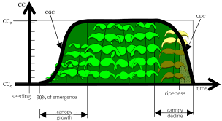
The ML regression model for damage percentage with change detection could work for certain crop stages
Limitations of DPI
DPI is almost unable to discriminate damage during senescence and physiological maturity.

Slide 18









Partners
Redefining Agricultural Insurance tools
For more information visit: http://beacon-h2020.com
This project has received funding from the European Union's Horizon 2020 research and innovation programme under grant agreement No 821964.

Slide 19


