Slide 1
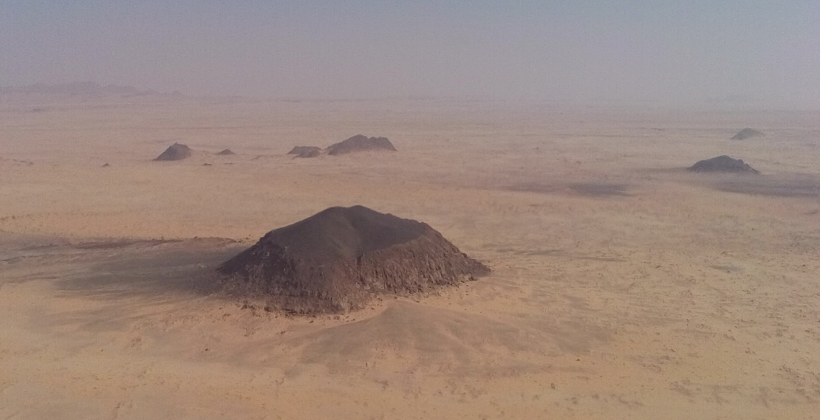
Hidden but ubiquitous:
the pre-rift continental mantle in the Red Sea region
Camilla Sani, Alessio Sanfilippo, Najeeb M.A. Rasul, Luigi Vigliotti, Nawaf Widinly, Abdulnasser S. AlQutub, Ahmed Osemi, and Marco Ligi.

Slide 2
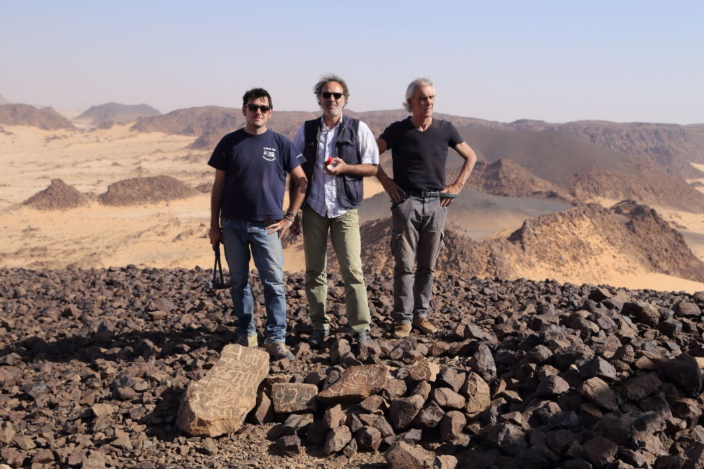
Field work
We conducted field work and sampling on a representative subset of Uwayrid lava flows in the spring of 2016.
Within the study area, the volcanic activity is represented by 2 principal groups:
lavas exposed on Harrat Uwayrid consisting of a sequence of flat lying, mainly alkali-olivine basalt flows;
basalts from volcanic pipes/diatremes intruding the Saq Sandstone immediately to the east of Uwayrid (Marthoum area), ~60 km north-northwest of Al’Ula.

Slide 3
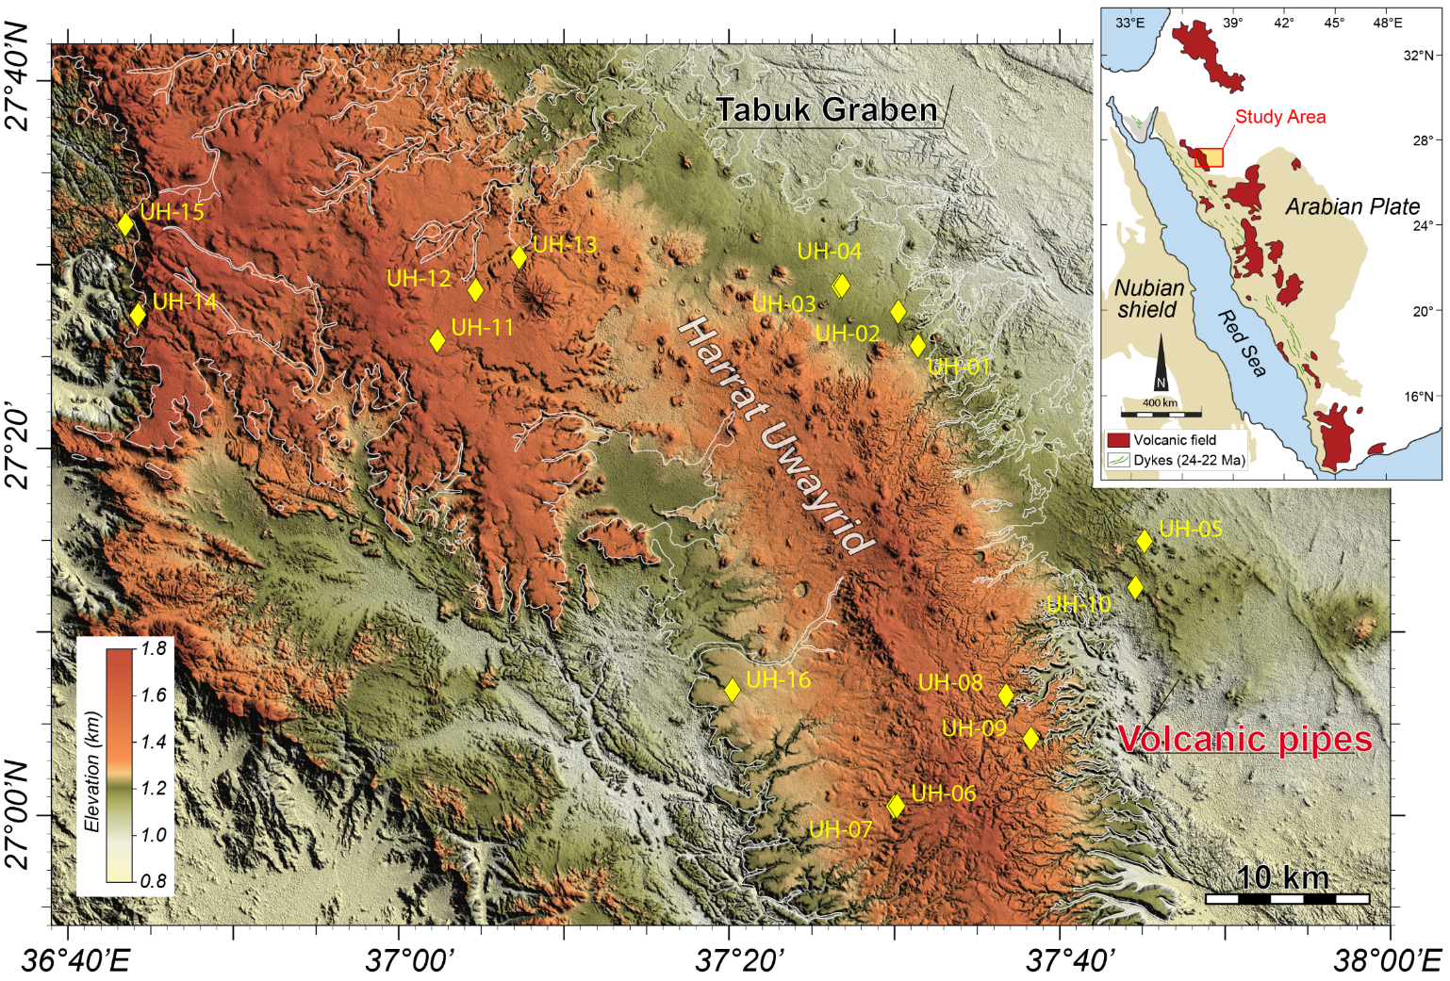
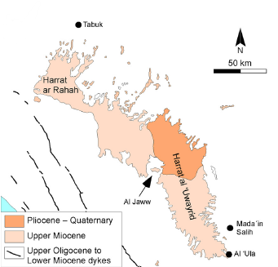
The Cenozoic volcanism in the Arabian plate is one of the largest alkali volcanic province on Earth ...
Samples in this study were recovered from the Harrat Uwayrid and on a subset of volcanic pipes outcropping along its eastern flank
Harrat Uwayrid
Heavily eroded series of older plateau basalts, overlaid by younger flows located mainly north of the Al Jaww depression (Brown et al., 1989; Coleman, 1993).
Based on K- Ar dating, the volcanic activity of Harrat Uwayrid in three groups: late Miocene, Pliocene and Quaternary volcanism (Altherr et al., 2019).
Sampling-study station
(Altherr et al., 2019, Lithos)

Slide 4
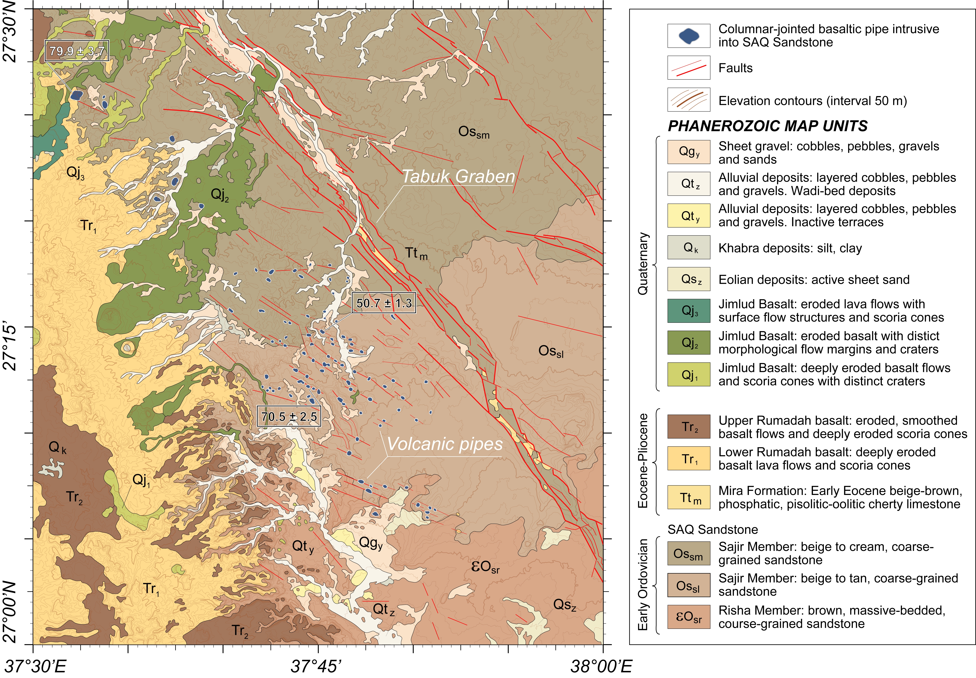
Harrat Uwayrid sampling
Samples in this study were recovered from the Harrat Uwayrid and on a subset of volcanic pipes outcropping along its eastern flank
Samples from Uwayrid were collected from different volcanic units:
Tr₁-Tr₂ to Qj₁-Qj₃ of Vaslet et al . (1994).
32 samples from the Harrat Uwayrid were selected for geochemical analysis
Geological map of the Tayma Quadrangle, Sheet 27 C, Scale 1:1250,000 (Vaslet et al., 1994, Saudi Geological Survay)

Slide 5
The Cenozoic volcanism in the Arabian plate is one of the largest alkali volcanic province on Earth ...
Samples in this study were recovered from the Harrat Uwayrid and on a subset of volcanic pipes outcropping along its eastern flank
Marthoum volcanic pipes
East of Harrat Uwayrid, within a 20 km by 30 km area comprised between 27°-27.5°N latitude and 37.5°-38°E longitude, aligned along the normal faults trending north-northwest that divides the Phanerozoic sandstones into long narrow horst-graben stripes, over 100 volcanic pipes intrude the sandstones occupying a stratigraphic horizon in the Saq formation (Liddicot, 1982).
Samples from the Marthoum area were collected from two different volcanic pipes, at the station UH-05 and UH-10.
5 samples from the volcanic pipes were selected for geochemical analysis.
Sampling-study station

Slide 6
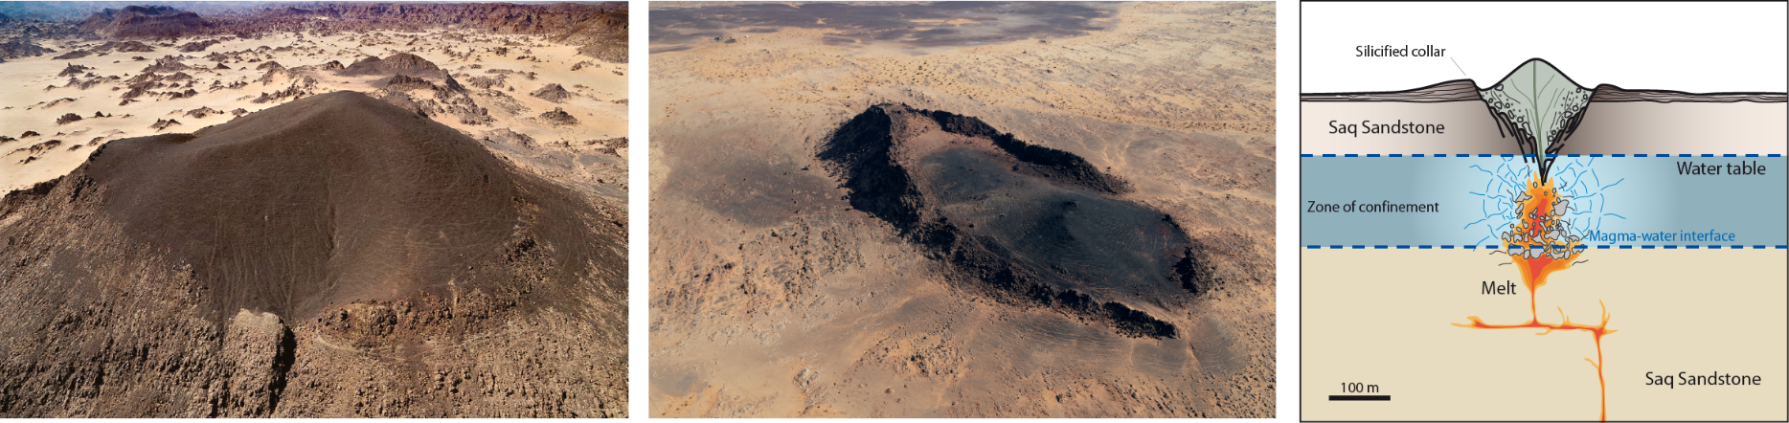
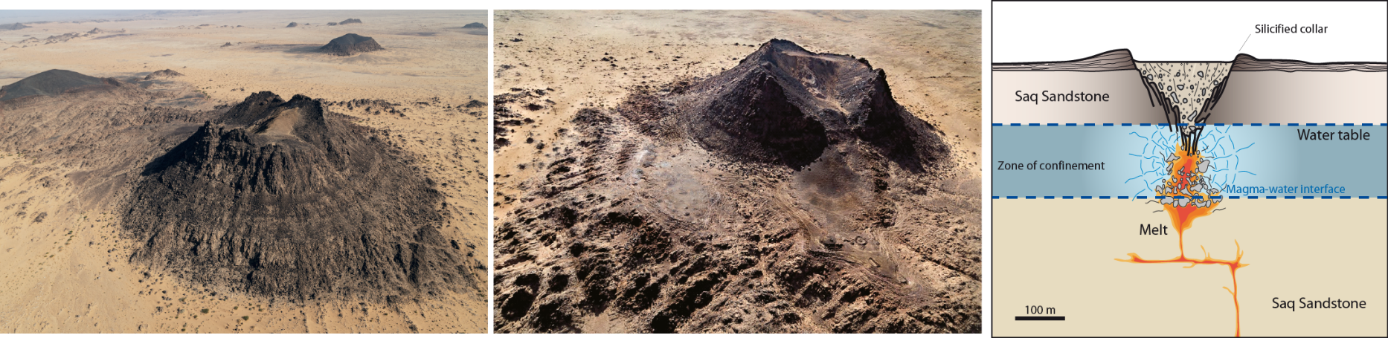
Volcanic pipes from Marthoum area
The volcanic pipes from a morphological point of view, can be divided into two distinct structures:
UH-05
UH-10
Most have a central basaltic core with vertical walls, and diameters commonly < 300 m, and the characteristic erosion-resistant collar of silicified sandstone.
50 Ma
80 Ma
Others (20%), despite having a sandstone collar, lack basalt with columnar jointing (or it is present only in small quantities) and commonly, have a crater with a depressed central part and a flat bottom. The filling of sedimentary blocks derived from higher stratigraphic levels is probably the result of the collapse of the maar walls into the crater. Thus, only these pipes can be considered diatremes (Liddicot, 1982)
Notes:
Non ho capito bene la diferenza, di cosa è riempita la seconda tipologia ti pipa????

Slide 7
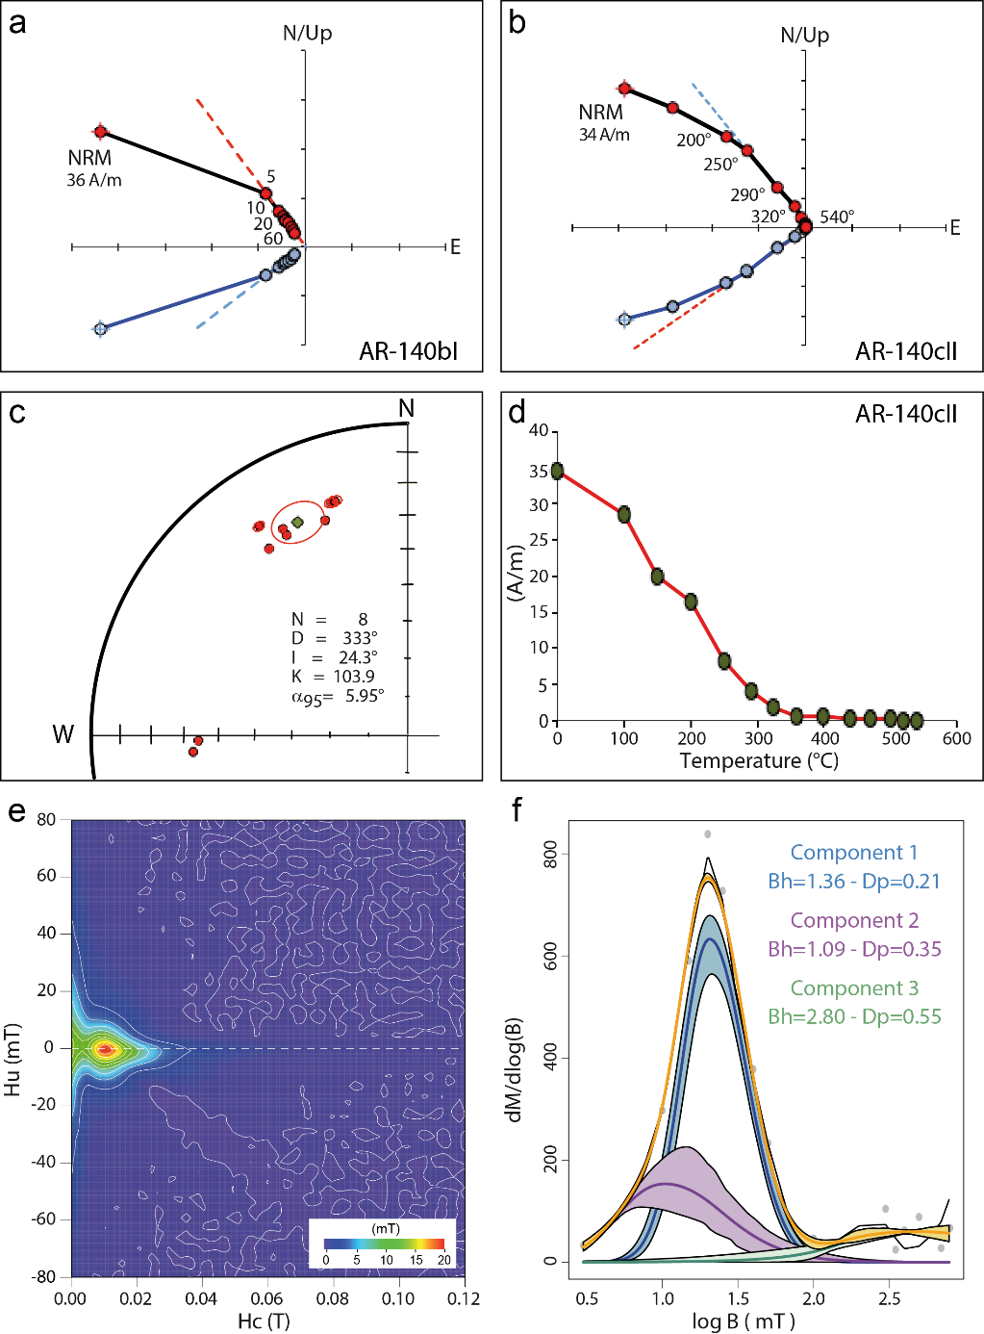
Paleo/Rock Magnetic Results
AF/thermal cleaning (a, b) show the presence of a minor secondary overprint removed after a peak field of 10-15 mT or a temperature of 150-200°C after which the directions stabilize indicating the presence of a stable vector representing the Characteristic Remanent Magnetization (ChRM). The mean paleomagnetic results (c) can be considered representative of the earth magnetic field present at the time of the eruption. The result indicates a counterclockwise rotation and a lower paleolatitude of the Arabian Plate at the timing of the emplacement of the rock. This is in agreement with the reconstructed movements of the Arabian Plates during the Tertiary.
The main carrier of the remanence is Titanomagnetite with a consistent amount of Ti as indicated by the decrease of the magnetization during the thermal cleaning (d).
Forc diagram indicates the presence of two grain size with dominant small grains in the PSD state and a contribution of larger grains (MD) evident by the spreading along the Hu axe (e). The two components are also evident in the coercivity distribution from IRM acquisition (f). They reflect the quenching history of the columnar basalts with the small grains (PSD) representing the rapid cooling occurring in correspondence of the phreatomagmatic explosions and the larger (MD) grains the post-depositional cooling.

Slide 8
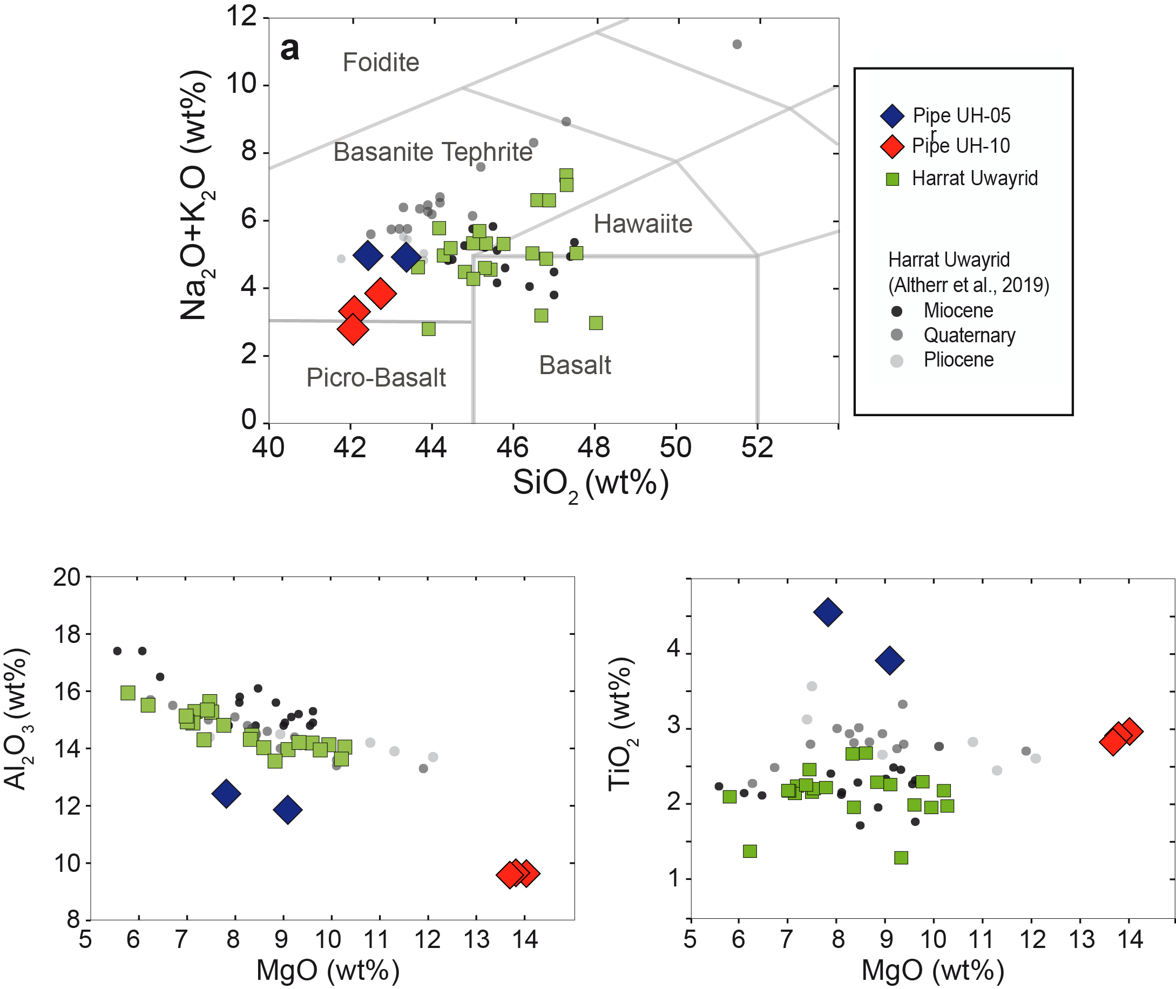
Gechemical results:
diffrences between lavas from the H.Uwayrid and the Marthoum volcanic pipes
alkaline-olivine basalts and fall into the field of basalts, hawaiite and basanite with SiO2 ranging within 42-48%.
Porphyritic texture with phenocrysts of fresh olivine (50-60%), clinopyroxene (20-30%) and oxides (5-10%) dispersed in a glassy matrix. Plagioclase is not present as phenocryst.
According to a fractional crystallization process, the rock samples show decreasing MgO at increasing SiO2, Al2O3 and most incompatible elements (K2O, Na2O, P2O3), whereas CaO, TiO2 and FeO tend to decrease.
Marthoum pipe sampels show different major compositions from those of the Harrat Uwayrid having lower Al2O3 (13-9 wt%) and higher TiO2 (3-4.7 wt%) contents.

Slide 9
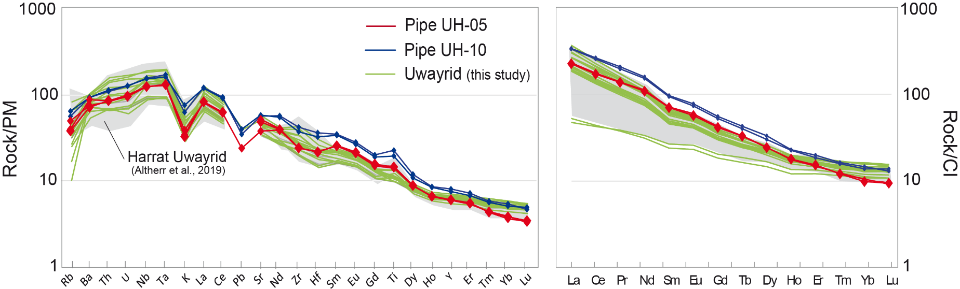
Gechemical results:
diffrences between lavas from the H.Uwayrid and the Marthoum volcanic pipes
For both series, lavas from H.Uwayrid and from the volcanic pipes (UH-o5; UH-10), show enrichement in incompatible elements:
high Nb and Ta
LILE (Rb, Ba, Cs) and Th and U are relatively low compared to Nb and Ta.
The low LILE relative to HFSE and REE contents reveal OIB-like enriched incompatible trace element patterns
The enriched compositions may reflect high Ba/Rb and Nb/Th-U ratios of the mantle source.
Pronunced negative K anomaly -> occurrence of an alkali-bearing phase, such as amphibole in the mantle source (e.g., Rosenthal et al., 2009)
Pipe UH-05
Pipe UH-10
Pronunced Ti positive anomaly
Depleted in Zr and Hf, if compered to the neighbours
Residual GARNET in their source
(Green et al., 2000; Dalou et al., 2009)
strongly depleted HREE relative to MREE (high Gd/Yb)

Slide 10
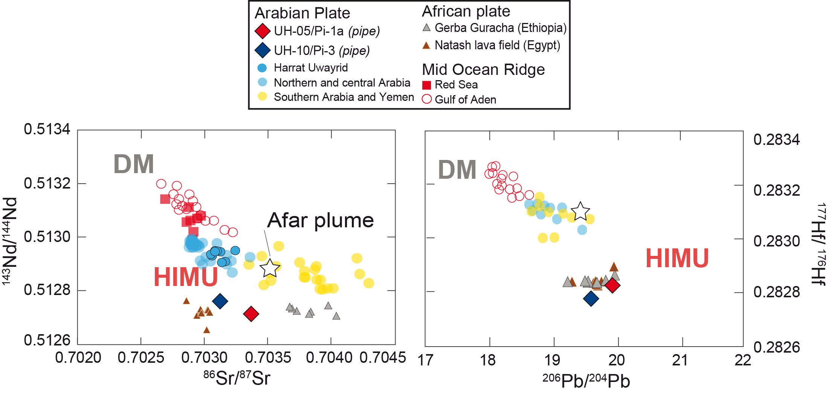
Isotopic results:
Marthoum volcanic pipes compered with other Arabian and Afriacn lava fields
Almost all alkaline lavas of the Arabian plate have relatively low ¹⁴³Nd/¹⁴⁴Nd, ¹⁴³Hf/¹⁴⁴Hf and ⁸⁷Sr/⁸⁶Sr isotopic ratios, and radiogenic ²⁰⁶Pb/²⁰⁴Pb ratio (Altherr et al. 1990; Stein and Hofmann 1992; Bertrand et al. 2003; Shaw et al. 2003; Moufti et al. 2013; Rooney et al. 2014).
These isotopic signatures indicate the involvement of a source with a high time-integrated ²³⁸U/²⁰⁴Pb ratio, for relatively low ⁸⁷Rb/⁸⁶Sr, ¹⁴³Sm/¹⁴⁴Nd and ¹⁷⁶Lu/¹⁷⁷Hf. These compositions point to a HIMU-like signature, somehow similar to that defined in OIB (Zindler and Hart 1986; Hofmann 1997).
Pipe UH-05/Pipe UH-10
Basalts from volcanic pipes have lower ¹⁴³Nd/¹⁴⁴Nd and ¹⁷⁶Hf/¹⁷⁷Hf ratios, and ⁸⁷Sr/⁸⁶Sr and ²⁰⁶Pb/²⁰⁴Pb ratios more radiogenic, than any lava ever reported in western Arabia.

Slide 11
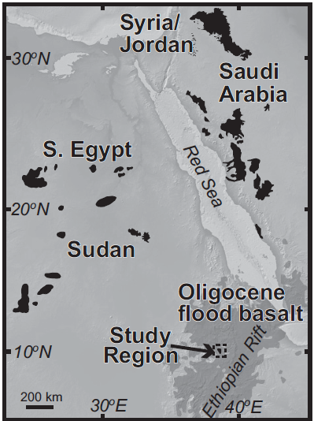
Isotopic results:
Marthoum volcanic pipes compered with other Arabian and African lava fields
Natash lava field
Pipe UH-05/Pipe UH-10
Gerba Guaracha
Basalts from volcanic pipes have enriched isotopic signatures similar to HIMU-like volcanism of East Africa (Rooney et al.,2014; Abu el Rus et al., 2018)
(modified after Rooney et al., 2014)

Slide 12
Origin of the HIMU-flavour in the Arabian Cenozic volcanism
Afar Plume: isotopic compositions of most lava fields in western Arabia lay on trends pointing towards an enriched source markedly different from the Afar plume (Rooney et al., 2012), having lower ⁸⁷Sr/⁸⁶Sr and lower ¹⁷⁷Hf/¹⁷⁶Hf and ¹⁴³Nd/¹⁴⁴Nd.
-> in addition the emplacement time of the volcanic pipes (50 and 70 Ma) is older than the Afar plume magmatism (30 Ma);
Israel plume: Based on recurring eruptions of alkali basalt with an isotopically enriched signature in Israel since ~200 Ma, Stein and Hoffman (1992) proposed that a “fossilized” plume head was accreted at the base of the lithosphere in the Jurassic, whose enrichedn material partially homogenized with the ambient mantle.
->the geochemical compositions of the Israel basalts are, however, much more radiogenic in Nd and Hf than those of the Marthoum pipes, and slightly less radiogenic in Sr.
Sub-continental lithosphere:
(1)Rooney et al., 2014, and Stein et al.,1997, proposed that the HIMU-like isotopic composition develops in the subcontinental lithosphere as consequence of rock-melt interaction and dehydration in the lowermost part of the mantle wedge above a subduction zone.
(2) metasomatism related to migration to carbonatitic melt (Weiss et al., 2016; Abu el Rus et al., 2018).

Slide 13
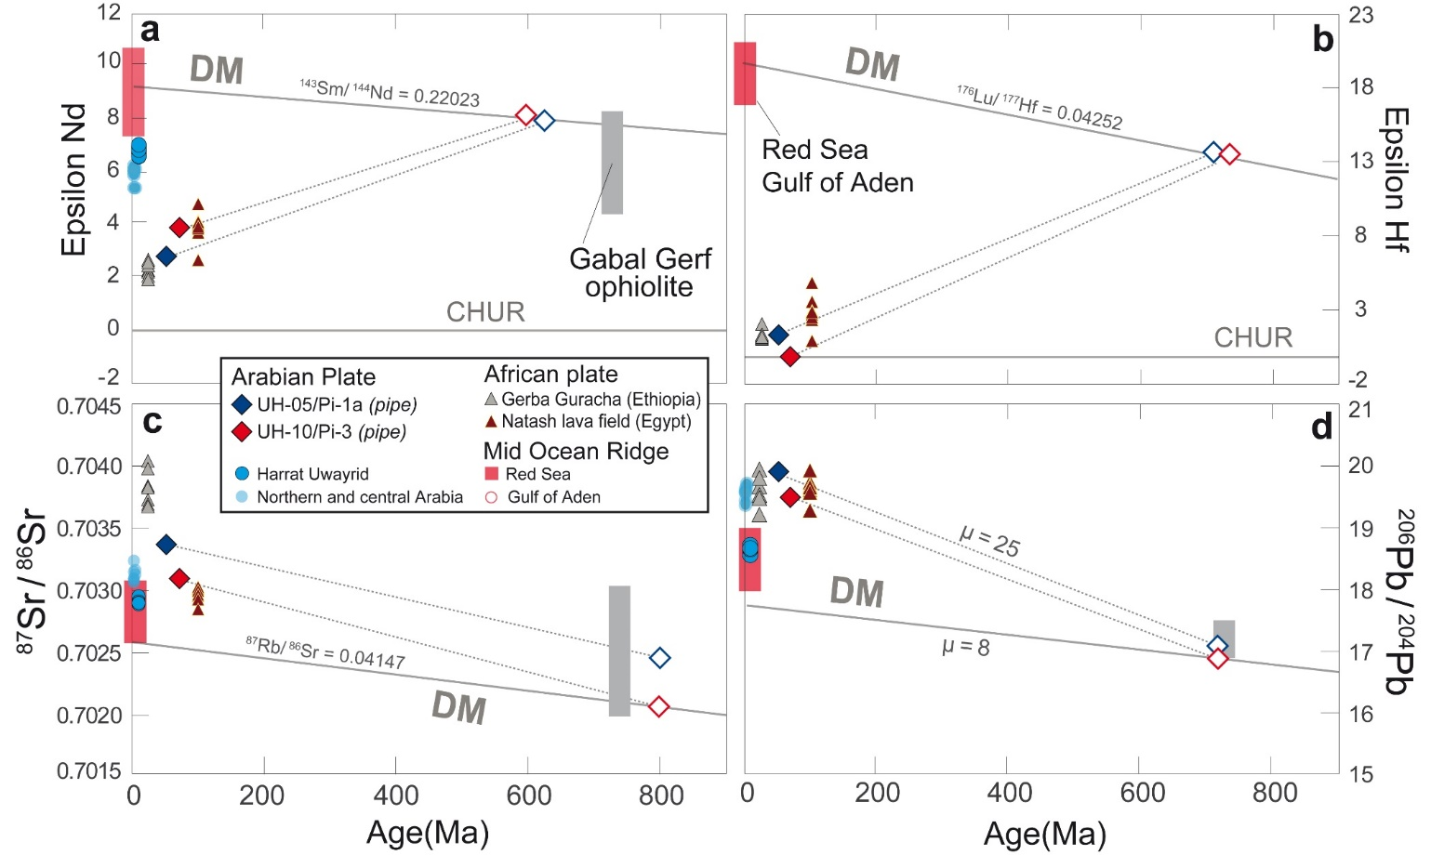
Isotopic evolution of the enriched mantle source
Taken together, our calculation shows that the metasomatic process, occurred in Peleozoic times, changed the parent/daughter ratios of the DM peridotites (calculated for a differentiation time of 3 Ga; Salters & Stracke, 2004), leading to increases of ²³⁸U/²⁰⁶Pb (u=8 to u=25), ¹⁴³Sm/¹⁴⁴Nd (0.220 to ~0.135) and ¹⁷⁶Lu/¹⁷⁷Hf (0.042 to ~0.005), along with small variations of ⁸⁷Rb/⁸⁶Sr ratios (0.041 to ~0.084).
These variations are in agreement with the two-stages process of magmatic metasomatism from hydrous-melts, followed by dehydration at the base of the lithosphere as proposed by Stein et al. (1997).
Note that Nd and Hf of the Marthousm volcanic pipes coherently indicate 600-700 Ma as time of isolation from the ambient mantle, constraining the age of the metasomatism in the Paleozoic (after Stein et al., 1997).
The metasomatic event occourred in Peleozoic times, corrisponding to the Pan-African orogeny ages.

Slide 14
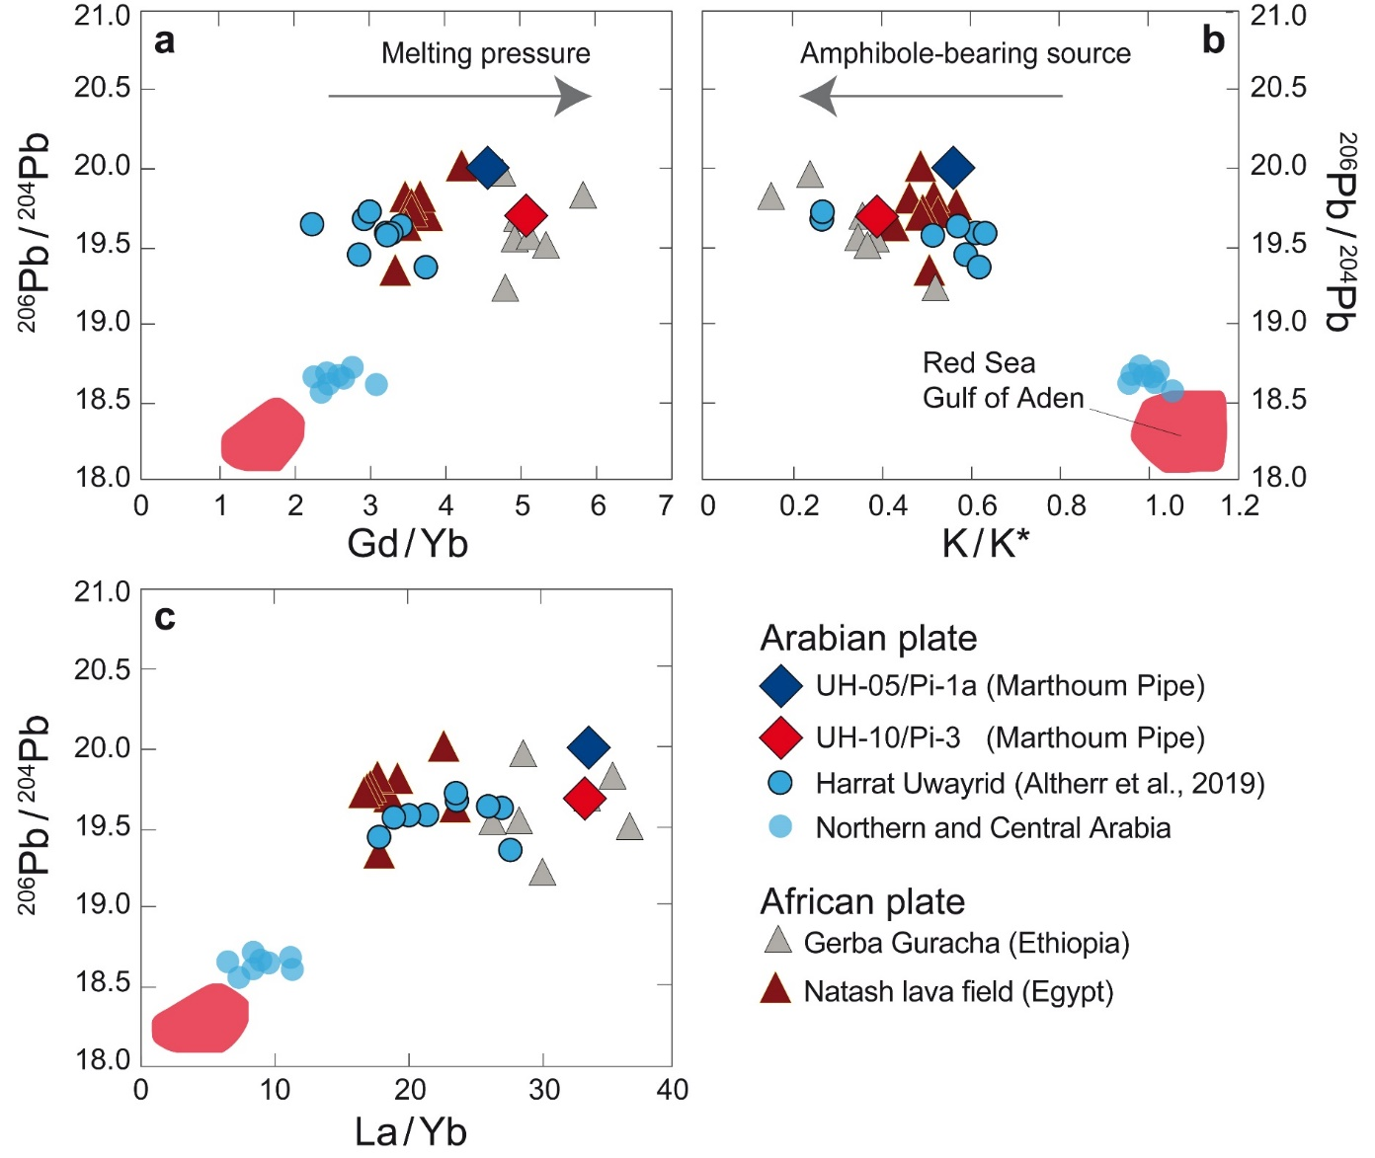
Widespread HIMU-flavor in the Arabian Cenozic volcanism
The alkali-basalts of western Arabia (Bertrand et al., 2003; Moufti et al., 2012) lie on binary mixing lines connecting asthenospheric (DM) components with MORB composition of the Red Sea and Golf of Aden (Altherr et al., 1988; Eissen et al., 1989; Volker et al., 1993, 1997) , and the enriched component residing in Marthoum pipes and in HIMU-like lava fields of East Africa (Rooney et al., 2014; Abu el Rus et al., 2018).
The progressive deepening of the K-anomaly (b) and overall increase of La/Yb (c) and Gd/Yb (a) ratios towards the more enriched isotopic compositions (i.e., high Sr and Pb, low Nd and Hf isotopic ratios) agree with the idea that:
The enriched end-member may be represented by an amphibole- and garnet-bearing lithospheric mantle (Rooney et al., 2014).

Slide 15
Conclusion
HIMU FLAVOUR IN THE ARABIAN LITHOSPHERE:
At this point our preferred hypothesis for the origin of the HIMU-like flavor in the Arabian-African alkaline volcanism is that it derives from a lithosphere enriched by an ancient process of refertilization and de-hydration in the deep portion of the mantle wedge during the Panafrican orogeny. -> idea also proposed by Rooney et al. 2014 and Abu el Rus. 2018, and in this study sustained by the referilization and dehydration two-stage model of Stein 1997.
We therefore propose that enriched portions of the lithosphere be thermally eroded and physically removed during progressive thinning of the lithospheric lid, triggered by regional extension and mantle upwelling. Under these conditions, the fertile geochemical components (metasomas) are preferentially melted at depth and at low degrees of melting. As the extension proceeds, the amount of melt from the enriched source progressively decreases and its contribution is easily concealed by mixing with melts produced by a depleted asthenosphere.
HIMU FLAVOUR IN THE MATHOUSM PIPES: Consequently, the enriched character would be better preserved in the pre-rift volcanism (50 and 80 Ma) generated beneath a thick continental lithosphere.
Although this enriched lithospheric component is apparently hidden, is therefore ubiquitous and widespread in the cratonic roots of the African and Arabian lithospheric mantle.

Slide 16
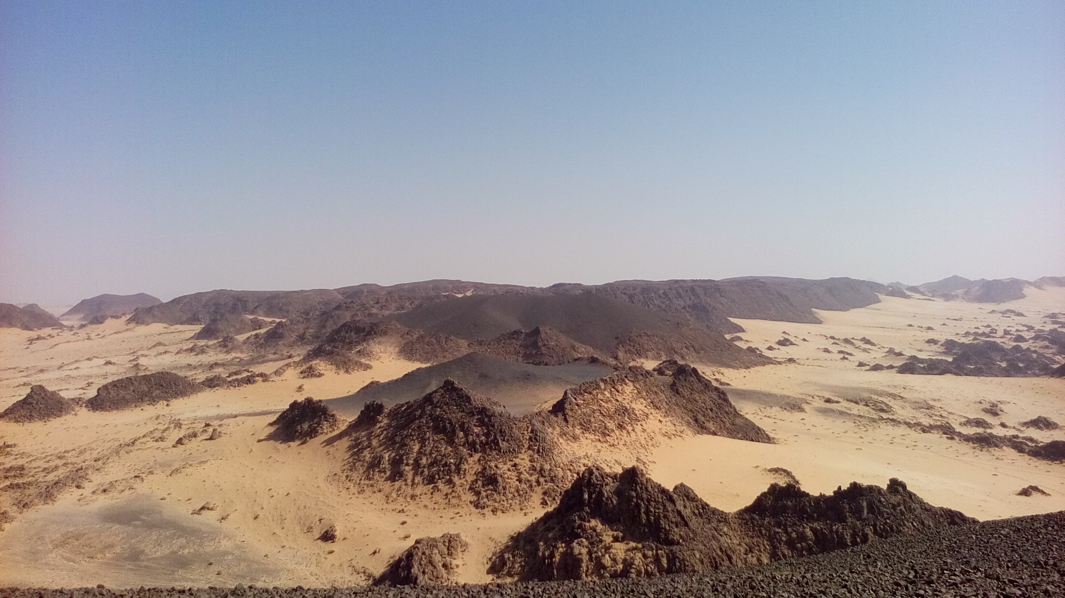
Thanks for your attention !!

Slide 17
References
Abu El-Rus, M. A., Chazot, G., Vannucci, R., and Paquette, J. (2018). Tracing the HIMU component within Pan-African lithosphere beneath northeast Africa: Evidence from Late Cretaceous Natash alkaline volcanics, Egypt. Lithos 300–301, 136-153. doi: 10.1016/j.lithos.2017.11.037
Altherr, R., Mertz-Kraus, R., Volker, F., Kreuzer, H., Henjes-Kunst, F., and Lange, U. (2019). Geodynamic setting of Upper Miocene to Quaternary alkaline basalts from Harrat al ‘Uwayrid (NW Saudi Arabia): Constraints from K Ar dating, chemical and Sr-Nd-Pb isotope compositions, and petrological modeling. Lithos 330-331, 120–138. doi: 10.1016/j.lithos.2019.02.007;
Bertrand, H., Chazot, G., Blichert-Toft, J., and Thoral, S. (2003). Implications of widespread high-m volcanism on the Arabian Plate for Afar mantle plume and lithosphere composition. Chem. Geology 198, 47–61. doi: 10.1016/S0009-2541(02)00418-7
Dalou, C., Koga, K. T., Hammouda, T., and Poitrasson, F. (2009). Trace element partitioning between carbonatitic melts and mantle transition zone minerals: Implications for the source of carbonatites, Geochim. Cosmochim. Acta, 73, 239–255. doi: 10.1016/j.gca.2008.09.020
Green, T., Blundy, J., Adam, J., and Yaxley, G. (2000). SIMS determinations of trace element partition coef ﬁ cients between garnet, clinopyroxenes and hydrous basaltic liquids at 2–7.5 GPa and 1080–1200 °C. Lithos 53, 165–187. doi: 10.1016/S0024-4937(00)00023-2
Hofmann, A. W., Jochum, K. P., Seufert, M., and White, W. M. (1986). Nb and Pb in oceanic basalts: new constraints on mantle evolution. Earth Planet. Sci. Lett. 79, 33–45. doi: 10.1016/0012-821X(86)90038-5
Liddicoat, W. K. (1982). Cenozoic volcanic pipes in the Marthoum area (27/37D). Saudi Arabian Deputy Ministry for Mineral resources, Jeddah, Open-File Report DGMR-OF-03-11, pp. 47.
Moufti, M. R., Moghazi, A. M., and Ali, K. A. (2012). Geochemistry and Sr–Nd–Pb isotopic composition of the Harrat Al-Madinah volcanic field, Saudi Arabia. Gondwana Res 21, 670–689. doi: 10.1016/j.gr.2011.06.003
Rosenthal, A., Foley, S. F., Pearson, D. G., Nowell, G. M., and Tappe, S. (2009). Petrogenesis of strongly alkaline primitive volcanic rocks at the propagating tip of the western branch of the East African Rift. Earth Planet. Sci. Lett. 284, 236–248. doi: 10.1016/j.epsl.2009.04.036.
Rooney, T. O., Hanan, B. B., Graham, D. W., Furman, T., Blichert-Toft, J., and Schilling, J.-G. (2012). Upper Mantle Pollution during Afar Plume–Continental Rift Interaction. J. Petrology 53, 365–389. doi: 10.1093/petrology/egr065
Rooney, T. O., Hanan, B. B., Graham, D. W., Furman, T., Blichert-Toft, J., and Schilling, J.-G. (2014). The role of continental lithosphere metasomes in the production of HIMU-like magmatism on the northeast African and Arabian plates. Geology 42, 419–422. doi: 10.1130/G35216.1
Vaslet, D., Janjou, D., Robelin, C., Al-Muallem, M. S., Halawani, M. A., Brosse, J.-M., Breton, J.-P., Courboulix, S., Roobol, M. J. and Dagain, J. (1994). Geologic map of the Tayma Quadrangle, Sheet 27C, Kingdom of Saudi Arabia. Saudi Arabian Directorate General of Mineral Resources Geoscience Map GM-134, scale 1:250,000, with explanatory text, pp. 51.
Weiss, Y., Class, C., Goldstein, S. L., Hanyu, T. (2016). Key new pieces of the HIMU puzzle from olivines and diamond inclusions. Nature 537, 666–670. doi: 10.1038/nature19113

