Slide 1
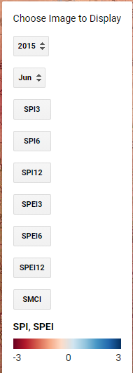
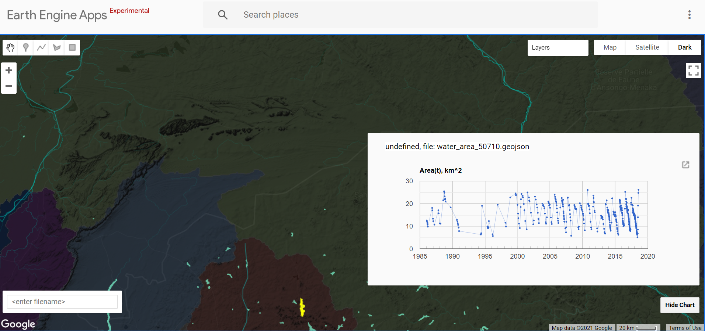
Next Generation Drought Index
A giving a complete overview off local/regional drought hazards and risks
Google Earth Engine application - combining open data and model simulations
drought indices: meteo, soil moisture, agriculture, low flows
&
water resources info: reservoirs, groundwater
Globally applicable, locally relevant.
Open source, easy access, low maintenance.
Historic and operational information (real-time & drought forecasting)

Slide 2
Next Generation Drought Index
A giving a complete overview off local/regional drought hazards and risks
Google Earth Engine application - combining open data and model simulations
drought indices: meteo, soil moisture, agriculture, low flows
sector specific thresholds
drought impact info
&
water resources info: reservoirs, groundwater
local time series: historic and forecasted
spatial map data
Integrate local impact datasets and operational monitoring data.

Slide 3
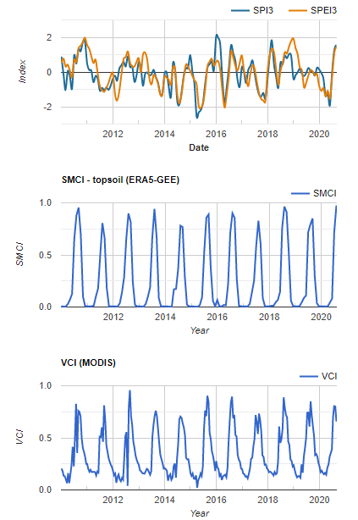
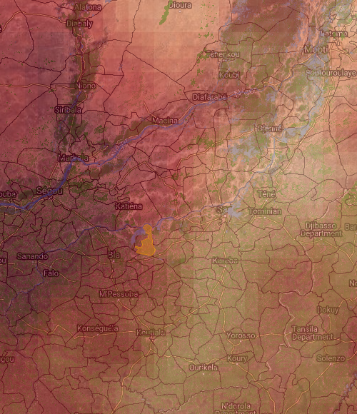
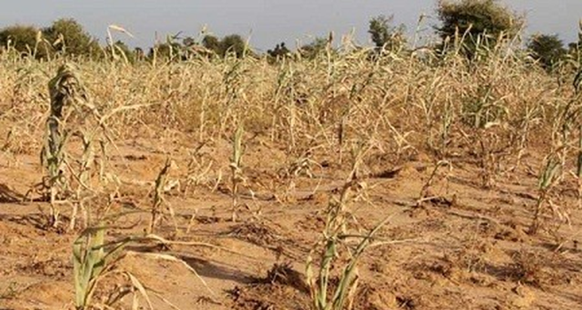
Next Generation Drought Index
A giving a complete overview off local/regional drought hazards and risks
Google Earth Engine application - combining open data and model simulations
experts involved:
INSERT IMAGE
Dimmie Hendriks
Pieter Hazenberg
Genna Donchyts
Arjen Haag
Patricia Trambauer
Frederiek Sperna-Weiland
Martijn Kwant
Jonas Götte
We are interested in cooperation to improve NGDI.
Please contact us: dimmie.Hendriks@deltares.nl

