Slide 1

Geochemical fingerprints and North-African dust sources: results from a multisite network of aerosol deposition in the south-western Europe
J. Pey^{1,2}, J.C. Larrasoaña³, J. Reyes³, N. Pérez⁴, J.C. Cerro^{5,6}, S. Castillo^{7,8}, M.P. Mata³, J.M. Orellana³, J. Causapé³, B.L. Valero-Garcés², B. Oliva⁹, J. Santos¹⁰, R.B. González¹⁰
1 Aragonese Foundation for Research and Development
2 Pyrenean Institute of Ecology-CSIC
3 Geological Survey of Spain
4 Institute of Environmental Assessment and Water Research-CSIC
5 University Balearic Islands
6 Regional Government Balearic Islands
7 Andalusian Institute for Earth System Research (IISTA-CEAMA)
8 Department Applied Physics, University of Granada. 18071 Granada, Spain
9 Autonomous University of Madrid
10 Universidad de León

Slide 2
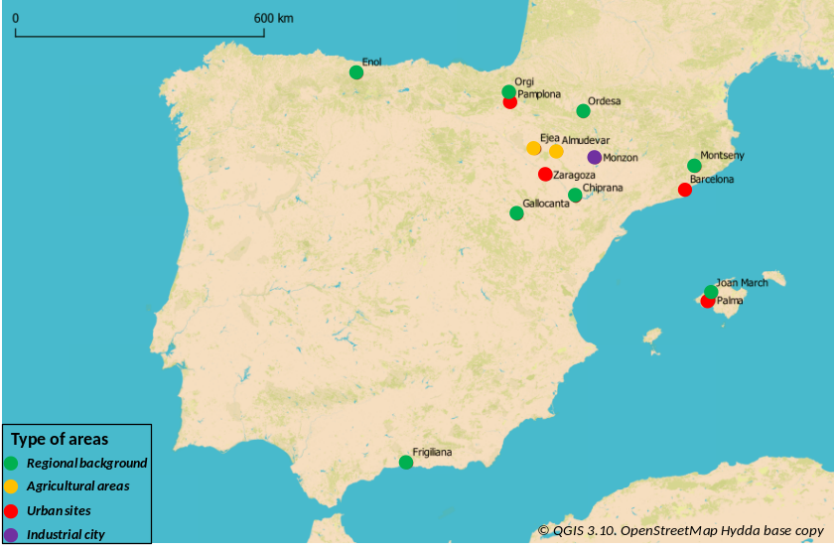
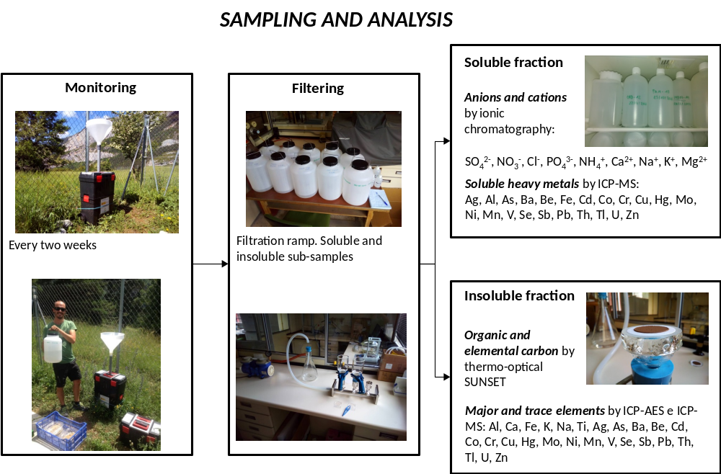
THE DONAIRE NETWORK
SAMPLING AND ANALYSIS
2016-2017
1 year
PMF v5.0

Slide 3
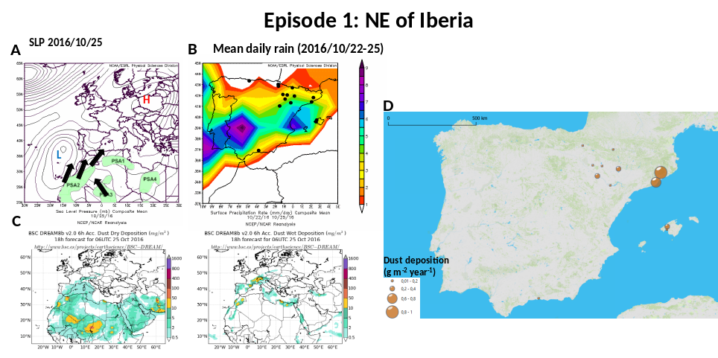
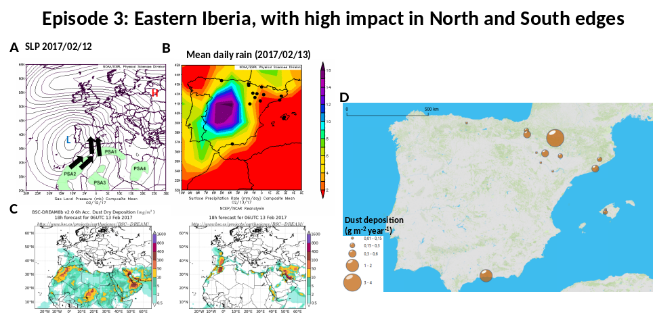
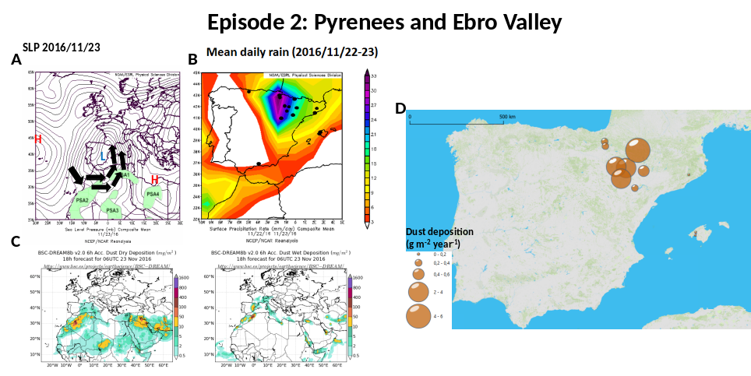
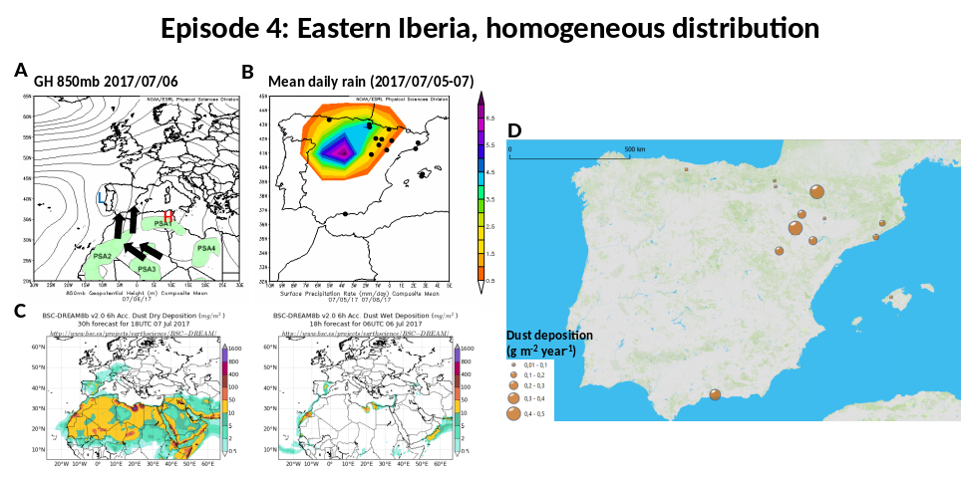
MAIN DUST EPISODES: METEOROLOGICAL CONTEXT, DUST CONCENTRATIONS AND POTENTIAL DUST SOURCES
Mixed PSA dust sources
Single PSA dust sources
Single PSA dust sources
Mixed PSA dust sources
PSA dust sources (Scheuvens et al., 2013)

Slide 4
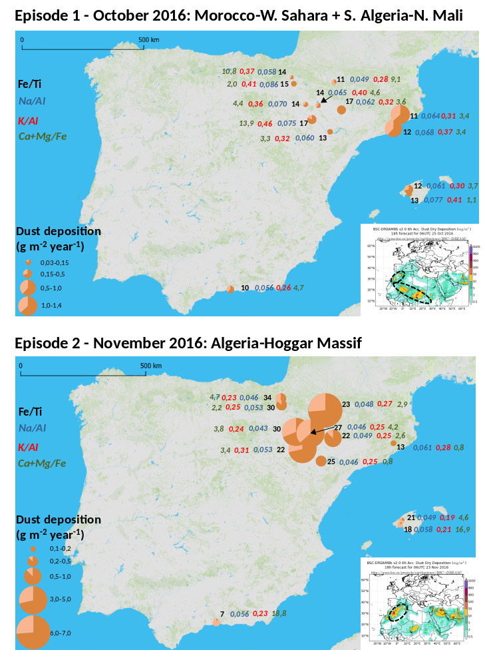
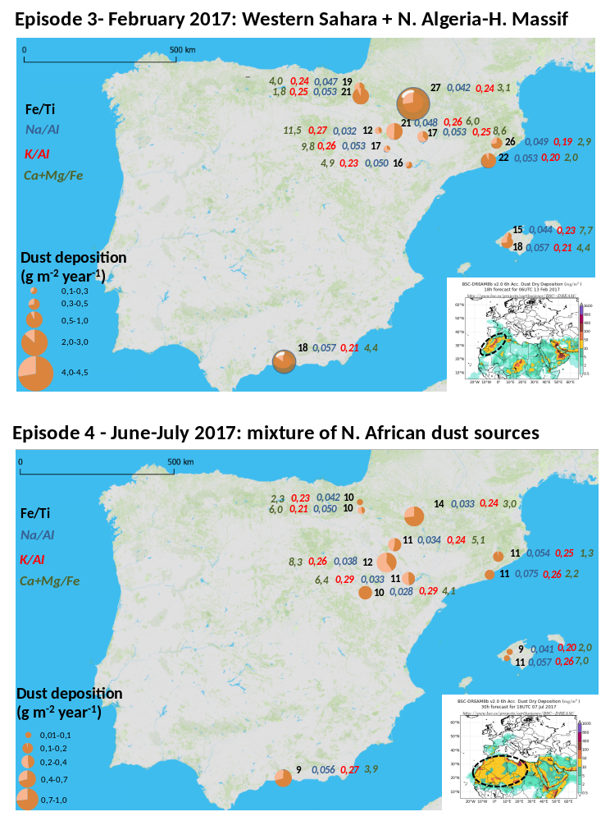
GEOCHEMICAL RATIOS: SPATIAL DISTRIBUTION AND ROBUSTNESS
Mixed
Single
Single
Mixed

Slide 5
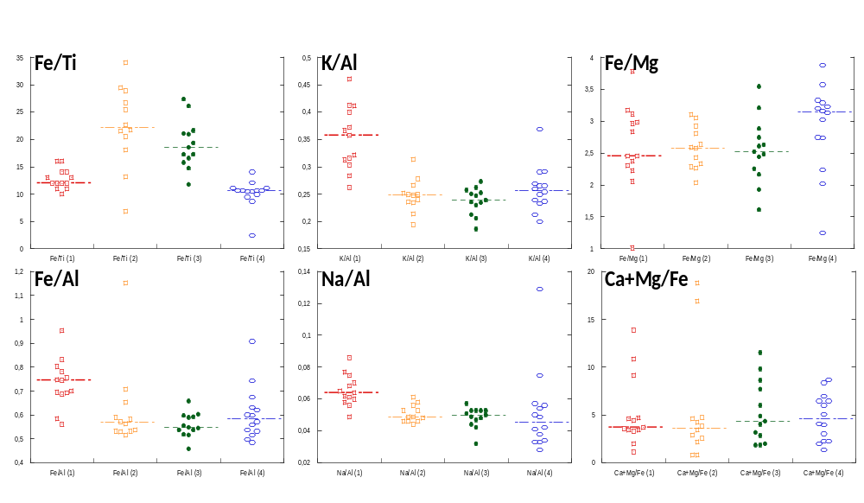
SUMMARY OF GEOCHEMICAL RATIOS
Mixed
Single
Single
Mixed
Mixed
Single
Single
Mixed
Mixed
Single
Single
Mixed

Slide 6
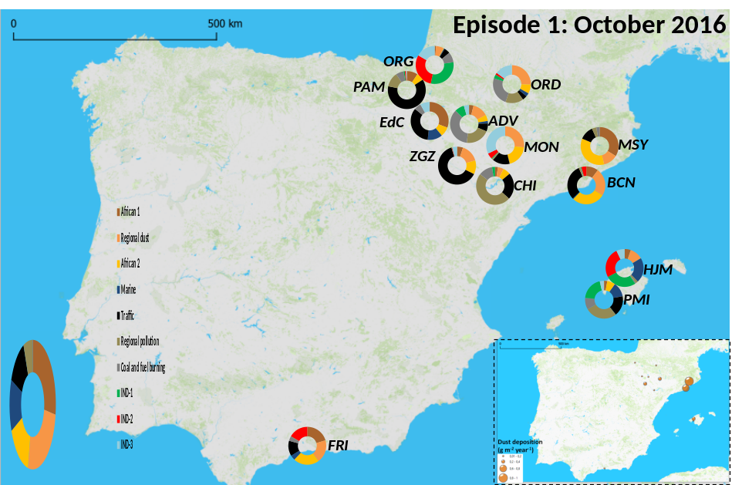
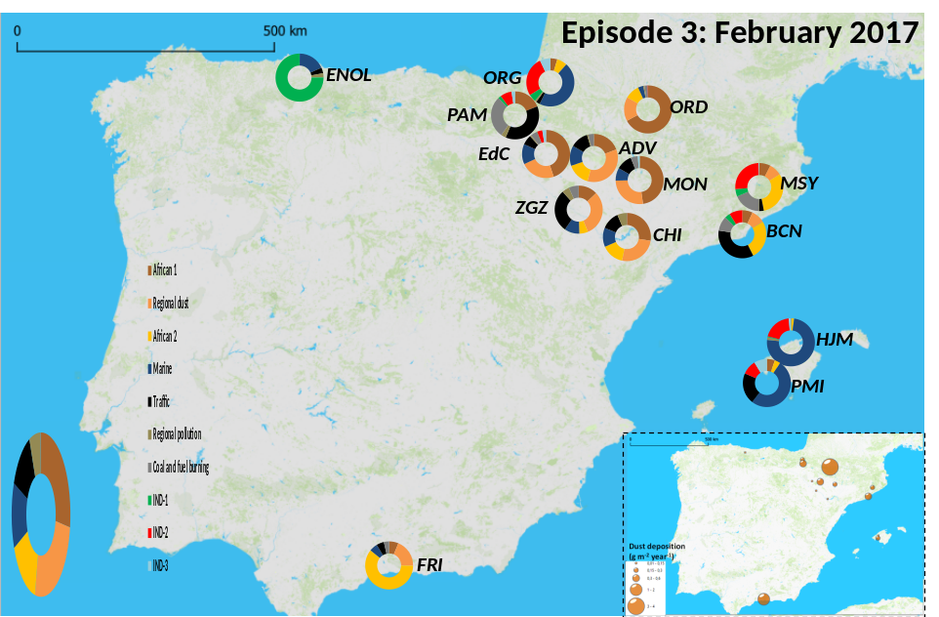
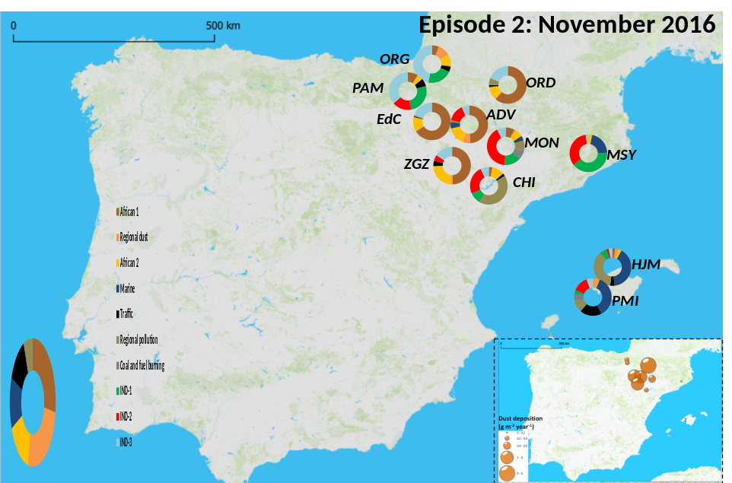
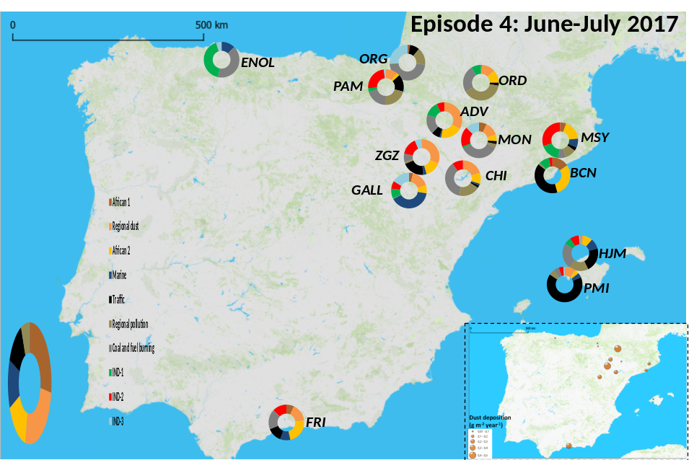
SOURCE APPORTIONMENT: POSITIVE MATRIX FACTORIZATION
AF2>AF1
AF1 >>AF2
AF1 >>AF2
Only AF2

Slide 7
CONCLUSIONS
DUST DEPOSITION AT 15 SITES IN SPAIN
GEOCHEMICAL SIGNATURES DURING DUST EPISODES RATHER UNIFORM AMONG SITES → ROBUST RESULTS
IN OUR CONTEXT, SOME GEOCHEMICAL RATIOS DISPLAY INTERESTING VARIATIONS: Fe/Ti; K/Al; Fe/Mg; Fe/Al; Na/Al; WHILE SOME OTHERS DO NOT: (Ca+Mg)/Fe
SOURCES DURING DUST EVENTS ARE DIVERSE, BUT PMF IS ABLE TO EXTRACT THREE MINERAL SOURCES: 2 FROM NORTH AFRICA; 1 FROM REGIONAL DUST
  AFRICAN 1: FROM NORTH-WESTERN AFRICA DUST SOURCES
  AFRICAN 2: MIXTURE OF SOURCES WITHOUT UNCLEAR ORIGIN
BOTH OCCUR ALREADY MIXED IN DIFEFRENT PROPORTIONS ALONG THE YEAR, BUT AFRICAN 1 IS NOT FREQUENT DURING SUMMER DUST OUTBREAKS (THE MOST FREQUENT, THE LESS LOADING IN TERMS OF DEPOSITION)

