Slide 1
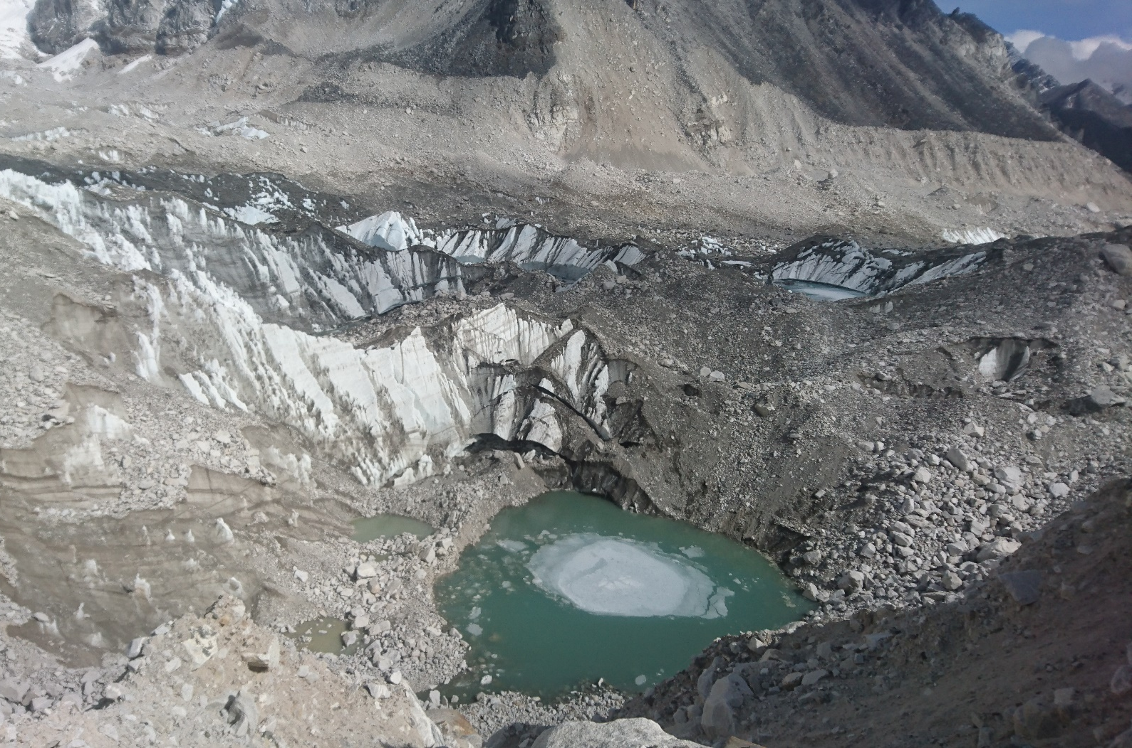


Global differences in melt rates of debris covered glacier surfaces
Evan Miles
Jakob Steiner
Pascal Buri
Walter Immerzeel
Francesca Pellicciotti
evan.miles@wsl.ch
@Miles_of_Ice
Eidg. Forschungsanstalt für Wald, Schnee und Landschaft WSL
Ein Forschungsinstitut des ETH-Bereichs
Notes:
Add logos

Slide 2
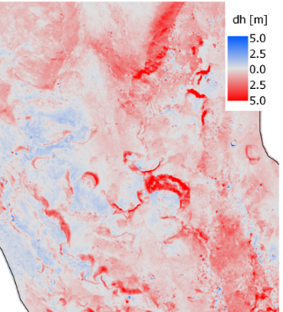

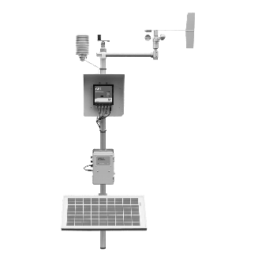
Motivation
DCGs exhibit highly-variable thinning rates
Approach
Use four energy-balance models
Evaluate for 13 AWS sites globally
Brun and others (2018); TC
Aims
What are relative melt rates for debris-covered glacier surfaces?
=> Ice, debris, cliffs, ponds
2. Are these melt factors consistent globally?
Khumbu Glacier, Nepal

Slide 3
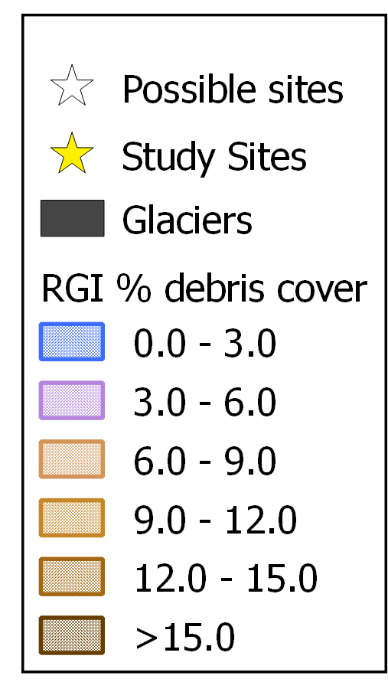


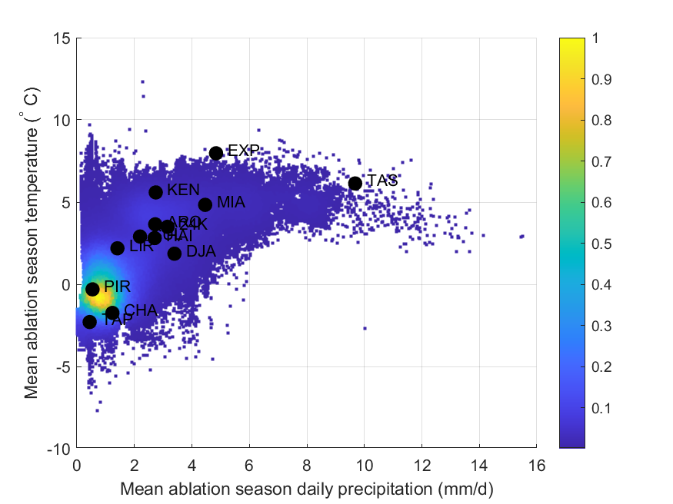
Towards a global set of DCG AWSs
Require
On-debris
1+ ablation season
Complete sensor set
-> 13 sites
Scherler and others, (2018); GRL
On-debris AWS gaps: KK, TS, LL, GR
Notes:
Add alaska!!

Slide 4
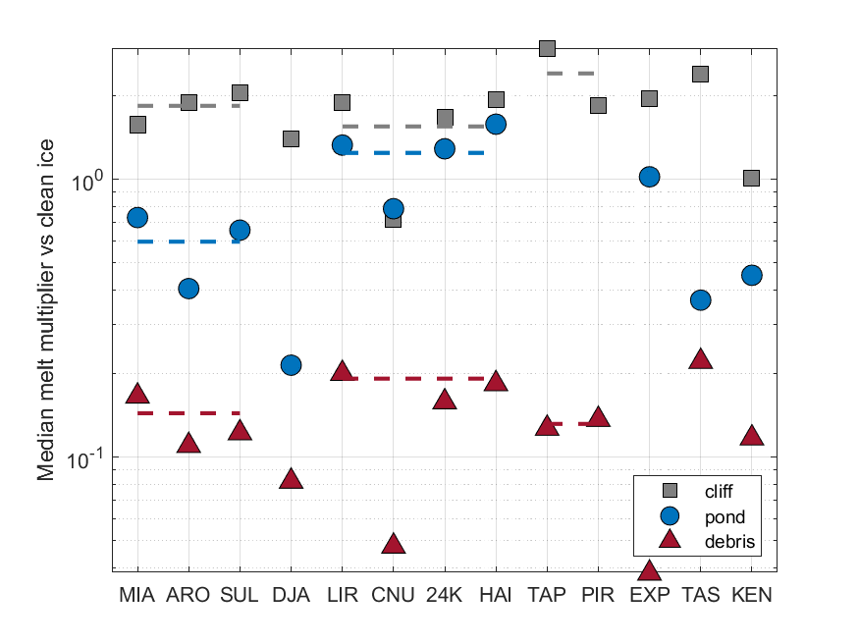
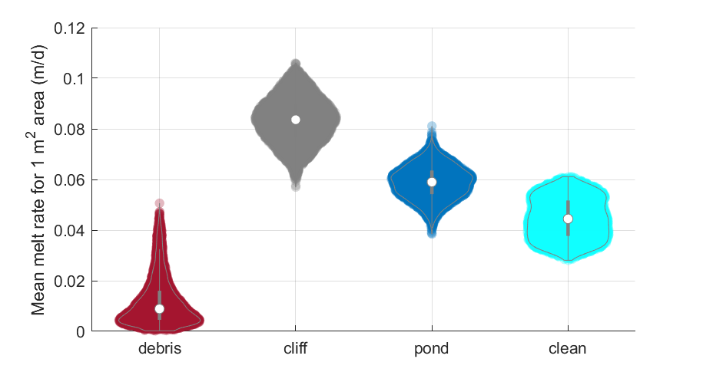
Melt factors at glacier and regional scales
2.5±0.4
0.6 ±0.2
0.14 ±0.03
2.1±0.8
1.2±0.4
0.19±0.06
3.3±0.7
0.02±0.6
0.13±0.01
Lirung Glacier, Nepal
Want to know more? Join the CR6.2 chat (Apr 27, 11:00AM - 12:30PM CET) or contact me (evan.miles@wsl.ch)
Notes:
Compare changri nup multiple years
Add map

