Slide 1
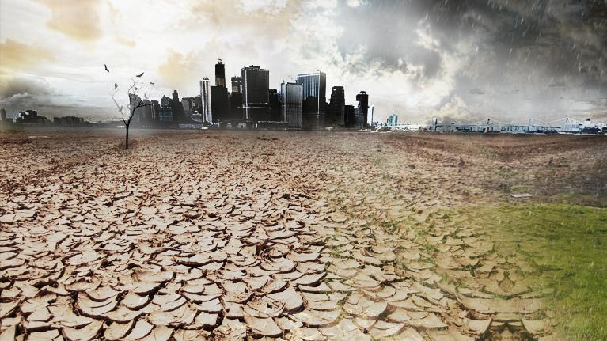

Drought risk in urban areas: risk monetization of 98 cities globally
Tristian Stolte, Philip Ward, Hans de Moel, Felix van Veldhoven, Snigdha Garg & Neuni Farhad

Slide 2
About the authors
Institute for Environmental Studies:
  Tristian Stolte, MSc (Lead author) – PhD student in the field of global urban disaster risk
  Prof. Philip Ward – Professor of Global Water Risk Dynamics
  Dr. Hans de Moel – assistant professor in the field of natural hazard risk management, climate change and adaptation
Climate Adaptation Services:
  Felix van Veldhoven – Climate change adaptation expert
C40 Cities:
  Snigdha Garg – Senior Manager, Adaptation Research and Integration
  Neuni Farhad – Adaptation Research Manager

Slide 3
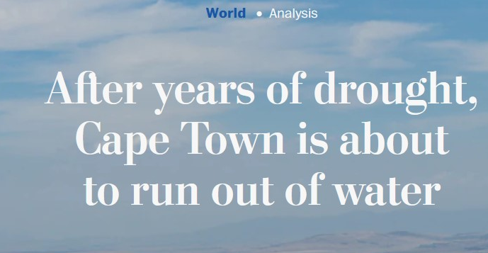
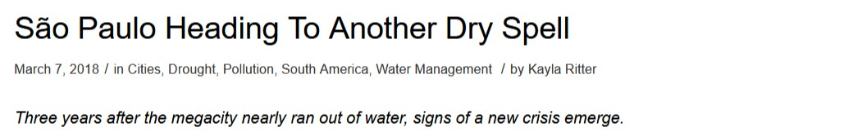
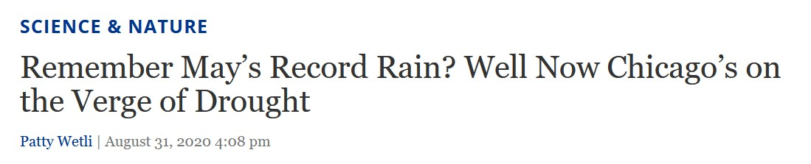
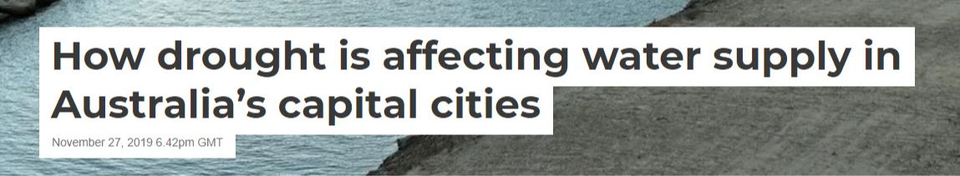
Drought in cities

Slide 4
Past research
Hazard-centric
Qualitative
Case specific

Slide 5
Our research
Hazard-centric → Risk-centric
Qualitative → Quantitative + Qualitative
Case specific → Global scale
Aim: To monetize drought risk & to identify corresponding possible adaptation actions in 97 cities globally for multiple climate and socioeconomic scenarios.

Slide 6
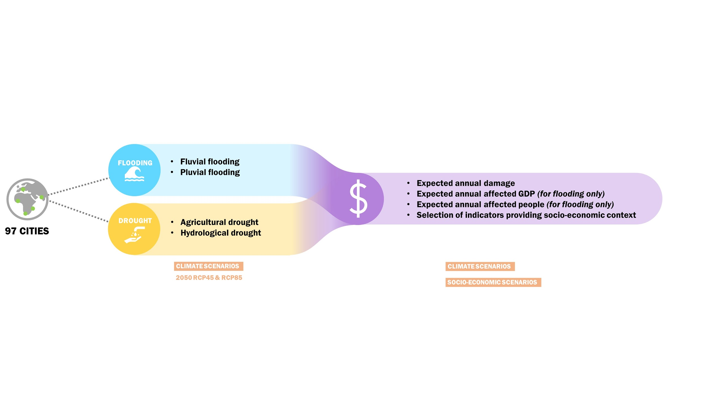
General overview
Hazard
Risk

Slide 7
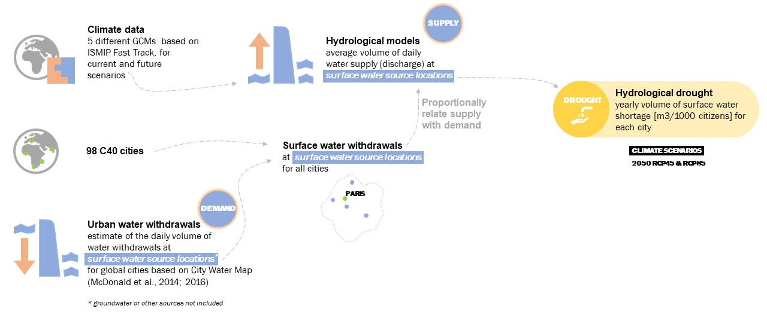
Hazard assessment – Hydrological drought

Slide 8
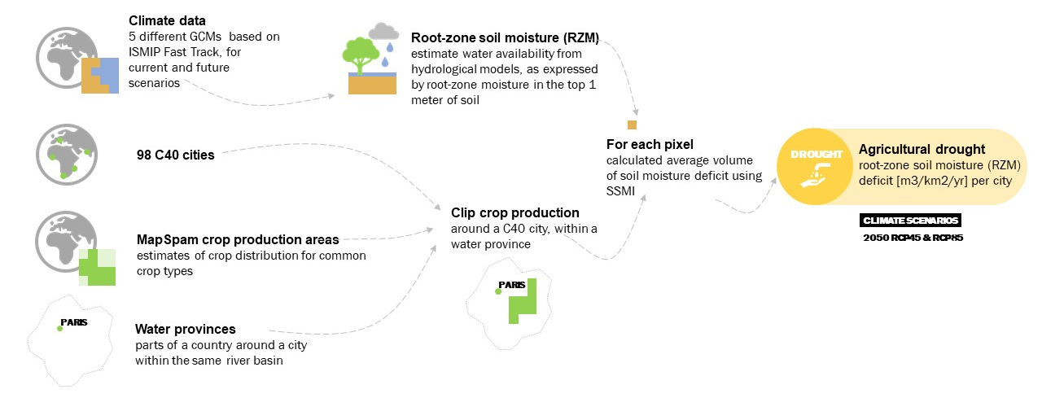
Hazard assessment – Agricultural drought

Slide 9
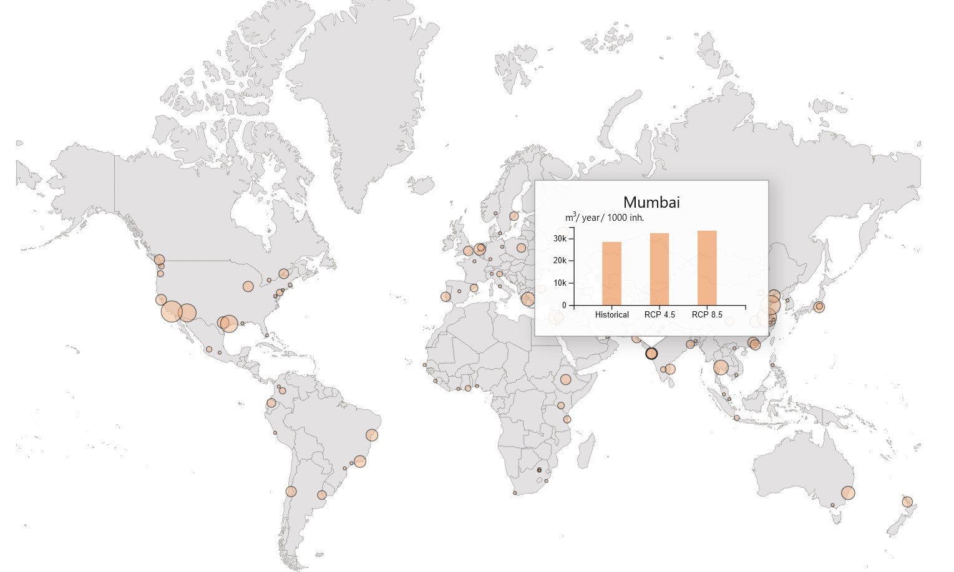
Results – hydrological drought hazard – city example

Slide 10
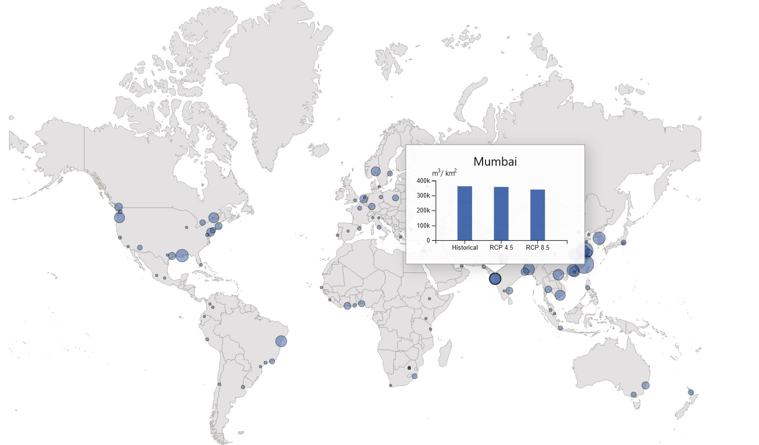
Results – agricultural drought hazard – city example

Slide 11
The costs of drought – unit prices of water saving
Unit cost of freshwater saving/production as a proxy of drought impact costs
Adaptation measure | Unit cost [USD/m³] | Source
Increase reservoir storage | Depends on water province | Ward et al. (2010)
Reuse urban-industry water | 0.3 | Straatsma et al. (2020)
Increase desalination | 1 | Straatsma et al. (2020)
Reduce urban /industrial demand | 2 | Straatsma et al. (2020)

Slide 12
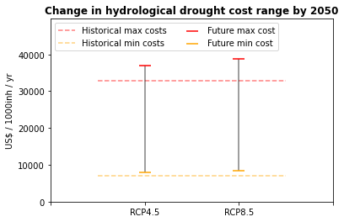
Results – costs of drought in 2050 example

Slide 13

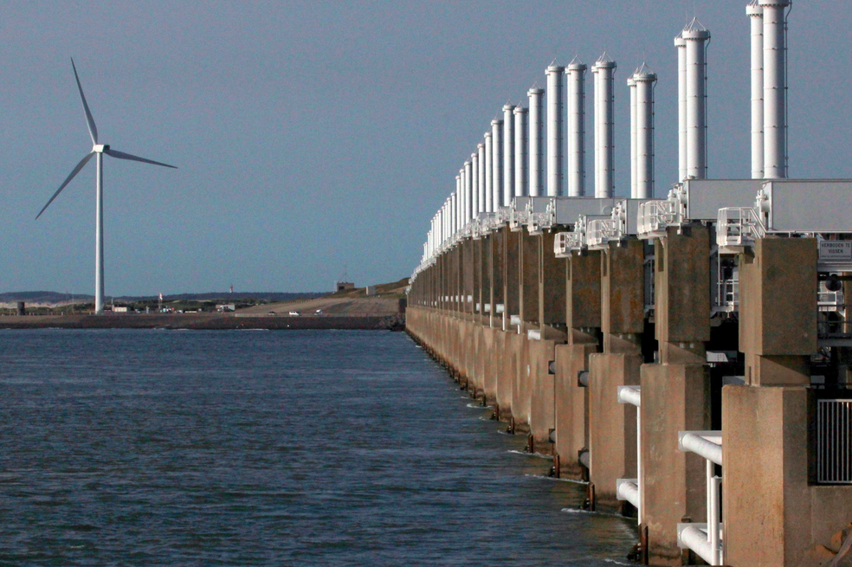
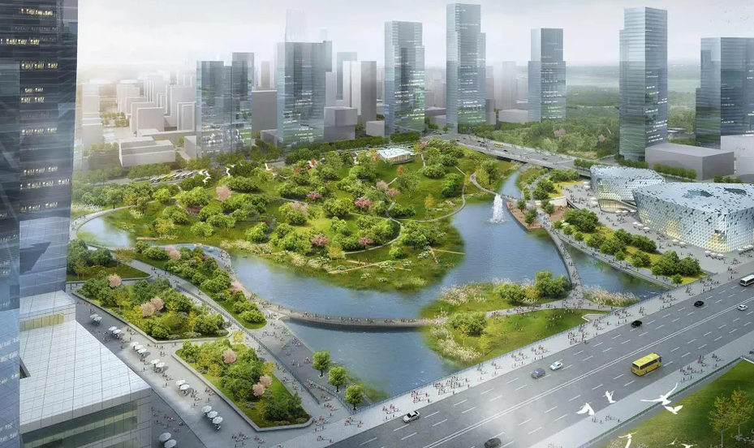
Adaptation frames

Slide 14
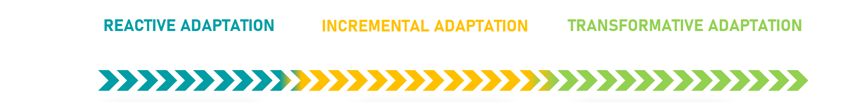
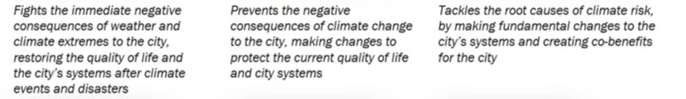
Adaptation types
For this project we will gather a list of possible adaptation options, including reactive, incremental, and transformative adatations.

Slide 15
Discussion point
First global overview of drought costs in urban areas
Simplified approach; could we improve on the cost estimates?

Slide 16
Contact us
Tristian Stolte - tristian.stolte@vu.nl

