Slide 1

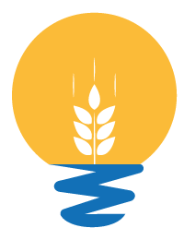


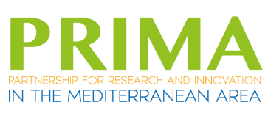
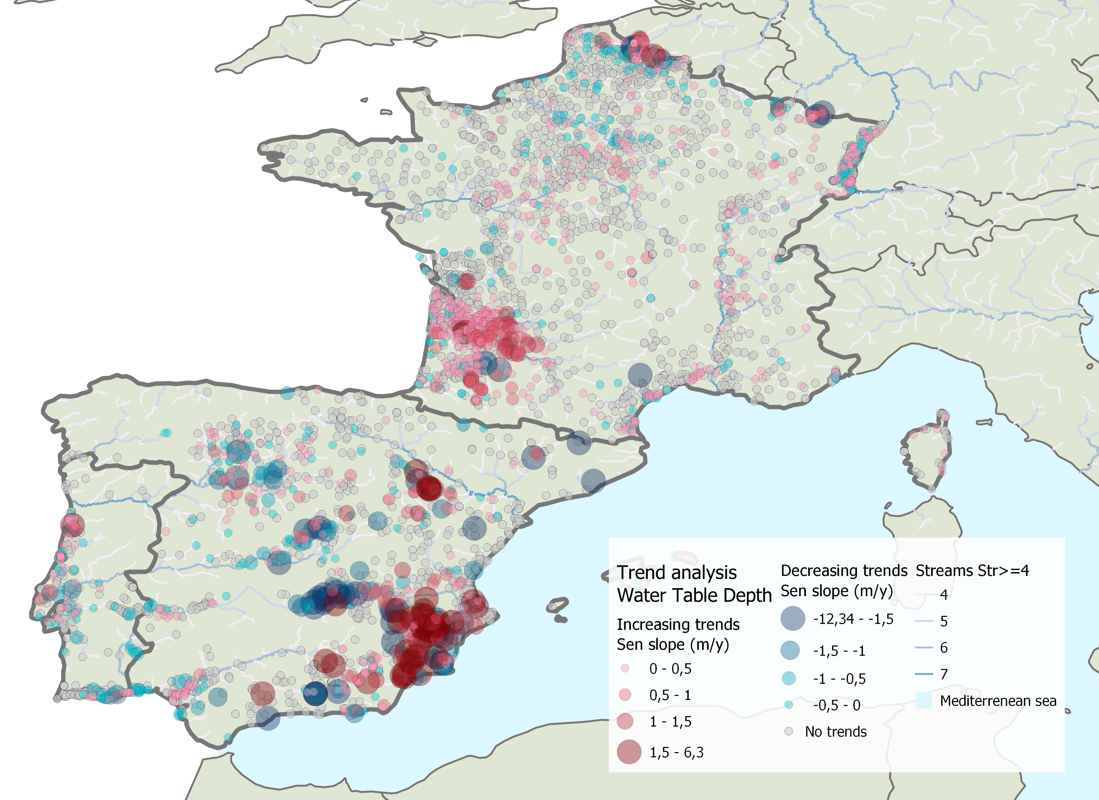
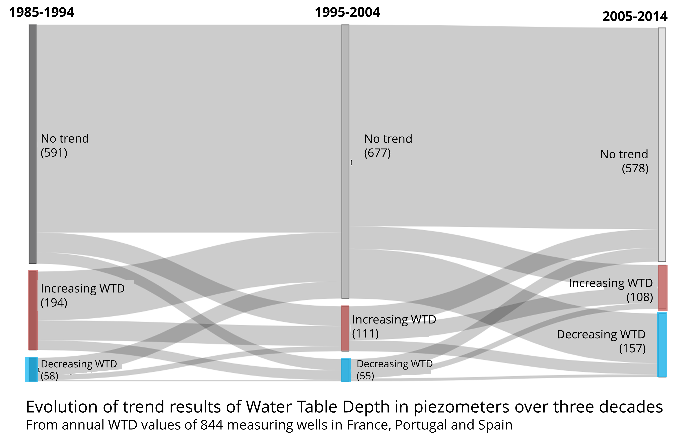
Long-term groundwater database and assessment for the Mediterranean region
Introduction
Methods
Data gathering (groundwater level)
The Mediterranean region faces water security challenges with increasing water demand
(Allam et al., 2020).
Groundwater as a key resource
Contrasting distribution of data availability (Leduc et al., 2017)
Country (time series obtained) | Status of progress
Spain (2,890) | Complete
Portugal (982) | Complete
France (4,790) | Complete
Italy (1,210) | In progress
Tunisia (>340) | In progress
Greece | In progress
Turkey | In progress
1. Data gathering
Rafael Chávez García Silva¹, Robert Reinecke², Emmanouil Varouchakis³, J. Jaime Gómez-Hernández⁴, Michael Rode¹ and Seifeddine Jomaa¹
2. Trend and time series analysis
Objectives
  Database creation
  Characterize trends and identify common trajectories that occur throughout the region
  Find relationships with drivers
3. Relationship to drivers
¹Department of Aquatic Ecosystem Analysis and Management, Helmholtz Centre for Environment Research - UFZ, Magdeburg, Germany, ²Potsdam University, Potsdam, Germany, ³School of Environmental Engineering, Technical University of Crete (TUC), Greece,⁴Institute of Water and Environmental Engineering, Universitat Politècnica de València, Valencia, Spain
a)
Preliminary trend analysis results (France, Portugal, Spain)
Further work
Temporal distribution
Continue building the database
Analyze the relationships of trend presence and multi-annual climate cycles
Find trajectory archetypes
Analyze the relationship between groundwater trajectories and anthropogenic drivers
Spatial distribution
Distribution of slope magnitude of WTD for wells with a trend
From annual WTD values of the entire time series 5,638 wells
Contact: rafael.chavez@ufz.de
Acknowledgement: This work was supported by InTheMED project, which is part of PRIMA programme supported and funded under Horizon 2020, the European Union’s Framework Programme for Research and Innovation (Grant agreement No 1923).
Notes:
Expecting longer dry spells and decreased annual precipitation (Cramer et al., 2018).

