Slide 1
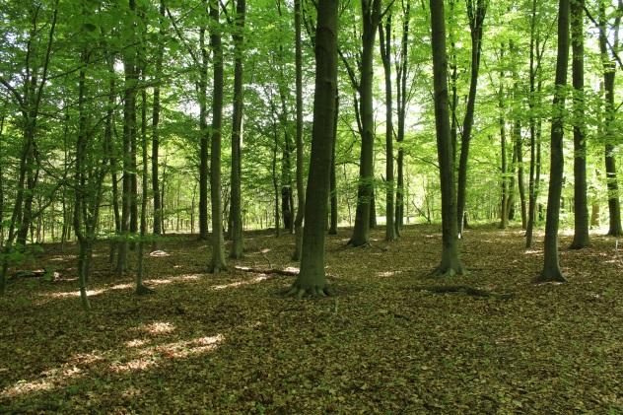
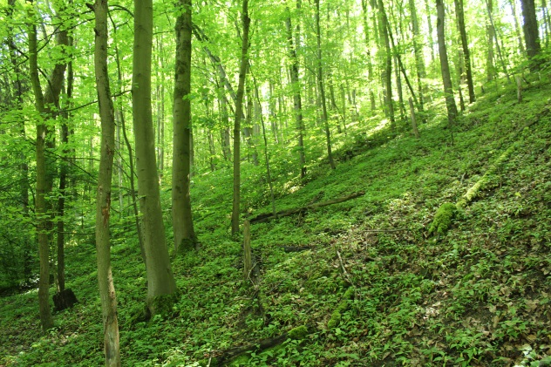
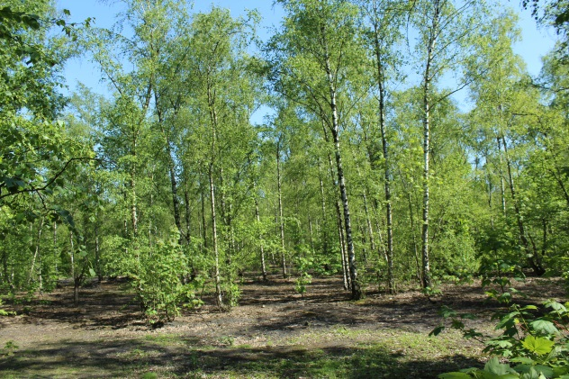







Semi-natural forests
Urban greening forests
Succession forests
Drought years of 2018 and 2019 affect CO₂ balance of urban forest ecosystems in the Ruhr Metropolitan Region (Germany) differently
EGU General Assembly 2021
„Complex case studies for ecosystem responses to climate and hydrological extremes“ (BG3.17)
27.04.2021
Tobias Scholz
Lutz Weihermüller
Thomas Schmitt
Let‘s start!

Slide 2
Drought years of 2018 and 2019 affect CO₂ balance of urban forest ecosystems in the Ruhr Metropolitan Region (Germany) differently
Introduction
Uptake
Methods & Results
Complete balance
Motivation & Objective
Methods
Results
Study sites
Drought years 2018/2019
Conclusion
Research Highlights
Respiration
Translocation
Results
Methods
Results
Implications
Methods
Back

Slide 3
Menu
Motivation & Objective
The history of settlement and the industrial past formed different types of temperate deciduous urban forest stands in the Ruhr Metropolitan Region in West-Germany, differing in species composition and soil characteristics:
  old-grown semi-natural forests on deep native soils,
  allochthone mixed forest stands planted in parks and on slag and slate heaps as remnants of the industrial past (urban greening forests) with limited rooting depth, and
  autochthone succession forests of birch, poplar, or willow established on industrial brownfields with loosy and coarse soils, and limited rooting depth.
CO₂ balance of those forest types were investigated on eleven monitoring sites for the years 2018 and 2019, considering CO₂ uptake by forest growth, CO₂ translocation by litterfall, and CO₂ release by soil respiration.
Both years were characterized by drought conditions, and therefore, we also studied the impact of the two years drought on CO₂ balance of the different forest types.
Semi-natural forests
Urban greening forests
Succession forests

Slide 4
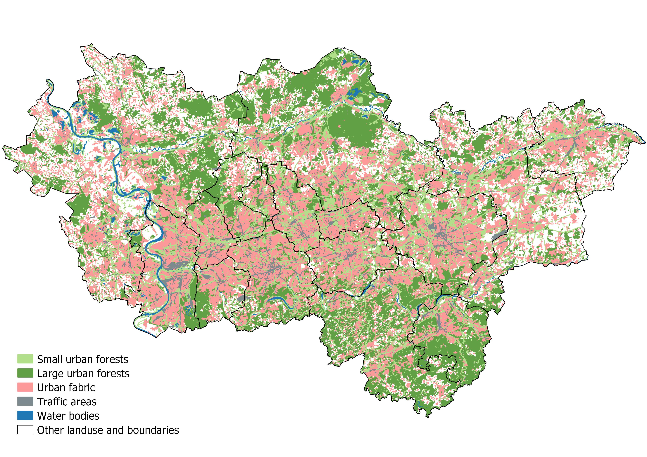
Menu
Study area
Zoom in to study sites
Ruhr Metropolitan Region in Germany is one of the biggest agglomerations in Europe
Polycentric structure with densely populated areas, but also large amounts of green infrastructure
Area of urban forests are estimated up to 822 km² which is 23 % of total area in the agglomeration

Slide 5
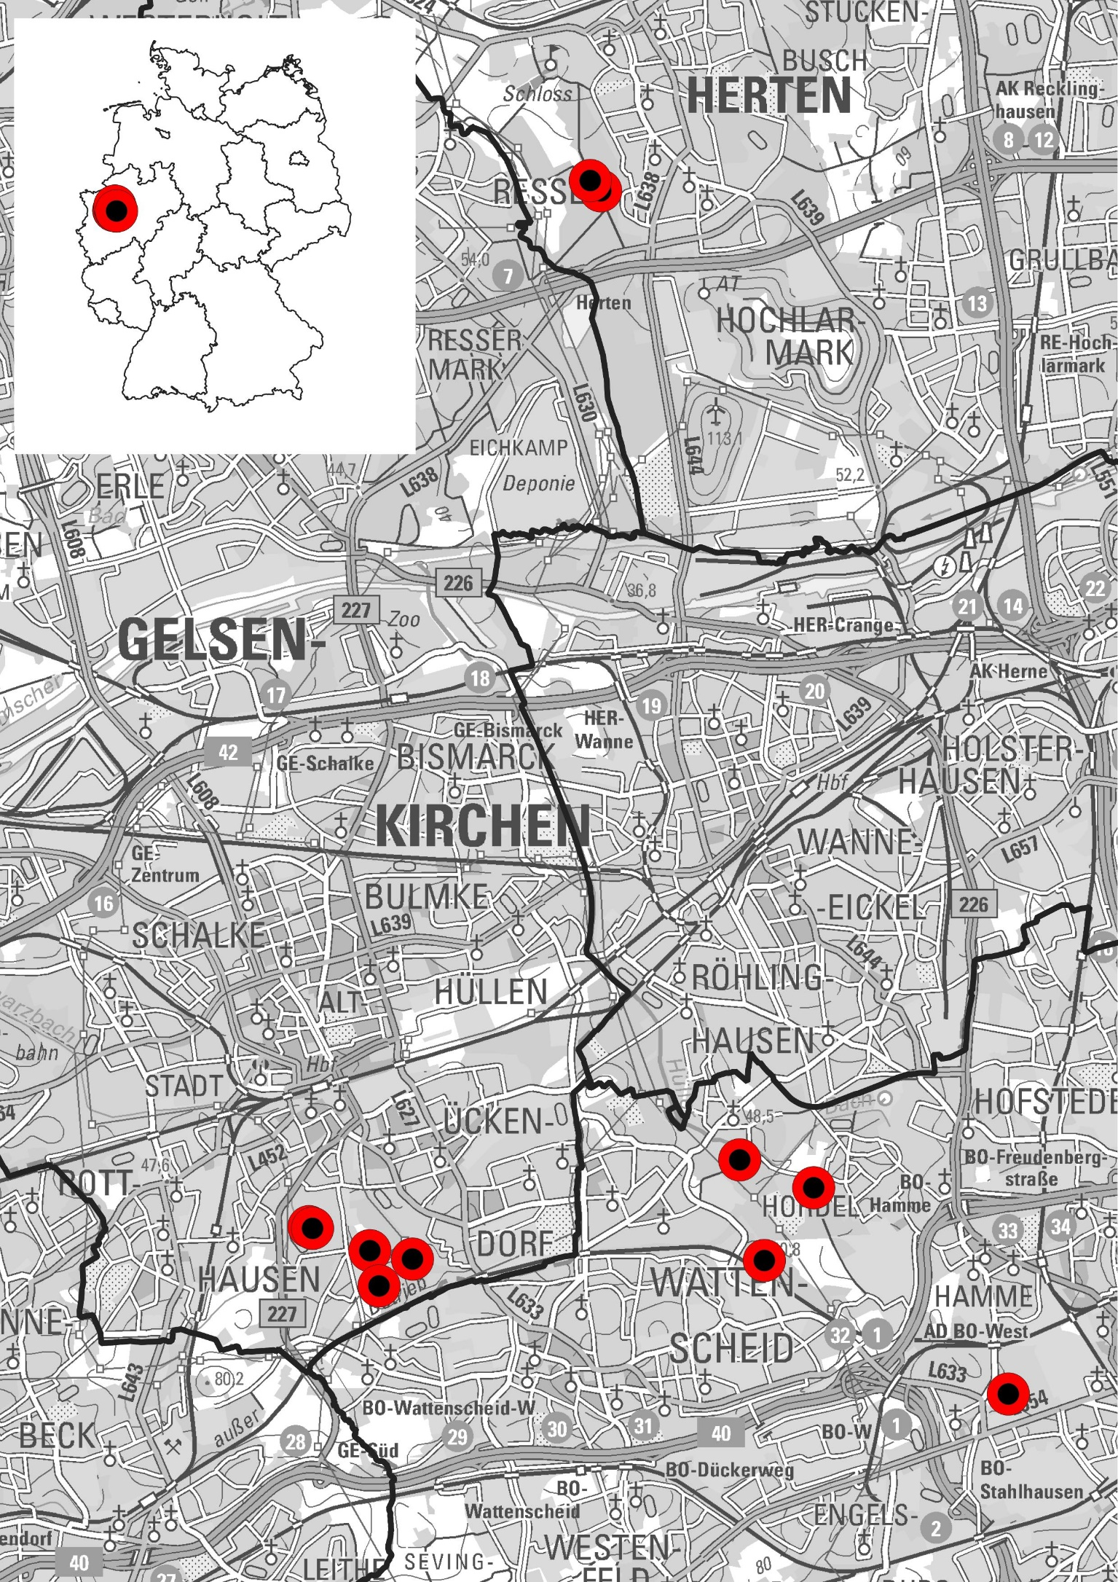
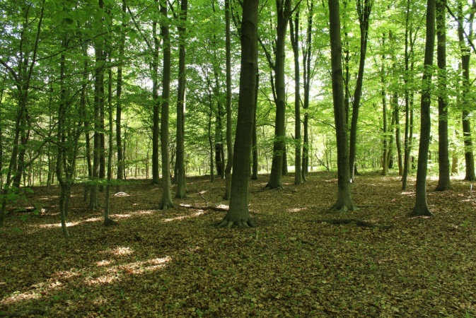

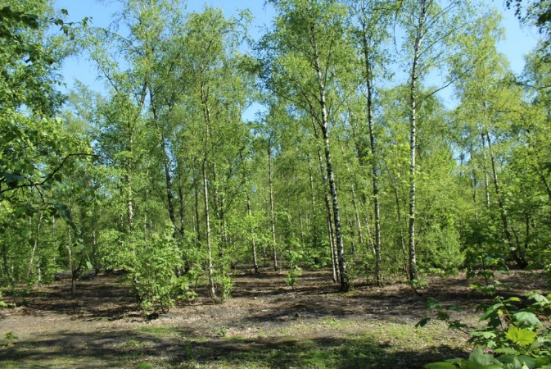
Menu
Investigation on CO₂ balance on eleven monitoring sites
Semi-natural forests
Urban greening forests
Succession forests

Slide 6
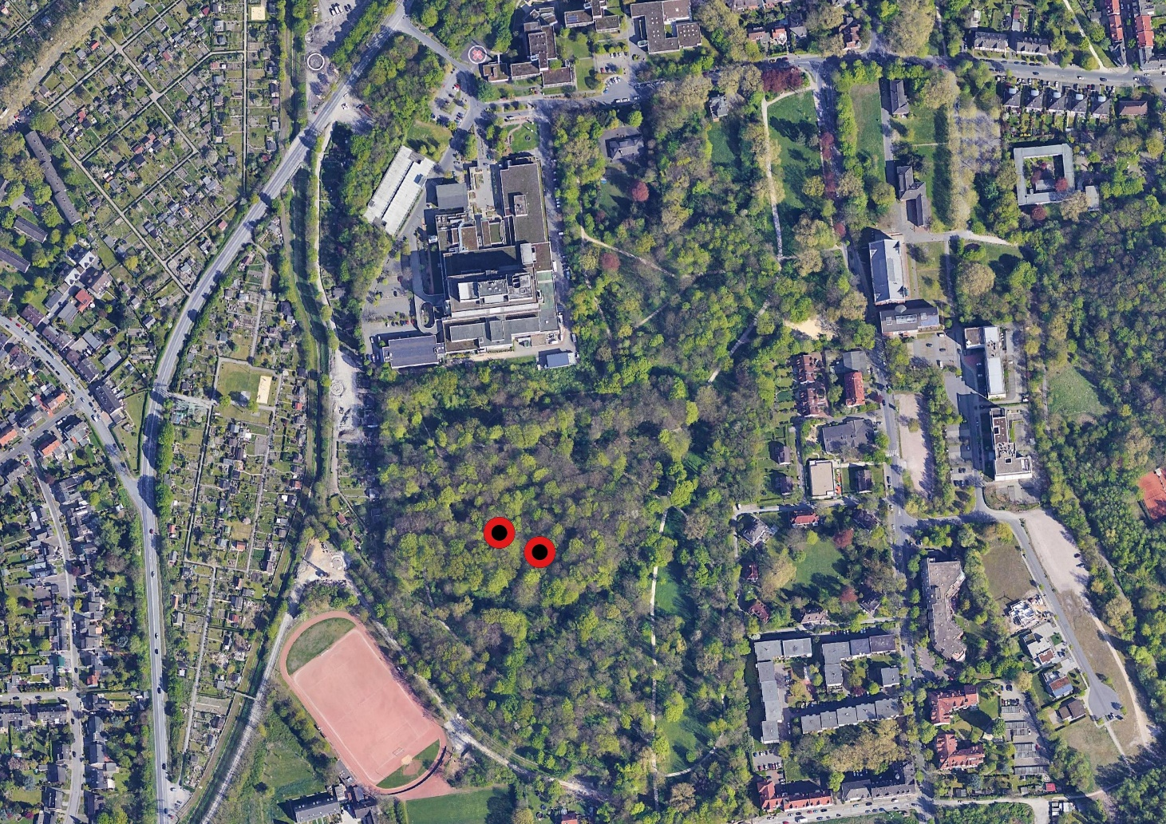
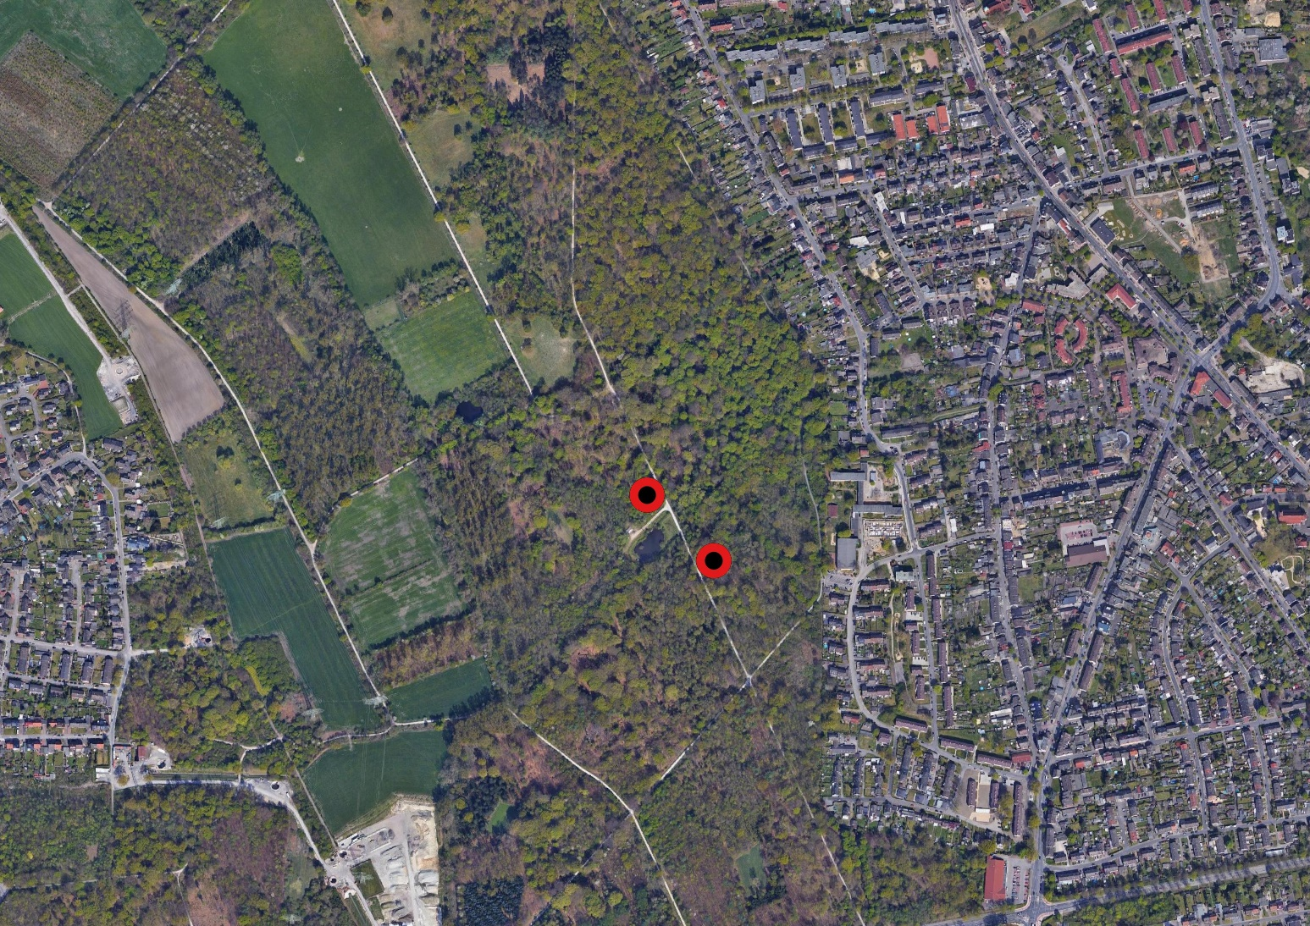
Menu
Semi-natural forests [click on points for site characteristics]
ID: RePa-Bu
Species: Fagus sylvatica
Area: 309.4 m²
Age: > 100 a
DBH: 47.7 ± 4.6 cm
Height: 39.9 ± 2.5 m
Soil: Cambisol
ID: RePa-Ah
Species: Acer pseudoplatanus
Area: 293.4 m²
Age: > 100 a
DBH: 34.6 ± 3.7 cm
Height: 28.4 ± 2.3 m
Soil: Cambisol
Old forests (> 100 a) as remnants of the traditional cultural landscape
Characterized by site-specific climax tree species like Fagus sylvatica or Quercus robur
Growing on deep native soils
ID: Hert-Ei
Species: Quercus robur,
Carpinus betulus
Area: 531.6 m²
Age: > 100 a
DBH: 35.7 ± 2.5 cm
Height: 21.9 ± 1.8 m
Soil: Stagnosol
ID: Hert-Bu
Species: Fagus sylvatica
Area: 623.4 m²
Age: > 100 a
DBH: 46.2 ± 4.8 cm
Height: 27.8 ± 2.7 m
Soil: Stagnosol
Study sites

Slide 7
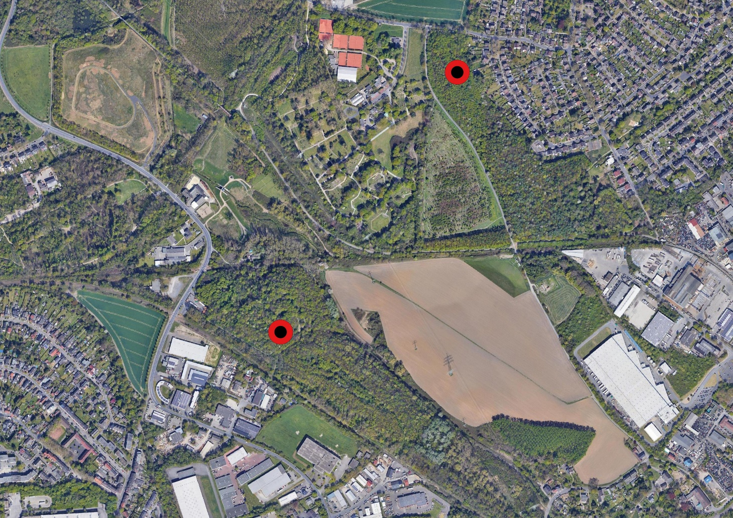
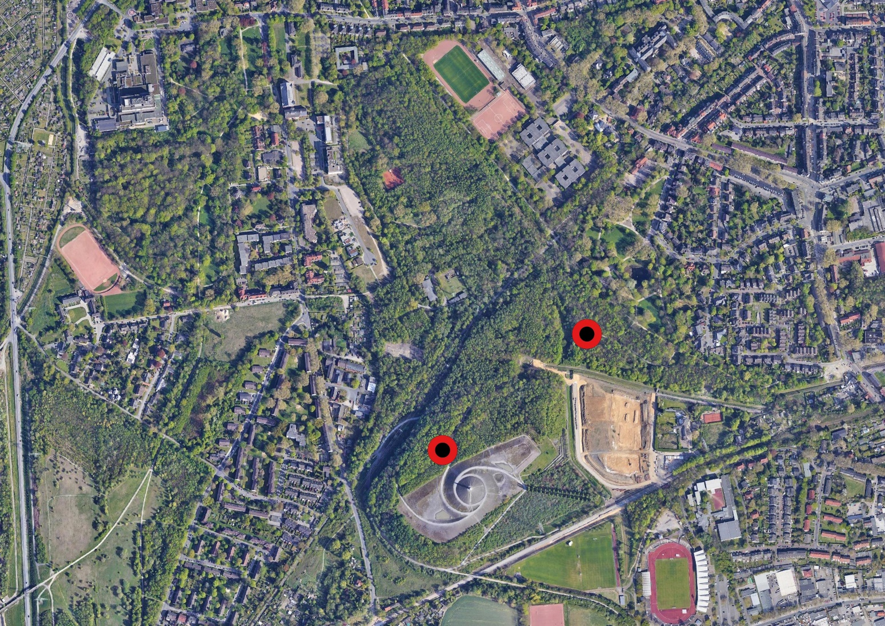
Menu
Urban greening forests [click on points for site characteristics]
ID:BlueHa
Species: Acer pseudoplatanus
Fagus sylvatica
Quercus robur
Carpinus betulus
Area: 157.3 m²
Age: 20-30 a
DBH: 18.0 ± 1.3 cm
Height: 18.4 ± 1.1 m
Soil: Regosol
Young or medium aged forests, planted in urban parks or on former anthropogenic sites (especially slag or slate heaps)
Mixed-species composition, mainly of intermediate tree species
Growing on thin regosols. Before planting, a topsoil on top of the anthropogenic substrates are generally added. Rooting is limited.
ID: BoHo
Species: Carpinus betulus
Area: 93.8 m²
Age: 20-30 a
DBH: 13.2 ± 0.7 cm
Height: 23.6 ± 1.2 m
Soil: Regosol
ID: ReHa-Ei
Species: Quercus robur
Carpinus betulus
Acer pseudoplatanus
Tilia cordata
Area: 151.2 m²
Age: 30-40 a
DBH: 17.1 ± 1.5 cm
Height: 16.0 ± 1.1 m
Soil: Regosol
ID: ReHa-Ah
Species: Acer pseudoplatanus
Area: 82 m²
Age: 30-40 a
DBH: 14.2 ± 1.3 cm
Height: 16.4 ± 1.4 m
Soil: Regosol
Study sites

Slide 8
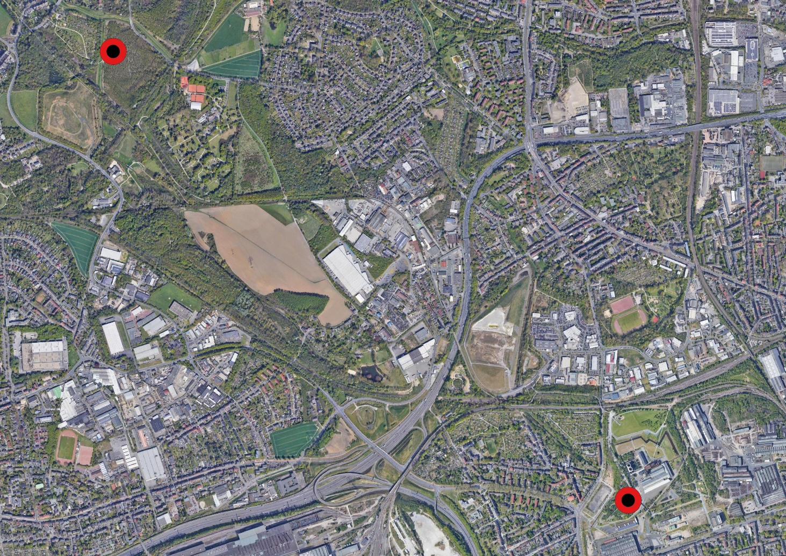
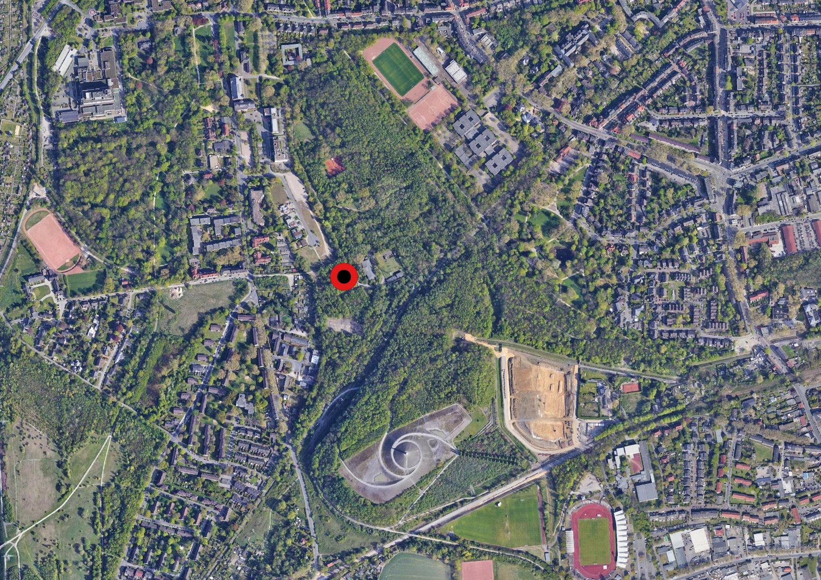
Menu
Succession forests [click on points for site characteristics]
ID: WePa
Species: Betula pendula
Area: 142.6 m²
Age: 30-40 a
DBH: 13.7 ± 1.0 cm
Height: 16.8 ± 1.5 m
Soil: Regosol
Pioneer forests on former coal mining or steel working sites, which are neither planted nor managed
Characterized by pioneer tree species like Betula pendula, Salix spec. or Populus spec. In old stands, pioneer species are mixed with intermediate species
Growing directly on top of the anthropogenic substrates. Rooting is limited.
ID: ZeHa
Species: Betula pendula
Tilia cordata
Area: 158.1 m²
Age: 30-40 a
DBH: 9.6 ± 0.8 cm
Height: 10.8 ± 1.1 m
Soil: Regosol
ID: ReHa-Bi
Species: Betula pendula
Acer pseudoplatanus
Area: 74.1 m²
Age: 60-70 a
DBH: 18.5 ± 1.7 cm
Height: 21.0 ± 2.6 m
Soil: Regosol
Study sites

Slide 9
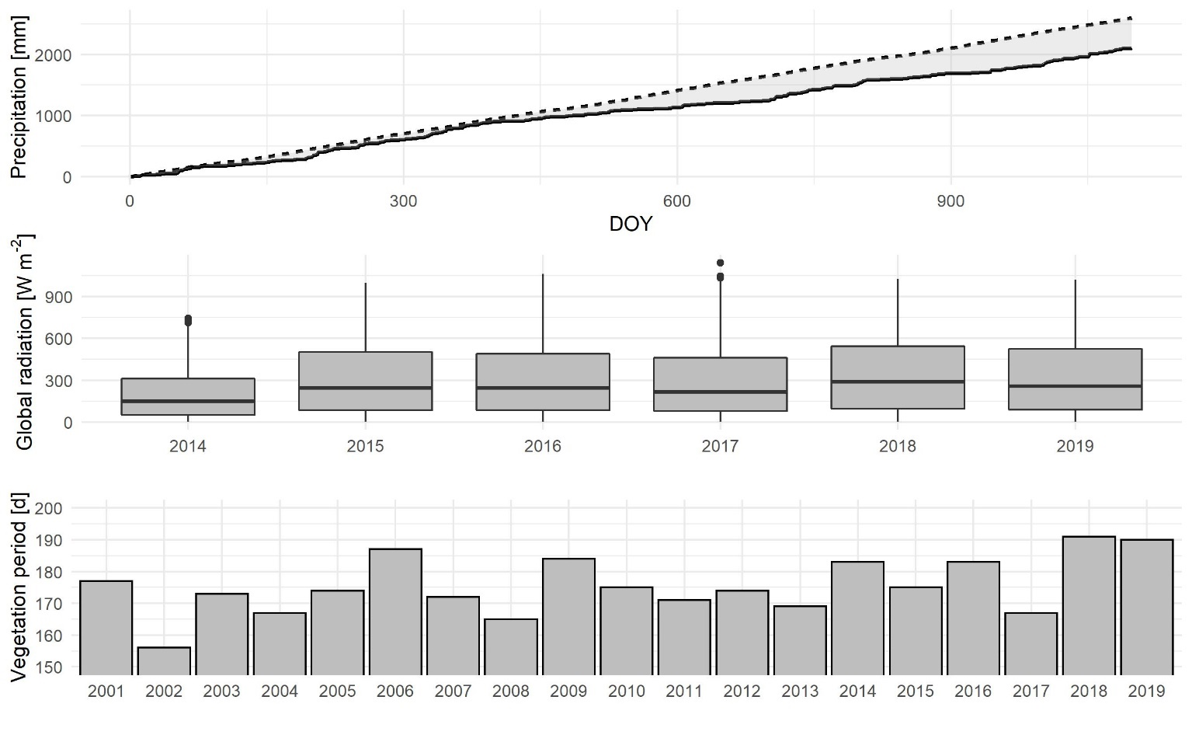
Menu
Characteristics of the drought years 2018/2019
Precipitation | Precipitation
Long-term | 865 mm
2018 | 544 mm
2019 | 739 mm
Temperature
Long-term | 11.0 °C
2018 | 11.6 °C
2019 | 11.2 °C
Experimental period (2018/2019) was much warmer and drier than typical.
Precipitation deficit of 321 mm (-37%) in 2018 and 126 mm (-15%) in 2019.
Warmer temperatures in autumn increased the length of the vegetation period about 16 days.

Slide 10
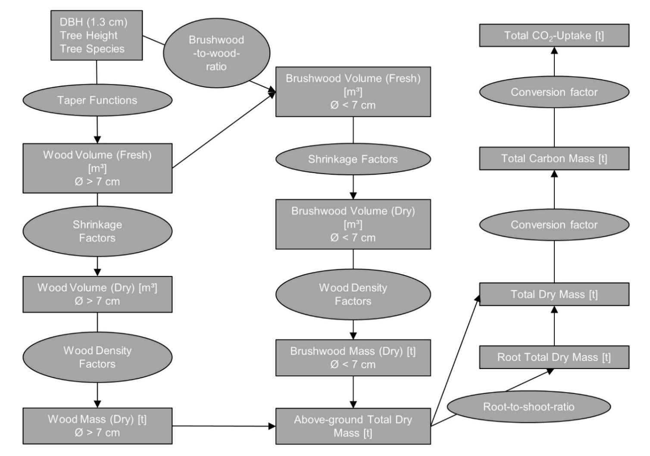
Menu
Estimating CO₂ uptake in forest biomass
Kublin (2003): A uniform description of stem profiles. Methods and programs. BDATPro. Forstwissenschaftliches Centralblatt 122 (3): 183-200.
3.65
Kollmann (1982): Technology of wood and wood products. Volume 1. Berlin, Heidelberg (german)
0.5
Grundner & Schwappach (1952): Mass panels to determine the wood content of forest trees and stands. 10. Edition. Berlin, Heidelberg (german)
IPCC (2003): Good practice guidance for land use, land-use change and forestry. Hayama.
Measurement of Diameter at Breast Height (DBH) and tree height in April 2018/2019/2020 of each tree.
Modelling annual tree biomass depending on species, DBH and tree height, considering coarse wood, brushwood, and roots (see flowchart).
Annual changes in carbon stocks represent the CO₂ uptake.

Slide 11
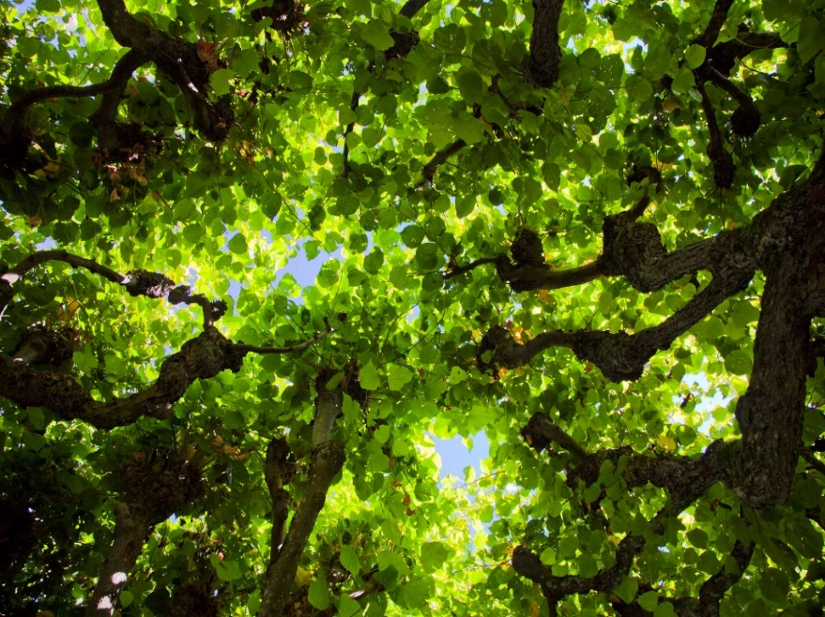
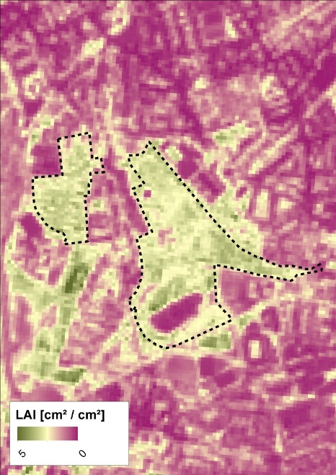


Menu
Estimating CO₂ translocation by litterfall
Measuring LAI weekly with Plant Canopy Analyzer + Estimating LAI with Sentinel-2 satellite images.
₊
Collecting 30 leaf samples of each species and determine Leaf Mass Area (LMA) [g cm⁻²].
Measuring leaf area (ImageJ)
Measuring dry weight after drying at 60 °C for one week
30 Leaf samples
Calculating annual stand leaf dry mass (LM) [kg m⁻²] with maximum stand-specific LAI [m² m⁻²] (LAI_{max}) and LMA [kg m⁻²] weighted by species.
$$LM= {LAI}_{max} ∗LMA$$

Slide 12
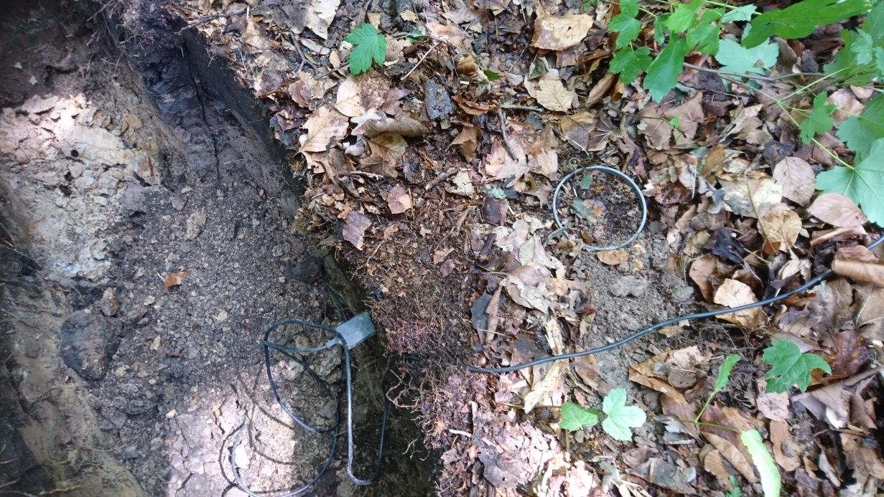
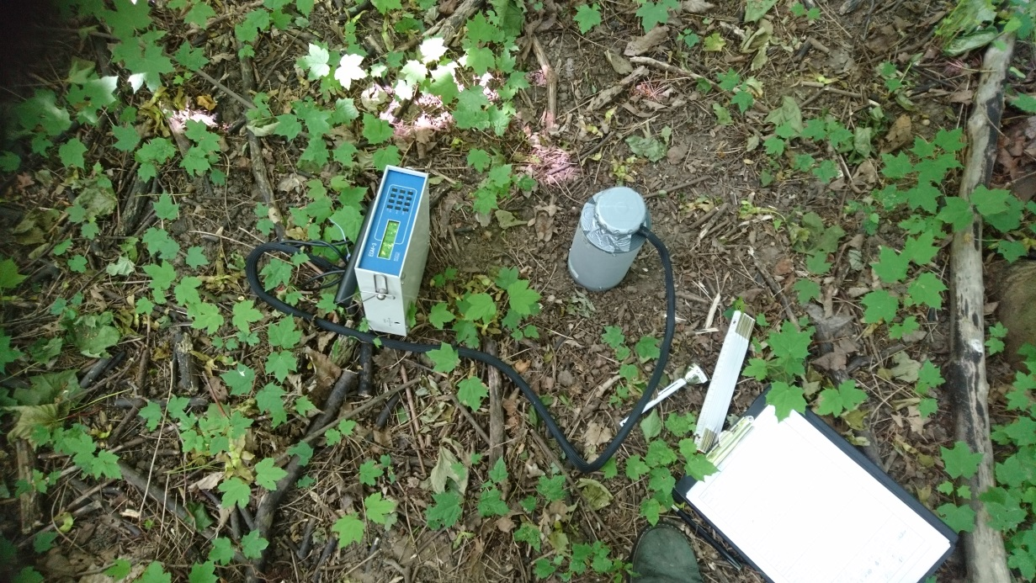
Menu
Measuring CO₂ release by soil respiration
4 measurement locations on each site.
PVC-Collar (Ø 11 cm, height 10 cm) for chamber.
Decagon soil temperature and moisture probe (5TE/5TM) in 5 cm depth beside each collar, which were read out simultaneously during respiration measurements.
Permanent data logger for soil temperature and moisture (Decagon EM50) at one location.
Weekly respiration measurements with EGM 3 Environmental Gas Monitor (Gas Chromatography-Infrared Spectroscopy) (PPSystems).
SRC-1 Soil respiration chamber (PPSystems).
2 minutes chamber closing time.

Slide 13
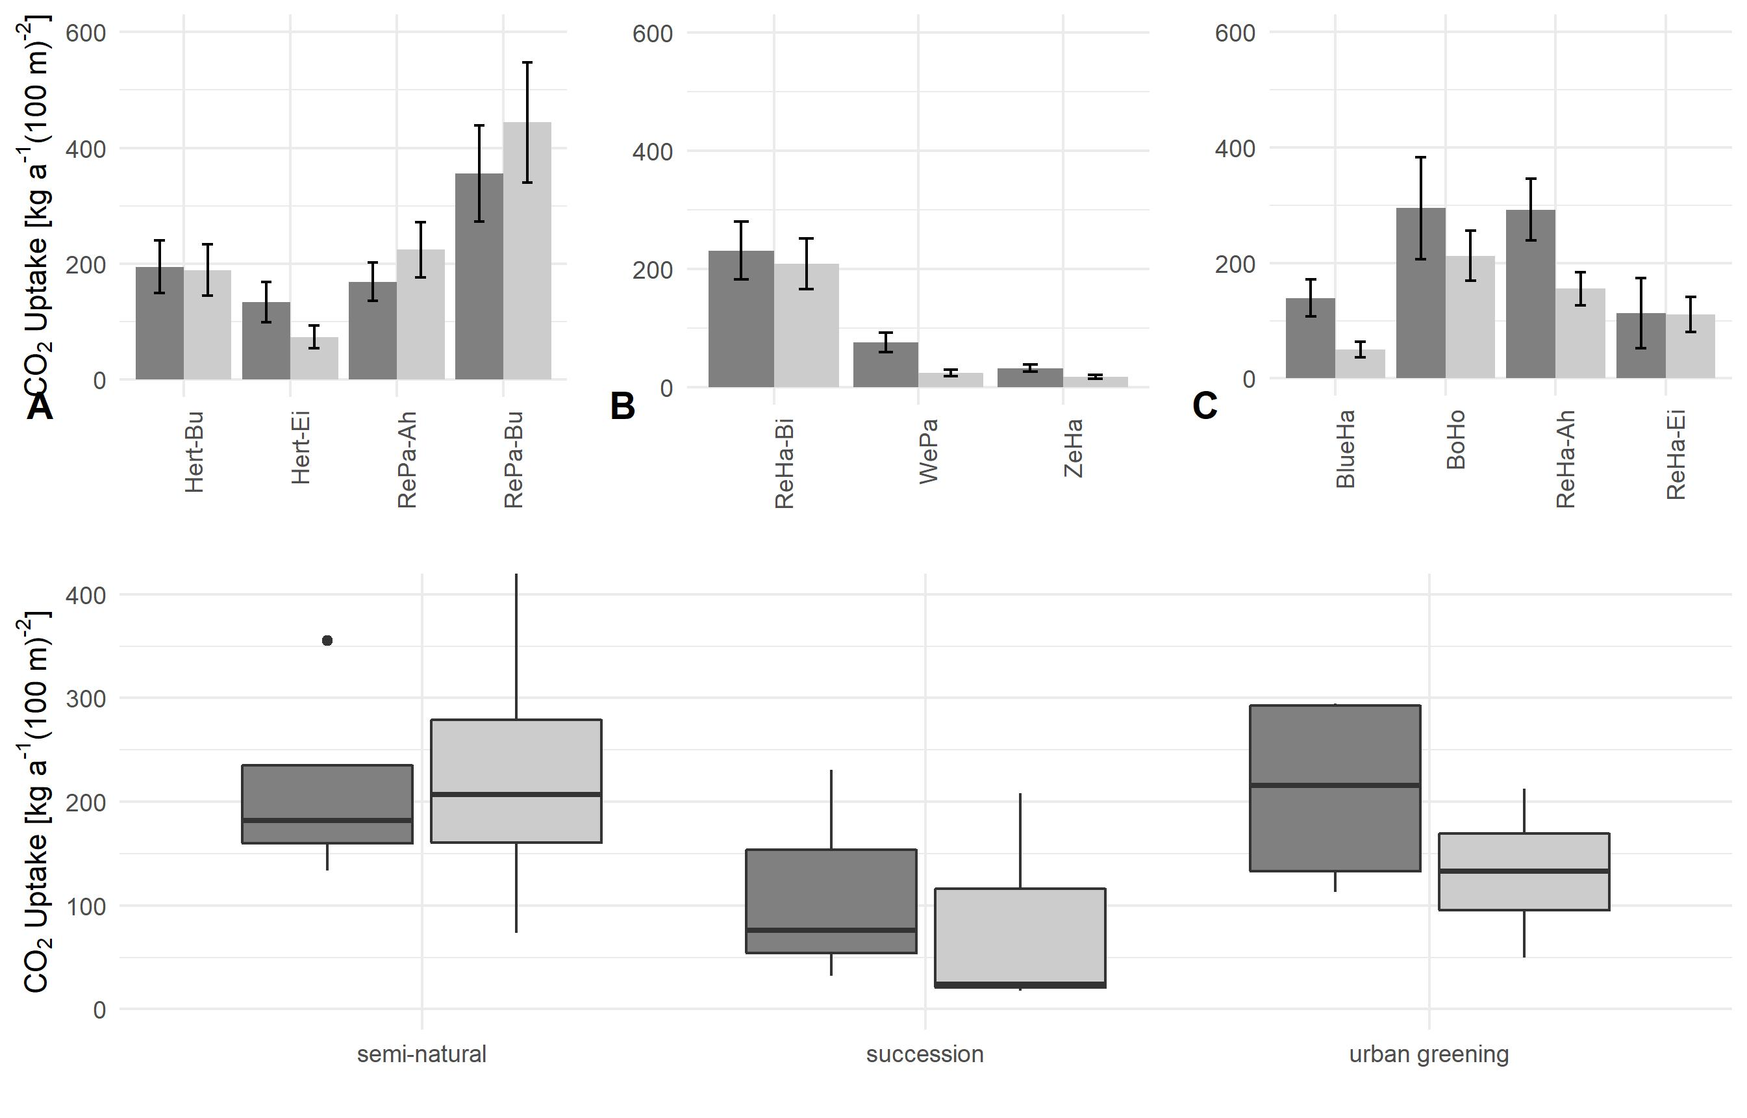
Menu
CO₂ uptake by forest growth
2018
Factors explaining annual differences
2019
A = semi-natural forests; B = succession forests; C = urban greening forests
Semi-natural forests: CO₂ uptake increased in 2019 in comparison to 2018.
Urban greening and succession forests: CO₂ uptake decreased in 2019 in comparison to 2018.

Slide 14
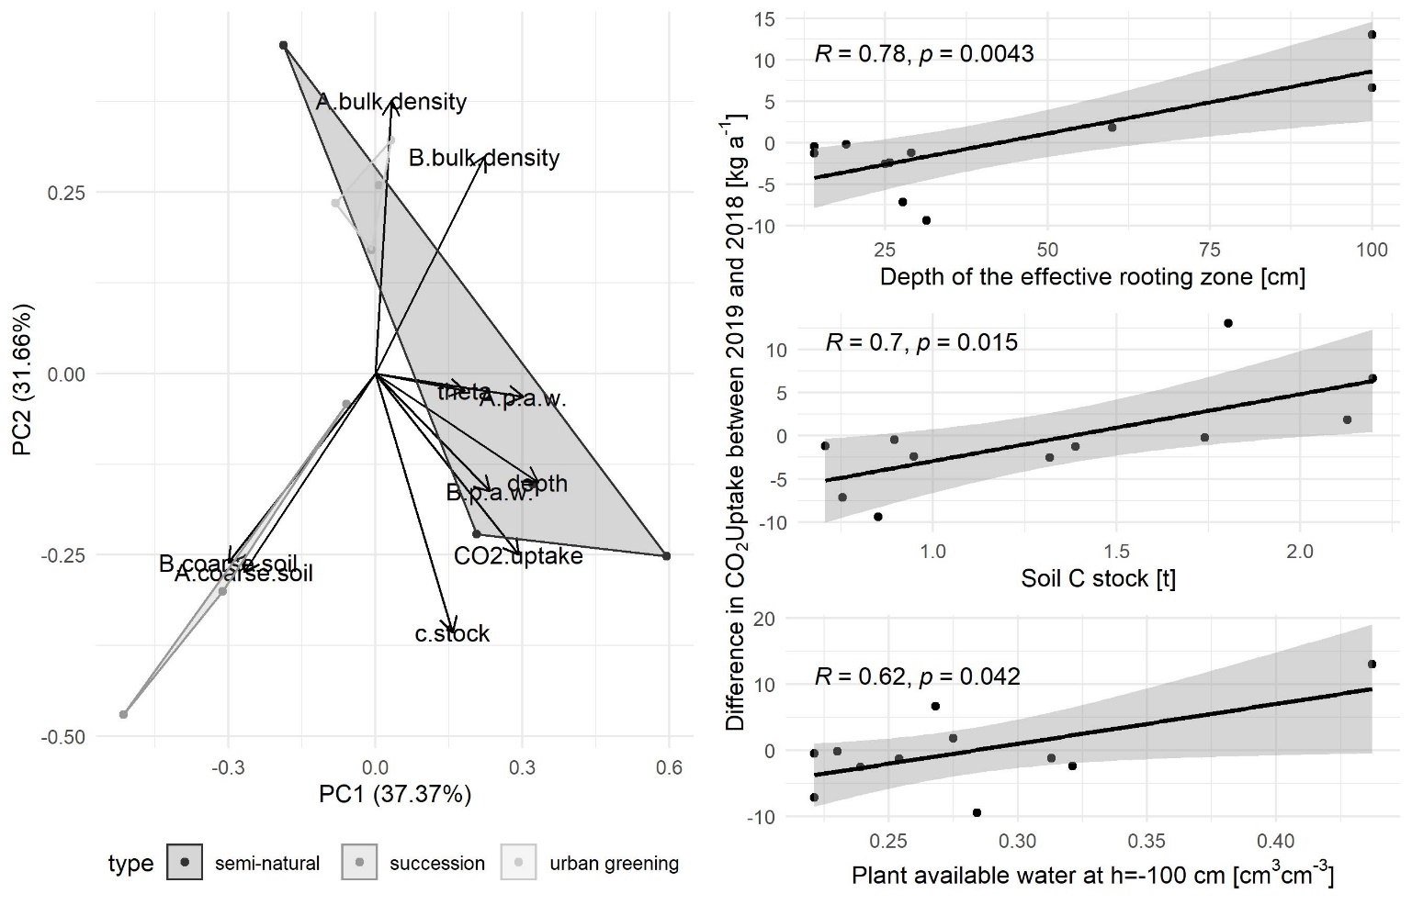
Menu
Factors explaining difference in CO₂ uptake
Results from CO₂ uptake
Decrease in annual CO₂ uptake was even larger, the smaller the effective rooting zone, the soil C stock, and the amount of plant available water was at the sites.
Effective rooting zone, soil C stock, and plant available water influence and represent, among others, the water availability for trees.

Slide 15
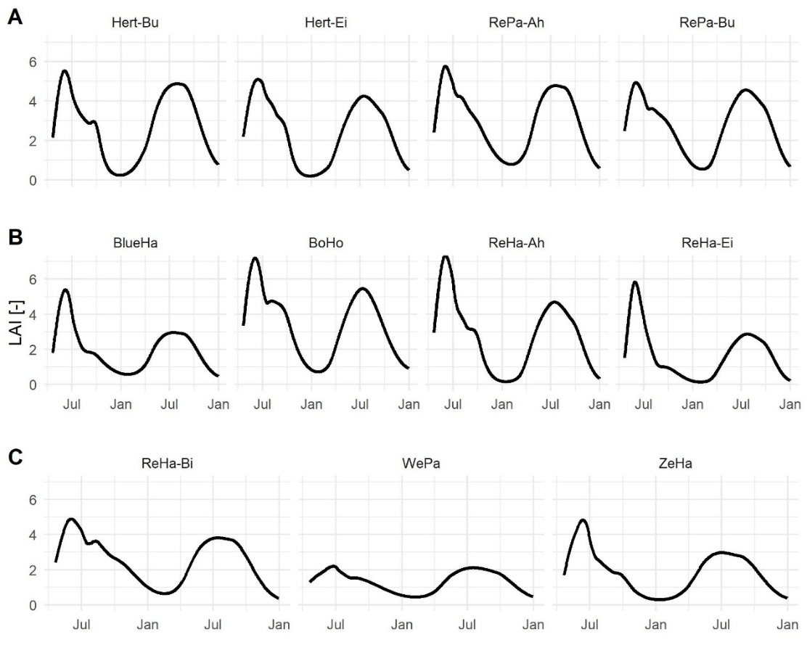
Menu
LAI development at the monitoring sites
Annual CO₂ translocation
At two sites massive loss of trees due to sooty bark disease in consequence of water shortage.
2018: Fast leaf development, where all leaves were exposed already in June, triggered by warm temperatures. Water stress induced early leaf fall in July.
2019: Forests adept to drought and build up their canopy more slowly. Leaves were fully exposed not until July. Maximum LAI was lower at all sites in comparison to 2018.

Slide 16
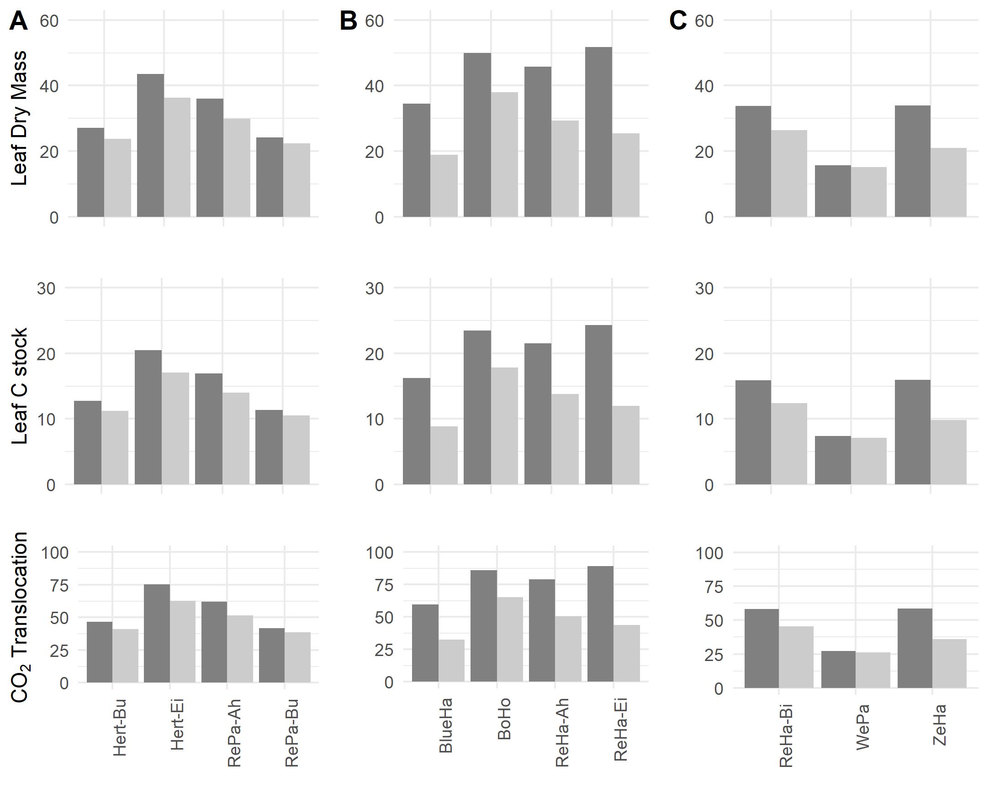
Menu
CO₂ translocation
Leaf development
2018
2019
A = semi-natural forests;
B = urban greening forests;
C = succession forests
[kg a⁻¹ (100 m)⁻²]
CO₂ translocation decreased at all sites in 2019 in comparison to 2018.
Decrease in annual CO₂ translocation is also correlated with effective rooting zone, soil C stock, and plant available water

Slide 17
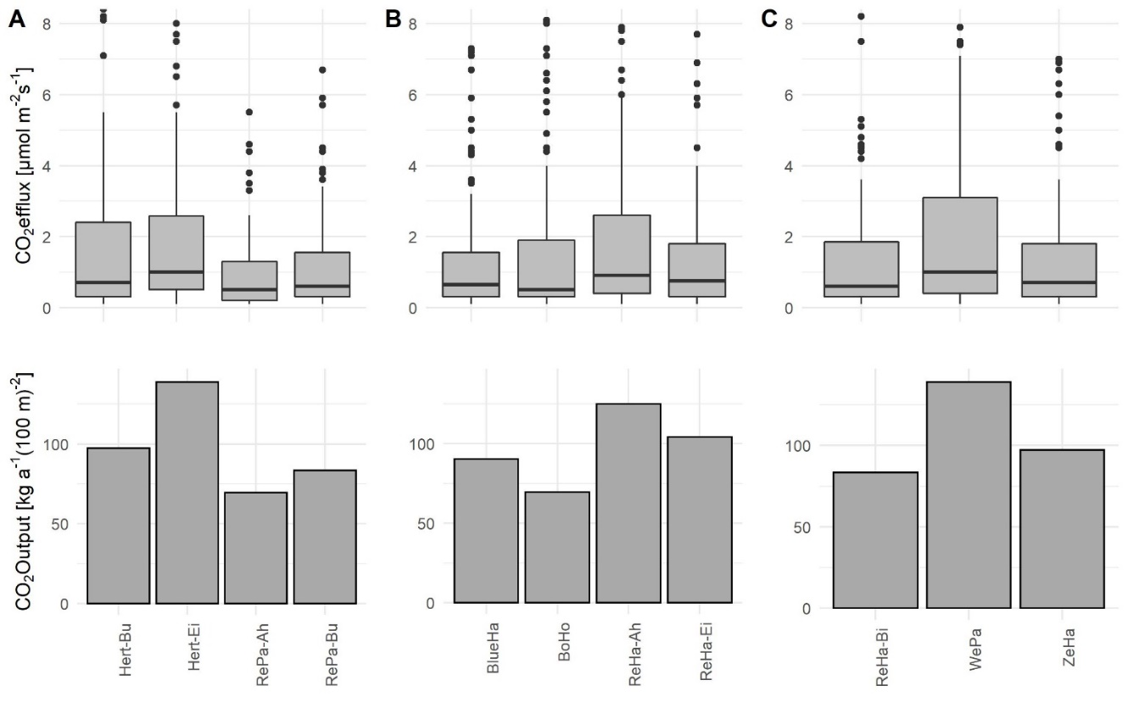
Menu
CO₂ release by soil respiration
Factors explaining differences
A = semi-natural forests; B = urban greening forests; C = succession forests
Mean CO₂ effluxes varies in a narrow range between 0.5 and 1 µmol CO₂ m⁻² s⁻¹, leading annual CO₂ output between 69.4 and 138.8 kg CO₂ a⁻¹ 100 m⁻²
We found no significant difference in CO₂ efflux between the sites

Slide 18
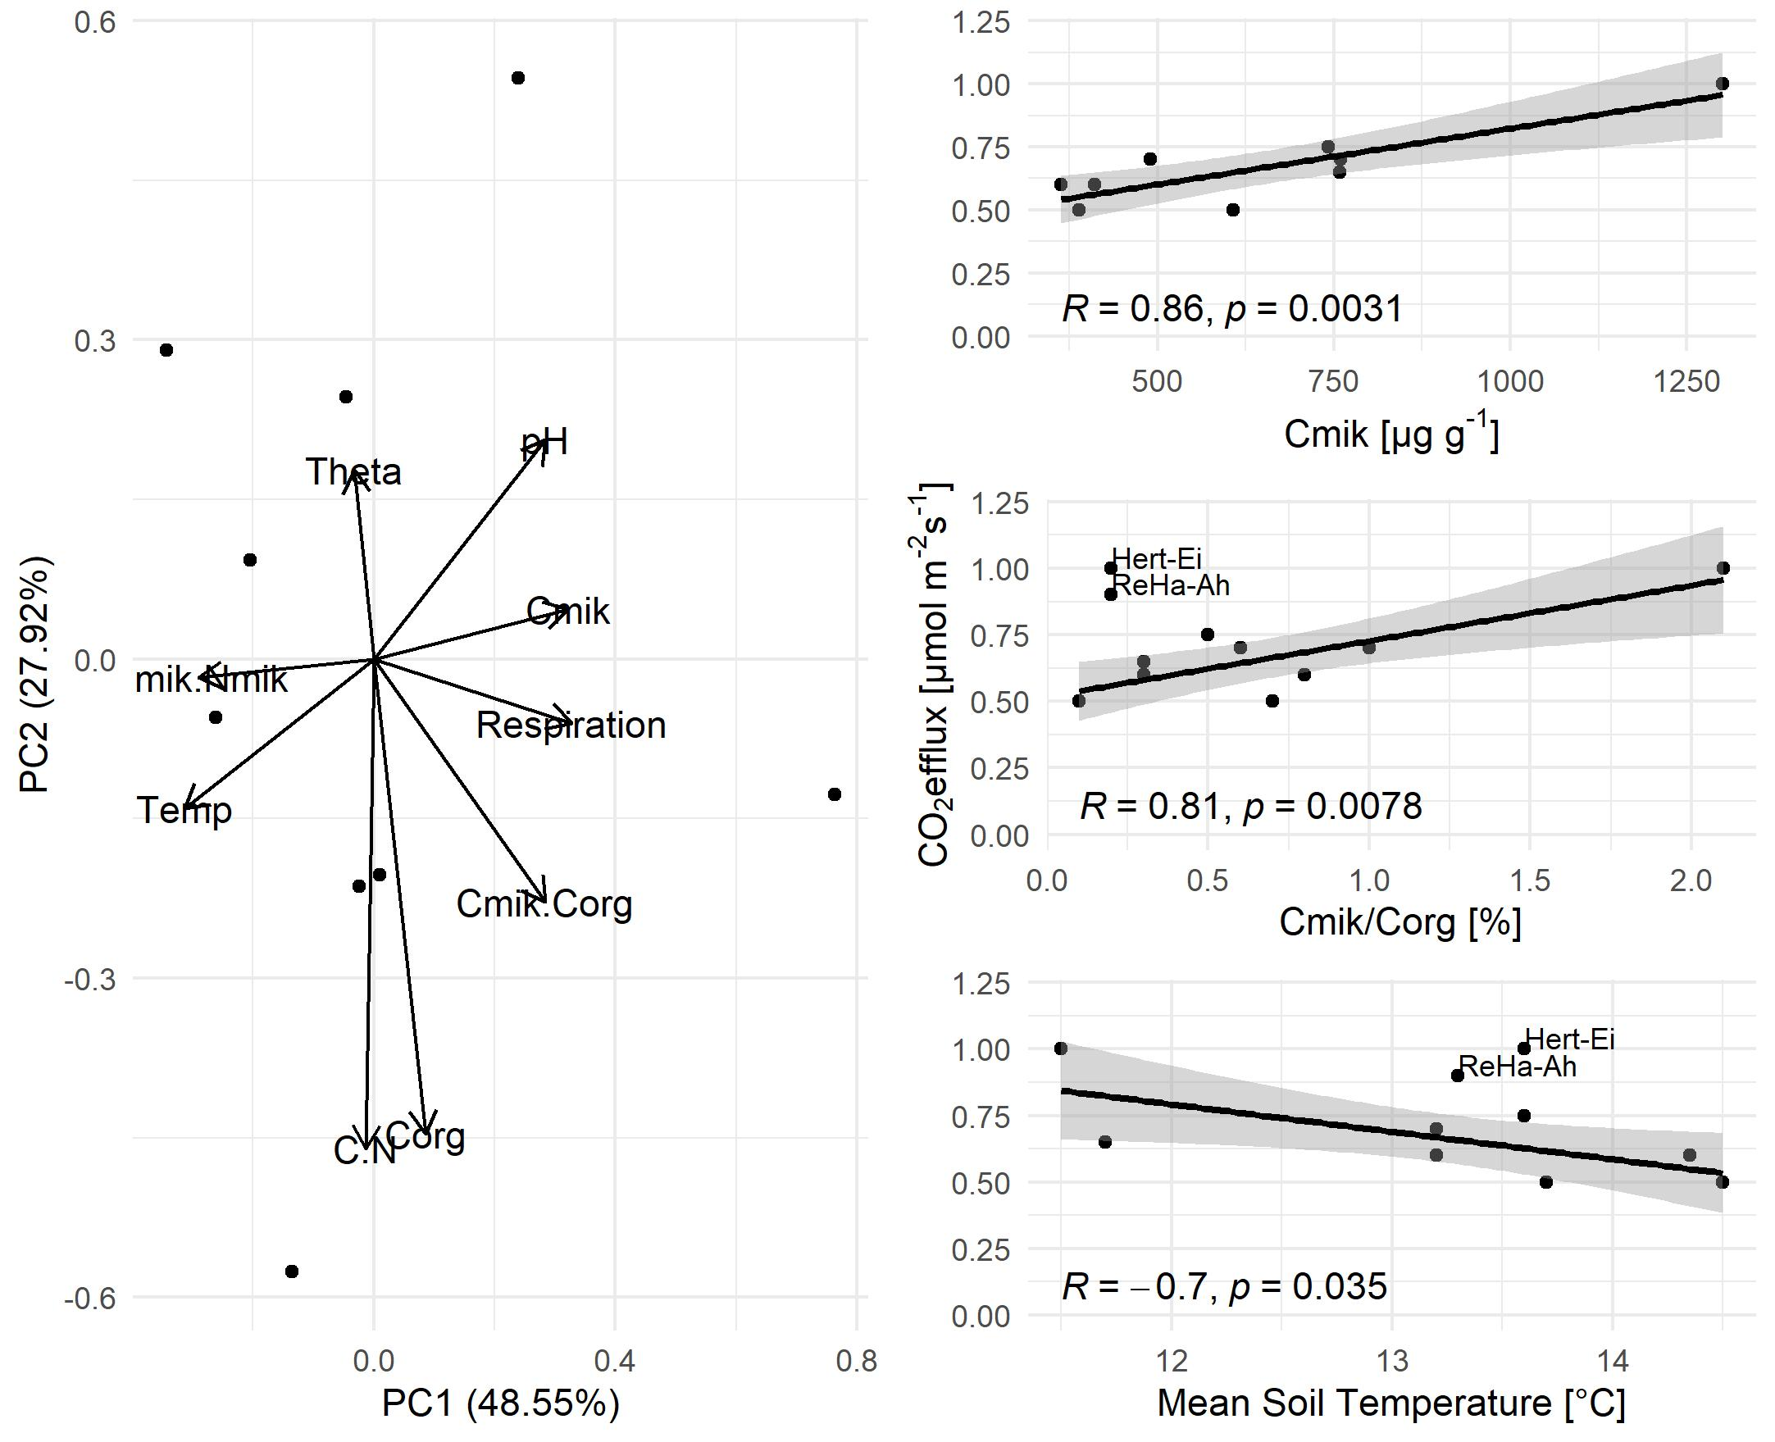
Menu
Factors explaining CO₂ release by soil respiration
Soil respiration
Microbial biomass effect
CO₂ efflux is even larger, the larger the amount of microbial biomass is. Therefore, the CO₂ efflux from soil respiration is clearly controlled by the amount of microbial biomass
Water shortage effect
C_{mik}/C_{org} ratio represents the decomposability and accessability of C for decomposition. Therefore, CO₂ efflux is even larger at sites with larger C_{mik}/C_{org} ratio. A C_{mik}/C_{org} < 1.2 % is a threshold for inhibiting conditions for decomposition activity. Only one site was above that threshold. Consequently, at nearly all sites inhibiting conditions were found. We assume, that the lack of soil water hinders access to organic matter, decreases the mobility of the microorganisms, and finally
decreases the CO₂ effluxes at the sites
Temperature effect
Normally, CO₂ efflux increases with soil temperature. Here, the opposite was found. We assume, that high temperatures, coupled with dry conditions, leading to thermal denaturation, which decreased the amount of microbial biomass (C_{mik} is negatively correlated with soil temperature (not shown)). Finally, lower amounts of Cmik leading to lower CO₂ efflux (see Microbial effect).
Mean CO₂ efflux is positive correlated with Cmik, representing the amount of microbial biomass, C_{mik}/C_{org} ratio, representing the decomposability and accessability of C, and negative correlated with mean soil temperature (for explanations, please click on the plus-signs in the plots)

Slide 19
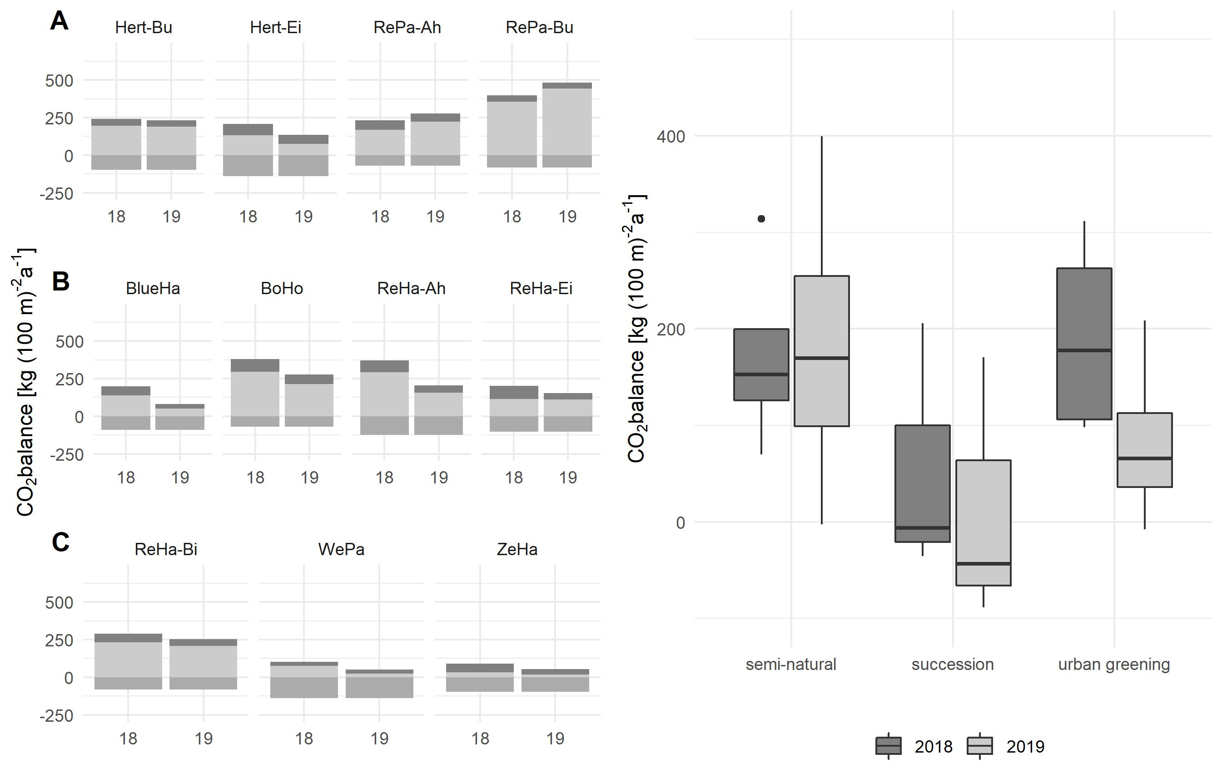
Menu
Complete CO₂ balance
CO₂ uptake
CO₂ translocation
CO₂ release
Semi-natural forests
Net CO₂ uptake increased about 9.9 % in 2019 in comparison to 2018. Indeed, only two sites increased the CO₂ uptake (RePa-Bu, RePa-Ah), while at the other two sites CO₂ uptake decreased. The Stellario-Carpinetum Hert-Ei turned from a carbon sink in 2018 to a source in 2019 (Net CO₂ release of 2.5 kg a⁻¹ 100 m⁻²). The site has a limited rooting zone and no access to ground water, caused by a dense Sd-horizon. Therefore, water supply depends on precipitation, which was absent during experimental period.
+21.4 %
-7.7 %
-103.6 %
+21.7 %
+9.9 %
-62.9 %
Urban greening forests
All sites decreased net CO₂ uptake in 2019 in comparison to 2018 by 62.9 %. One site (BlueHa) turned from a carbon sink in 2018 to a source in 2019, because 45 % of all trees died in consequence of sooty bark disease, which infest mainly young sycamore trees under water stress.
-85.0 %
-33.1 %
-67.1 %
-107.2 %
-48.4 %
Succession forests
The succession forests were CO₂ sources in both drought years and even increased their CO₂ release in 2019 in comparison to 2018 by 85 %. At WePa and ZeHa, we found bad growth conditions, caused by very thin, coarse and loosy soils with low plant available water. The slow forest growth faced relatively high soil respiration rates, leading to a net CO₂ release in both years. On the other hand, the old birch forest ReHa-Bi is a strong carbon sink with a net CO₂ uptake of 205.9 kg a⁻¹ 100 m⁻² in 2018 and 170.4 kg a⁻¹ 100 m⁻² in 2019.
-17.3 %
-59.8 %
-85.0 %
A = semi-natural forests; B = succession forests; C = urban greening forests

Slide 20
Menu
Research Highlights
In urban areas growth conditions of urban forest stands differ widely, leading to different amounts of annual CO₂ sequestration, depending on the individual interaction between forest growth, litterfall, and soil respiration
The two consecutive drought years 2018/2019 decreased CO₂ uptake, translocation, and respiration in the second year, but the urban forest types reacted differently on the drought
Semi-natural forests
Succession (birch) forests
Urban greening forests
In contrast, urban greening forests and semi-natural forests on more extreme locations (Stellario-Carpinetum) are more prone to droughts, because of limited rooting zones by sealed soil layers, low soil carbon content, and plant available water. Those forests drastically decreased their CO₂ fixation potential in the second drought year and two sites turned from carbon sinks into sources.
Semi-natural forests on mesophilic locations were able to buffer the elevated temperatures and low precipitation and keep up the net CO₂ uptake even in the second drought year. This is caused by high soil carbon content, plant available water, and a deep rooting zone, where the trees are able to access water reservoirs in deeper soil zones
Succession forests were CO₂ sources in both years, because of bad growth conditions (thin, coarse, and loosy soils with low amounts of plant available water), which faced relatively high soil respiration rates.
Implications

Slide 21
Menu
Implications
As a consequence of climate change, drought periods will increase in intensity, duration, and frequency in the following years
This study shows, that urban forest ecosystems are prone to droughts, because forests in urban areas are often limited in rooting and the water supply depends on rainwater
If the vitality of forest decrease, the provision of ecosystem services such as CO₂ sequestration decreases as well
Following recommendations can be made:
  Semi-natural forests on deep native soils are able to sustain longer drought periods and keep up their CO₂ fixation potential. Because of that, those forests are important for the urban carbon budget and should be preserved against other landuses
  If new urban forests are planned, practioneers should provide good growth conditions, especially a deep rooting zone and carbon rich soils, which supplies large amounts of plant available water, to ensure good vitality even under drought conditions for urban forest ecosystems
Research highlights

