Slide 1
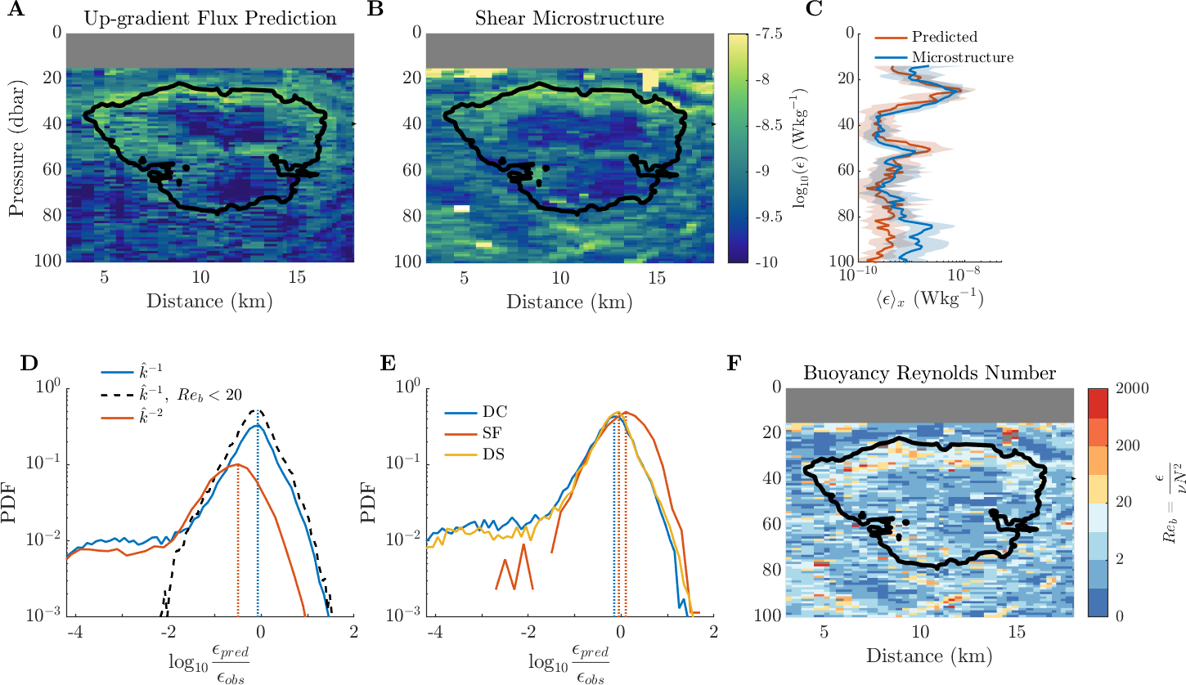


Estimating double-diffusive dissipation rates
Leo Middleton, Effie Fine, Jennifer Mackinnon, Matthew Alford and John Taylor

Slide 2
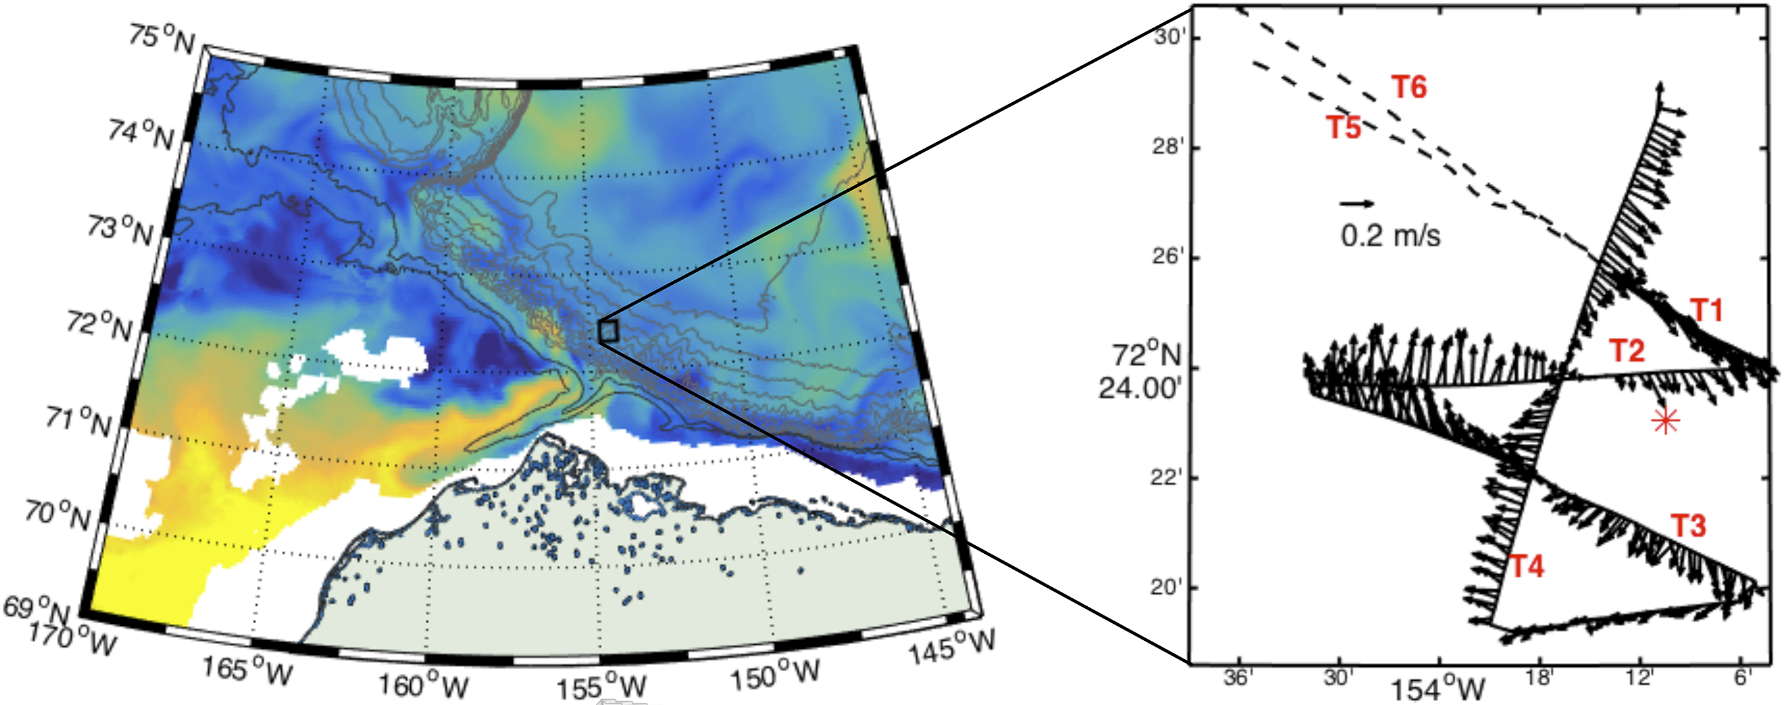
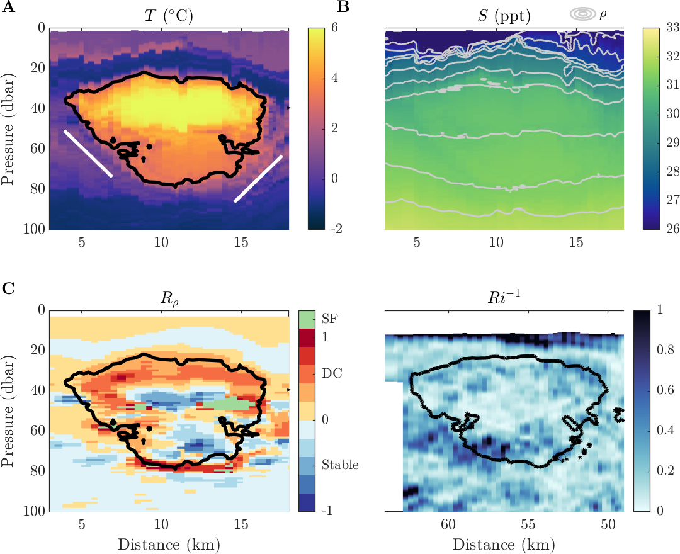
Observations
Fine et al. 2018
High resolution eddy observations (including microstructure) on Chuchki slope (Arctic Ocean) presented in Fine et al. 2018
Regions of enhanced dissipation were observed on the edges of the eddy, thought to be caused by double-diffusive convection
Can we predict the dissipation rate due to double-diffusive convection?

Slide 3
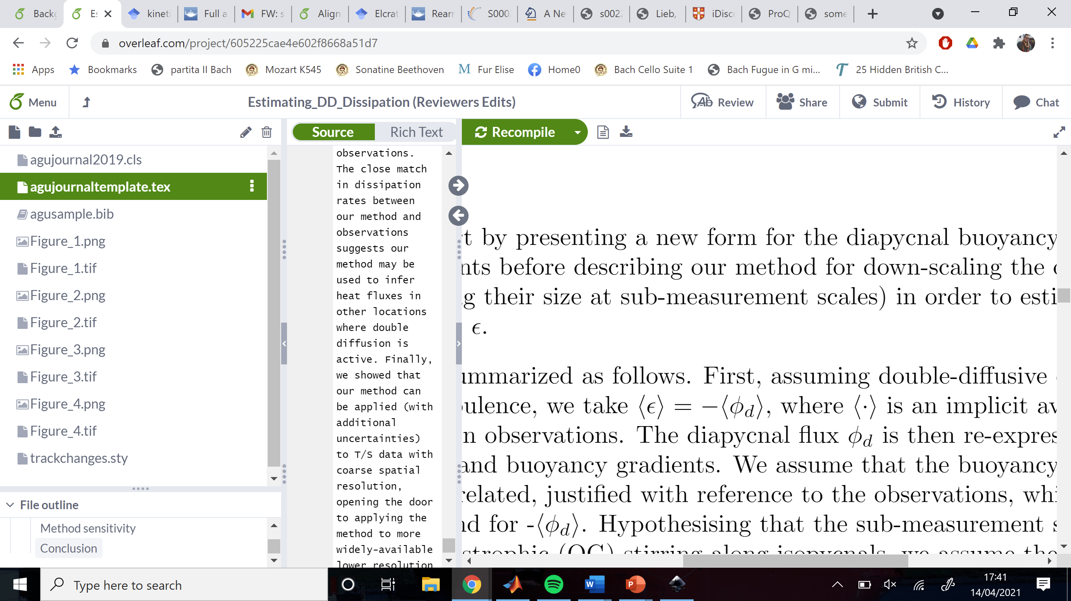
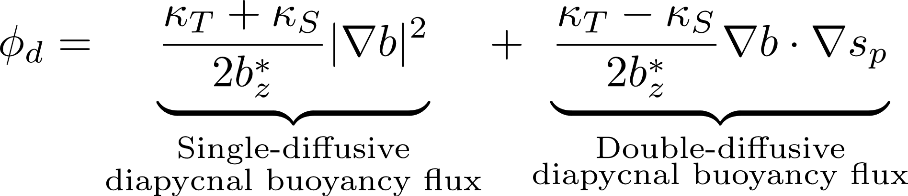
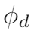


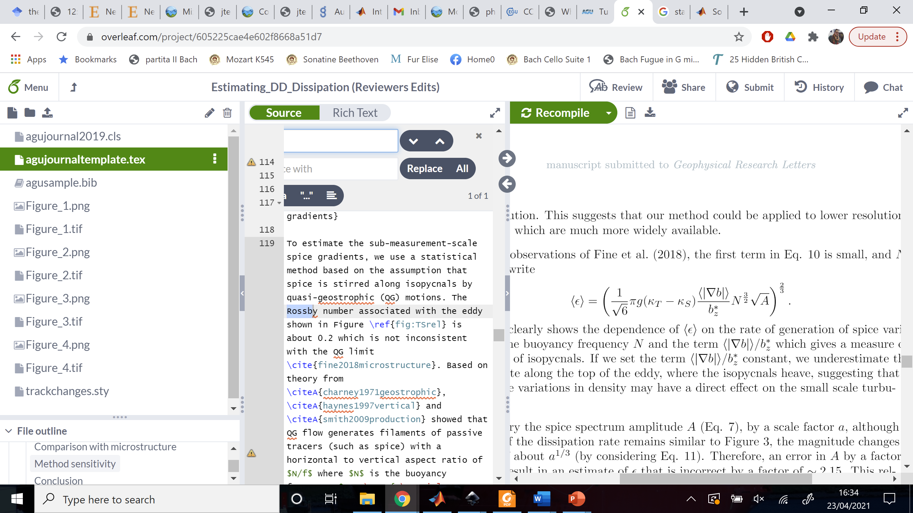

Method outline
Our method relies on two main assumptions:
The dissipation rate is forced by an up-gradient buoyancy flux (i.e. double-diffusive convection is the driver of turbulence),
so (see Middleton and Taylor 2020)
Rewriting the diapycnal buoyancy flux in terms of buoyancy and spice,
the first term is positive, so the second term must dominate to give , so we estimate the second term
Molecular diffusivity for temperature
Molecular diffusivity for salt
Buoyancy
Spice
Sorted buoyancy gradient
Dissipation rate
Diapycnal buoyancy flux

Slide 4
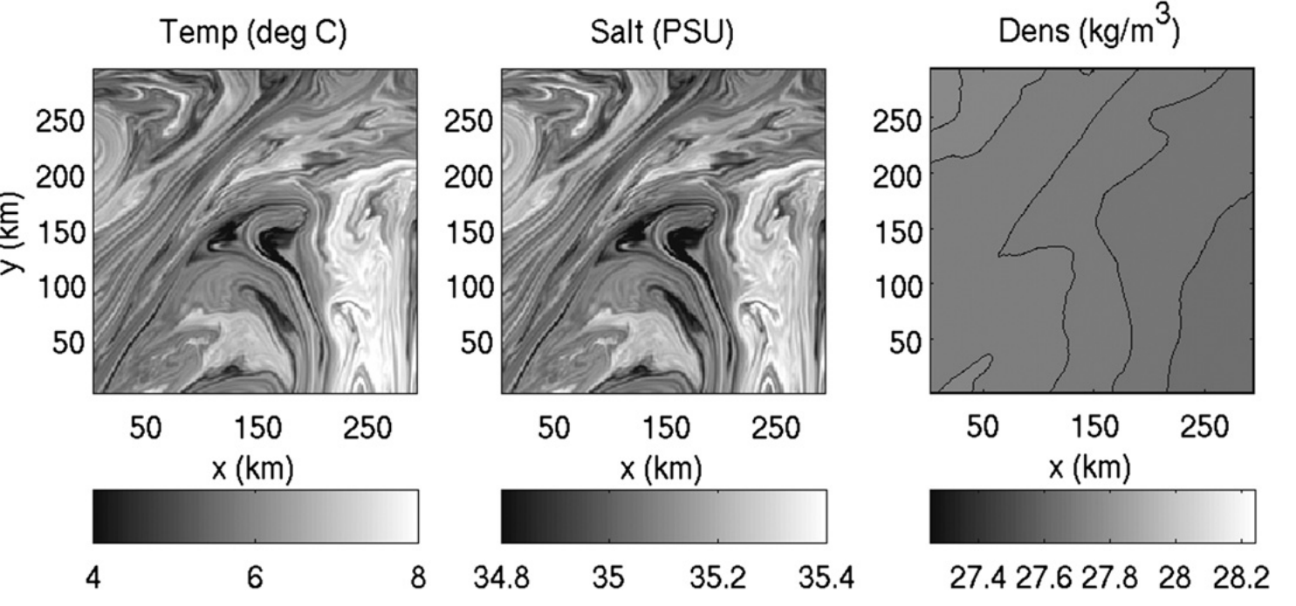
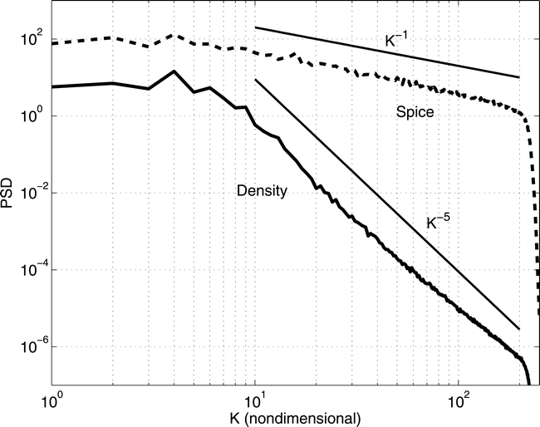
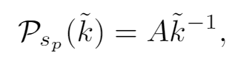
Method outline
Assumption 2 is discussed further at the end of the presentation
Quasi-geostrophic stirring preferentially mixes temperature and salinity along isopycnals
Smith and Ferrari 2009 showed that for QG stirring,
Spice is fluxed to small scales, giving much larger spice gradients than buoyancy gradients
We assume the QG scaling for spice to project the observed spice gradients down to small scales
Figures from QG model of NATRE region in Smith and Ferrari 2009

Slide 5
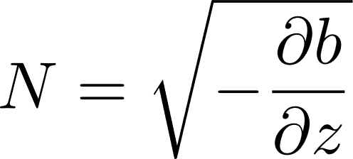
Dissipation rate prediction
Combining our assumptions, we can derive an equation for the dissipation rate*
We estimate the power spectral amplitude A using a two-point correlation.
Applying this equation at each grid point, we get the prediction
is the buoyancy frequency
* Given in slightly simplified form

Slide 6
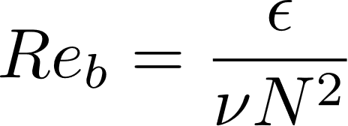

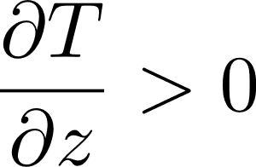
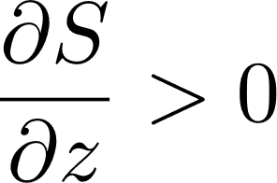
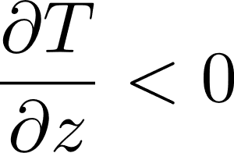
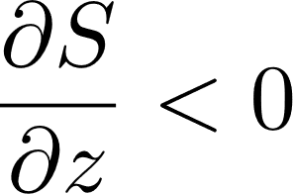
Applicability
The method works well for low buoyancy Reynolds number
consistent with previous studies of double diffusion (e.g. Inoue 2007)
The method does not work well in regions of high shear (i.e. the mixed layer and below the eddy), where is large
Our method assumes lateral stirring of spice causes opposing gradients at small scales, so does not rely on opposing vertical gradients on the scale of the observations i.e. it works in ‘DC’, ‘SF’ and ‘DS’ regimes
‘Diffusive Convection’ -favourable (DC)
‘Salt Fingering’ –favourable (SF)
‘Doubly Stable’ (DS)

Slide 7
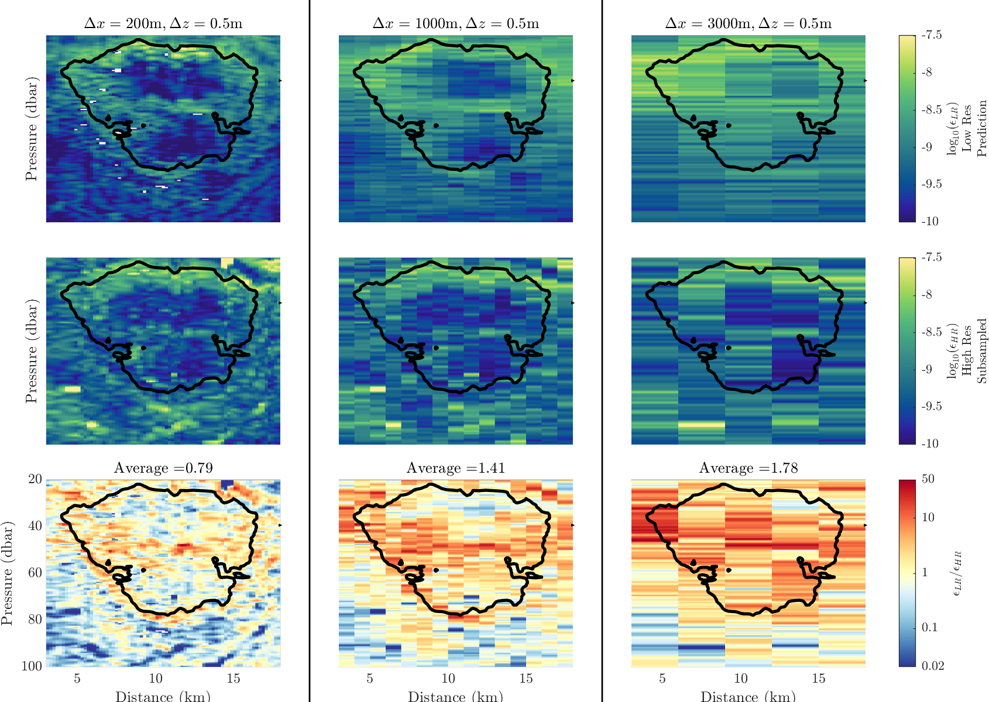
Resolution
We apply our method coarse sub-samplings of the temperature/salinity data to demonstrate it’s variability with resolution
The dissipation prediction reduces in skill with scale, however still maintains relatively high skill with a coarser resolution
The change with resolution can be improved by using a more accurate spice spectrum

Slide 8
Conclusions
Middleton et al. 2021 in review
We developed a new method for predicting the dissipation rate associated with double-diffusive convection using Temperature and Salinity data alone
The method works well for regions of low buoyancy Reynolds number (i.e. weakly turbulent regions) but does not work in shear-dominated regions
The method is based on physical reasoning, so may be used in conjunction with microstructure to distinguish regions where double-diffusive convection can (or can not) explain the observed dissipation rates
The opposing gradients needed for double-diffusion are hypothesised to result from lateral stirring of T/S along isopycnals, so does not rely on the usual criteria of opposing vertical gradients in T/S
The method performs well even at coarse resolution so may be used for estimating dissipation rates using coarse T/S surveys
Further details on the method are provided below

Slide 9
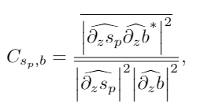
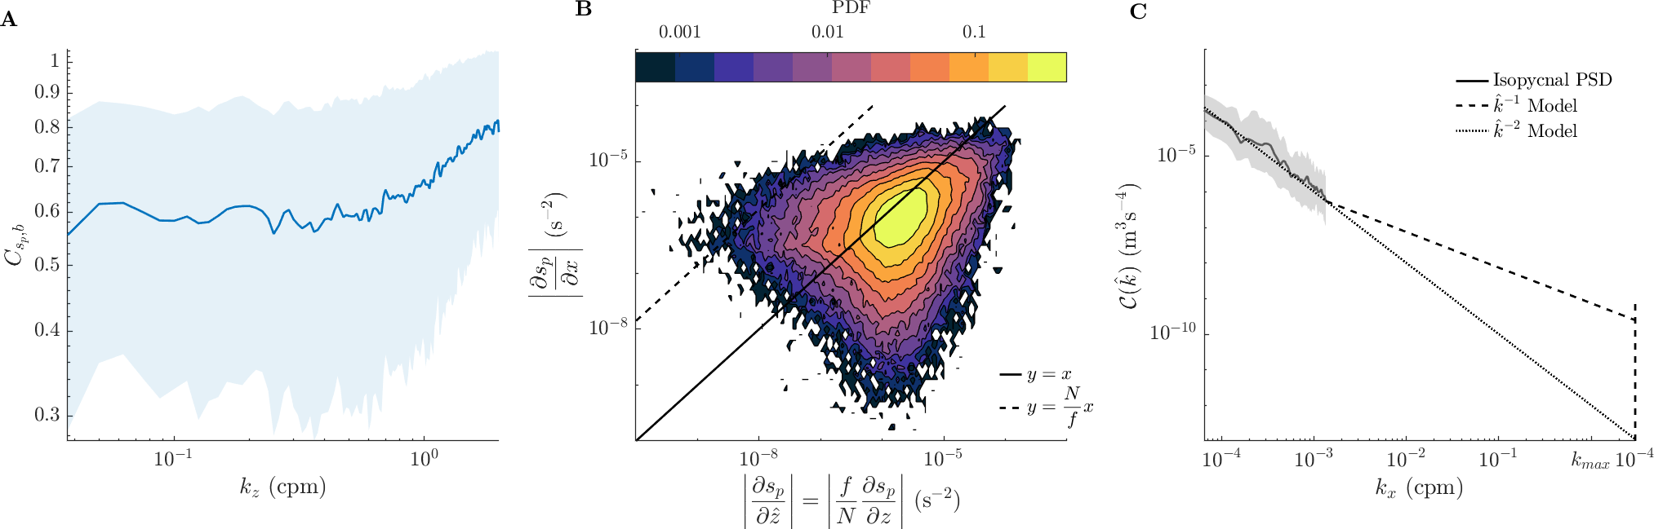

Is assumption 2. valid?
The observations show a k^-2 scaling for along-isopycnal spice, however the k^-1 scaling is thought to apply at smaller scales than those measured.
Note the coherence rises at smaller wavelengths than the along-isopycnal observations
Further observations of the O(1m)-O(100m) range are needed!
Coherence of spice and buoyancy (same as the coherence of T and S)
increases at small scales in the observations
The coherence is defined as
And gives a measure of how correlated the two variables are at a given wavelength
High coherence at small scales is consistent with our model of QG stirring along isopycnals
We use an assumption of high coherence to estimate

Slide 10
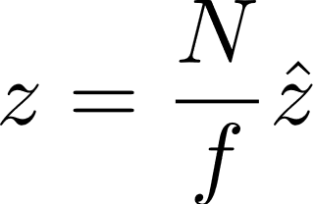
Is assumption 2. valid?
QG theory suggests spice should be isotropic in the stretched coordinates
Which is consistent with observations of spice gradients shown below
QG theory also suggests that spice should display filaments with a slope of f/N. Spice is dominated by temperature in this region, and lines of slope f/N are shown in white.
The Rossby number is 0.2, not inconsistent with QG stirring

Slide 11
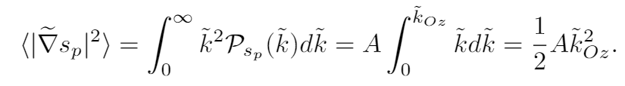
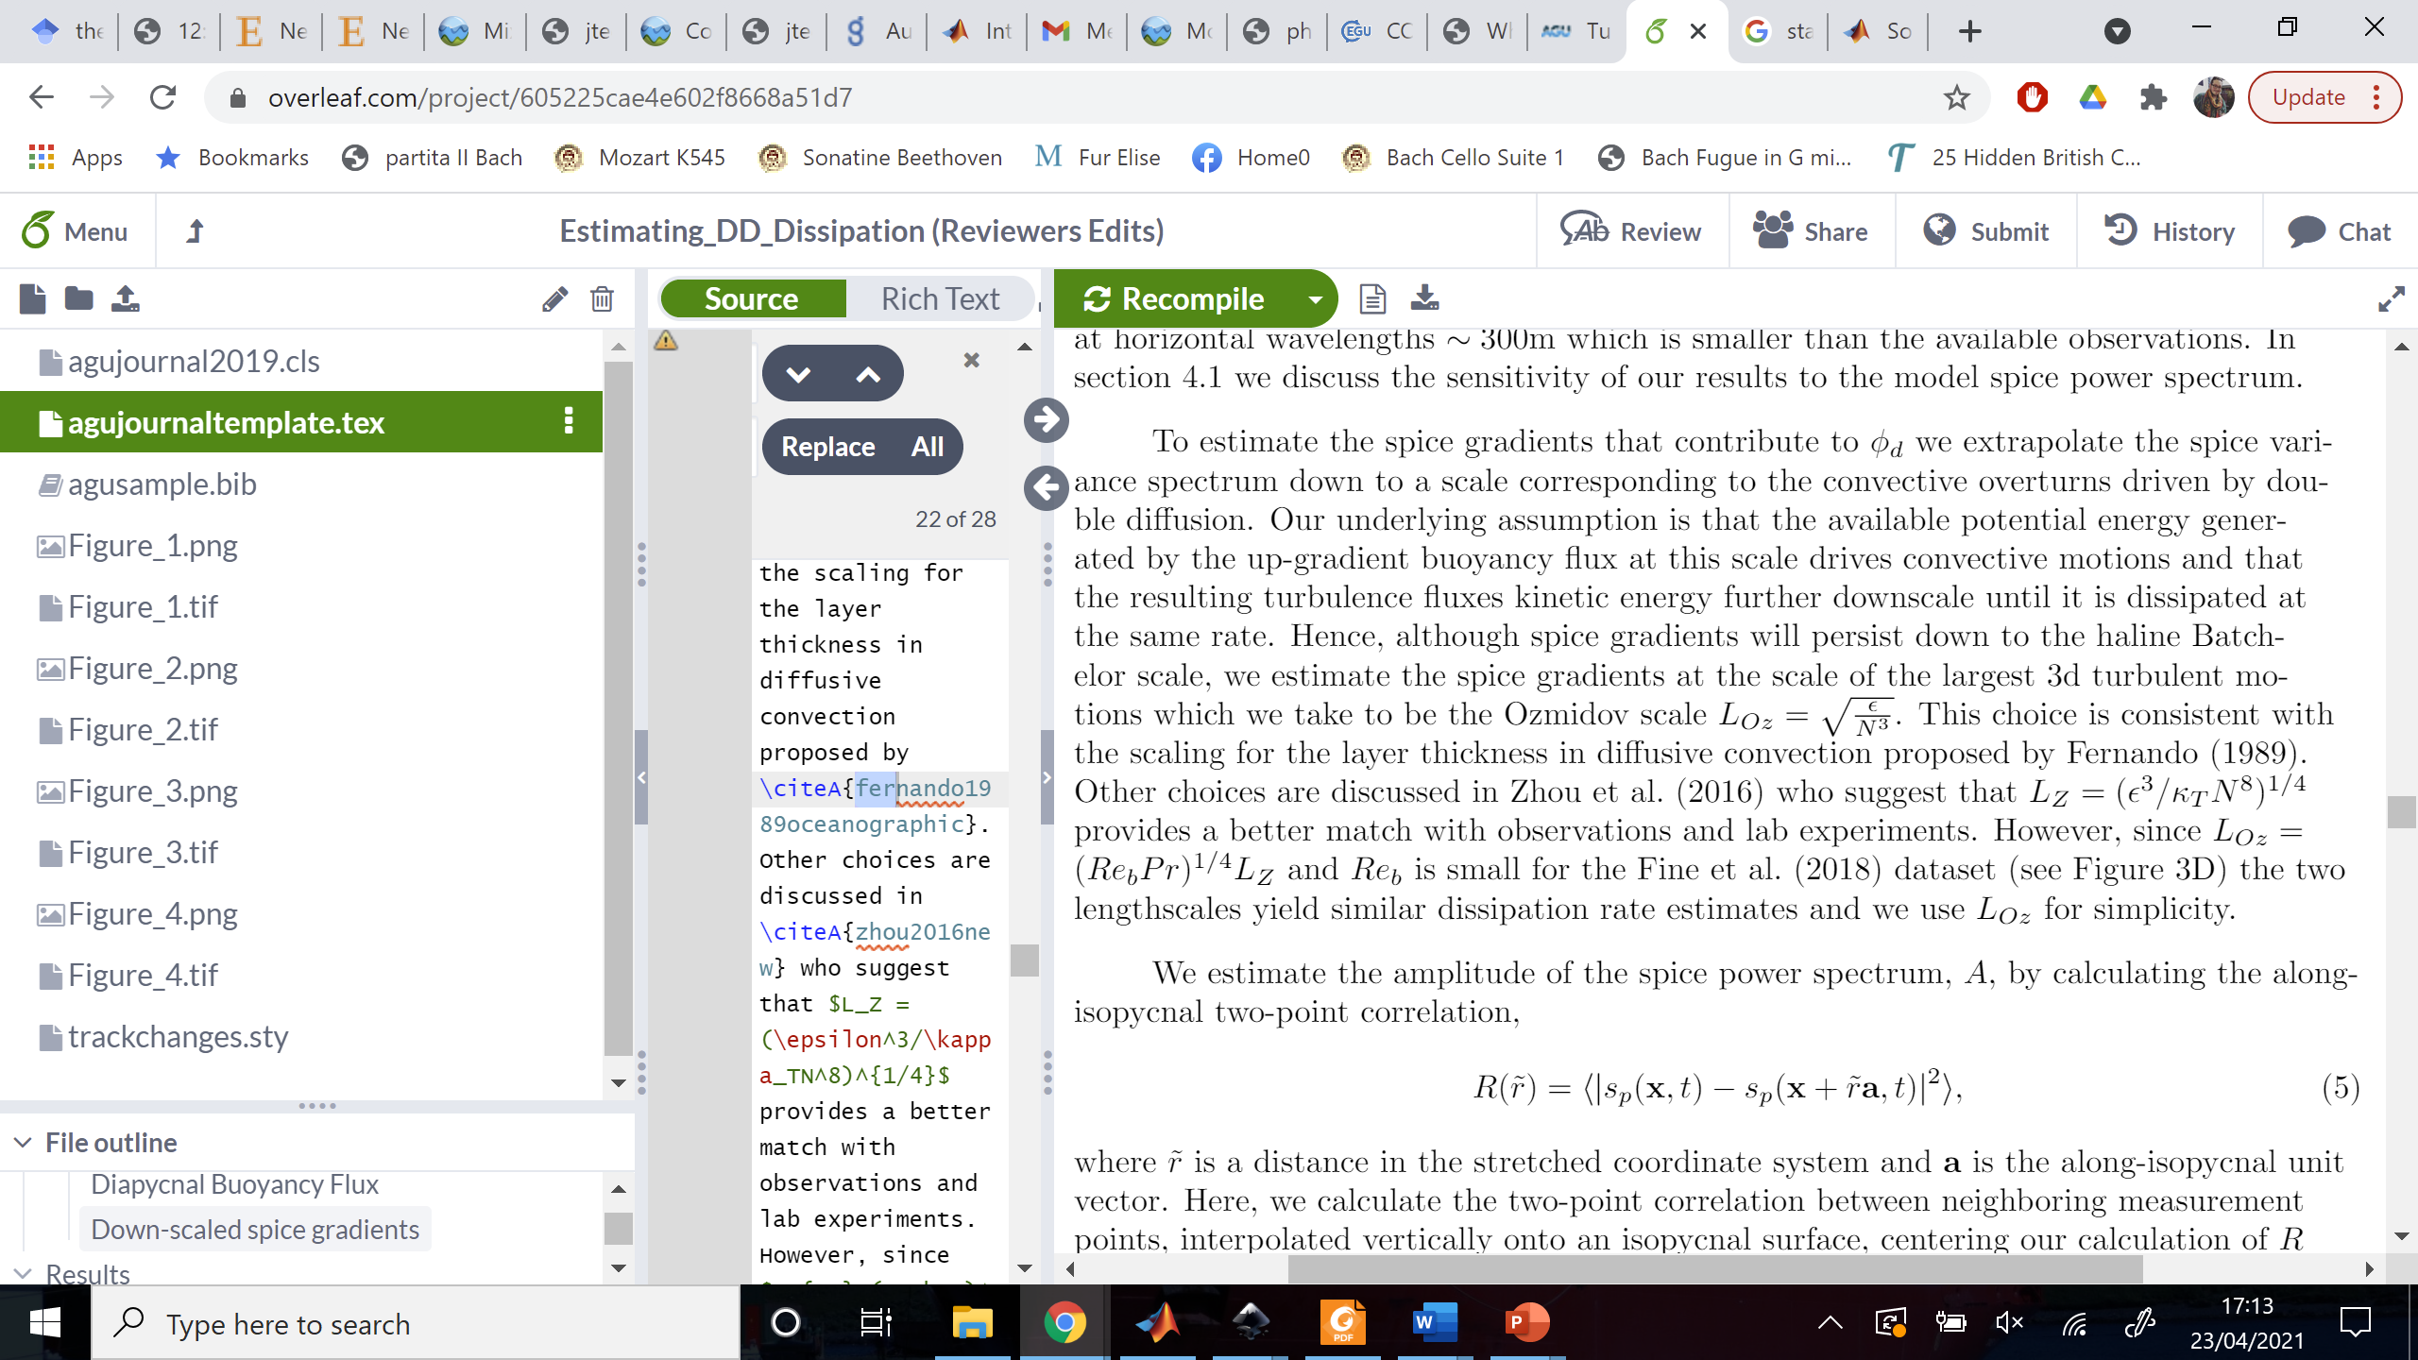
What scale to project down to?
We estimate the magnitude of the spice gradient in our method by integrating the spectrum down to the overturning length scale
We take the overturning length scale to be the Ozmidov scale
in double diffusive convection, following the work of Fernando (1989).
An alternative length scale was suggested by Zhou et al. (2016)
That includes dependence on the molecular diffusivity for temperature. This length scale was found to match observations of staircases more accurately.
However, using Zhou’s length scale has no significant effect on the method, so we use the Ozmidov scale for simplicity.

