Slide 1
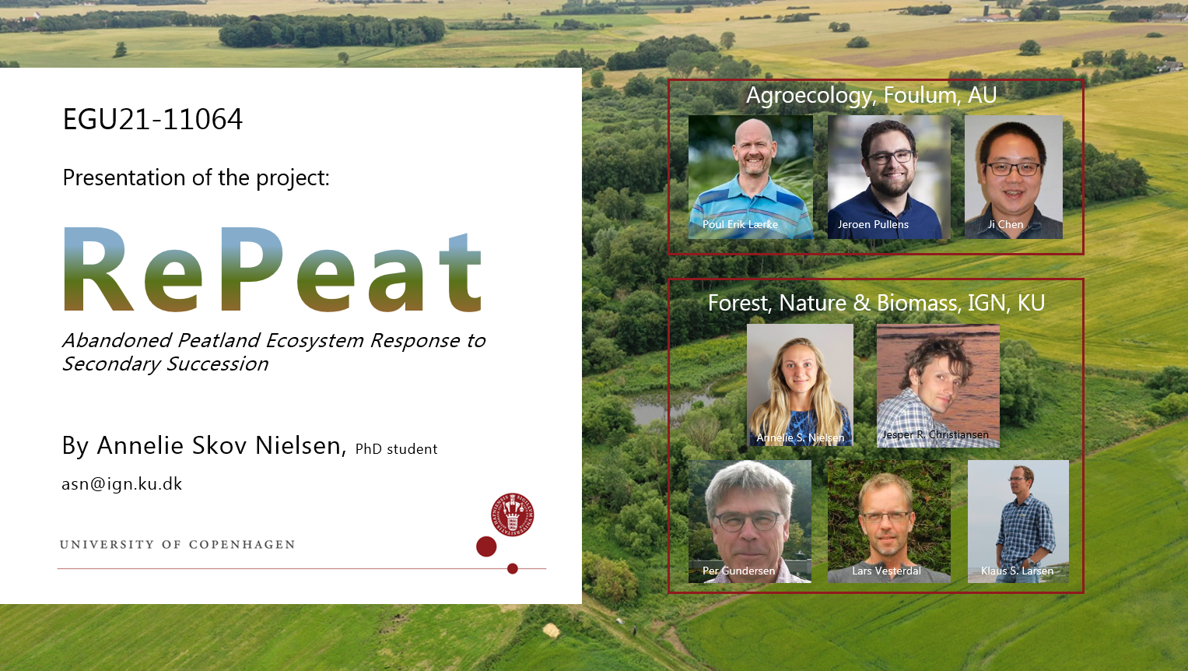

Slide 2
Agenda
20 min:
Introduction to the research project RePeat
WP2: Abandoned Peatland Ecosystem Response to Secondary Succession
Field sites
Methods and Instruments
Data collection and preliminary results

Slide 3
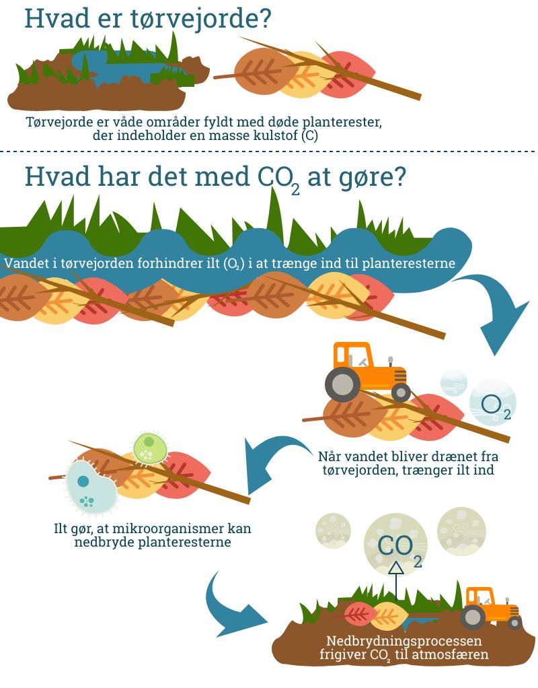
RePeat – Introduction to the “Danish lowland issue”
• 61 % of the total area in Denmark is used for cultivation (Danmarks Statistik, 2020)
• 7 % of the cultivated area consists of drained lowland
and emits ca. 4.8 mio. ton CO₂e annually (The Danish Council on Climate Change, 2020)
• Corresponding to 6-7 % of the total national annual GHG emissions (Nielsen, O. K. et al., 2020)
Organic soils: 6-12 % OC
Peatland: > 12 % OC
N₂O
CH₄
= “Lowlands” (Lavbundsjorde)
C pool
C pool
Figures: Videnskab.dk

Slide 4
RePeat – Introduction to the project
Funding: Danish Agriculture Agency: 2019 Call for climate research in agriculture
Purpose: Increase our data and knowledge on greenhouse gas emissions from organic soils managed by different practices
Research group:
  KU: Jesper R. Christiansen, Klaus S. Larsen, Lars Vesterdal, Per Gundersen and Annelie S. Nielsen
  AU: Poul Erik Lærke, Johannes Pullens and Ji Chen
Four WPs:
  WP1: Annual GHG budget on different extensification types
  WP2: Annual GHG budget on abandoned organic soils (my primary study)
  WP3: C and N pools in soil and biomass and soil-water-chemistry properties
  WP4: Modelling and improving emission factors

Slide 5
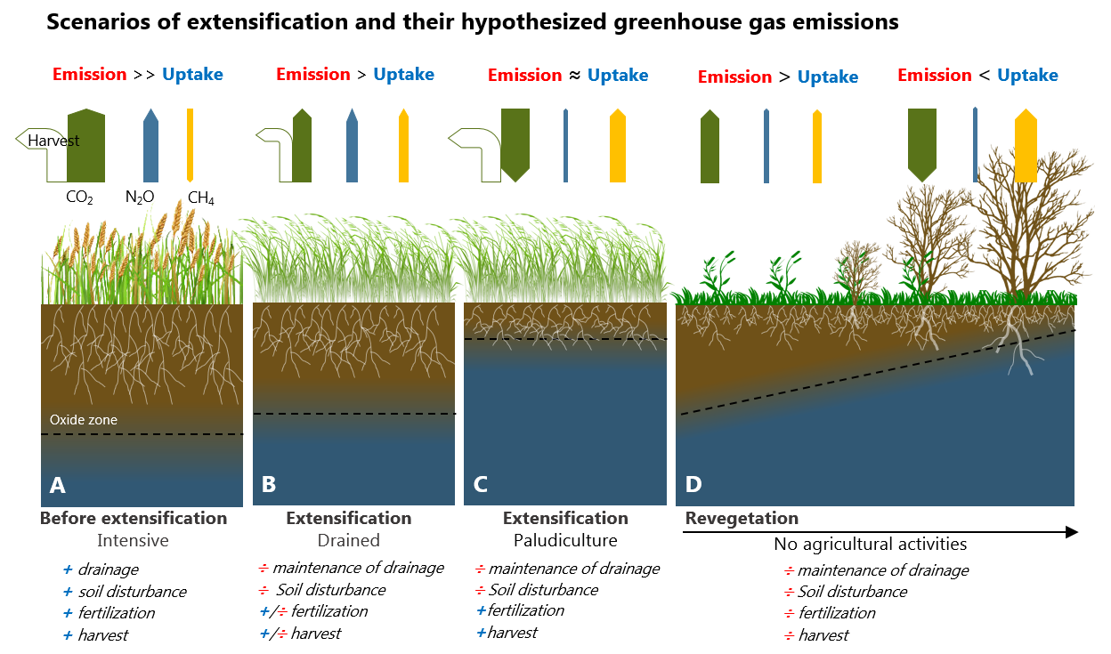
RePeat – Project parts illustration
WP1
WP2
Figure: RePeat project group

Slide 6
RePeat – WP2
WP2: Abandoned Peatland Ecosystem Response to Secondary Succession
Purposes and goals:
  Contribute to data collection of soil GHG emission measurements
  By measuring the total annual greenhouse gas budget of CO₂ and CH₄
  Estimate the annual net ecosystem exchange (NEE) of CO₂ and CH₄ and net carbon stock (NCS) for lowland soils
Hypothesis (H1):
By abandoning farmed peatland, over time, the land will turn into a net carbon sink through secondary succession.

Slide 7
RePeat – WP2
WP2: Abandoned Peatland Ecosystem Response to Secondary Succession Hypothesis (H1):
By abandoning farmed peatland, over time, the land will turn into a net carbon sink through secondary succession.
Δ (net carbon loss for eco.):
Primary by CO₂ and CH₄
[g C m⁻² yr⁻¹]
+C [mass/area] (C source to the atmosphere)
ATM
+C [mass/area] (C sink to the ecosystem)
Δ (net carbon stock for eco.):
Soil and biomass
[g C m⁻² yr⁻¹]
Ecosystem
0
30 yr
60 yr
time

Slide 8
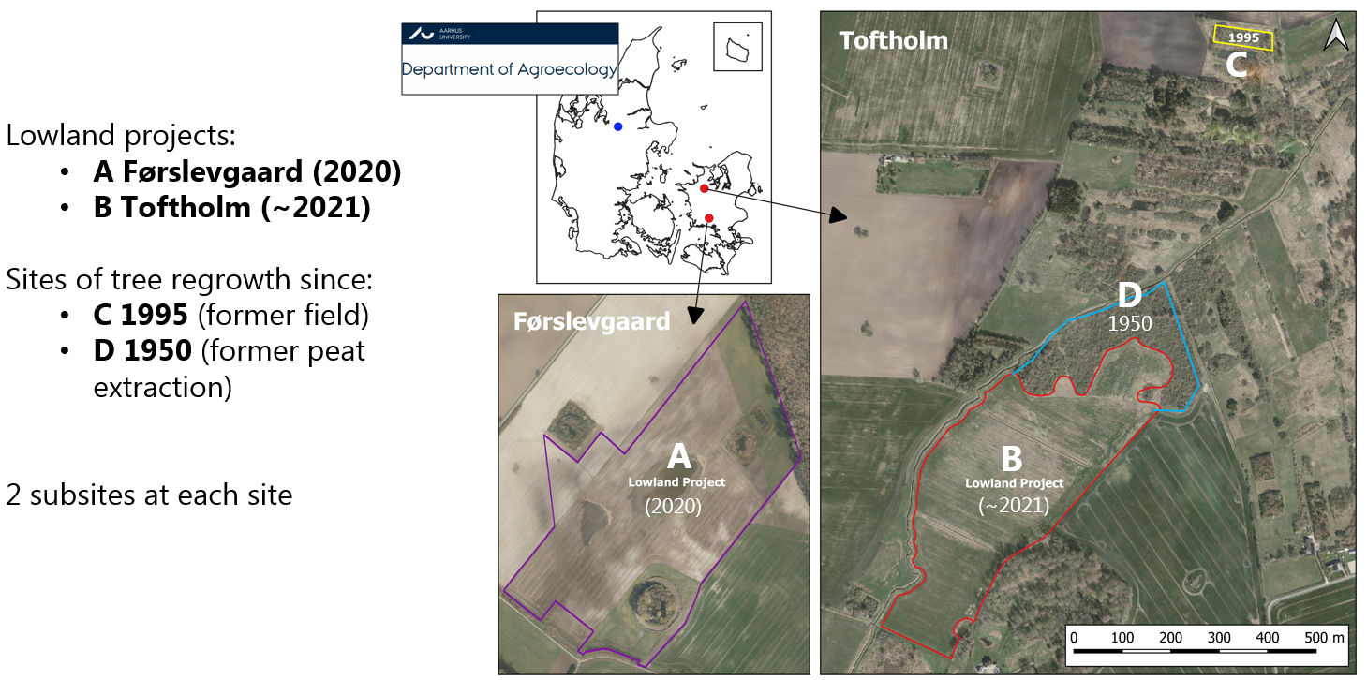
Four field sites

Slide 9
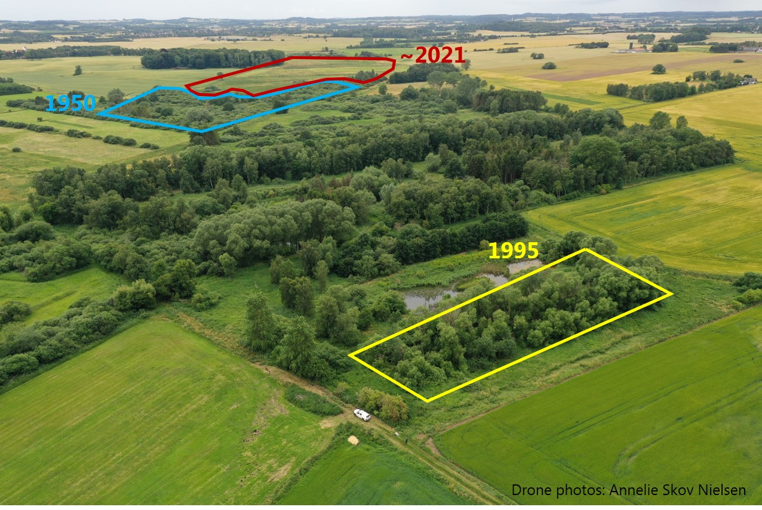
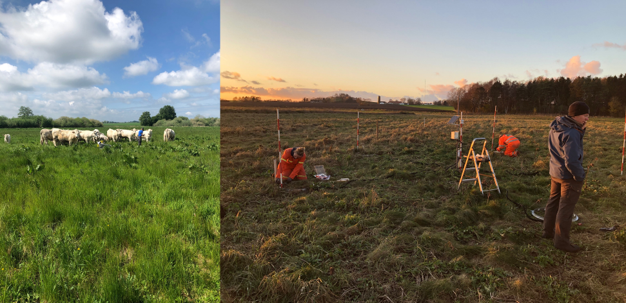
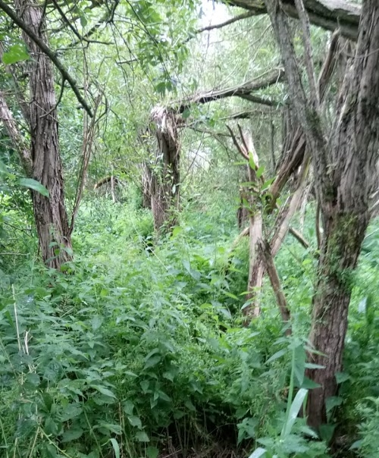
Field sites - Toftholm

Slide 10
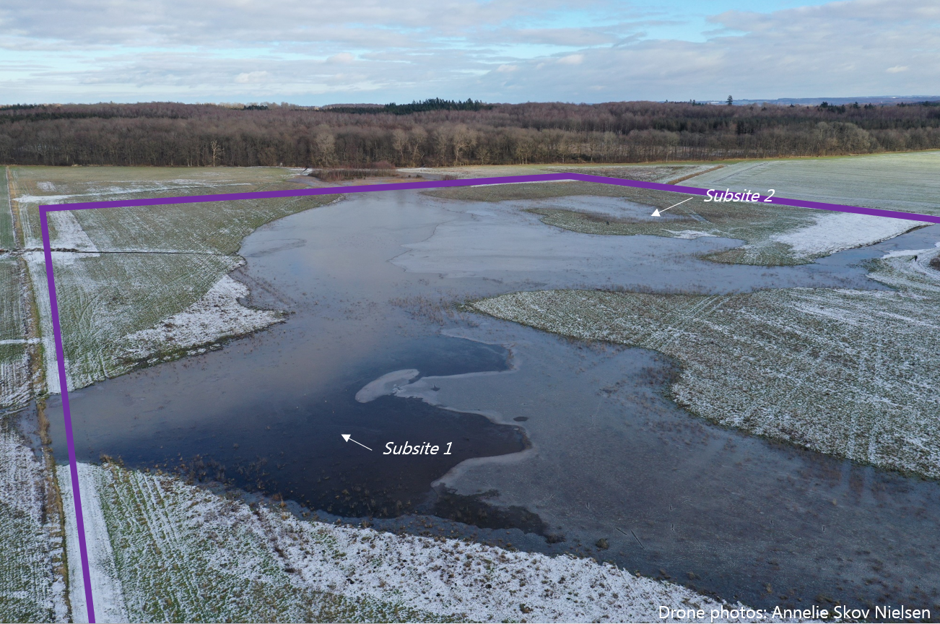
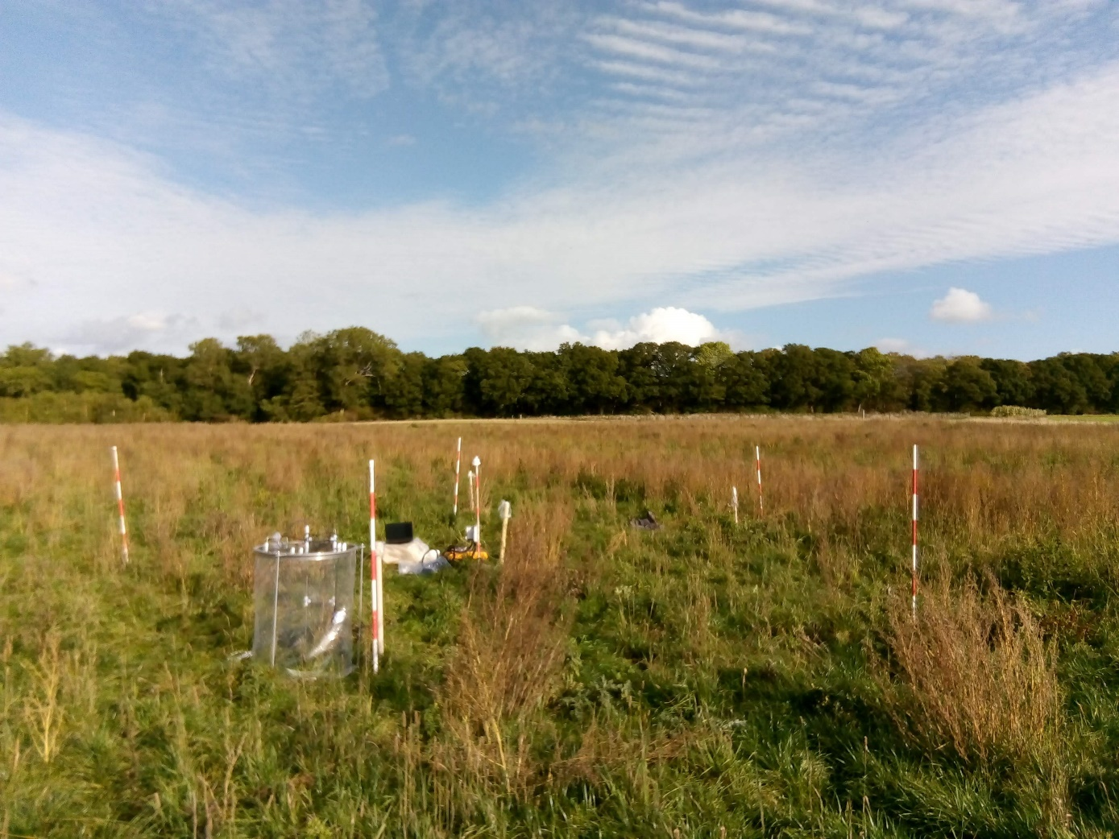
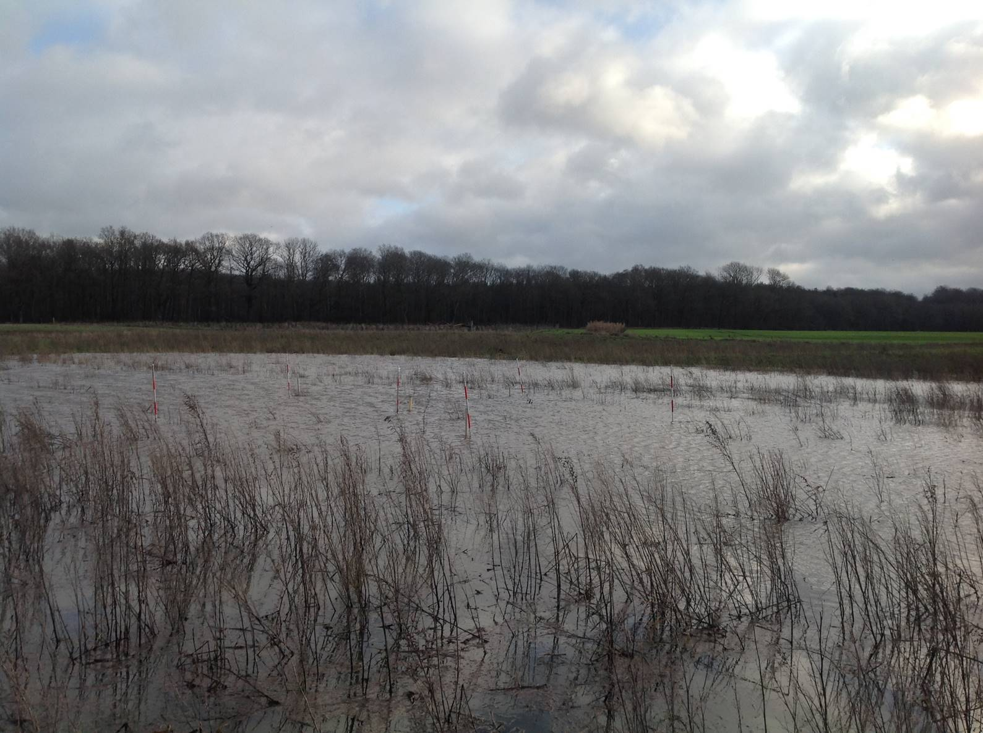
Field sites - Førslevgaard (rewetted 2020)
Photos: Annelie Skov Nielsen

Slide 11
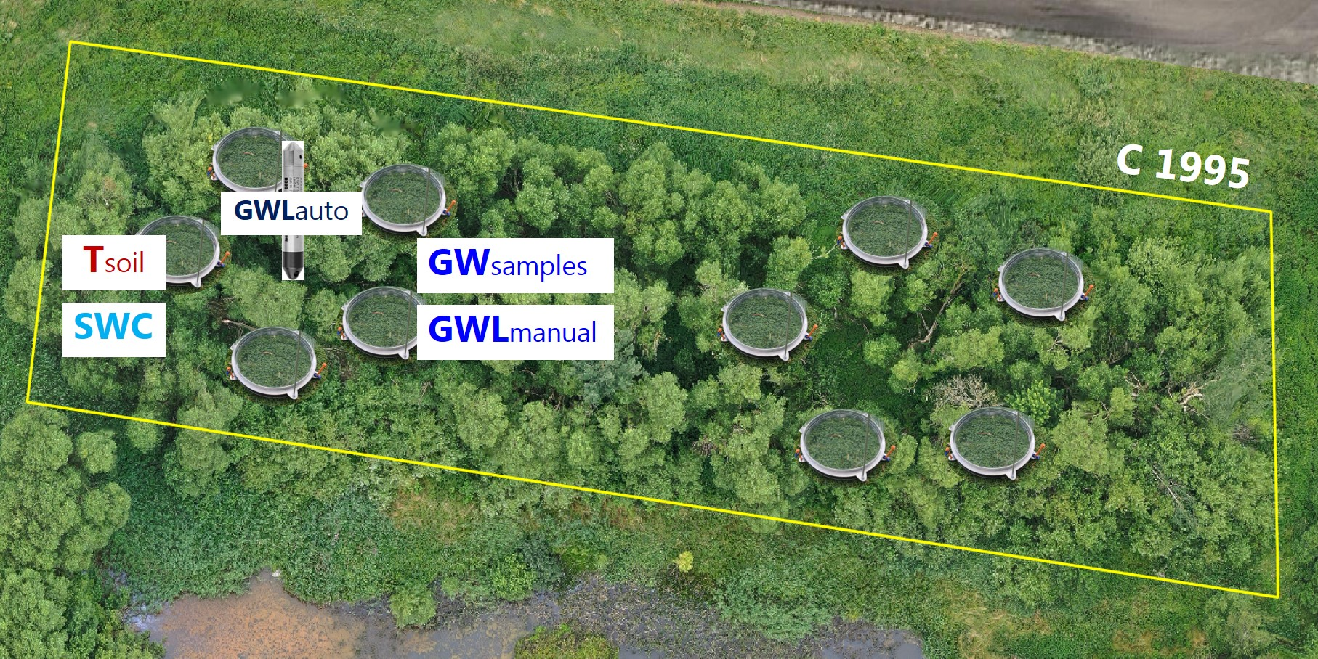
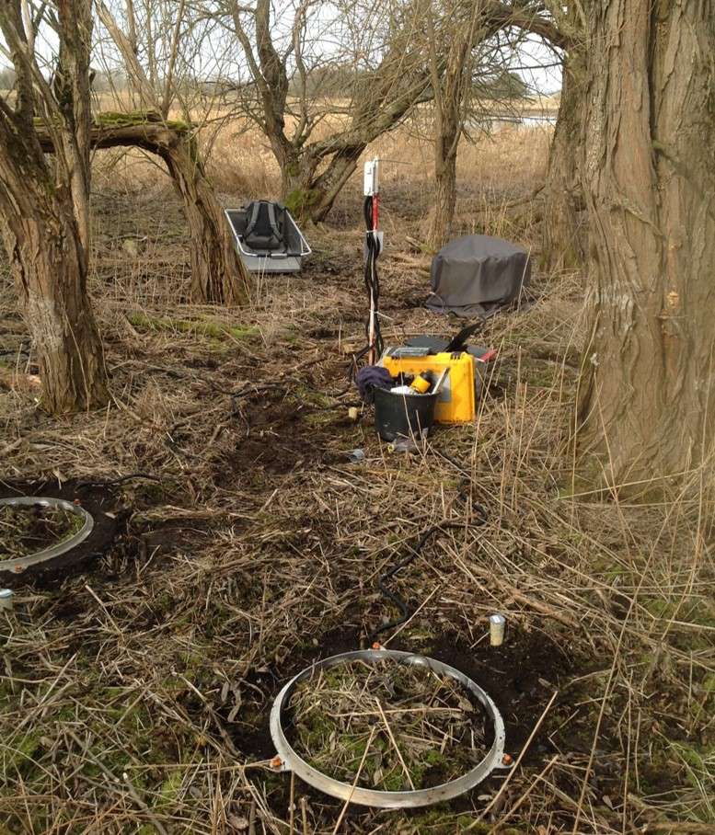

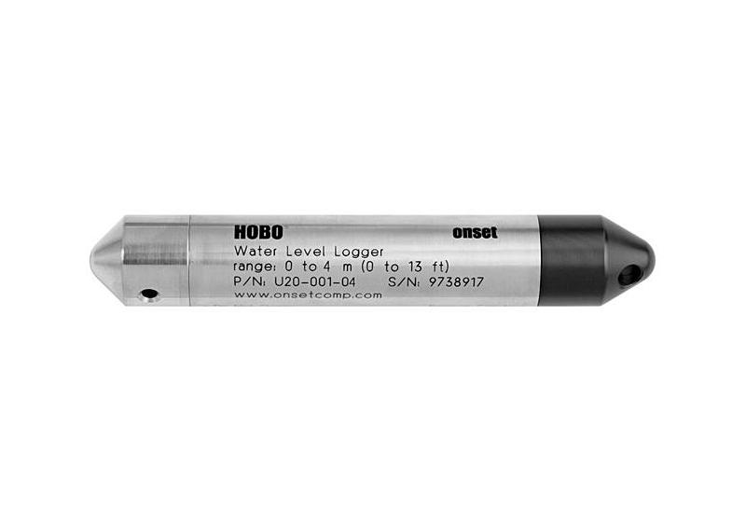
Field site setup - Instruments
10 plots x 4 field sites = 40 plots
Tsoil
Wsoil
GWLauto

Slide 12
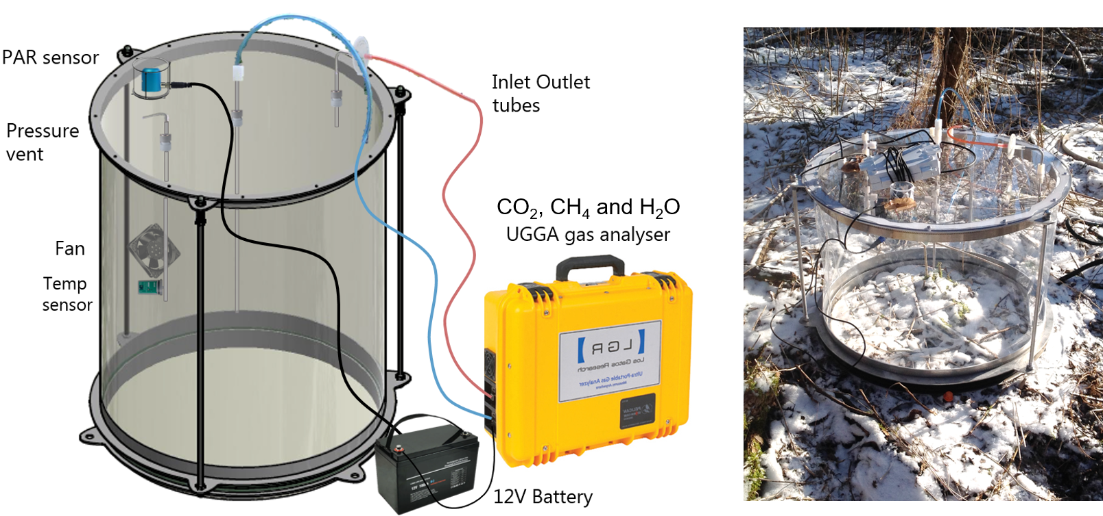
Methods – Instruments – Static chamber

Slide 13
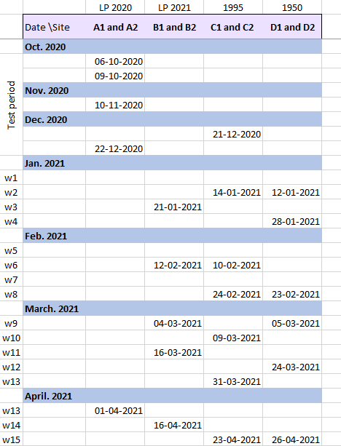
Data collection
Field campaign every 3rd week at each site in entire 2021 as a minimum:
Field campaign manual measurements:
  CO₂, CH₄ and H₂O
  N₂O (summer campaign 2021)
  T_{chamber} and PAR_{chamber}
  Groundwater level at each plot
  Groundwater samples for Nutrition and DOC
  Biomass (bio samples and NDVI)
  Soil core samles
Automatic measurements:
  Meteorological measures from field-installed MET-station incl. PAR
  T_{soil} at each plot
  Soil moisture at each plot
  Groundwater level at each subsite
Every 3rd week
1-2 times in 2021
Data log per 1hr

Slide 14
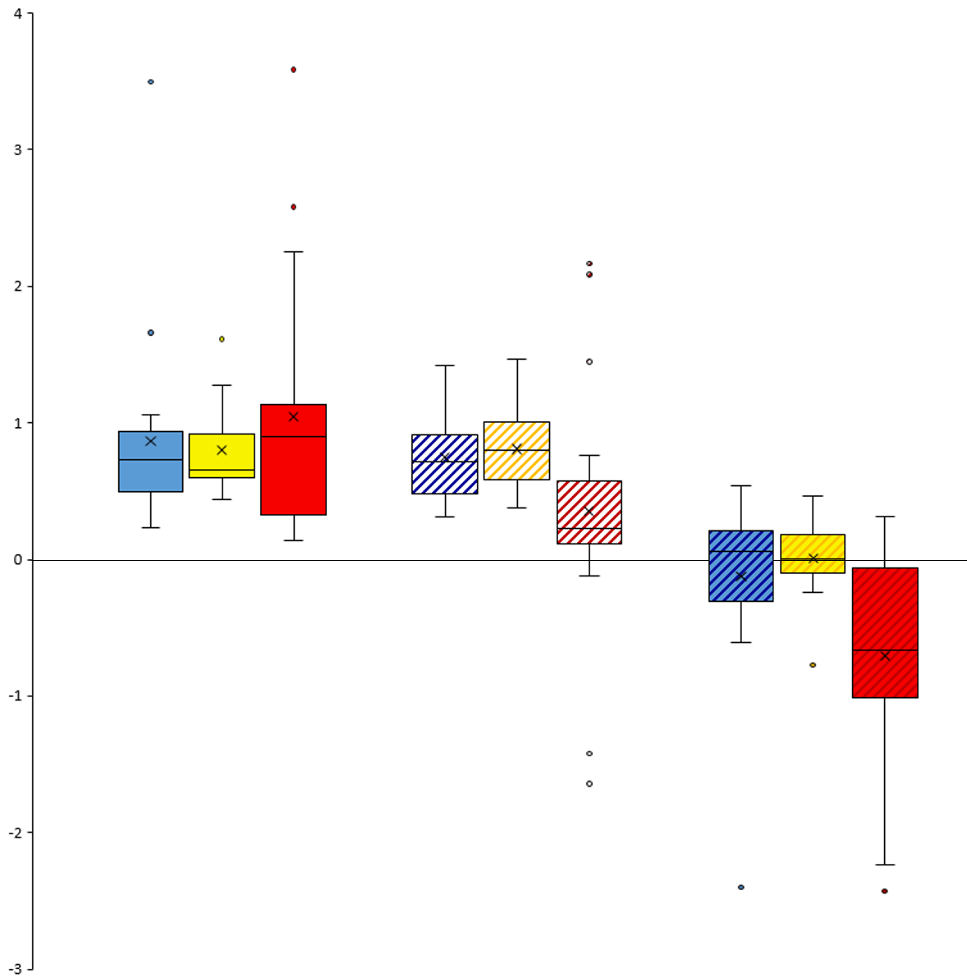
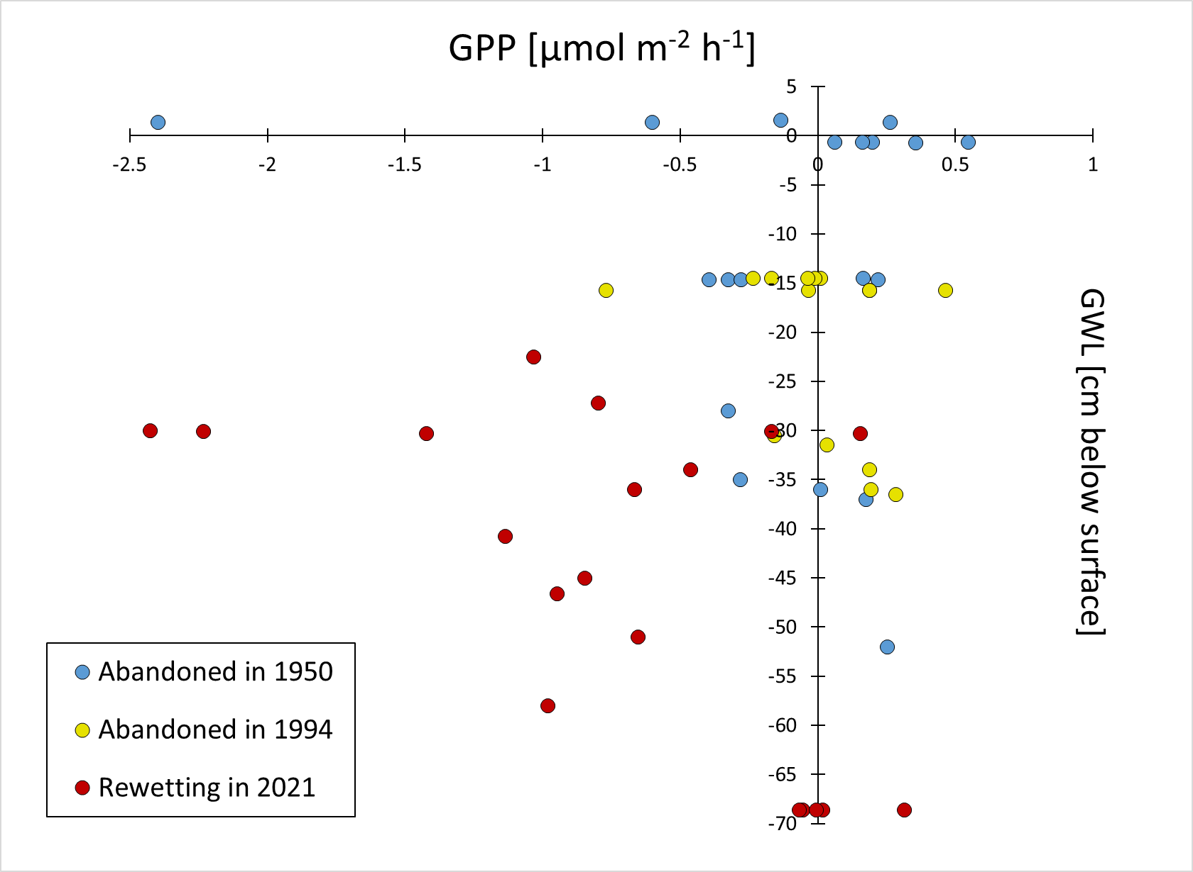
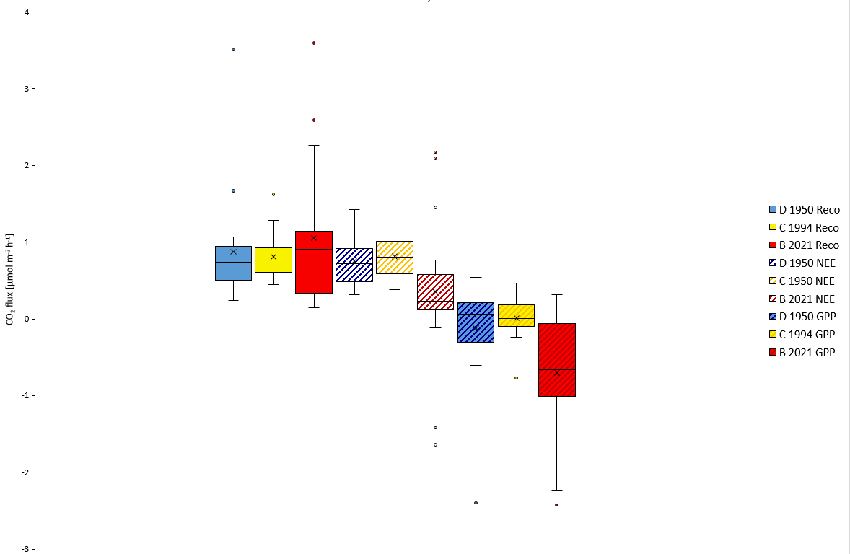
Preliminary results
Chronosequence of peatland sites left for secondary succession
Static chamber CO₂ measurements
Combined January to March 2021 data
Reco
NEE
GPP
CO₂ flux [µmol m⁻² h⁻¹]

Slide 15
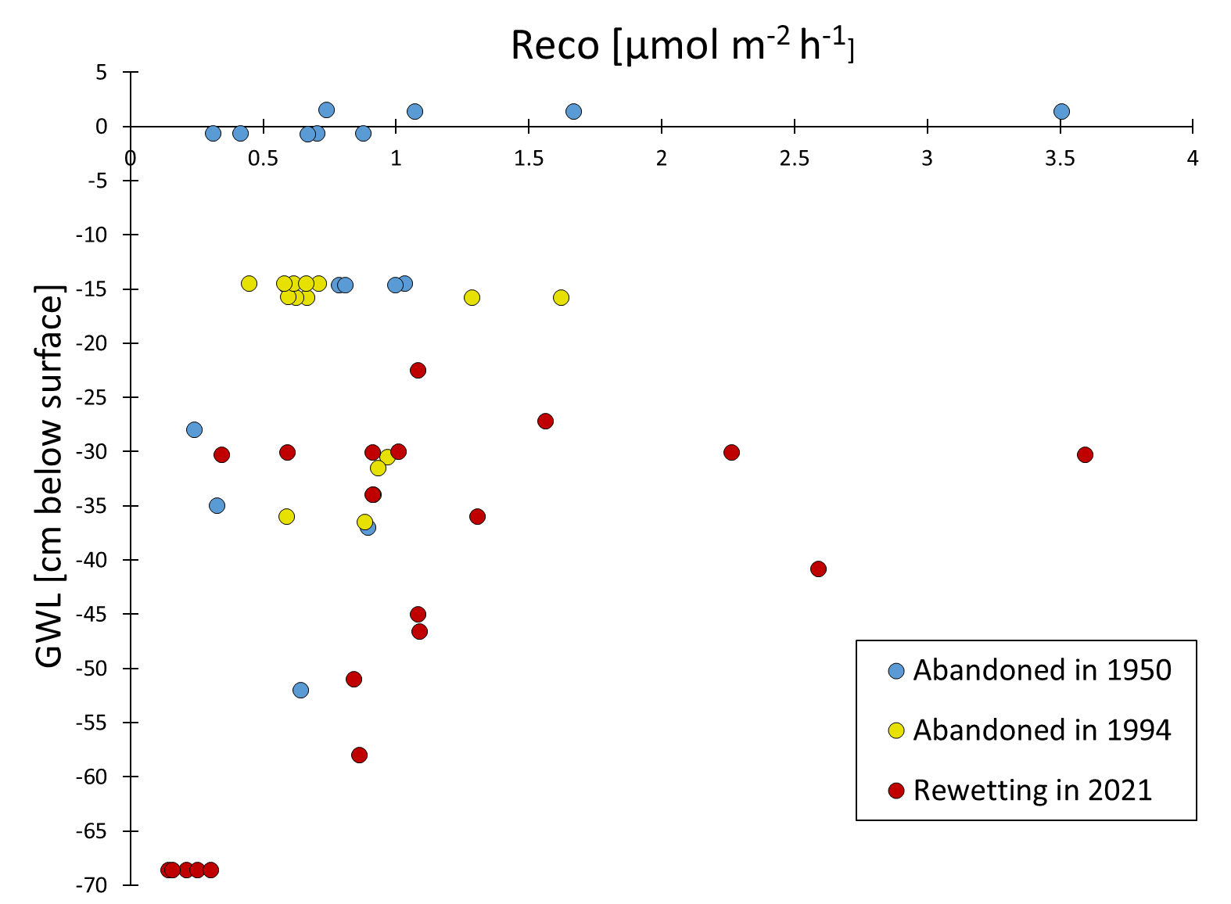
Preliminary results
Static chamber CO₂ measurements - Combined January to March 2021 data
Reco vs Groundwater level GPP vs Groundwater level

Slide 16
Thank you for your attention!

Slide 17
References
Danmarks Statistik (2020) Danmarks landbrugsareal er stort internationalt set. Copenhagen. Available at: www.dst.dk/stattabel/868 (Accessed: 28 April 2021).
Hemes, K. S. et al. (2019) Assessing the carbon and climate benefit of restoring degraded agricultural peat soils to managed wetlands, Agricultural and Forest Meteorology. Elsevier, 268(October 2018), pp. 202–214. doi: 10.1016/j.agrformet.2019.01.017. Available at: https://www.rednueva.es/wp-content/uploads/2019/06/07-2-Hemes-et-al.-2019-AFM.pdf (Accessed: 11 March 2021).
Nielsen, O.-K. et al. (2020) Denmark’s National Inventory Report 2020: Emission Inventories 1990-2018 - Submitted under the United Nations Framework Convention on Climate Change and the Kyoto Protocol. Aarhus University, DCE - Danish Centre for Environment and Energy. Available at: http://dce2.au.dk/pub/SR372.pdf (Accessed: 11 March 2021).
The Danish Council on Climate Change (2020) Carbon rich peat soils - Proposal for a new model for effective regulation and rewetting, Copenhagen. Available at: file:///C:/Users/mpv590/Downloads/engkulstofrige_lavbundsjorder_final3_16dec20_final4%20(1).pdf (Accessed: 10 March 2021).

