Slide 1




Hurricane Ocean Wind Speeds
Ad.Stoffelen@knmi.nl
KNMI: Gert-Jan Marseille, Weicheng Ni,
IFREMER: Alexis Mouche,
JPL: Federica Polverari,
ICM: Marcos Portabella,
NUIST: Wenming Lin,
NOAA: Joe Sapp, Paul Chang, Zorana Jelenak
IWW15, 12-16 April 2021

Slide 2
Need for accurate extreme winds
Nowcasting, though dropsondes are the adopted wind speed reference here; if the wind speed reference changes, hurricane scales change too as everything relies on dropsonde wind speed calibration (SFMR, Dvorak, .. )
NWP, to formulate drag and air-sea interaction stresses
Oceanography, to determine mixing depth in hurricanes
Climate monitoring, to determine climate change at the extremes
Climate prediction, to well describe coupled ocean and atmosphere dynamics
Improved description of hurricane dynamics
Satellite ocean surface wind speed calibration for active and passive microwave remote sensing

Slide 3
Validation metrics
Based on dropsondes as these are used in the operational community (though open questions remain on their accuracy as articulated in CHEFS)
Use CHEFS method for spatial scaling, collocation, ..
SFMR, Dvorak, SMAP, SMOS, .. , depend on dropsondes
Use stress-equivalent 10-m ECMWF and buoy winds
Triple collocation
CMOD7D
250
240
230
220
210
200
Dropsonde
1:1
190
180
170
160
150
140
130
120
110
SFMR speed
100
90
80
70
60
50
40
30
20
10
0
0
10
20
30
40
50
60
70
80
90
CMOD7 ASCAT speed
Polverari et al., in review

Slide 4
Moored buoys
Best controlled resource for in-situ wind speed calibration at moderate and high winds
Work well up to 25 m/s as verified with wind tower
Dynamically corrected platform winds
Claims of ocean wave shielding lead to non-substantiated sources
Cup anemometer biases at extreme winds may be a few % (only)
Rare encounter with hurricanes
Ethan Wright, IOVWST 2021

Slide 5
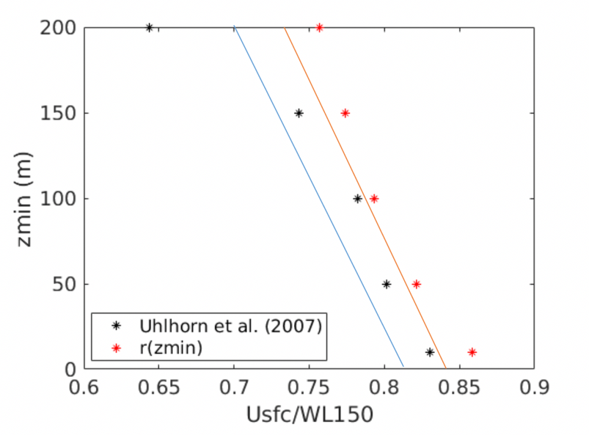
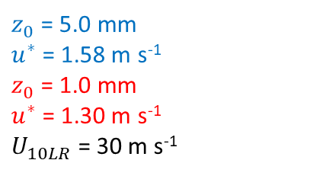
Dropsondes open issues
Dropsondes cannot follow the wind near the surface, due to the strong deceleration as function of the drag;
The correction for this leads to an integration effect in the vertical, where the wind profile is logarithmic;
10-m SFMR winds in hurricanes are inconsistent with a log profile;
The position computation by the dropsonde GPS chip has not (yet) been investigated, nor its derivation of speed and acceleration, with may cause further bias in strong deceleration (drag);
Most passive satellite winds, SFMR, best track, etc. are all calibrated with respect to dropsondes and show the same inconsistency with respect to the buoy winds;
The above conversion takes the spatio-temporal scale of the verification sources into account, hence differences are believed not to be dominated by local gradient effects;
On the other hand, ASCAT and ECMWF follow the moored buoy scale (up to recently).
Buoy winds are not frequent in hurricanes, but are validated by masts to be unbiased up to 25 m/s (within ~10%), while at 25 m/s the conversion bias from (1) is 45%;
Other in-situ (incl. land-based) wind sources suffer from wind flow distortion biases, positive and negative, or from height down conversion errors to 10m;
These results call for further investigation of the true in-situ wind speed reference in hurricane conditions.
Due to the above-mentioned inconsistency, calibration of satellite winds (above 25 m/s) is uncertain, as well as their assimilation in NWP and the associated drag formulation in Earth System Models.
$z_{0}$ = 5.0 mm
$u^{∗}$ = 1.58 m s⁻¹
$z_{0}$ = 1.0 mm
$u^{∗}$ = 1.30 m s⁻¹
$U_{10LR}$ = 30 m s⁻¹

Slide 6
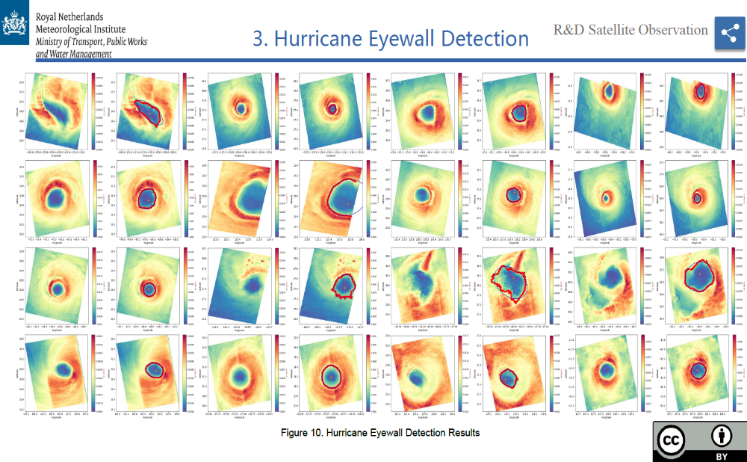
Exploit SAR for hi-res information
2DVAR for vortex construction for SAR and scatterometer

Slide 7
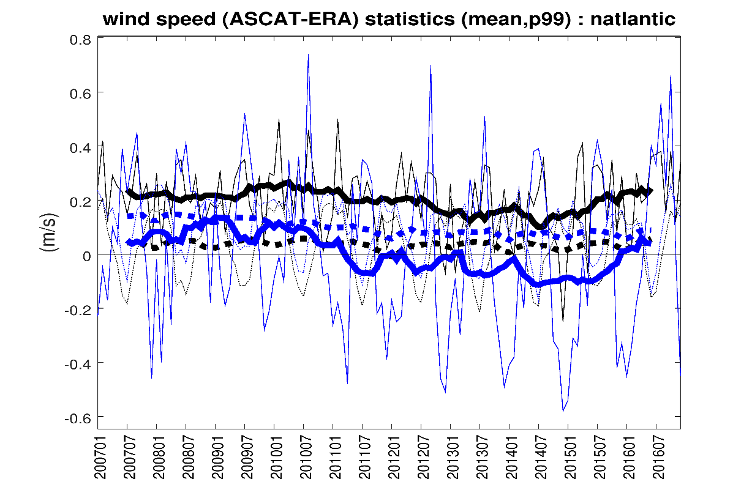
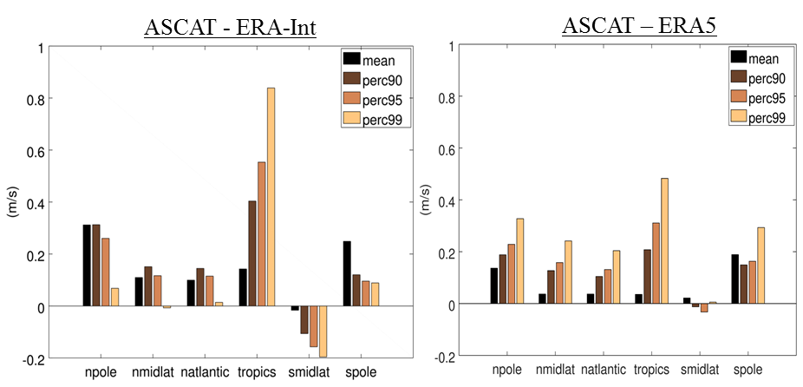
Decadal differences ASCAT-ERA5
Windstorm Information Service
C3S WISC
ASCAT versus ERA5 first guess
Also ERS, QuikScat and OSCAT
Passive wind instruments reliable? From 1988

Slide 8
Discussion
Hurricanes are among the deadliest and costly natural disasters
Extreme wind measurements come in two different flavours
Uncertainty about the extremes propagates into the modelling of hurricane dynamics and hurricane occurrence
Further research is needed on dropsondes wind speeds, particularly in the lowest tens of meters
Although moored buoy winds show less dispersion around 20 m/s than dropsondes, there is room for further uncertainty assessment and attribution (Wright et al., IOVWST 2021)
Mixing instruments/producers for determining climate trends is not recommendable due to variable sampling and calibration
Validate reanalyses by collocated stable single-instrument series
ESA MAXSS project on satellite hurricane winds
Further supporting slides follow this slide

Slide 9
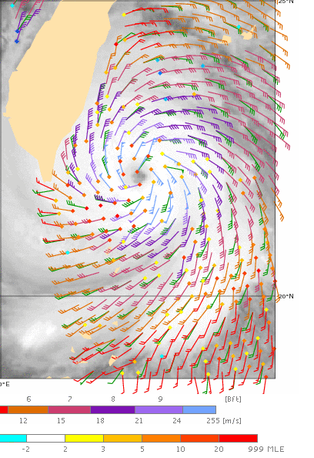
EUMETSAT CHEFS Objectives
VH GMF: The understanding of the future C-band VH information contribution to high and extreme wind retrievals from C-band scatterometer missions;
Spatial scaling of extremes: The definition of spatial scaling issues and related consequences for product sample resolutions and validation approaches;
Understanding of extremes: To further understanding of satellite remote sensing of high and extreme wind conditions over the ocean.
In-situ wind speed reference needed for all extreme wind products, from satellites, reanalyses to NWP models

Slide 10
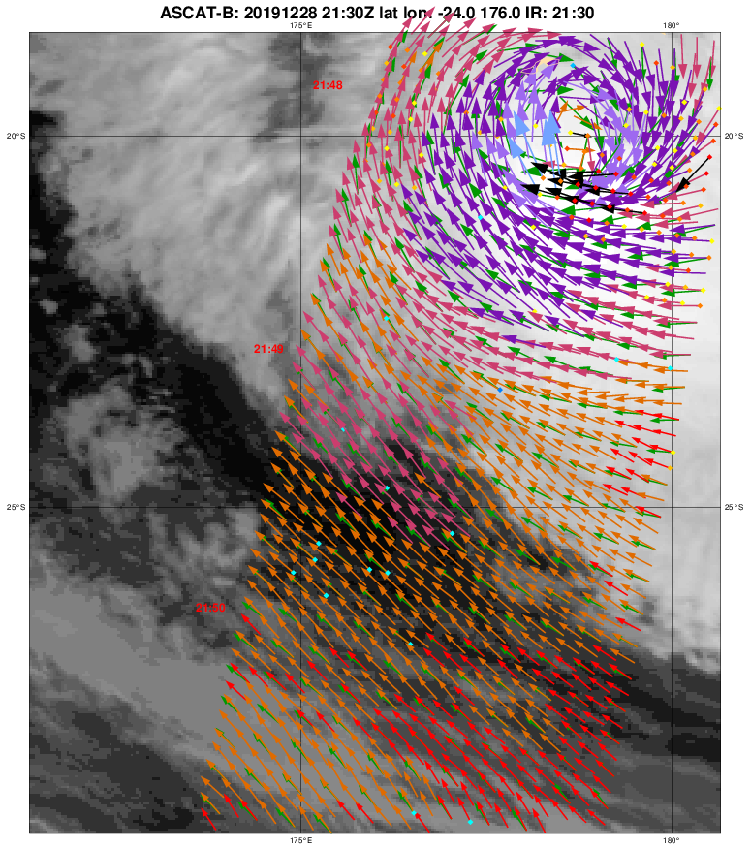
CHEFS
EUMETSAT ITT 16/166
      Extreme winds calibration
      VH test data
KNMI
      EPS-SG design and VH
      GMF and retrieval
      Calibration strategy
ICM
      Scatterometer science
IFREMER
      SAR wind retrieval
      Data lab, L-band, GMF

Slide 11
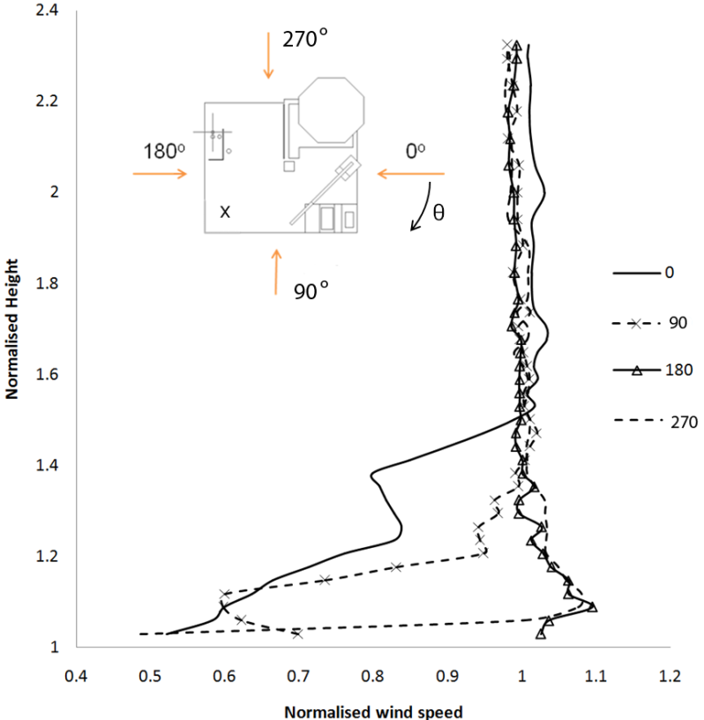
Other references?
+ve and –ve wind flow distortion around platforms
Verification shows differences to platforms 2x as high as to buoys; what is this scatter? Does it cause bias? Useful as calibration reference?
Platform motion (ships)
Errors are not well controlled, larger than for moored buoys and tend to be environmentally dependent
Hasager et al., 2013

Slide 12
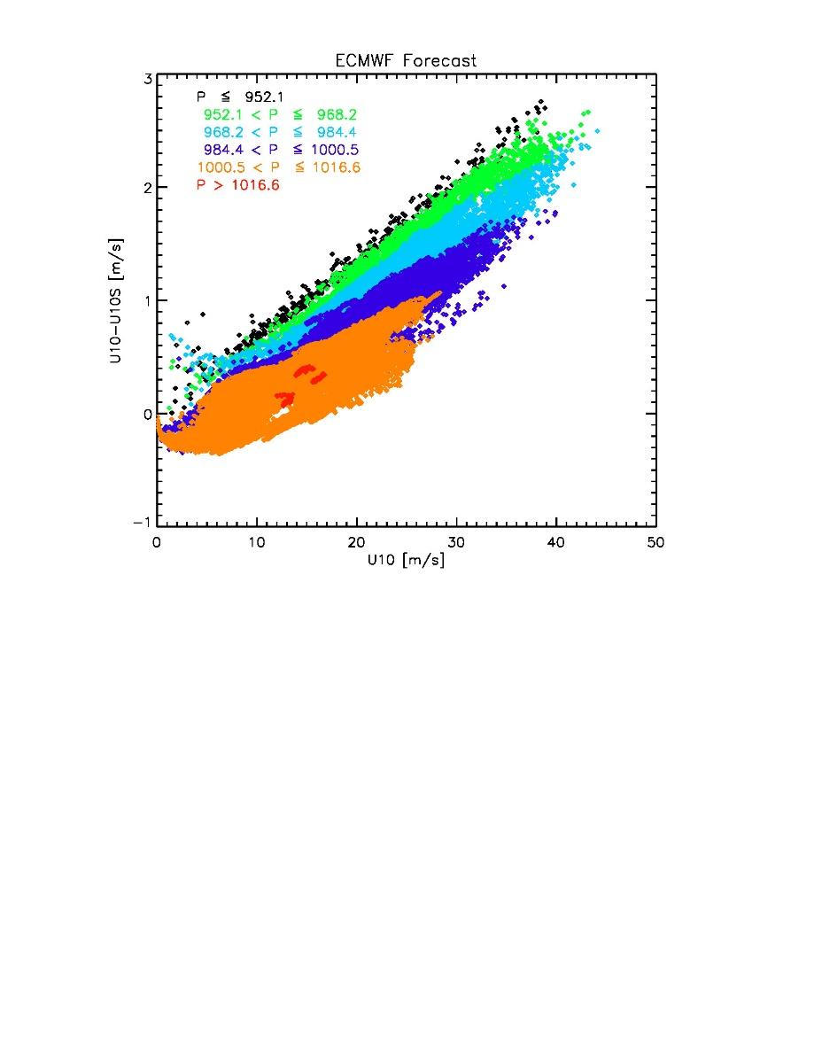
Stress-equivalent winds in TCs
Only near tropical cyclones (TC)
Pressure and humidity affect air mass density
Particularly near TC centres
At extreme winds up to a few m/s (5%)
Needs to be accounted for

Slide 13
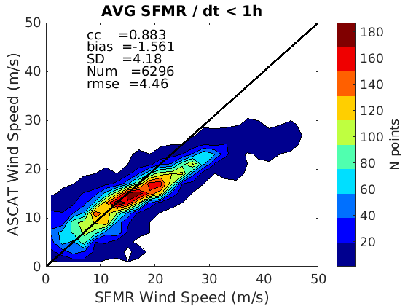
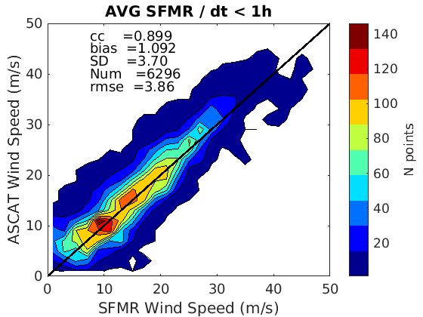
ASCAT-VV calibrated to SFMR
Storm centered
SFMR relatively high
SFMR is based on dropsondes
ASCAT VV is based on buoys
y = 0.57x + 5.16
> 12 m/s apply for x=V(ASCAT): V’(ASCAT)=0.0095x²+1.52x-7.6
Better cc, bias, SD and rmse for the same sample with CMOD7D
Good match up to 40 m/s
Recalibrated

Slide 14
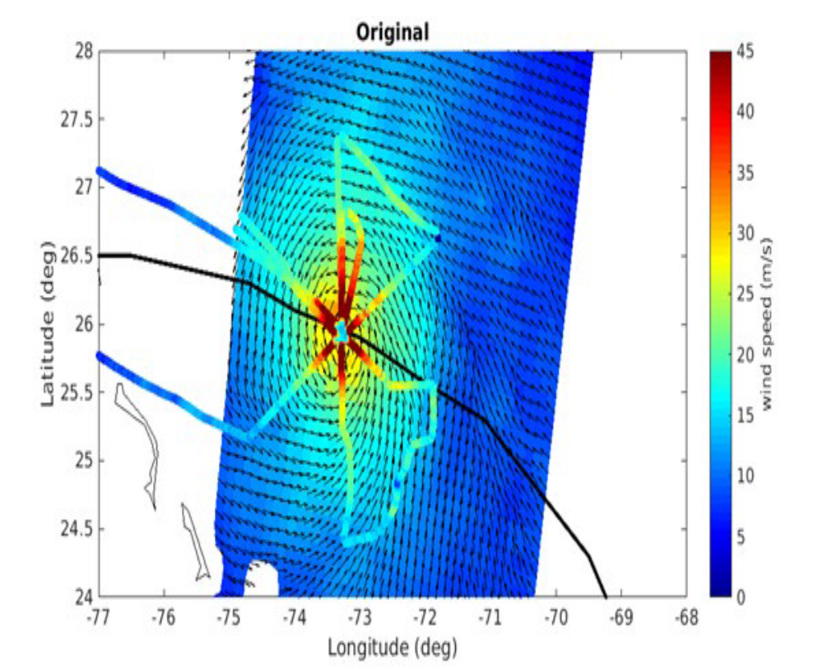
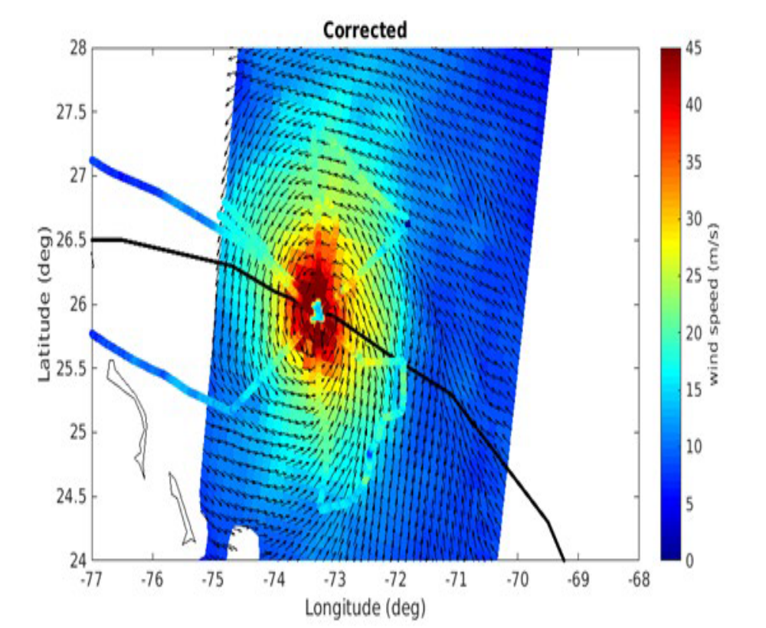
Operational CMOD7 versus CMOD7D
CMOD7
CMOD7D

Slide 15
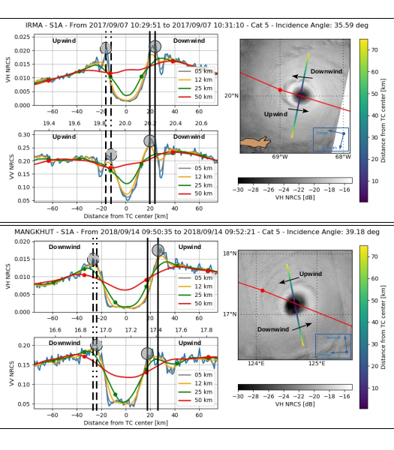
SAR aggregated NRCS

Slide 16
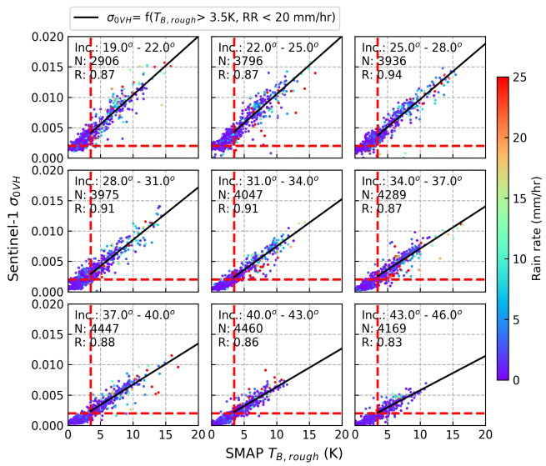
VH and L-band T_{B}
Linear dependency
Theoretically not obvious to relate Bragg to L T_{B}
Measurement accuracy will determine quality of L-band and VH extreme winds
High rain enhances VH NRCS at 19-22 and 40-43 degrees
High rain reduces VH NRCS at 22-25 and 31-34 degrees
SCA VH is excellent choice for extremes

Slide 17
Recommendations
Use dropsonde U_{10S} rather than WL150
Perform a log-profile analysis
Investigate speed-dependent deceleration error dropsondes at 10 m
Convert buoys, dropsondes and model winds to U_{10S}
Investigate different buoy types and possible wave effects on buoy measurements
Investigate direct buoy-dropsonde collocations > 15 m/s
After in-situ wind speed calibration, SFMR needs adaptation, as well as all satellite sea surface winds
It furthermore will allow NWP model drag parameterization tuning
Closer collaboration with JCOMM, satellite wind producers and ECMWF will be very beneficial to consolidate the in situ, satellite winds and NWP community practices
Refine ASCAT calibration, VV GMF (cone) and retrieval at high/extreme winds
Extend SAR and NOAA campaigns for refined geophysical studies

Slide 18
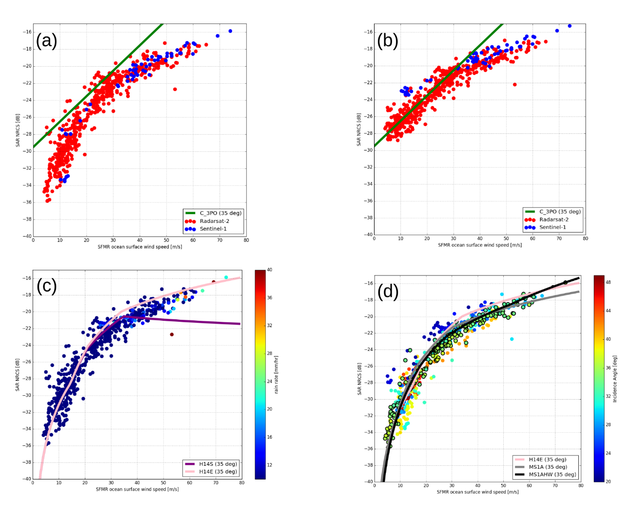
CHEFS Conclusions
We still lack a consolidated in-situ wind speed reference
Affects satellite & NWP products and hurricane advisories!
Confidence in moored buoys up to 25 m/s
U10S needed
Questions drop sondes?
ASCAT VV correlates well at high winds
SCA VH excellent choice
?

Slide 19
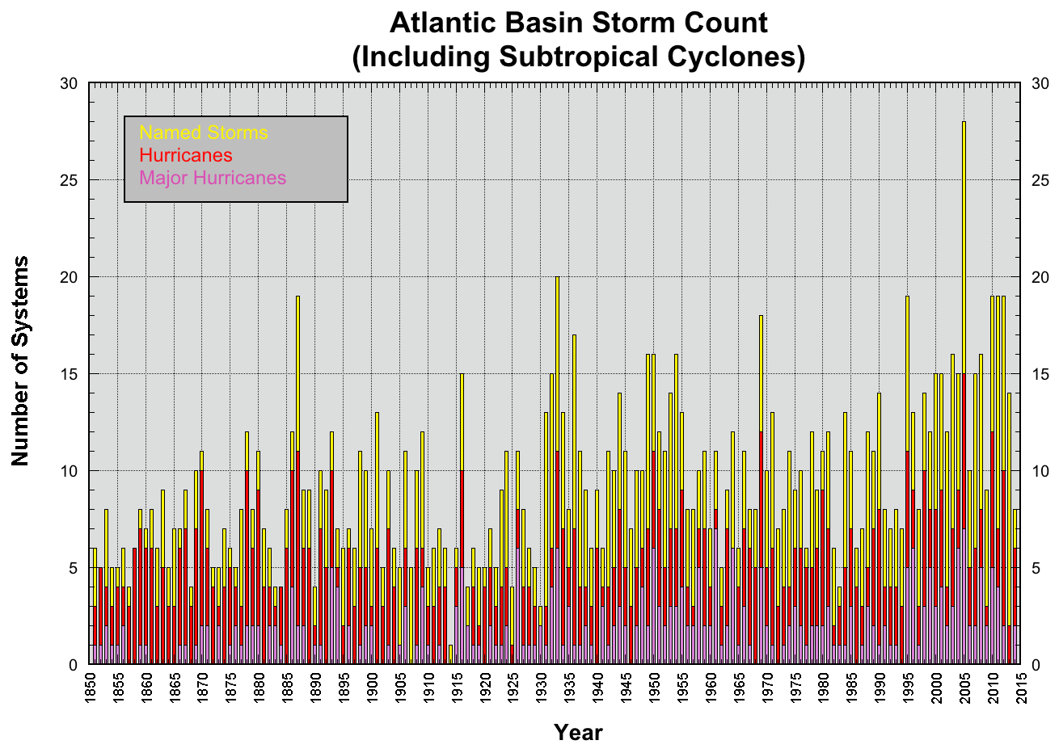
Decadal extreme changes
Huge year-to-year variability in extremes
Depends on El Nino
Use longest possible satellite record
Depends on observing system sampling, single processor version (calibration, QC), uniform sampling over decade
Use overlapping single-instrument/single-processor series for climate analyses

Slide 20
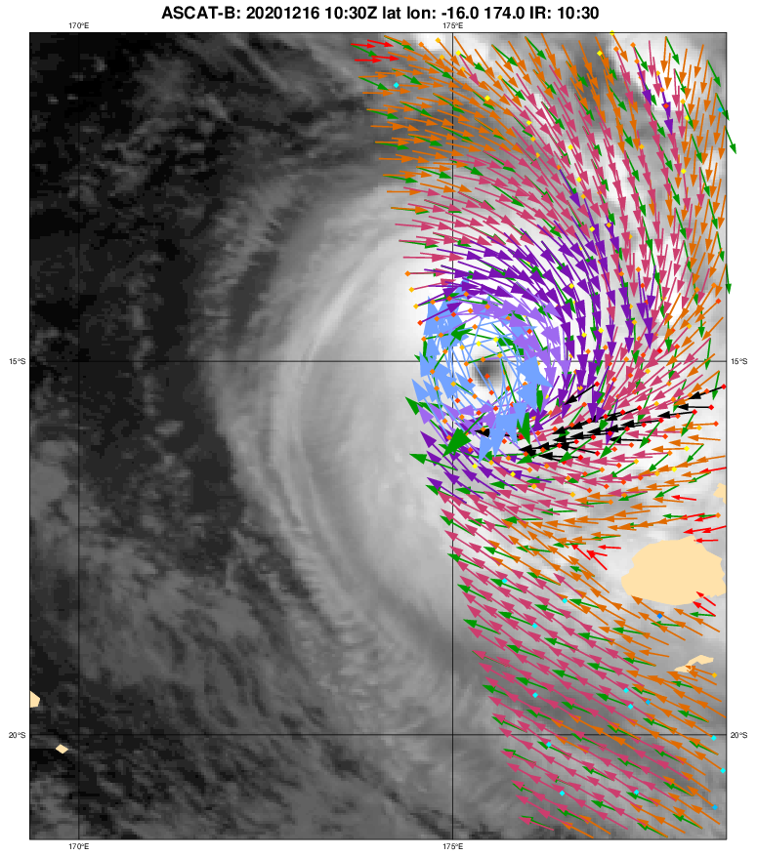
NRT OSI SAF visualization at KNMI
Considered as part of ESA MAXSS project
Storm-centric tiles based on track predictions of TC and Polar Low?
Dropsonde scale
SMOS, SMAP, radiometers?
High resolution, 5.6 km for ASCATs ?
Maintenance in OSI SAF ?

Slide 21
ESA Marine Atmosphere eXtreme
Satellite Synergy (MAXSS)
IFREMER has scientific lead
Tropical Cyclones (TC), extra-tropical cyclones (ETC), polar lows (PL)
Integrate research and operational instruments: SMOS, SMAP, SSMI, AMSR, WindSat
Integrated product (atlas)
Intercalibration, production, visualization, monitoring
Application in climate, nowcasting, NWP, ..
Links to EUMETSAT OSI SAF, EU C3S, EU CMEMS

Slide 22
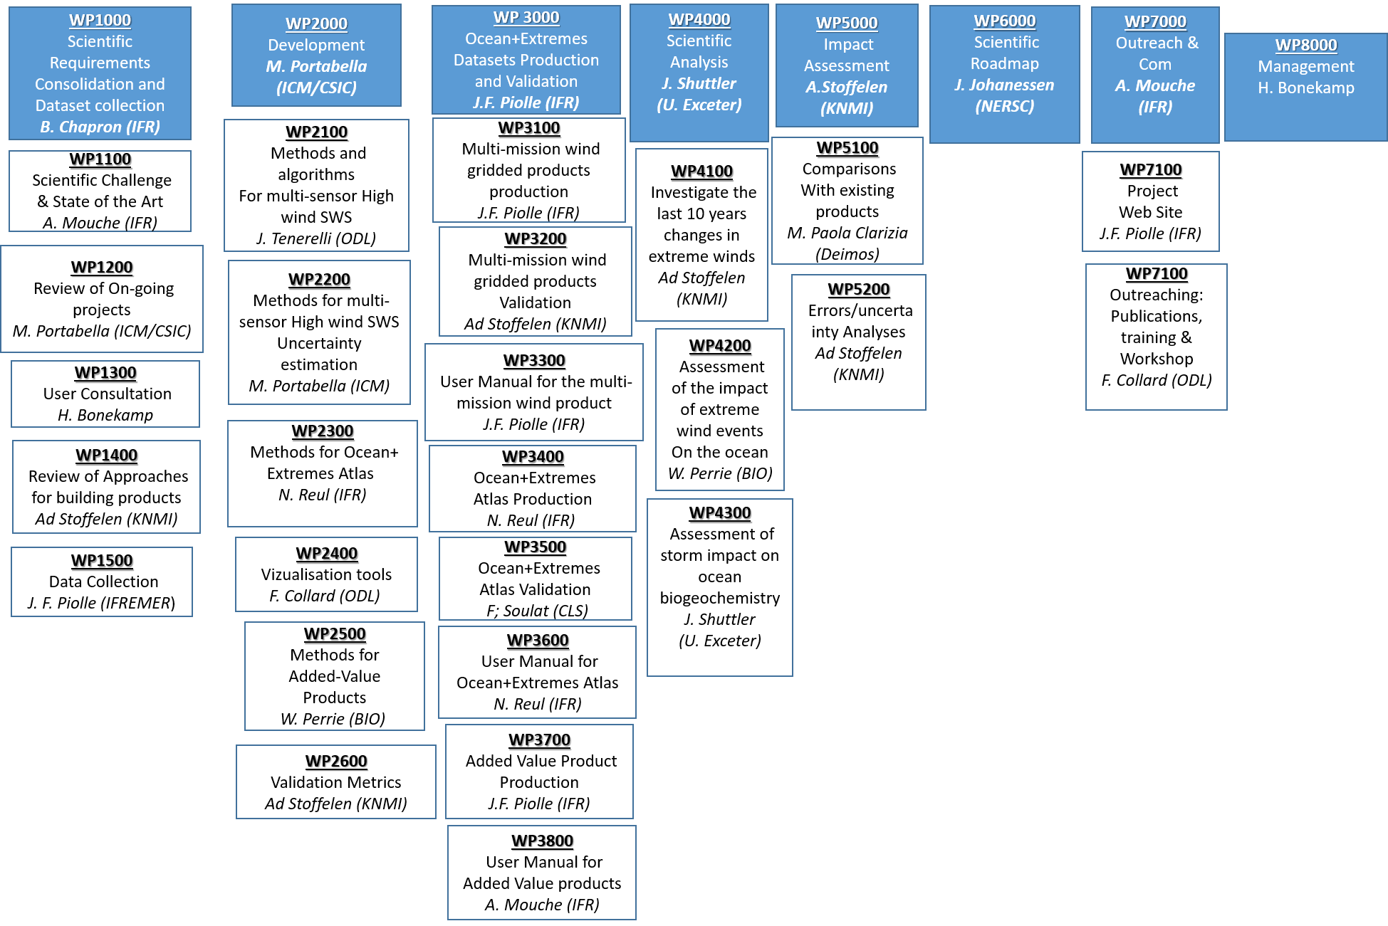
ESA MAXSS project WPs and SubWPs

