Slide 1
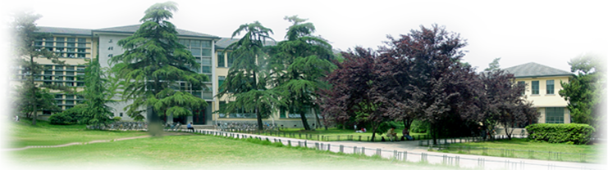
vEGU2021
The evolution of the tidal asymmetry in a river networks system
29,Apr,2021
Hohai University
Wei Zhang, Xiaoya Luo

Slide 2
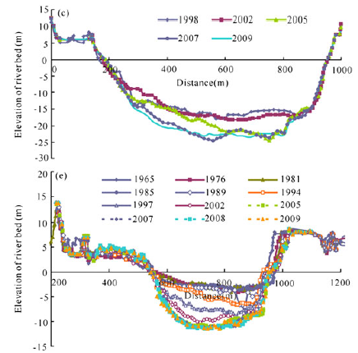
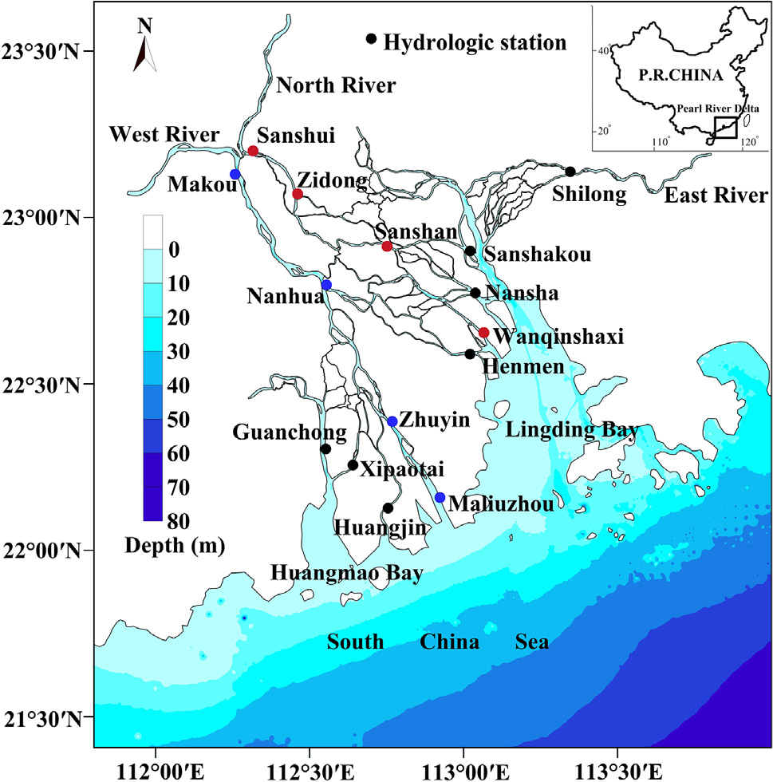
1. Background and Data
Significant riverbed cutdown caused by sand mining
The Pearl River Delta
Observed water levels from 15 stations during 1961-2012
Notes:
珠江三角洲位于我国的南部，是典型的河网型三角洲。当潮波在河口内传播时，由于受到地形、摩阻等因素的影响，潮波发生变形，涨落潮的历时不对等，我们称为潮汐不对称现象。在全球气候变暖的背景下，全球海平面持续上升。从而抬高近海潮位，改变近海潮动力特征。另外，由于频繁的人类活动的影响，三角洲河道局部发生显著下切，对潮波在河道内传播变形造成影响。三角洲潮汐不对称特性质也会发生一些改变。三角洲内的泥沙输运、盐度分布与潮汐不对称密切相关

Slide 3
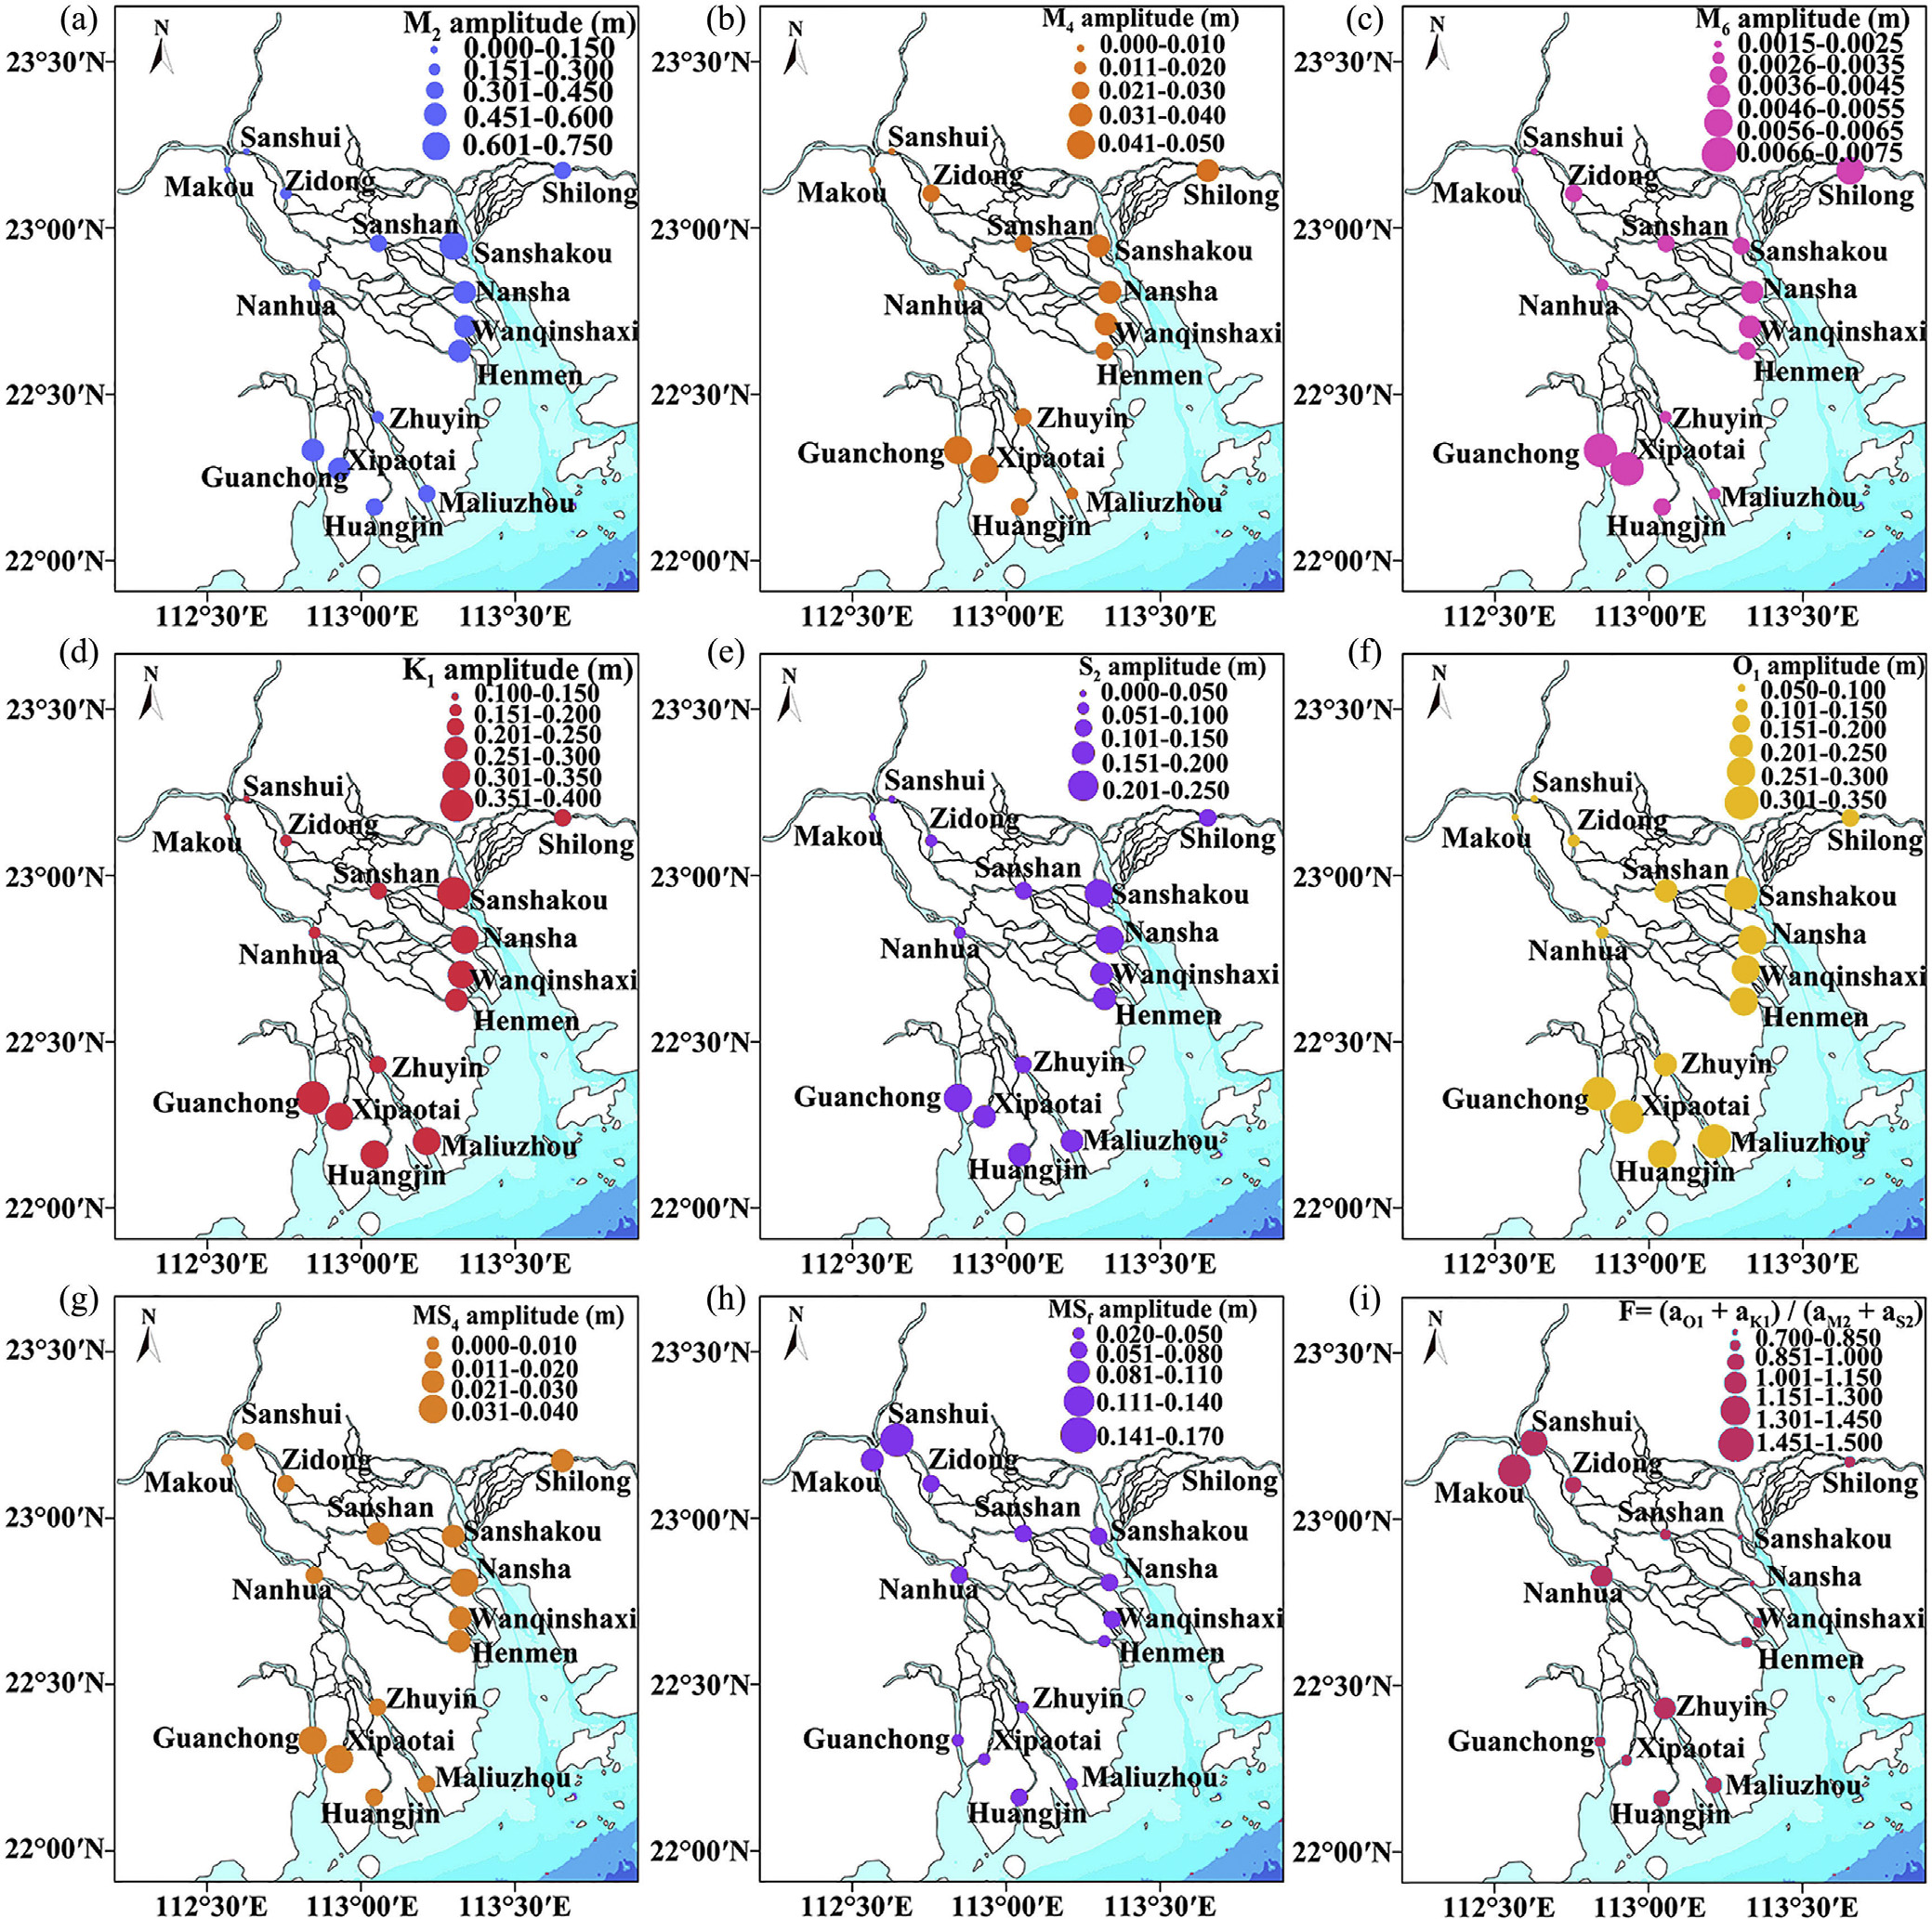
2. Results
2.1 Spatial variation of tidal amplitudes
    Astronomical tides: decay in the upstream
    Shallow water tides: increase at first and then decrease in the landward
    Fortnightly tides: increase in the landward
Notes:
通过调和分析计算出8个主要分潮的空间分布特征。可以看出，原始天文分潮向上游沿程衰减，浅水分潮先逐渐产生，后沿程衰减，半月分潮沿程增加
3

Slide 4
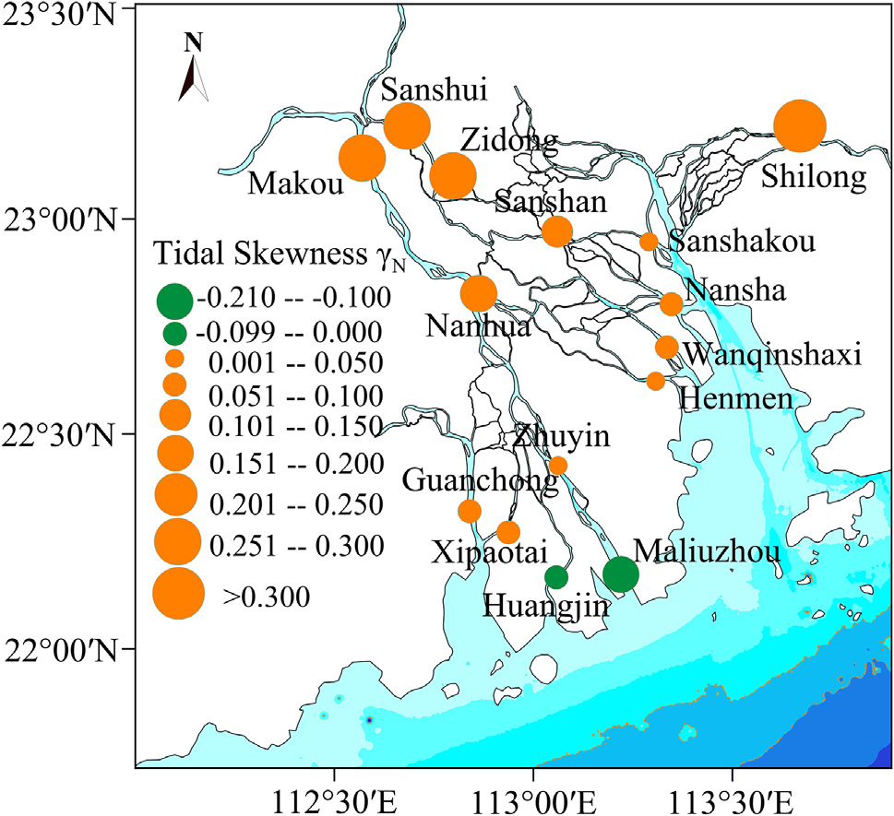
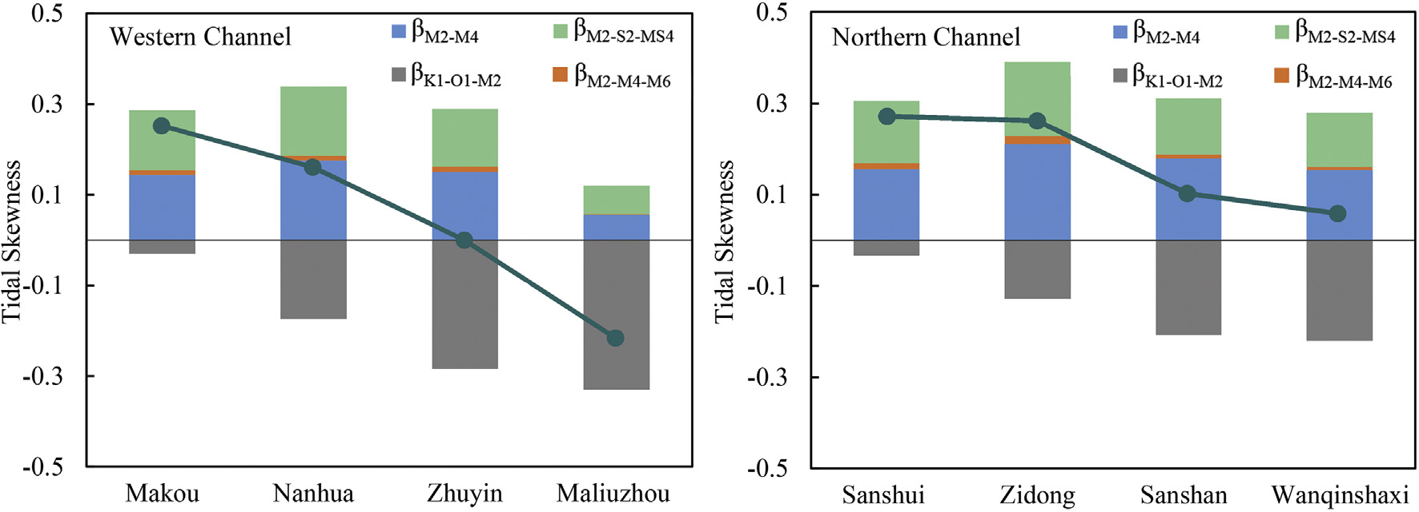
2. Results
2.2 Spatial variation in multiple tidal asymmetries
Total asymmetry
Contributions of different interaction
    Inside delta: Flood dominant Outlets: ebb dominant
    K₁-O₁-M₂ : negative, ebb dominant, decay in the landward
    Shallow water tides interaction: positive, flood dominant, increase at first and then decay
Notes:
通过调和分析计算出8个主要分潮的空间分布特征。可以看出，原始天文分潮向上游沿程衰减，浅水分潮先逐渐产生，后沿程衰减，半月分潮沿程增加
4

Slide 5
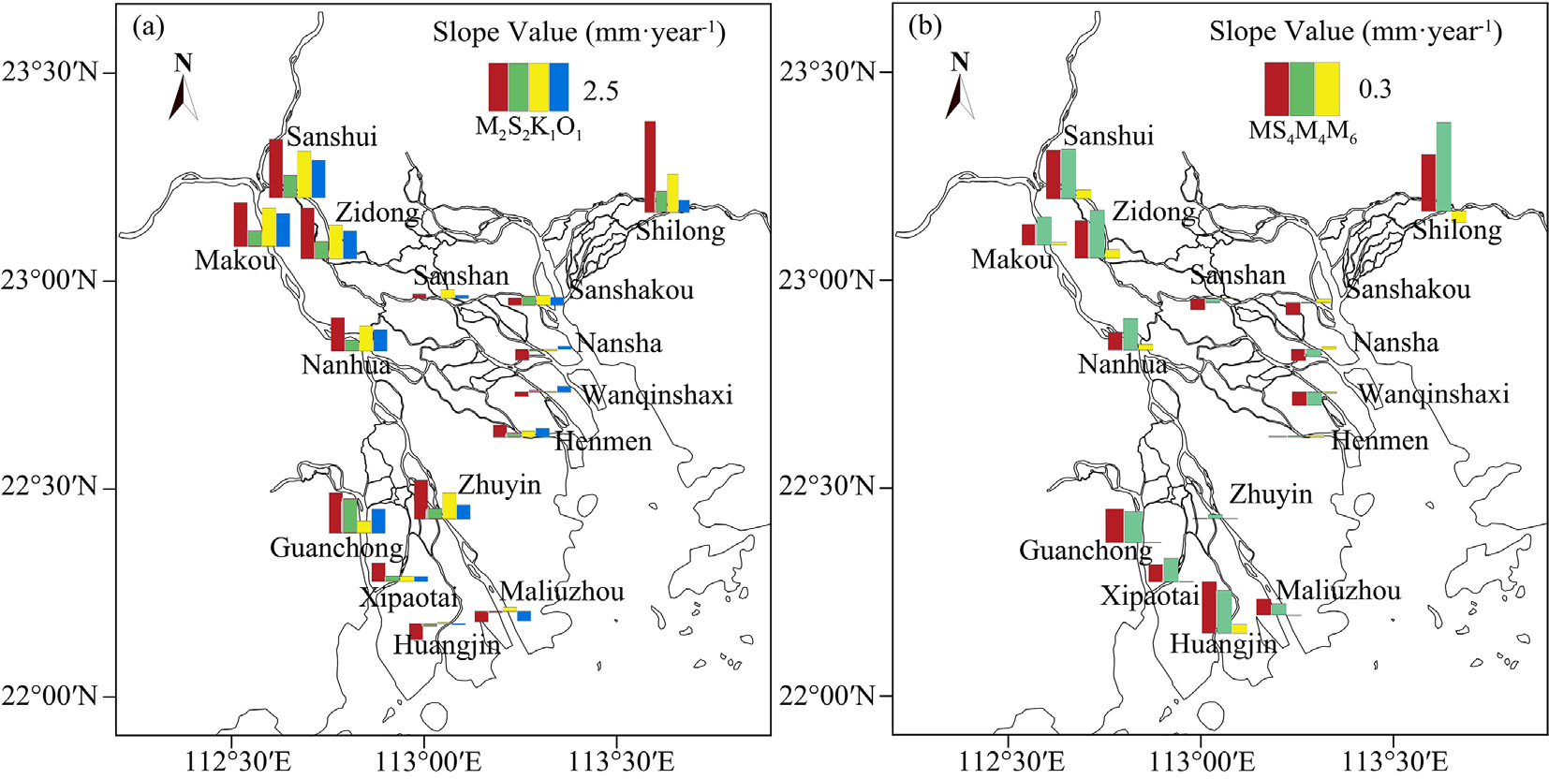
2. Results
2.3 Temporal trends of tidal amplitudes
    Upstream stations: amplitudes increase significantly
    Outlets: amplitudes change slightly
Notes:
通过调和分析计算出8个主要分潮的空间分布特征。可以看出，原始天文分潮向上游沿程衰减，浅水分潮先逐渐产生，后沿程衰减，半月分潮沿程增加
5

Slide 6
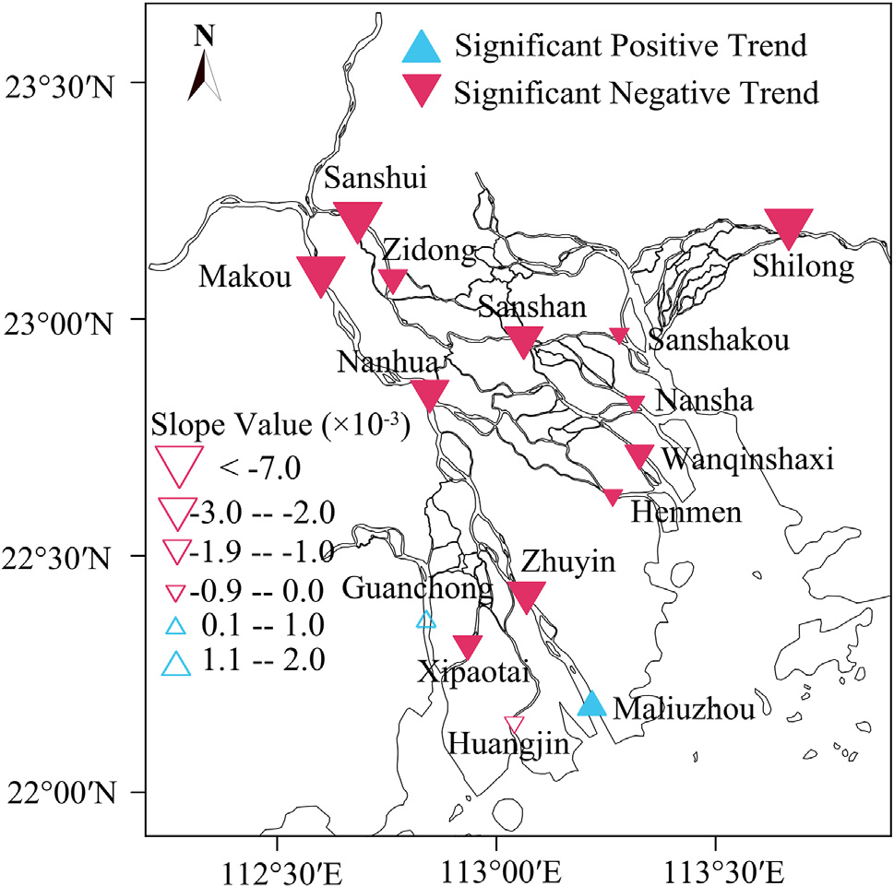
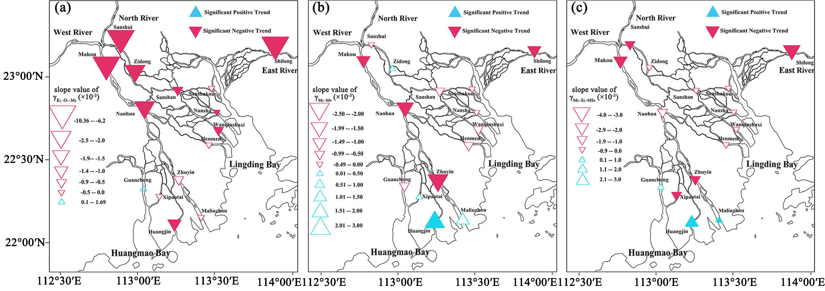
2. Results
2.4 Temporal trends of tidal asymmetries
Total asymmetry trends
Trends of different contributions
    Total asymmetry decreases, tides are becoming more symmetrical
    Contribution of K₁-O₁-M₂ increase, and shallow water interactions decrease
Notes:
通过调和分析计算出8个主要分潮的空间分布特征。可以看出，原始天文分潮向上游沿程衰减，浅水分潮先逐渐产生，后沿程衰减，半月分潮沿程增加
6

