Slide 1



VALIDATION OF CALIBRATED GOCE GRAVITY GRADIENTS GRD_SPW_2 BY LEAST-SQUARES SPECTRAL WEIGHTING
Martin Pitoňák¹, Michal Šprlák¹, Vegard Ophaug², Ove C. D. Omang³ and Pavel Novák¹
¹NTIS-New Technologies for the Information Society, Faculty of Applied Sciences, University of West Bohemia, Plzeň, Czech Republic
²Faculty of Science and Technology (RealTek),
Norwegian University of Life Sciences (NMBU),
Ås, Norway
³Norwegian Mapping Authority,
Hønefoss, Norway
vEGU21, 19 – 30 April 2021

Slide 2
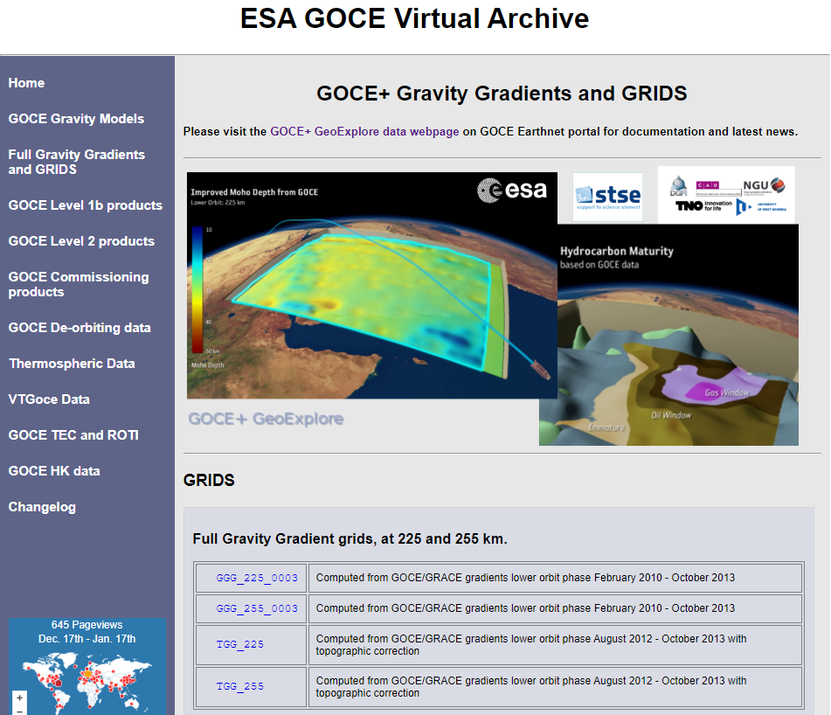
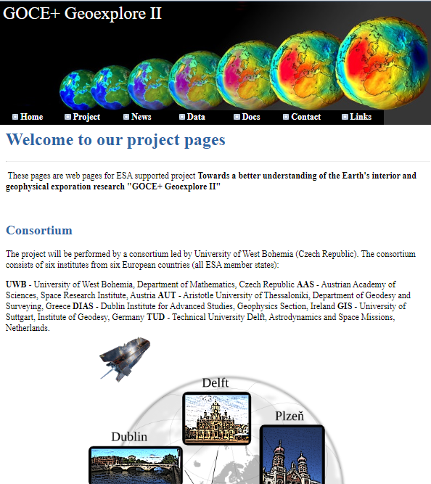
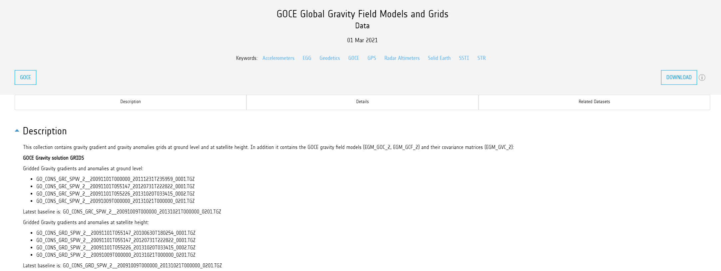
Motivation:
grids of gravitational gradients produced by three groups:
- ESA-funded GOCE+ GeoExplore project,
- GOCE+ GeoExplore II project,
- Space-wise GOCE grid products – SPW_GRD_2_),
a method for recovering gravitational field quantities on the Earth surface,
validation of the official GOCE Level 2 SPW_GRD_2_.
Pitoňák et al.
Validation of GOCE-based gravitational gradients grids by spectral combination method
1/21

Slide 3
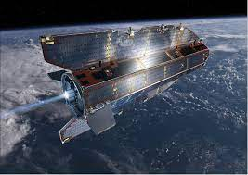
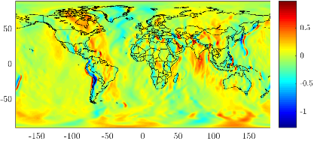
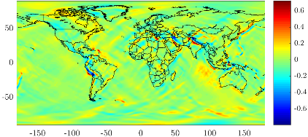
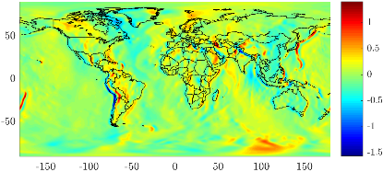
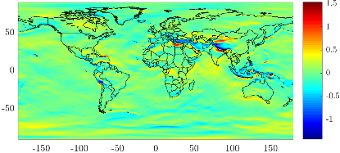
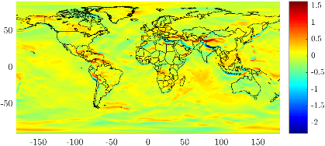
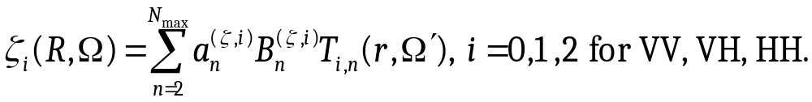
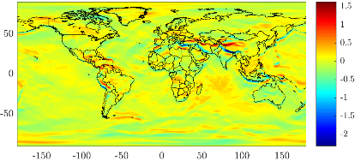
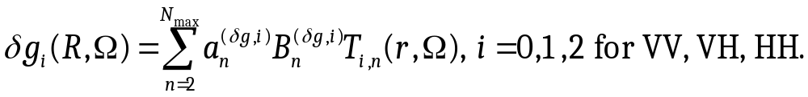

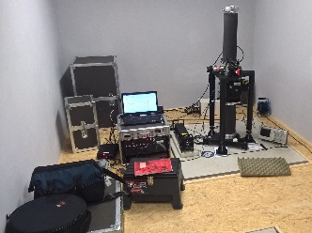
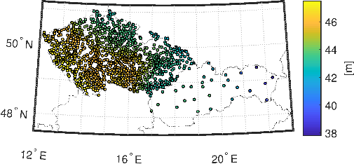
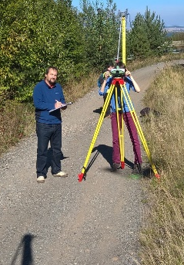
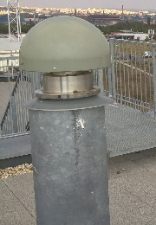
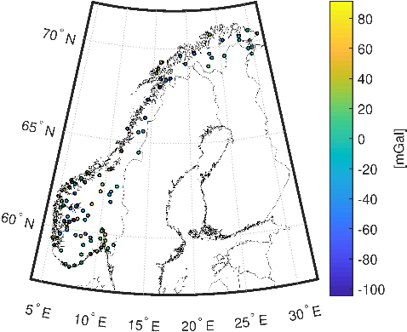
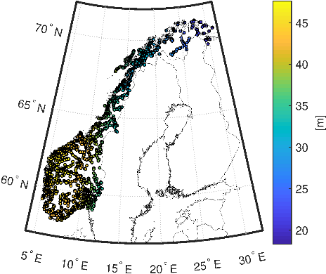
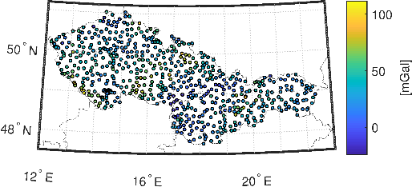
Motivation:
GRD_SPW_2_r2
GRD_SPW_2_r4
GRD_SPW_2_r5
GRD_SPW_2_r6
Pitoňák et al.
Validation of GOCE-based gravitational gradients grids by spectral combination method
2/21

Slide 4
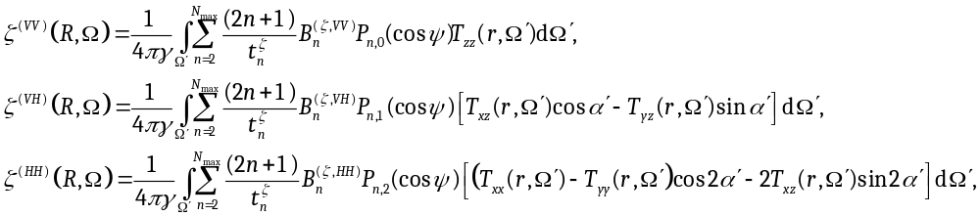
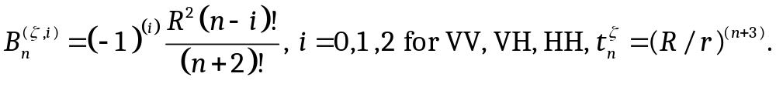
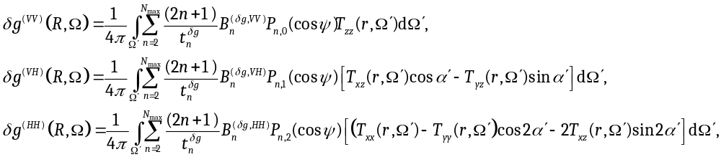
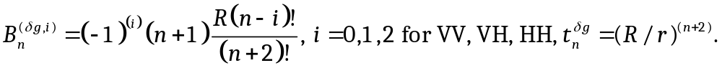
Spectral combination method:
The solution of the spherical gradiometric boundary-value problem (BVP) for height anomalies is defined as:
where
We present the solution of the spherical gradiometric boundary-value problem (BVP) for gravity disturbances in the following form:
where
Pitoňák et al.
Validation of GOCE-based gravitational gradients grids by spectral combination method
3/21

Slide 5
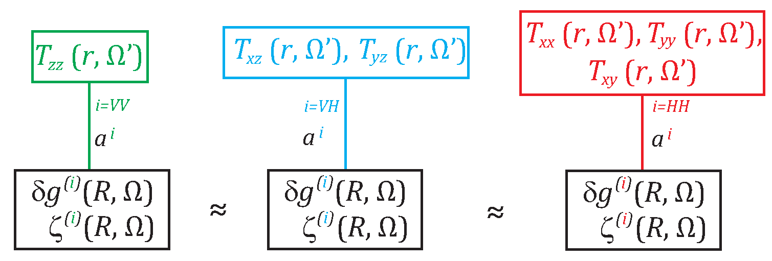
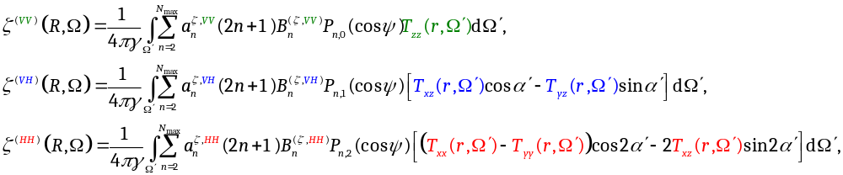
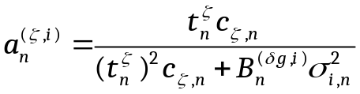
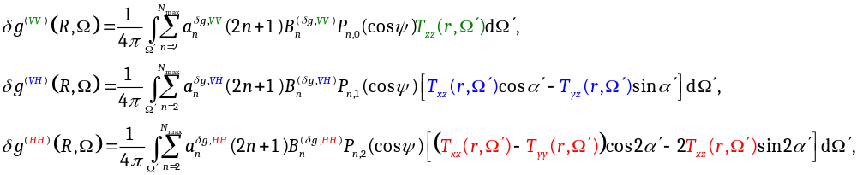
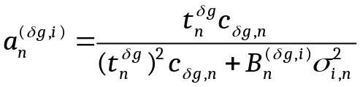
Spectral combination method: one component estimator
Pitoňák et al.
Validation of GOCE-based gravitational gradients grids by spectral combination method
4/21

Slide 6
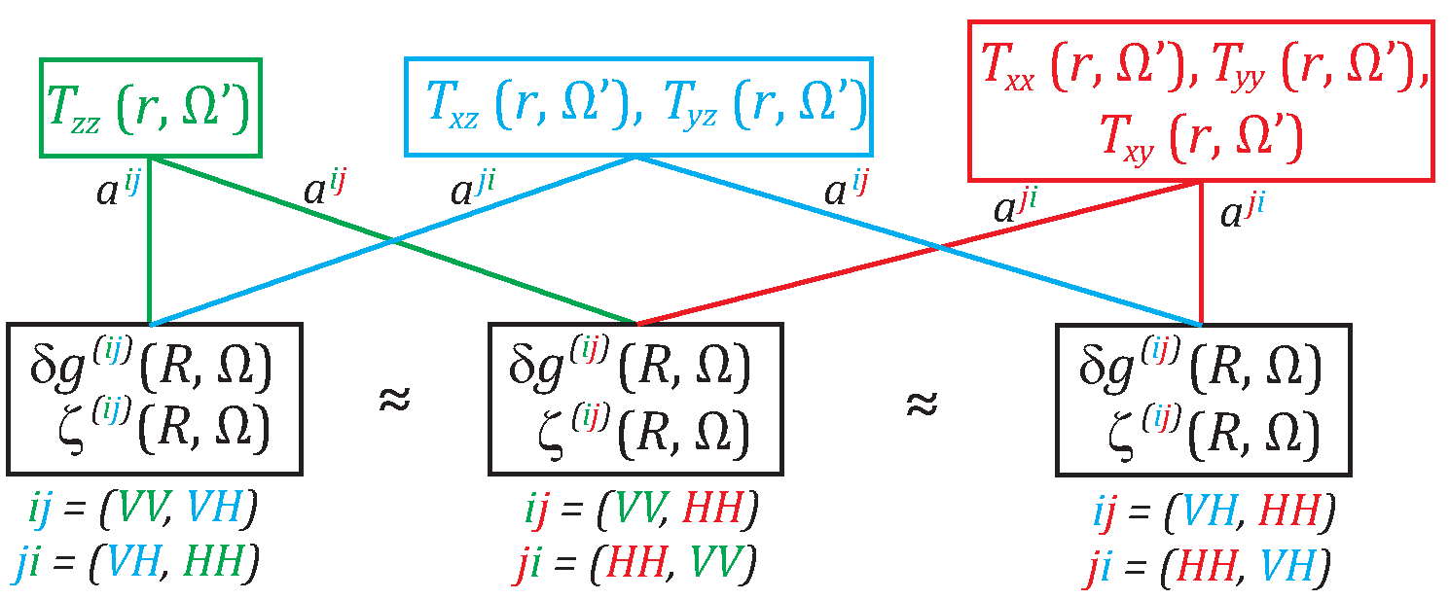
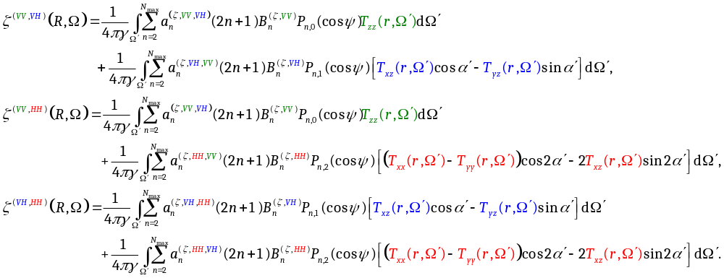
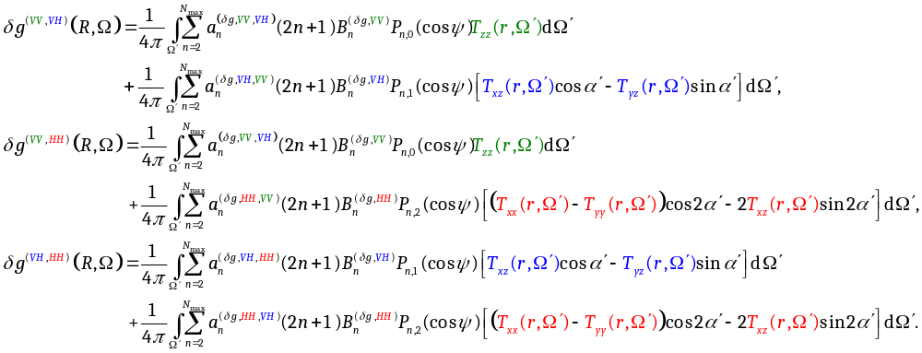
Spectral combination method: two component estinmator
Pitoňák et al.
Validation of GOCE-based gravitational gradients grids by spectral combination method
5/21

Slide 7
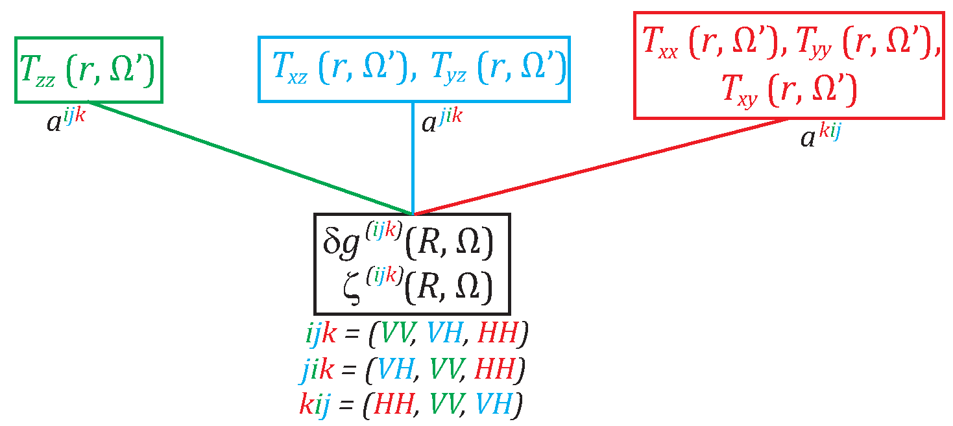
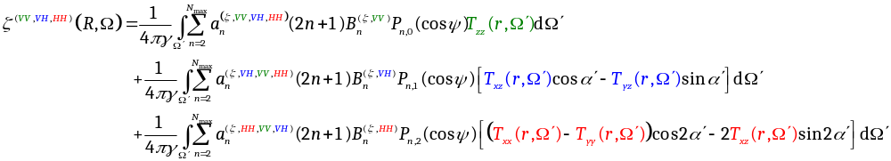
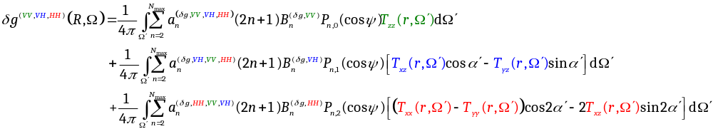
Spectral combination method: three component estimator
Pitoňák et al.
Validation of GOCE-based gravitational gradients grids by spectral combination method
6/21

Slide 8
Closed-loop test of the method:
Test area: Czech republic and Slovakia
Input data: topographic heights from Earth2014 (Hirt and Rexer, 2015), gravity data from EIGEN6C4 (Förste et al. 2014)
Coordinates of the test points.
 | φ [°] | λ [°] | r [m] | H [m]
A | 48.966667 | 20.116667 | 6363203.060 | 2121.332
B | 48.433333 | 21.833333 | 6356990.306 | 92.490
Differences (in mGal) between the estimated values of gravity disturbances and their counterparts from GGM EIGEN-6C4 up to the degree 200 (upper), 250 (middle), 300 (bottom).
 | VV | VH | HH | (VV,VH) | (VV,HH) | (VH,HH) | (VV,VH,HH)
A | -0.005 | -0.005 | 0.009 | -0.005 | 0.009 | 0.009 | 0.009
B | -0.010 | -0.008 | -0.009 | -0.008 | -0.009 | -0.009 | -0.009
A | 0.080 | 0.072 | 0.019 | 0.072 | 0.019 | 0.019 | 0.019
B | -0.041 | -0.061 | 0.031 | -0.061 | 0.031 | 0.031 | 0.031
A | -0.195 | -0.067 | -0.476 | -0.067 | -0.476 | -0.476 | -0.476
B | 0.454 | 0.232 | 0.488 | 0.232 | 0.488 | 0.488 | 0.488
Pitoňák et al.
Validation of GOCE-based gravitational gradients grids by spectral combination method
7/21

Slide 9

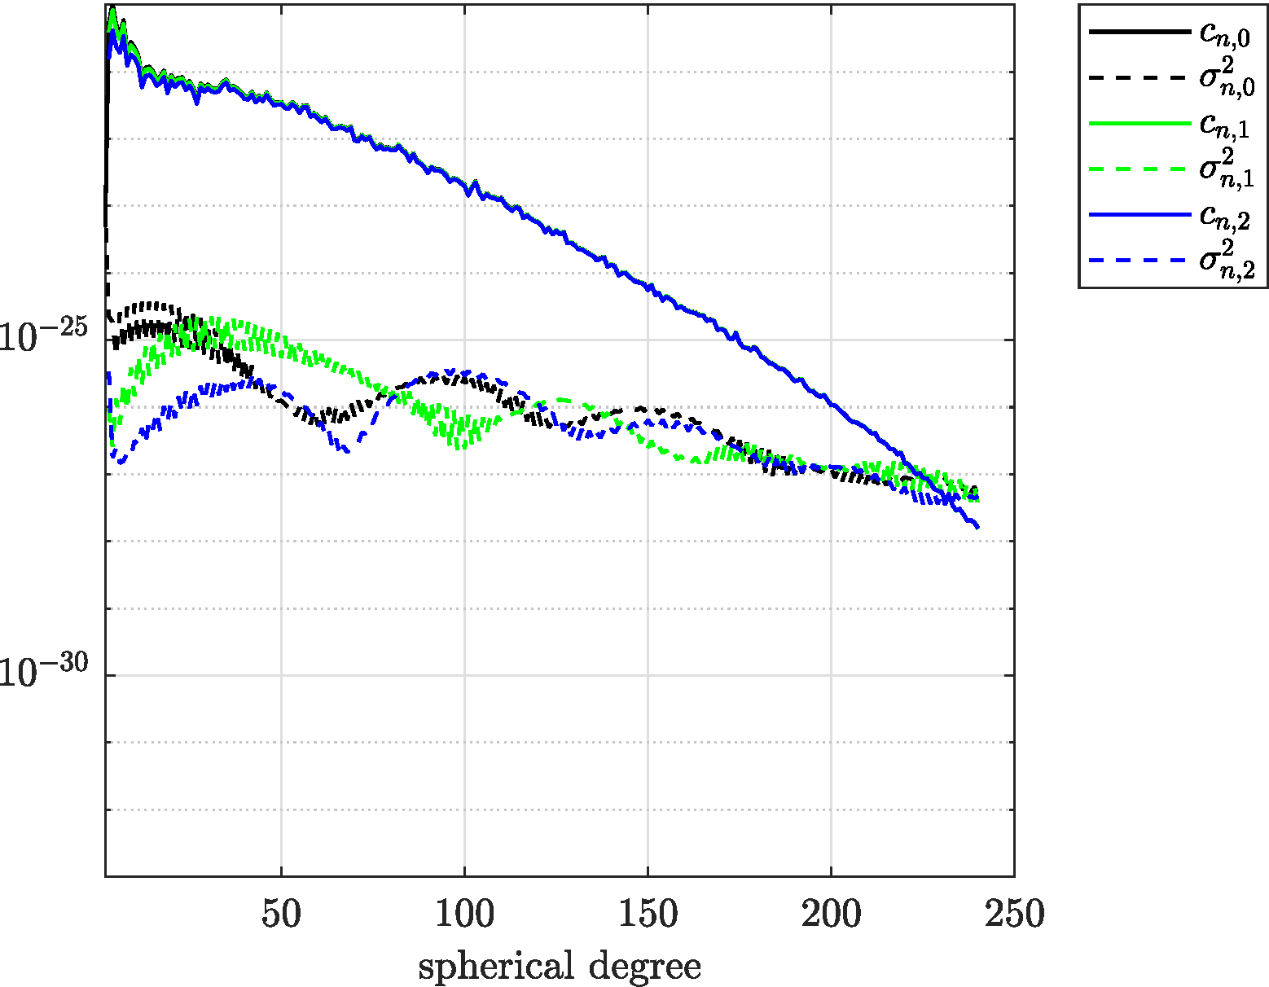
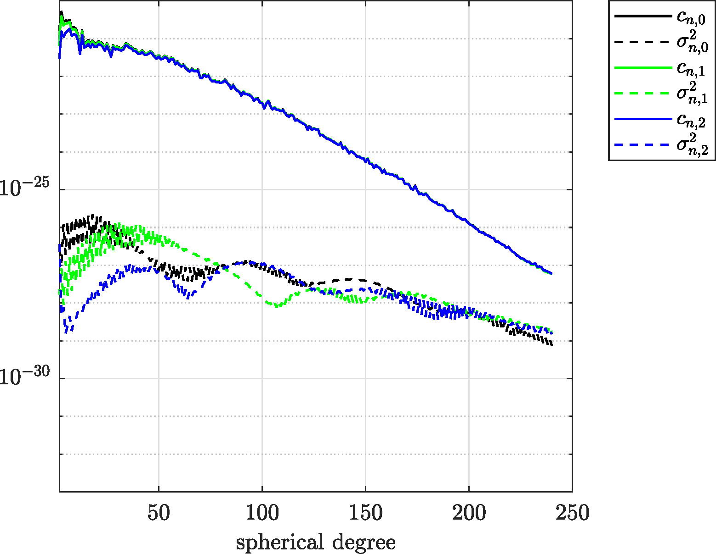
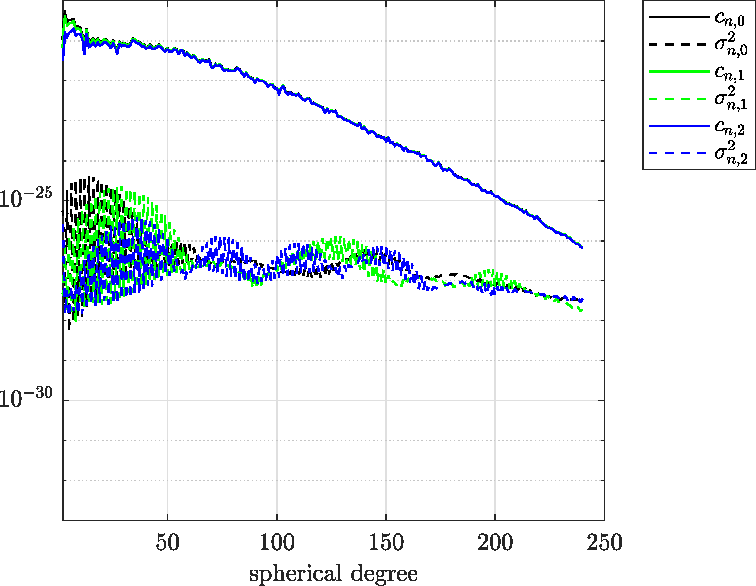
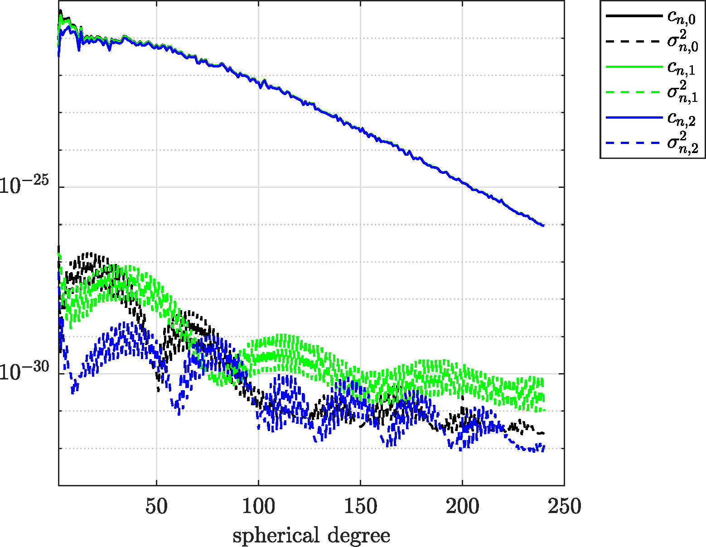
Numerical experiment: Input data (the official GOCE Level 2 SPW_GRD_2):
 | Release 2 |  | Release 4 | Release 5 | Release 6
Inputs | - EGG_NOM_2 - EGG_IAQ_1b SST_PSO_2 tide model, ephemeris, Earth rotation parameters A priori gravity field model for signal covariance modelling
Data period | 31/10/2009 – 5/7/2010 | 1/11/2009 – 31/7/2012 |  | 1/11/2009 –20/10/2013 | 9/10/2009 –21/10/2013
Grid area
Grid resolution | 0.2°
Reference radius [m] | 6637655.2 | 6637655.2 |  | 6600000 | 6600000
Outputs | V_{nn}, V_{ee}, V_{rr}, V_{en}, V_{er}, V_{nr}
Reference | Gatti et al. (2014) | Gatti et al. (2014) |  | Gatti et al. (2014) | Reguzzoni et al. (2019)
Pitoňák et al.
Validation of GOCE-based gravitational gradients grids by spectral combination method
8/21

Slide 10




Numerical experiment: Input data (terrestrial data):
The terrestrial data over Czech republic (421 points of Czech gravimetric network, 1024 GNSS/levelling points )
and Slovakia (233 points of Slovak gravimetric network, 31 GNSS/levelling points)
The gravity accelerations on 104 points measured by A10 gravimeter and height anomalies on 1668 points over Norway
Pitoňák et al.
Validation of GOCE-based gravitational gradients grids by spectral combination method
9/21

Slide 11
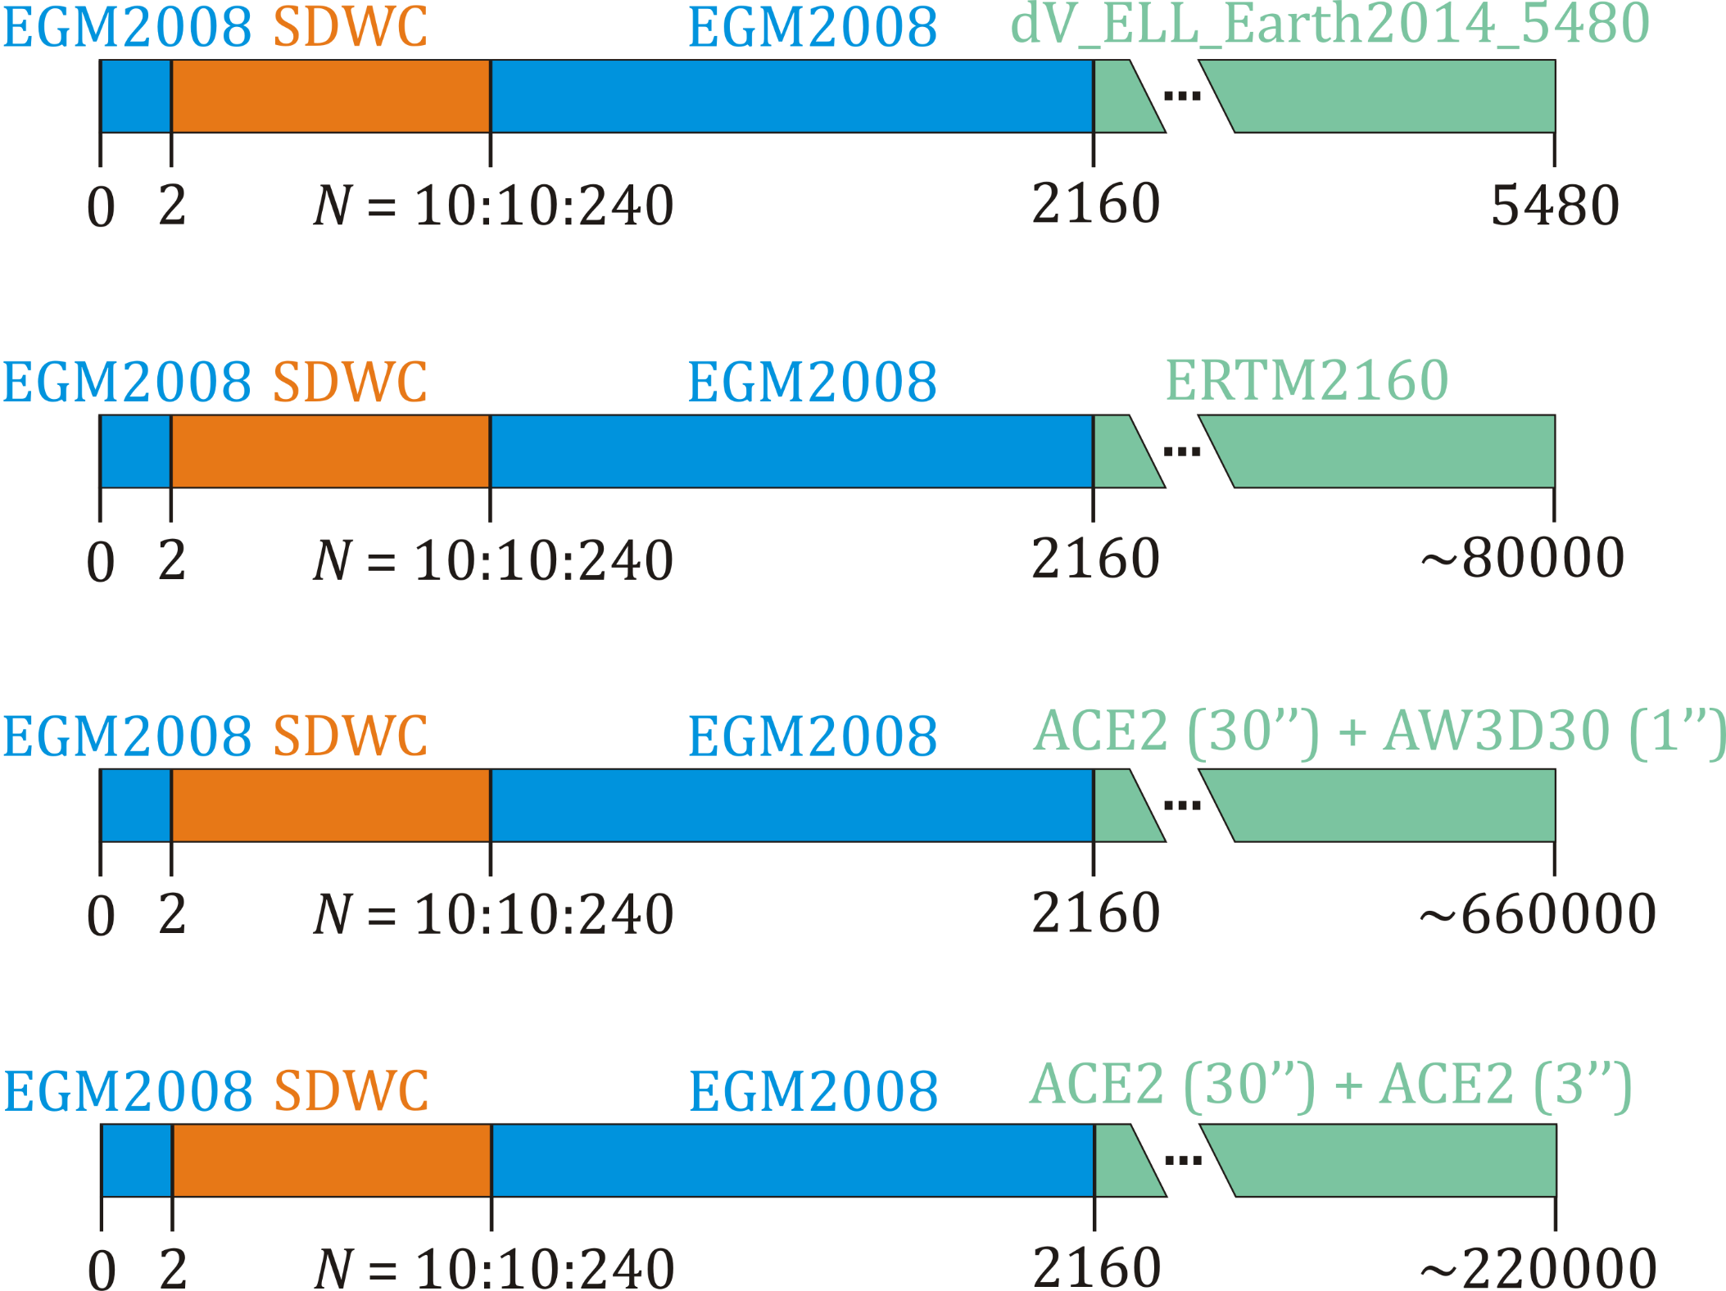
Omission error modelling:
Scenario 1:
Scenario 2:
(not applied in Norway due to ERTM2160
(Hirt et al. 2014) geographical limitations)
Scenario 3: Czechia and Slovakia
DTMs were smoothed by
DTM2006.0 (Pavlis et al. 2007, N = 2160)
Scenario 3: Norway
Pitoňák et al.
Validation of GOCE-based gravitational gradients grids by spectral combination method
10/21

Slide 12
Results: area of Czechoslovakia (height anomalies [cm]/gravity disturbances [mGal]) – release 2
Scenario 1:
N_{max} = 240
 | VV | VH | HH | (VV,VH) | (VV,HH) | (VH,HH) | (VV,VH,HH)
std | 17.8/8.9 | 19.0/9.3 | 19.0/9.3 | 19.0/9.3 | 19.0/9.3 | 19.0/9.3 | 19.0/9.3
max | -44.7/24.0 | -47.8/27.1 | -48.1/27.3 | -47.8/27.1 | -48.1/27.3 | -48.1/27.3 | -48.1/27.3
min | -172.0/-39.5 | -169.7/-40.5 | -170.1/-40.4 | -169.7/-40.5 | -170.1/-40.4 | -170.1/-40.4 | -170.1/-40.4
mean | -128.3/-0.3 | -128.4/-0.2 | -128.4/-0.2 | -128.4/-0.2 | -128.4/-0.2 | -128.4/-0.2 | -128.4/-0.2
Scenario 2:
 | VV | VH | HH | (VV,VH) | (VV,HH) | (VH,HH) | (VV,VH,HH)
std | 17.8/8.6 | 19.0/8.9 | 19.0/9.0 | 19.0/8.9 | 19.0/8.9 | 19.0/8.9 | 19.0/8.9
max | -44.7/51.0 | -47.8/53.2 | -48.1/53.3 | -47.8/53.2 | -48.1/53.3 | -48.1/53.3 | -48.1/53.3
min | -171.2/-36.3 | -168.9/-36.2 | -169.3/-36.3 | -168.9/-36.2 | -169.3/-36.3 | -169.3/-36.3 | -169.3/-36.3
mean | -128.2/2.8 | -128.3/2.9 | -128.3/2.9 | -128.3/2.9 | -128.3/2.9 | -128.3/2.9 | -128.3/2.9
Scenario 3:
 | VV | VH | HH | (VV,VH) | (VV,HH) | (VH,HH) | (VV,VH,HH)
std | 17.8/6.1 | 19.0/6.6 | 19.0/6.6 | 19.0/6.6 | 19.0/6.6 | 19.0/6.6 | 19.0/6.6
max | -44.7/21.7 | -47.8/24.3 | -48.1/24.4 | -47.8/24.3 | -48.1/24.4 | -48.1/24.4 | -48.1/24.4
min | -172.0/-14.5 | -169.7/-13.5 | -170.1/-13.4 | -169.7/-13.5 | -170.1/-13.4 | -170.1/-13.4 | -170.1/-13.4
mean | -128.3/3.5 | -128.4/3.6 | -128.4/3.6 | -128.4/3.6 | -128.4/3.6 | -128.4/3.6 | -128.4/3.6
Pitoňák et al.
Validation of GOCE-based gravitational gradients grids by spectral combination method
11/21

Slide 13
Results: area of Czechoslovakia (height anomalies [cm]/gravity disturbances [mGal]) – release 4
Scenario 1:
N_{max} = 240
 | VV | VH | HH | (VV,VH) | (VV,HH) | (VH,HH) | (VV,VH,HH)
std | 12.4/7.9 | 12.4/8.0 | 12.8/8.0 | 12.4/8.0 | 12.8/8.0 | 12.8/8.0 | 12.8/8.0
max | -32.3/21.1 | -32.4/21.8 | -31.2/22.5 | -32.4/21.8 | -31.2/22.5 | -31.1/22.5 | -31.1/22.5
min | -174.2/-40.8 | -175.9/-40.9 | -179.3/-42.3 | -175.9/-40.9 | -179.4/-42.3 | -179.2/-42.3 | -179.2/-42.3
mean | -128.8/-0.8 | -128.6/-0.7 | -128.4/-0.6 | -128.6/-0.7 | -128.4/-0.6 | -128.3/-0.6 | -128.3/-0.6
Scenario 2:
 | VV | VH | HH | (VV,VH) | (VV,HH) | (VH,HH) | (VV,VH,HH)
std | 12.5/7.6 | 12.4/7.7 | 12.9/7.6 | 12.4/7.7 | 12.9/7.6 | 12.9/7.6 | 12.9/7.6
max | -32.3/46.5 | -32.4/46.6 | -31.2/49.3 | -32.4/46.6 | -31.2/49.3 | -31.1/49.3 | -31.1/49.3
min | -174.9/-35.9 | -176.5/-35.7 | -178.5/-35.8 | -176.5/-35.7 | -178.6/-35.8 | -178.4/-35.8 | -178.4/-35.8
mean | -128.7/2.3 | -128.5/2.4 | -128.3/2.5 | -128.5/2.4 | -128.3/2.5 | -128.2/2.5 | -128.2/2.5
Scenario 3:
 | VV | VH | HH | (VV,VH) | (VV,HH) | (VH,HH) | (VV,VH,HH)
std | 12.4/4.8 | 12.3/4.9 | 12.8/4.8 | 12.3/4.9 | 12.8/4.8 | 12.8/4.8 | 12.8/4.8
max | -32.2/16.6 | -32.4/16.7 | -31.2/17.4 | -32.4/16.7 | -31.2/17.4 | -31.1/17.4 | -31.1/17.4
min | -174.3/-12.2 | -175.9/-12.8 | -179.3/-11.1 | -175.9/-12.8 | -179.4/-11.1 | -179.2/-11.1 | -179.2/-11.1
mean | -128.8/3.0 | -128.6/3.1 | -128.4/3.2 | -128.6/3.1 | -128.4/3.2 | -128.3/3.2 | -128.3/3.2
Pitoňák et al.
Validation of GOCE-based gravitational gradients grids by spectral combination method
12/21

Slide 14
Results: area of Czechoslovakia (height anomalies [cm]/gravity disturbances [mGal]) – release 5
Scenario 1:
N_{max} = 240
 | VV | VH | HH | (VV,VH) | (VV,HH) | (VH,HH) | (VV,VH,HH)
std | 10.2/7.6 | 10.3/7.6 | 9.7/7.6 | 10.3/7.6 | 9.7/7.6 | 9.7/7.6 | 9.7/7.6
max | -21.1/22.5 | -21.0/22.3 | -22.6/22.8 | -21.0/22.3 | -22.6/22.8 | -22.8/22.8 | -22.8/22.8
min | -171.3/-41.2 | -171.8/-40.6 | -171.5/-40.5 | -171.8/-40.6 | -171.5/-40.5 | -171.7/-40.5 | -171.7/-40.5
mean | -128.3/-0.9 | -128.7/-0.9 | -128.4/-0.8 | -128.7/-0.9 | -128.4/-0.8 | -128.6/-0.8 | -128.6/-0.8
Scenario 2:
 | VV | VH | HH | (VV,VH) | (VV,HH) | (VH,HH) | (VV,VH,HH)
std | 10.2/7.3 | 10.3/7.4 | 9.8/7.3 | 10.3/7.4 | 9.8/7.3 | 9.8/7.3 | 9.8/7.3
max | -21.0/46.3 | -21.0/45.6 | -22.6/46.5 | -21.0/45.6 | -22.6/46.5 | -22.8/46.5 | -22.8/46.5
min | -171.9/-35.1 | -172.4/-35.9 | -172.1/-35.1 | -172.4/-35.9 | -172.1/-35.1 | -172.3/-35.1 | -172.3/-35.1
mean | -128.2/2.2 | -128.6/2.2 | -128.3/2.3 | -128.6/2.2 | -128.3/2.3 | -128.5/2.3 | -128.5/2.3
Scenario 3:
 | VV | VH | HH | (VV,VH) | (VV,HH) | (VH,HH) | (VV,VH,HH)
std | 10.2/4.5 | 10.3/4.5 | 9.7/4.4 | 10.3/4.5 | 9.7/4.4 | 9.7/4.4 | 9.7/4.4
max | -21.0/16.9 | -21.0/17.0 | -22.6/16.2 | -21.0/17.0 | -22.6/16.2 | -22.8/16.2 | -22.8/16.2
min | -171.3/-12.1 | -171.8/-12.5 | -171.5/-12.2 | -171.8/-12.5 | -171.5/-12.2 | -171.7/-12.2 | -171.7/-12.2
mean | -128.3/2.9 | -128.3/2.9 | -128.4/3.0 | -128.7/2.9 | -128.4/3.0 | -128.6/3.0 | -128.6/3.0
Pitoňák et al.
Validation of GOCE-based gravitational gradients grids by spectral combination method
13/21

Slide 15
Results: area of Czechoslovakia (height anomalies [cm]/gravity disturbances [mGal]) – release 6
Scenario 1:
N_{max} = 240
 | VV | VH | HH | (VV,VH) | (VV,HH) | (VH,HH) | (VV,VH,HH)
std | 9.3/7.3 | 9.2/7.3 | 9.1/7.3 | 9.2/7.3 | 9.1/7.3 | 9.1/7.3 | 9.1/7.3
max | -22.0/21.1 | -22.5/21.2 | -22.0/21.2 | -22.5/21.2 | -22.0/21.2 | -22.0/21.2 | -22.0/21.2
min | -174.8/-37.3 | -175.0/-37.8 | -174.6/-37.6 | -175.0/-37.8 | -174.6/-37.6 | -174.6/-37.6 | -174.6/-37.6
mean | -125.1/-1.0 | -125.1/-1.0 | -125.1/-1.0 | -125.1/-1.0 | -125.1/-1.0 | -125.1/-1.0 | -125.1/-1.0
Scenario 2:
 | VV | VH | HH | (VV,VH) | (VV,HH) | (VH,HH) | (VV,VH,HH)
std | 9.3/7.1 | 9.3/7.1 | 9.2/7.1 | 9.3/7.1 | 9.2/7.1 | 9.2/7.1 | 9.2/7.1
max | -22.0/43.9 | -22.5/44.1 | -22.0/44.3 | -22.5/44.1 | -22.0/44.3 | -22.0/44.3 | -22.0/44.3
min | -174.1/-35.4 | -174.2/-35.3 | -173.8/-35.3 | -174.2/-35.3 | -173.8/-35.3 | -173.8/-35.3 | -173.8/-35.3
mean | -125.0/2.1 | -125.0/2.1 | -125.0/2.1 | -125.0/2.1 | -125.0/2.1 | -125.0/2.1 | -125.0/2.1
Scenario 3:
 | VV | VH | HH | (VV,VH) | (VV,HH) | (VH,HH) | (VV,VH,HH)
std | 9.3/4.1 | 9.2/4.1 | 9.1/4.1 | 9.2/4.1 | 9.1/4.1 | 9.1/4.1 | 9.1/4.1
max | -21.9/15.6 | -22.4/15.4 | -22.0/15.5 | -22.4/15.4 | -22.0/15.5 | -22.0/15.5 | -22.0/15.5
min | 174.8/-10.6 | -175.0/-10.4 | -174.6/-10.3 | -175.0/-10.4 | -174.6/-10.2 | -174.6/-10.2 | -174.6/-10.2
mean | -125.0/2.8 | -125.0/2.8 | -125.1/2.8 | -125.1/2.8 | -125.1/2.8 | -125.1/2.8 | -125.1/2.8
Pitoňák et al.
Validation of GOCE-based gravitational gradients grids by spectral combination method
14/21

Slide 16
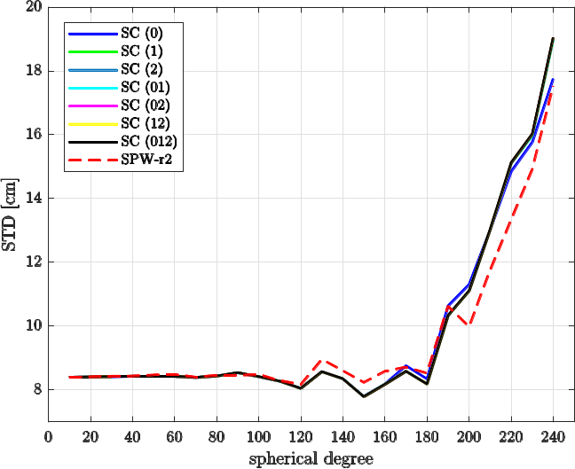
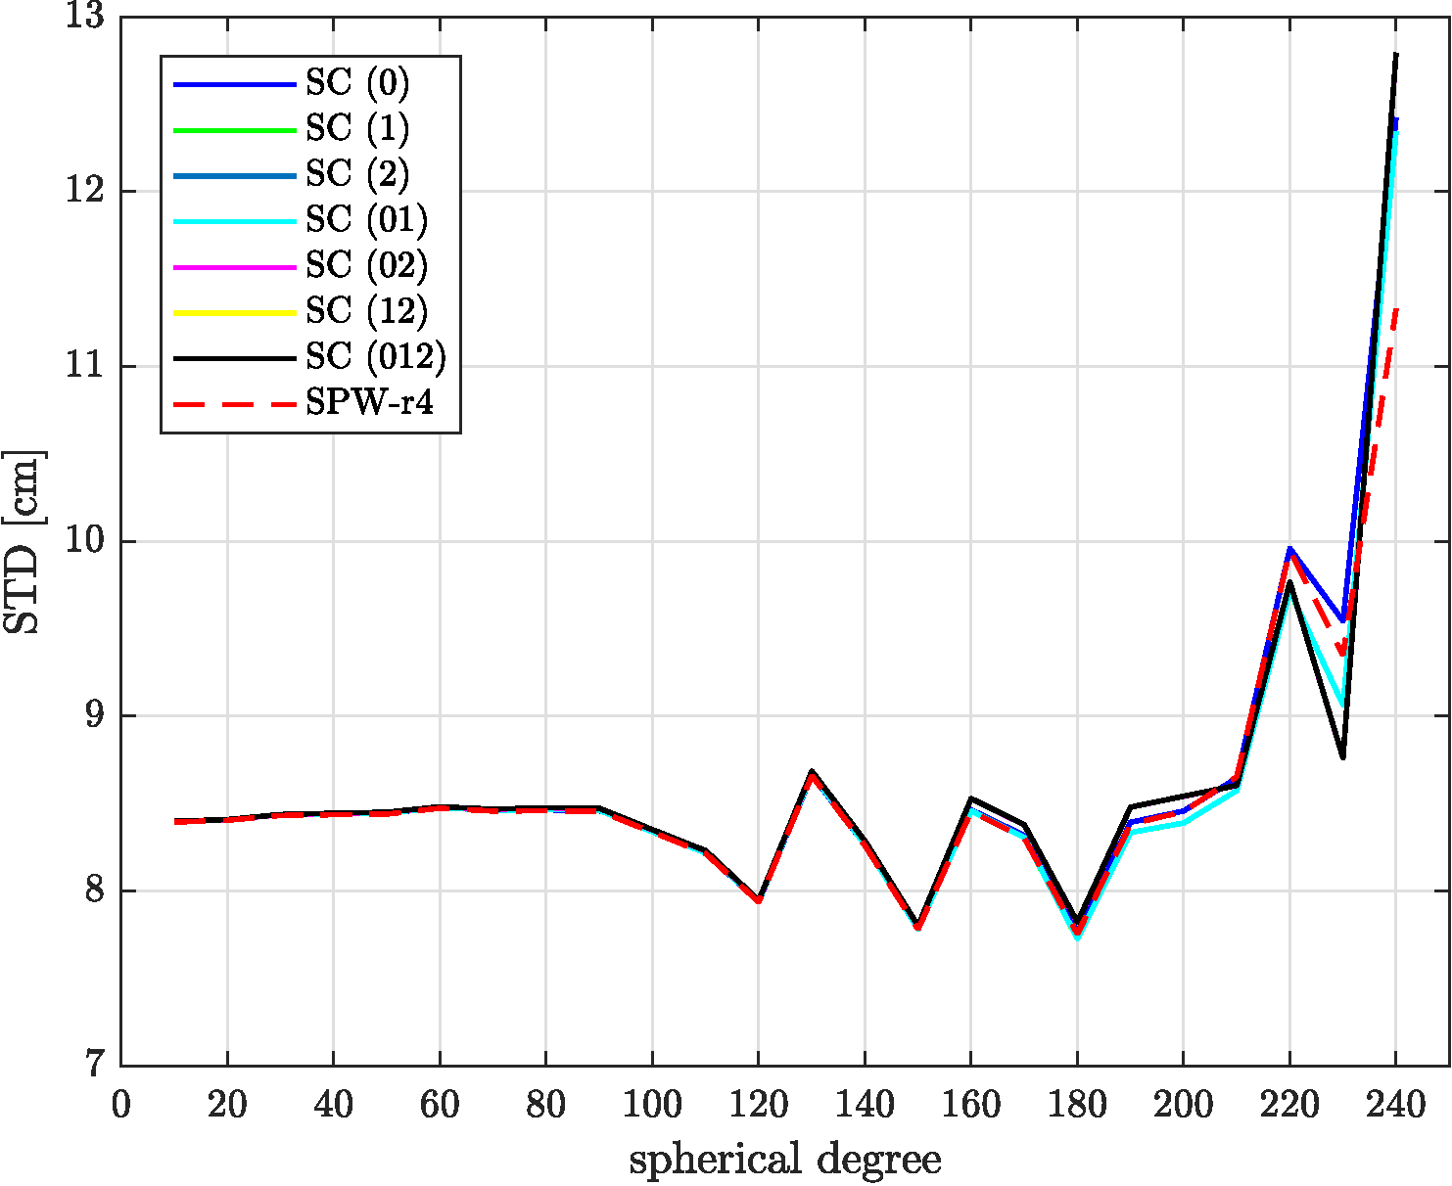
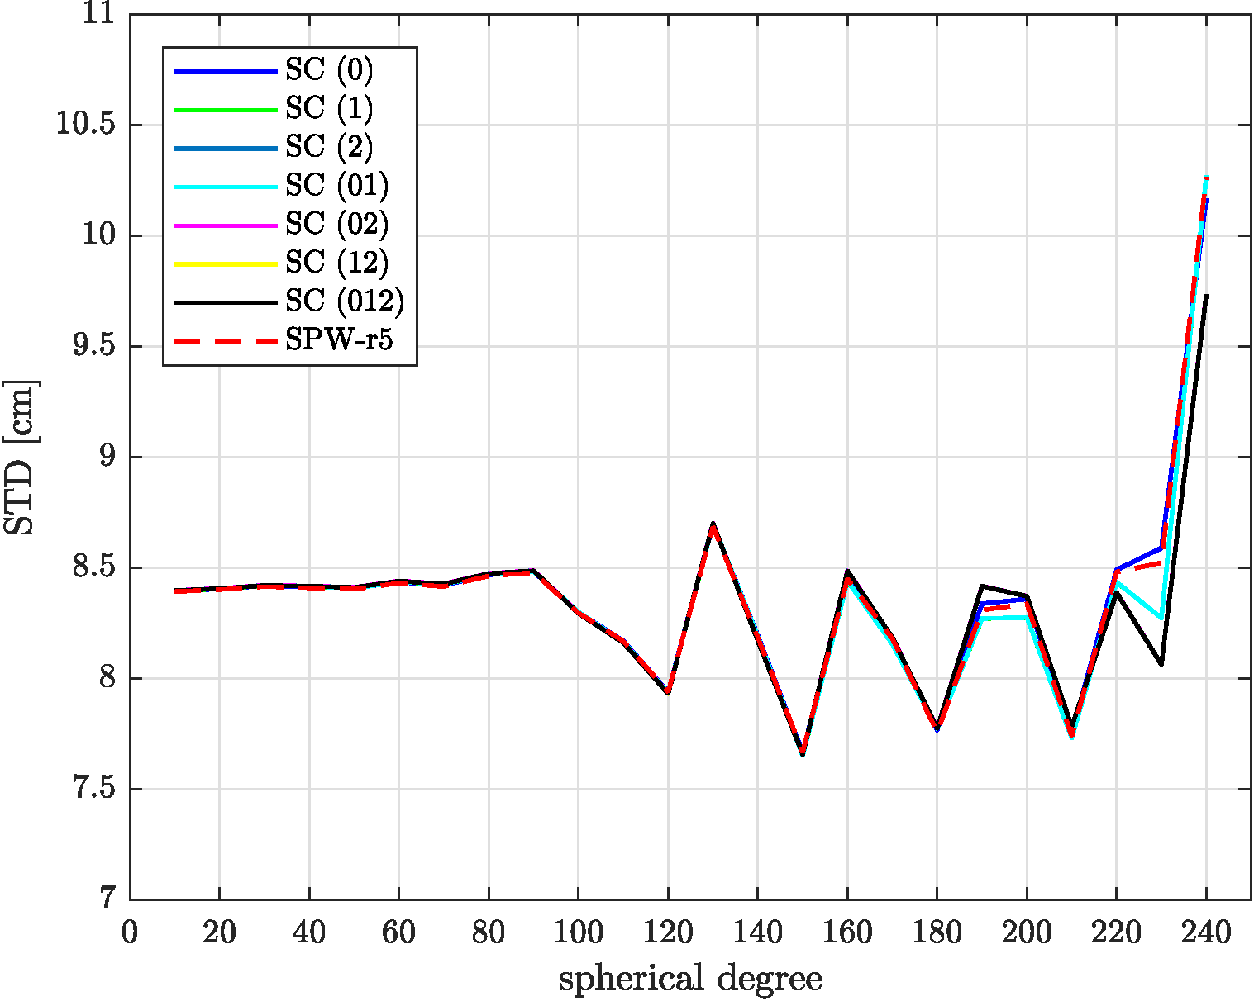
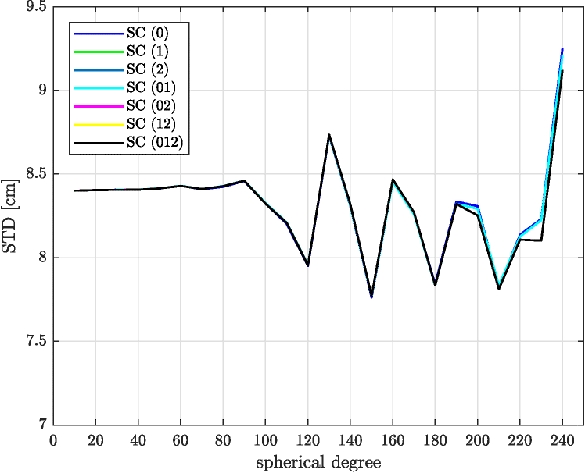
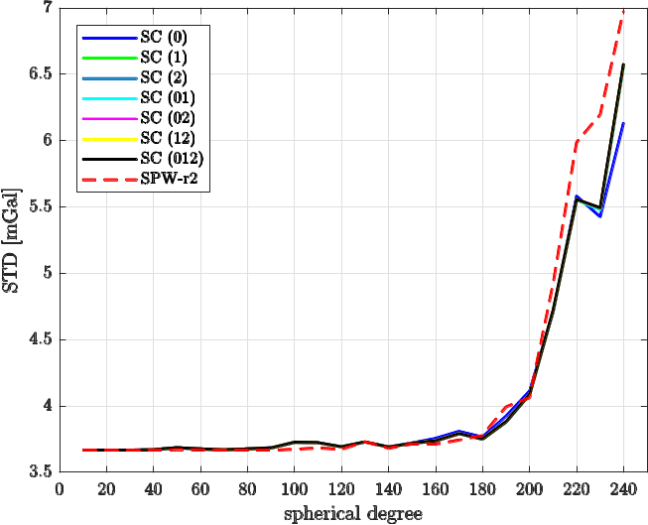
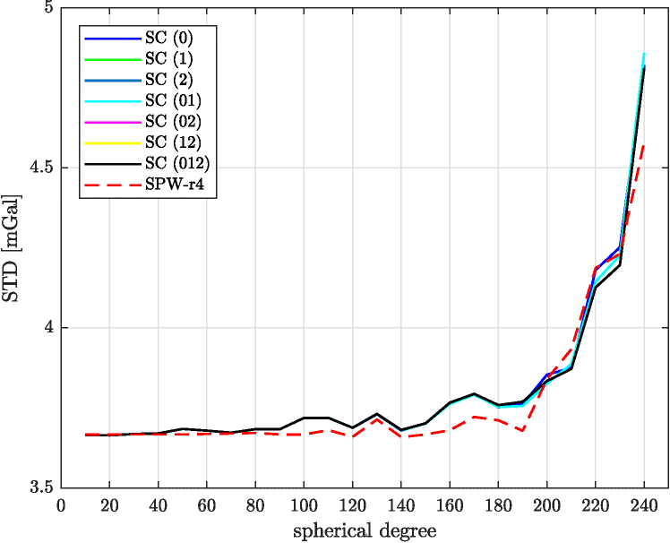
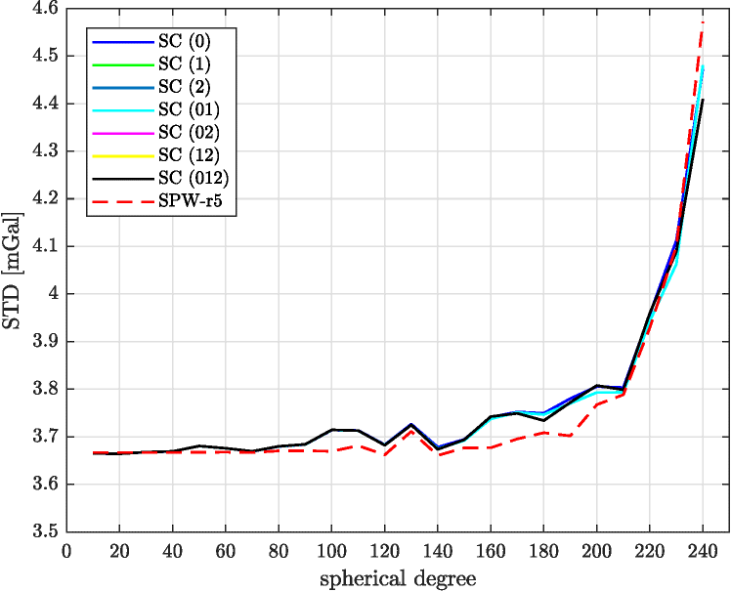
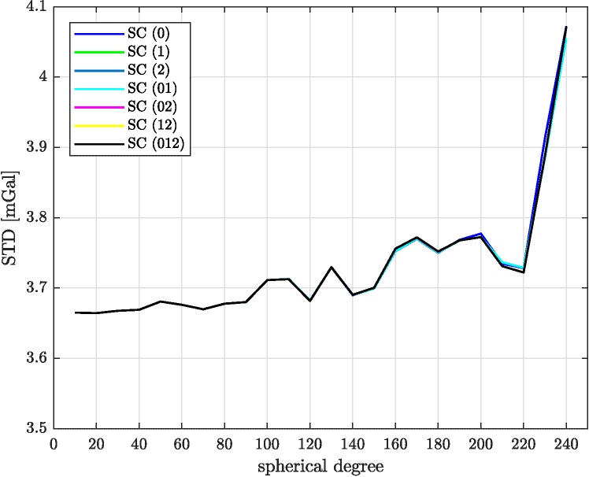
Results: area of Czechoslovakia (height anomalies [cm]/gravity disturbances [mGal])
Pitoňák et al.
Validation of GOCE-based gravitational gradients grids by spectral combination method
15/21

Slide 17
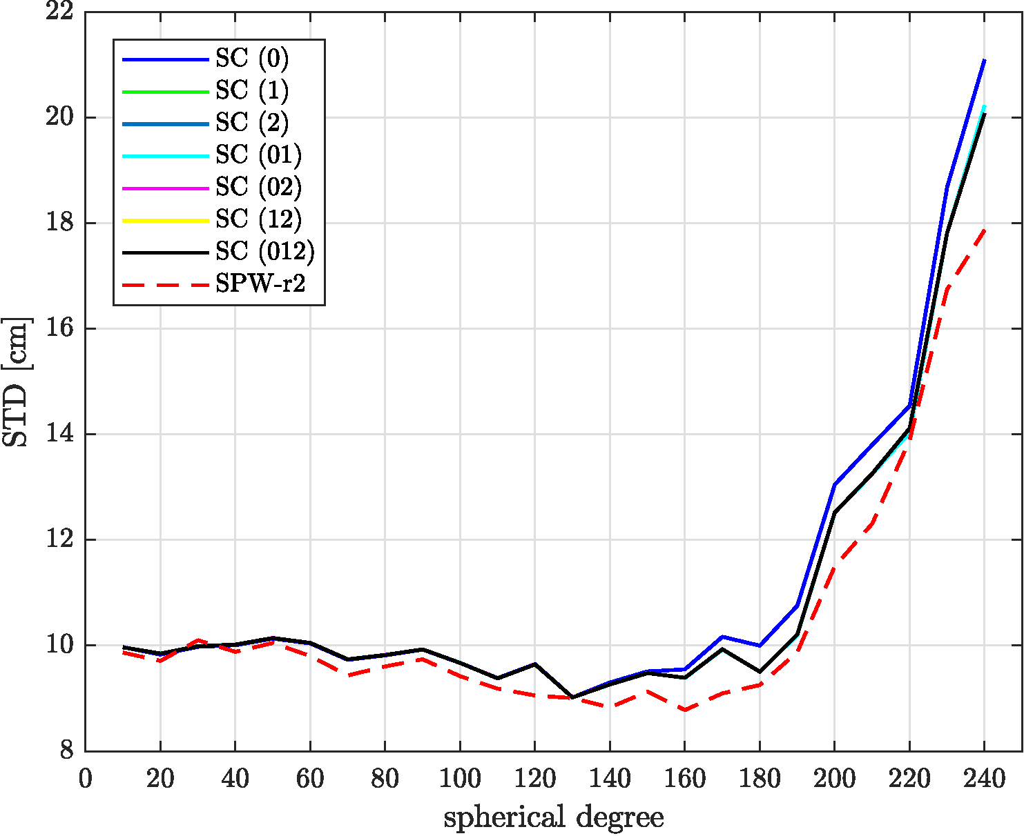
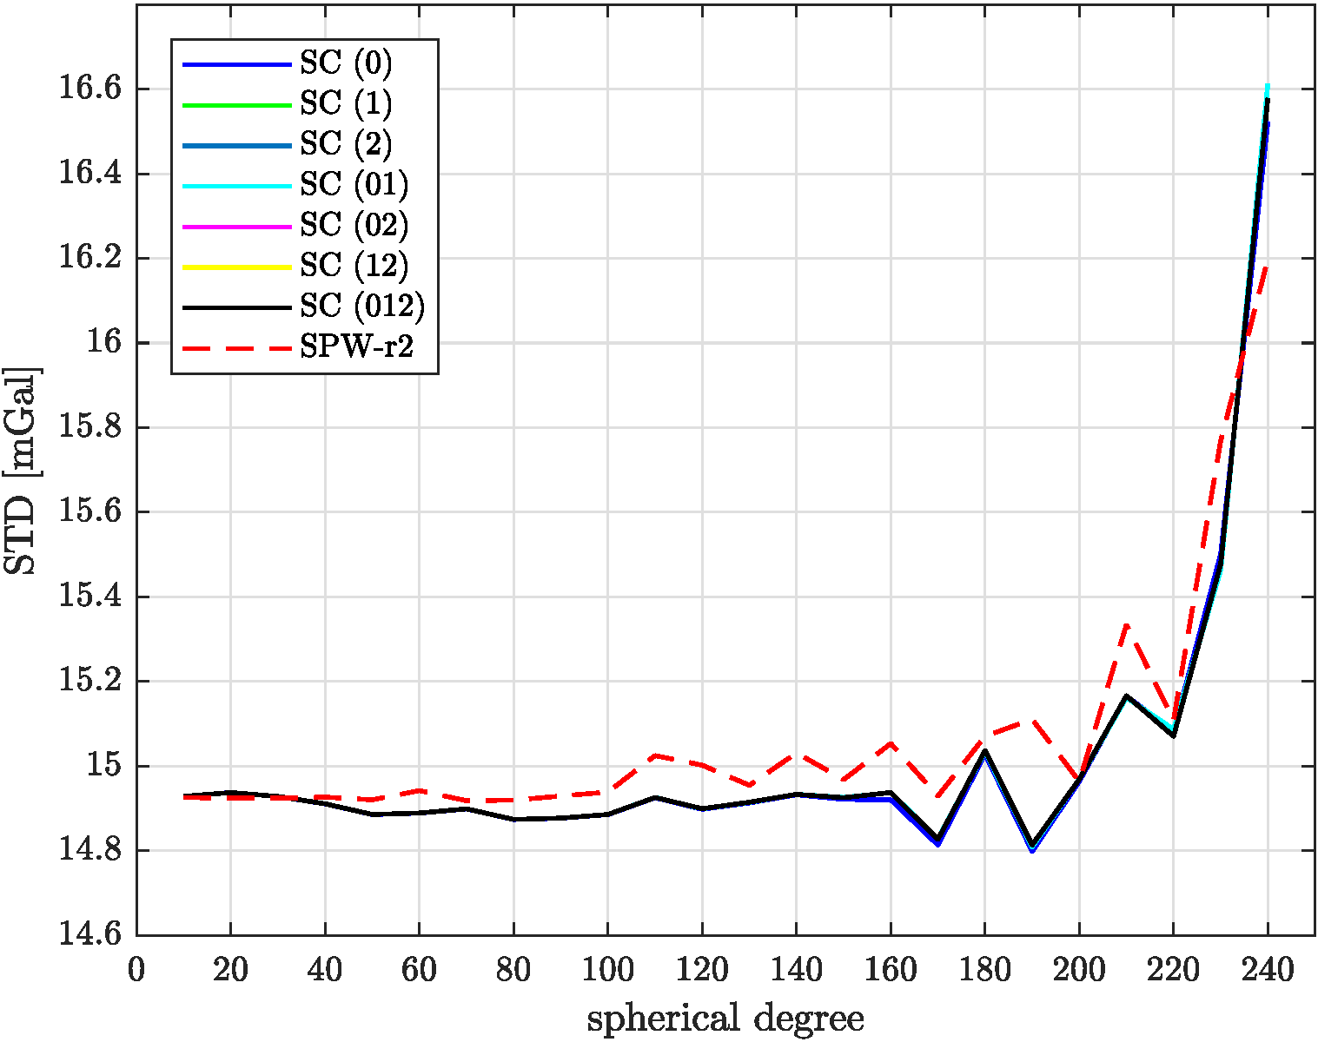
Results: Norway(height anomalies [cm]/gravity disturbances [mGal]) – release 2
Scenario 1:
N_{max} = 240
 | VV | VH | HH | (VV,VH) | (VV,HH) | (VH,HH) | (VV,VH,HH)
std | 21.0/28.7 | 20.1/28.8 | 20.0/28.8 | 20.1/28.8 | 20.0/28.8 | 20.0/28.8 | 20.0/28.8
max | -75.9/45.6 | -80.6/45.7 | -80.6/45.5 | -80.6/45.7 | -80.6/45.5 | -80.6/45.5 | -80.6/45.5
min | -231.0/-124.4 | -224.7/-124.7 | -224.3/-124.8 | -224.7/-124.7 | -224.3/-124.8 | -224.3/-124.8 | -224.3/-124.8
mean | -159.8/-17.5 | -159.5/-17.3 | -159.4/-17.3 | -159.5/-17.3 | -159.4/-17.3 | -159.4/-17.3 | -159.4/-17.3
Scenario 3:
 | VV | VH | HH | (VV,VH) | (VV,HH) | (VH,HH) | (VV,VH,HH)
std | 21.1/16.5 | 20.2/16.6 | 20.1/16.6 | 20.2/16.6 | 20.1/16.6 | 20.1/16.6 | 20.1/16.6
max | -74.4/48.0 | -79.1/48.4 | -79.1/48.0 | -79.1/48.4 | -79.1/48.0 | -79.1/48.0 | -79.1/48.0
min | -229.6/-31.8 | -223.2/-33.2 | -222.9/-33.4 | -223.2/-33.2 | -222.9/-33.4 | -222.9/-33.4 | -222.9/-33.4
mean | -160.1/4.9 | -159.8/5.1 | -159.7/5.1 | -159.8/5.1 | -159.7/5.1 | -159.7/5.1 | -159.7/5.1
Pitoňák et al.
Validation of GOCE-based gravitational gradients grids by spectral combination method
16/21

Slide 18
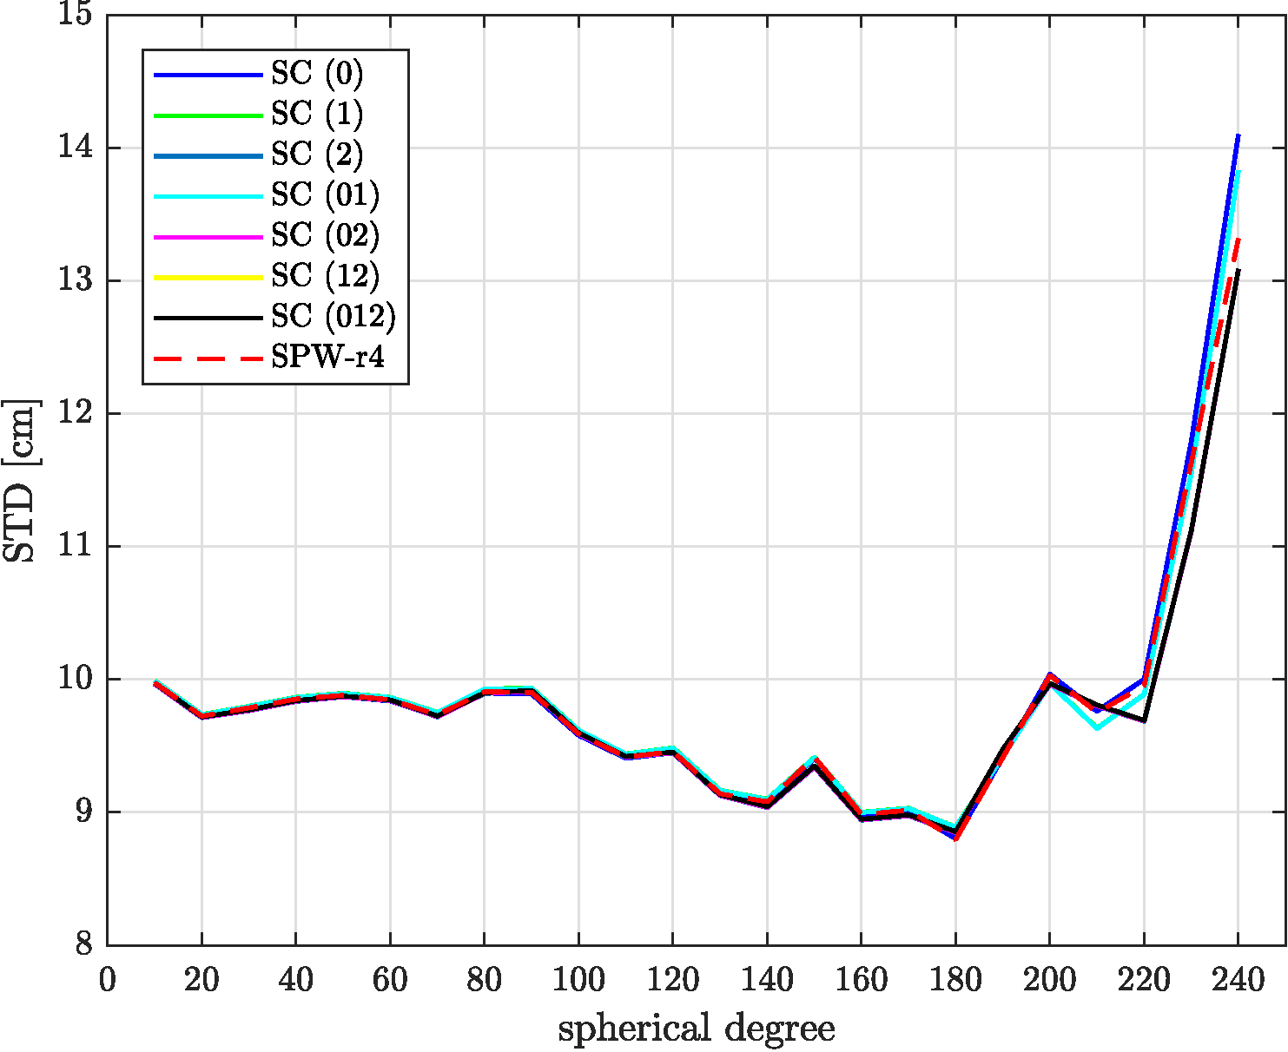

Results: Norway(height anomalies [cm]/gravity disturbances [mGal]) – release 4
Scenario 1:
N_{max} = 240
 | VV | VH | HH | (VV,VH) | (VV,HH) | (VH,HH) | (VV,VH,HH)
std | 13.9/28.4 | 13.7/28.4 | 12.9/28.3 | 13.7/28.4 | 12.9/28.3 | 12.9/28.3 | 12.9/28.3
max | -109.0/46.2 | -111.8/46.7 | -115.2/45.0 | -111.7/46.7 | -115.3/45.0 | -115.1/45.0 | -115.1/45.0
min | -200.2/-127.6 | -205.1/-125.6 | -204.8/-126.3 | -205.1/-125.6 | -204.9/-126.3 | -204.7/-126.3 | -204.7/-126.3
mean | -158.7/-17.0 | -159.1/-17.0 | -159.3/-16.8 | -159.1/-16.9 | -159.4/-16.8 | -159.2/-16.8 | -159.2/-16.8
Scenario 3:
 | VV | VH | HH | (VV,VH) | (VV,HH) | (VH,HH) | (VV,VH,HH)
std | 14.1/16.1 | 13.8/16.3 | 13.1/16.1 | 13.8/16.3 | 13.1/16.1 | 13.1/16.1 | 13.1/16.1
max | -112.5/50.3 | -112.3/51.2 | -114.2/52.4 | -112.3/51.2 | -114.2/52.4 | -114.1/52.4 | -114.1/52.4
min | -202.6/-28.0 | -208.4/-28.8 | -208.1/-26.6 | -208.4/-28.8 | -208.2/-26.6 | -208.0/-26.6 | -208.0/-26.6
mean | -159.0/5.4 | -159.4/5.5 | -159.6/5.6 | -159.4/5.5 | -159.7/5.6 | -159.5/5.6 | -159.5/5.6
Pitoňák et al.
Validation of GOCE-based gravitational gradients grids by spectral combination method
17/21

Slide 19


Results: Norway(height anomalies [cm]/gravity disturbances [mGal]) – release 5
Scenario 1:
N_{max} = 240
 | VV | VH | HH | (VV,VH) | (VV,HH) | (VH,HH) | (VV,VH,HH)
std | 11.3/28.2 | 10.8/28.3 | 11.1/28.4 | 10.8/28.3 | 11.1/28.4 | 11.1/28.4 | 11.1/28.4
max | -125.0/45.0 | -127.0/45.8 | -125.8/45.1 | -127.0/45.8 | -125.8/45.1 | -126.0/45.1 | -126.0/45.1
min | -191.2/-122.7 | -190.0/-123.4 | -190.1/-123.8 | -190.0/-123.4 | -190.2/-123.8 | -190.3/-123.8 | -190.3/-123.8
mean | -159.0/-16.8 | -159.2/-16.8 | -158.8/-16.7 | -159.2/-16.8 | -158.9/-16.7 | -159.0/-16.7 | -159.0/-16.7
Scenario 3:
 | VV | VH | HH | (VV,VH) | (VV,HH) | (VH,HH) | (VV,VH,HH)
std | 11.5/15.8 | 11.0/15.7 | 11.3/15.8 | 11.0/15.7 | 11.3/15.8 | 11.3/15.8 | 11.3/15.8
max | -123.6/51.0 | -126.0/50.7 | -124.5/51.0 | -126.0/50.7 | -124.5/50.9 | -124.6/50.9 | -124.6/50.9
min | -191.5/-27.8 | -189.9/-27.3 | -189.6/-27.6 | -190.0/-27.3 | -189.6/-27.6 | -189.8/-27.6 | -189.8/-27.6
mean | -159.3/5.6 | -159.5/5.6 | -159.2/5.7 | -159.5/5.6 | -159.2/5.7 | -159.3/5.7 | -159.3/5.7
Pitoňák et al.
Validation of GOCE-based gravitational gradients grids by spectral combination method
18/21

Slide 20


Results: Norway(height anomalies [cm]/gravity disturbances [mGal]) – release 6
Scenario 1:
N_{max} = 240
 | VV | VH | HH | (VV,VH) | (VV,HH) | (VH,HH) | (VV,VH,HH)
std | 9.3/28.1 | 9.3/28.2 | 9.4/28.2 | 9.3/28.2 | 9.4/28.2 | 9.4/28.2 | 9.4/28.2
max | -120.1/45.7 | -120.3/45.7 | -120.1/45.7 | -120.3/45.7 | -120.1/45.7 | -120.1/45.7 | -120.1/45.7
min | -184.3/-124.3 | -184.0/-124.5 | -183.5/-124.4 | -184.0/-124.5 | -183.5/-124.4 | -183.5/-124.4 | -183.5/-124.4
mean | -154.8/-16.6 | -154.8/-16.6 | -154.9/-16.6 | -154.8/-16.6 | -154.9/-16.6 | -154.9/-16.6 | -154.9/-16.6
Scenario 3:
 | VV | VH | HH | (VV,VH) | (VV,HH) | (VH,HH) | (VV,VH,HH)
std | 9.6/15.4 | 9.6/15.4 | 9.6/15.4 | 9.6/15.4 | 9.6/15.4 | 9.6/15.4 | 9.6/15.4
max | -119.2/54.0 | -119.4/54.1 | -119.2/54.0 | -119.4/54.1 | -119.2/54.0 | -119.2/54.0 | -119.2/54.0
min | -187.6/-26.9 | -187.3/-26.8 | -186.8/-27.1 | -187.3/-26.8 | -186.8/-27.1 | -186.8/-27.1 | -186.8/-27.1
mean | -155.1/5.8 | -155.1/5.8 | -155.2/5.8 | -155.1/5.8 | -155.2/5.8 | -155.2/5.8 | -155.2/5.8
Pitoňák et al.
Validation of GOCE-based gravitational gradients grids by spectral combination method
19/21

Slide 21
Conclusions:
the method for validation of the official GOCE Level 2 SPW_GRD_2_ has been presented and tested,
there are not significant differences between global geopotential models calculated by space-wise approach and their grids counterparts,
- models dV_ELL_Earth2014_5480 and ERTM2160 do not represent the omission error as accurate
as RTC based on forward modelling in spatial domain,
- the reprocessed version of the official GOCE Level 2 SPW_GRD_2_r6 is about 10% more accurate
comparing to SPW_GRD_2_r5
Pitoňák et al.
Validation of GOCE-based gravitational gradients grids by spectral combination method
20/21

Slide 22
Thank you for your attention
pitonakm@ntis.zcu.cz
Acknowledgment: We thank the Geodetic and Cartographic Institute in Bratislava and Czech Office for Surveying, Mapping and Cadastre in Prague for providing the gravity data sets. Martin Pitoňák, Michal Šprlák and Pavel Novák were supported by the project No. 21-13713S of the Czech Science Foundation.
Pitoňák et al.
Validation of GOCE-based gravitational gradients grids by spectral combination method
21/21

