Slide 1
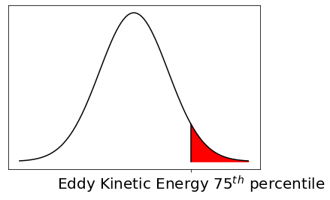
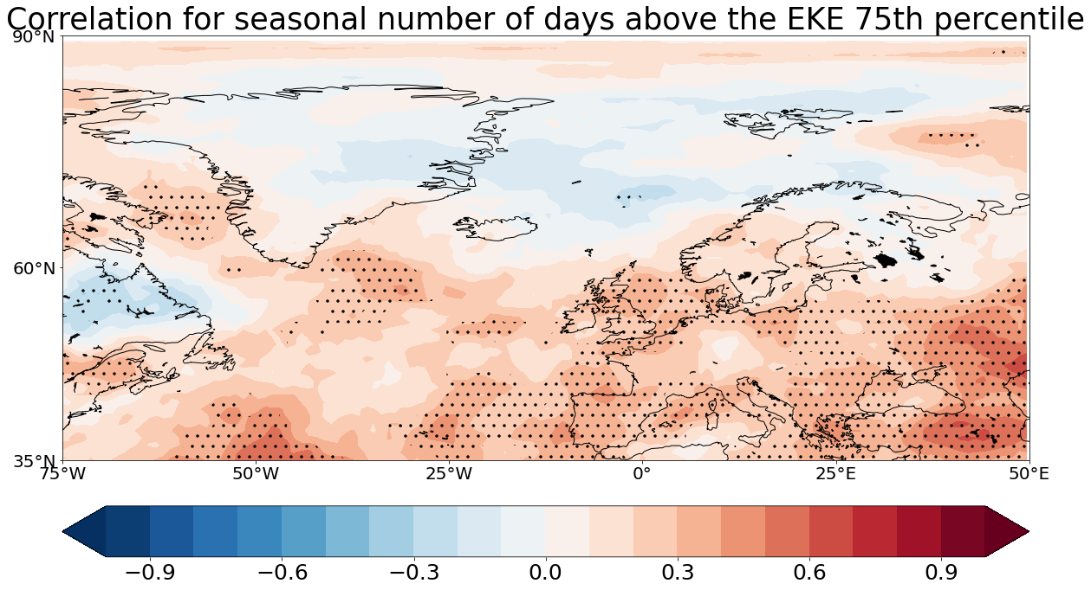
Seasonal Predictability of Wintertime mid-latitude Cyclonic Activity over the North Atlantic and Europe
EGU21-11134
Alvise Aranyossy^{1,2}, Sebastian Brune², Lara Hellmich^{3,4}, and Johanna Baehr²
alvise.aranyossy@uni-hohenheim.de
Spatial Autocorrelation of EKE for different jet stream positions
ERA5
MPI-ESM-HR
Significant High Values
Significant Low Values
Can these connections between Eddy Kinetic Energy and jet stream be used to improve seasonal prediction skill?
¹Faculty of Natural Sciences, Universität Hohenheim, Stuttgart, Germany
²Institute of Oceanography, CEN, Universität Hamburg, Hamburg, Germany
³Max Planck Institute for Meteorology, Hamburg, Germany
⁴International Max Planck Research School on Earth System Modelling, Hamburg, Germany

Slide 2
1. The EKE 75th percentile
The upper part of the Eddy Kinetic Energy distribution is observed. In this way, only the most relevant events are taken into account.
The distribution of every grid-cell is taken, and for each the 75th percentile is calculated. All the days in that grid-cell that present a value exceeding this threshold are then taken and used for the analysis.

Slide 3
2. EKE and the large-scale climate: the NAO
Strong correlation between positive phases of the NAO and Eddy Kinetic Energy activity in the northern northern portion of the North Atlantic.
A negative phase is instead related to a more equatorward high activity.

Slide 4
3. Seasonal Predictability: the subsampling
The ensembles in MPI-ESM have been selected based on the two most common seasonal jet stream positions. The method have been tested both from the jet stream positions from the observations and from MPI-ESM itself.
Correlation for seasonal number of days above the EKE 75th percentile

