Slide 1
Crustal architecture of Amsterdam-St. Paul Island from an integrated geophysical approach
Pankaj Kumar, Pratyush Anand, Dibakar Ghosal, and Pabitra Singha
Indian Institute of Technology Kanpur, Earth Sciences, Kanpur, India
EGU General Assembly 2021
Abstract : EGU21-11155|ECS

Slide 2
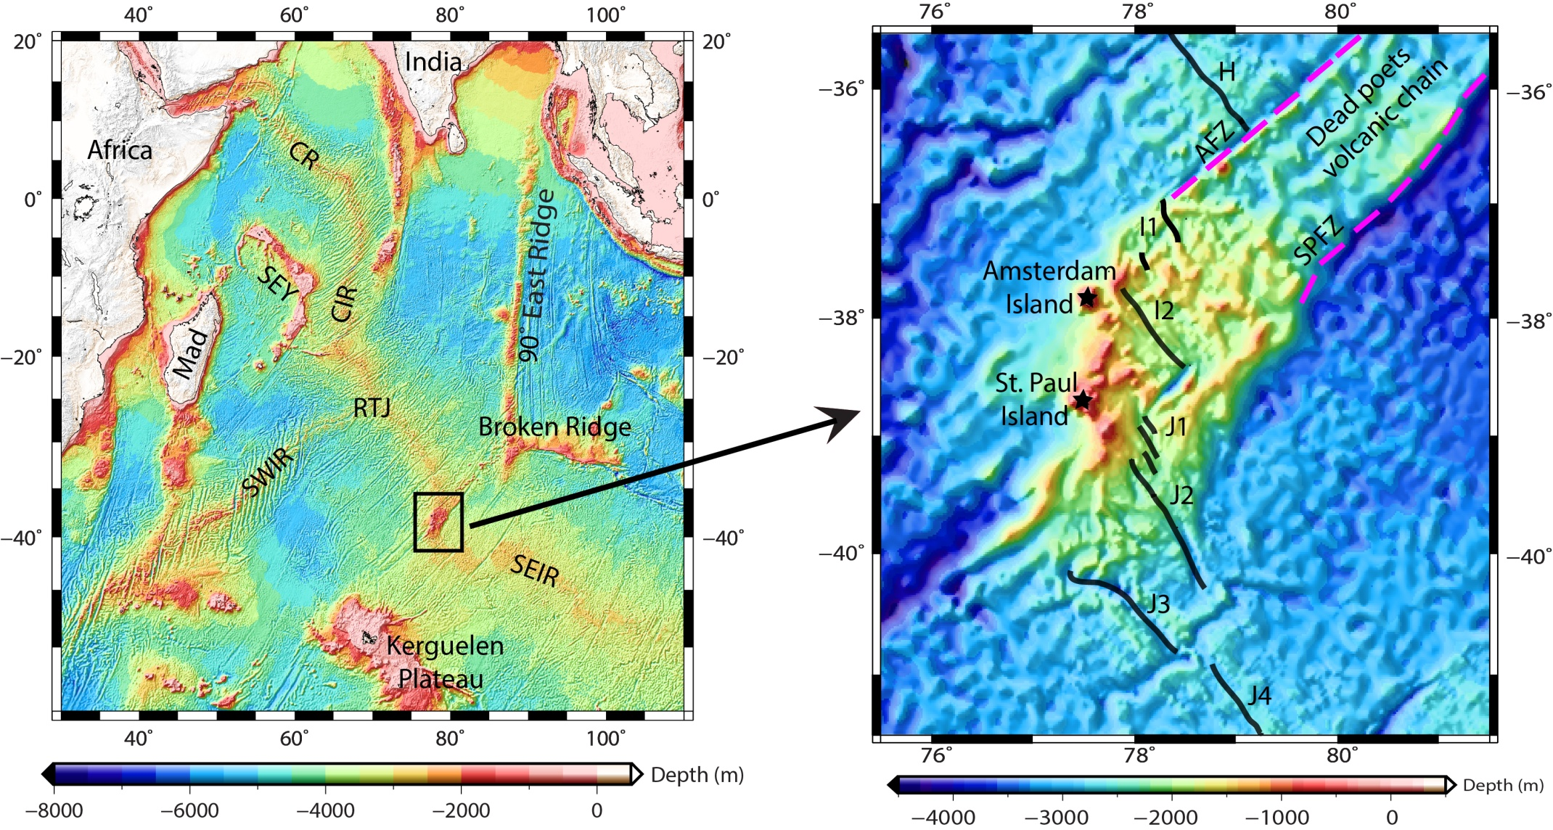
Study area

Slide 3
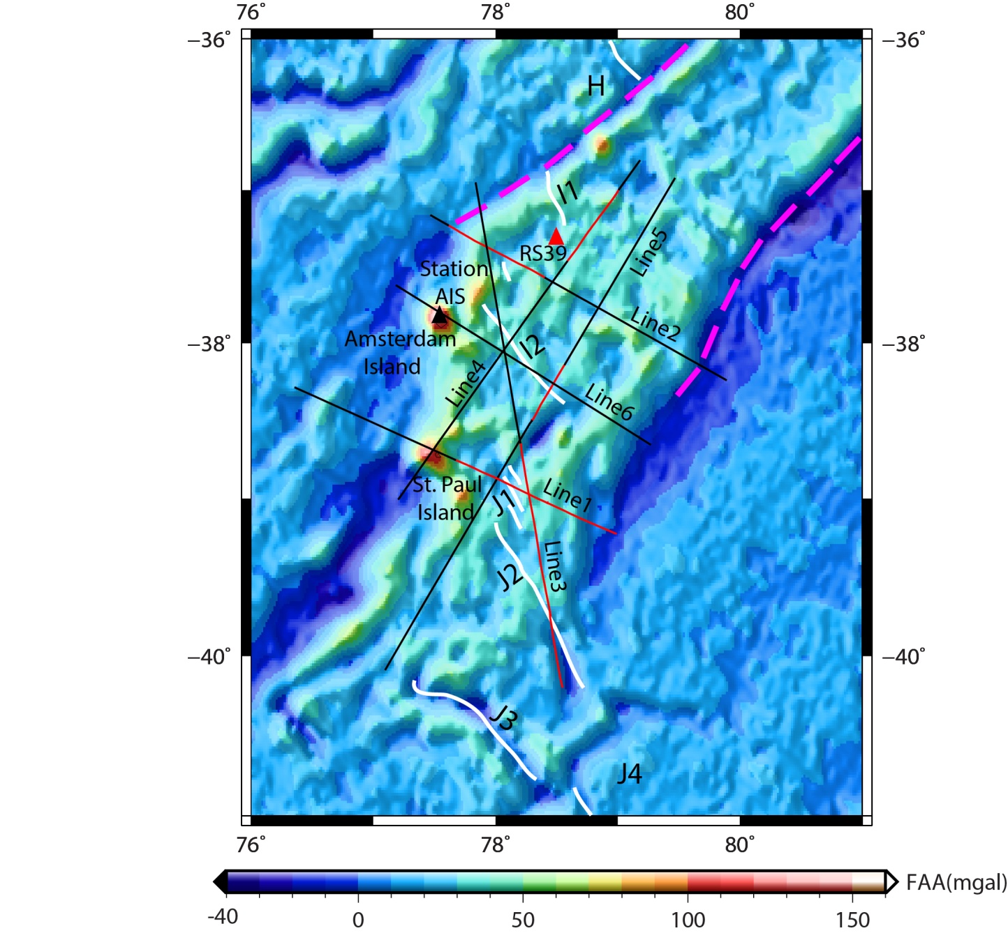
Integrated GM modeling along selected profiles are performed to find the crustal structure below the ASP plateau.
Methodology

Slide 4
Crustal model along line 3 over the ASP plateau

Slide 5
Results
Lava flow has carpeted the entire ASP plateau causing high magnetic anomaly of -1000 to 1500 nT.
The crust beneath the plateau is suggested to be highly affected by volcanic activity and is underlain by high-density underplated material.
Magmatic intrusions of normal as well as reverse polarity are interpreted in the crust of ASP plateau.
Moho varies from ~12-17 km beneath the plateau.

Slide 6
Thank You

