Slide 1
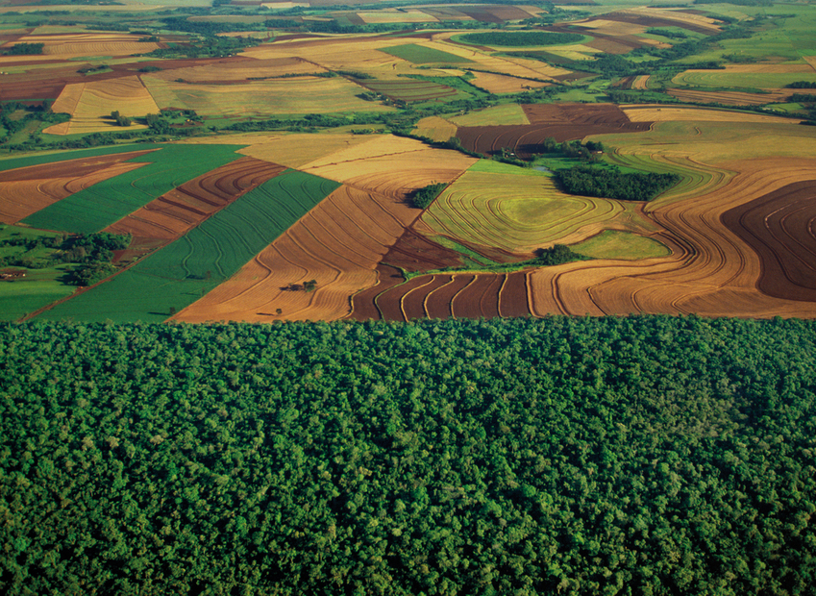


Assessing the effects of climate and land use land cover changes on recent carbon storage in terrestrial ecosystem using model-satellite approach over Wallonia, Belgium
Arpita Verma¹, Louis Francois¹, Ingrid Jacquemin¹², Merja Tölle³, Huan Zhang³, Benjamin lanssens¹
¹University of Liege, Department of Astrophysics, Geophysics and Oceanography, Belgium, (arpita.verma@student.uliege.be)
²University of Liege, Department of Environmental Sciences and Management, Belgium
³Center for Environmental Systems Research, University of Kassel, Germany
EGU VIRTUAL GENERAL ASSEMBLY 2021, Session, Online, 29th aApril, 2020

Slide 2
OBJETIVE
Assessing and quantifying the sensitivity of terrestrial carbon sequestration due to change in land use and climate variables using a dynamic vegetation model at high resolution (1 km)

Slide 3
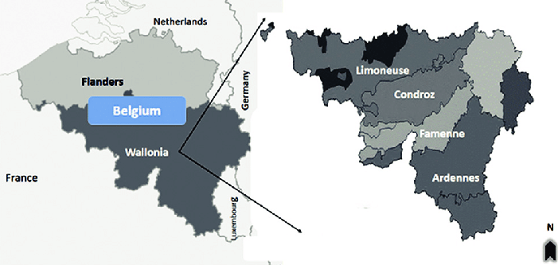
Study Area

Slide 4
Datasets
Climate data – COSMO-CLM
COSMO-CLM Version 5.16
Spatial Resolution-3 km x 3 km interpolated at 1 km2
Time Period 1980-2019
Satellite Based datasets
Data Set Product Temporal Domain Spatial Res. Temporal Res
Landsat 5 1984-2012 30 meter 16 days
Landsat 7 1999-present 30 meter 16 days
Landsat 8 2013-Present 30 meter 16 days

Slide 5








Satellite Data (1985-2019)
Landsat 5,Landsat 7 and Landsat 8 (LAND USE)
Methodology
Input
Dynamic Vegetation Model
CARAIB
Input
Climate Data COMOS-CLM
Over 1km Grid (Precipitation, Air Temperature, Wind Speed, Relative Humidity, Solar Radiation)

Slide 6
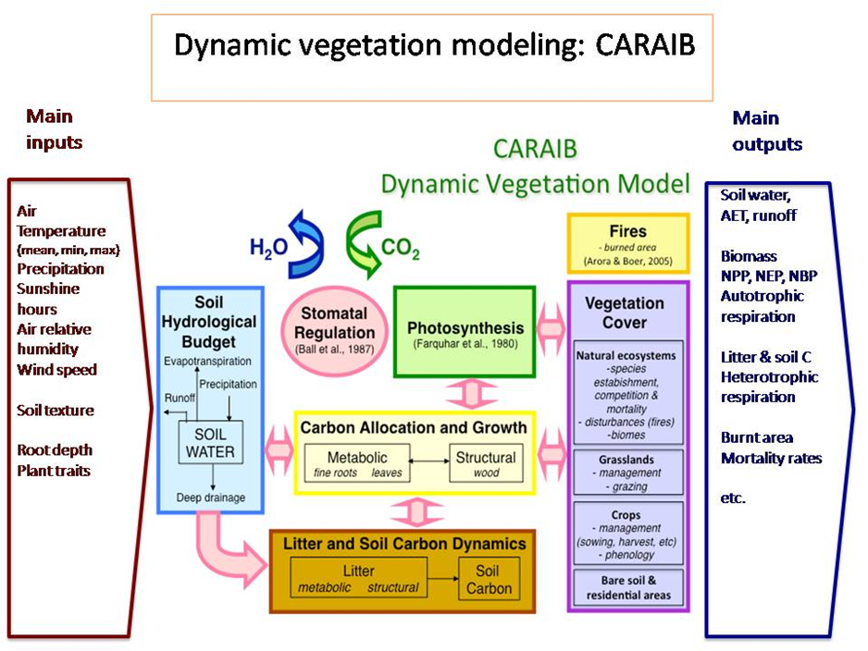

Slide 7
Results and Analysis
Land Use Change 1985-2019
Area (km²)

Slide 8
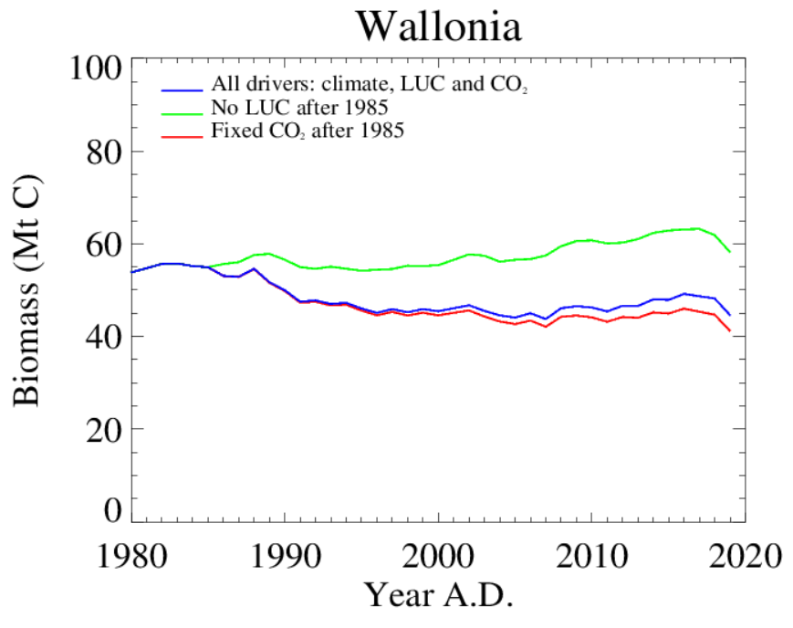
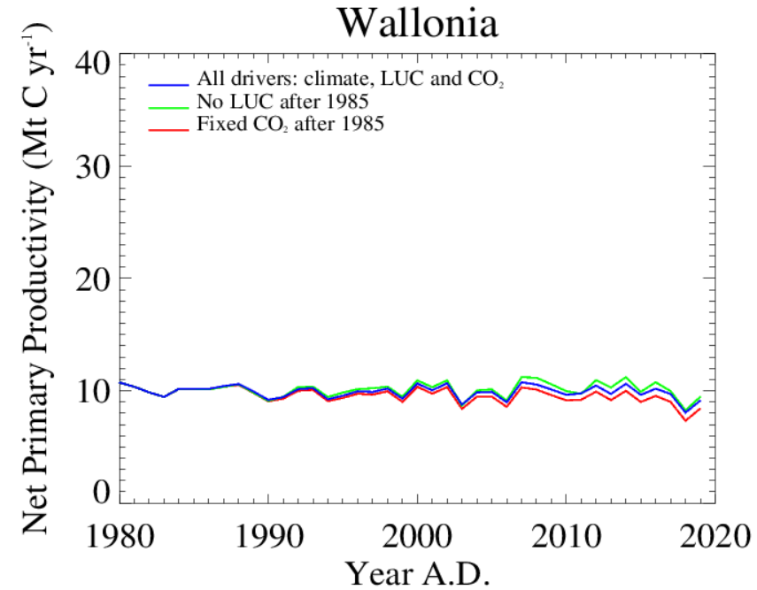
Biomass & NPP with dynamic and fixed (Land use,CO₂ and climate)

Slide 9
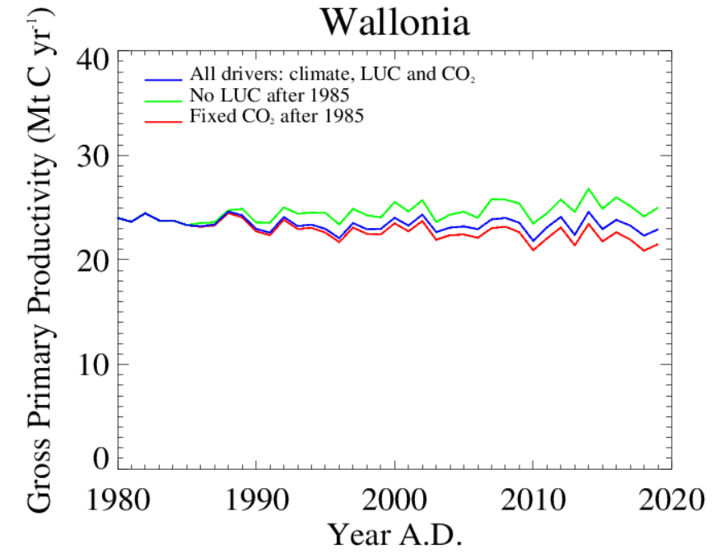
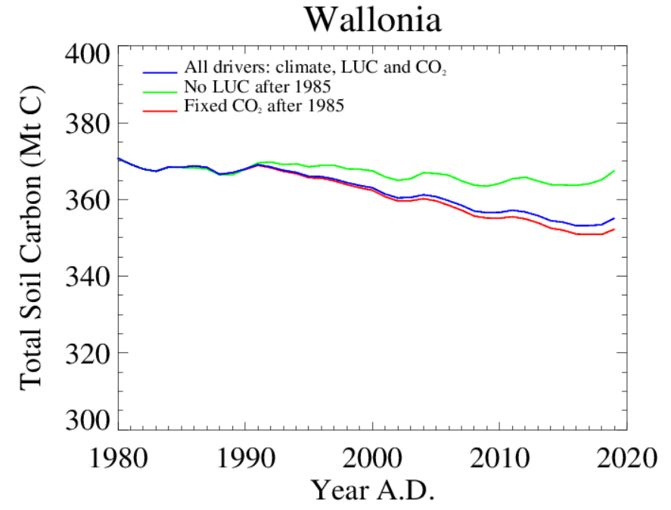
Change in GPP and total soil carbon with change in land use

Slide 10
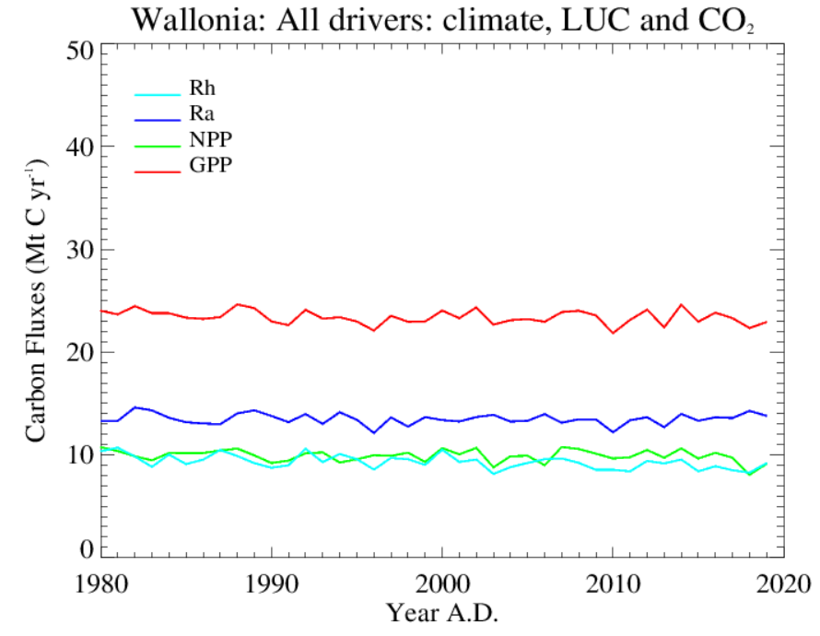
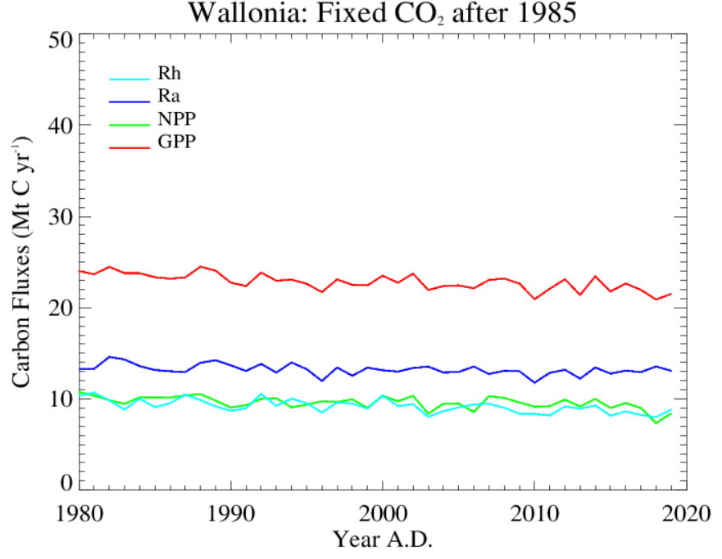
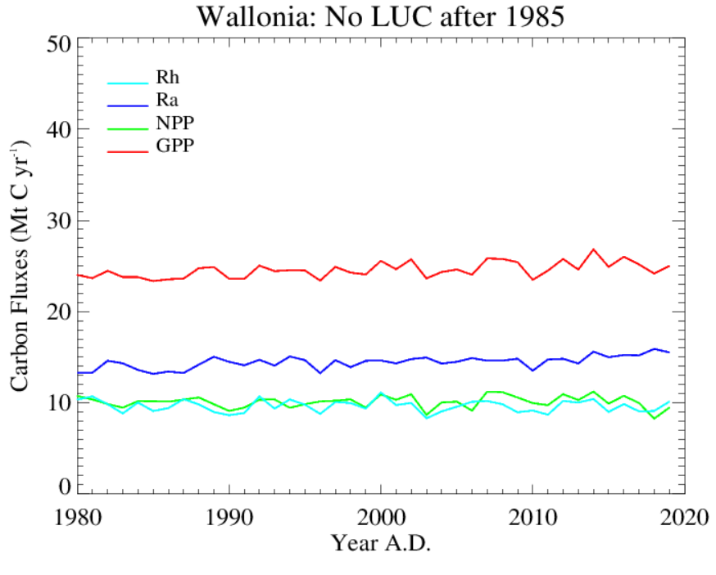
Change in Carbon fluxes with change in land use and constant CO₂

Slide 11
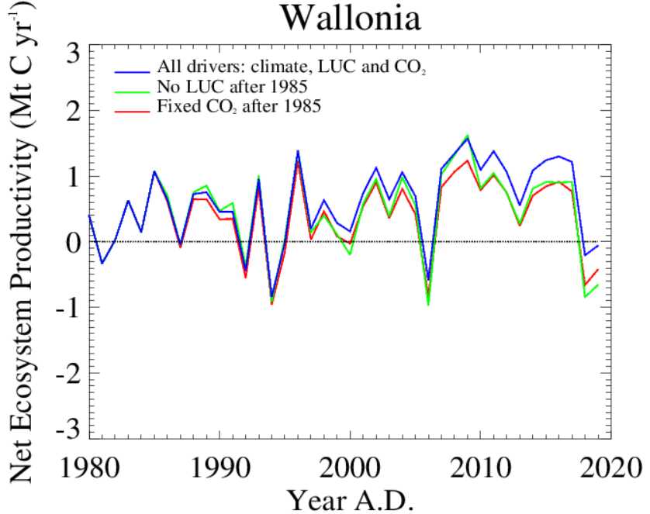
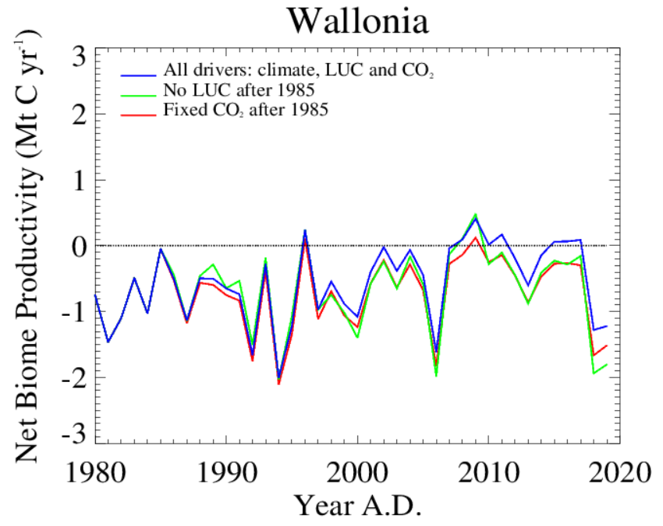
Change in NPP and NBP with change in land use , climate and fixed CO₂

Slide 12
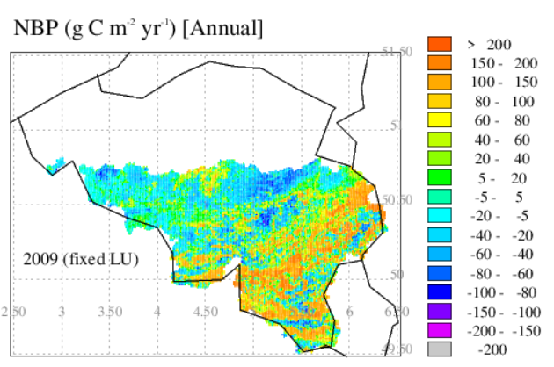
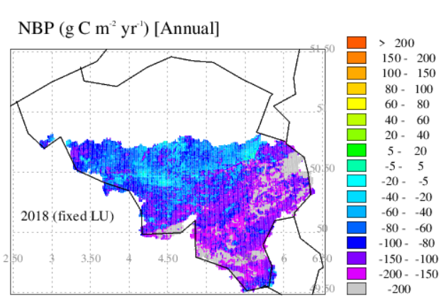
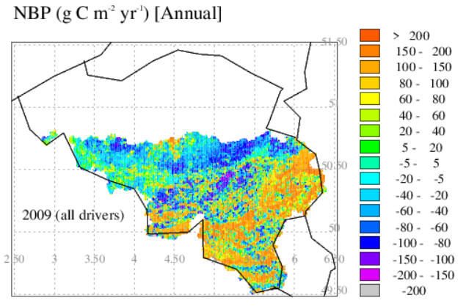
Impact of extreme events on NBP

Slide 13

CONCLUSION
There is strong change in the biomass from fixed to dynamic land use
Increase in urban land may impact the decrease in soil carbon because of less litter production
There is only small impact of CO₂ fertilization
According to this study we can say that the dynamic land use is more important for the carbon budget than CO₂ fertilization
Heat waves and droughts may also impact the total carbon budget
Acknowledgement
This project is funded by Wallonia-Brussels Federation under FRIA-FNRS

Slide 14

THANK YOU

