Slide 1
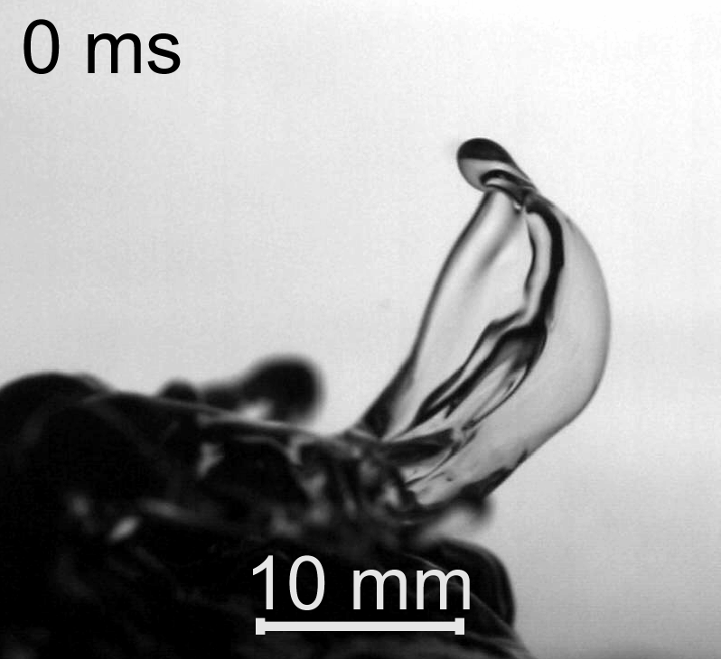
Explosive interaction of gravity-capillary triads as the initial stage of “bag-breakup” droplet generation mechanism at high winds
Dmitry S. Kozlov and Yulia I. Troitskaya,
Institute of Applied Physics RAS,
Russia, Nizhny Novgorod

Slide 2
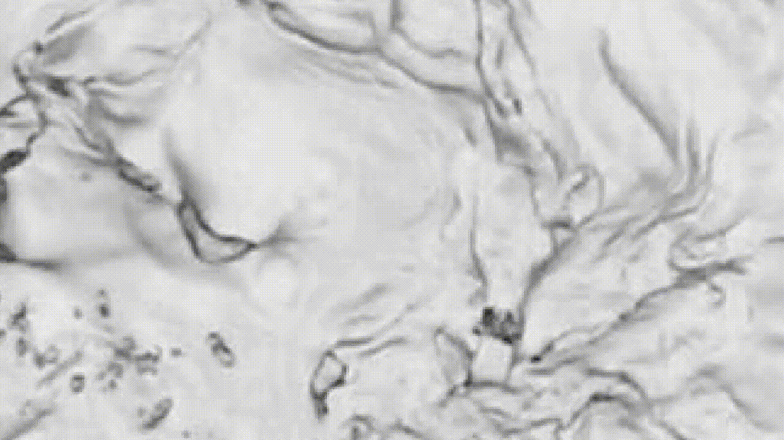
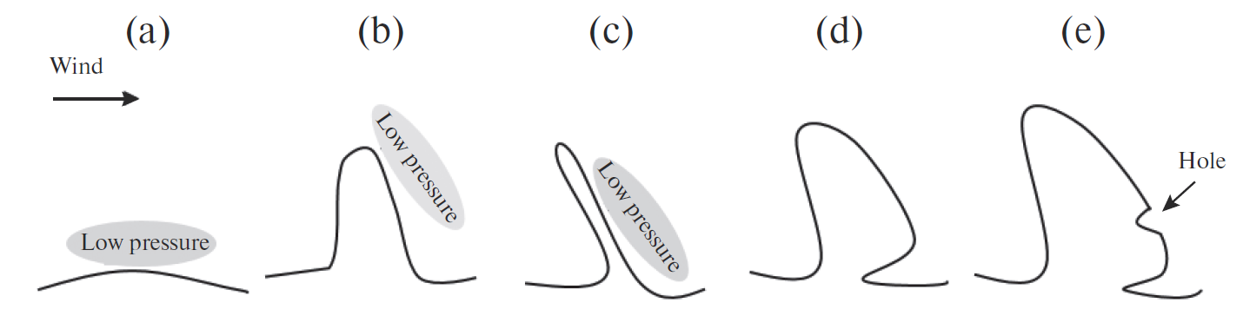

The “bag-breakup” fragmentation event
(top view)
$$U_{10}=26.7 m/s$$
Scheme of the formation the bag. (a) Formation of the initial perturbation, (b) its further growth, (c) perturbation deformation and formation of the sail, (d) formation of a «sail», and (e) beginning of the rupture.

Slide 3













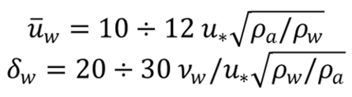

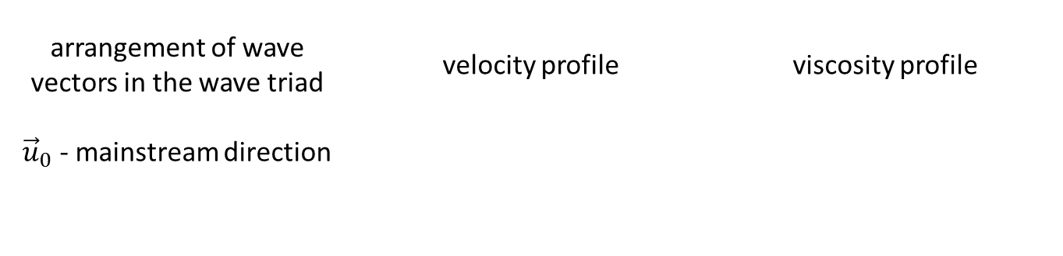
Nonlinear resonant interaction of three
gravitational-capillary waves
air
water
arrangement of wave vectors in the wave triad | velocity profile | viscosity profile
${\vec{u}}_{0}$ - mainstream direction

Slide 4
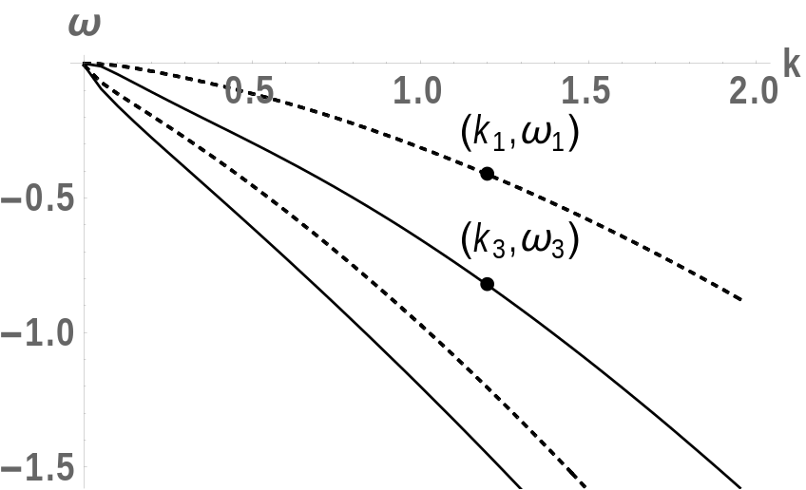
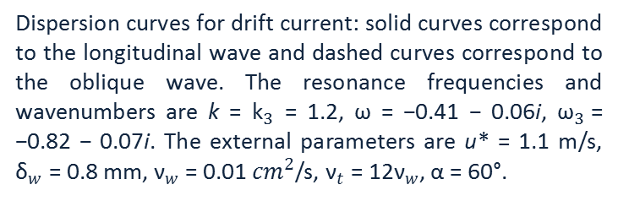
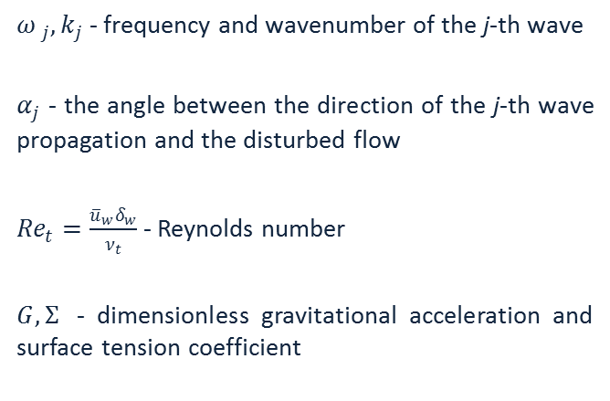
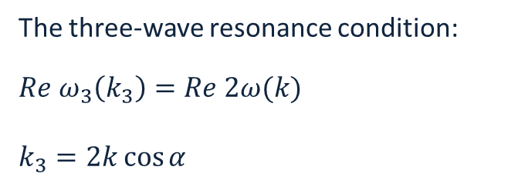
Linear dispersion relation for wave perturbations
for drift current
${ω }_{j},k_{j}$ - frequency and wavenumber of the j-th wave
$α_{j}$ - the angle between the direction of the j-th wave propagation and the disturbed flow
${Re}_{t}=\frac{{\overline{u}}_{w}δ_{w}}{ν_{t}}$ - Reynolds number
$G, Σ$ - dimensionless gravitational acceleration and surface tension coefficient
The three-wave resonance condition:
$$Re ω_{3}\left(k_{3}\right)=Re 2ω(k)$$
$$k_{3}=2k\cos{α}$$
Dispersion curves for drift current: solid curves correspond to the longitudinal wave and dashed curves correspond to the oblique wave. The resonance frequencies and wavenumbers are k = ${\text{k}}_{3}$ = 1.2, ω = −0.41 − 0.06i, ${\text{ω}}_{3}$= −0.82 − 0.07i. The external parameters are u* = 1.1 m/s, ${\text{δ}}_{w}$ = 0.8 mm, ${\text{ν}}_{w}$ = 0.01 ${cm}^{2}$/s, ${\text{ν}}_{t}$ = 12${\text{ν}}_{w}$, α = 60°.
Notes:
переход

Slide 5
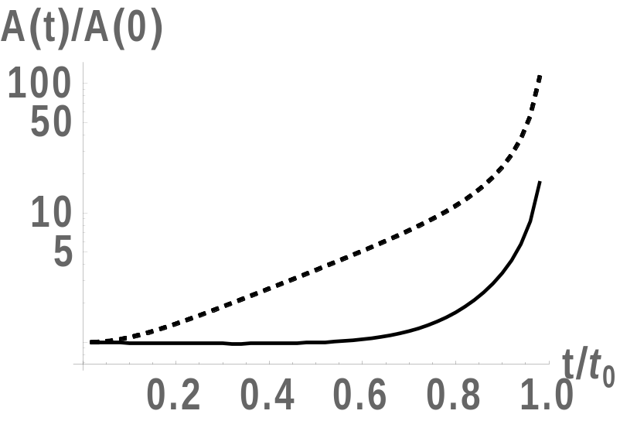
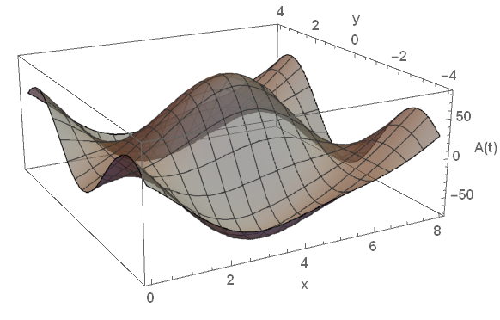
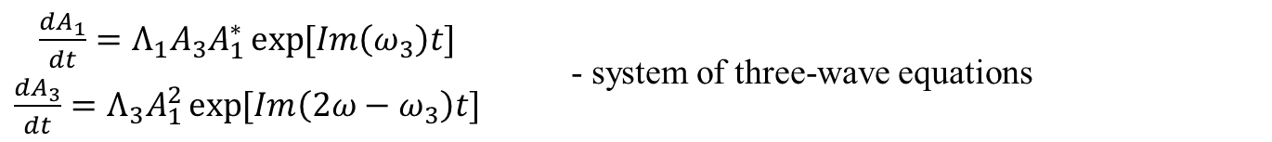
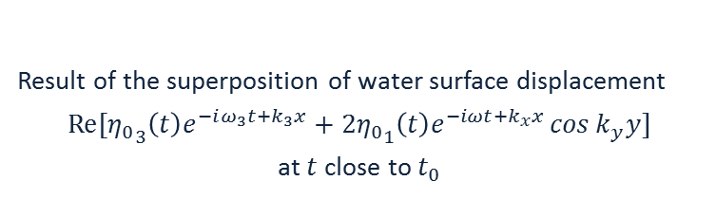
Explosive three-wave interaction
$\begin{matrix}\frac{dA_{1}}{dt}=Λ_{1}A_{3}A_{1}^{∗}\exp{[Im\left(ω_{3}\right)t]} \\ \frac{dA_{3}}{dt}=Λ_{3}A_{1}^{2}\exp{[Im\left(2ω−ω_{3}\right)t]}\end{matrix}$ - system of three-wave equations
Result of the superposition of water surface displacement
$Re[{η_{0}}_{3}\left(t\right)e^{−iω_{3}t+k_{3}x}+2{η_{0}}_{1}\left(t\right)e^{−iωt+k_{x}x}\cos{k_{y}y}]$
at $t$ close to $t_{0}$
Characteristic dependence of perturbation amplitudes
on time. The solid line corresponds to the amplitude
of the longitudinal wave; the dashed line corresponds to
the amplitude of the oblique wave.

Slide 6
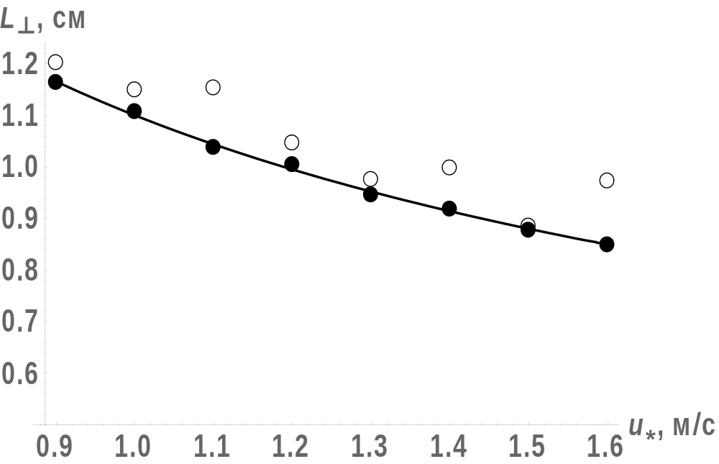
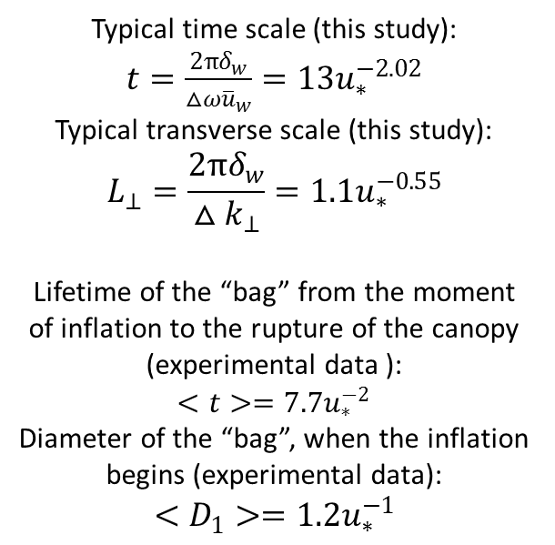
Comparison of the model problem
solution and experimental data
Typical time scale (this study):
$t=\frac{2πδ_{w}}{△ω{\overline{u}}_{w}}=13u_{∗}^{−2.02}$
Typical transverse scale (this study):
$$L_{⊥}=\frac{2πδ_{w}}{△k_{⊥}}=1.1u_{∗}^{−0.55}$$
Lifetime of the “bag” from the moment of inflation to the rupture of the canopy
(experimental data ):
$$<t>=7.7u_{∗}^{−2}$$
Diameter of the “bag”, when the inflation begins (experimental data):
$$<D_{1}>=1.2u_{∗}^{−1}$$
Transverse scale of the “bags": black circles - estimation obtained in this study, line - its approximation, empty circles - experimental data (Troitskaya et al. 2018)
D. S. Kozlova, and Yu. I. Troitskaya. On the role of the explosive interaction of three surface waves at the initial stage of spray generation in strong winds// Izvestiya, Atmospheric and Oceanic Physics, 2021, Vol. 57, No. 2, pp. 180–191

Slide 7
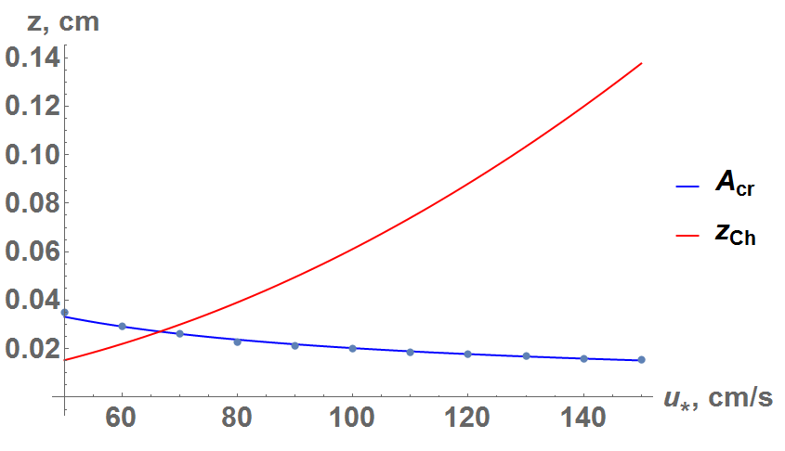
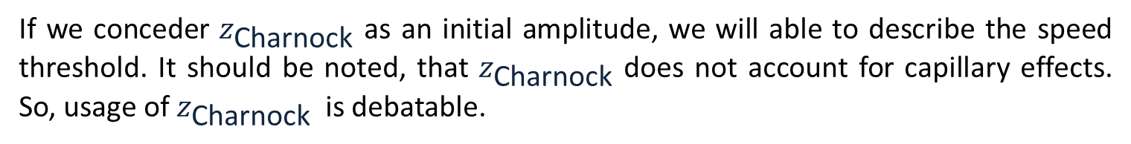
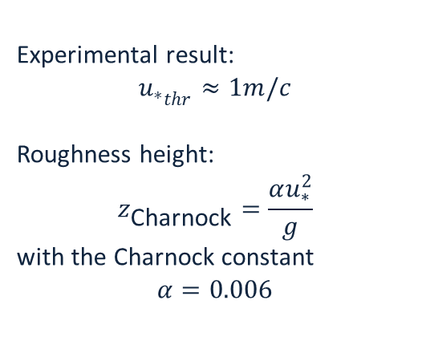
Threshold dependence of the “bag” formation on speed
Experimental result:
$${u_{∗}}_{thr}≈1m/c$$
Roughness height:
$$z_{\text{Charnock}}=\frac{αu_{∗}^{2}}{g}$$
with the Charnock constant
$$α=0.006$$
Dependence of the initial amplitude threshold and roughness height on the friction velocity
If we conceder $z_{\text{Charnock}}$ as an initial amplitude, we will able to describe the speed threshold. It should be noted, that $z_{\text{Charnock}}$ does not account for capillary effects. So, usage of $z_{\text{Charnock}}$ is debatable.

