Slide 1
Applying BEL1D for transient electromagnetic sounding inversion
Arsalan Ahmed¹, Hadrien Michel^{1,2,3}, Wouter Deleersnyder^{1,4}, David Dudal⁴, and Thomas Hermans¹
¹Ghent University, Department of Geology, Ghent, Belgium
²University of Liege, Urban and Environmental Engineering Department, Faculty of Applied Sciences, Liege, Belgium
³F.R.S.-FNRS(Fonds de la Recherche Scientifique), Brussels, Belgium
⁴KU Leuven Campus Kortrijk - Kulak, Department of Physics, Kortrijk, Belgium

Slide 2
Table of content
Objectives
BEL1D
SimPEG
PCA
CCA
Posterior models
Cascade Application/Results
Conclusion
Reference
Appendix

Slide 3
Objectives
Adaptation of BEL1D
Generation of synthetic data set from SimPEG by forward modelling.
Avoiding the classical inversion.
Cascade Application: Varying the Prior every time while keeping the true model remain the same , in order find the uncertainty range of given parameter that can project the true model.
Predicting ‘Model Parameters’ that best fixed with ‘True Model’.

Slide 4
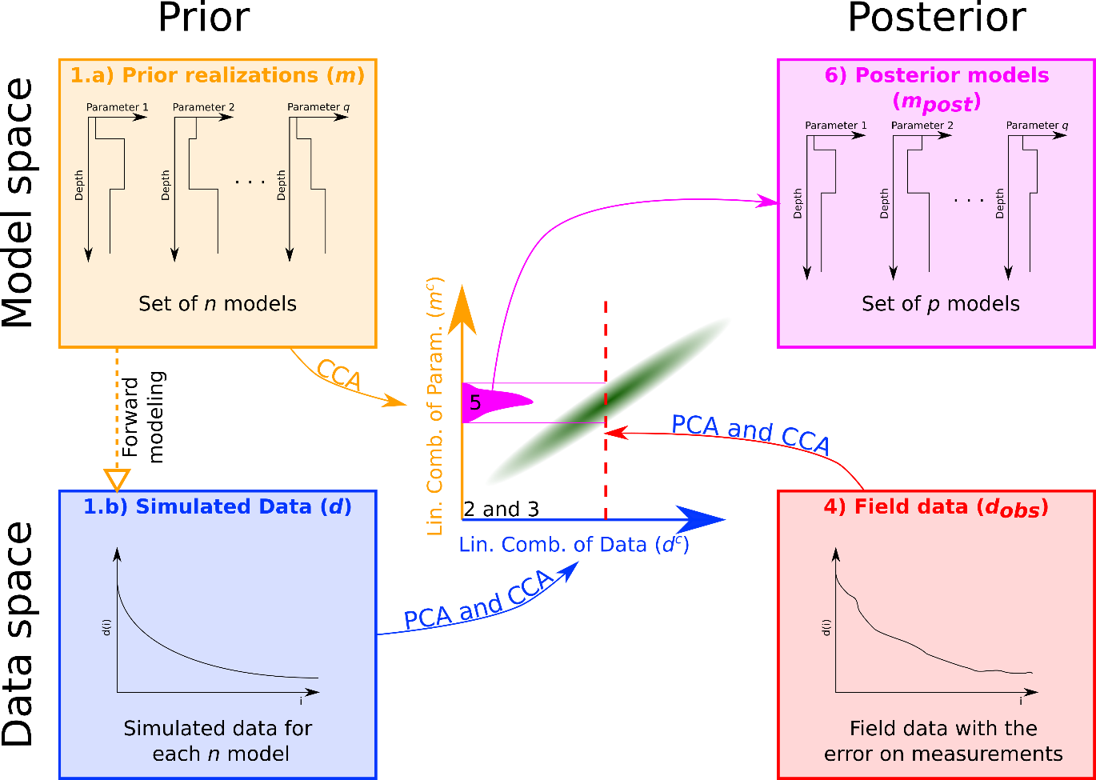
BEL1D
Adaptation of BEL
Schiedt et al., Uncertainty quantification in subsurface system,2018)
Relationship between
- Synthetic models
- Corresponding datasets
Generating posterior from this relationship

Slide 5
Schematic illustration of BEL1D
First step is to create prior realizations : parameters like thickness, conductivity.
Generating data space from given prior model by forward modeling. In SimPEG
For 1000s models →1000s data sets
Principal component analysis (PCA) and CCA approach for reducing the dimensionality in data set (explaining the large dataset into less dimension, and Linking the model parameter with reduced datasets?
PCA seeks for linear combination that explains the maximum reliability in a given data set density.
100 points are 10 dimension of data sets
Statistical relationship between model parameters and data.
Projecting real data on statistical relationship.

Slide 6
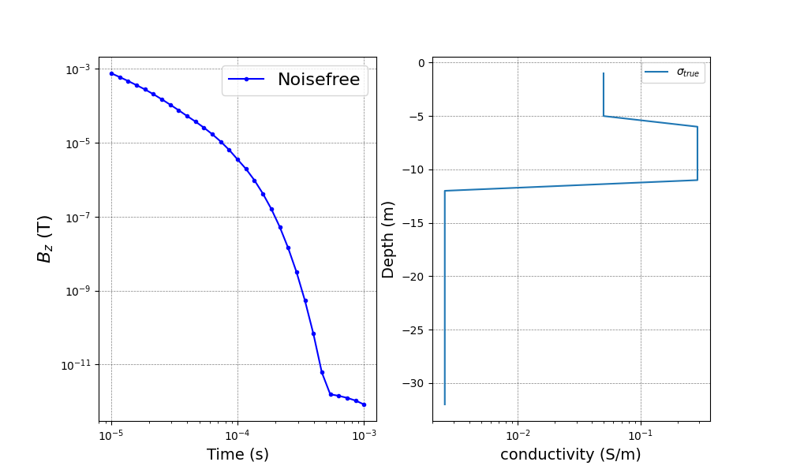
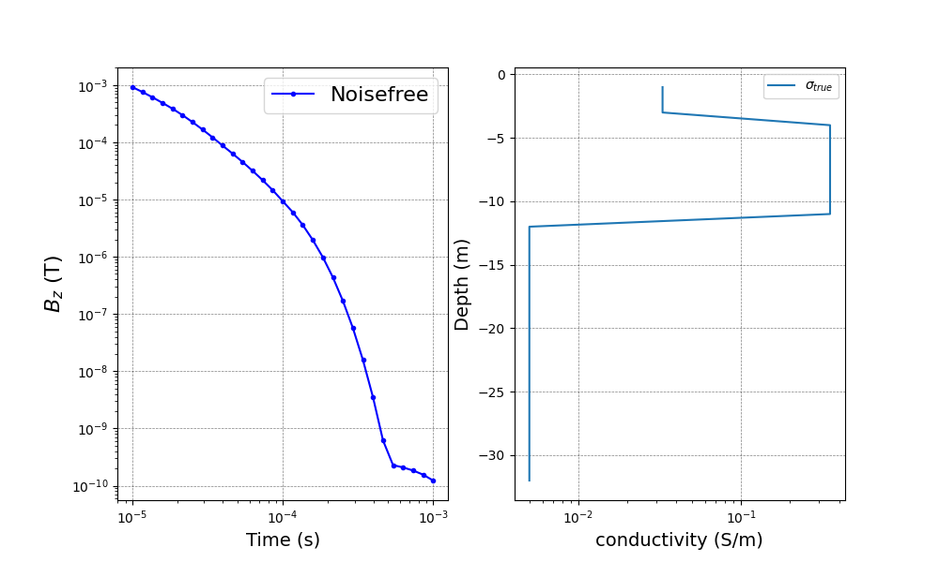
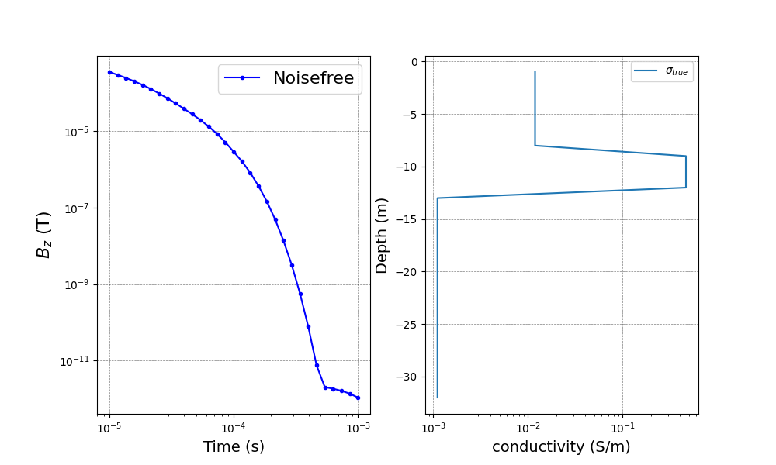
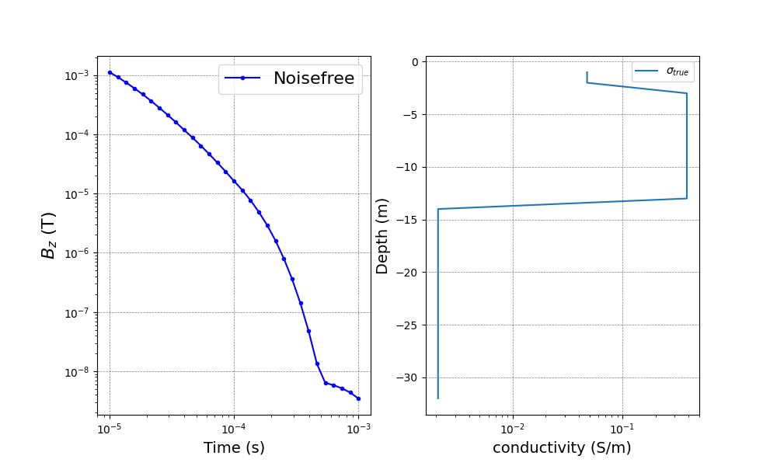
SimPEG : Forward Modeling
An open-source Python package, for solving the electromagnetic forward and inverse problem.
However, SimPEG inverse solution is deterministic and thus only one possible solution among many others.
Random generation of synthetic data set by forward modelling from prior .

Slide 7
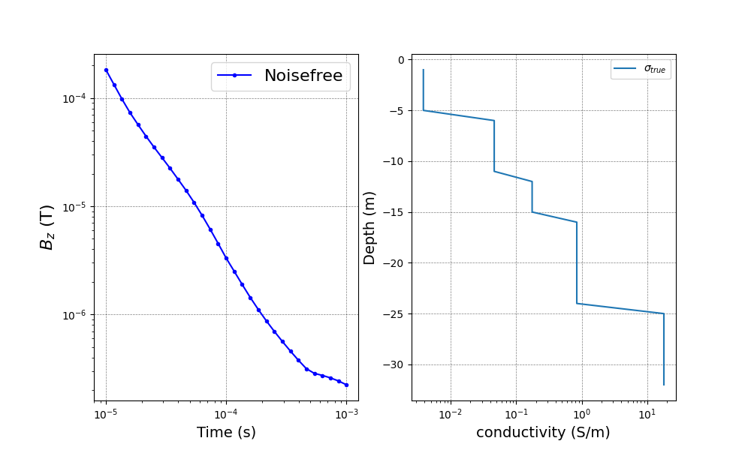
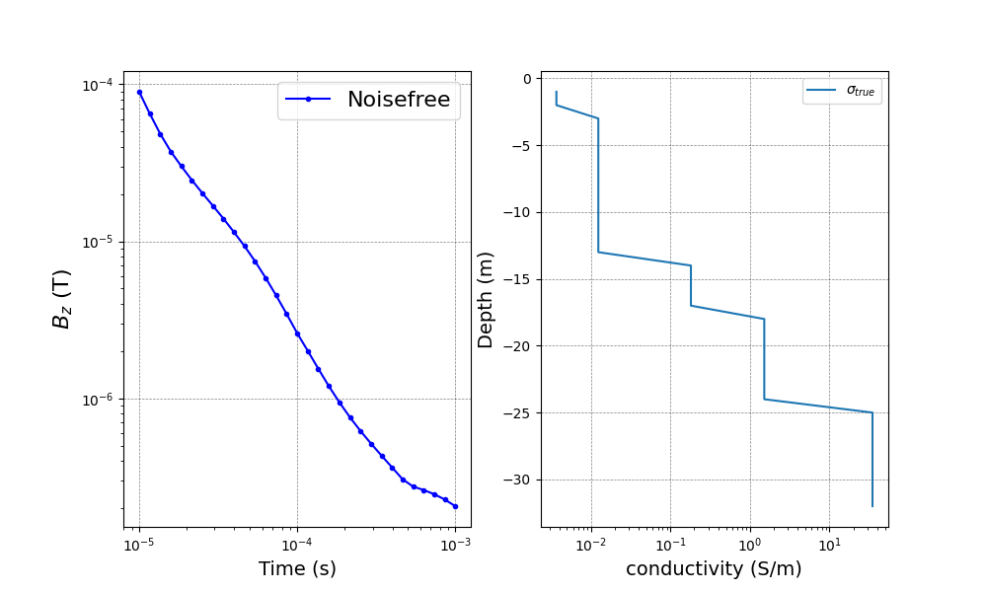
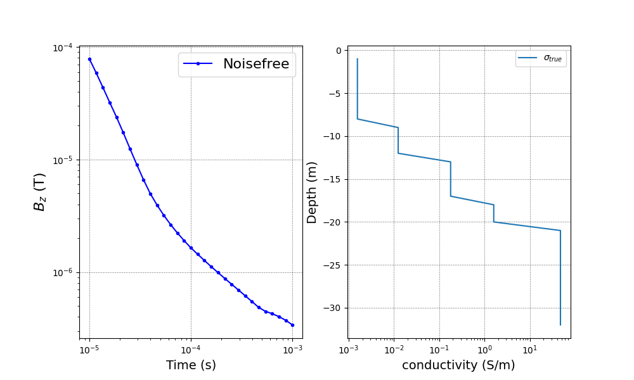
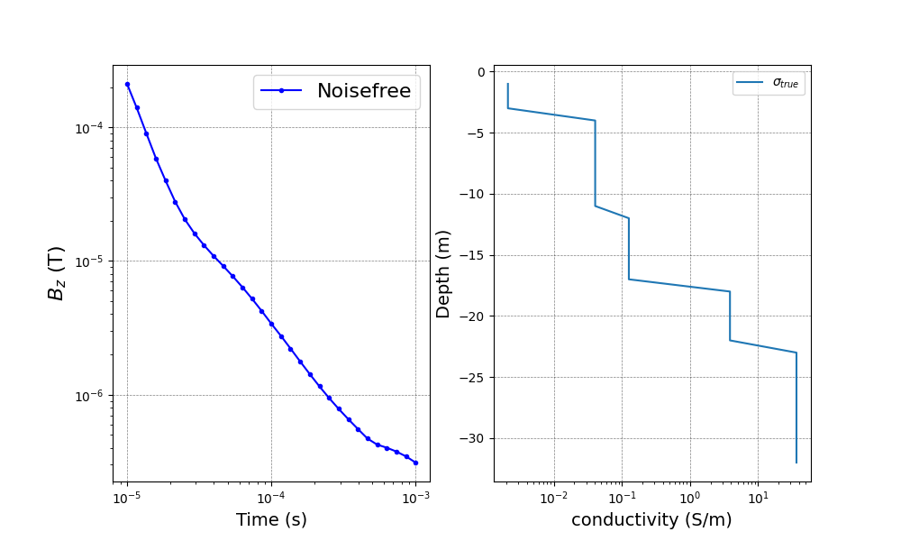
Five layers synthetic model representation of data set

Slide 8
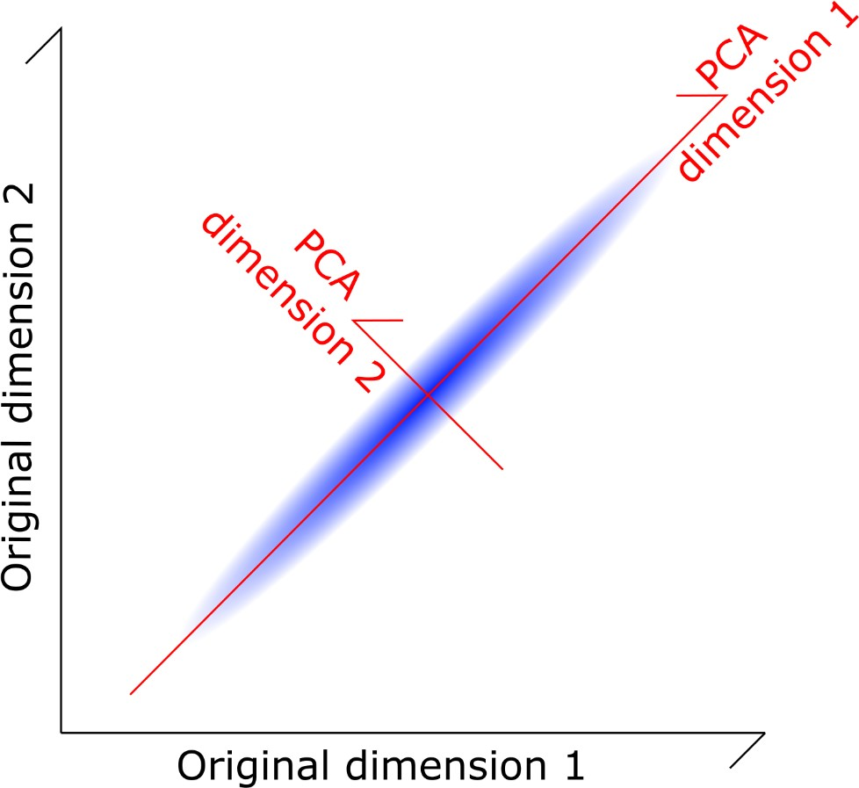
Reducing Dimensionality (PCA)
From 100 dimension in datasets to around 10.
- Keeping 90% variability

Slide 9
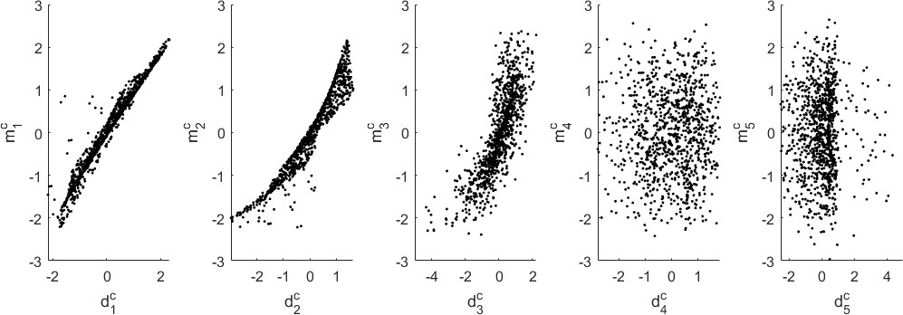
Canonical correlation analysis (CCA)
Linking the models' parameters to the reduced datasets:( CCA)

Slide 10
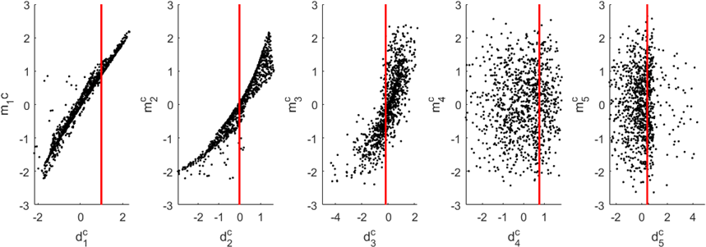
Extracting the posterior in reduced space
Transform the field dataset (PCA and CCA)
Extracting the obtained kernel Density Estimation

Slide 11
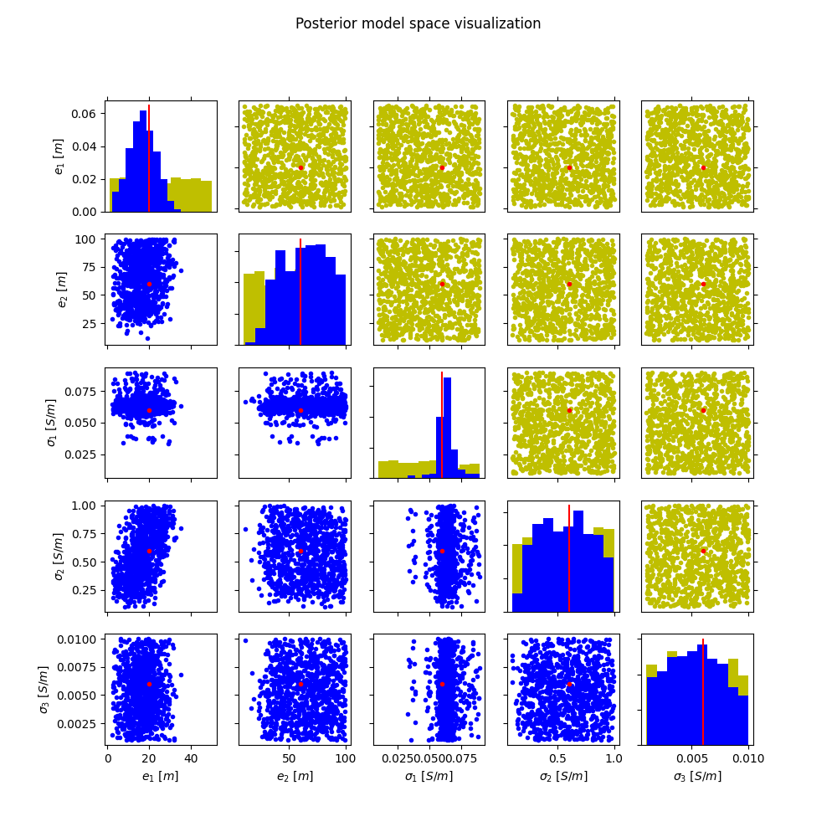
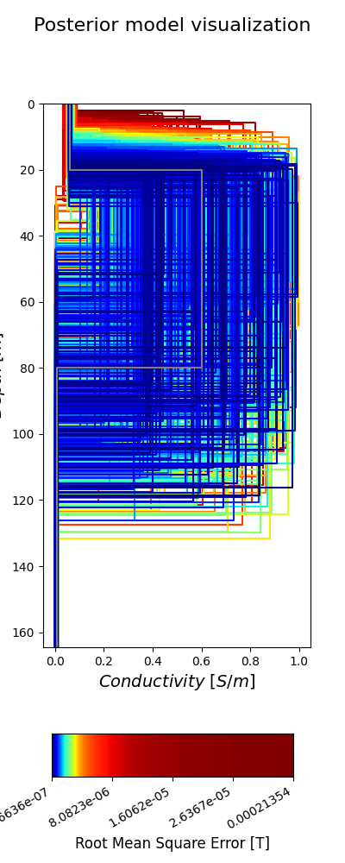
Posterior model space /model visualization
Color Representation:
Red Dot → True Model Yellow Dots → Prior Blue Dots → Posterior Models
Gray Line → True Model

Slide 12
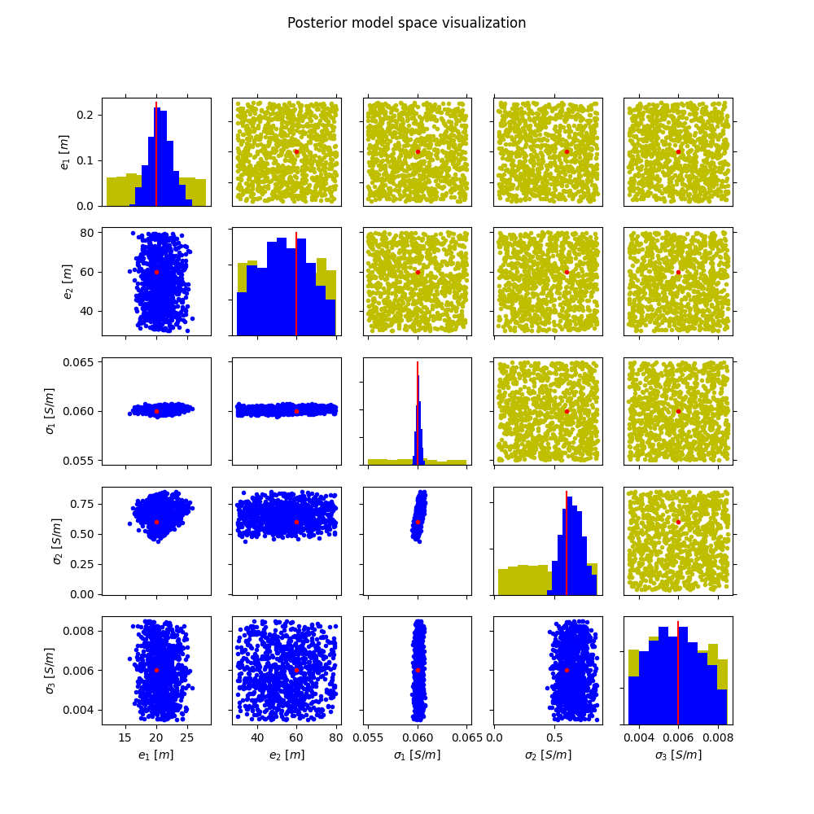
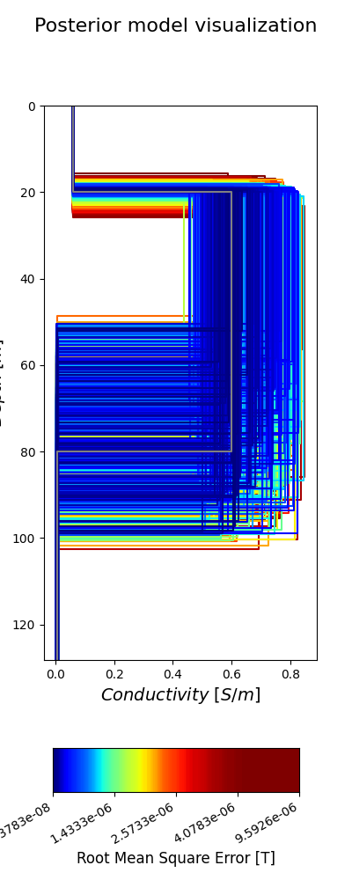
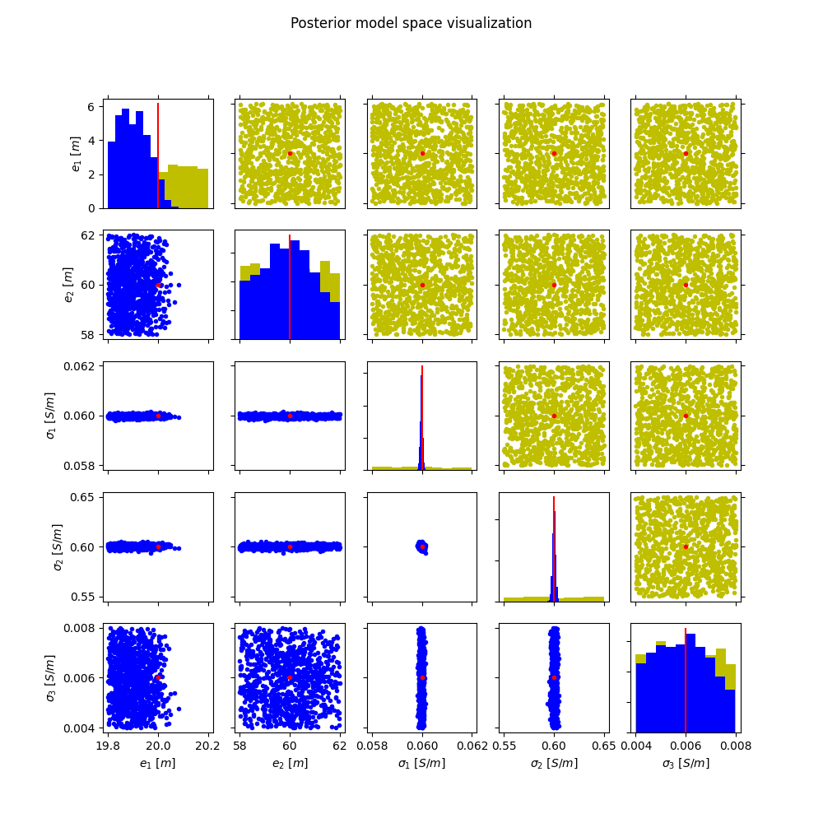
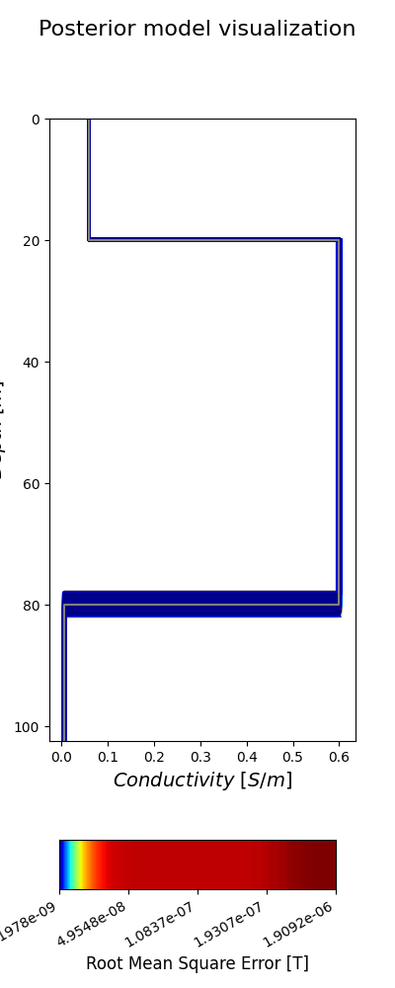
Cascade Application
Changing the large prior and keeping the true model constant
To find out the uncertainty range of parameters that best fits with the true model.

Slide 13
Conclusion
Prediction of range of uncertainty of model parameters for observed data is possible in this statistical learning technique.
Cascade application gives large uncertainty range of parameters.
Due to little change in forward solution and using large prior distribution, BEl1D runs largely overestimate the uncertainty.
And finding the best fit artificially in cascade application is difficult
Iterative BEL would be the solution.

Slide 14
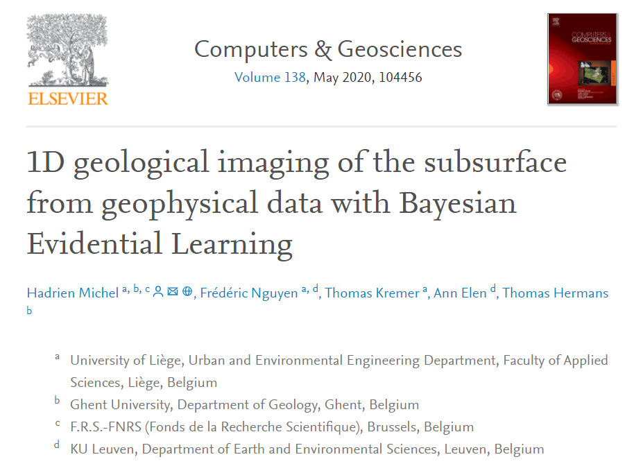
Reference
https://doi.org/10.1016/j.cageo.2020.104456

Slide 15
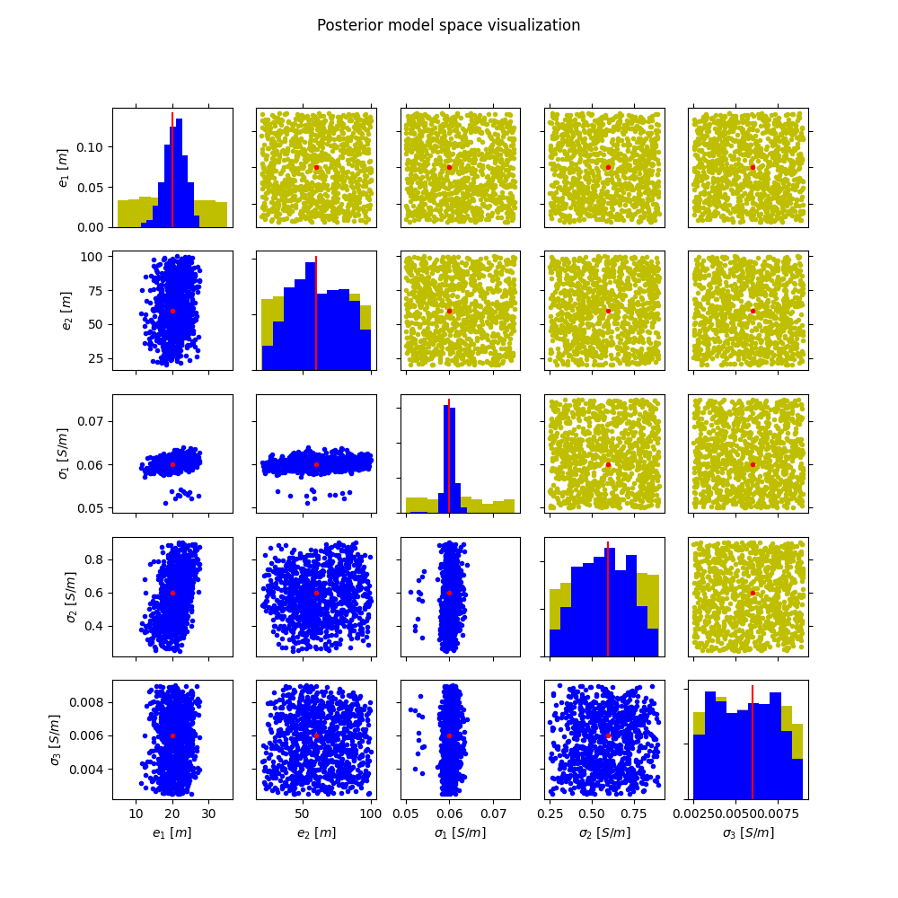
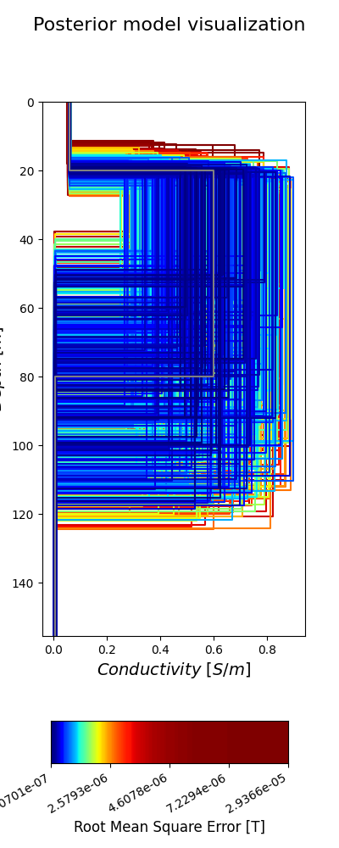
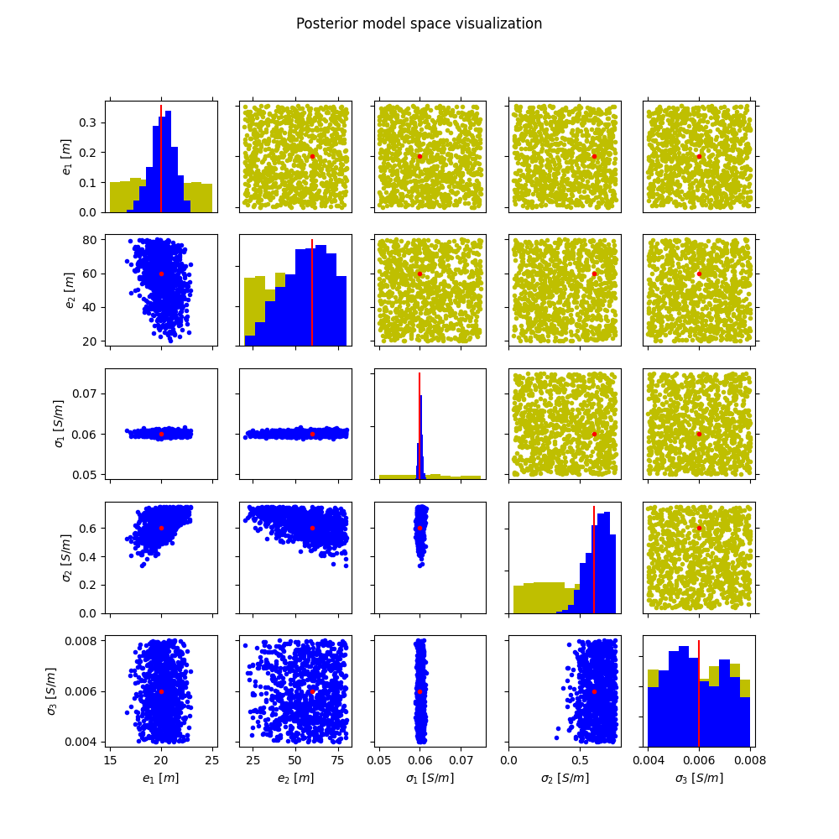
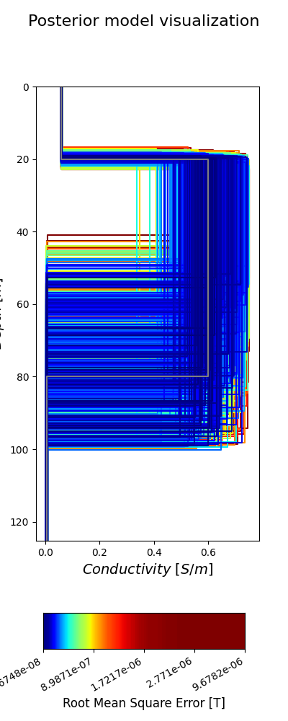
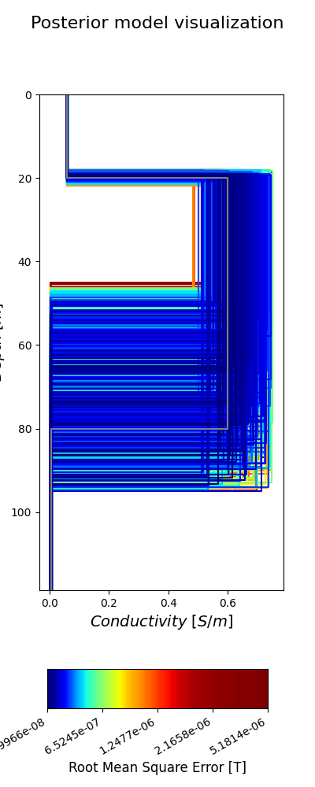
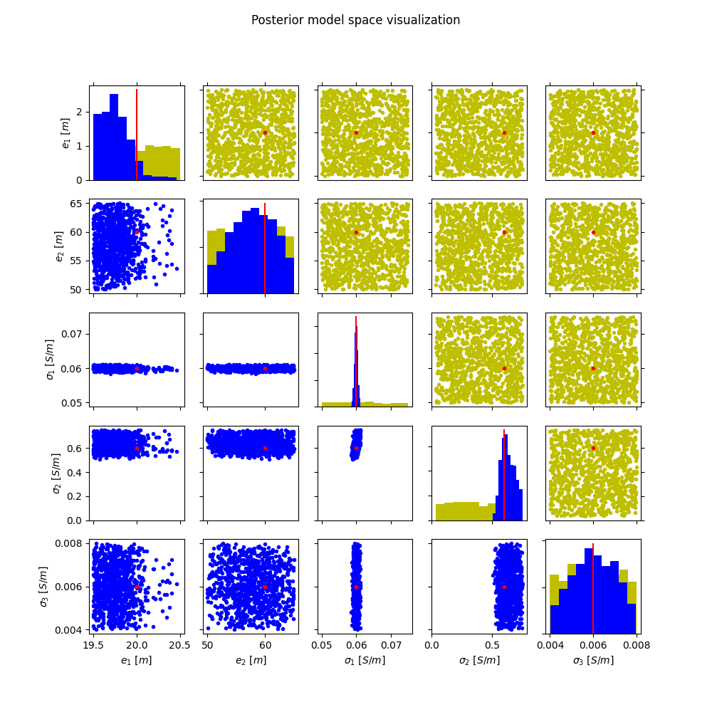
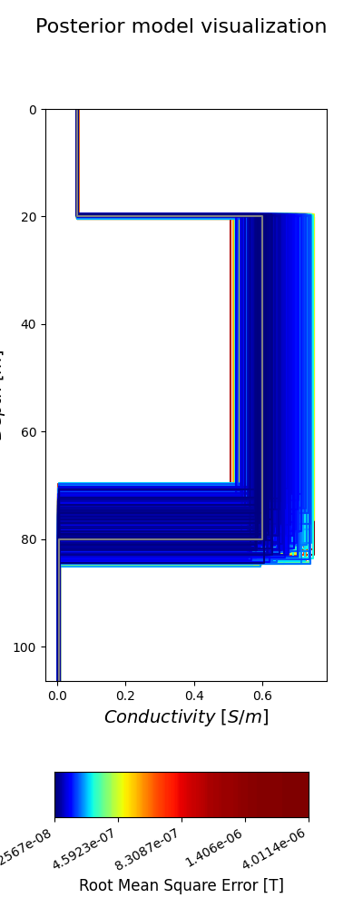
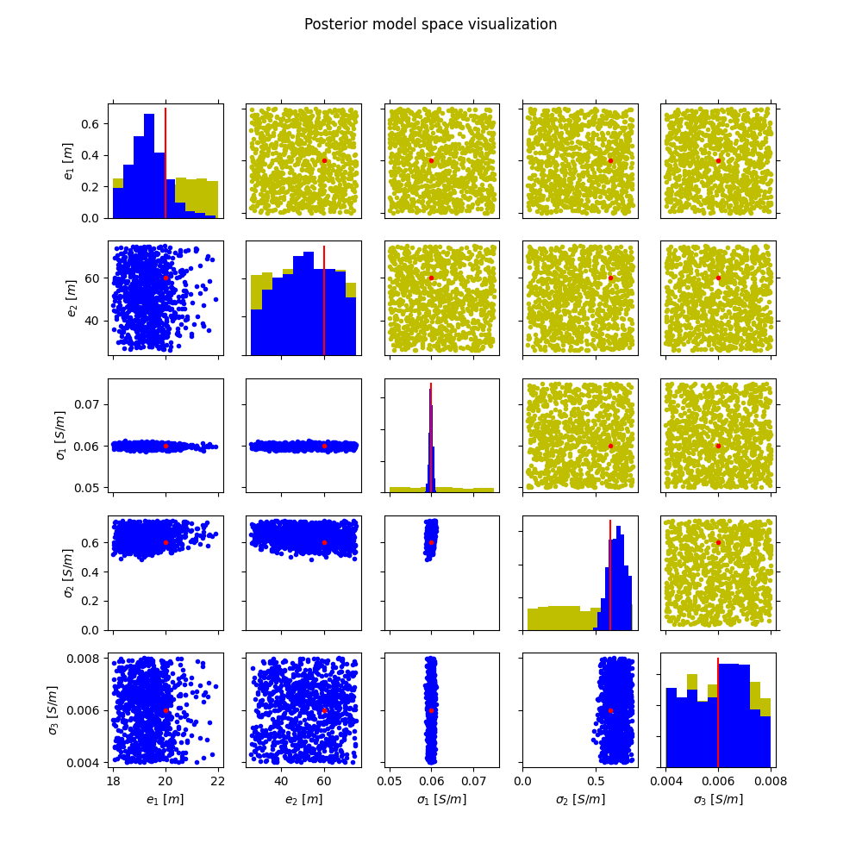
Appendix

Slide 16
Appendix

