Slide 1





Towards synergy of GNSS and InSAR mining deformation monitoring with Sentinel-1 data
Damian Tondaś, Maya Ilieva, Witold Rohm, Jan Kapłon

Slide 2
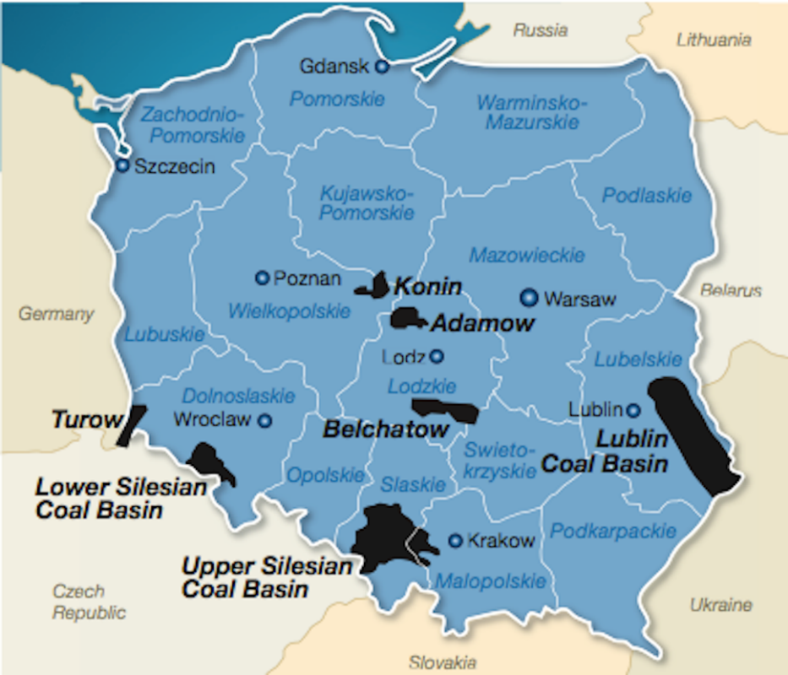
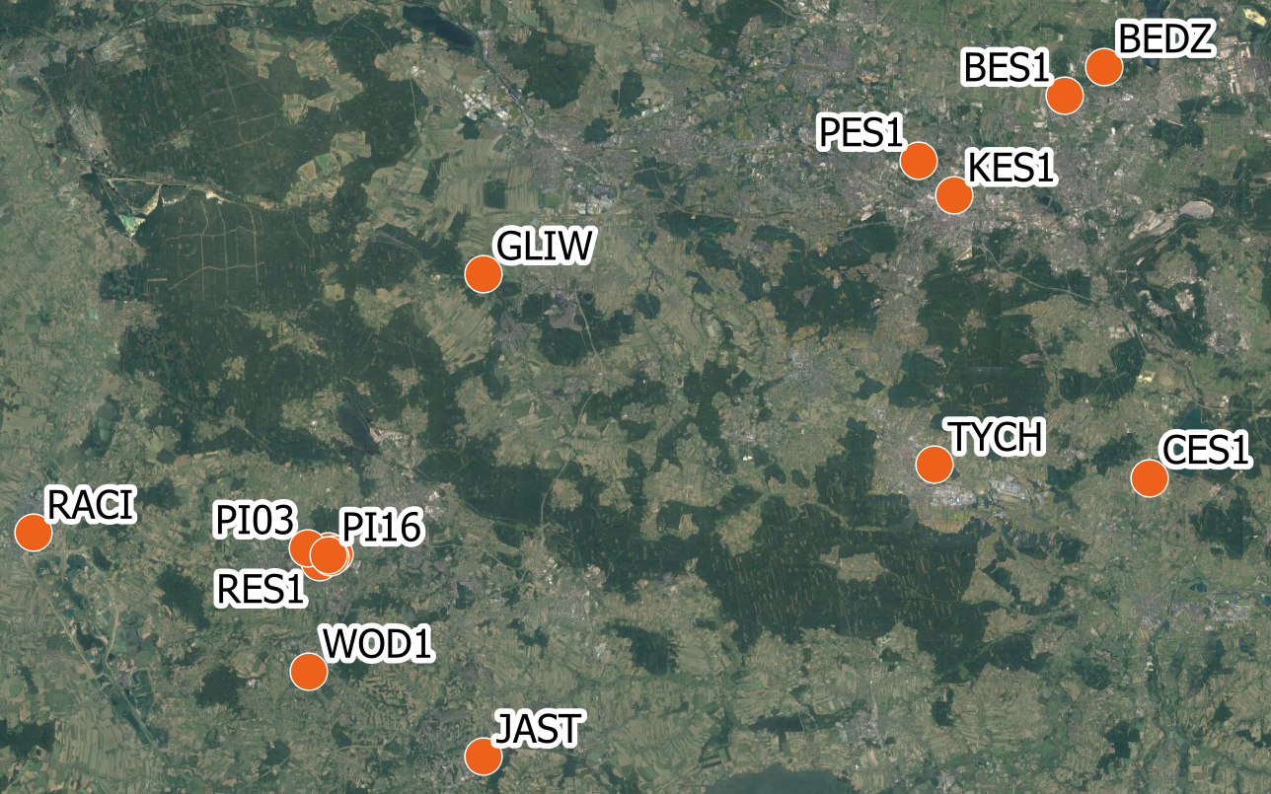
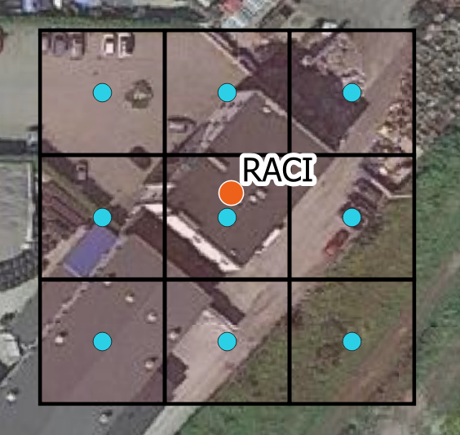
The area of interest
In this paper, we are focus on the comparison of the deformation effects measured by Global Navigation Satellite Systems (GNSS) and satellite Interferometric SAR (InSAR) methods in the Upper-Silesian Coal Basin (Poland).
Area: ~3 300 km²
Fig.2. The area of interest: Upper Silesian Coal Basin (orange dots – the GNSS stations)
Fig.3. Cross-location of GNSS station and DInSAR pixels
Fig.1. Polish coal deposits
(www.modernpowersystems.com)

Slide 3
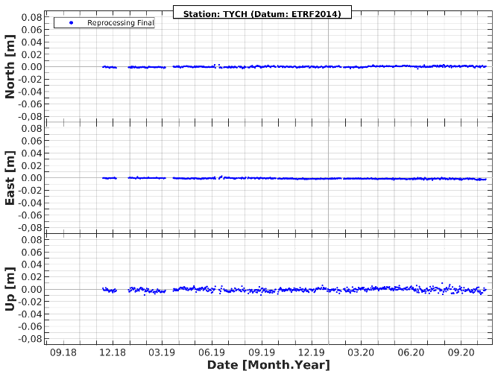
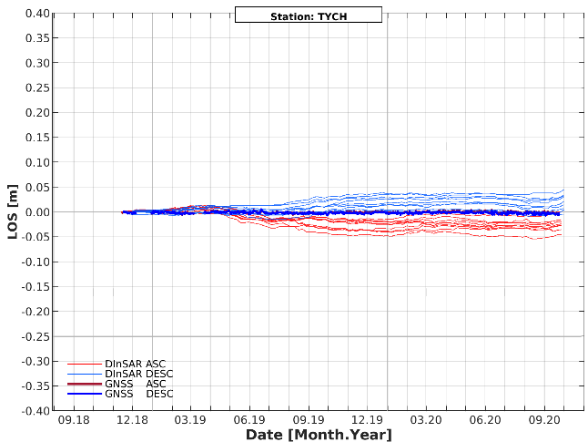
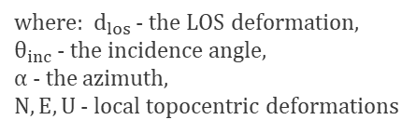
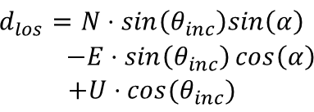
Scheme of conversion GNSS geocentric coordinates to LOS
GNSS
ITRF2014
ITRF2000
ETRF2000
XYZ
XYZ
XYZ
NEU
LOS
BLh
$$\begin{aligned}d_{los}=N⋅sin\left(θ_{inc}\right)sin\left(α\right) \\ −E⋅\sin\left(θ_{inc}\right)\cos\left(α\right) \\ +U⋅cos⁡(θ_{inc})\end{aligned}{ }$$
where: $d_{los}$ - the LOS deformation, $θ_{inc}$ - the incidence angle,
α - the azimuth,
$N,E,U$ - local topocentric deformations
Fig.4. Time series of GNSS North, East, Up displacments for TYCH station
Fig.5. Time series of GNSS and InSAR LOS displacements for Ascending and Descending obrits for TYCH location

Slide 4
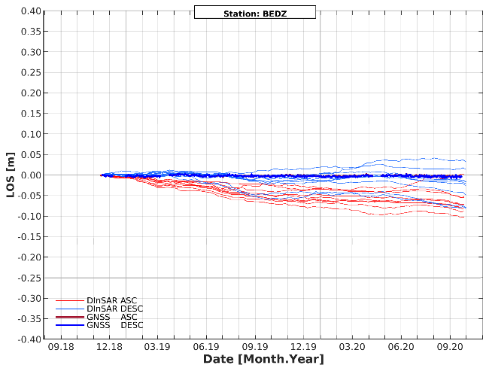
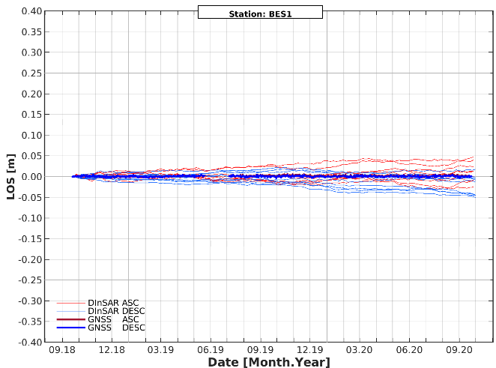
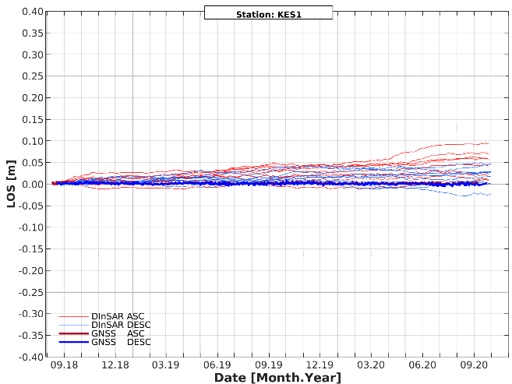
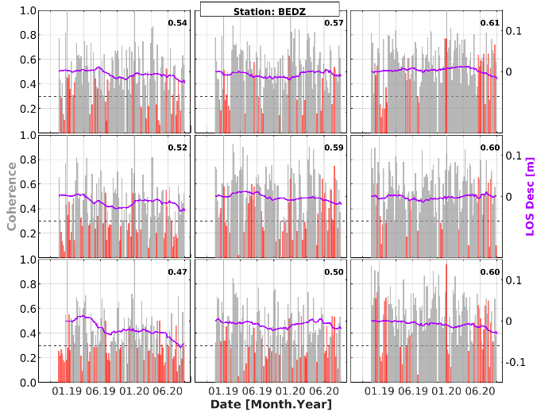
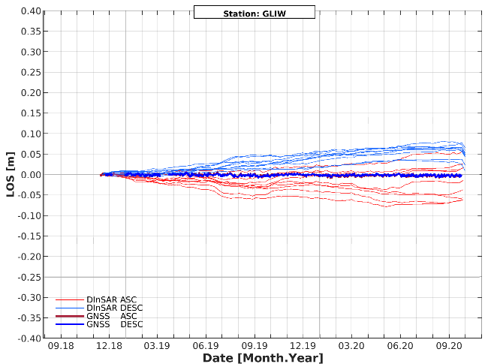
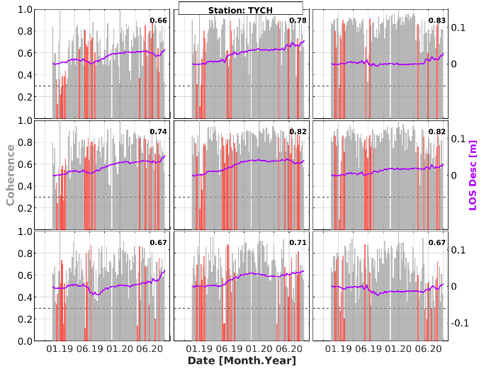
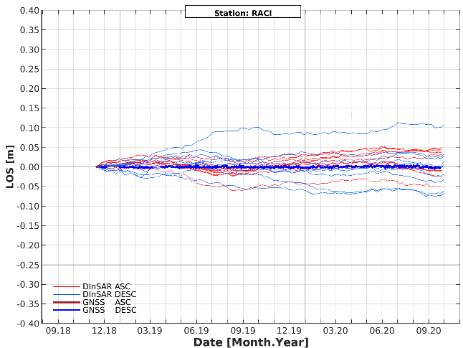
Examples of non-deforming sites
a.
b.
c.
g.
d.
e.
f.
h.
Fig.6. Time series of GNSS and InSAR deformations in LOS direction for non-deforming sites (a.-f.)
Fig.7. Time series of InSAR coherence (grey) with outliers (red) and LOS deformation for Descending orbit in BEDZ (g.) and TYCH (h.) sites

Slide 5
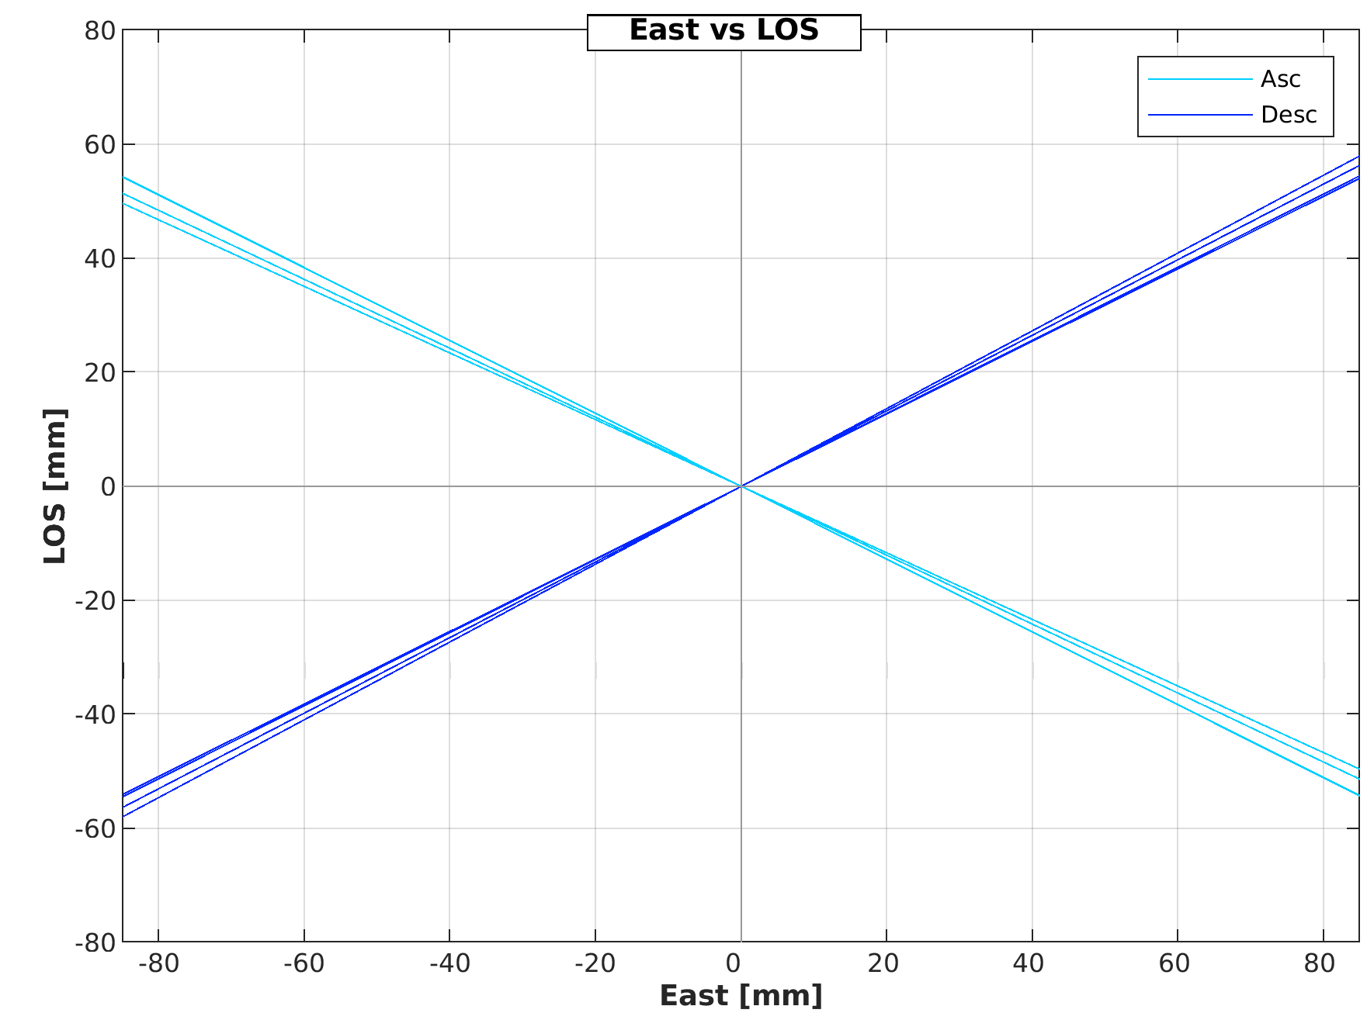
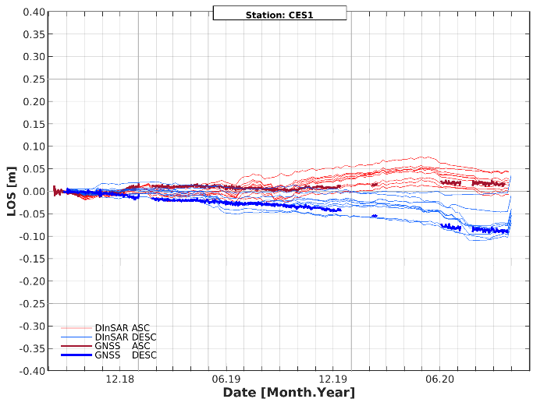
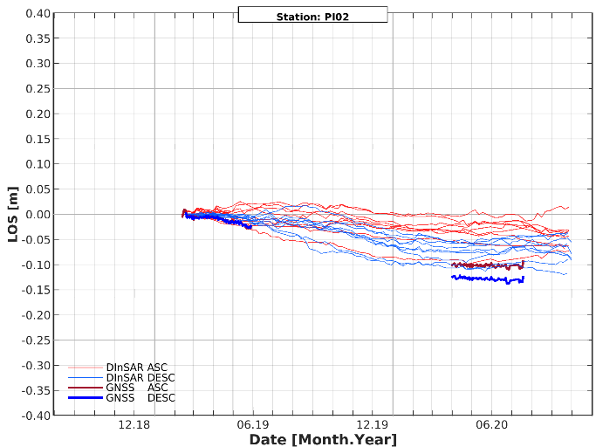
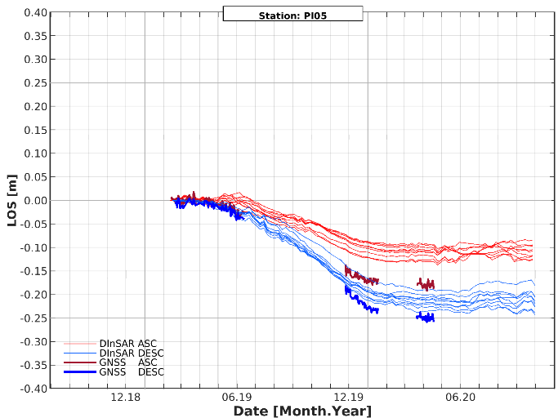
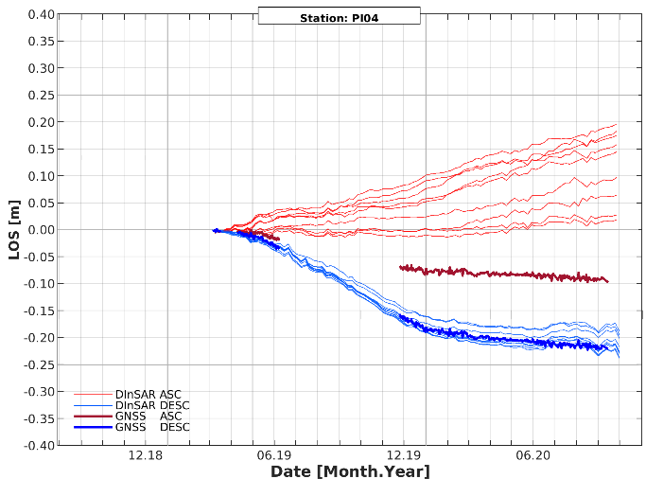
1. Question: What causes the discrepancy between LOS deformations for Ascending and Descending orbits?
a. PI02 (East) : -26 mm/year
b. CES1 (East) : -41 mm/year
1. Answer: The volume of the East deformation
c. PI05 (East) : -66 mm/year
d. PI04 (East) : -84 mm/year
b.
a.
c.
d.
Fig.9. Diagram of the dependence between East component and LOS deformation
Fig.8. Time series of GNSS and DInSAR observations in the area affected by deformation (a.-d.)

Slide 6
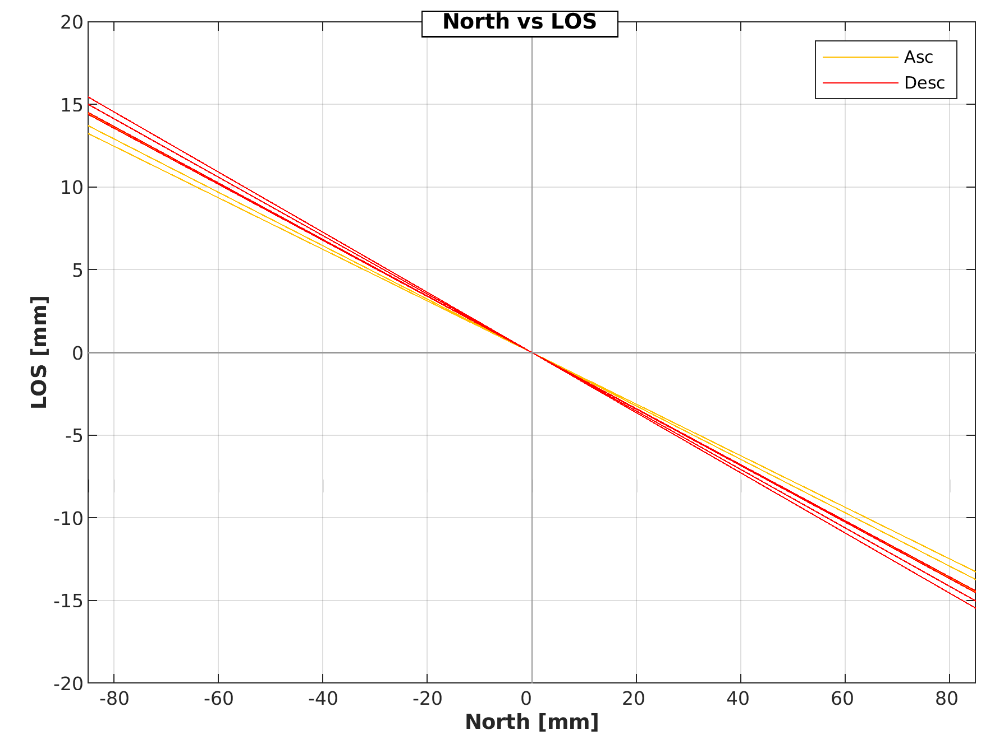
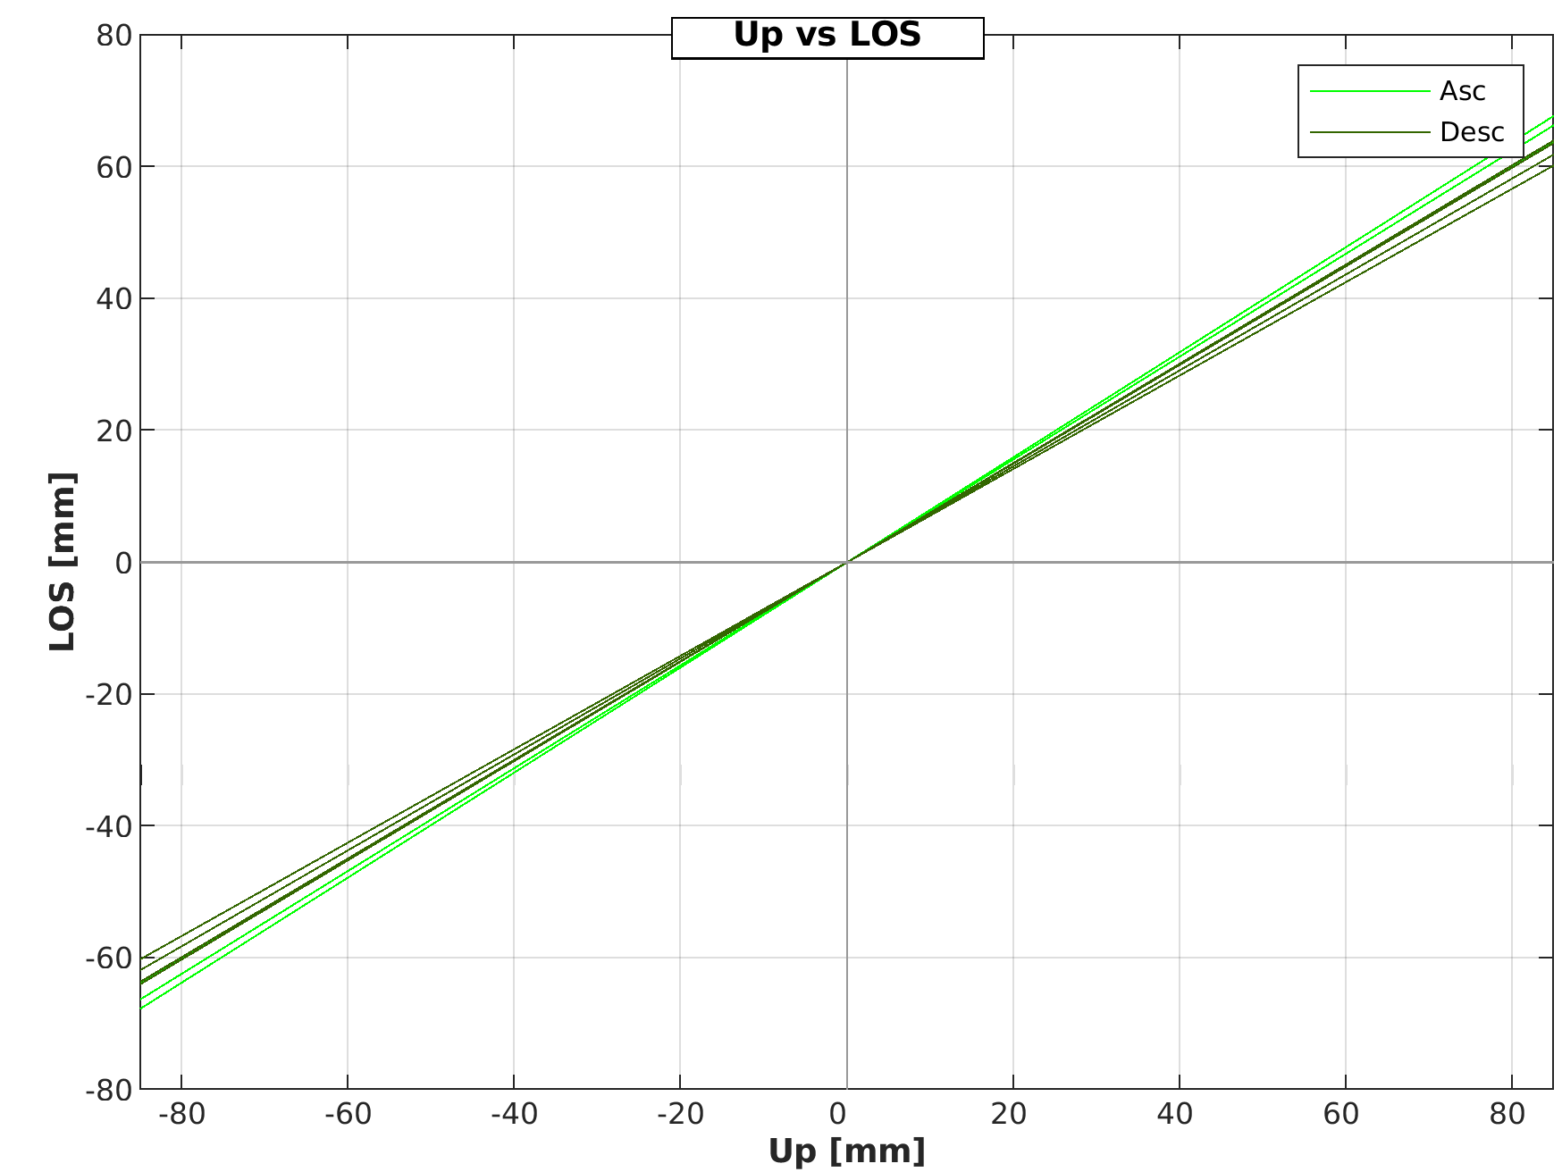
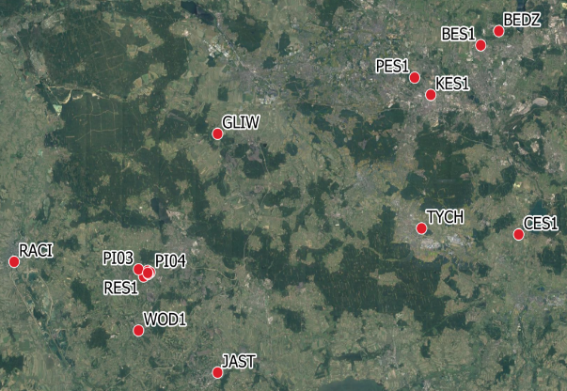

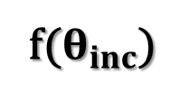


The impact of NEU components values on LOS deformations
$$d_{los}=N⋅sin\left(θ_{inc}\right)sin\left(α\right)−E⋅\sin\left(θ_{inc}\right)\cos\left(α\right)+U⋅cos⁡(θ_{inc})$$
${los}_{N}=N∗sin\left(θ_{inc}\right)sin\left(α\right){ }$
a.
c.
b.
${los}_{U}=U∗cos\left(θ_{inc}\right){ }$
f($θ_{inc}$)
${los}_{E}=E∗−sin\left(θ_{inc}\right)cos\left(α\right){ }$
Fig.11. Diagram of the dependence between North (a.), East (b.) and Up (c.) components and LOS deformation
Fig.10. The area of interest (cyan rectangle) created by four four outermost GNSS stations (blue circles)

Slide 7
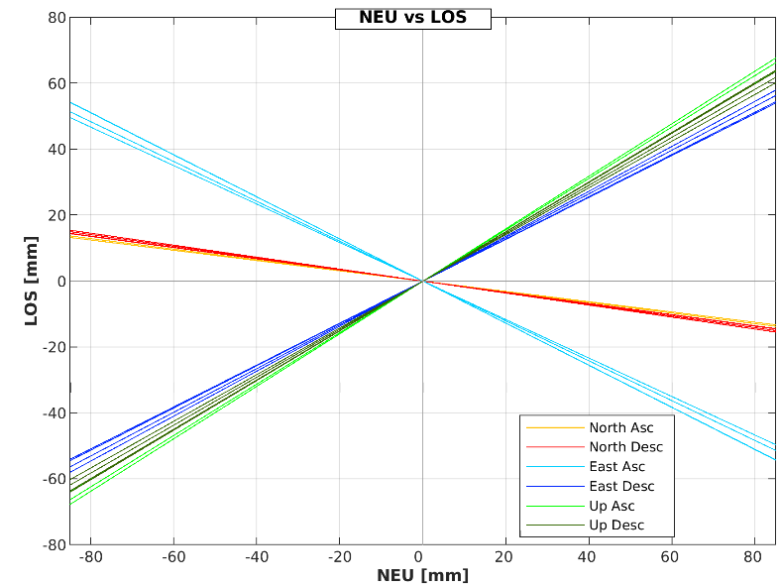
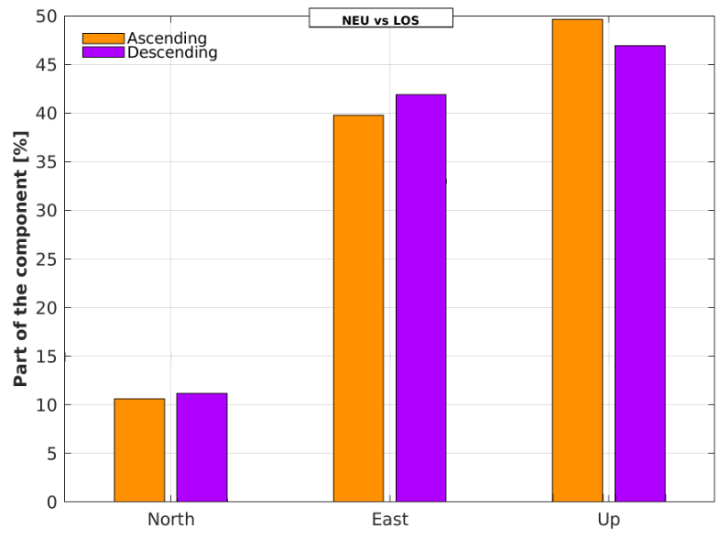
2. Question: How the north component affects on LOS deformation value?
To determine the impact of the northern component, we can assume the same value of GNSS deformation in each direction (north, east and up).
N=E=U= -50 mm/year
-
-
+
-
+
+
Fig.12. Diagram of the dependence between NEU components and LOS deformation
Fig.13. Percentage contribution of the components N,E,U on the deformation value in the LOS direction assuming their equal value
2. Answer: The influence of the northern component is around 10% for both Ascending and Descending orbits. This influence is inversely proportional to the LOS deformation.

Slide 8
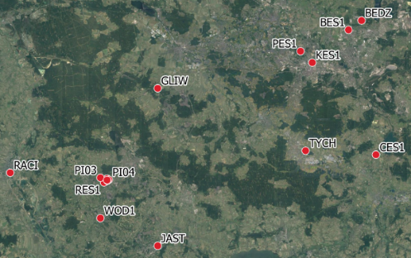
3. Question: What is more influential: location in the study area or direction of deformation (North, East or Up)?
Fig.13. The area of interest (cyan rectangle) created by four four outermost GNSS stations (blue circles)
Tab.1. The summary of the directional coefficients of the straight lines, depending on the N,E,U components and the LOS deformation for the Ascending and Descending orbits
GNSS site | Location | Asc |  |  | Desc
 |  | vN | vE | vU | vN | vE | vU
RACI | west | -0.16 | -0.58 | 0.80 | -0.18 | 0.68 | 0.71
JAST | south | -0.16 | -0.60 | 0.78 | -0.18 | 0.66 | 0.73
CES1 | east | -0.17 | -0.64 | 0.75 | -0.17 | 0.64 | 0.75
BEDZ | north | -0.17 | -0.64 | 0.75 | -0.17 | 0.64 | 0.75
Mean |  | -0,16 | -0.62 | 0.77 | -0.17 | 0.66 | 0.73
Fig.12. Diagram of the dependence between NEU components and LOS deformation
3. Answer: The direction of the deformation has a greater significance than the place where it occurs

Slide 9

Damian Tondaś
damian.tondas@upwr.edu.pl

