Slide 1


Lomonosov Moscow State University
Faculty of geology, Department of Geophysics
Algorithms for constructing structural surfaces by geophysical data based on neural networks
Shklyaruk A.D.,
Kuznetsov K.M.,
Arutyunyan D.A.,
Lygin I.V.
E-mail: alexsh9898@gmail.com

Slide 2
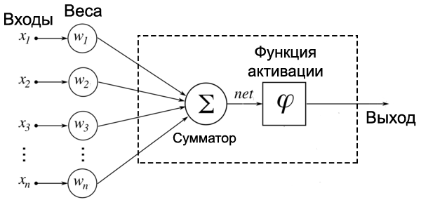
Introduction
At the stage of small and medium-scale geological and geophysical studies, in addition to seismic exploration, methods of potential fields (gravimetry and magnetometry) are usually actively used. These methods, in contrast to the profile seismic observations, taking into account modern satellite and aviation technologies, provide a high-quality areal density and magnetic characteristics of the study area. The main tasks of modern gravimetry and magnetometry include the task of constructing areal models, contrasting in density and magnetization of surfaces. Among a large number of algorithmic solutions, the most effective are methods using an integrated approach, in which seismic data on the morphology of reflecting horizon is used as a reference.
A neural network is a distributed parallel processor consisting of elementary information processing units (neurons) that accumulate experimental knowledge and provide it for further processing using synapses.
Inputs
Weights
Neuron
Activation
function
Outputs

Slide 3
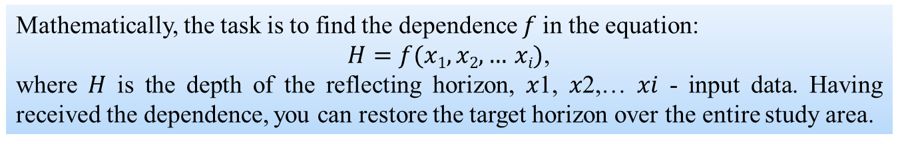
Reconstruction of structural surfaces by potential fields
Input
Mathematically, the task is to find the dependence 𝑓 in the equation:
$H=f(x1,x2,… xi)$,
where 𝐻 is the depth of the reflecting horizon, 𝑥1, 𝑥2,… 𝑥𝑖 - input data. Having received the dependence, you can restore the target horizon over the entire study area.
Δg, mGal
Gravity field
Algorithm
Ta, nT
Output
Magnetic field
Depth, m
Linear regression;
Regression based on Gaussian processes;
Regression tree;
«Random forest»;
Neural networks;
and etc.
Depth, m
The relief of the bottom of the sedimentary cover

Slide 4
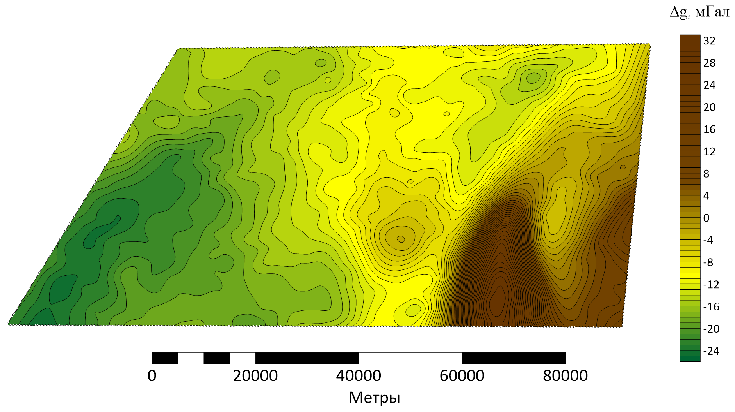
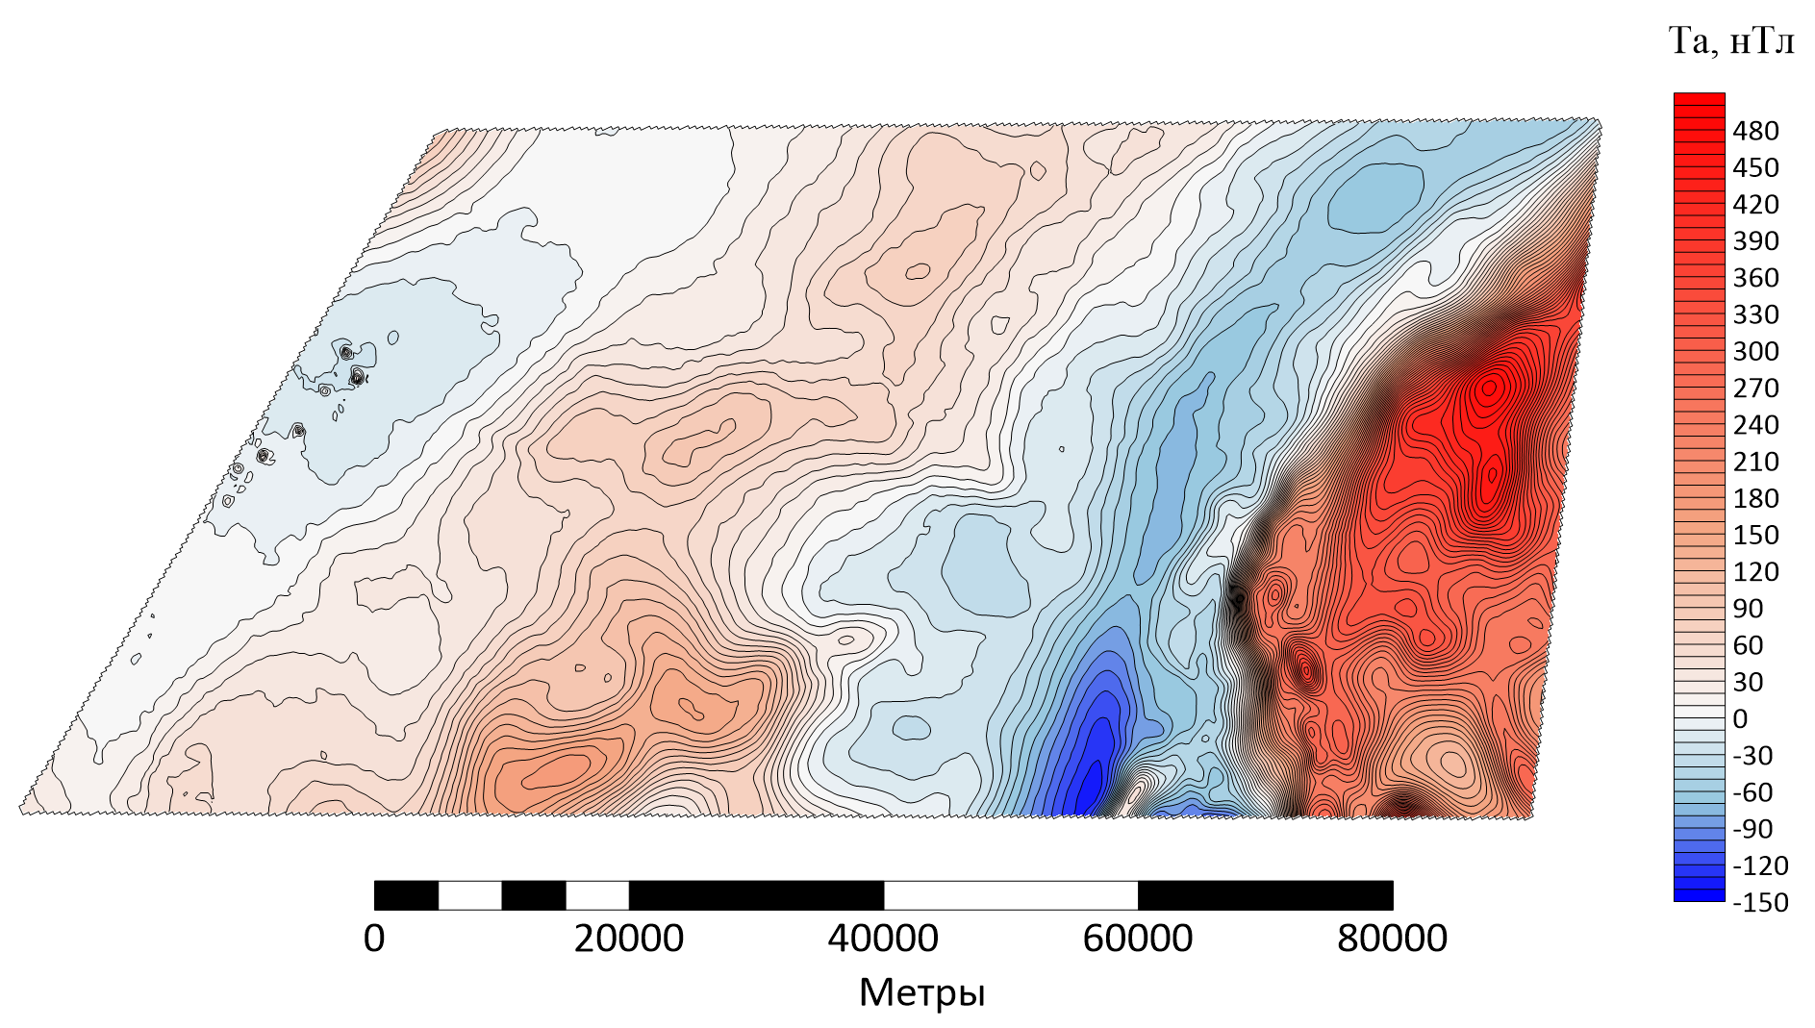
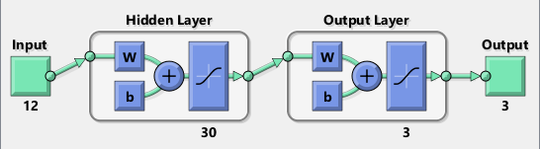
Initial data
Δg, mGal
Ta, nT
meters
meters
In the course of the work, several configurations of neural networks were considered. The result with the smallest residual is provided by a two-layer neural network with 30 and 3 neurons in the first and second layers, respectively. As an input signal for a neural network, 12 fields (gravitational and magnetic fields and their transformants) and 3 reflecting horizons located at different depths are considered.

Slide 5
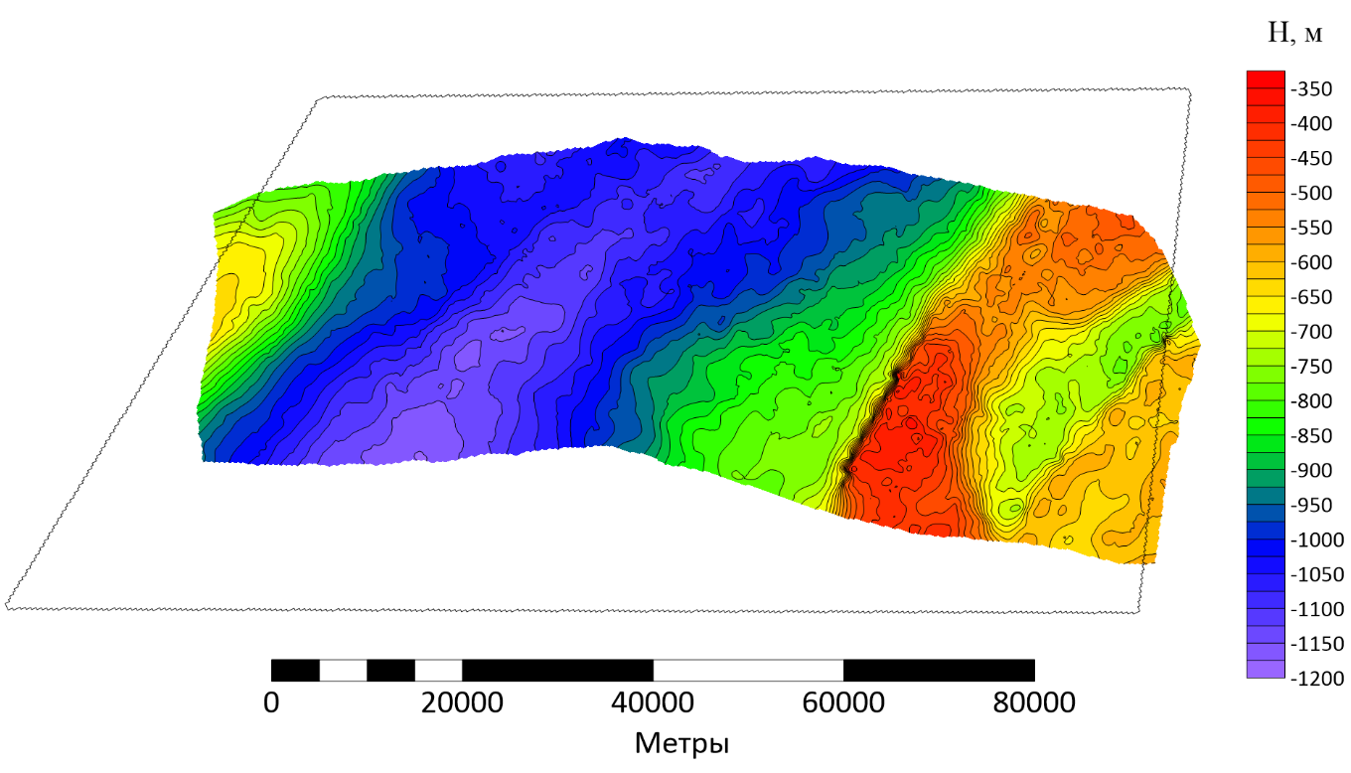
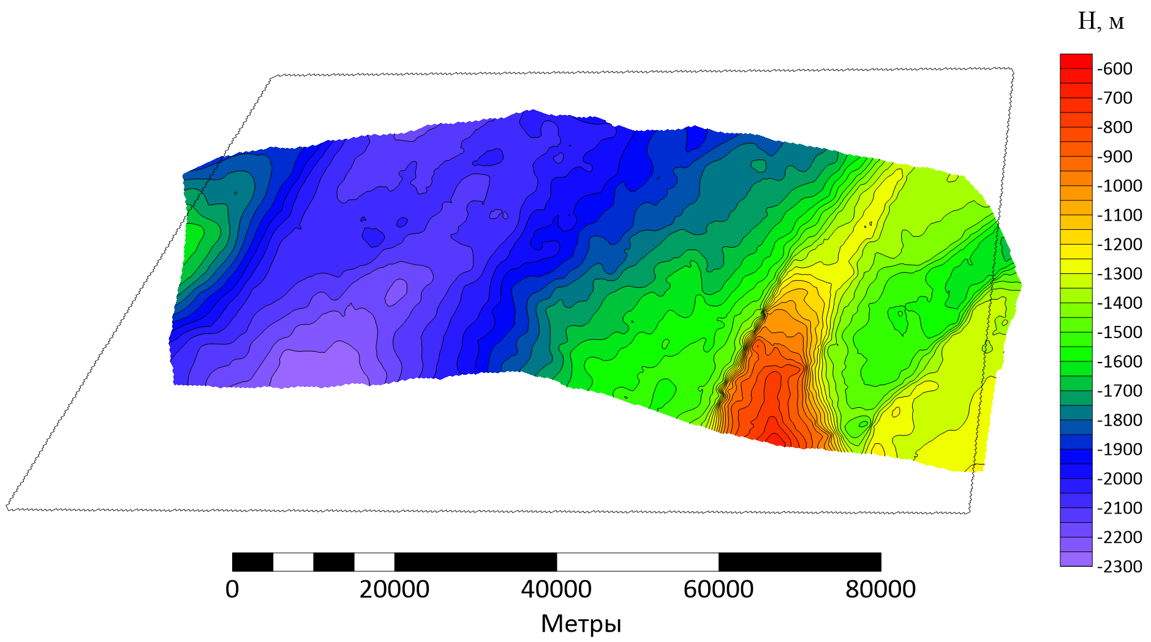
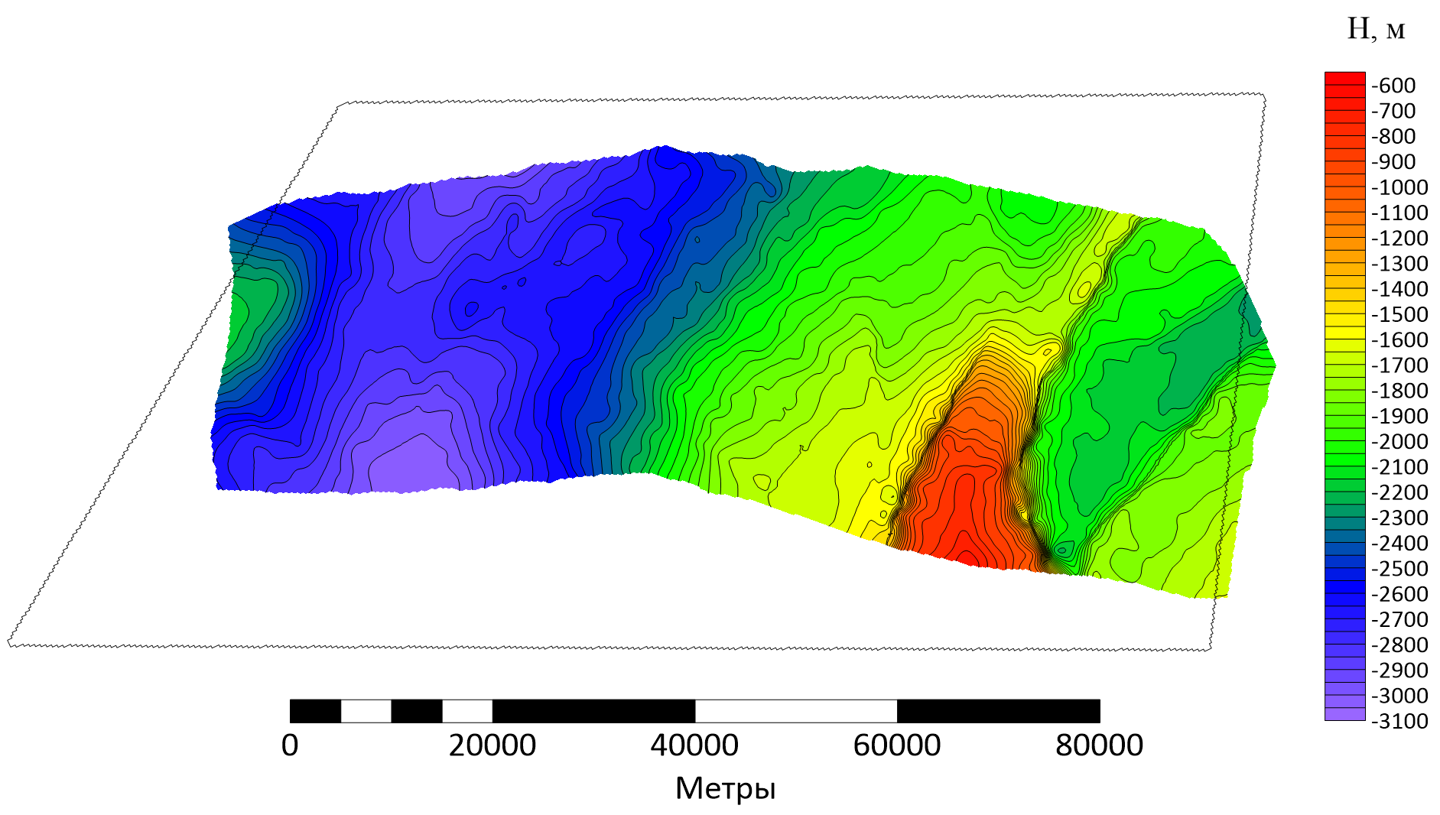
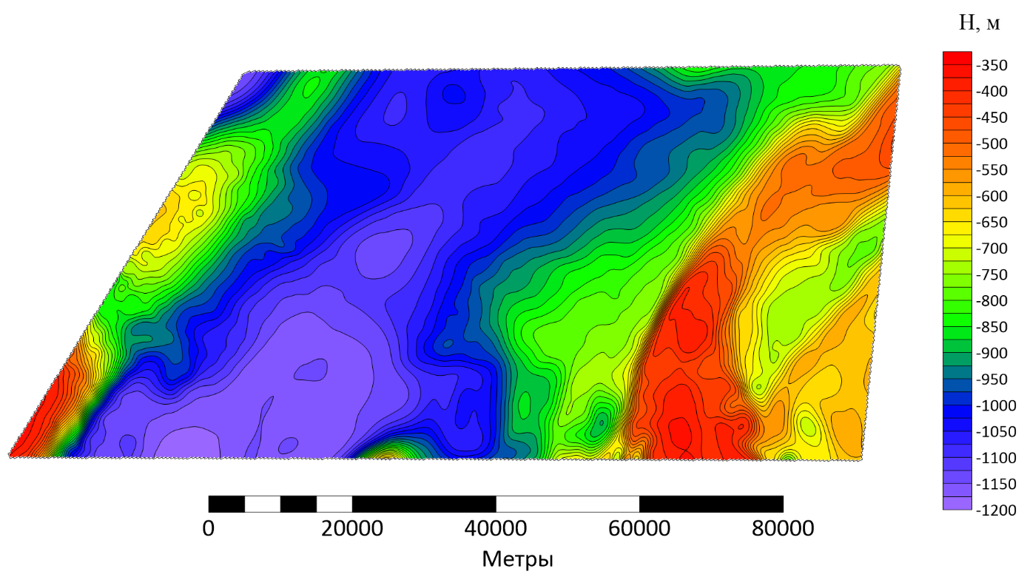
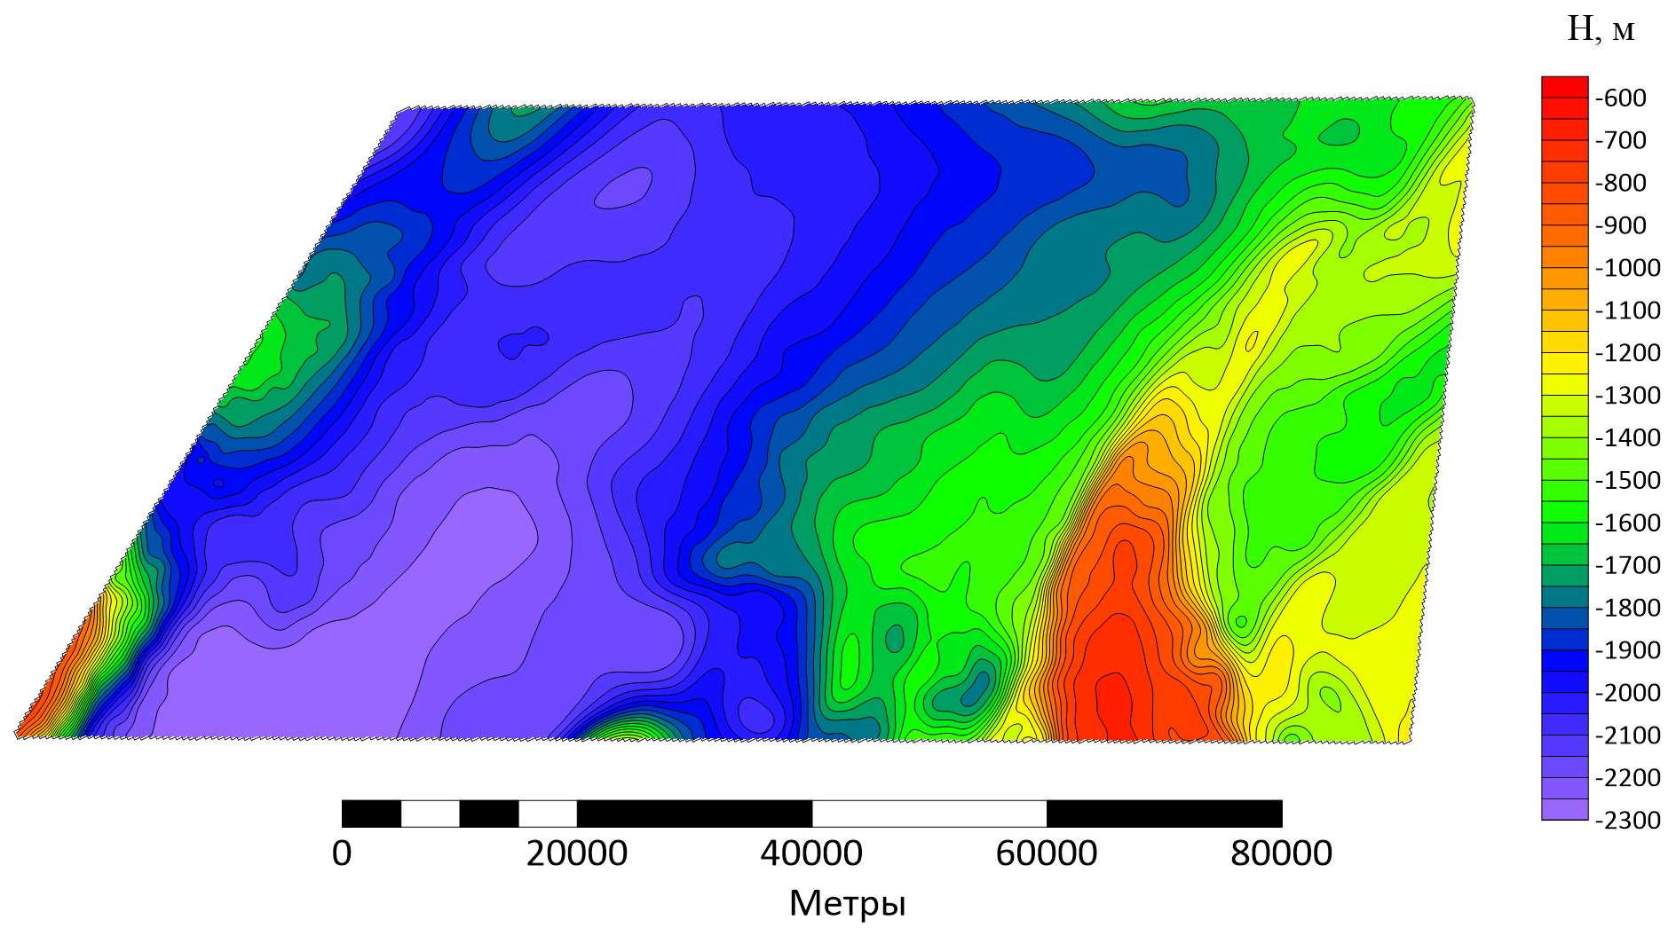
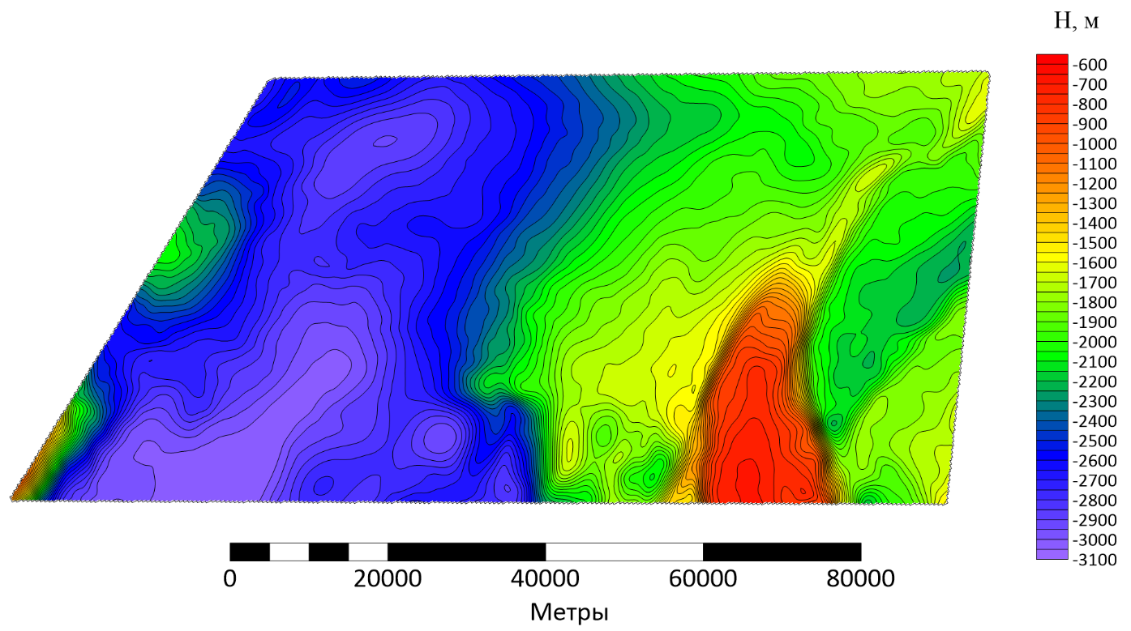
Horizon restoration results
To train neural networks were used 54,627 points, for restoration - 91,343 points, the step between points was 250 meters. Difference maps (the difference between the relief of the reflecting horizons and the reconstructed horizons using a neural network) were calculated to assess the accuracy of the reconstruction. The SD parameter was 20 meters.

