Slide 1


EGU21-11552 | vPICO presentations | TS7.8
How seismicity relates to lithospheric heterogeneity in the Alps
Ajay Kumar¹, Cameron Spooner^{1,2}, Magdalena Scheck-Wenderoth^{1,3}, Mauro Cacace¹
1 – GFZ – German Research Centre for Geosciences
2 – Potsdam University, Germany
3 – RWTH Aachen University
Notes:
1

Slide 2
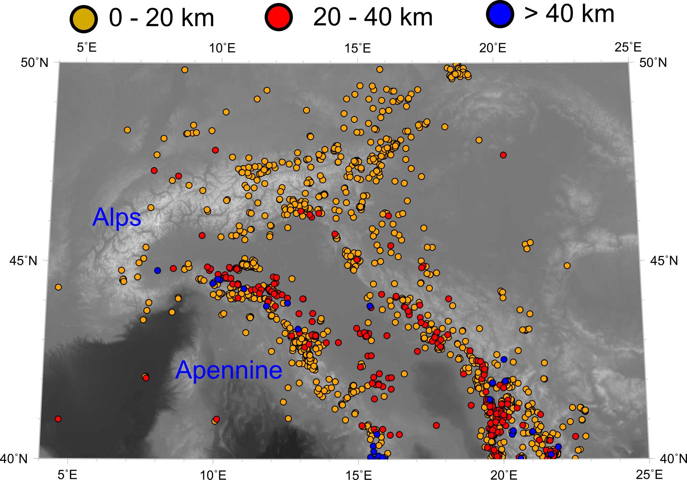
Upper crust
Lower crust
Subduction
Upper-crust level seismicity in the Alps in contrast to whole crust level seismicity in the forelands.
ISC reviewed bulletin

Slide 3
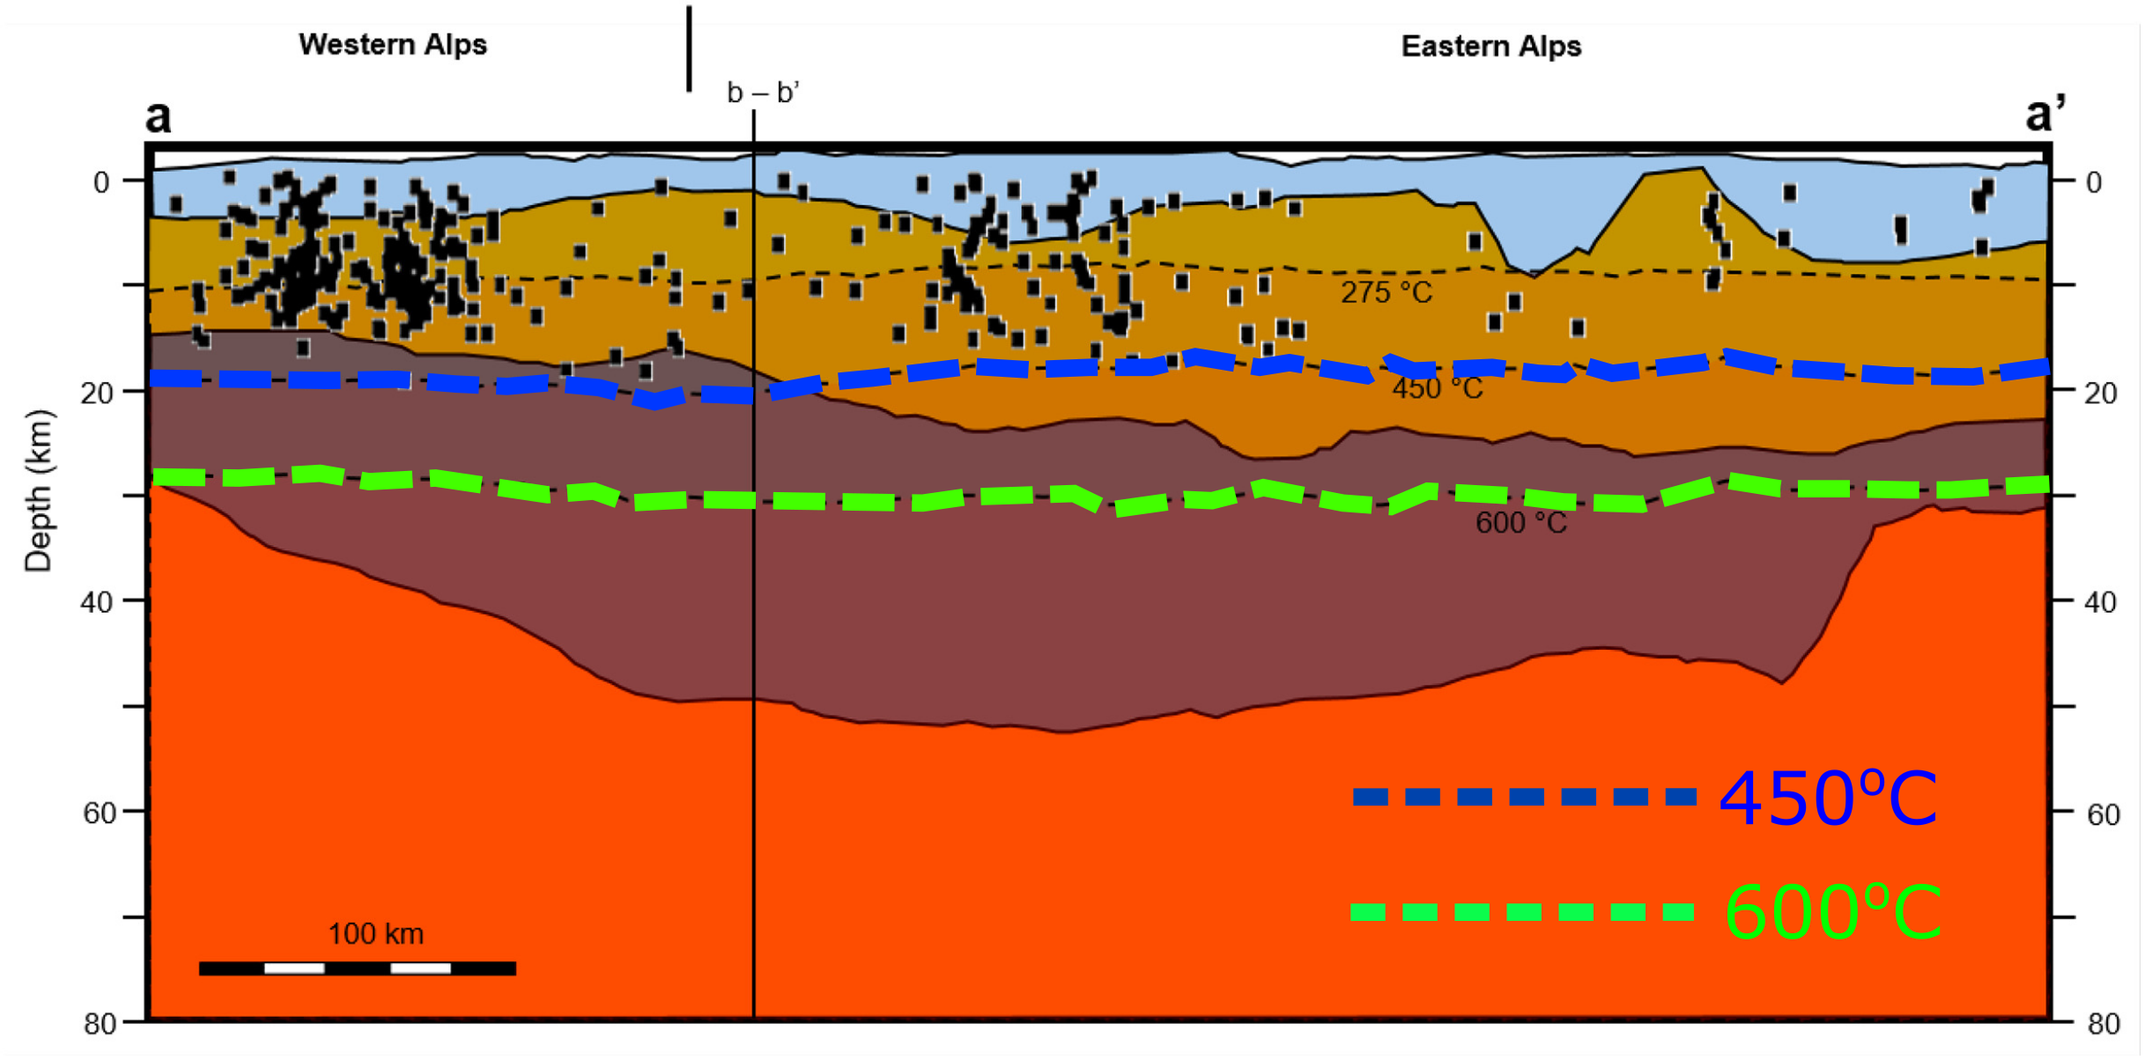
Upper crust
Lower crust
Subduction
Western Alps
Eastern Alps
ISC reviewed bulletin
Almost all of the seismicity in the Alps is restricted below 450 ºC isotherm
Spooner et al. (2020)

Slide 4
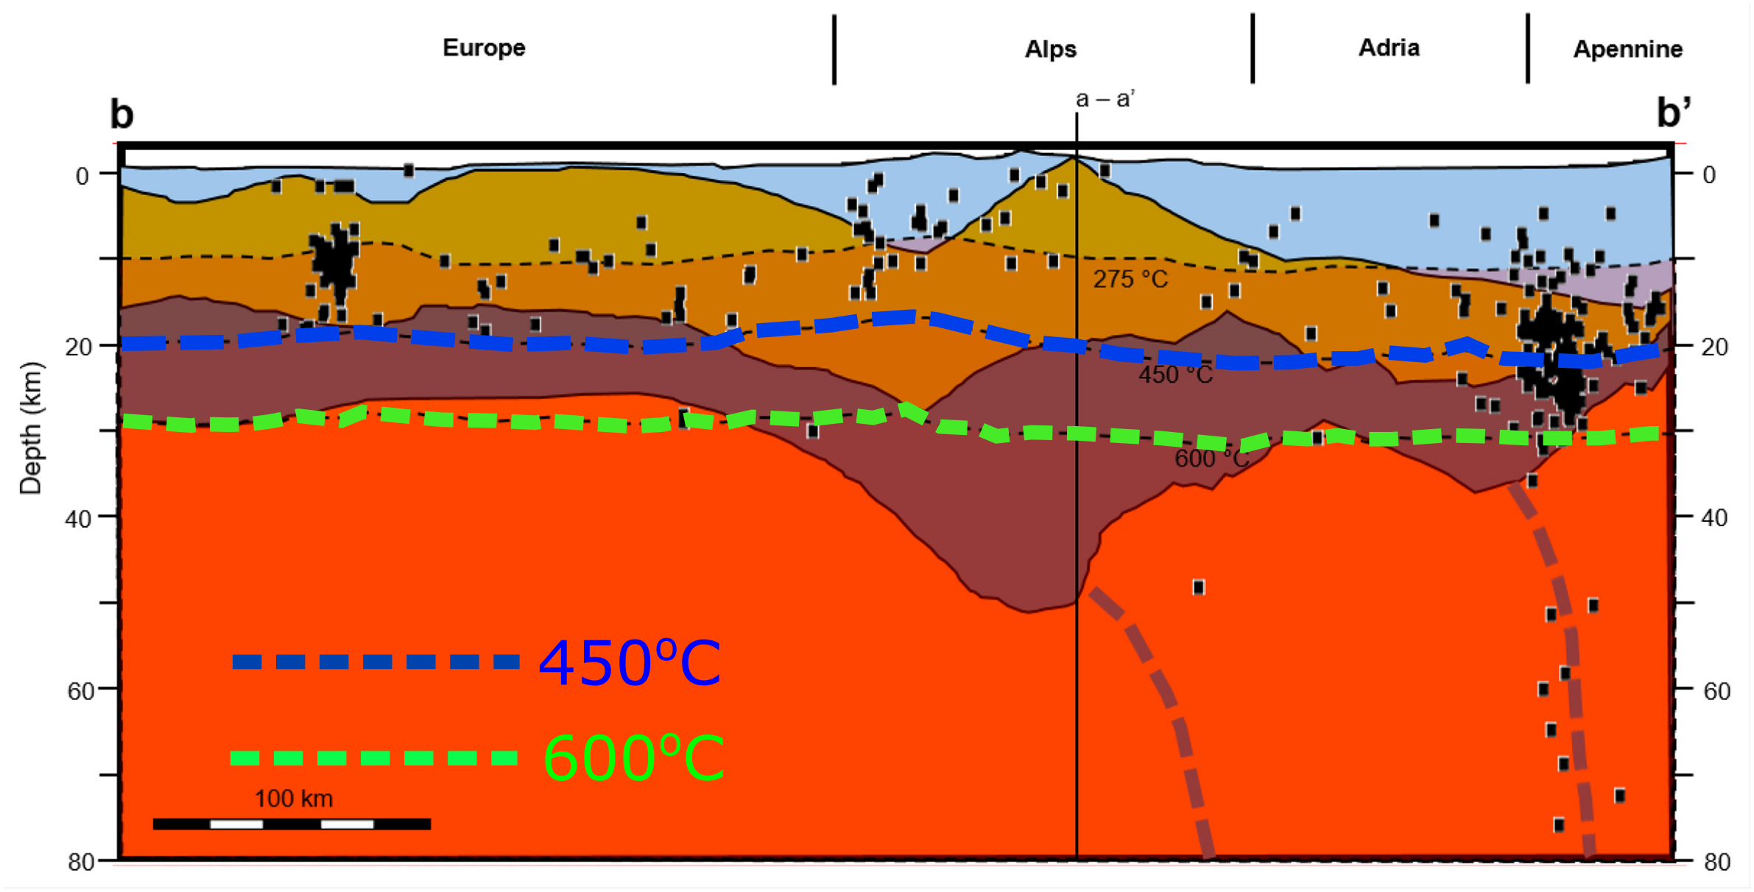
Upper crust
Lower crust
Subduction
Europe
Alps
Adria
Regions where seismicity is above 600 ºC are know to have subducting slab as in Apennine.
ISC reviewed bulletin
Spooner et al. (2020)

Slide 5
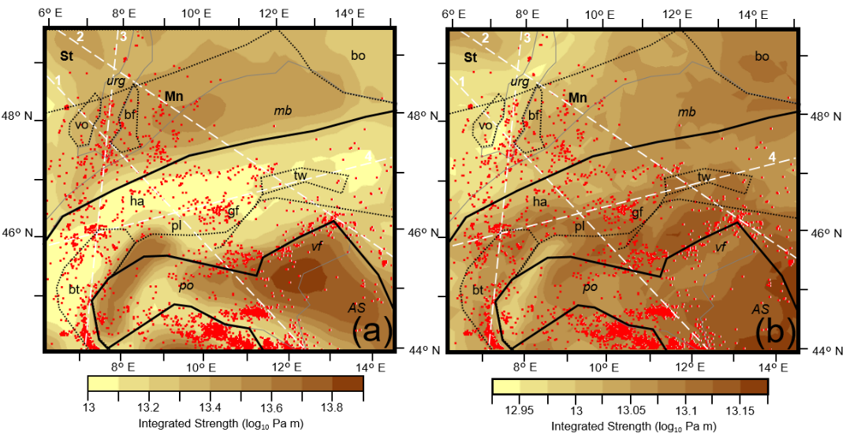
Upper crust
Lower crust
Subduction
Lithospheric
strength
Crustal
strength
Weak
Strong
ISC reviewed bulletin
*Earthquakes complemented by local catalogue.
Alpine seismicity correlates to weaker regions of both crust and lithosphere, North and West of the Guidicarie line.
Spooner et al. (2021) in review

Slide 6
Upper crust
Lower crust
Subduction
Lithospheric
strength
Crustal
strength
Weak
Strong
ISC reviewed bulletin
Northern foreland seismicity correlates to weaker areas of the crust (CERS), where temperatures are higher and the crust is thinned.
*Earthquakes complemented by local catalogue.
Spooner et al. (2021) in review

Slide 7
Upper crust
Lower crust
Subduction
Lithospheric
strength
Crustal
strength
Weak
Strong
ISC reviewed bulletin
Southern foreland seismicity correlates with lithospheric strength, occurring at the edges of the strong Adriatic indenter.
*Earthquakes complemented by local catalogue.
Spooner et al. (2021) in review

Slide 8
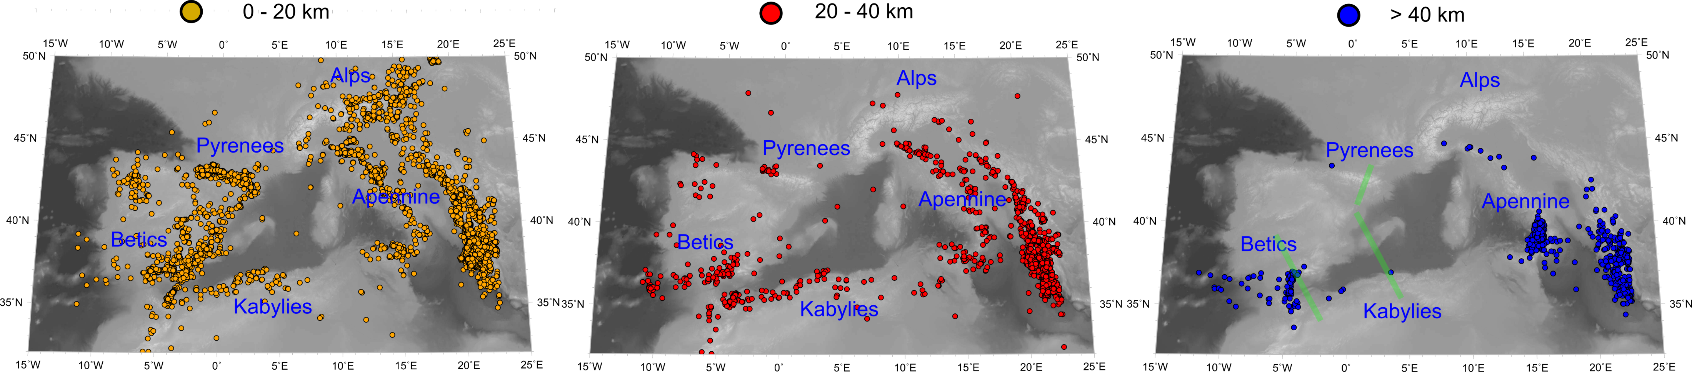
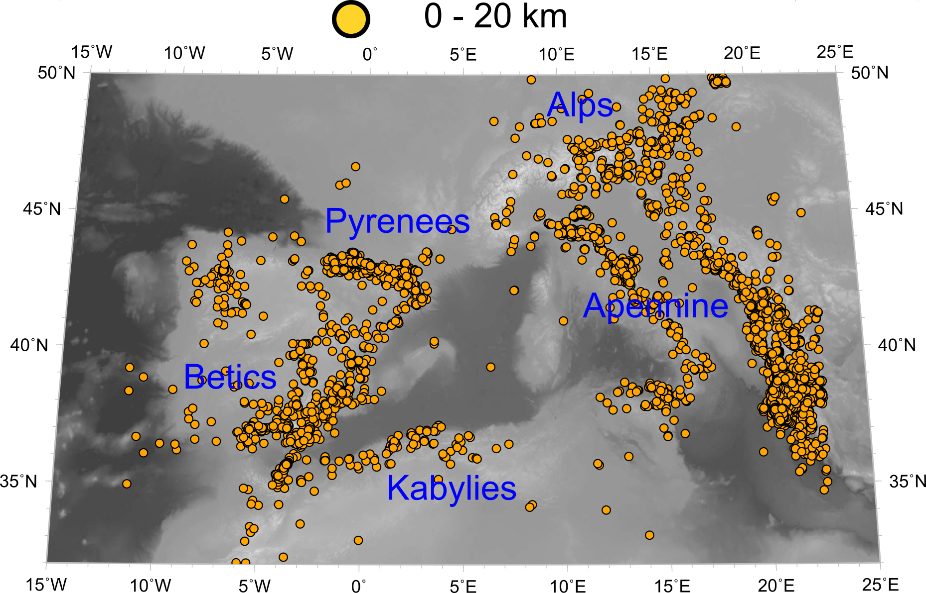
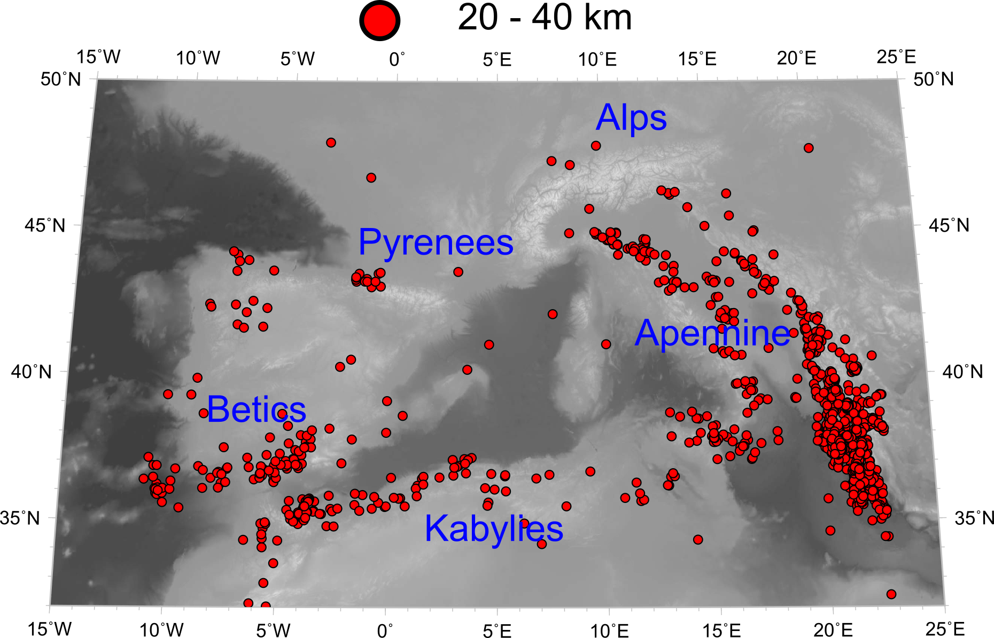
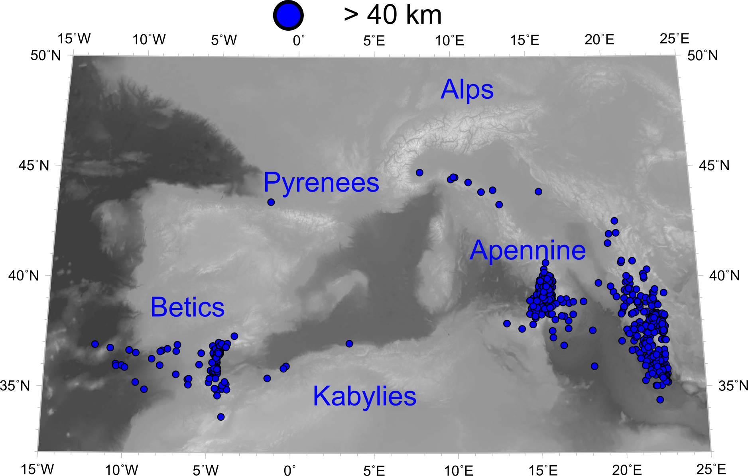
Despite the similar order of convergence rate different depth level seismicity!
Betics and Kabylies show entire crustal level seismicity.
Upper crust level seismicity
Lower crust level seismicity
deep seismicity
In the other mountains of the Western Mediterranean where convergence rate are of similar order of magnitude as Alps, Betics and Kabylies show whole crust level seismicity and Pyrenees, similar to the Alps, upper crust level seismicity.

Slide 9
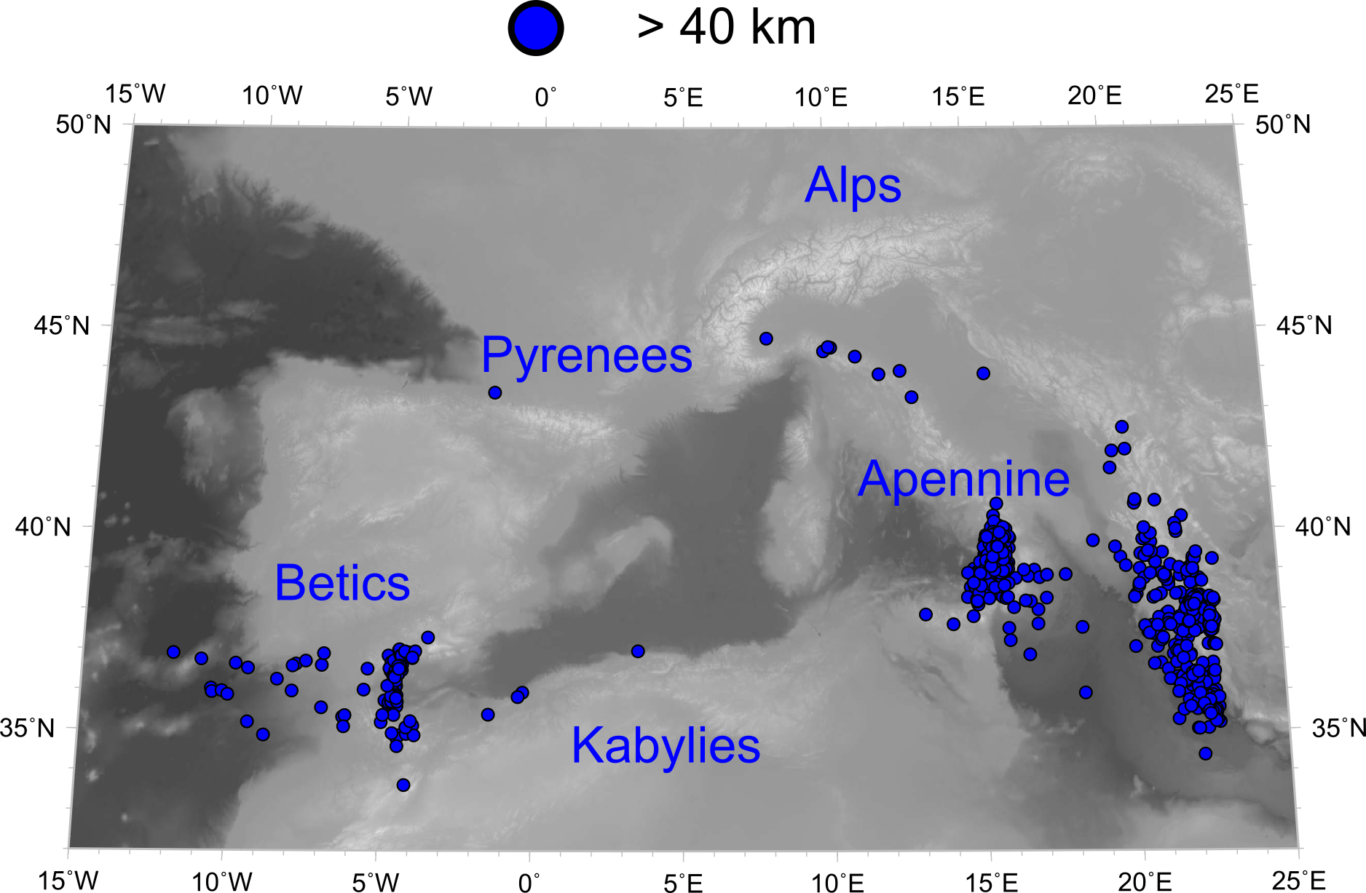
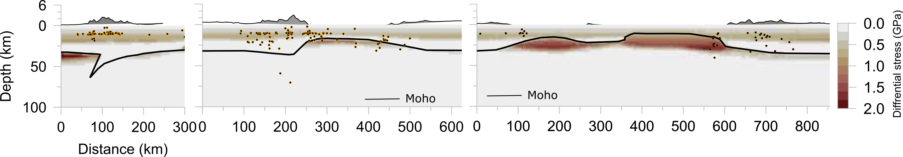
Seismicity in Betics is bounded by the stronger and recently thinned lithosphere of Alboran basin.
Seismicity in Kabylies is bounded by the stronger and recently generated back-arc oceanic lithosphere of Algerian basin.
North
Pyrenees
Betics
Alboran Basin
CCR
Algerian Basin
Kabylies
Weak
Strong
Kumar et al. (2021) in review;Carballo et al., (2015a)

Slide 10
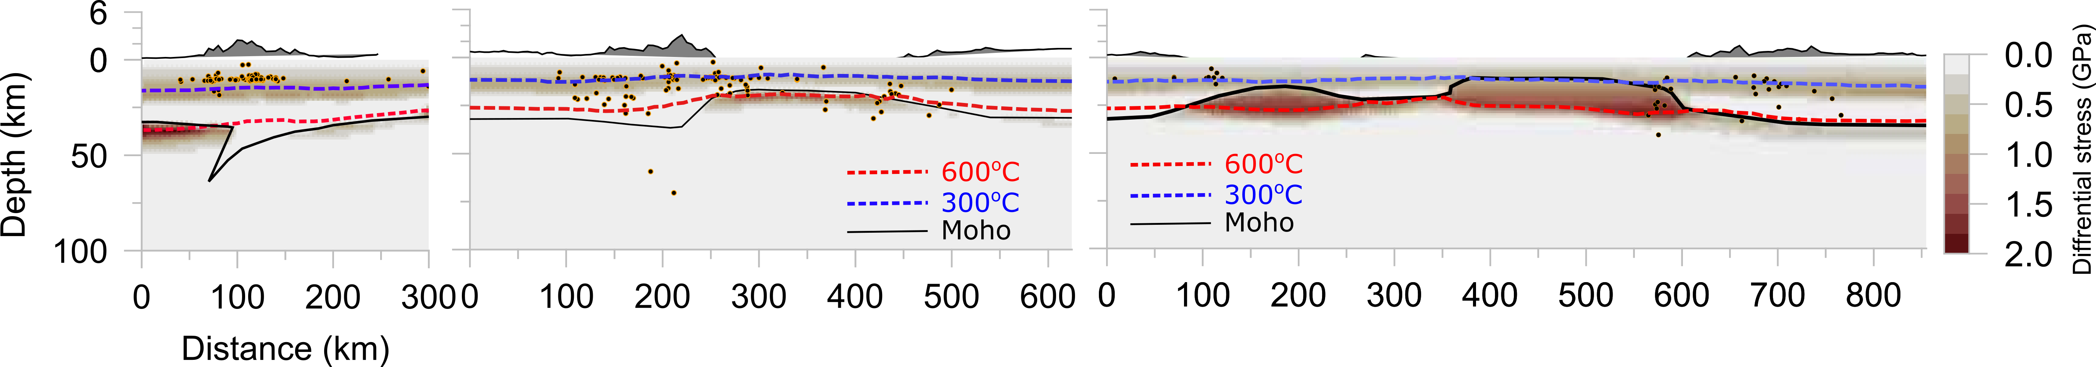
Seismicity is bounded by ~650 ºC isotherm in Betics and Kabylies.
Whereas by ~300 ºC isotherm in Pyrenees and Catalan Coastal Ranges (CCR)
Except in orogens where slabs are imaged in the mantle.
Pyrenees
Betics
Alboran Basin
CCR
Algerian Basin
Kabylies
Weak
Subduction?
Alboran slab
Strong
Kumar et al. (2021) in review; Carballo et al., (2015a)

Slide 11
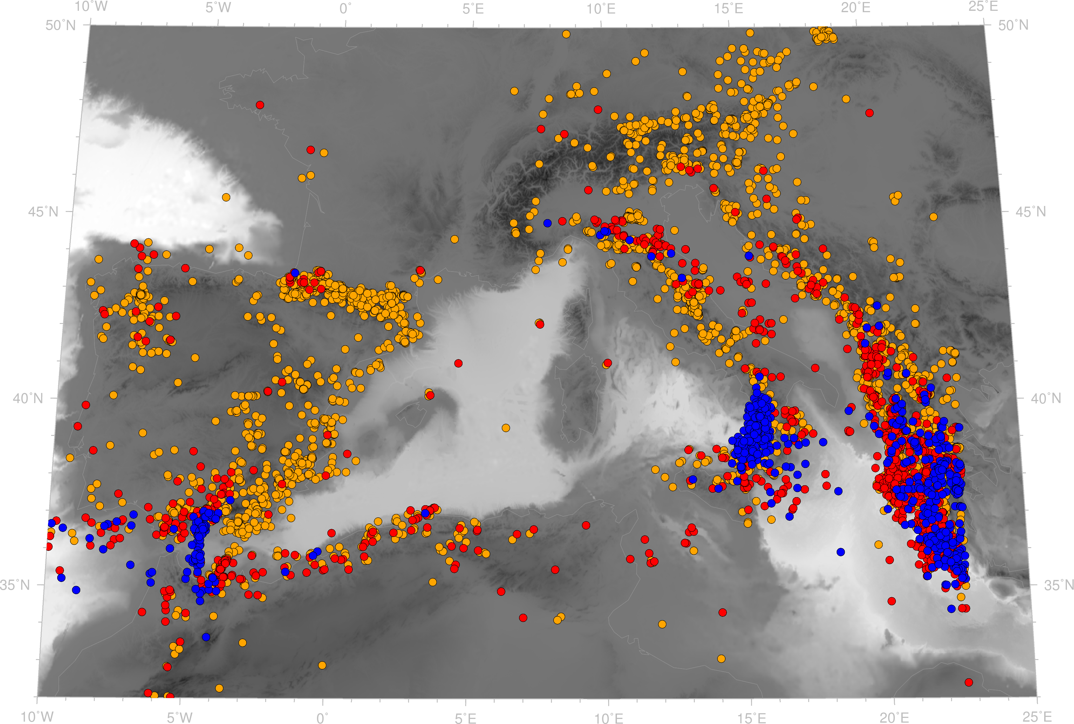
Outlook
Upper crust
Lower crust
Subduction
Why do we have whole crust level seismicity in the Betics and Kabylies in comparison to the Alps and Pyrenees?
Does it have to do with the active subduction in the Betics and initiation of subduction at north margin of Africa?
What does it tell us about the composition or the hydration state of the crust?
How does other mountains in the Alpine-Himalayan collision zone, e.g. Tibet, Zagros, compares to their respective forelands?
Alps
Pyrenees
Apennine
Betics
Kabylies
Kumar et al. (2021) in review; Carballo et al., (2015a)

