Slide 1

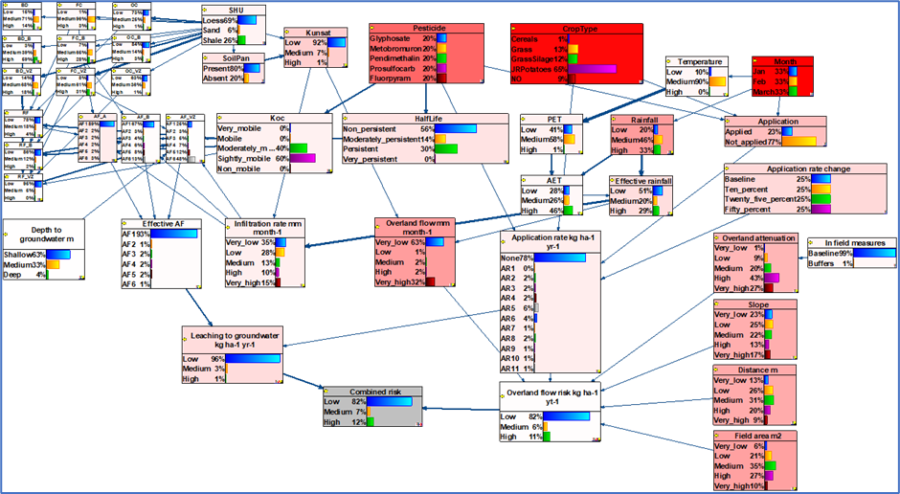
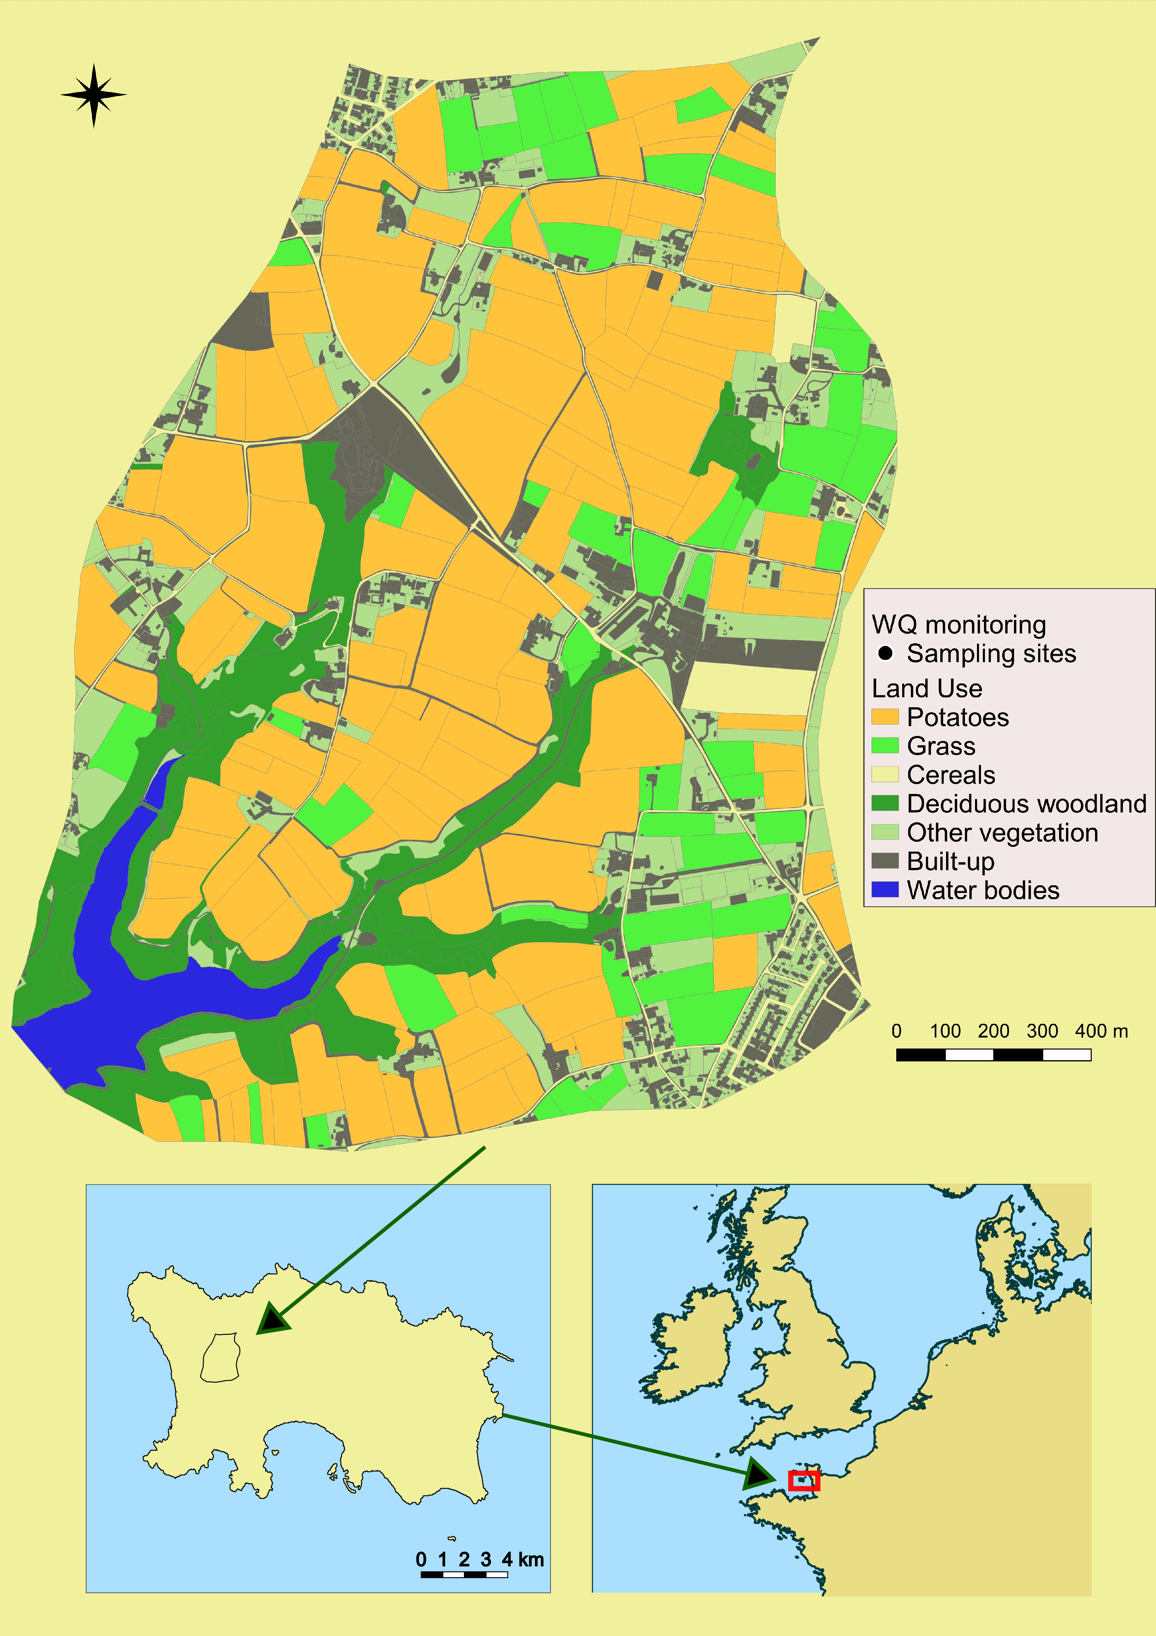
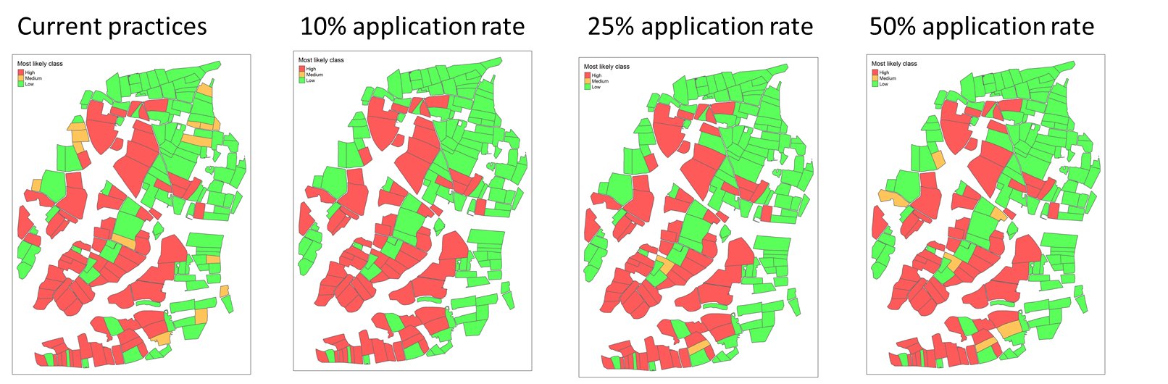
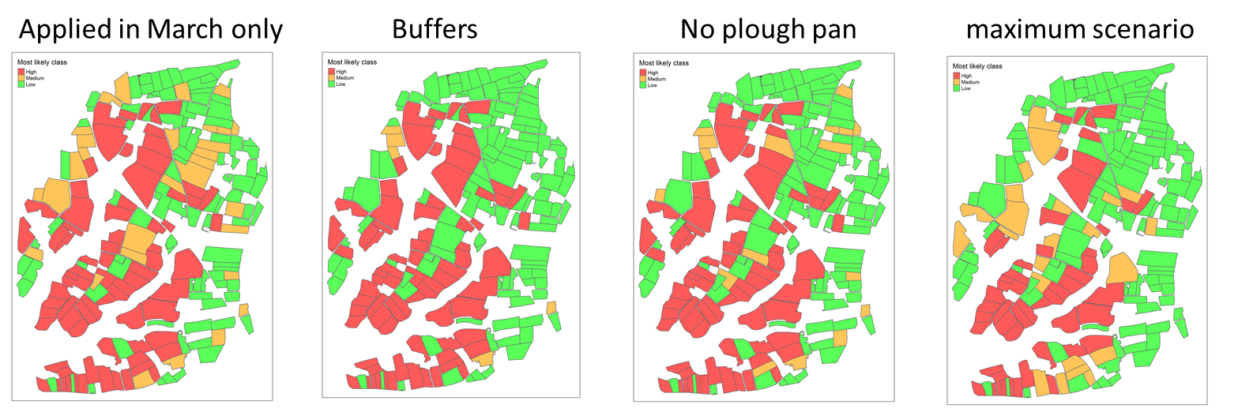
A probabilistic decision support tool for field level pesticide risk assessment in a small drinking water catchment on the Island of Jersey
Miriam Glendell¹, Mads Troldborg¹, Zisis Gagkas¹, Andy Vinten¹, Allan Lilly¹, and Donald Reid²
¹The James Hutton Institute, Environmental and Biochemical Sciences Group, Craigiebuckler, Aberdeen , Scotland, UK Email: miriam.glendell@hutton.ac.uk
²Jersey Water, Mulcaster House, Westmount Road, Jersey, JE1 1DG
Pesticides continue to present a significant risk to drinking water quality.
Effectiveness of pollution mitigation measures is uncertain and needs to consider local biophysical, agronomic and social aspects.
We developed a probabilistic decision support tool (DST) based on spatial Bayesian Belief Networks (BBN) to simulate inherent pesticide leaching risk to ground- and surface- water quality in a small drinking water catchment (3.5 km²) with limited observational data.
The simulated inherent risk of pesticide loss via overland flow and leaching to groundwater for five active ingredients considered:
climate and hydrology (temperature, rainfall, evapotranspiration, overland and subsurface flow)
soil properties (texture, organic matter content, water retention)
topography (slope, distance to surface water/depth to groundwater)
landcover and agronomic practices, pesticide properties and usage
Simulated mitigation measures included:
timing of pesticide application
10%, 25% and 50% reduction in application rate
field buffers
presence/absence of soil pan
Figure 1 Val de la Mare catchment on the Island of Jersey
Figure 3 Full conceptual model structure. Deeper red indicates more sensitive variables. Application timing, active ingredient and crop type were identified as the most important risk factors.
Figure 4 Overland risk for Methobromuron. Combined interventions of 50% reduced pesticide application rate, management of plough pan, delayed application timing and field buffer installation reduced the probability of high-risk from overland flow while the impact of individual interventions was limited.
Figure 2 Conceptual diagram of sub-models represented in the BBN
Acknowledgements
This research was funded by Jersey Water company.
The graphical nature of the BBN facilitated interactive model co-development and was deemed ideal for engaging in dialogue with stakeholders. The model can be easily transferred to similar catchments with limited data, while accounting for uncertainties.

