Slide 1
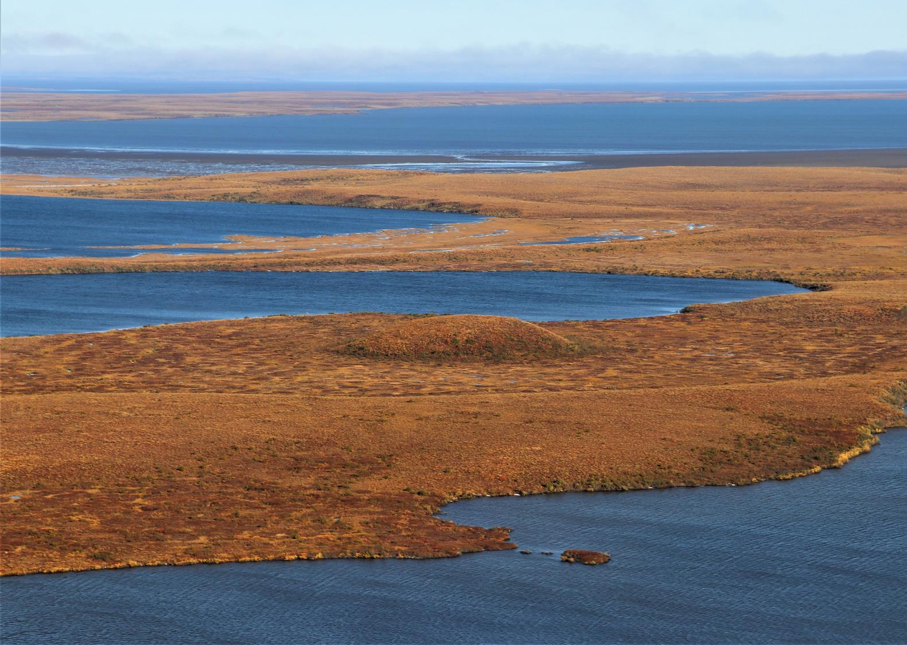

Multi-methodological three-dimensional investigation of a closed-system Pingo in Northwestern Canada
Julius Kunz & Christof Kneisel

Slide 2
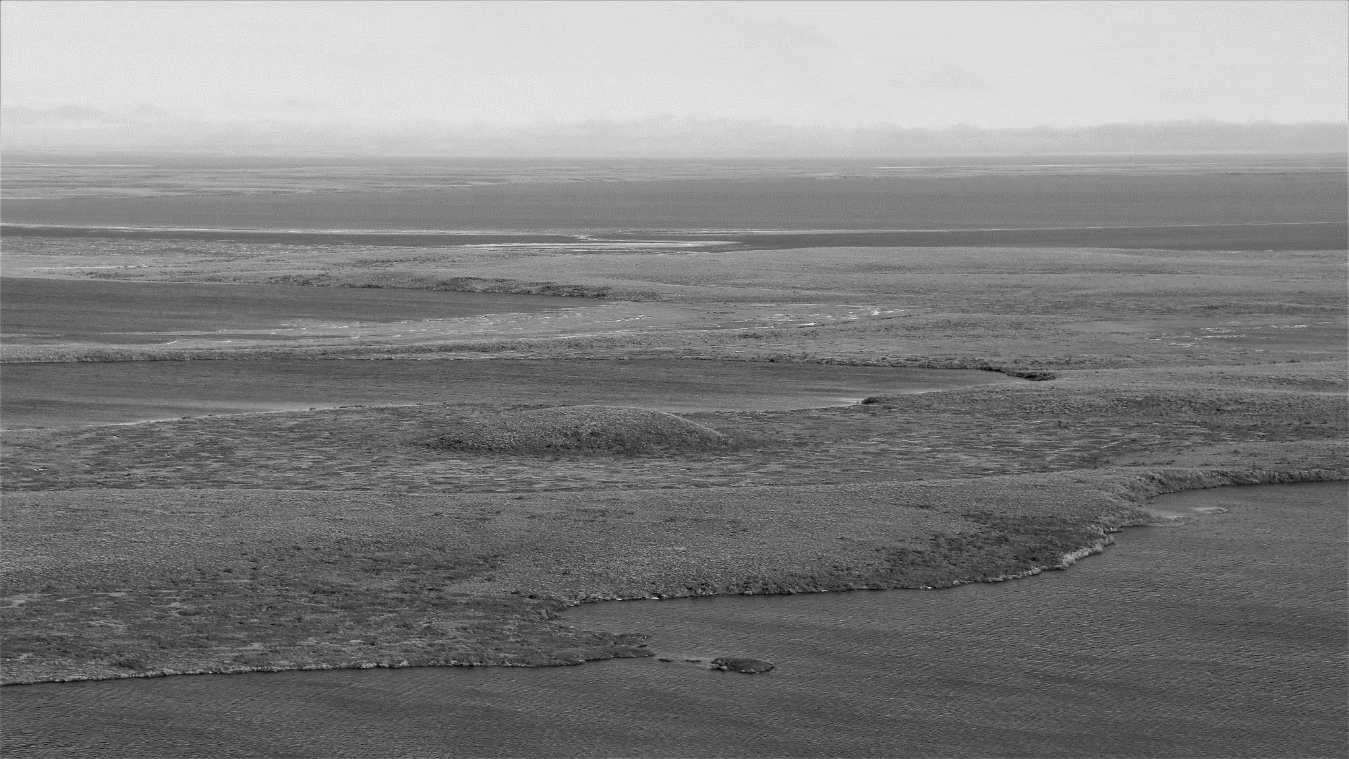
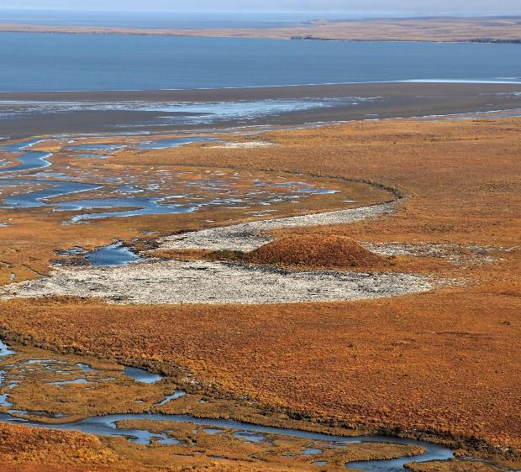
Home
Introduction
Theory of closed-system pingo formation
References
Conclusion
Study Site
Discussion
Methods
Results

Slide 3
Introduction
pingos are one of the largest periglacial landforms on earth
they are sensitive to climate change due to the massive ice core
their internal structures have been studied only rarely using three-dimensional approaches
the knowledge about internal heterogeneties within pingos is limited
the current study presents a detailed three-dimensional (geophysical) investigation of internal structures of a closed-system pingo

Slide 4
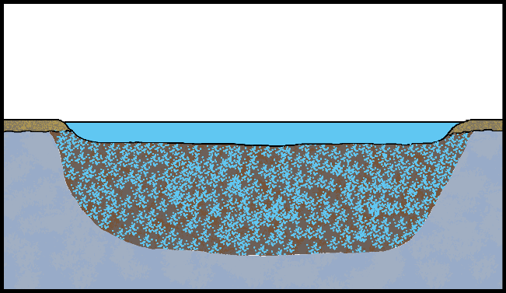
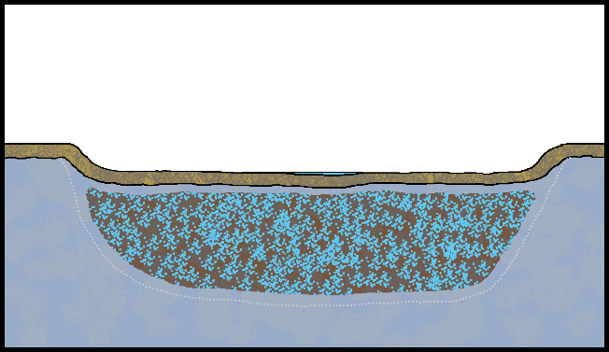
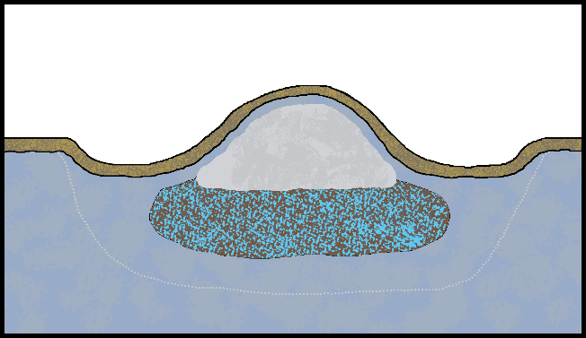

State of the Art – closed-system pingo formation
Klick on the sketches for more details!
Fig. 1: Schematic model of closed-system pingo formation.

Slide 5
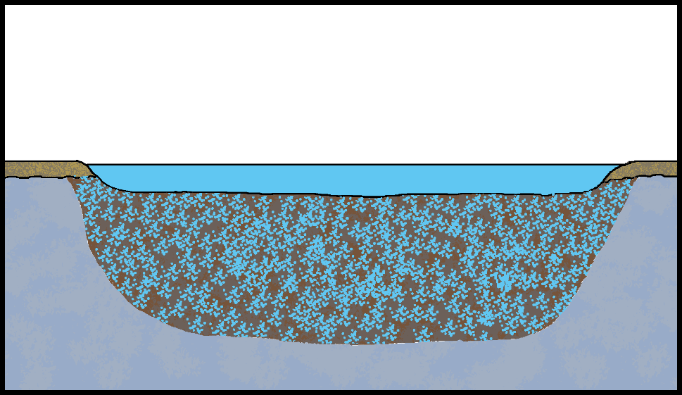
State of the Art – closed-system pingo formation
State I
thermal influence by thermokarst lake due to high heat capacity of water
talik formation if water depth exceeds 2/3 of the late winter lake ice thickness
thermo erosion leads to lake enlargement and therefore to talik enlargement
Fig. 2: Closed-system pingo formation – State I.

Slide 6

State of the Art – closed-system pingo formation
State II
(partial) lake drainage prevents further talik isolation
initial permafrost recovery starts at the surface, but also at the bondary to the surounding permafrost
top-down refreeze isolates the talik, forming a closed hydrological sytem
residual pond
former talik boundary
Fig. 3: Closed-system pingo formation – State II.

Slide 7
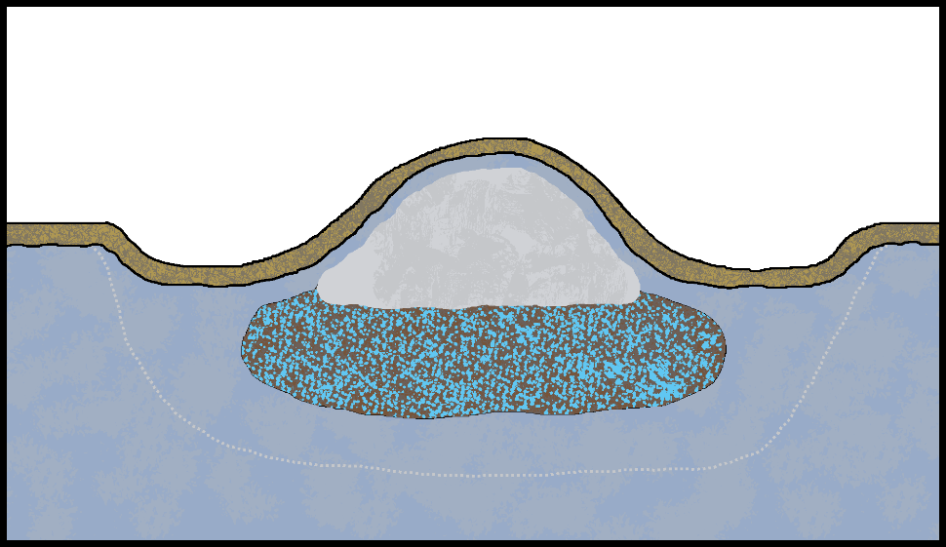
State of the Art – closed-system pingo formation
State III
top-down and bottom-up refreeze generate hydrostatic pressure within the closed system
pressurized water migrates towards the surface, where it freezes due to lower temperatures
formation of a massive ice core consisting of injection and segregation ice
volume increase of freezing water leads to an uplift of the land surface
residual talik / sub-pingo water lense
former talik boundary
Fig. 4: Closed-system pingo formation – State III (after Kunz & Kneisel¹).

Slide 8
Study site
located in the southern part of the Tuktoyaktuk Peninsula southeast of Parsons Lake
surface geology: Wisconsinan sandy ice-contact deposits of the Laurentide Ice Sheet²
mean anual air temperature*: -9°C
mean anual precipitation*: 200 mm
continous permafrost, permafrost temperatures between -5°C and -6°C⁵
Fig. 5: Landsat true-color composit of the Mackenzie-Delta region after Nill et al.⁶.
* derived based on a linear gradient between the climate stations Tuktoyaktuk and Inuvik^{3,4}

Slide 9
Study site
slightly oval-shaped pingo
  length: 190 m
  width: 140 m
  height: 4.5 m
  classified as broad-based pingo after Walker et al.⁷
drained lake basin area: 0.118 km²
Have a look at the pingo!
Fig. 6: Arctic DEM⁸ (top) and UAV-based DEM (bottom) of the study area (after Kunz & Kneisel¹).

Slide 10
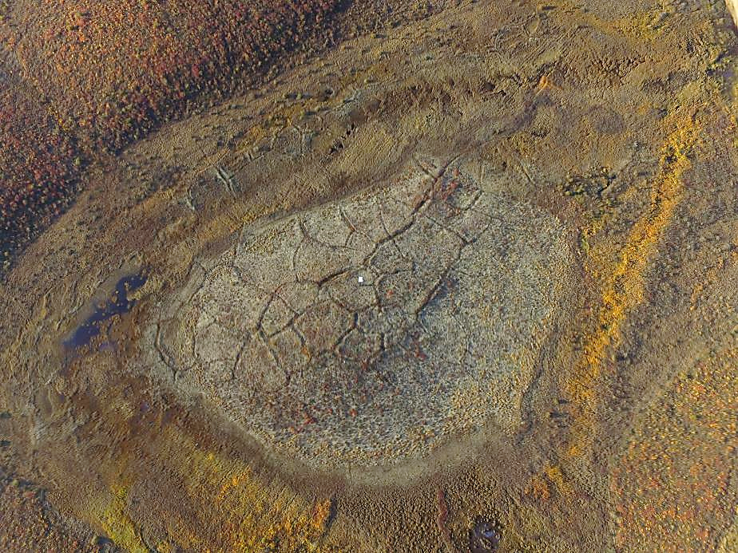
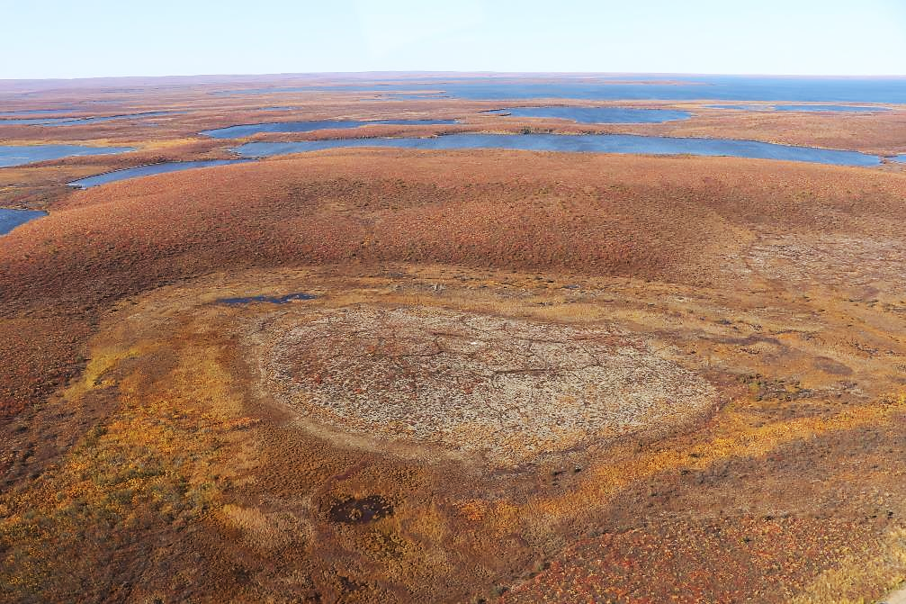
Study site
Have a look at the pingo!
Fig. 7 & 8: UAV based images of the investigated pingo, September 2019 (J. Kunz / A. Bury).

Slide 11
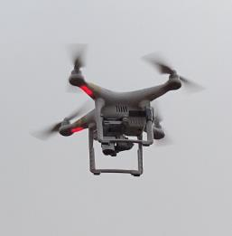
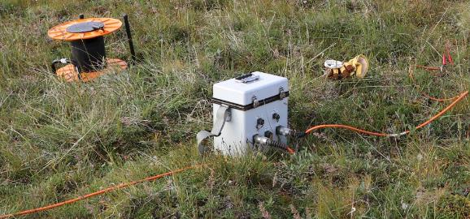
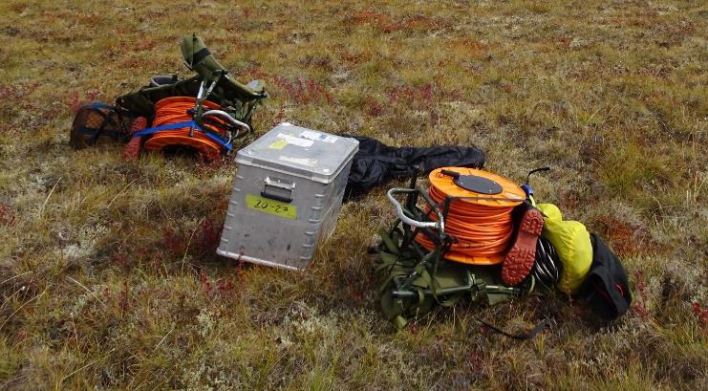
Methods
quasi-3D Electrical Resistivity Tomography (ERT)
Ground-penetrating Radar (GPR)
manual frost probing (every 6 m)
UAV-based Structure-from-Motion
  DEM and Orthophoto generation
more about ERT measurements
more about GPR measurements

Slide 12
Quasi-3D Electrical Resistivity Tomography
Syscal Switch Pro (Iris Instruments)
dipole-dipole array
21 longitudinal profiles
  72 electrodes
  3 m electrode spacing
  6 m interline spacing
13 cross profiles
  72 electrodes
  2 m electrode spacing
  12 m interline spacing
data processing: Res3DINVx64
Fig. 9: Electrode positions of the q3D ERT grid.

Slide 13
Ground-penetrating Radar (GPR)
NOGGIN-System
(Sensors and Software Inc.)
250 MHz antennas (unshielded)
38 longitudinal profiles
  1 m / 2 m interline spacing
data processing: EKKO Project V5
Fig. 10: Location of the GPR grid.

Slide 14
Results – Frost Probing
Frost probing shows distinct zonation of active layer depths (ALDs):
  high ALDs in the surrounding flat (and wet) area (> 50 cm)
  low ALDs in the transition zone (15 – 30 cm)
  medium to low ALDs in the elevated area (25 – 45 cm)
    only at single spots in the elevated part the ALD rises above 55 cm
  in some areas of ponding water the permafrost table could not be detected and musst be located deeper than 120cm below the ground surface
Fig. 11: Active layer depth derived from frost probing (after Kunz & Kneisel¹).

Slide 15
Results – GPR
GPR enabled area-wide detection of the permafrost table and displayed also small-scale variabilities
GPR derived ALDs show significant relation between higher ALDs and frost crack / ice wedge positions in the elevated area of the pingo
detection of ice wedges up to a depth of 3 m below the surface
Fig. 12: examplary GPR profile showing the permafrost table (red line) and some ice wedges (a) and derived ALDs (b). Location of (a) is marked with the black arrow in (b).¹.

Slide 16
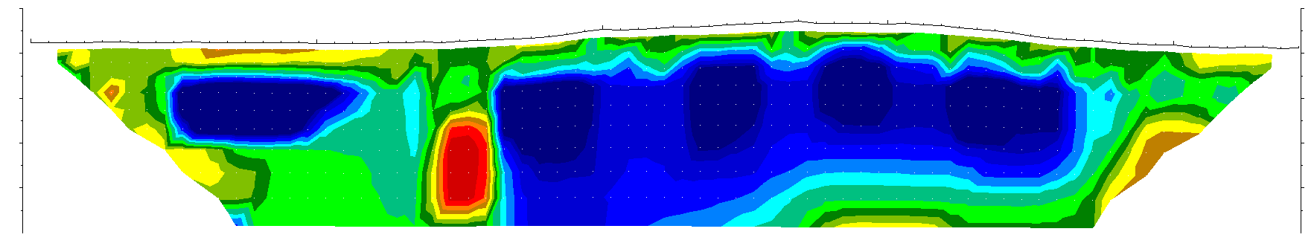
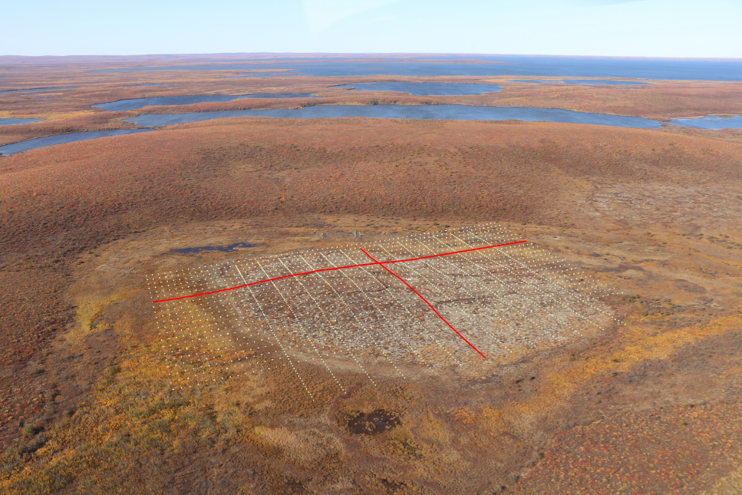
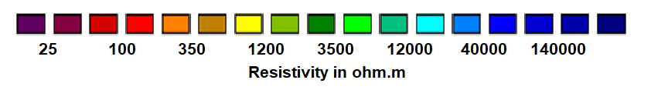
Results – Internal Structure
40
21
69
117
165
ERT enabled a delineation of frozen and unfrozen areas in the subsurface
  cross-checking with frost probing results delivered a threshold range between 800 Ωm and 1000 Ωm for the delineation of the active layer and underlying permafrost
  < 800 Ωm: (partly) unfrozen
  > 1000 Ωm: frozen
  > 30.000 Ωm: massive (pingo) ice
30
Elevation (m a.s.l.)
20
Iteration: 5
Abs error: 11.4 %
Klick here to see the cross profile!
Fig. 13: Longitudinal ERT profile.

Slide 17
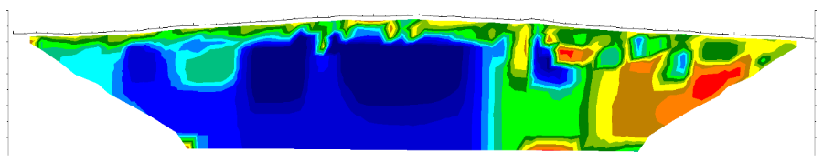
Results – Internal Structure
32
64
96
128
ERT enables a delineation of frozen and unfrozen areas in the subsurface
  cross-checking with frost probing results delivered a threshold range between 800 Ωm and 1000 Ωm for the delineation of the active layer and underlying permafrost
  < 800 Ωm: (partly) unfrozen
  > 1000 Ωm: frozen
  > 30.000 Ωm: massive (pingo) ice
30
Elevation (m a.s.l.)
20
Iteration: 5
Abs error: 7.5 %
Fig. 14: ERT cross profile.

Slide 18
Results – Internal Structure
q3D-ERT enabled a detailed delineation of the massive ice core
  ~ 200 m in length, but less than 100 m in width
  upper boundary: ~ 3 m below the ground surface
  lower boundary: in > 20 m depth
  contrary to expectations, its position and shape does not correspond to that of the pingo
eastern flank of the pingo is characterised by low electrical resistivity values indicating at least partly unfrozen conditions
conection between the partly unfrozen area and the active layer in the southernmost part of the grid
currently no hydrostatic pressure
Fig. 15: Selected depth slices of the q3D ERT grid data set, which is characterised by an absolute error of 4.73 % using the 5th iteration. ERT scale as seen before.¹

Slide 19
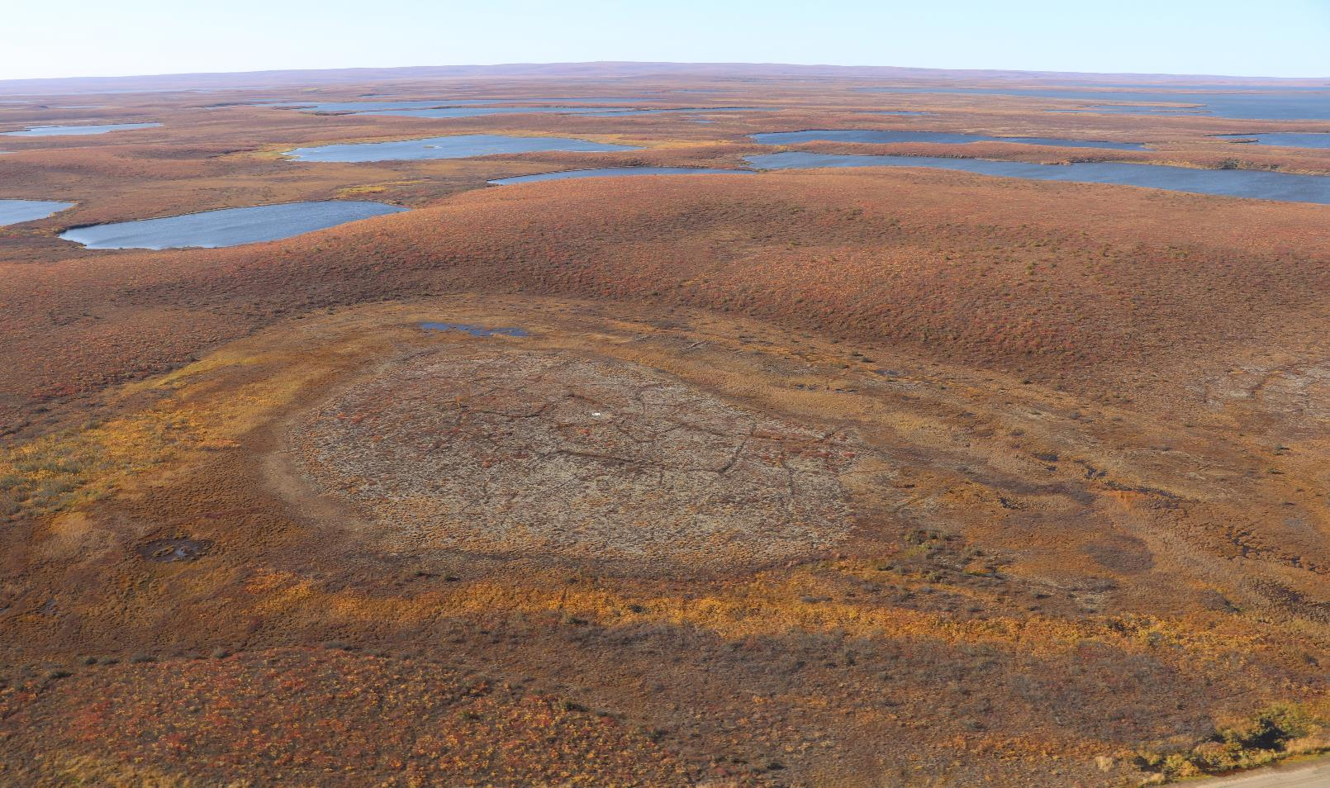
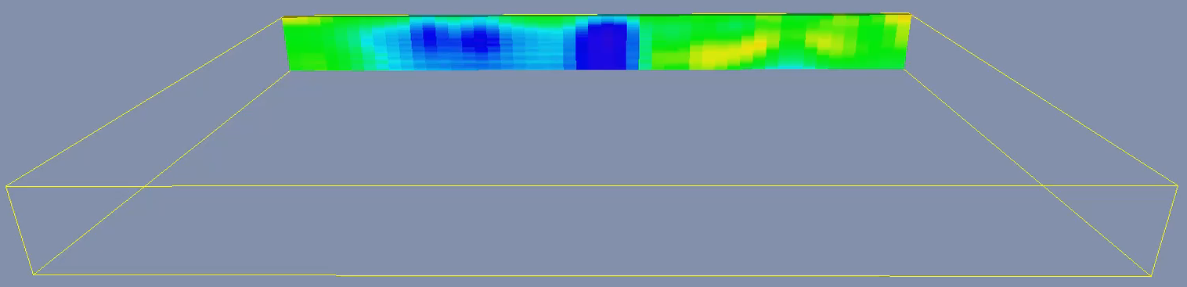
Results – Internal Structure
Klick on the video to start!

Slide 20
Discussion
Theory vs. Reality
???
Fig. 16: Schematic illustration of the differences between theory (left) and the findings based on our ERT model (right).¹

Slide 21
Discussion
The internal structures of the investigated pingo differ significantly from the theoretical buildup of closed-system pingos ^{(e.g. 9, 10)}
  massive ice core is not located below the centre of the pingo
  the eastern flank is underlain by (at least partly) unfrozen sediments
  currently the system is not a closed system, since there is a connection between the partly unfrozen area and the active layer
But why?

Slide 22
Discussion
  But why? …possible reasons:
Missing hydrostatic pressure
Ice core location and talik preservation in the eastern flank
sequenced lake drainage
no morphological hints within the drained lake basin!
different ground temperature regimes due to asymmetric snow accumulation
no asymmetric snow cover or snow melt visible in remote sensing data!
thermal impact by lateral water flow within the active layer beside the eastern flank of the pingo
    possible, due to surface water discharge into the drained lake basin by a more southern lake!
methodological uncertainties in the ERT-based delineation of frozen and unfrozen areas
    should be excluded by cross check with frost probing results!
    cannot be ruled out completely due to possible salt expulsion within the talik, but the region is not known for high pore water salinity
connection between talik and active layer is possibly only a recent feature caused by increasing ALDs
connection is may part of the transition layer and exists only in years with especially high ALDs
the system is only a seasonal closed system
  questionable whether hydrostatic pressure generated by this is sufficient for uplift

Slide 23
Conclusion
the multi-methodological approach enabled an area-wide delineation of frozen and unfrozen areas
  high-resolution information on ALDs and permafrost table topography
  detailed three-dimensional delineation of the massive ice core and the adjacent talik (or partly unfrozen area at least)
the results present internal structures differing significantly from currently accepted theory
  Are pingos possibly more heterogeneous and complex in their structure than previously thought?

Slide 24
Thanks for your interest!
If you have any questions…
… contact us during the discussion…
… and have a look at our new paper:
Kunz, J., & Kneisel, C., (accepted): Three-dimensional investigation of an open- and a closed-system Pingo in northwestern Canada. Permafrost and periglacial processes.

Slide 25
References
¹Kunz, J., & Kneisel, C., (accepted): Three-dimensional investigation of an open- and a closed-system Pingo in northwestern Canada. Permafrost and periglacial processes.
² Rampton, V. N., & Wecke, M. (1987). Surficial Geology, Tuktoyaktuk Coastlands, District of Mackenzie, Northwest Territories. Geological Survey of Canada.
³Government of Canada. Canadian Climate Normals 1981-2010 Station Data - TUKTOYAKTUK A. Published December 4, 2019. Accessed May 28, 2020. URL: https://climate.weather.gc.ca/climate_normals/results_1981_2010_e.html? searchType=stnName&txtStationName=tuktoyaktuk&searchMethod=contains&txtCentralLatMin=0&txtC entralLatSec=0&txtCentralLongMin=0&txtCentralLongSec=0&stnID=1700&dispBack=1.
⁴Government of Canada. Canadian Climate Normals 1981-2010 Station Data - INUVIK A. Published December 4, 2019. Accessed May 28, 2020. URL: https://climate.weather.gc.ca/climate_normals/results_1981_2010_e.html?search Type=stnName&txtStationName=Inuvik&searchMethod=contains&txtCentralLatMin=0&txtCentralLatSec=0&txtCe ntralLongMin=0&txtCentralLongSec=0&stnID=1669&dispBack=1.
⁵Burn, C. R., & Kokelj, S. V. (2009). The environment and permafrost of the Mackenzie Delta area. Permafrost and periglacial processes, 20(2), 83-105.
⁶Nill, L., Ullmann, T., Kneisel, C., Sobiech-Wolf, J., & Baumhauer, R. (2019). Assessing spatiotemporal variations of Landsat land surface temperature and multispectral indices in the Arctic Mackenzie Delta Region between 1985 and 2018. Remote Sensing, 11(19), 2329.
⁷Walker, D. A., Walker, M. D., Everett, K. R., & Webber, P. J. (1985). Pingos of the Prudhoe Bay Region, Alaska. Arctic and alpine research, 17(3), 321-336.
⁸Porter C, Morin P, Howat I, et al. ArcticDEM. Published online 2018. doi:10.7910/DVN/OHHUKH
⁹Mackay, J. (1998). Pingo growth and collapse, Tuktoyaktuk Peninsula area, western Arctic coast, Canada: A long-term field study. Géographie physique et Quaternaire, 52(3), 271-323.
¹⁰Gurney, S. D. (1998). Aspects of the genesis and geomorphology of pingos: perennial permafrost mounds. Progress in Physical Geography, 22(3), 307-324.

