Slide 1




Evaluation of three short-range (0-6h) rain ensemble forecasts: study of the Aude October 2018 flash floods (southeastern France)
Charpentier--Noyer, M.¹,
Payrastre, O.¹,
Gaume, E.¹,
Nicolle, P. ¹,
Bouttier, F. ²,
Marchal, H. ²
¹ GERS-LEE, Univ Gustave Eiffel, IFSTTAR, F-44344 Bouguenais, France
² CNRM, Université de Toulouse, Météo-France, CNRS, Toulouse, France

Slide 2
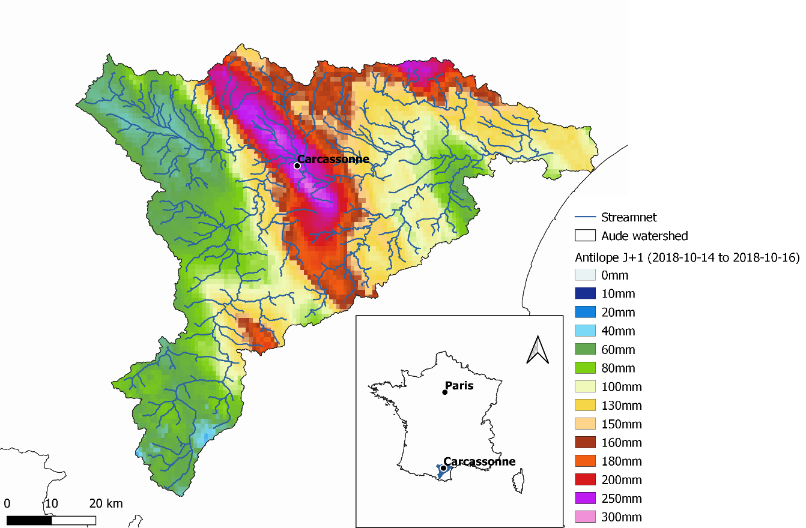
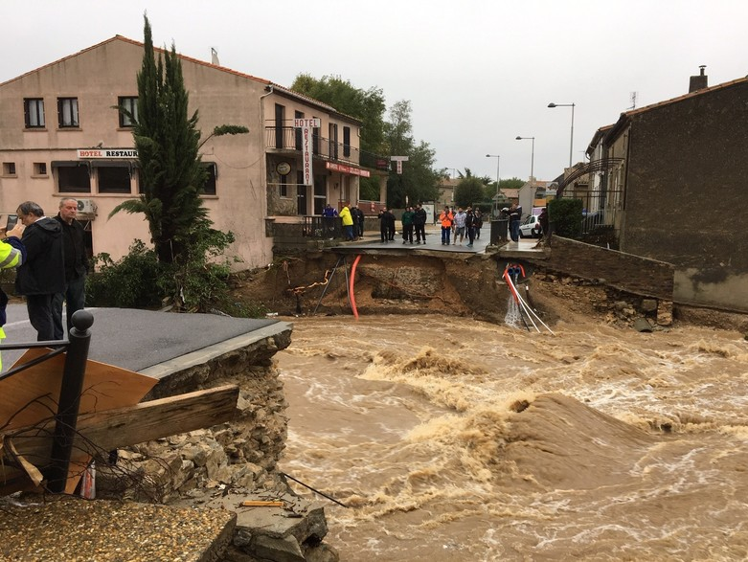




The October 2018 flash flood event in the Aude river watersheld
The October 2018 flash flood
Short range rainfall ensemble forecast products
Hydrological ensemble forecasts
First evaluation results
Second evaluation framework
Results
Conclusions
Figure 1: Location of the event and cumulated measured rainfall (14-16 October 2018) and consequences on a small town Villegailhenc (from Nice-Matin)
An historical flood on the intermediate part of the Aude river and its tributaries
Maximum observed rainfall close to 300mm in Carcassonne (210mm in 6 hours)
Casualties:
    15 deaths
    A hundred injuried people
Larges damages to buildings and infrastructures:
  200 million euros of material damages (CCR)
1

Slide 3
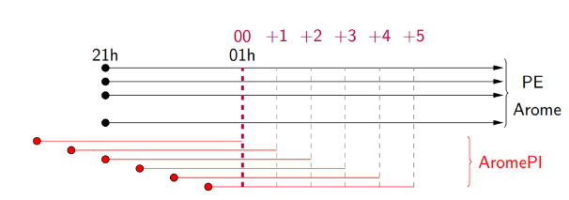
Short range rainfall ensemble forecast products (A. Fleury – CNRM – 2019) (1/4)
The October 2018 flash flood
Short range rainfall ensemble forecast products
Hydrological ensemble forecasts
First evaluation results
Second evaluation framework
Results
Conclusions
Three different short range ensemble products proposed (PICS project):
AROME-PE :
  Ensemble of 12 AROME simulations
  The only operational ensemble forecast product compatible with flash flood forecasting
06h
Figure 2: Representation of the PE ensemble
Adapting from : Fleury, A. (2019), Approche ensembliste pour la production de scénarios de pluie adaptées aux échéances courtes.
2

Slide 4
Short range rainfall ensemble forecast products (A. Fleury – CNRM – 2019) (2/4)
The October 2018 flash flood
Short range rainfall ensemble forecast products
Hydrological ensemble forecasts
First evaluation results
Second evaluation framework
Results
Conclusions
Three different short range ensemble products proposed (PICS project):
PEPI:
  New product developed in the framework of PICS
  Combination of AROME-PE and AROME-PI (lag ensemble of a determinist forecast)
Figure 3: Combining the forecasts to obtain the PEPI ensemble
From : Fleury, A. (2019), Approche ensembliste pour la production de scénarios de pluie adaptées aux échéances courtes.
3

Slide 5
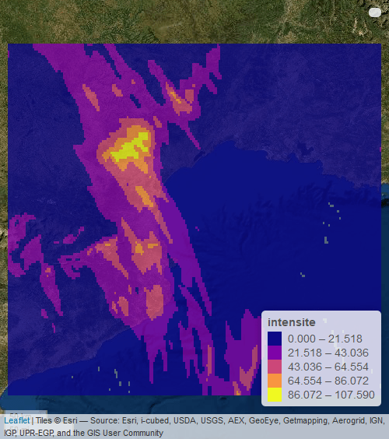
Short range rainfall ensemble forecast products (A. Fleury – CNRM – 2019) (3/4)
The October 2018 flash flood
Short range rainfall ensemble forecast products
Hydrological ensemble forecasts
First evaluation results
Second evaluation framework
Results
Conclusions
Three different short range ensemble products proposed (PICS project):
PertDpepi:
  New product developed in the PICS project
  Combination of AROME-PE and AROME-PI: same basis as PEPI
  Addition of spatial perturbations > location uncertainties (4 members)
4
Figure 3: Illustration of the spatial perturbation for the ensemble pertDpepi

Slide 6
Short range rainfall ensemble forecast products (A. Fleury – CNRM – 2019) (4/4)
The October 2018 flash flood
Short range rainfall ensemble forecast products
Hydrological ensemble forecasts
First evaluation results
Second evaluation framework
Results
Conclusions
Synthesis for the three different short range ensemble products:
Table 1: Evolution of the members number according to the lead-time
Lead-time | +1h | +2h | +3h | +4h | +5h | +6h
PE | 12 members | 12 members | 12 members | 12 members | 12 members | 12 members
PEPI | 18 members | 17members | 16 members | 15 members | 14 members | 13 members
PertDpepi | 90 members | 85 members | 80 members | 75 members | 70 members | 65 members
Three different ensemble forecast products:
Built from AROME-PE and enriched with AROME-PI and a spatial perturbation
Evolution of the number of ensemble members according to the forecast lead-time
5

Slide 7
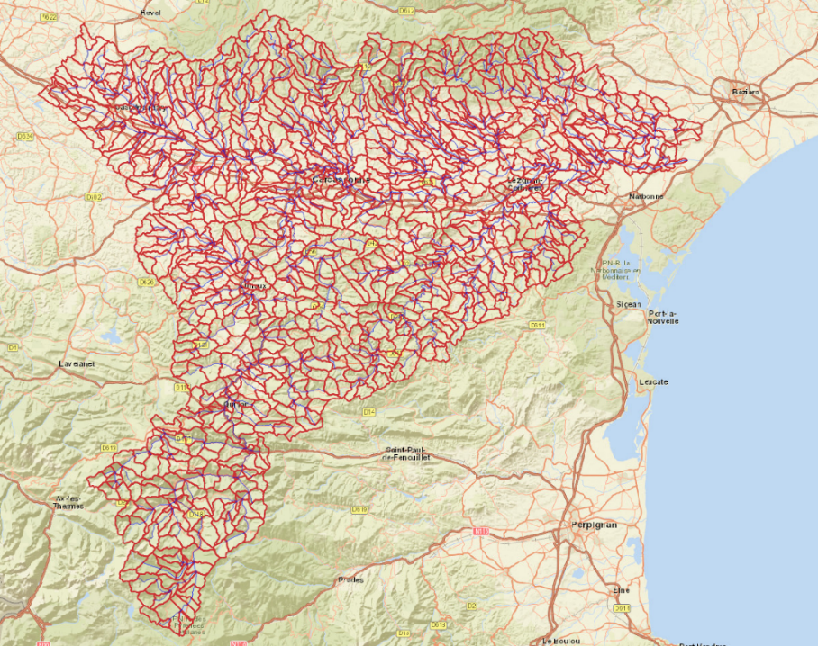
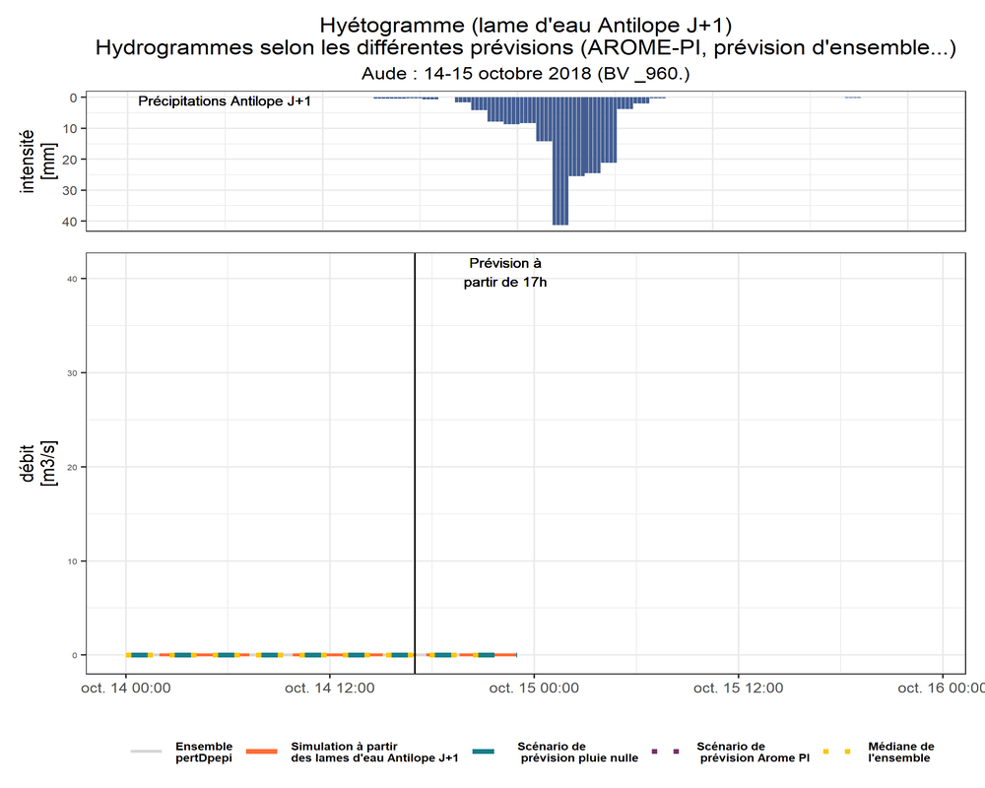
Hydrological ensemble forecasts
The October 2018 flash flood
Short range rainfall ensemble forecast products
Hydrological ensemble forecasts
First evaluation results
Second evaluation framework
Results
Conclusions
Quantitative precipitation estimates: ANTILOPE J+1
Data from January 2008 – October 2018
Available at the hourly time step and at a grid resolution of 1 km x 1 km
Result of radar measurements corrected by rain gauge observations one day after the data was observed (Laurantin, 2008)
Figure 4: Division into sub-basins of the Aude watersheld
Hydrological distributed model: CINECAR
Developted to simulate the dynamics of flash floods at regional scale (Naulin, 2013).
Production function: SCS-CN and transfer function: kinematic wave
Application in the case of the Aude:
  Divided into 1174 sub-basins : elementary surface of 5km²
  Adjusted to reproduce peak flows
6
Figure 5: Example of hydrological ensemble forecasts for a sub-basin

Slide 8
First evaluation results – Methodology
The October 2018 flash flood
Short range rainfall ensemble forecast products
Hydrological ensemble forecasts
First evaluation results
Second evaluation framework
Results
Conclusions
First evaluation with traditional criteria – synthetic scores
Objectives of the ensembles:
  Reliability: predicting correct probabilities
  And sharpness: reasonable dispersion of the ensemble
Reference for the evaluation: CINECAR hydrograph obtained from ANTILOPE J+1 (quantitative precipitation estimates)
Evaluation only concentrates on the intense period of precipitations (10p.m. to 10a.m.) but integrating the 1174 sub-basins
Rank diagram for the reliability of the ensemble (Talagrand & Vautard, 1997; Hamill, 2001) and maps of the observation rank (spatial representation of the rank diagram)
CRPS for sharpness and reliability
7

Slide 9
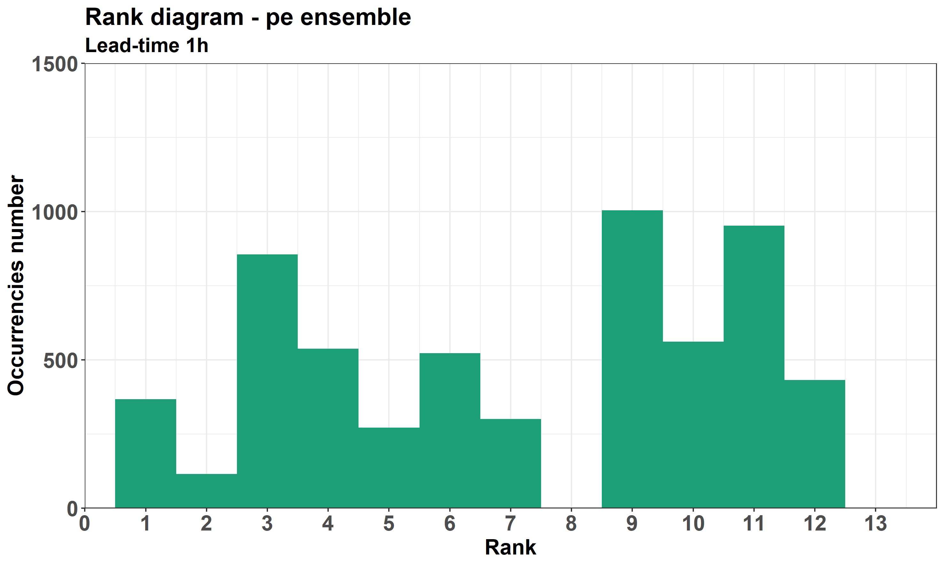
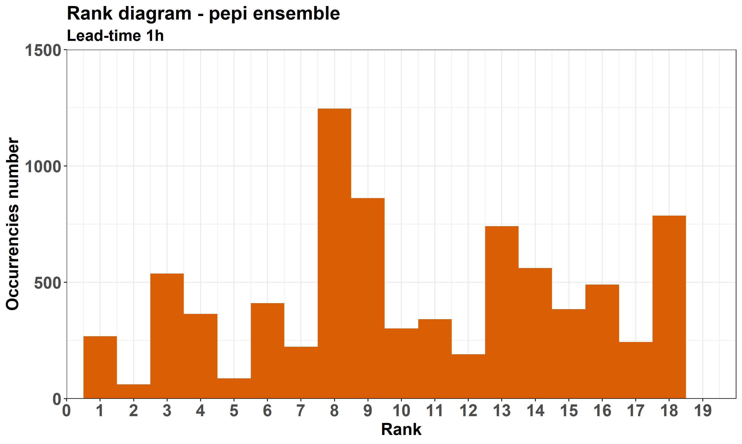
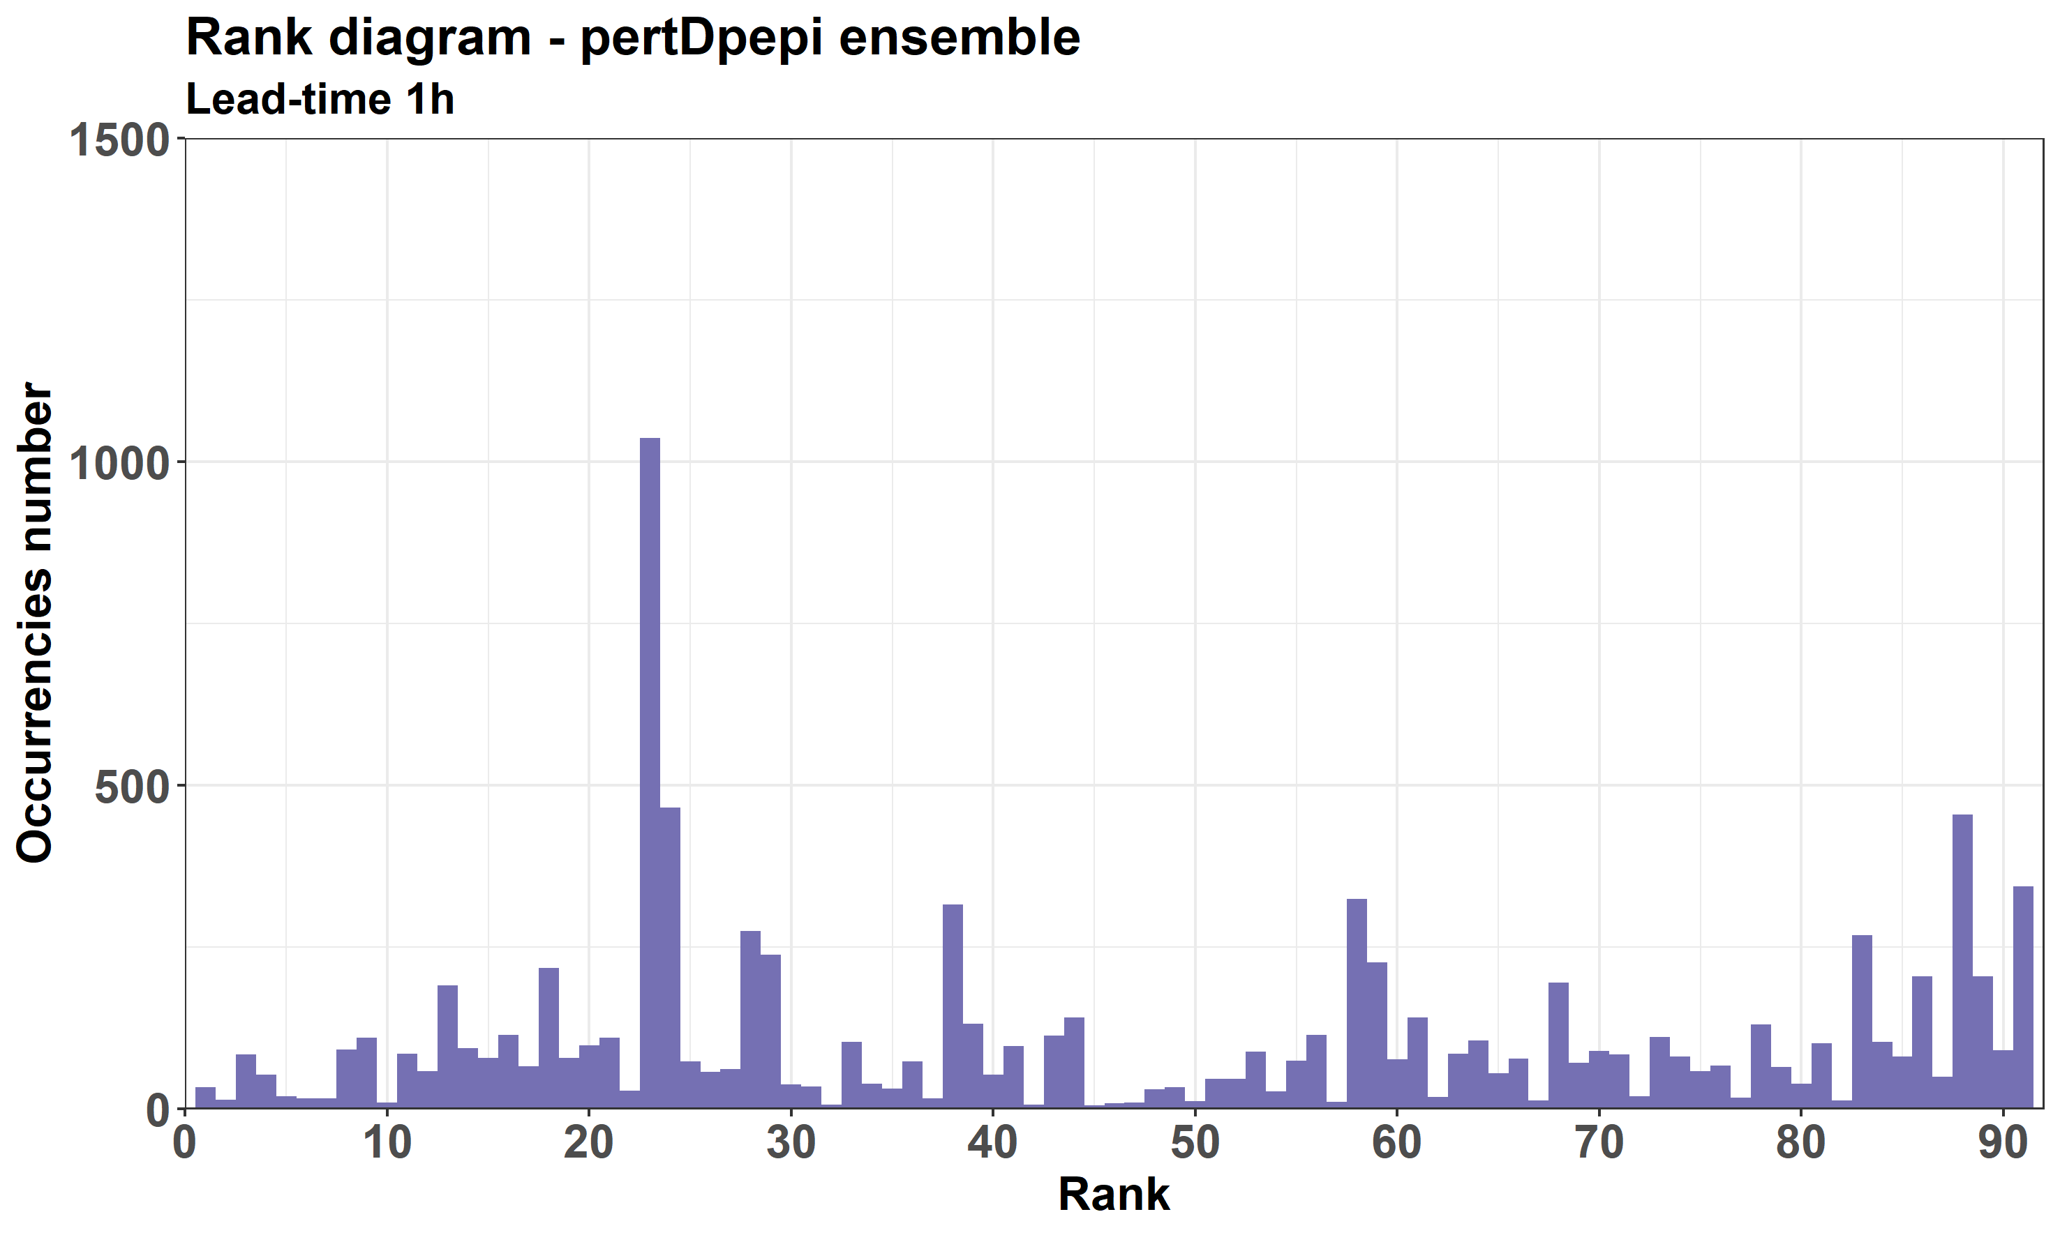
First evaluation results – Rank diagrams – 1h lead-time (1/2)
The October 2018 flash flood
Short range rainfall ensemble forecast products
Hydrological ensemble forecasts
First evaluation results
Second evaluation framework
Results
Conclusions
8
Figure 6: Rank diagram for discharges for three ensembles

Slide 10
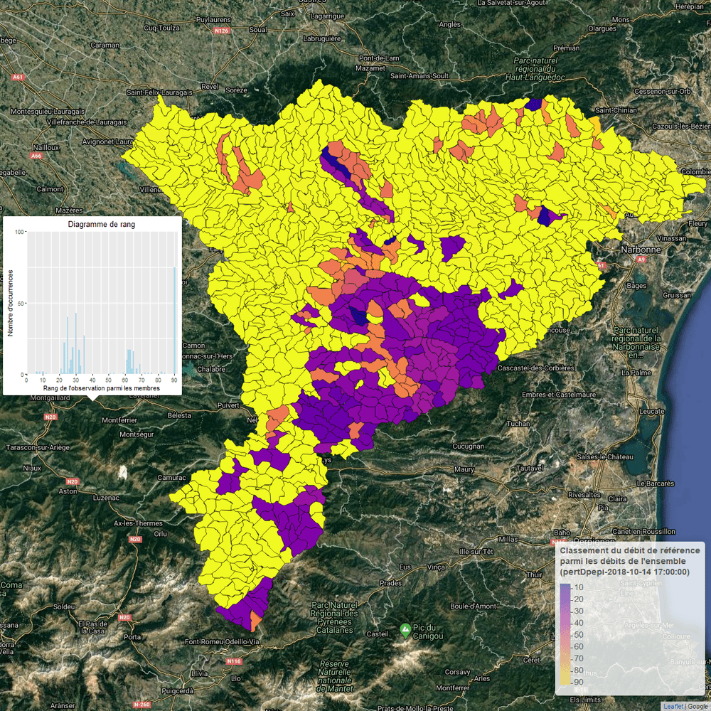
First evaluation results – Rank diagrams – 1h lead-time (1/2)
The October 2018 flash flood
Short range rainfall ensemble forecast products
Hydrological ensemble forecasts
First evaluation results
Second evaluation framework
Results
Conclusions
Details of the rank diagram for pertDpepi
Hour by hour representation of the data used to build the rank diagram, i.e. the ranking of the ANTILOPE J+1 discharge among those obtained with the ensemble forecast for each sub-basin.
Conclusion:
Trend to underestimate at the beginning of an event and overestimate at the end
Time lag between observations and forecasts
9
Figure 7: Spatialised rank diagram for the pertDpepi ensemble
Notes:
Construction of the map: Hour by hour representation of the data used to build the rank diagram, i.e. the ranking of the ANTILOPE J+1 flow among those obtained with the ensemble forecast for each sub-basin.
Comments on the map obtained: Tendency to underestimate at the beginning of an event and overestimate at the end - time lag between observations and forecasts

Slide 11
First evaluation results – CRPS
The October 2018 flash flood
Short range rainfall ensemble forecast products
Hydrological ensemble forecasts
First evaluation results
Second evaluation framework
Results
Conclusions
Difficult to find a difference between the three ensembles with these criteria but a first trend can be seen:
  Slight hierarchy between ensemble products
  Effect of the lead-time
  Advantage to pertDpepi
Figure 8: CRPS for the three ensembles
10

Slide 12
Second evaluation framework – Methodology
The October 2018 flash flood
Short range rainfall ensemble forecast products
Hydrological ensemble forecasts
First evaluation results
Second evaluation framework
Results
Conclusions
Purpose of the new evaluation:
Evaluation framework closer to the user
Review of threshold exceedances
Second evaluation: user-oriented approach
Adaptation of the traditional way of building ROC curves (Mason 1982; Wilks, 2011) for a user-oriented approach
Reference for the evaluation: CINECAR hydrograph obtained from ANTILOPE J+1 (quantitative precipitation estimates)
Thresholds fixed as a return period for each sub-basin
Focus the analysis on the period preceding the actual threshold exceedance, without looking at a fixed lead-time
Anticipation: difference between the time of actual threshold, and the time of the first run detecting the exceedance (anticipation histograms)
11

Slide 13
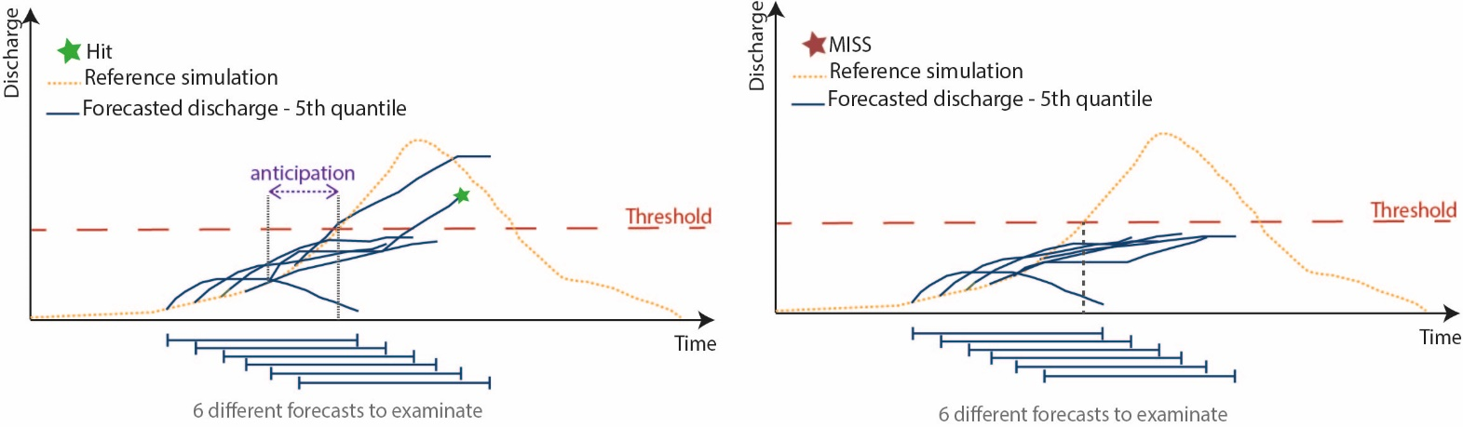
Second evaluation framework – ROC curves construction (1/2)
The October 2018 flash flood
Short range rainfall ensemble forecast products
Hydrological ensemble forecasts
First evaluation results
Second evaluation framework
Results
Conclusions
First possibility: The threshold is exceeded
Examination of the six runs preceding the time of the actual exceedance in chronological order
If one run exceeds the threshold: HIT
If none of the six runs examined exceeds the threshold: MISS
HIT
MISS
12
Anticipation: difference between the time of actual threshold, and the time of the first run detecting the exceedance (anticipation histograms)

Slide 14
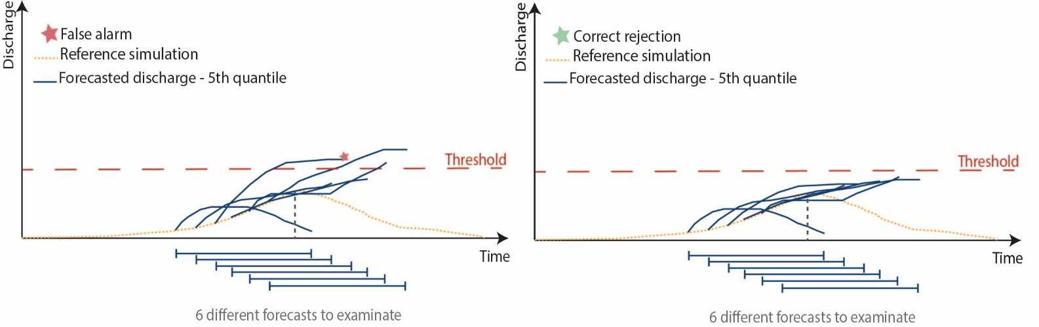
Second evaluation framework – ROC curves construction (2/2)
The October 2018 flash flood
Short range rainfall ensemble forecast products
Hydrological ensemble forecasts
First evaluation results
Second evaluation framework
Results
Conclusions
Second possibility: The threshold is not exceeded
Examination of the six runs preceding the maximum discharge for the simulation reference
If one run exceeds the threshold: FALSE ALARM
If none of the six runs examined exceeds the threshold: CORRECT REJECTION
FALSE ALARM
CORRECT REJECTION
13

Slide 15
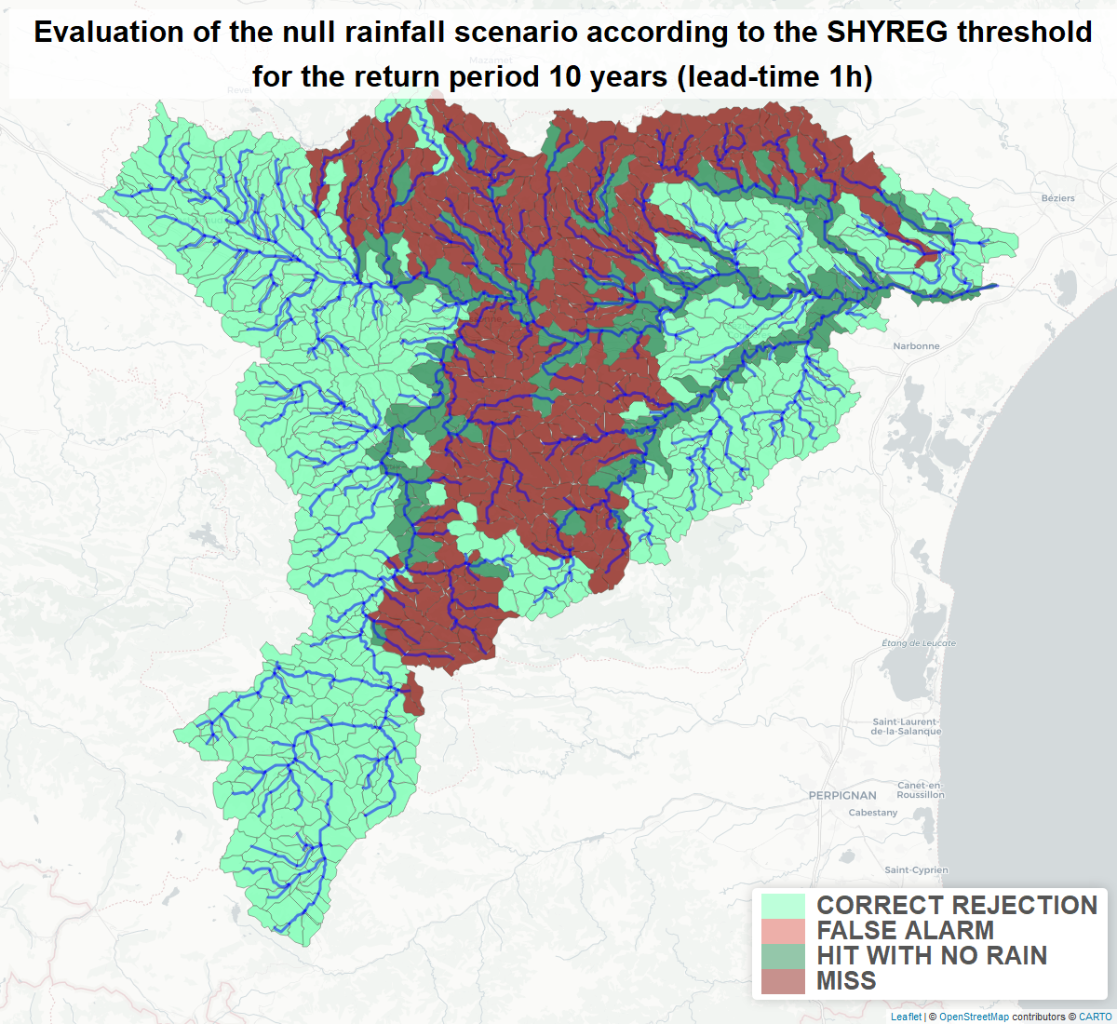
Second evaluation framework - Preliminary results with no future rainfall scenario
The October 2018 flash flood
Short range rainfall ensemble forecast products
Hydrological ensemble forecasts
First evaluation results
Second evaluation framework
Results
Conclusions
Some HITs are observed without rainfall forecasts: due to the response times of the watersheds
Conclusion:
No future rainfall scenario considered as reference for the evaluation of ROC curves and anticipation times
14
Figure 9: Results of thresholds exceedances for the no rainfall scenario (return period 10 years – lead time 1h)

Slide 16
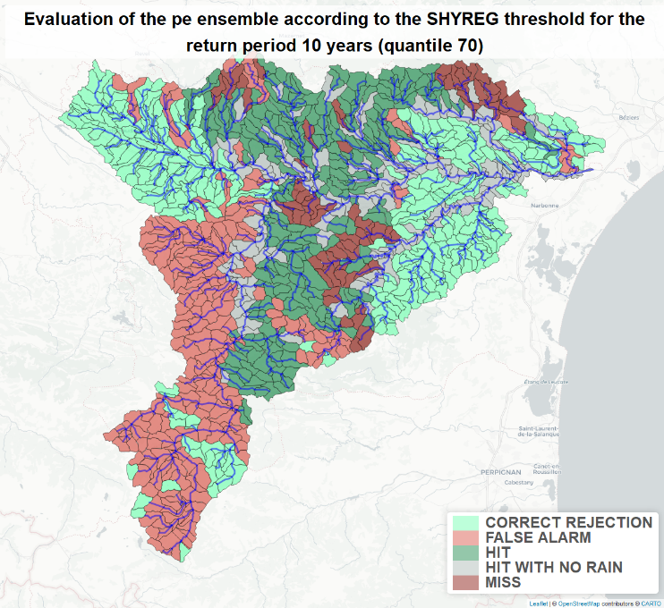
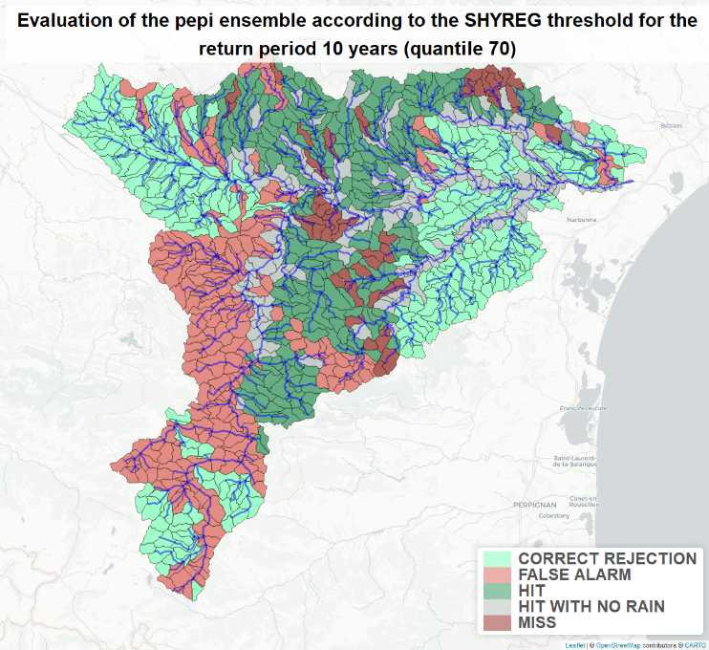
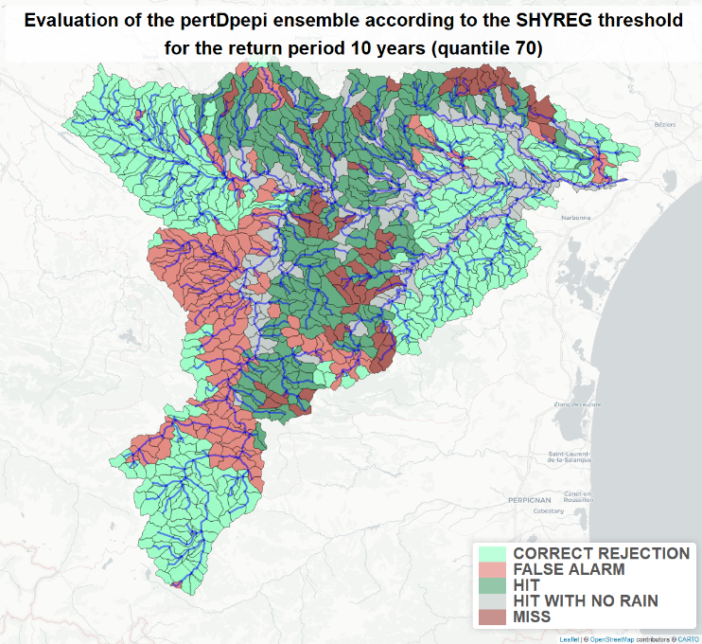
Results – Comparison of ensembles spatial performance
The October 2018 flash flood
Short range rainfall ensemble forecast products
Hydrological ensemble forecasts
First evaluation results
Second evaluation framework
Results
Conclusions
Figure 10: Spatialised contingency table results for the three ensemble (70% quantile)
Conclusion:
Lower number of false alarms with PertDPEPI
15
Notes:
Penser à changer les cartes !!!!

Slide 17
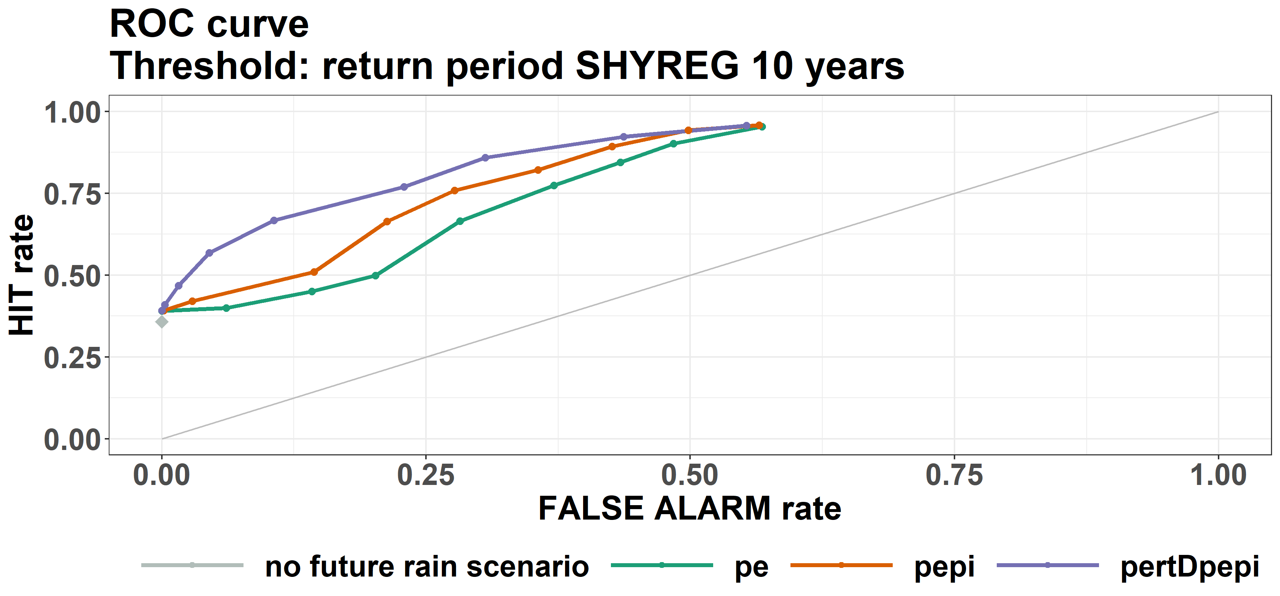
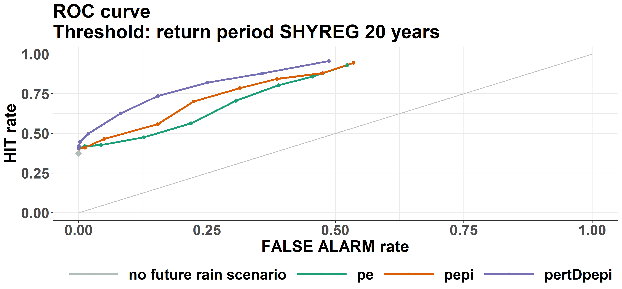
Results – ROC Curves obtained
The October 2018 flash flood
Short range rainfall ensemble forecast products
Hydrological ensemble forecasts
First evaluation results
Second evaluation framework
Results
Grey point: value for the no future rainfall scenario
Hierarchy the three forecast products:
  The pertDpepi shows a better performance: for a low FAR the HIT rate increases quickly.
  Non-obvious added value of pe ensemble compared to the results obtained with a no future rainfall scenario
Conclusion:
Contribution to discharge forecasting: better results for pepi and pertDpepi than without any rain forecast
Non-evident contribution for the pe ensemble
Figure 11: Results for the ROC curves (return period 10 and 20 years)
16

Slide 18
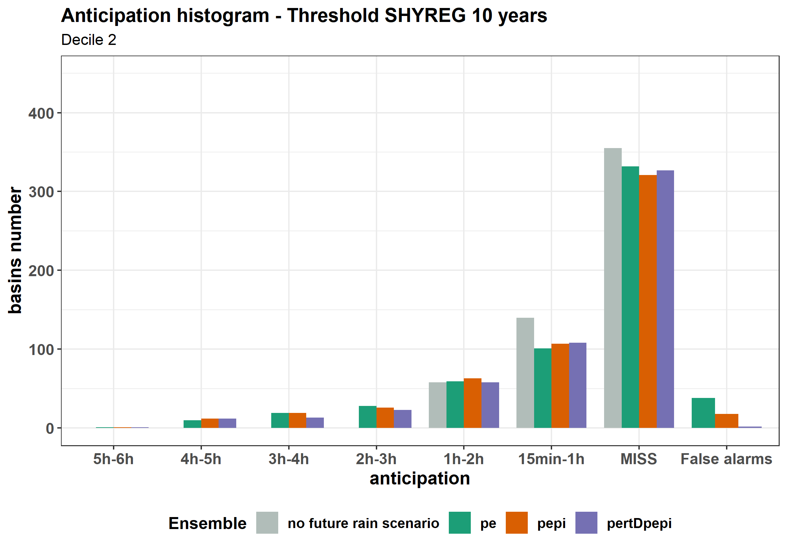
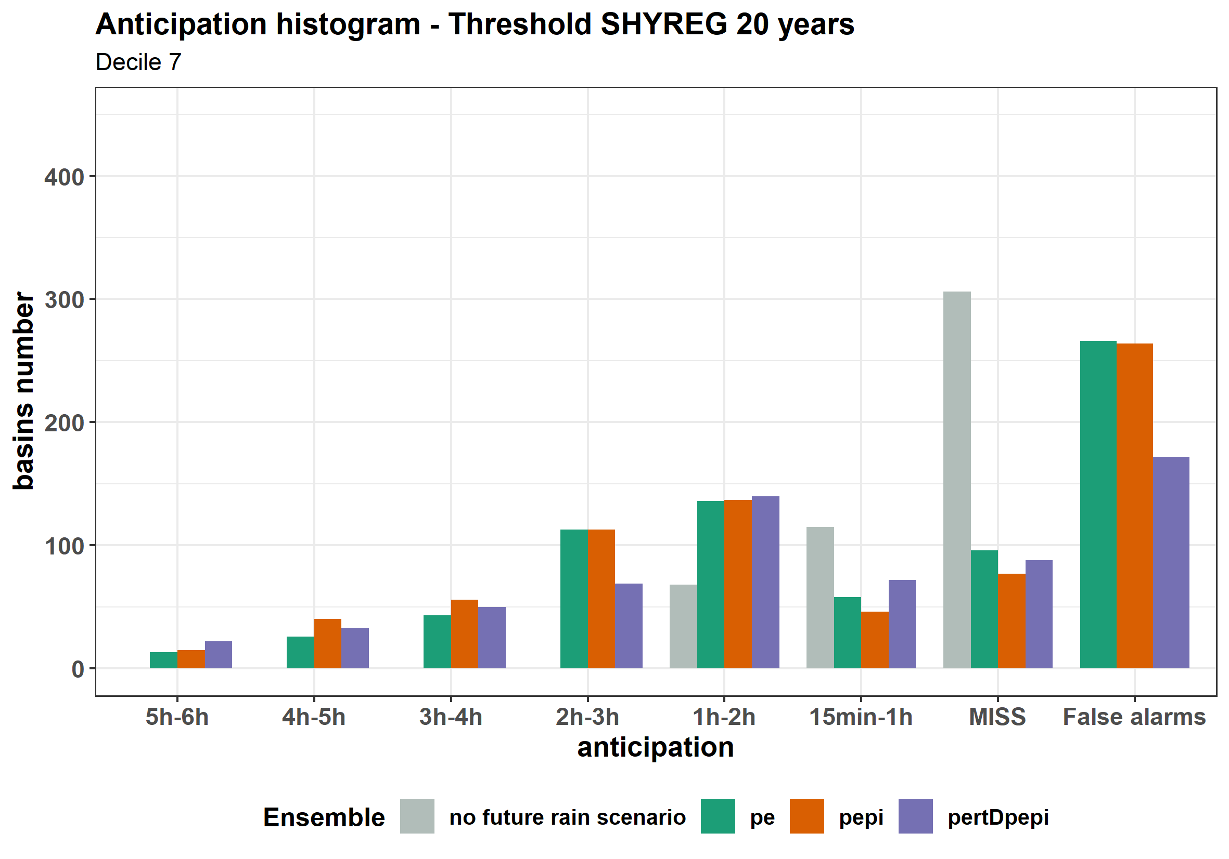
Results – Anticipation histogram
The October 2018 flash flood
Short range rainfall ensemble forecast products
Hydrological ensemble forecasts
First evaluation results
Second evaluation framework
Results
Conclusions
Calculation of the anticipation: difference between the time of actual threshold, and the time of the first run detecting the exceedance
Figure 12: Anticipation diagrams for the return period 10 years – 20% quantile (left) and 70% quantile (right)
Improved anticipation at the penalty of false alarms
For a low decile, limited FA and slight improvement of anticipation
For a larger decile, increased FA
17

Slide 19
Conclusions
The October 2018 flash flood
Short range rainfall ensemble forecast products
Hydrological ensemble forecasts
First evaluation results
Second evaluation framework
Results
Conclusions
Construction of three ensembles compatible with ensemble forecast of flash floods, based on AROME-PE and enriched with AROME-PI and a spatial perturbation (CNRM)
An evaluation based on “traditional” criteria (CRPS, rank diagram) of the ensemble forecast has shown its limitations to distinguish the different ensemble forecast products
Proposal of a new method closer to the user's point of view based on an adaptation of ROC curves:
  Exceedance anticipation of a flood alert threshold
Lower number of false alarms with PertDPEPI ensemble
pepi and pertDpepi perform better than no future rain scenario
Non-evident contribution for the pe ensemble
Balance to be found between miss of threshold exceedance, false alarms and anticipation times
18

Slide 21
References
Fleury, A. (2019). Approche ensembliste pour la production de scénarios de pluie adaptées aux échéances courtes.
Hamill, T. M. (2001). Interpretation of rank histograms for verifying ensemble forecasts. Monthly Weather Review, 129 (3), 550–560.
Laurantin, O. (2008). Hourly rainfall analysis merging radar and rain gauge data. Proceedings of the International Symposium on Weather Radar and Hydrology, 2–8.
Mason, I. (1982). A model for assessment of weather forecasts. Aust. Meteor. Mag, 30, 291–303.
Naulin, J. P., Payrastre, O., & Gaume, E. (2013). Spatially distributed flood forecasting in flash flood prone areas: Application to road network supervision in Southern France. Journal of Hydrology, 486, 88–99.
Talagrand, O., & Vautard, R. (1997). Evaluation of probabilistic prediction systems for a scalar variable. Quarterly Journal of the Royal Meteorological Society, Vol. 131, pp. 2131–2150.
Wilks, D. (2011). Statistical methods in the atmospheric sciences. Academic press.
19

