Slide 1



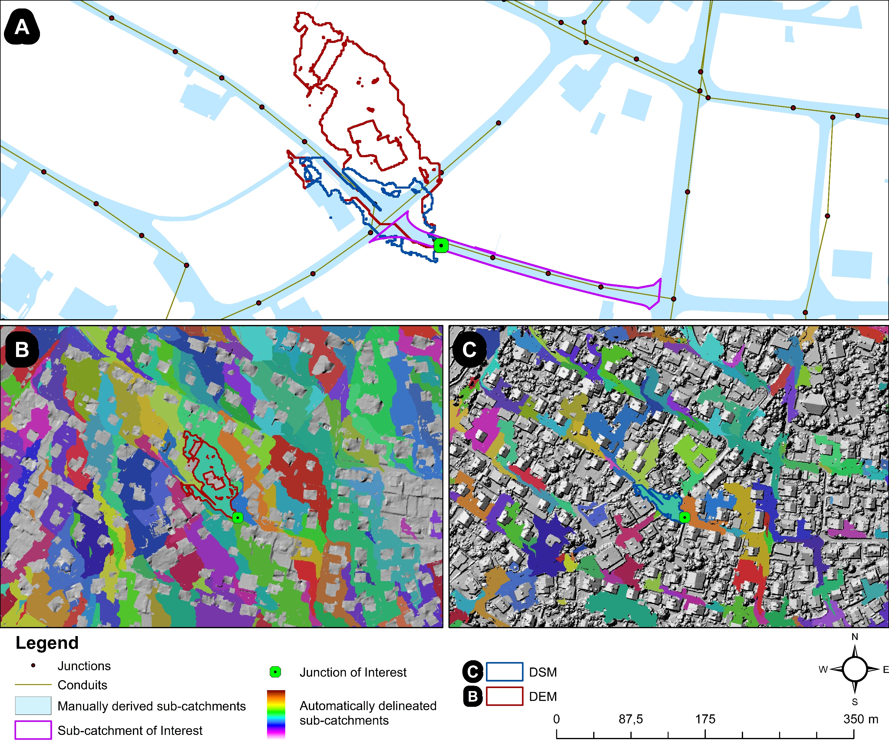
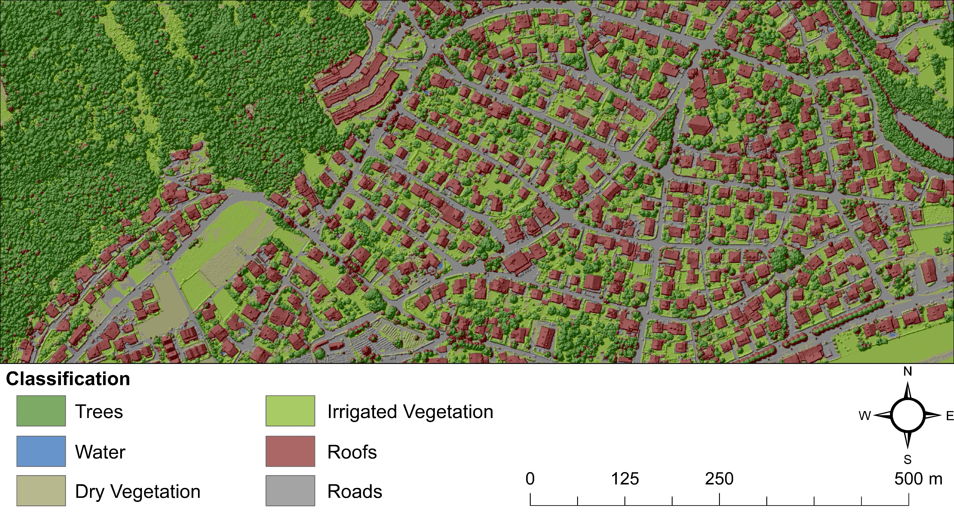
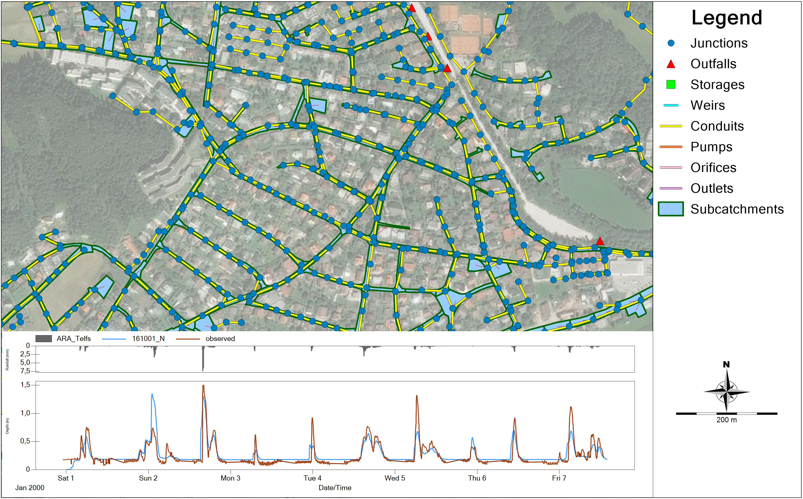
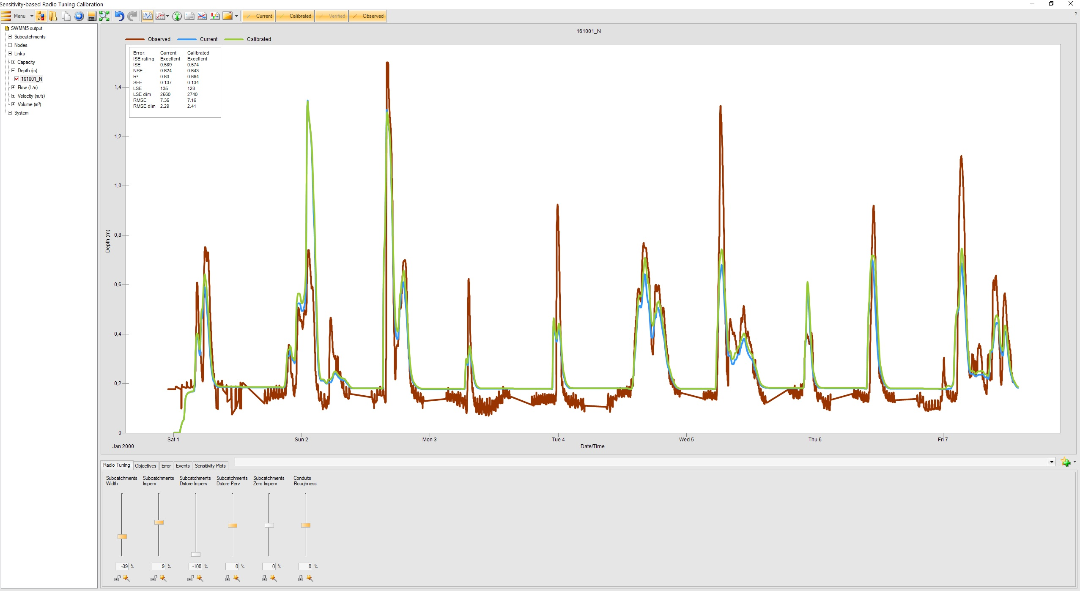

Comparing urban sub-catchment delineation approaches for dynamic hydrological modelling
Yannick Back¹, Fabian Funke¹, Peter M. Bach², Joao P. Leitão², Wolfgang Rauch¹ and Manfred Kleidorfer¹
¹ Unit of Environmental Engineering, University of Innsbruck, Technikerstrasse 13, 6020 Innsbruck, Austria
² Swiss Federal Institute of Aquatic Science & Technology (EAWAG), Überlandstrasse 133, 8600 Dübendorf, ZH, Switzerland
Modelling Approach
GIS-based delineation
NDVI-based Classification
REFERENCES
Hiscock, O.H., Back, Y., Kleidorfer, M. et al. A GIS-based Land Cover Classification Approach Suitable for Fine‐scale Urban Water Management. Water Resour Manage 35, 1339–1352 (2021).
https://doi.org/10.1007/s11269-021-02790-x
Hydrodynamic Modelling in SWMM
ACKNOWLEDGEMENT
This work is funded by:
The Austrian Climate and Energy Fund in the project cool-INN (Project No. KR19SC0F14953), funding period: February 2020 until January 2023 in the Smart City Demo program.
The Federal Ministry Republic of Austria of Agriculture, Regions and Tourism in the project BEJOND, funding period: September 2020 until February 2023.
CONTACT
Fabian Funke
PhD Student
Fabian.Funke@uibk.ac.at
University of Innsbruck
Unit of Environmental Engineering
Umwelttechnik.uibk.ac.at

