Slide 1

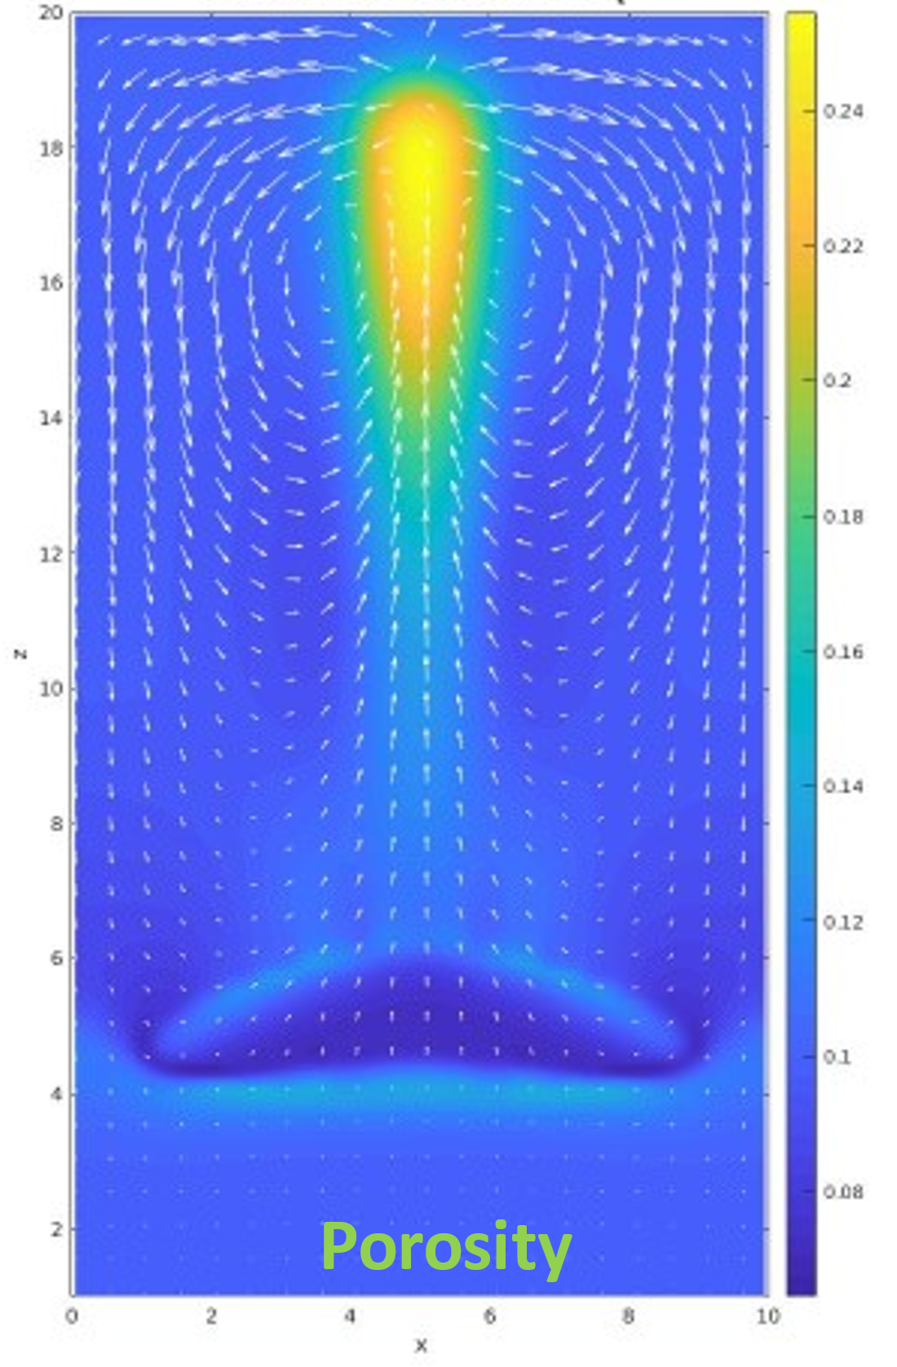
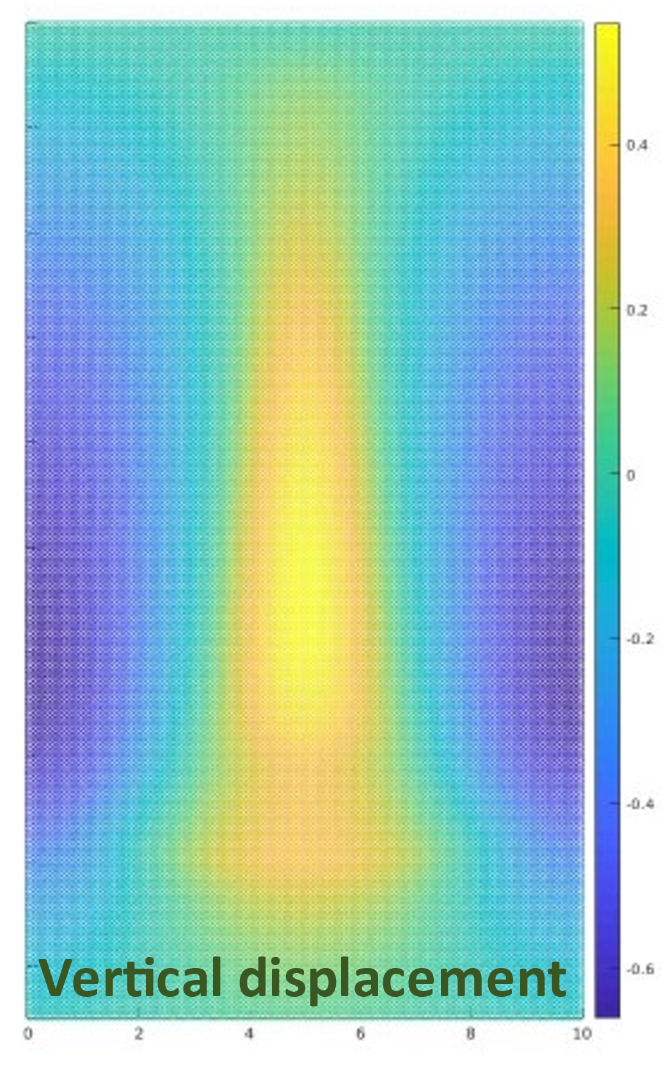
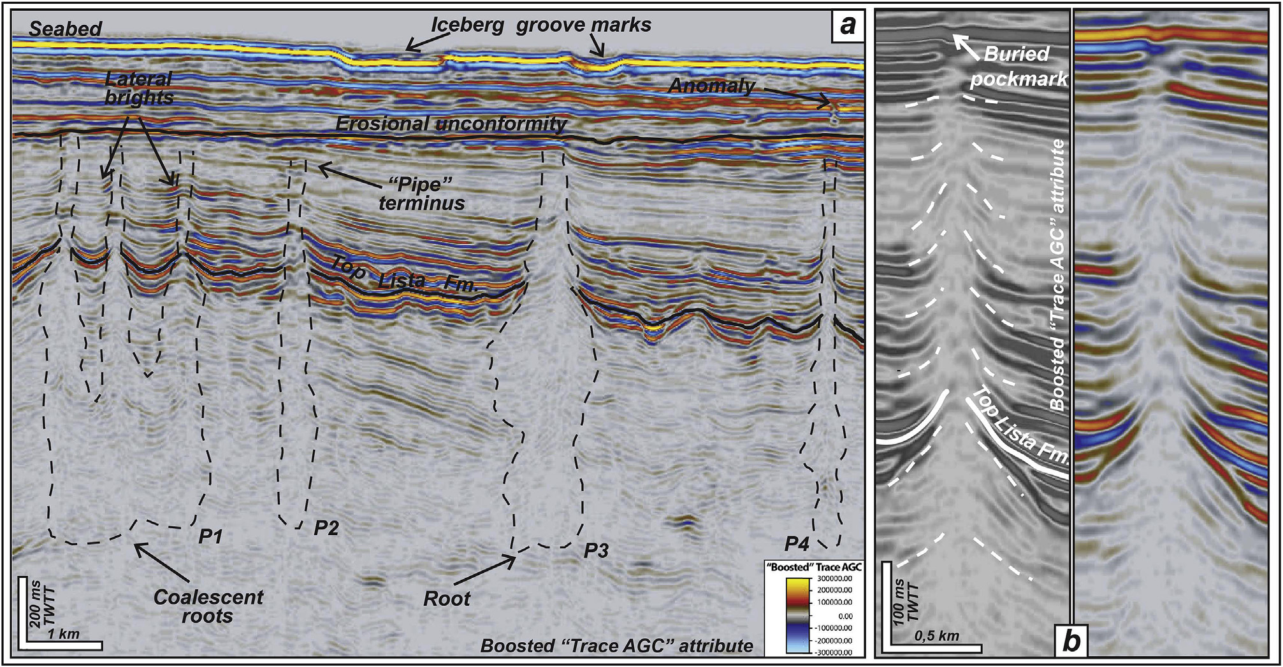
Introduction
Mechanism
Method
Result
Conclusion
Department of Reservoir technology, Institute of Energy Technology, Norway,
University of Lausanne, Institute of Earth Sciences, Lausanne, Switzerland
Forskning for en bedre fremtid
Flow and Environmental Technologty
Modelling channelized fluid flow with viscoplastic deformation in porous media
Lawrence Hongliang Wang Viktoriya Yarushina, Yury Podladchikov, Magnus Wangen
Maestrelli et al. 2017

Slide 2
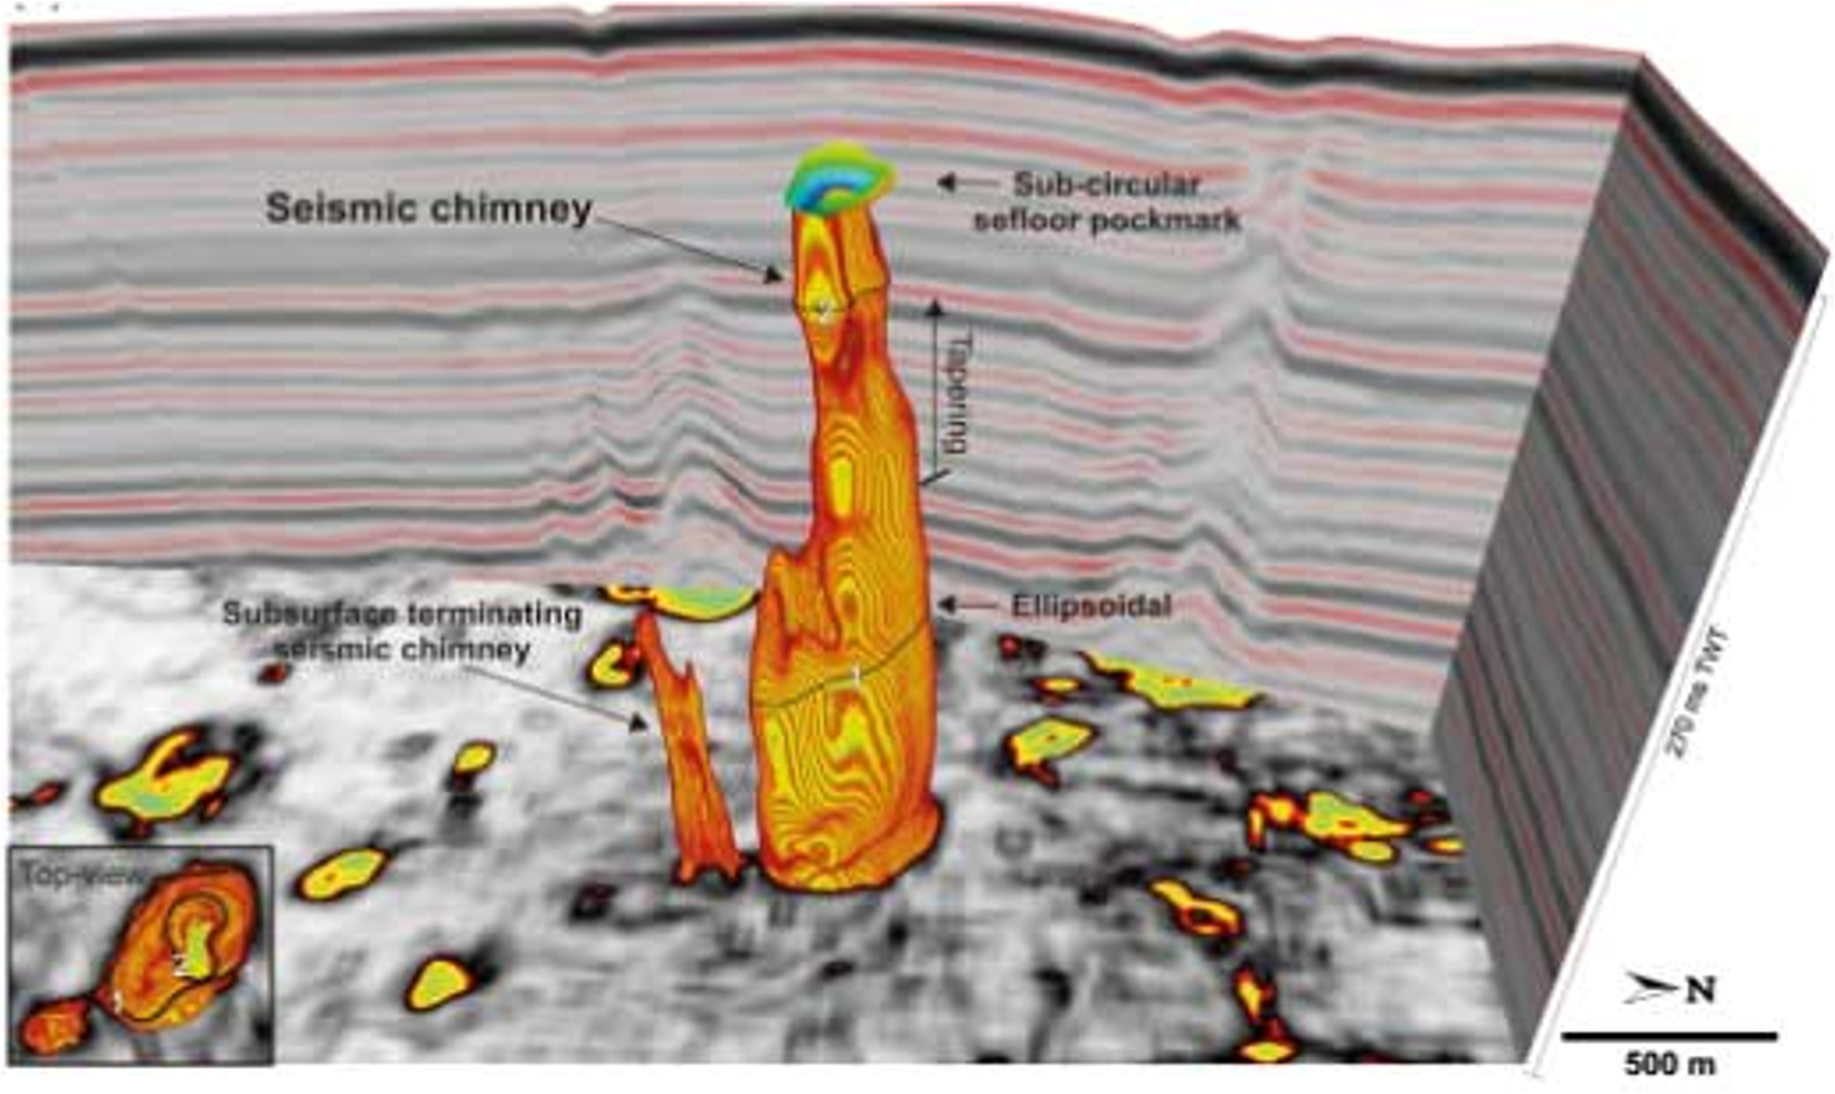
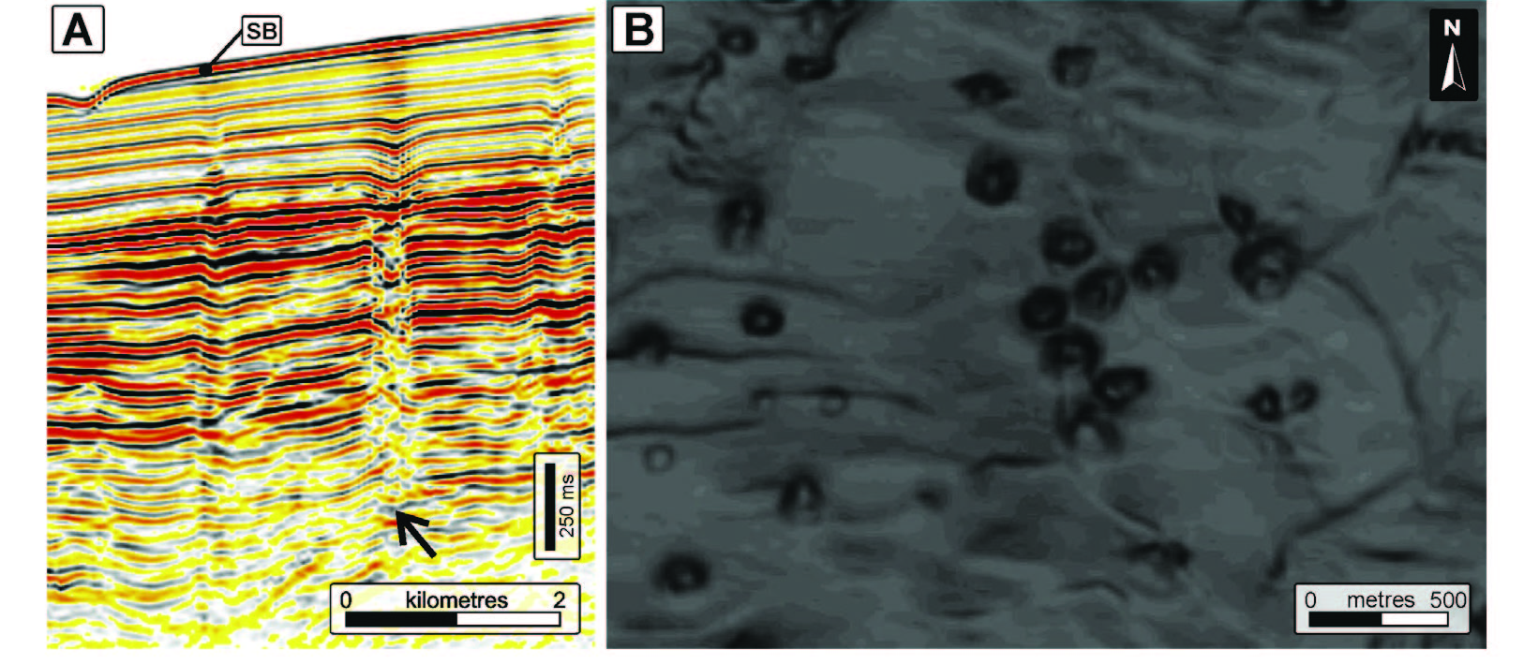
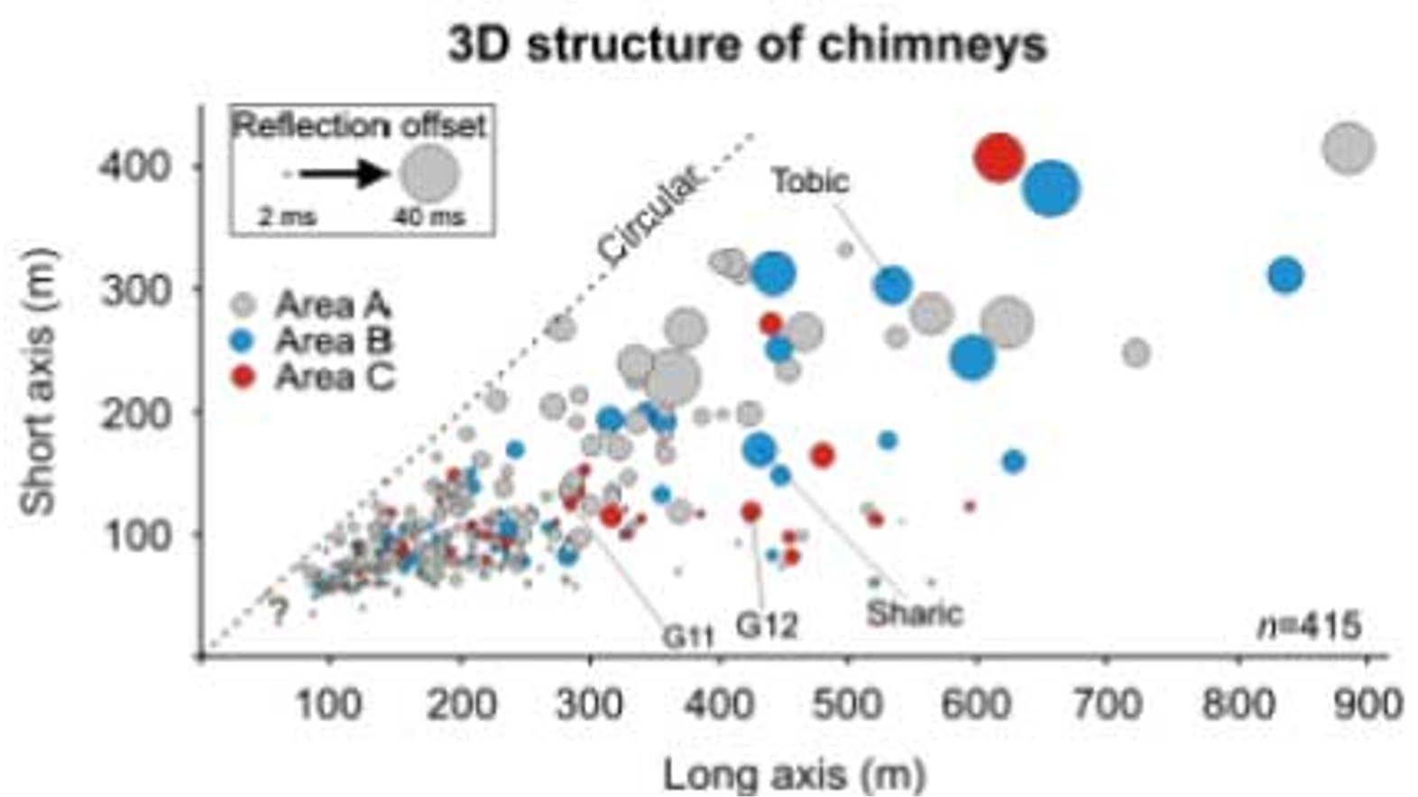
Introduction: Seismic chimneys from observations
Cartwright and Santamarina, 2015
Offshore Namibia
Hustoft et al., 2010
Nyegga area, mid-Norwegian continental margin
Seismic chimneys and pockmark field
Focalized fluid flow
Cross section from nearly circular to elliptical
Long axis from ~100 m to 900 m
What is the mechanism of these seismic chimneys?
Hustoft et. al, 2010

Slide 3
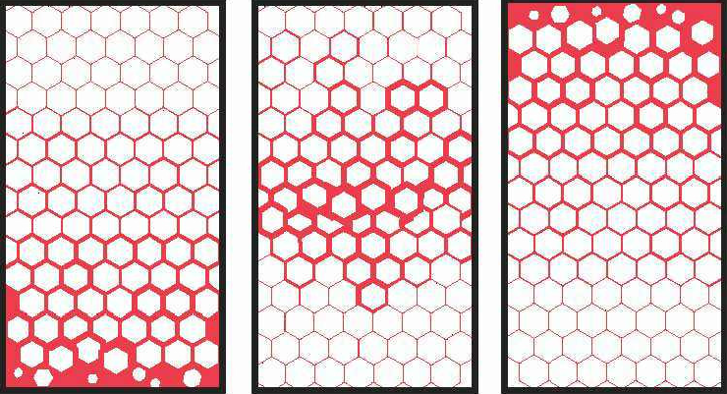

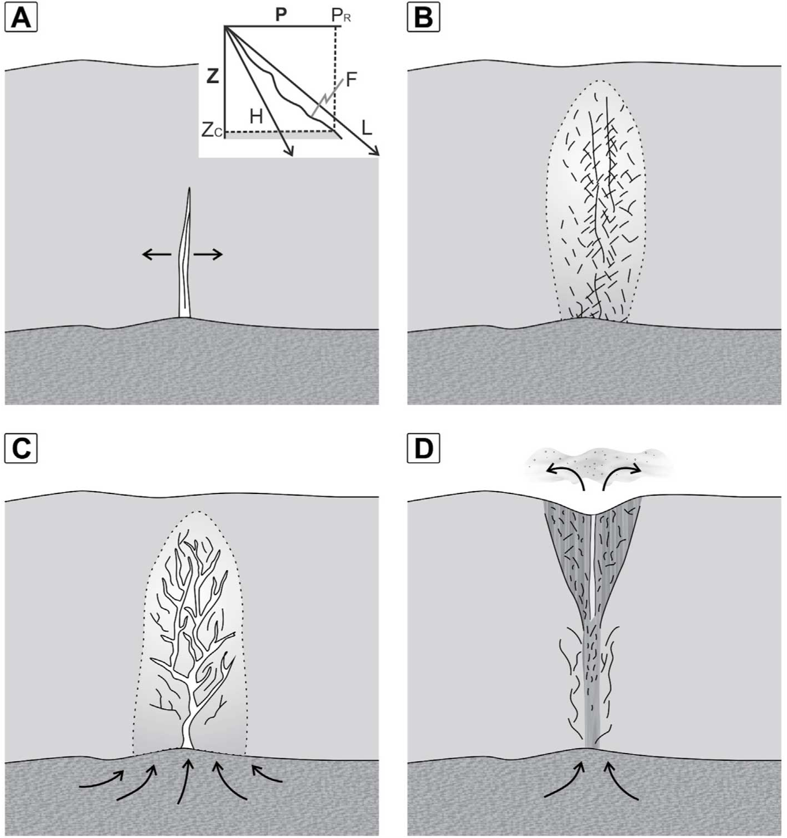
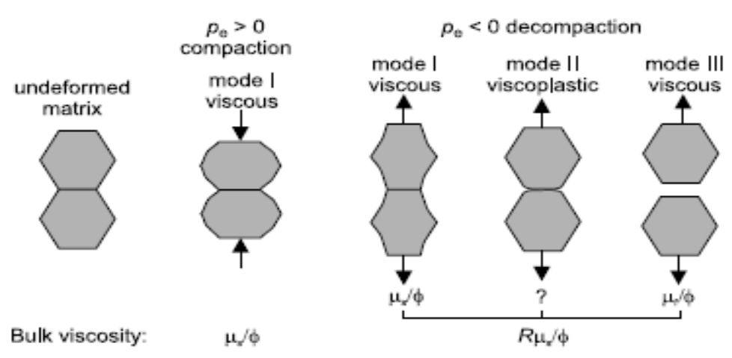
Mechanisms for seismic chimneys
4. Porous waves: Two-phase flow theory: solid + fluid
1. Hydralic fracture: i.e brittle rock
2. erosive fluidization
3. Capillary invasion
Decompaction
Compaction
Richard & Schmeling. 2008
Asymmetric
rheology
Cartwright and Santamarina, 2015
With porous wave mechanism, the fluid migration through opening (decompaction) and closing (compaction) poro-space in the solid matrix. The asymmetric rheology for compaction and decompaction will lead to channel formation.

Slide 4


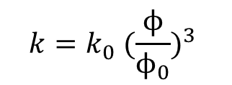
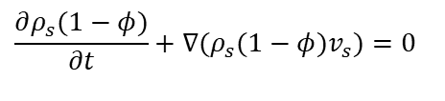

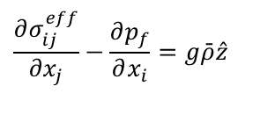
Method: Fully coupled geomechanics and flow
Mass balance
$$\frac{∂ρ_{s}(1−φ)}{∂t}+∇(ρ_{s}(1−φ)v_{s})=0$$
Nonlinear Permeability
$$\frac{∂ρ_{f}φ}{∂t}+∇(ρ_{f}φv_{f})=0$$
$$k=k_{0} {(\frac{ϕ}{ϕ_{0}})}^{3}$$
Force balance
$$\frac{∂σ_{ij}^{eff}}{∂x_{j}}−\frac{∂p_{f}}{∂x_{i}}=g\bar{ρ}\hat{z}$$
porosity (stress) dependent
Darcy’s law
$$φ(v_{f}−v_{s})=−\frac{k(φ)}{μ_{f}}∇\left(p_{f}+ρ_{f}gz\right)$$
Important parameters:
permeability, rock bulk viscosity and fluid viscosity
Rheology:
Bulk viscosity
$$η_{φ}=f(Pe, ϕ, τ)$$
By using novel numerical method (pseudo-transisent method), we solve the above nonlinear equations with asymmetric rheology and model the formation of fluid channels.
Yarushina and Podladchikov, JGR, 2015, 2020

Slide 5
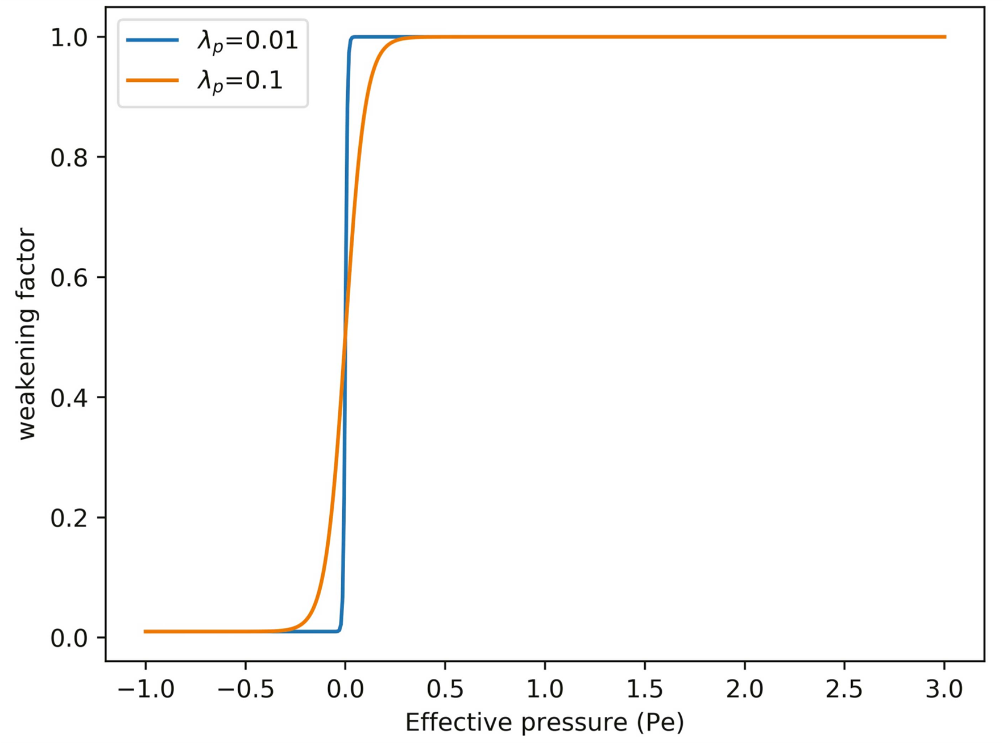
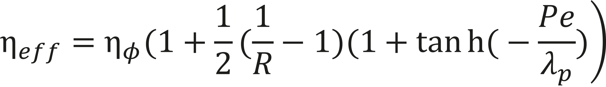

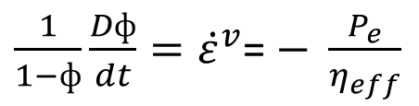
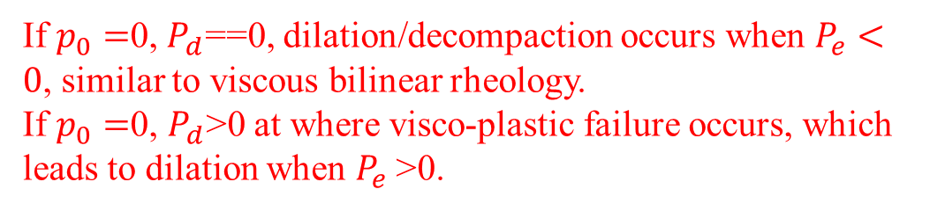

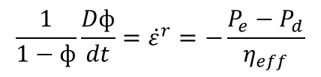
Method: Rheology
Type 1: Viscous bilinear
$\frac{1}{1−ф}{\frac{Dф}{dt}=\dot{ε}}^{v}$= $− \frac{P_{e}}{η_{eff}}$
Decompaction occurs ($P_{e}=P_{t}$- $P_{f}<0$).
Räss et al. 2018
Type 2: Visco-plastic
Viscoplastic strainrate ${\dot{ε}}^{vp}$
$$\frac{1}{1−ф}{\frac{Dф}{dt}=\dot{ε}}^{r}=−\frac{P_{e}−P_{d}}{η_{eff}}$$
$${\dot{ε}}^{r}={\dot{ε}}^{v}+{\dot{ε}}^{vp}$$
If $p_{0}=$0, $P_{d}$==0, dilation/decompaction occurs when $P_{e}<0$, similar to viscous bilinear rheology.
If $p_{0}=$0, $P_{d}$>0 at where visco-plastic failure occurs, which leads to dilation when $P_{e}$>0.
Click here for full formulations
Yarushina et al. 2020

Slide 6
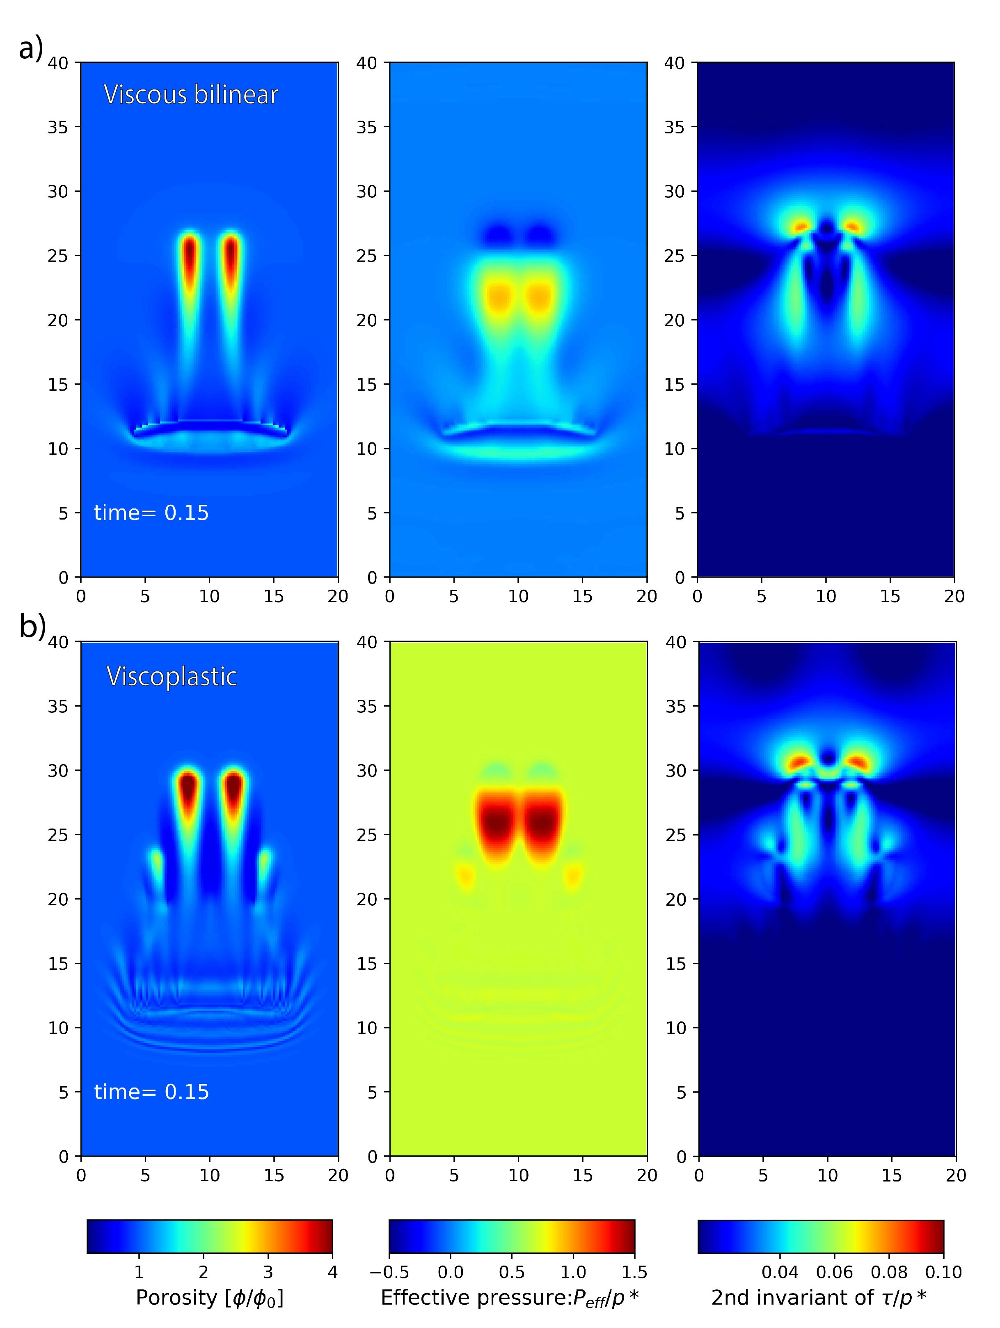
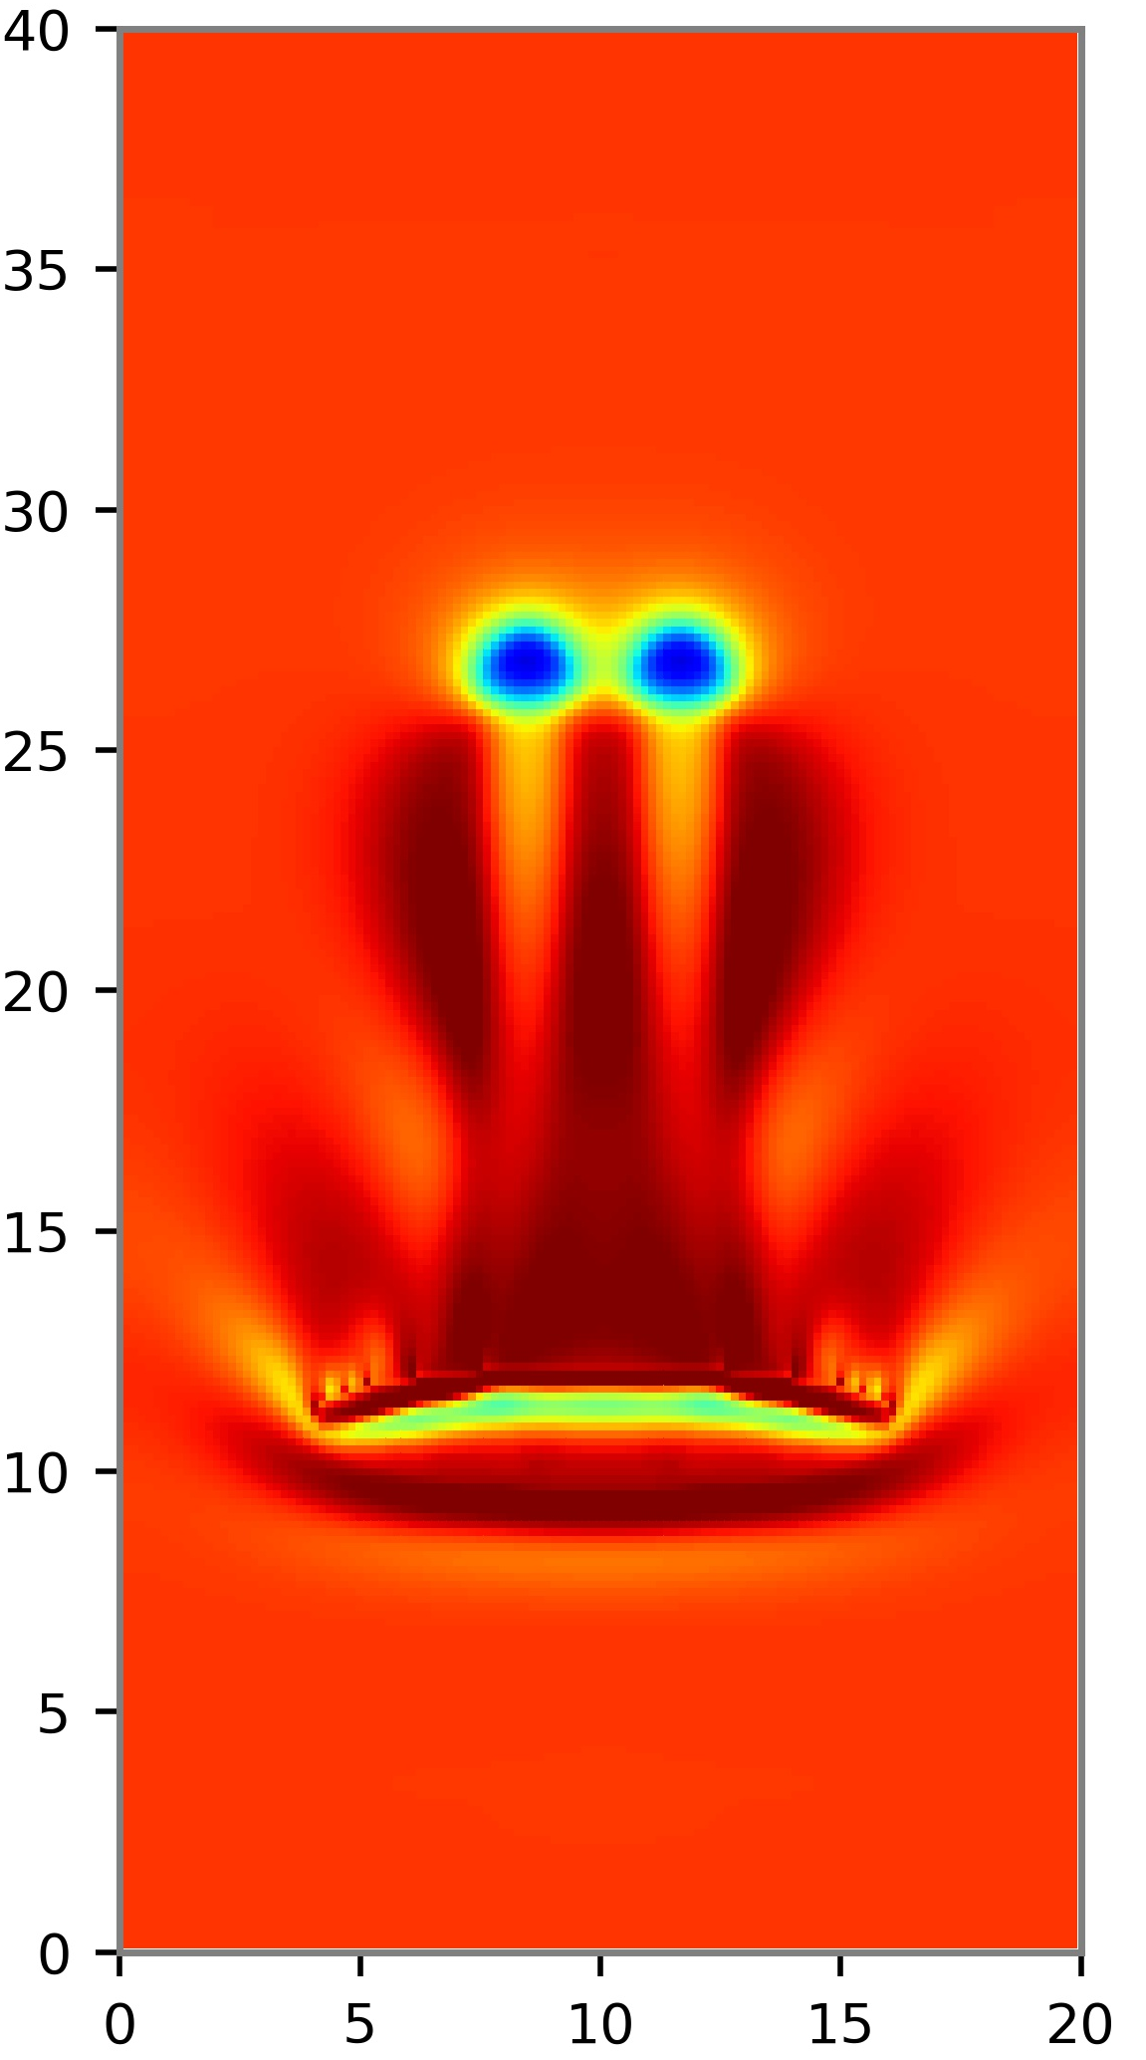
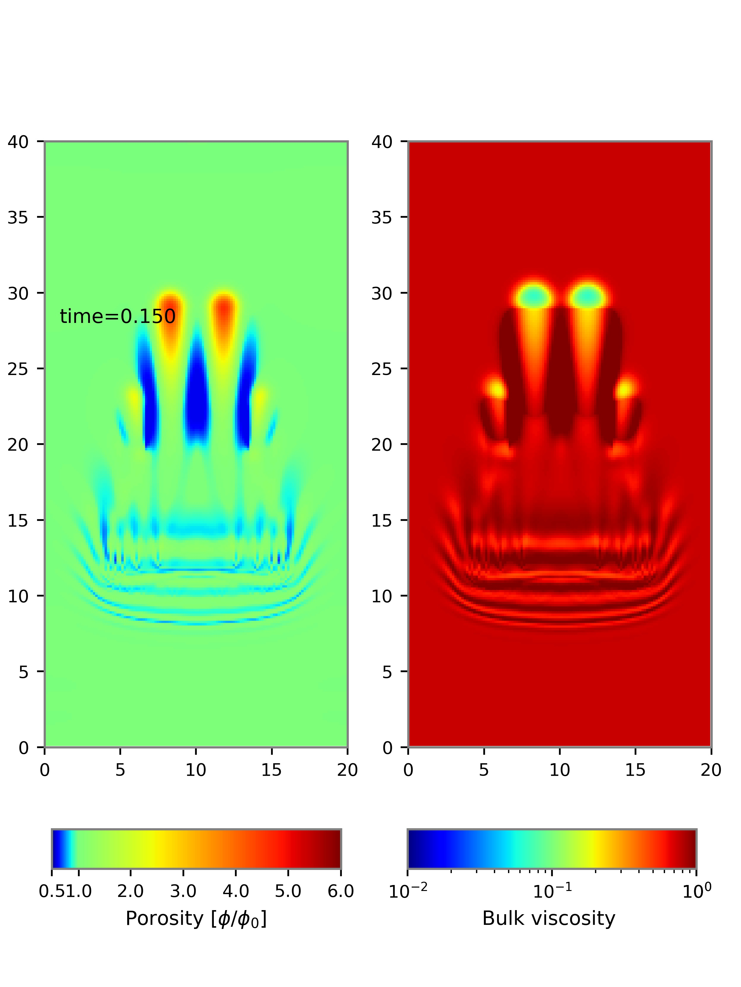
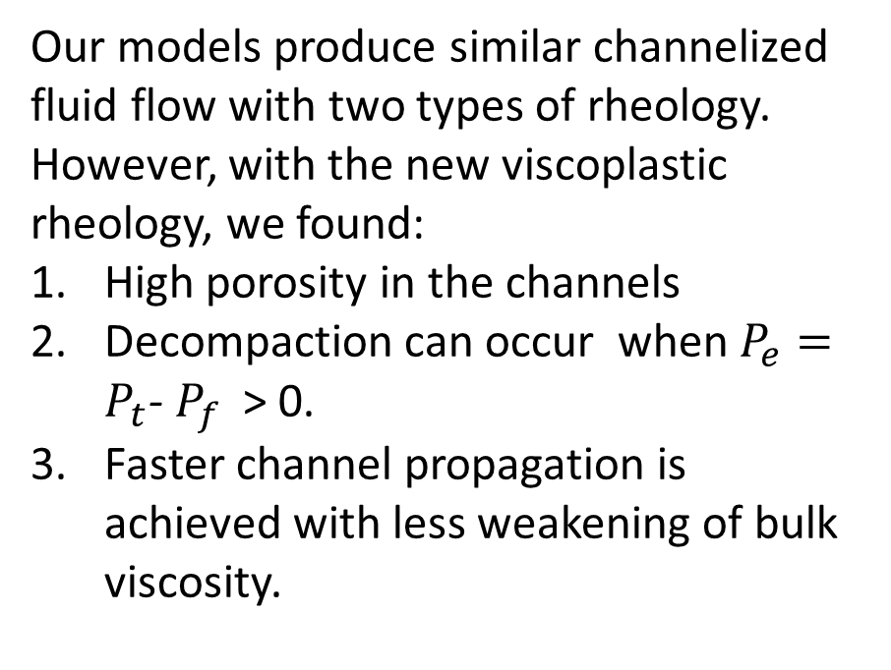
Result: Channels in rocks with two types of rheology
Our models produce similar channelized fluid flow with two types of rheology. However, with the new viscoplastic rheology, we found:
High porosity in the channels
Decompaction can occur when $P_{e}=P_{t}$- $P_{f}$ > 0.
Faster channel propagation is achieved with less weakening of bulk viscosity.
Yarushina et al. 2020
Notes:
Need to put an colorbar for the pressure!.

Slide 7
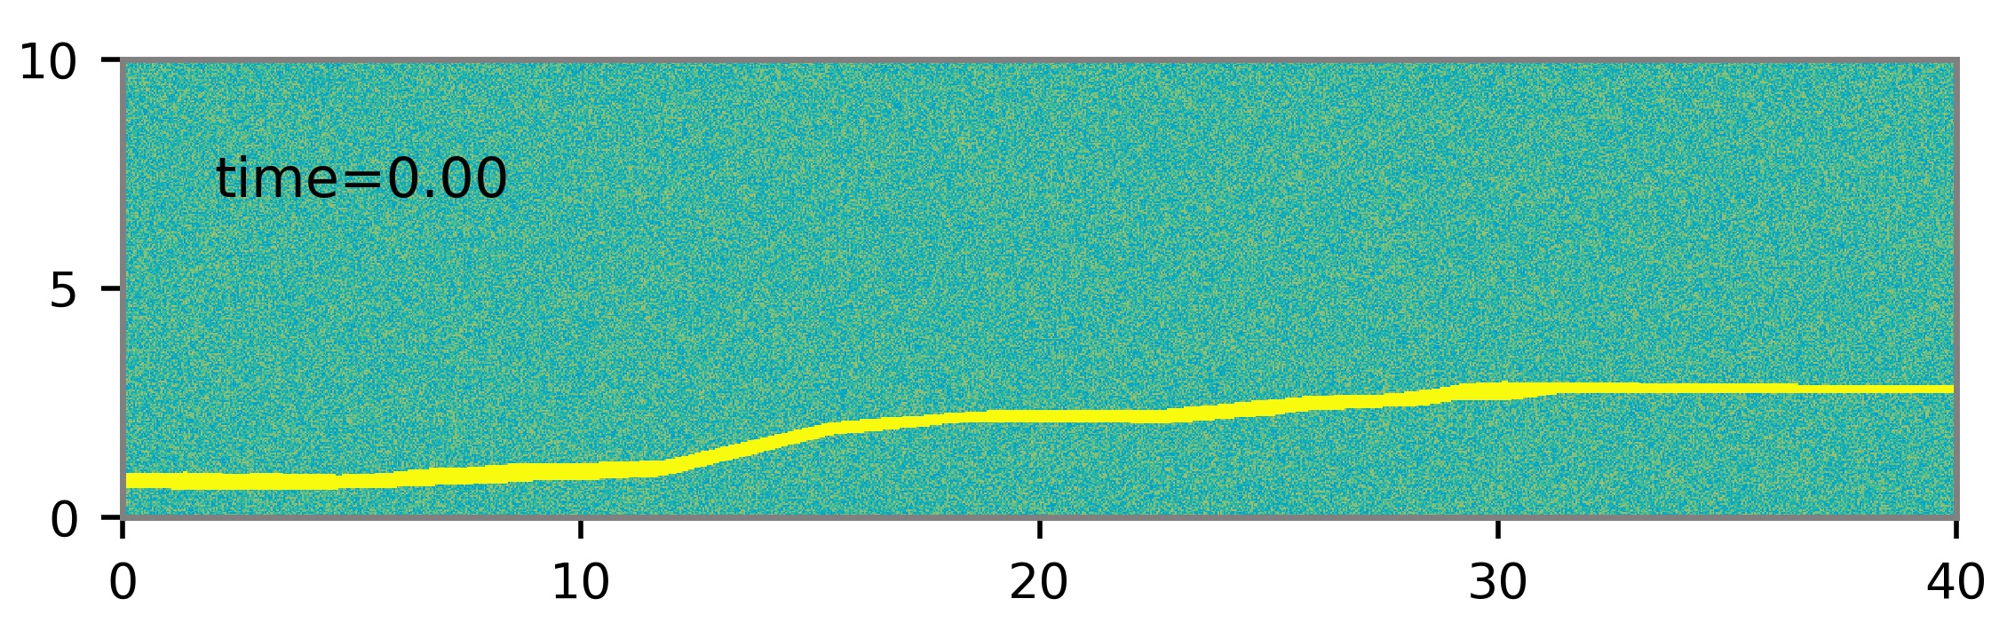
Result: Model setup for a geological setting
Modelling domain is 12 km*3 km, mimicking a geological area that contains seismic chimneys. The background compaction length is 300 m, thus we have a model domain of 40*10 compaction lengths.
A reservoir layer with high porosity is at the bottom of the domain (yellow).
Background porosity: 10%+3%*random noise; Reservoir porosity: 30%
Reference reservoir
Yarushina et al. 2021 (in review)
Notes:
Why do we split the domain? 1. It is easier to compute and postprocess for smaller areas. 2 The horizontal flow is very limited as shown in the movie. Thus it won’t hurt the modelling at all!

Slide 8
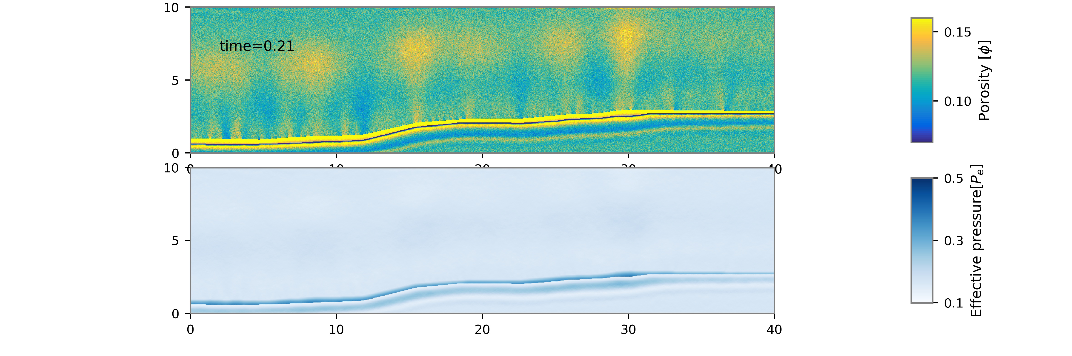
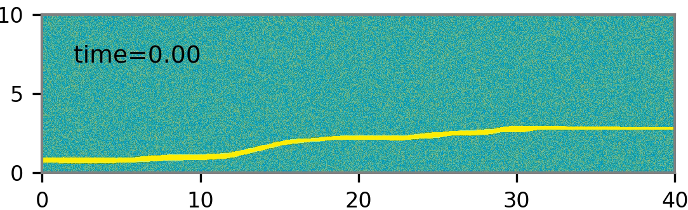
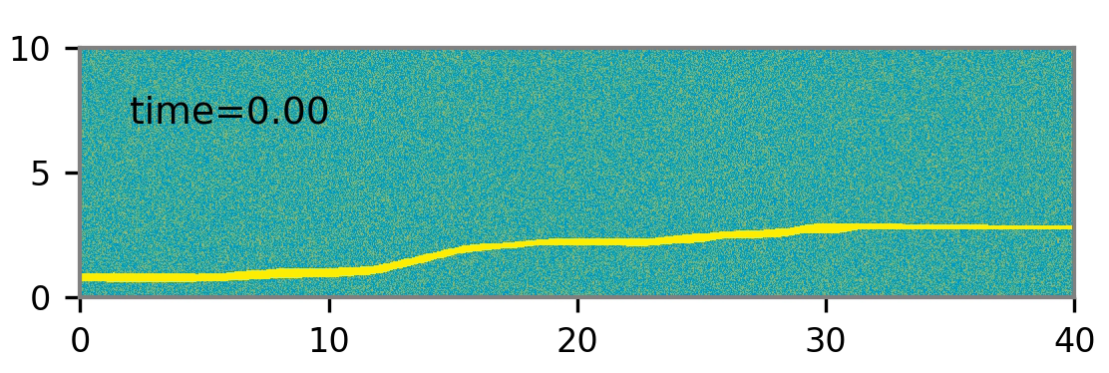
Result: Chimney formation in models with two types of rheology
Viscous bilinear R=100
By comparison, models with viscoplastic rheology has:
Fast channels opening
Quicker closure of the channels
3. More small chimneys
Viscoplastic
Notes:
Need to put an colorbar for the pressure!.

Slide 9
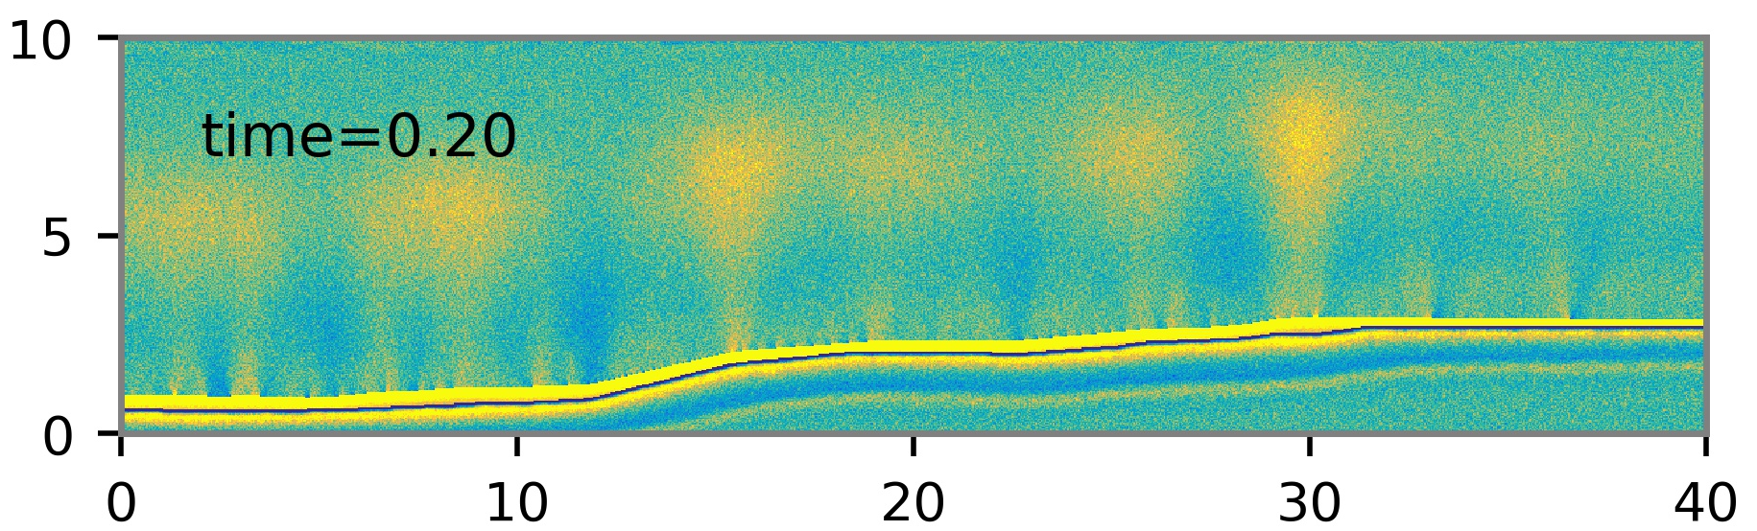
Result: Viscoplastic rheology
Focused fluid pathways rise up at locations of major depth changes in the reservoir
Besides the major chimneys, many small chimneys form later
The horizontal migration of the fluid is very limited
Notes:
Need to put an colorbar for the pressure!.

Slide 10
Geological examples: Loyal Field, Scotland, UK
Maestrelli et al. 2017
More example

Slide 11
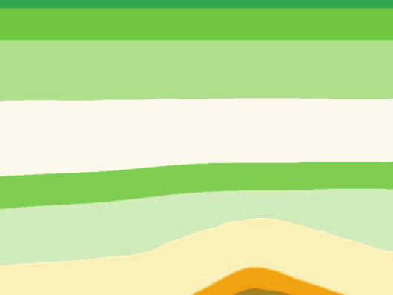

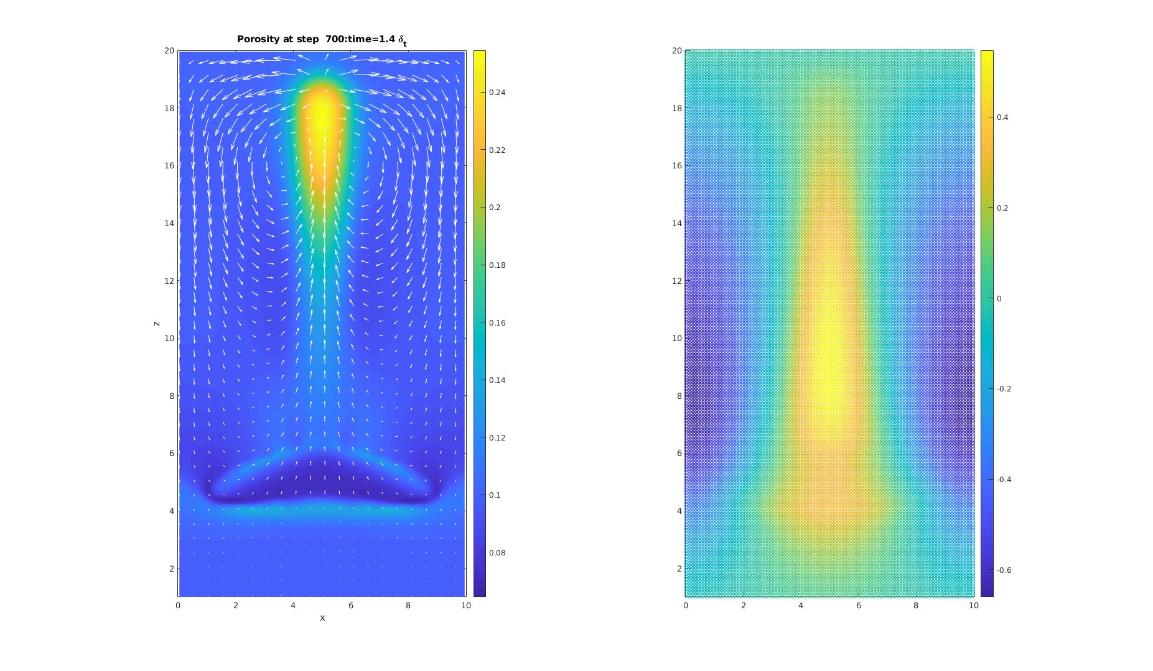
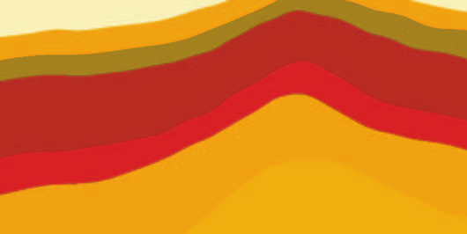
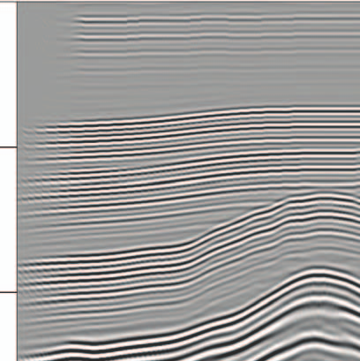
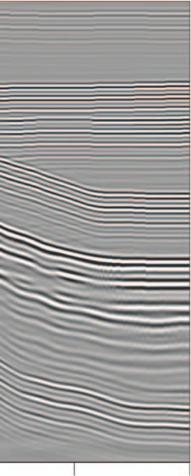
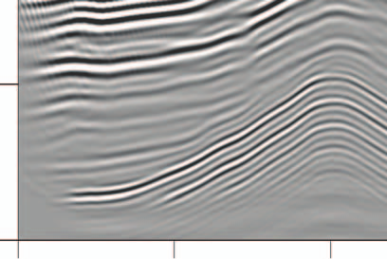
Solid deformation during chimney growth
Numerical model
Seismic images
Seismic modelling
Porosity
Vertical displacement
1.0
1.5
Depth (km)
2.0
2.5
6.5
7.0
7.5
8.0
8.5
Distance (km)
0.0
4.3
1.0
2.0
3.0
Depth (km)
Chimney growth causes the deformation of the solid: upward movement. The vertical displacement of the solid is plotted.
Maestrelli et al. 2017
4.0
How about lab experiment for fluid flow?
5.0
2.0
4.5
7.0
9.5
12.0
Arntsen et al 2007

Slide 12
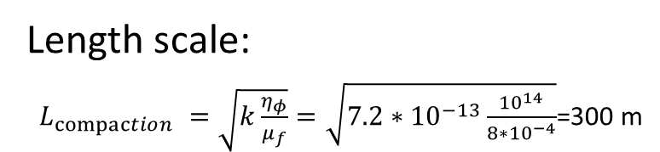
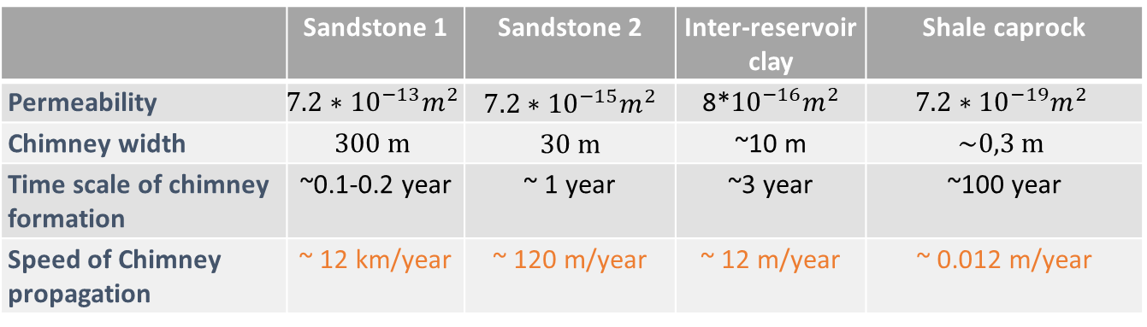
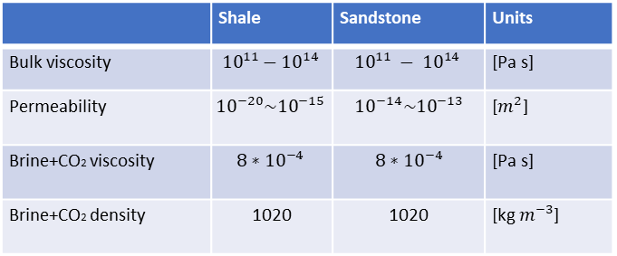
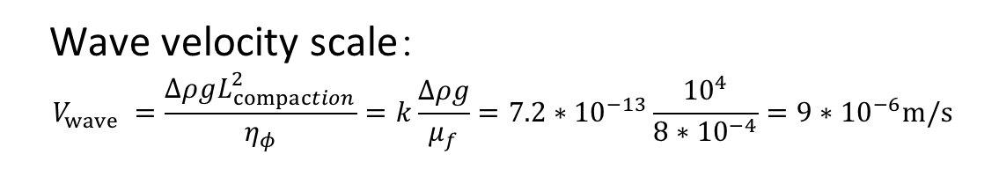
Result: Characteristic scales of the model
 | Sandstone 1 | Sandstone 2 | Inter-reservoir clay | Shale caprock
Permeability | $${7.2∗10}^{−13}m^{2}$$ | $${7.2∗10}^{−15}m^{2}$$ | 8*${10}^{−16}m^{2}$ | $${7.2∗10}^{−19}m^{2}$$
Chimney width | $$300 m$$ | 30 m | ~10 m | $$\sim 0,3 m$$
Time scale of chimney formation | ~0.1-0.2 year | ~ 1 year | ~3 year | ~100 year
Speed of Chimney propagation | ~ 12 km/year | ~ 120 m/year | ~ 12 m/year | ~ 0.012 m/year
Length scale:
$L_{compaction} =\sqrt{k\frac{η_{φ}}{μ_{f}}}=\sqrt{{7.2∗10}^{−13}\frac{{10}^{14}}{8∗{10}^{−4}}}$=300 m
 | Shale | Sandstone | Units
Bulk viscosity | $${10}^{11}−{10}^{14}$$ | $${10}^{11} − {10}^{14}$$ | [Pa s]
Permeability | $${10}^{−20}{\sim 10}^{−15}$$ | $${10}^{−14}{\sim 10}^{−13}$$ | [$m^{2}$]
Brine+CO2 viscosity | $${8∗10}^{−4}$$ | $${8∗10}^{−4}$$ | [Pa s]
Brine+CO2 density | 1020 | 1020 | [kg $m^{−3}$]
Wave velocity scale：
$$V_{wave} =\frac{ΔρgL_{compaction}^{2}}{η_{φ}}=k\frac{Δρg}{μ_{f}}={7.2∗10}^{−13}\frac{{10}^{4}}{8∗{10}^{−4}}={9∗10}^{−6}m/s$$
Dong et al 2010
Rass et al. 2014
Rass et a. 2017
Notes:
Here we use characterist timescale that doesn’t include background porosity. Then it is about 1 year and it take about 1year *0.15=1.8month for the fluid channel development in reference model. the The bulk viscosity 1e14 could also change. If it increase by 10 time (while k reduce by 10), we still have compaction length of 300m. Then time scale is ~ 10year. Nondimensiontal length and time scale is 1 and phi0=0.1 (or background porosity).

Slide 13
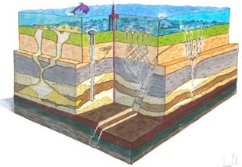

Conclusion
We implemented the new viscoplastic rheology in our novel pseudo-transient solver. Our numerical model result shows:
1. The new rheology can produce channelized fluid flow at moderate fluid pressure increase.
2. Due to the visco-plastic failure and its resultant dilation pressure, less weakening of the bulk viscosity is required to have fast channel propagation.
3. Our model shows focused fluid channels rise up at where there are major depth changes of the reservoir or deep reservoir anomaly.
4. The solid deformation of porous wave fit with the images of seismic chimneys
5. The widths of the channels depend on the bulk viscosity and permeability of the rock, which explains the width range of the seismic chimneys.

Slide 14
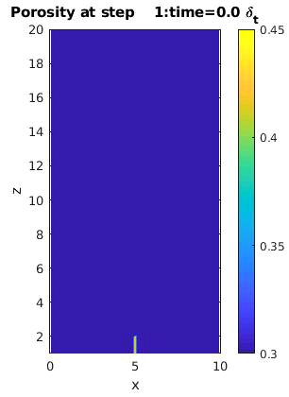
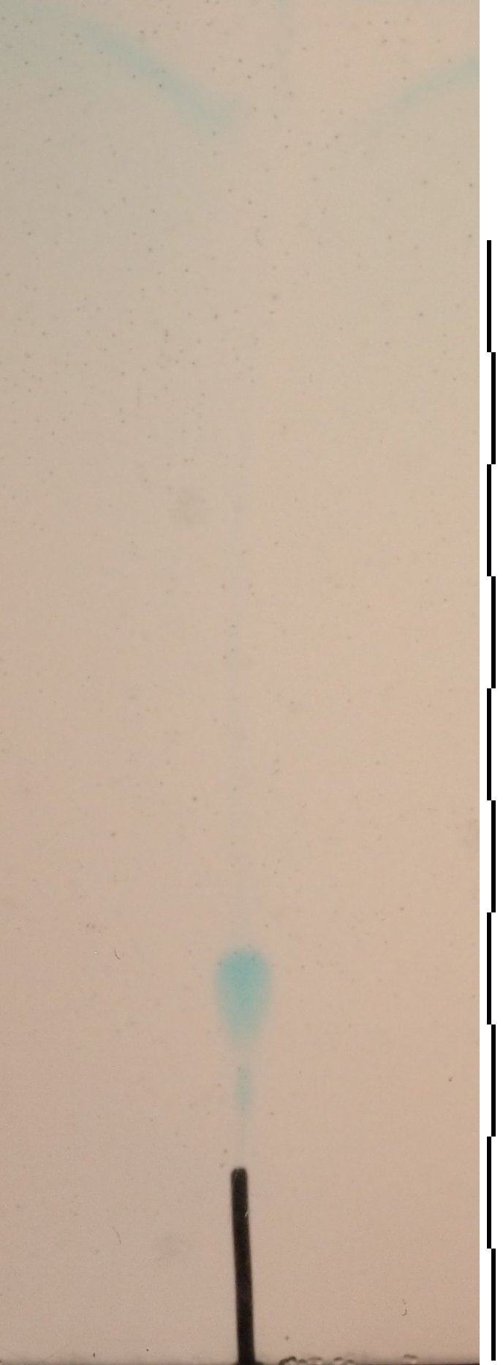
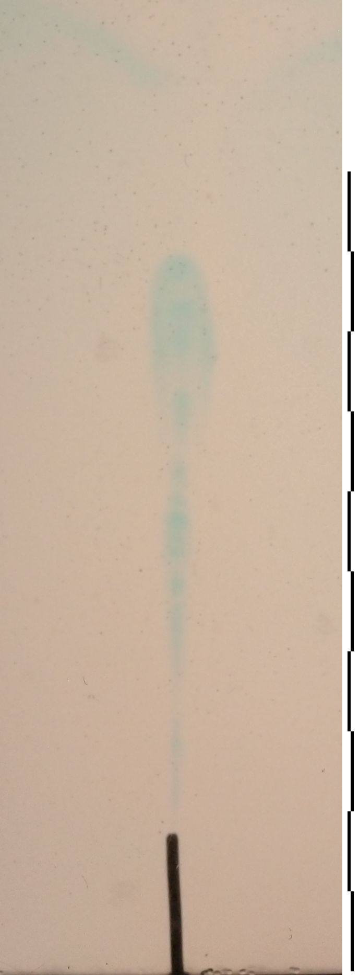
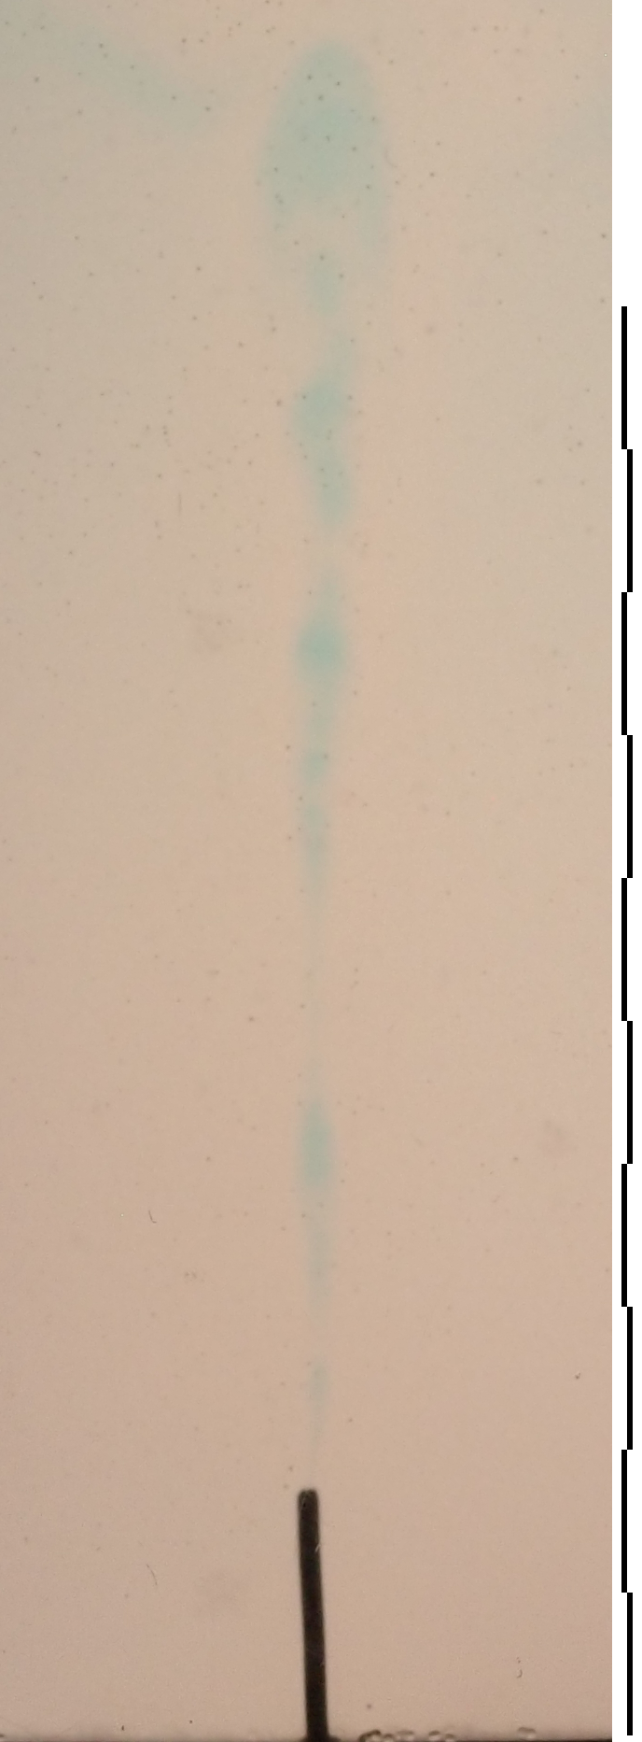
Experiment result VS numerical models
EGU21-8341 in Session GD7.2.
EGU21-8341 in Session GD7.2 for model details

Slide 15
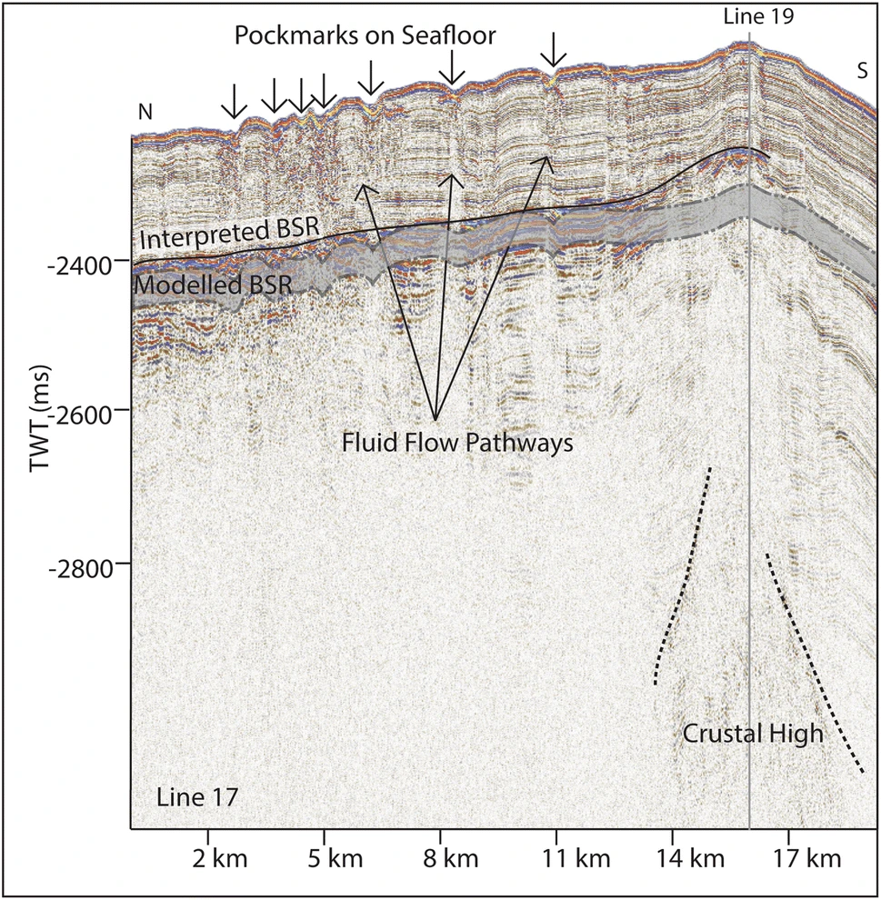
Geological examples: Svyatogor Ridge, Fram Strait, W-Svalbard margin
Bunz et al. 2020

Slide 16
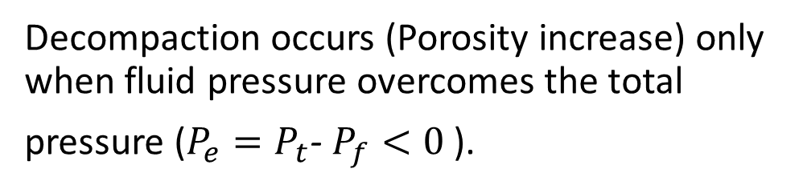
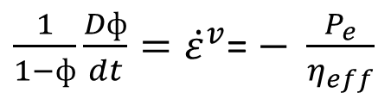
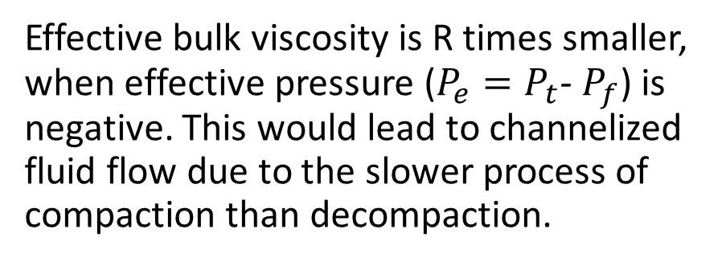
Rheology: Viscous bilinear (Type 1)
$\frac{1}{1−ф}{\frac{Dф}{dt}=\dot{ε}}^{v}$= $− \frac{P_{e}}{η_{eff}}$
Decompaction occurs (Porosity increase) only when fluid pressure overcomes the total
pressure ($P_{e}=P_{t}$- $P_{f}<0$).
Räss et al. 2018
Effective bulk viscosity is R times smaller, when effective pressure ($P_{e}=P_{t}$- $P_{f}$) is negative. This would lead to channelized fluid flow due to the slower process of compaction than decompaction.

Slide 17
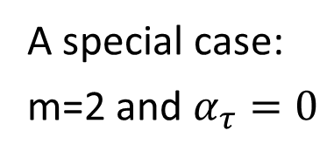
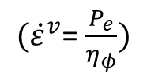
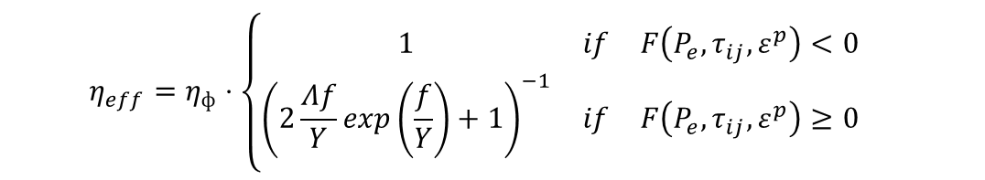
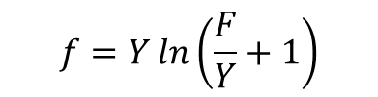
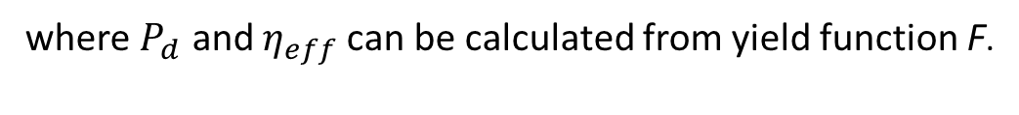





Rheology: visco-plastic failure (Type 2)
$${\dot{ε}}^{r}={\dot{ε}}^{v}+{\dot{ε}}^{vp}$$
Viscoplastic strainrate ${\dot{ε}}^{vp}$
Constitutive equation
${(\dot{ε}}^{v}$= $\frac{P_{e}}{η_{φ}})$
$$F=\left(1+{\left(\frac{τ}{τ_{0}}\right)}^{n}\right)\exp\left({\left|\frac{P_{e}−α_{τ}τ−p_{0}}{Y}\right|}^{m}−1\right)Y−Y−\frac{h}{φ}ε^{p}$$
Yield surface
$$f=Y\ln\left(\frac{F}{Y}+1\right)$$
A general format
$${\dot{ε}}^{r}=−\frac{P_{e}−P_{d}}{η_{eff}}$$
where $P_{d}$ and $η_{eff}$can be calculated from yield function F.
If $p_{0}=$0, $P_{d}$==0, dilation/decompaction occurs when $P_{e}<0$, similar to viscous bilinear rheology.
If $p_{0}=$0, $P_{d}$>0 at where visco-plastic failure occurs, which leads to dilation even when Pe>0.
$$P_{d}=\left\{\begin{matrix}0 & if & F\left(P_{e},τ_{ij},ε^{p}\right)<0 & \\ 2Λ\frac{p_{0}}{Y}f\exp\left(\frac{f}{Y}\right){\left(2\frac{Λf}{Y}\exp\left(\frac{f}{Y}\right)+1\right)}^{−1} & if & F\left(P_{e},τ_{ij},ε^{p}\right)≥0 & \end{matrix}\right.$$
A special case:
m=2 and $α_{τ}=0$
$$η_{eff}=η_{ф}⋅\left\{\begin{matrix}1 & if & F\left(P_{e},τ_{ij},ε^{p}\right)<0 & \\ {\left(2\frac{Λf}{Y}\exp\left(\frac{f}{Y}\right)+1\right)}^{−1} & if & F\left(P_{e},τ_{ij},ε^{p}\right)≥0 & \end{matrix}\right.$$
Yarushina et al. 2020 ( in review)

Slide 18




Rheology: with visco-plastic failure (Type 2)
$${\dot{ε}}^{r}=−\frac{P_{e}−P_{d}}{η_{eff}}$$
A general format.
A special case: m=2 and $α_{τ}=0$
$$P_{d}=\left\{\begin{matrix}0 & if & F\left(P_{e},τ_{ij},ε^{p}\right)<0 & \\ 2Λ\frac{p_{0}}{Y}f\exp\left(\frac{f}{Y}\right){\left(2\frac{Λf}{Y}\exp\left(\frac{f}{Y}\right)+1\right)}^{−1} & if & F\left(P_{e},τ_{ij},ε^{p}\right)≥0 & \end{matrix}\right.$$
$$η_{eff}=η_{ф}⋅\left\{\begin{matrix}1 & if & F\left(P_{e},τ_{ij},ε^{p}\right)<0 & \\ {\left(2\frac{Λf}{Y}\exp\left(\frac{f}{Y}\right)+1\right)}^{−1} & if & F\left(P_{e},τ_{ij},ε^{p}\right)≥0 & \end{matrix}\right.$$
Yarushina et al. 2020 ( in review)

Slide 19

Effects of a strong layer
A stronger horizontal
layer with 10 times
of the bulk viscosity
The fluid ponds beneath the strong layer for a short time before it develops channel within the strong layer.
Wider fluid channels forms in the strong layer, which is due to the change of the bulk viscosity.

