Slide 1
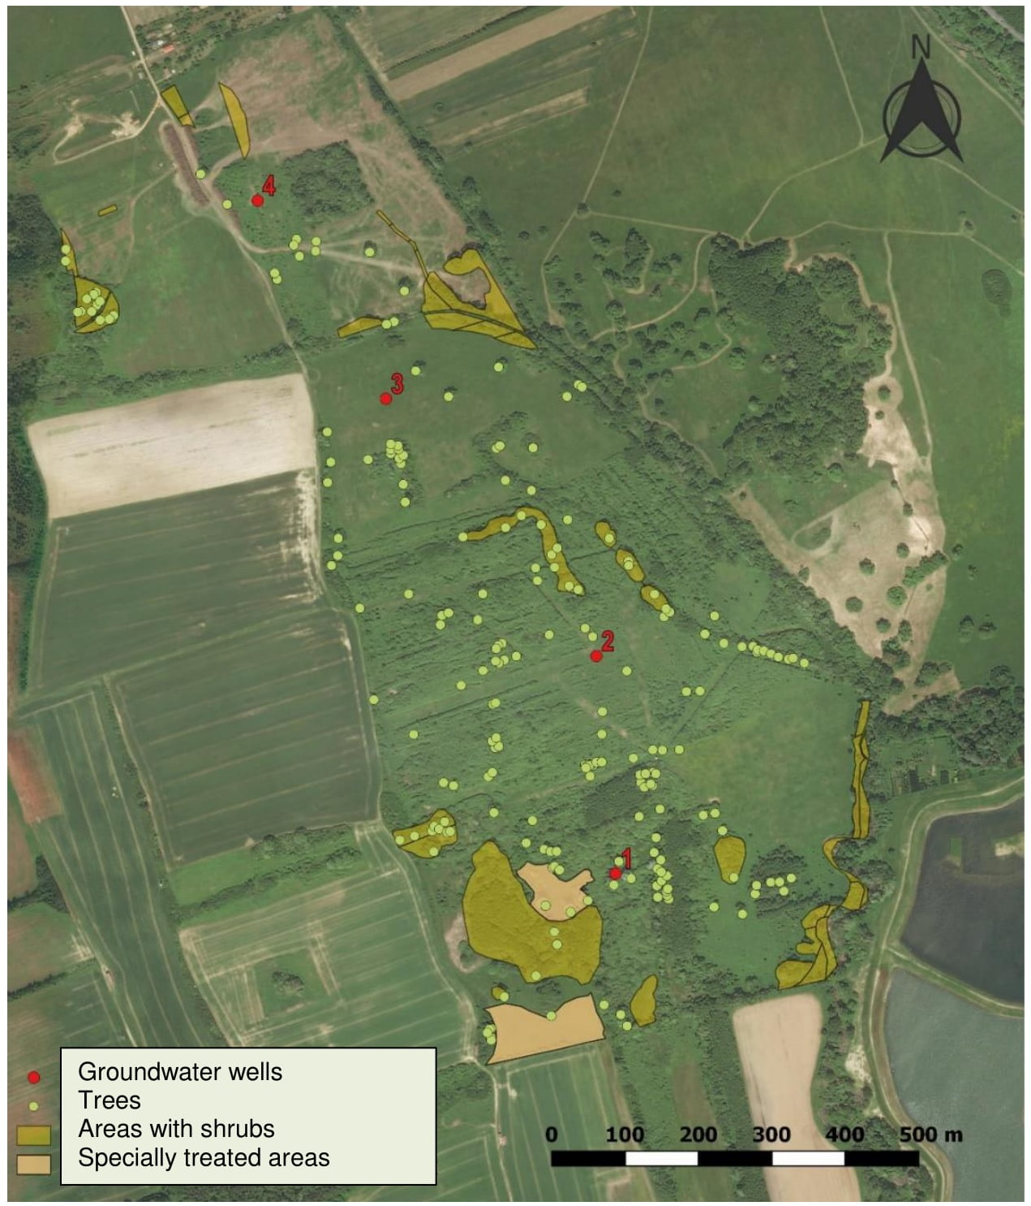
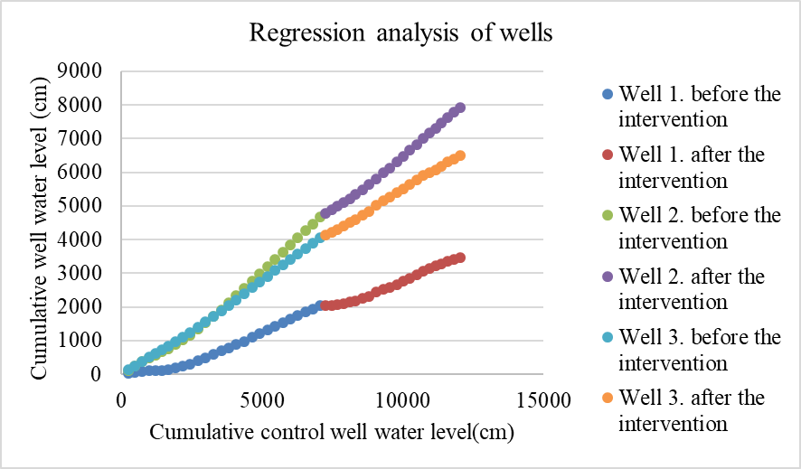
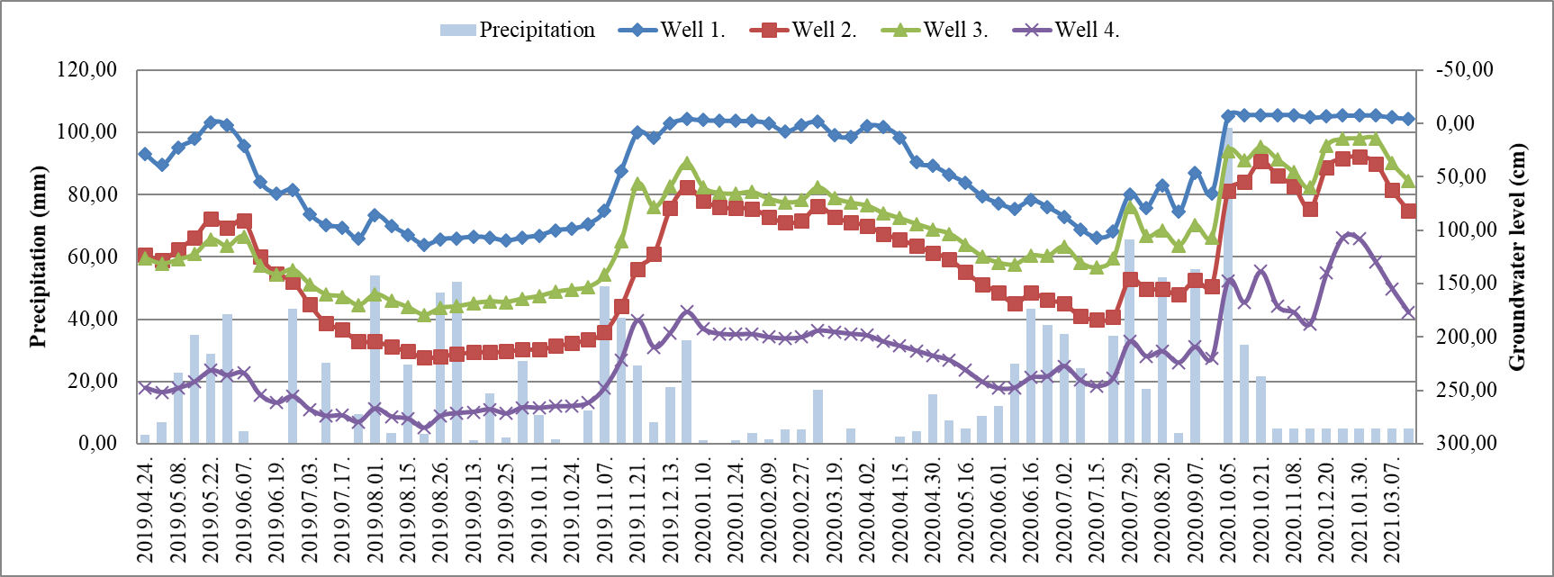
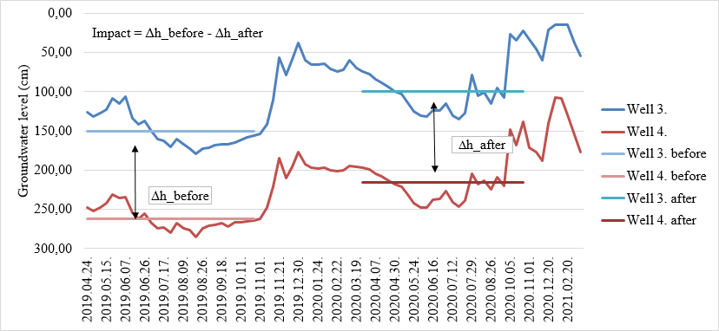
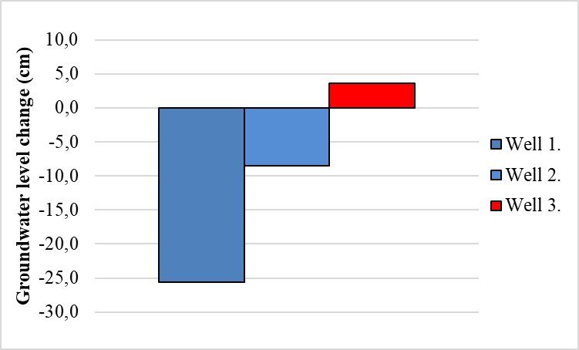
Riparian zone hydrological rehabilitation along the Gyöngyös stream (Hungary)
Előd Szőke¹, Péter Csáki¹, Péter Kutschi², Péter Kalicz¹,Zoltán Gribovszki¹
¹ University of Sopron, 9400 Sopron, Bajcsy-Zs. u. 4., Hungary
² Őrség National Park Directorate
E-mail: elod0324@gmail.com
Groundwater monitoring wells (4) from April 2019 to March 2021
Analysis “double mass curve” (Figure 4) and a “treatment-control space-time deviations” (Figure 5) approach.
Local meteorological data in Kőszeg were used for analysis (Figure 3).
Well-1 and Well-2 behave similarly.
Positive effect only on the Well-3 (Figure 2).
1. figure: The location of the groundwater wells in the habitat reconstruction project area near Kőszeg
4. figure: Double mass curve
2. figure: Change in groundwater level relative to the control well
3. figure: Changes in groundwater levels and precipitation patterns.
5. figure: Treatment-control space and time deviations
This research has been supported by Ministry of Agriculture in Hungary.

