Slide 1
Impacts of COVID-19 lockdown restrictions on NO₂ and O₃ level in Germany with consideration of meteorological impacts and seasonal variation
Vigneshkumar Balamurugan ^{1*}, Jia Chen ^{1*}, Xiao Bi ¹, Zhen Qu ², Johannes Gensheimer ¹, Ankit Shekhar ³, Shrutilipi Bhattacharjee ⁴, Frank N. Keutsch ²
¹ TUM Department of Electrical and Computer Engineering, Technical University of Munich, Munich, Germany.
² School of Engineering and Applied Science, Harvard University, Cambridge, United States.
³ Department of Environmental Systems Science, ETH Zurich, Zurich, Switzerland.
⁴ Department of Information Technology, National Institute of Technology Karnataka, Surathkal, India.
* vigneshkumar.balamurugan@tum.de, jia.chen@tum.de

Slide 2
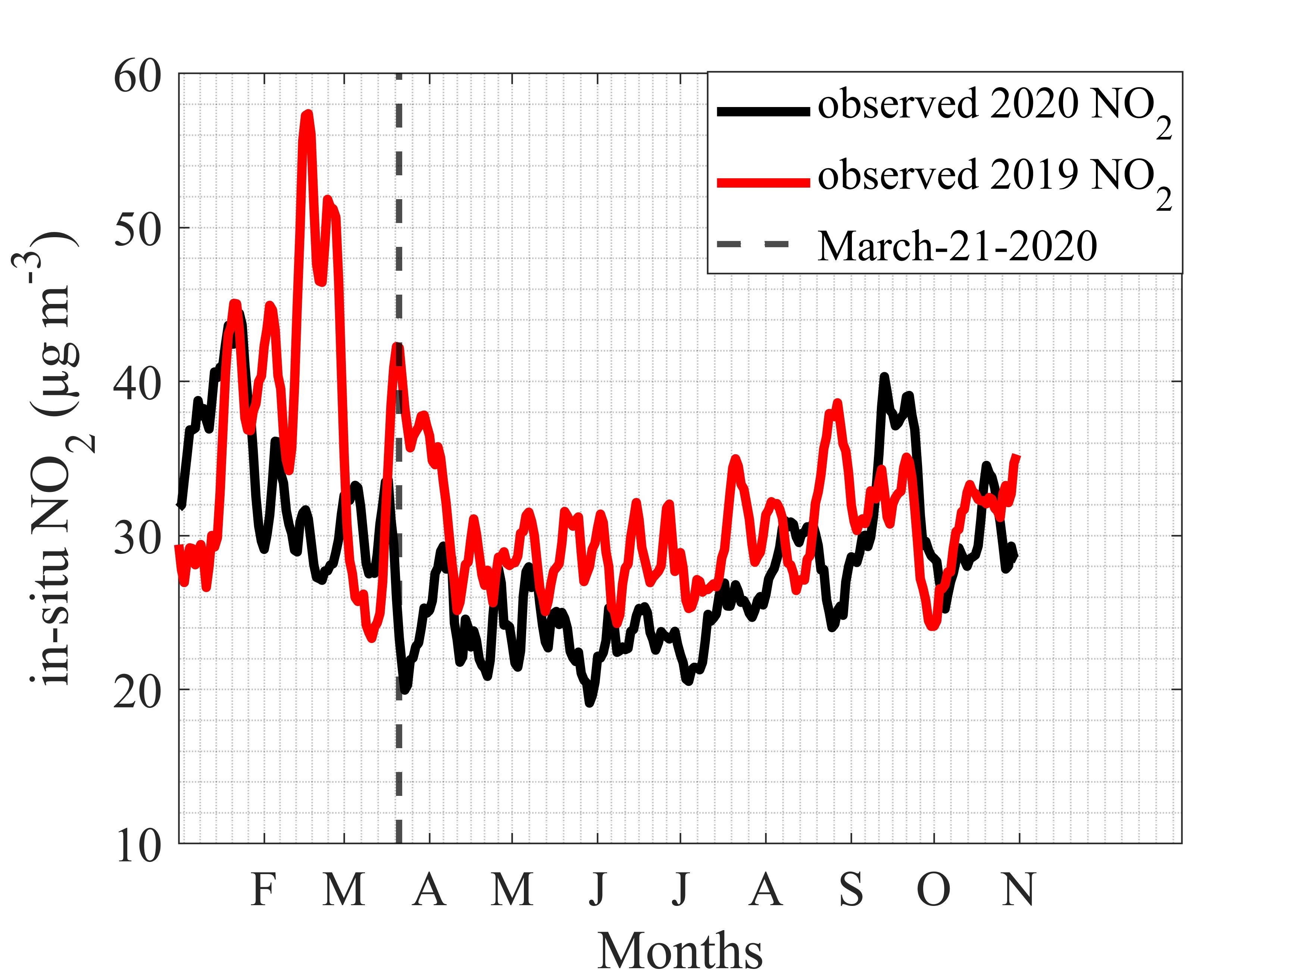
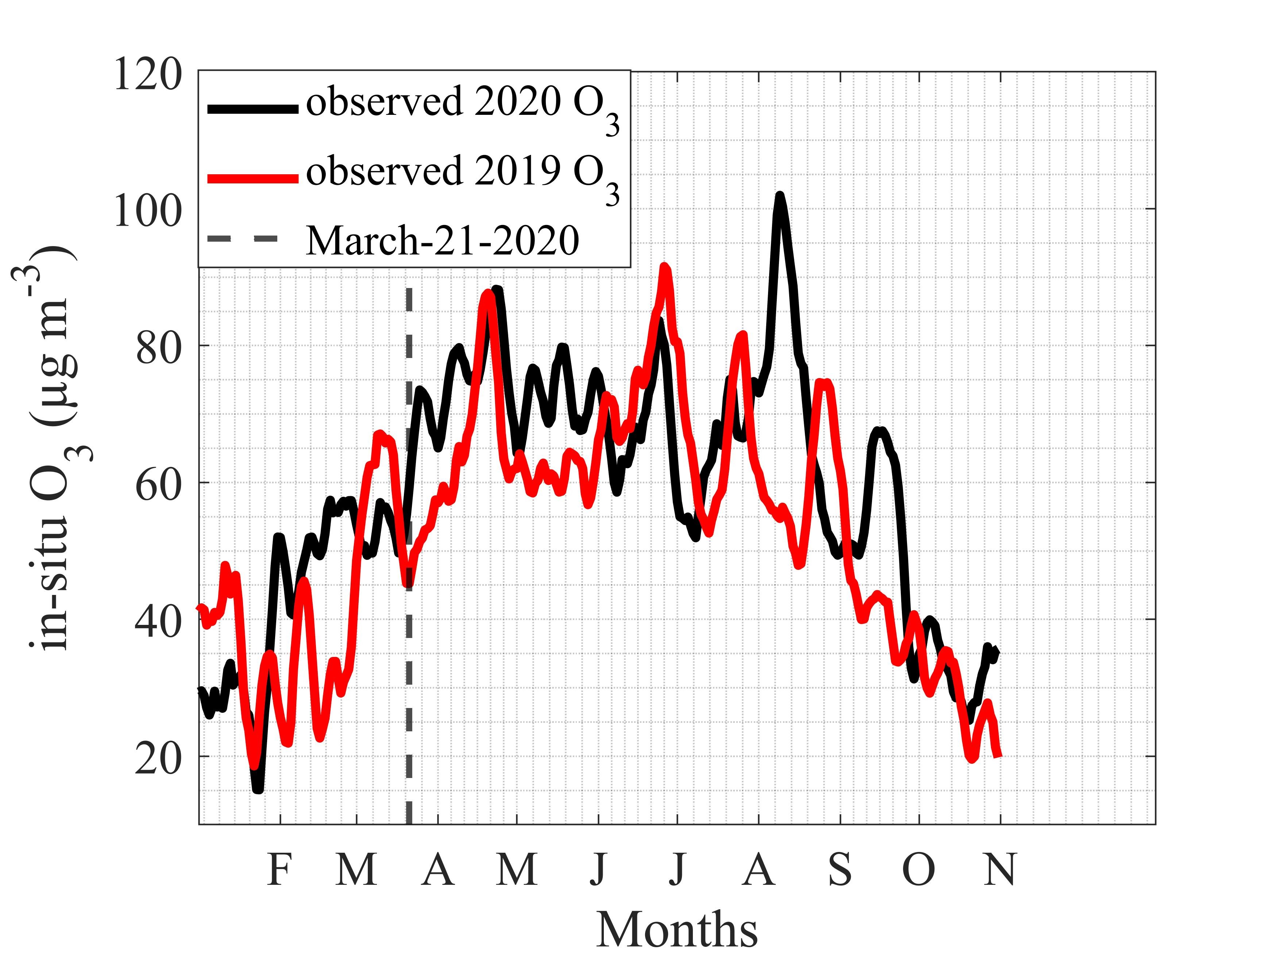
PROBLEM STATEMENT
Various measures are taken by governments to prevent the spread of the COVID-19 virus (includes physical distancing, a ban on large group gatherings, home office work, and international and domestic travel restrictions).
These measures resulted in a significant reduction in economic activity and mobility, and as a result, emissions are reduced.
A direct comparison of lockdown period pollutant concentrations with pre-lockdown period pollutant concentrations includes both meteorological and COVID-19 emission reduction influences.
Compared to 2019, prior to the lockdown, 2020 NO₂ concentrations are low due to unusually high wind speeds caused by storms in February 2020.
Figure 1. 7-day rolling mean of eight German
metropolitan areas.

Slide 3
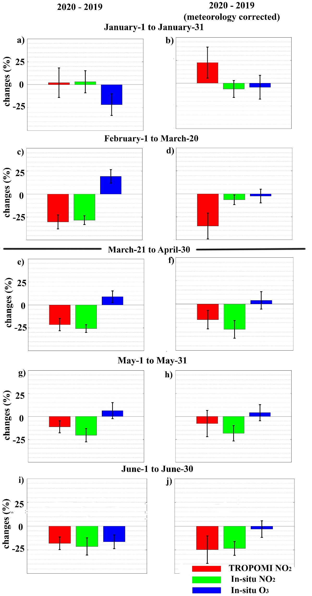
RESULTS
The first governmental COVID-19 lockdown restrictions went into effect on March 21, 2020.
We used GEOS-Chem model simulations to account for meteorological impacts
Significant decrease in urban in-situ NO₂ concentration.
Marginal increase in urban in-situ O₃ concentration.
Fig 2. Mean relative changes in meteorological impacts uncorrected (left column) and corrected (right column) NO₂ and O₃ concentrations in eight metropolitan cities between 2020 and 2019.

Slide 4
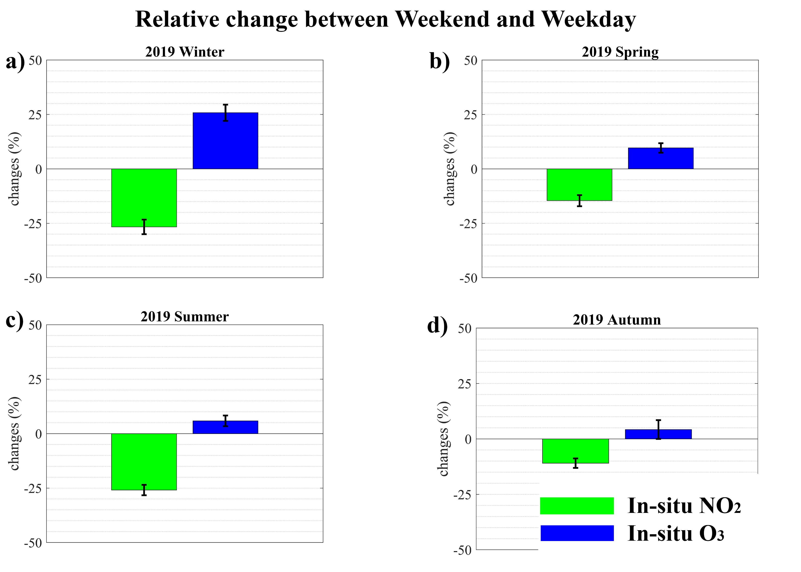
RESULTS
NO₂ is a precursor for the formation of tropospheric O₃.
NO_{X} limited regimes (low NO_{X} and high VOCs):
O₃ decreases as NO_{X} decreases
NO_{X} saturated regimes (high NO_{X} and low VOCs):
O₃ increases as NO_{X} decreases
Weekend NO₂ concentrations are low due to reductions in mobility: reduced NO_{X} emission on weekends increase the concentration of O₃, i.e., NO_{X} saturated conditions prevail.
Figure 3. Mean relative change in in-situ NO₂ and O₃ concentrations in Munich between weekends and weekdays.

Slide 5
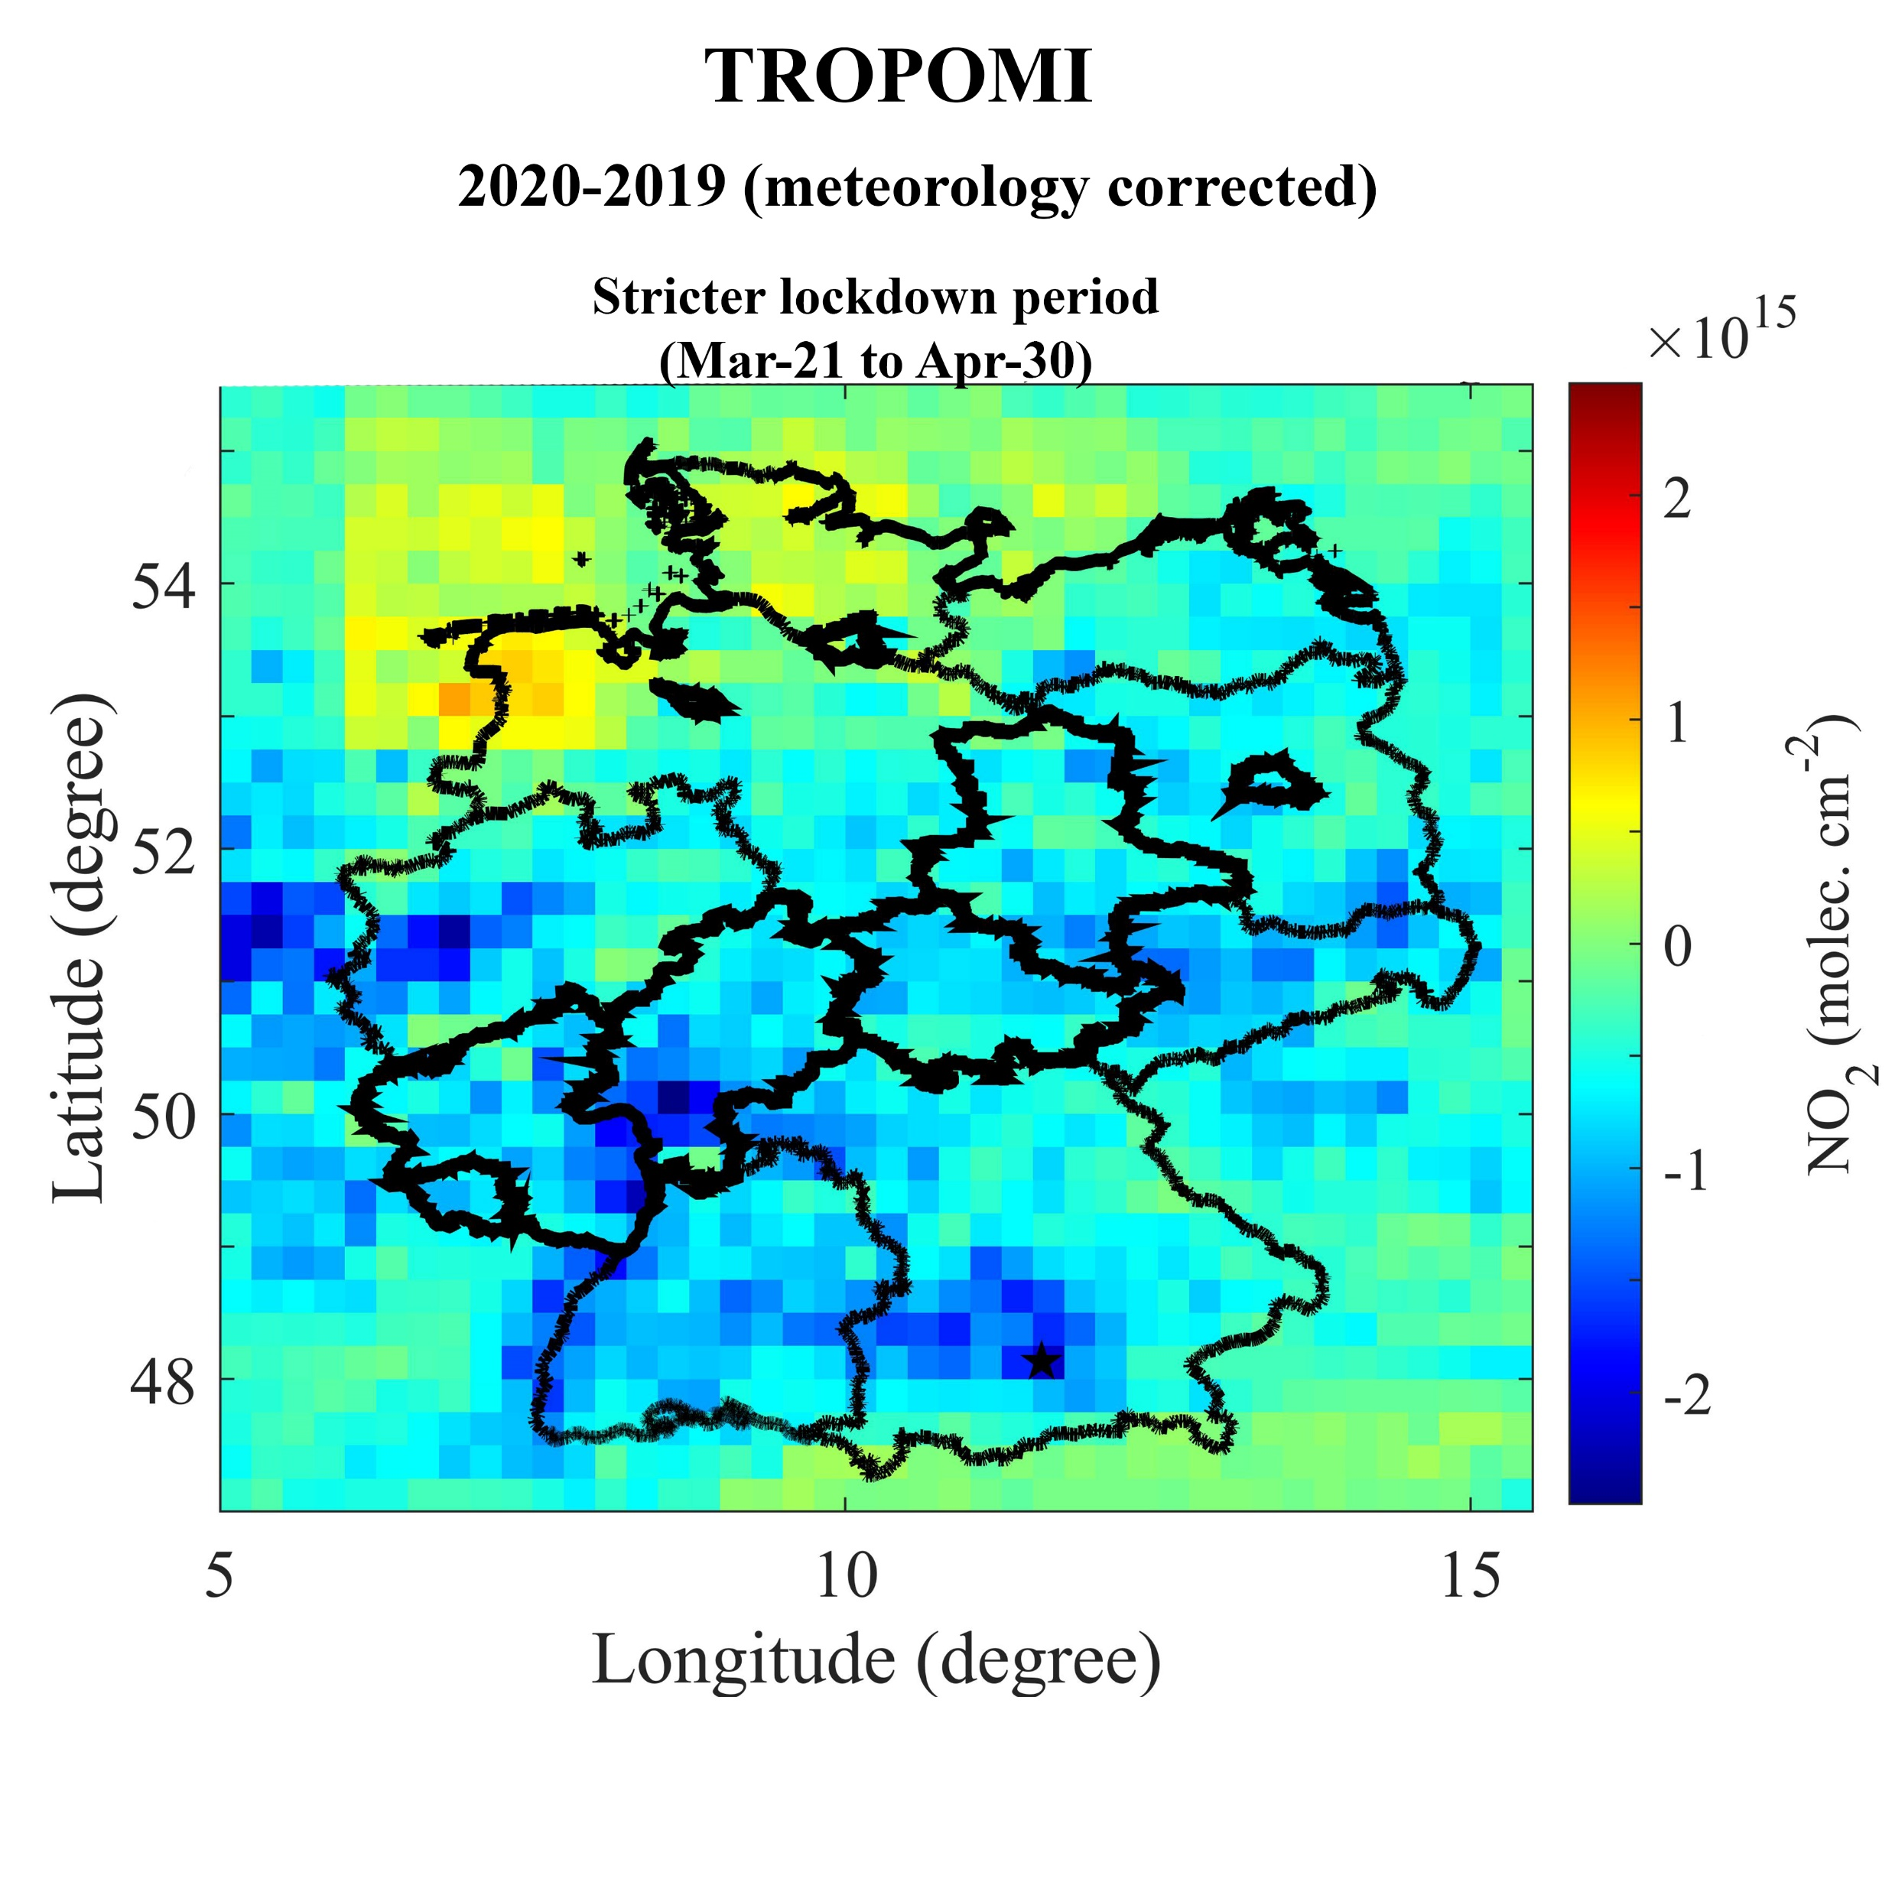
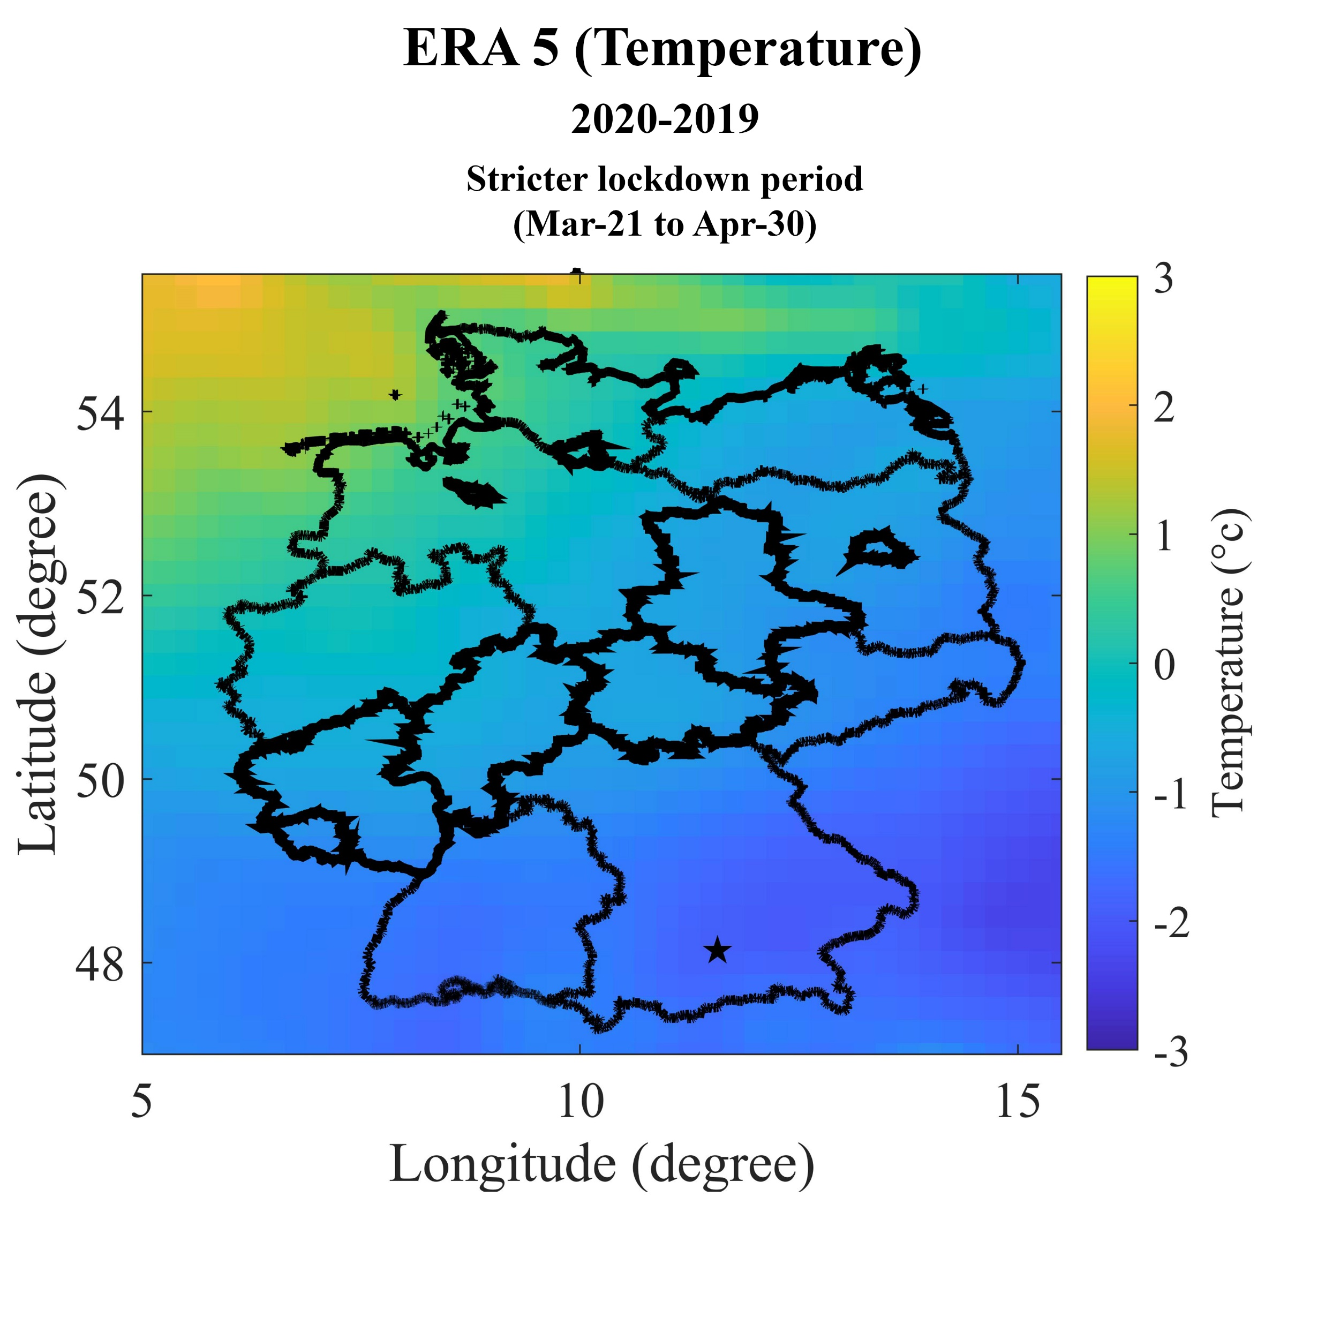
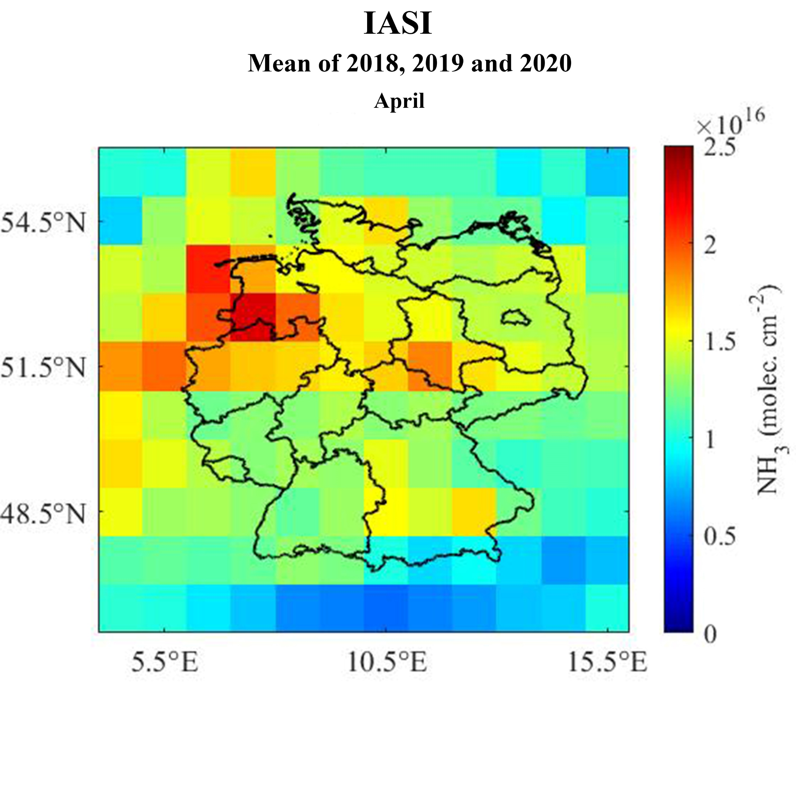
RESULTS
A nationwide decrease in NO₂ is observed, except for North-West Germany, attributable to enhanced soil NO_{X} emissions.
We hypothesise that North-West Germany is a hot spot of soil NO_{X} emissions in elevated-temperature environments due to intensive agricultural practices (fertilizer applications) during the early spring.
The IASI NH₃ satellite data also supports our statement that North-West Germany is an intensive agricultural region during the early spring.

Slide 6
CONCLUSION
As a result of reductions in anthropogenic emission in German metropolitan cities during the lockdown period, NO₂ concentrations decreased and O₃ concetrations increased.
A NO_{X} saturated ozone production regime in German metropolitan cities explains the marginal increase in O₃ concentrations during the lockdown period.
Future reductions in NO_{X} emissions are likely to increase ozone pollution in these cities.
Appropriate NO_{X} and VOCs emission control plans are required to limit ozone pollution in metropolitan cities of Germany.

