Slide 1

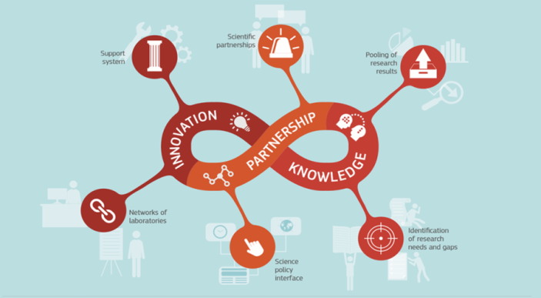
The European Commission’s science
and knowledge service
Disaster Risk Management Knowledge Centre
Joint Research Centre
Risk Data Hub methodology on multi-hazard risk assessment
Tiberiu Antofie, & DRMKC
28th April 2021

Slide 2
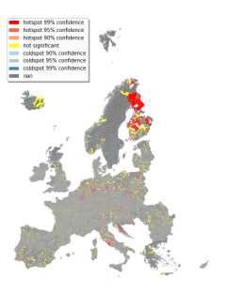
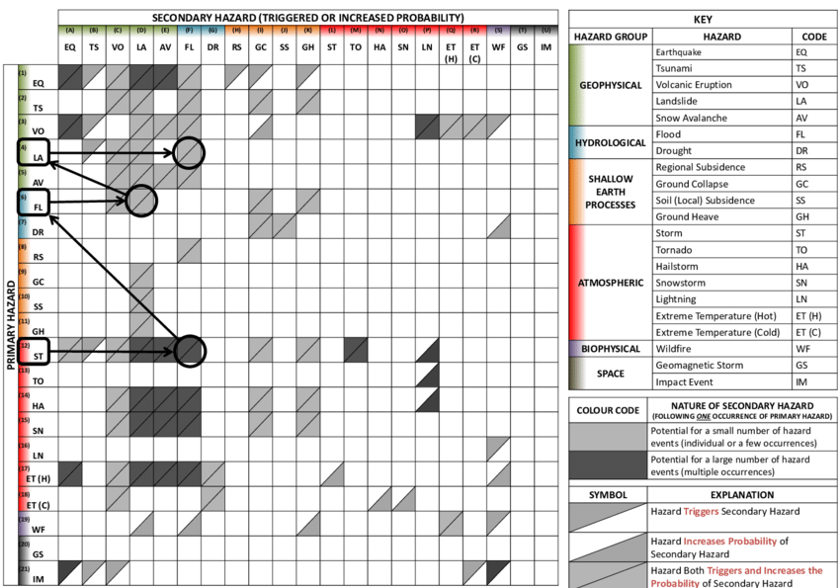
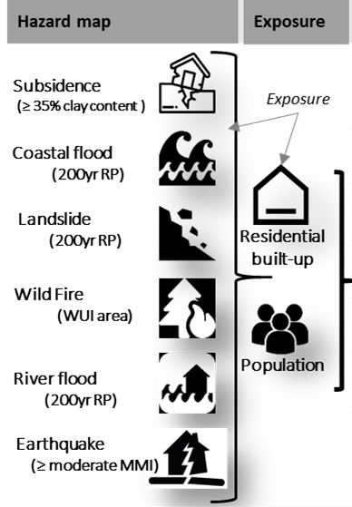
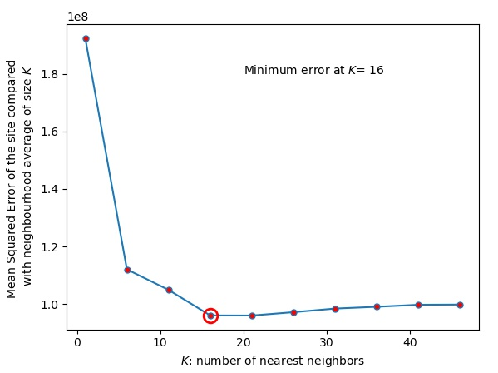

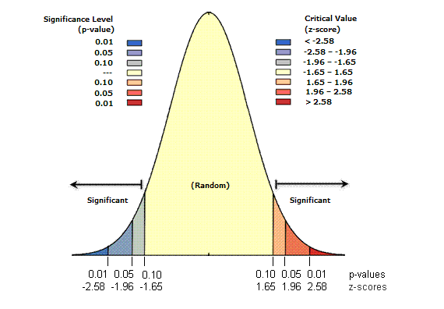
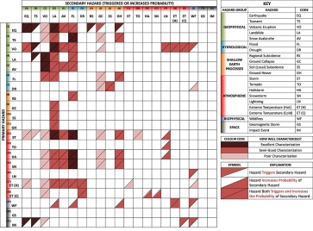

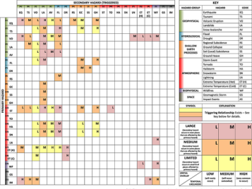
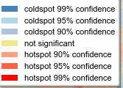
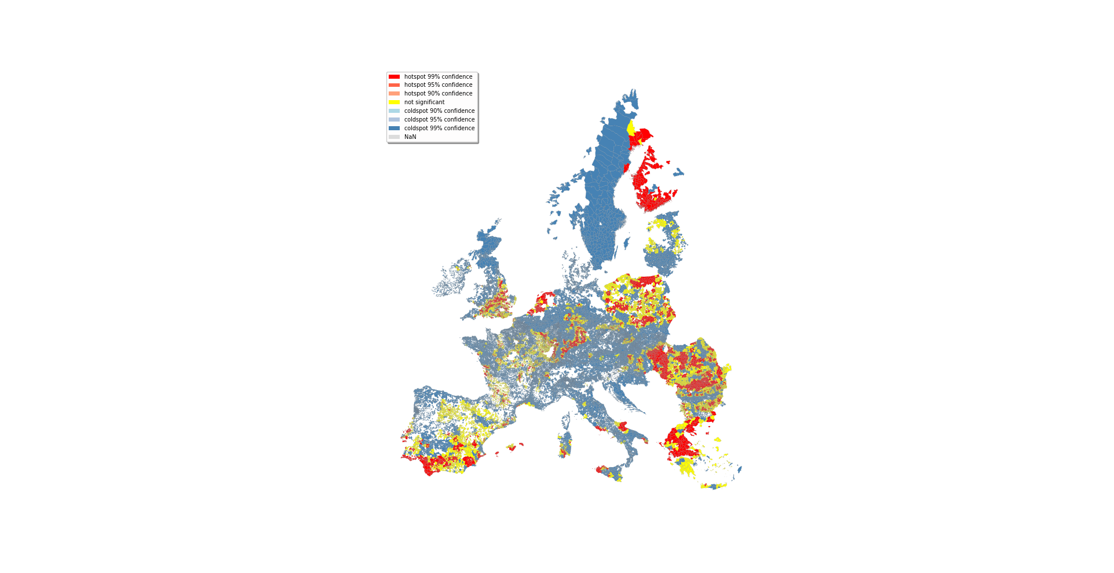

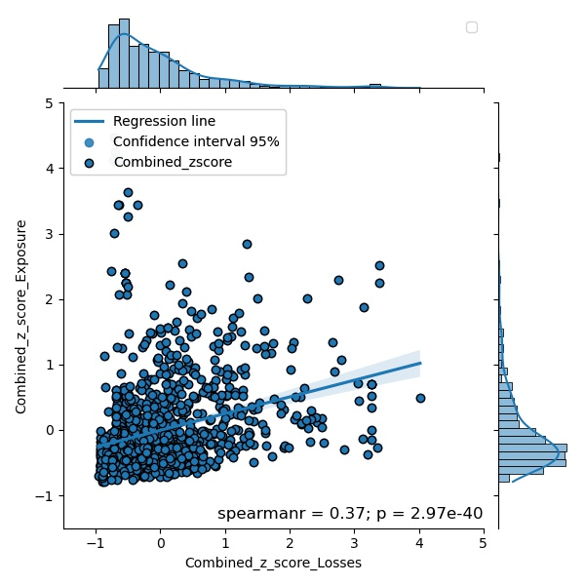
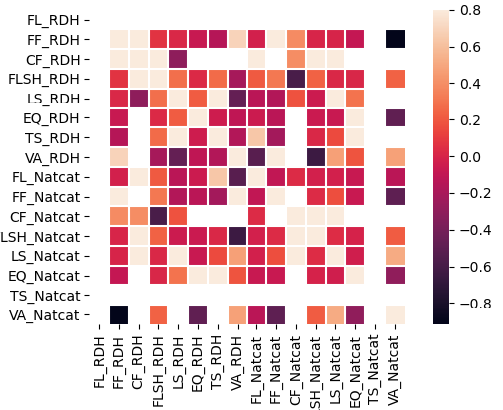
Methodologies:
Multi-hazard interaction:
1. Exposure
2. Spatial dependency
3. Single hazard hotspot
Single hazard Exposure
K_mean clustering for spatial dependence
Spatial clustering of values
(hotspot analysis local Gi*)
SciPy
Sklearn
pysal
- esda
The forecasting of Secondary hazard :
Mapping multi-hazard theoretical analysis (Gill et al 2014) :
Temporary likelihood of triggering relationship:
Multi-hazard potential impact area in Europe:
4. Hotspots combined
Combining z-score from independent tests (Stouffer method):
SciPy
-combine_pvalues
Validation against the RDH L&D database

