Slide 1
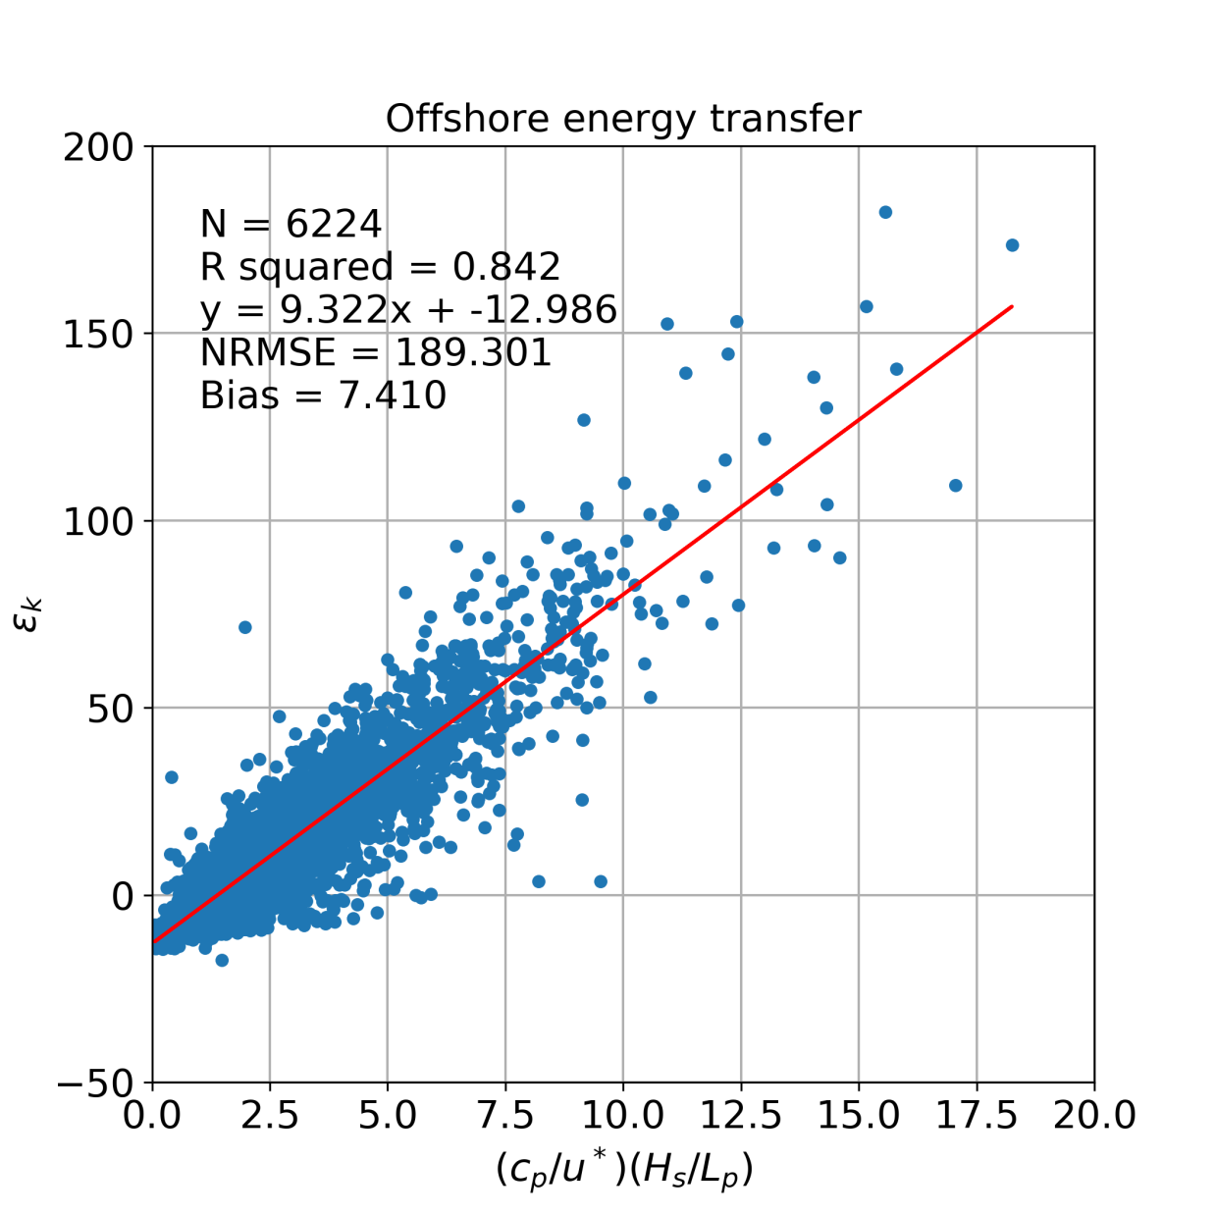
Development of surface roughness length and drag parameterizations over deep seas - Alberto S. Rabaneda (arabaneda@icm.csic.es)
$$z_{0}=\frac{u_{∗}^{2}}{U_{10}^{2}}\frac{H_{s}^{2}}{L_{p}}|\cos{θ|}$$
New surface roughness length parameterization free of empirical parameters, Lettau’s adaption to offshore locations
$$U\left(z\right)=\left(\frac{u_{∗}}{κ}\right)\left[\ln\left(\frac{z}{z_{0}}\right)+Ψ_{s}\left(\frac{z}{L_{s}}\right)+ε_{k}\left(\frac{c_{p}}{u_{∗}}, \frac{H_{s}}{L_{p}}\right)\right]$$
New correction parameter for the offshore logarithmic law due to wind/wave kinetic energy exchange
$$C_{Dz}={\left[\frac{κ}{\ln\left(\frac{z L_{p}}{C_{Dz}{ H}_{s}^{2} \left|\cos{θ}\right|}\right)+ε_{k}+Ψ_{s}}\right]}^{2}$$
U_{z} : Wind speed at height z
u* : friction velocity
k : von Karman constant
Ψs : atmospheric stability correction
L_{S} : Obukhov length
C_{d} : Drag coefficient
θ : angle between wind and wave directions
L_{p} : Wave length
H_{s} : Significant wave height
z₀ : Aerodynamical surface roughness length
c_{p} : Phase speed of waves
$ε_{k}$ : Kinetic energy exchange between wind and waves
Figure. Correlation of wind/wave kinetic energy exchange against wave age and wave slope under neutral atmospheric stability conditions. Dataset from Egmond aan Zee meteorological mast in Netherlands (July 2005 - Dec 2008).

Slide 2
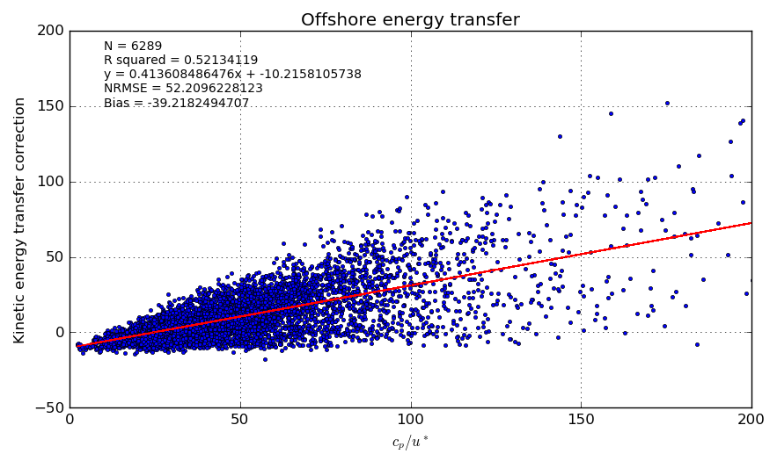
Development of equation: Kinetic Energy Transfer Correction (KETC)
$$U\left(z\right)=\left(\frac{u_{∗}}{κ}\right)\left[\ln\left(\frac{z}{z_{0}}\right)+Ψ_{s}\left(\frac{z}{L_{s}}\right)+ε_{k}\left(\frac{c_{p}}{u_{∗}}\right)\right]$$
Kinetic energy transfer correction between ocean and atmosphere (KETC)
$$y=0.414 \frac{c_{p}}{u^{∗}} −10.216$$
KETC | $${c_{p}}/{u^{∗}}$$ | Sea type
< 0 | < 24.68 | Growing
≈ 0 | = 24.68 | Fully developed
> 0 | > 24.68 | Decaying
This wave age for fully developed seas agrees with literature where fully developed seas are meant to be found between 22 – 35 $\frac{c_{p}}{u^{∗}}$
However, there was a lot of scatter as shown in the figure.

Slide 3
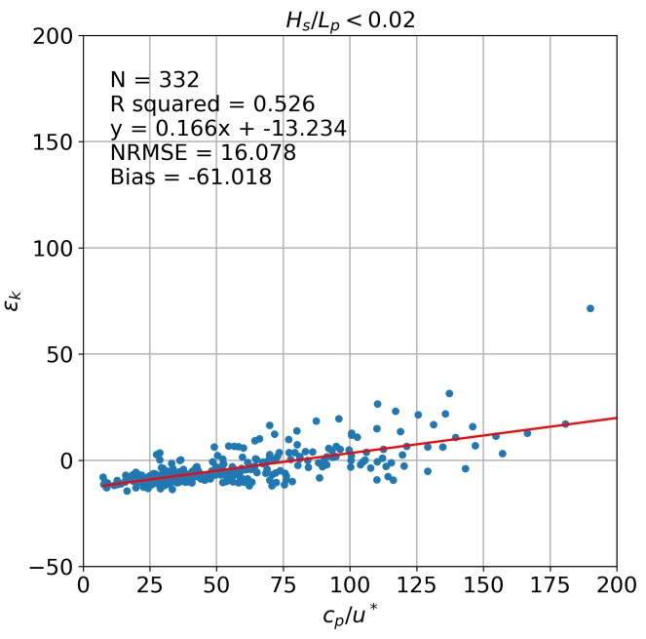
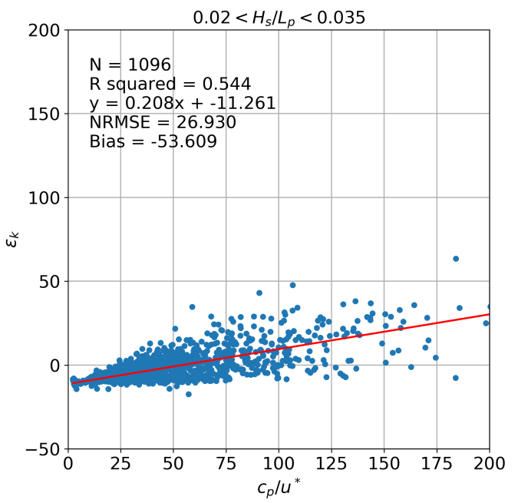
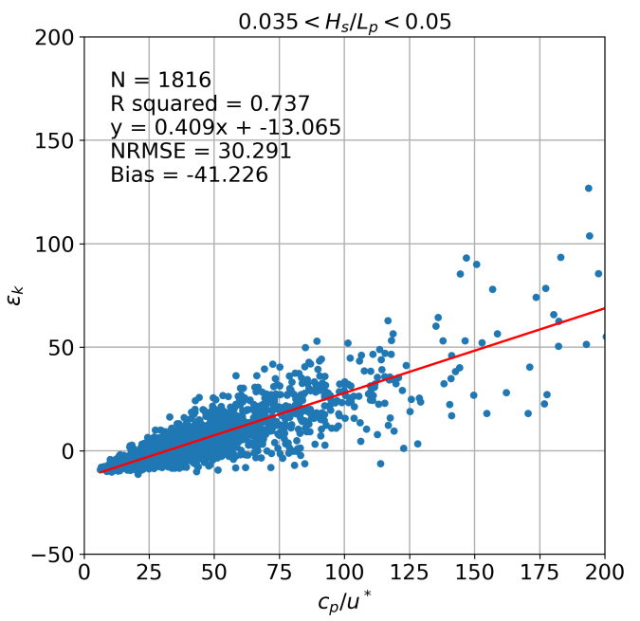
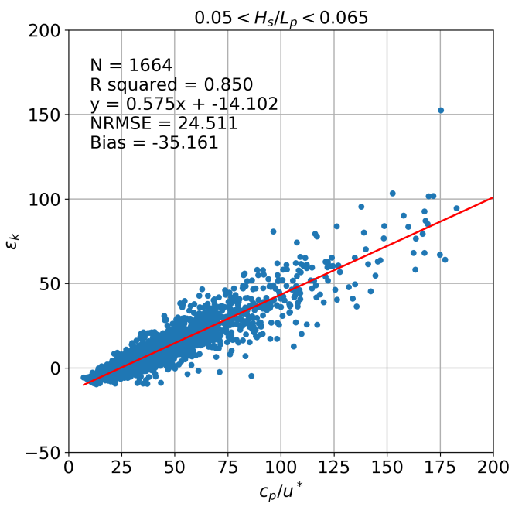
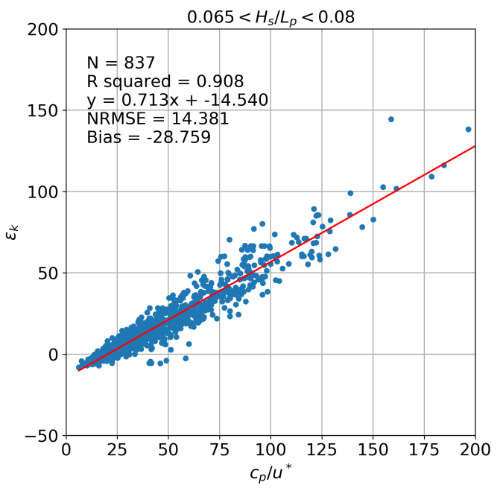
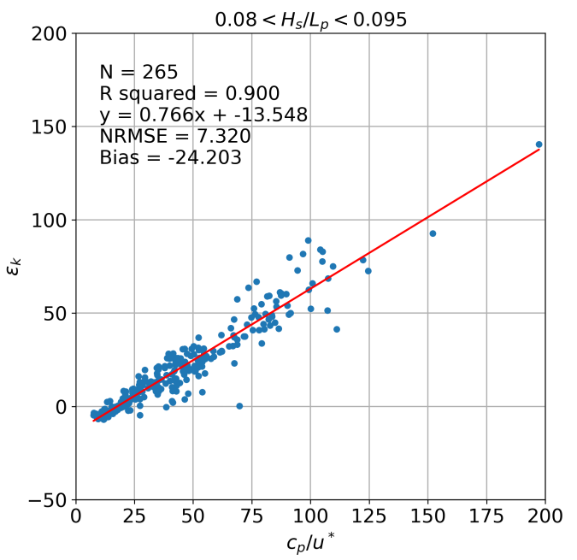
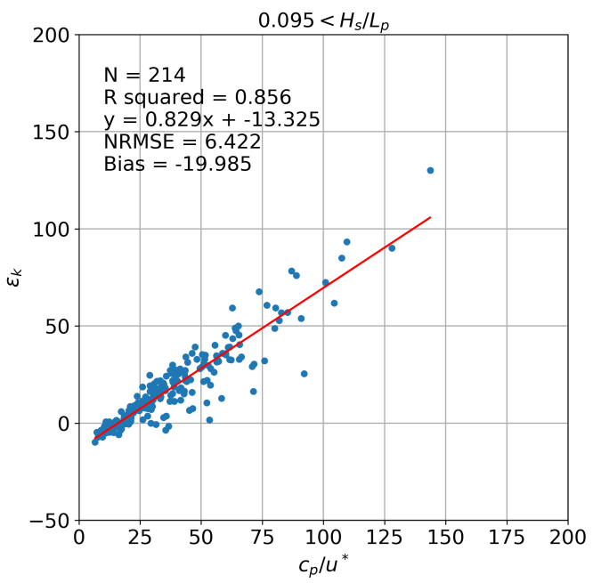
Development of equation: Kinetic Energy Transfer Correction (KETC)
Wave slope effect over the kinetic energy exchange between wind and waves.
Since the energy of a wave depends on its amplitude and wavelength

Slide 4
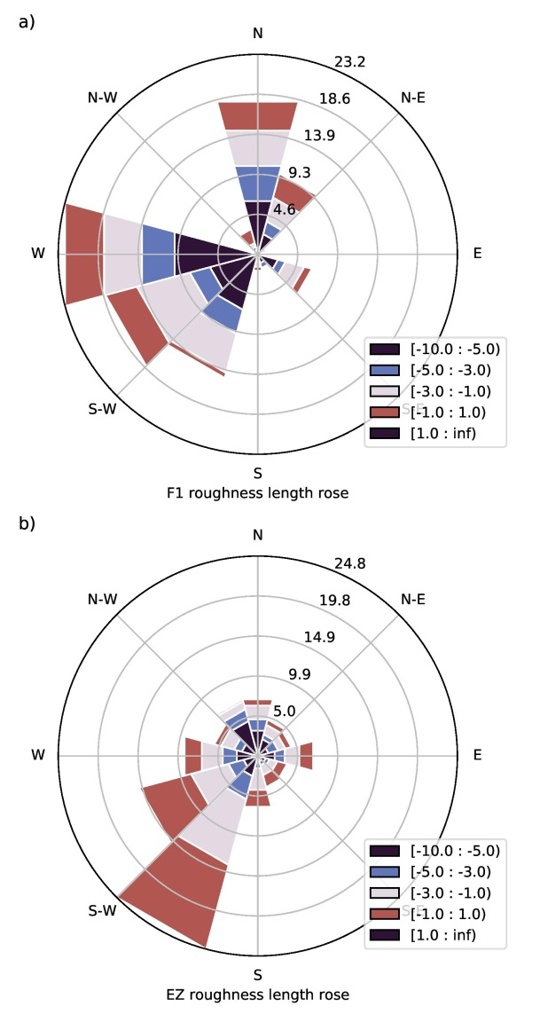
On high z₀ values: Atmospheric stability and wake analysis
50-min z₀ roses in logarithmic scale for F1 and EZ under neutral stability conditions. The concentric lines represent frequency as percentage. The rose legend values represent z₀ in m.
50-min z₀ plotted against the inverse Obukhov length for EZ dataset.
z₀ threshold over 2 metres !!!

